Slide 1

感恩遇见，相互成就，本课件资料仅供您个人参考、教学使用，严禁自行在网络传播，违者依知识产权法追究法律责任。
更多教学资源请关注
公众号：溯恩高中英语
知识产权声明

Slide 2
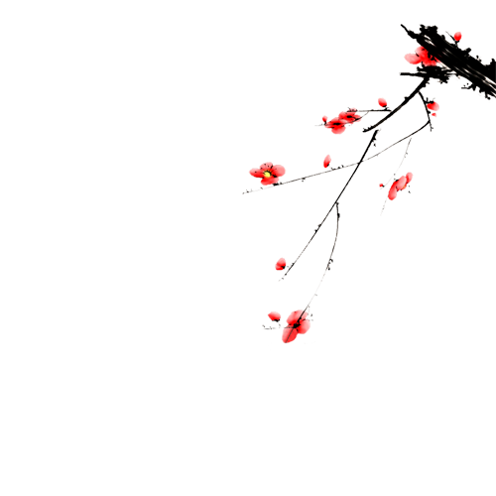
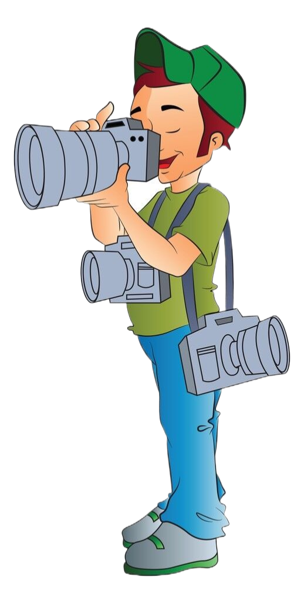


2023年1月8号浙江首考
应用文真题解析
杭州二中树兰高级中学 郭合英

Slide 3


The structure of a news report
Build up some vocabulary
contents
Appreciation of model essay

Slide 4
The structure of a news report
标题（title）
简要、突出、吸人眼球
导语（headline）
简明扼要概述事情发生的大致经过
正文（body）
添加细节，宣扬主题
结尾（ending）
概述活动的意义，感想等

Slide 5
when
who
what
上周末你参加了学校学生会组织的“认识你身边的植物”活动，请你给校英文报写一篇报道。
1.活动的过程；
2.收获与感想。
注意：
1.写作词数应为80左右；
2.请按以下格式在答题纸的相应位置作答。
Getting to Know the Plants Around Us
—————————————————————————————————————————————————————————————————————
key points
writing stytle:
a news report
the ending part

Slide 6
headline
上周末你参加了学校学生会组织的“认识你身边的植物”活动，请你给校英文报写一篇报道。
1.活动的过程；2.收获与感想。
1. Last weekend witnessed an activity with the theme “Getting to Know the Plants Around Us”, which greatly stimulated the students’ interest in nature .
2. In order to inspire students to get close to nature, our school specially held an activity named “Getting to Know the Plants Around Us” last weekend.

Slide 7
headline
上周末你参加了学校学生会组织的“认识你身边的植物”活动，请你给校英文报写一篇报道。
1.活动的过程；2.收获与感想。
3. Aimed at enriching the students’ school life, an activity “Getting to Know the Plants Around Us” was held in our school last weekend.
4. For the purpose of raising the awareness of protecting the plants and enriching the students’ school life, last weekend witnessed an activity called “Getting to Know the Plants Around Us”.

Slide 8

正文（body）
上周末你参加了学校学生会组织的“认识你身边的植物”活动，请你给校英文报写一篇报道。
1.活动的过程；2.收获与感想。
出发的时间、地点、交通方式、及参加人员
正文
（body）
细节增加1
细节增加2
活动的过程
Activity 1
Activity 2

Slide 9
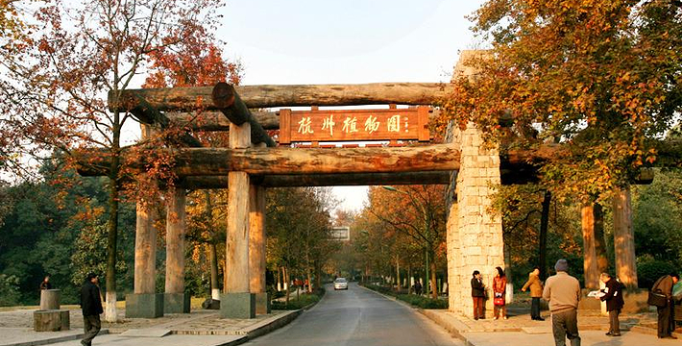
出发的时间、地点及交通方式
1. This activity which explored the nature saw the whole process from our school gate at 8:00 am.to the Hangzhou Botanical Garden.
2. With the purpose of getting close to nature, we set off by bus with exhilaration from our school gate to the Hangzhou Botanical Garden; we came back at about 4 pm.
3. Taking several buses, we set off at 8:00 from our school gate to the Hangzhou Botanical Garden, and the activity lasted 5 hours.

Slide 10
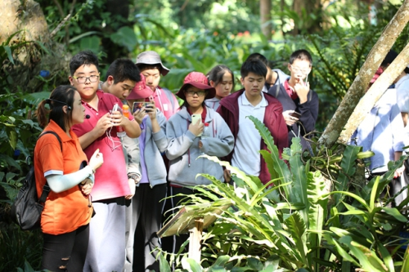
参与人员
1. Every student in senior one and senior two took part in the activity.
2. Approximately 1200 participants from our school took part in this organized activity.
3. Those who were interested in the activity signed up for it.
4. The activity with the theme of getting close to nature attracted 1200 faculty and students to compete in it.
5. 90% of the participants were students, the rest of whom were teachers.

Slide 11
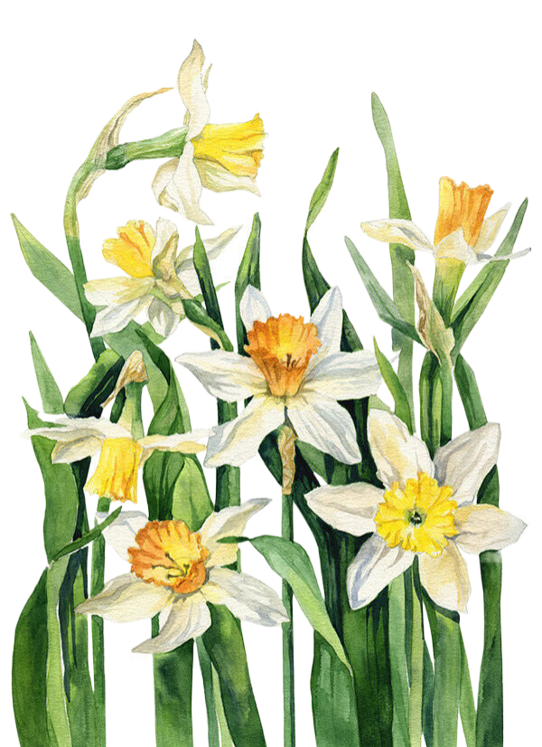
Activity 1
1. In order to make students get a better understanding of some plants, our school invited an experienced plant expert to give us some explanation about plants on the spot, from which we got some detailed information about a variety of plants.
2. In order to know some plants around us, in the activity, we took a lot of photos, for those that we were unfamiliar with, we could either turn to some experts or search them on the internet, through which we students have learned a lot.

Slide 12
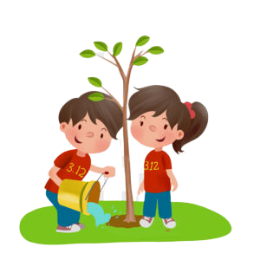
Activity 2
1. In order to dvevlop the students’ love with nature, we hold a match named “Planting Trees” at 2 pm. we actively competed in it, some digging, some planting and others watering. The board with some words “The students and teachers form xx school planted the trees in person” found our activity.
2. During the activity, 500 new trees were planted by our school as planned.
3. In order to give plants a friendly environment to grow, we spontaneously organized an activity to pull weeds out at 10 am..

Slide 13
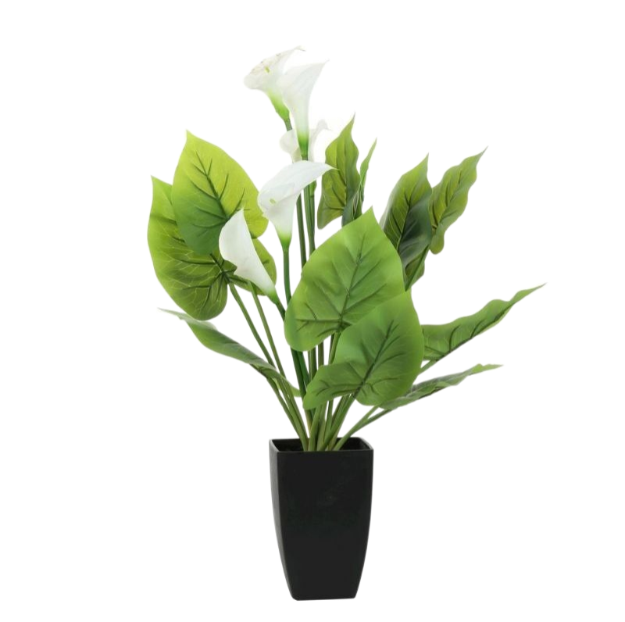
结尾（ending）:对活动意义的收获和感想
上周末你参加了学校学生会组织的“认识你身边的植物”活动，请你给校英文报写一篇报道。
1.活动的过程；2.收获与感想。
Through the activity not only did we know some plants but also we got a better understanding of some plants’ behaviour.
As is known to all, protecting plants is to help ourselves. Only when the plants grow well can they provide a peaceful home for our human.
We realize that we can make ourselves useful to those plants that need help and care.

Slide 14

We benefit a lot from their behaviour of the plants, For example, we have learned the tenacity from the grass, and we will apply the spirit to our study, which will help me a lot in the future.
We exposed ourselves to the beautiful nature. Not only did it erase our pressure from heavy study, but also it was a comprehensive education for us students. Therefore, we all think highly of it, expecting more activities like this can be held in the future.
We got a lot of benefits from the activity. Not only did it provide us an chance to get close to nature and it offered us relaxation from heavy school life.

Slide 15
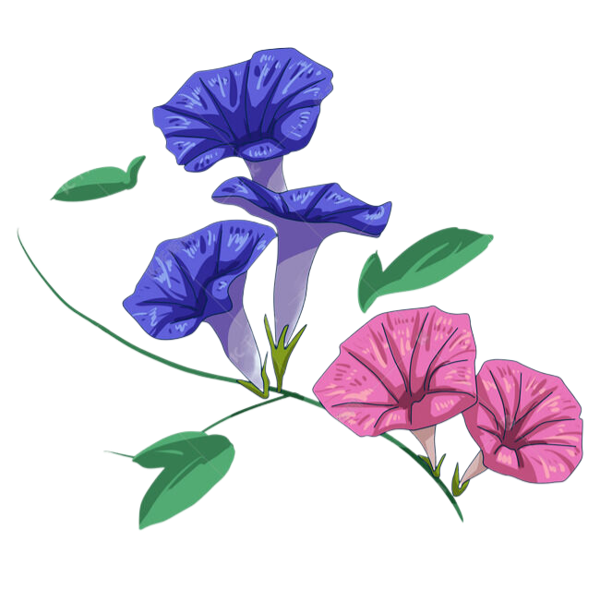
Exhausted as we were, we all felt the activity was worth. Because it aided us to rediscover the world--- realizing the importance of protecting the plants: Plants are to us what water is to fish.
Not only did the activity strengthen the friendship among our students , but also it assisted us in building a positive attitude towards life. We do hope that more similar activities will be carried out in the not-far future.

Slide 16

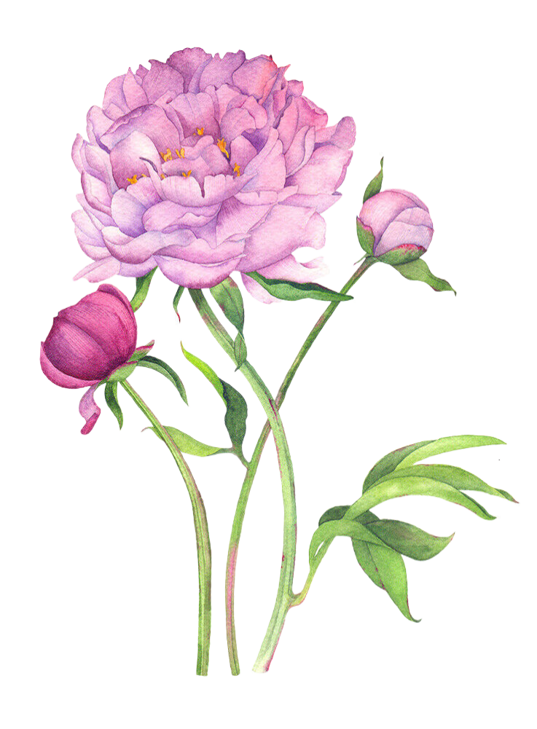
A possible answer 1
Getting to Know the Plants Around Us
For the purpose of raising the awareness of protecting the plants and enriching the students’ school life, last weekend witnessed an activity called “Getting to Know the Plants Around Us”.
We set off at 8:00 am. from our school gate to the Hangzhou Botanical Garden by bus. There, not only could we admire the beauty of plants, but also we learnt the lifestyles of them. Additionally, we hold a match named “Planting Trees” at 2 pm to dvevlop the students’ love with nature. we actively competed in it. The board with some words “The students and teachers form xx school planted the trees in person” found our activity.
We exposed ourselves to the beautiful nature. Not only did it erase our
pressure from heavy study, but also it was a comprehensive education
for us students. Therefore, we all think highly of it, expecting more
activities like this can be held in the not-far future.

Slide 17
A possible answer 2
Getting to Know the Plants Around Us
Aimed at enriching the students’ school life, an activity “Getting to Know the Plants Around Us” was held in our school last weekend.
Taking several buses, we set off at 8:00 from our school gate to the Hangzhou Botanical Garden. In order to make students get a better understanding of some plants, our school invited an experienced plant expert to give us some introductions about plants on the spot, from which we got some detailed information about a variety of plants. what’s more, we spontaneously organized an activity at 2 pm., helping to pull weeds out to give the plants a friendly environment to grow.
Not only did the activity strengthen the friendship among our students,
but also it assisted us in building a positive attitude towards life.
We do hope that more similar activities will be carried out in the
not-far future.

Slide 18


