Slide 1

感恩遇见，相互成就，本课件资料仅供您个人参考、教学使用，严禁自行在网络传播，违者依知识产权法追究法律责任。
更多教学资源请关注
公众号：溯恩高中英语
知识产权声明

Slide 2
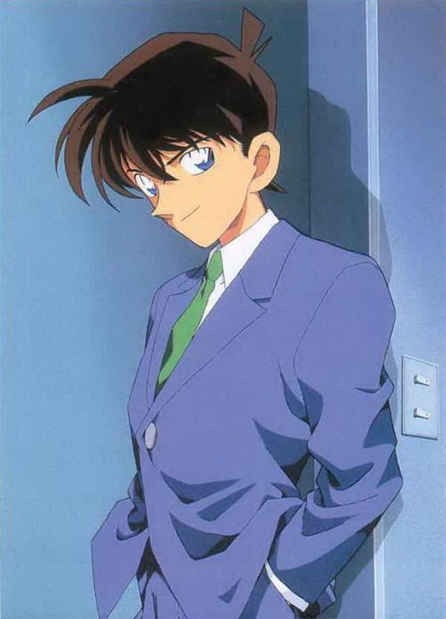
By the end of the class, students will be able to：
1 recognize body language in classroom and tell its meanings
2 describe body language and infer its meanings
3 write a passage to describe body language of someone
4 understand the importance of body language in classroom

Slide 3
Unit 4 Body Language
Using Language P44
How do I know my students?

Slide 4
Unit 4 Body Language
Reading for Writing
How do I know my students?

Slide 5
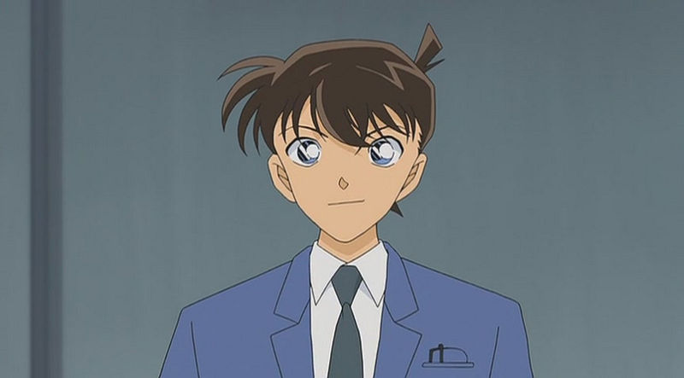
I am a teacher, not a detective.
But I also need some detective skills.

Slide 6
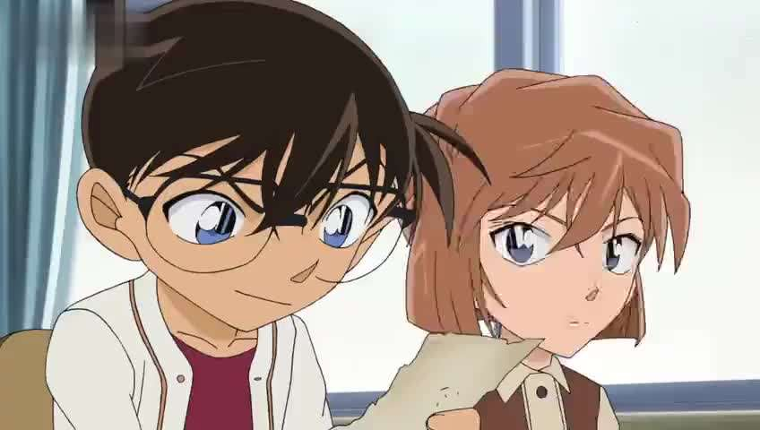
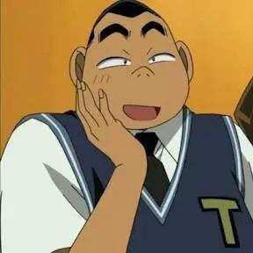
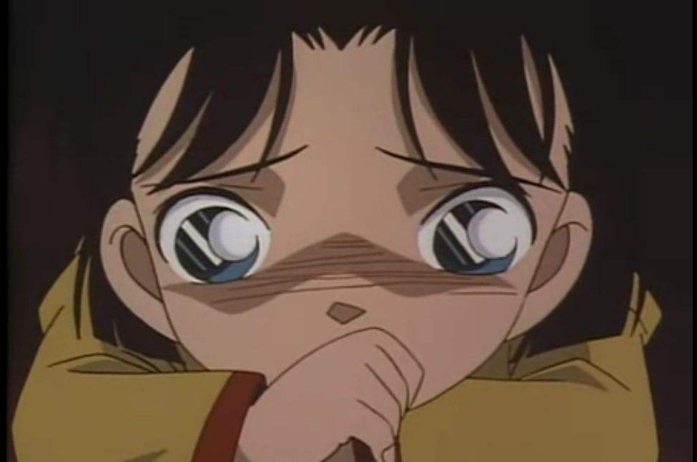
I need to know if my students are listening.
Who is focused in class?
A
B
C
D

Slide 7
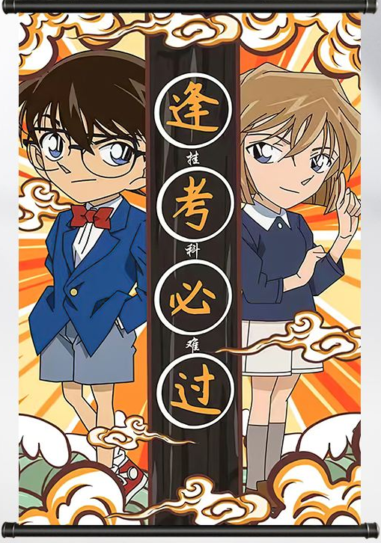
look at the teacher/the text
serious and focused

Slide 8
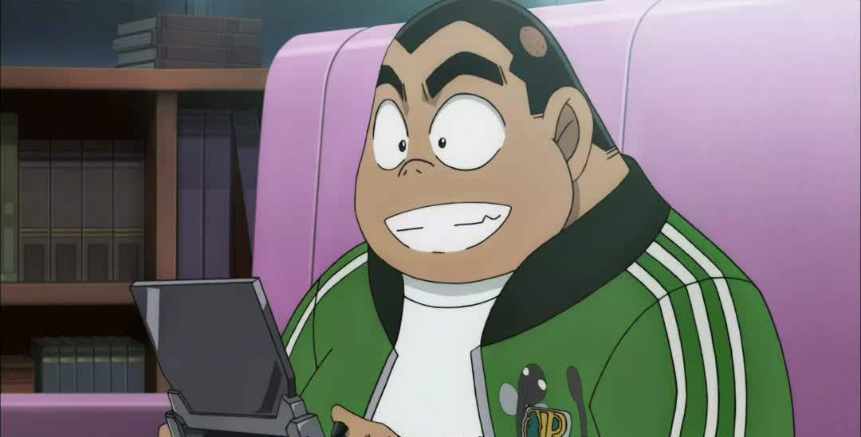

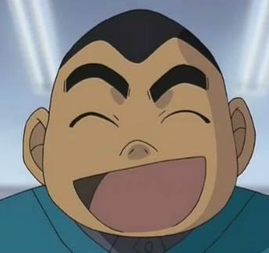
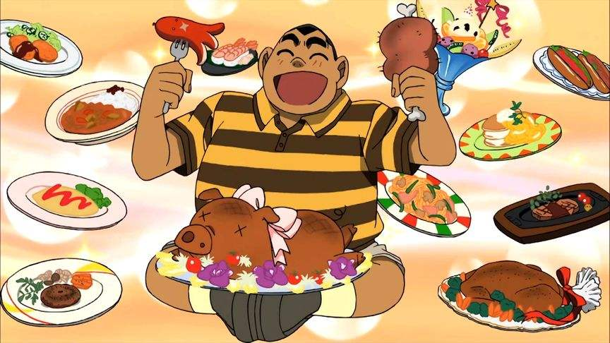
rest his chin on his hand
an absence of eye contact
daydreaming
distracted

Slide 9
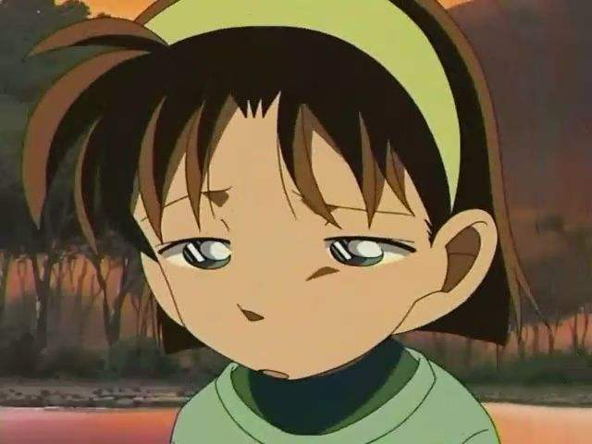
sad or worried
look down, have arms crossed, wear a frown

Slide 10
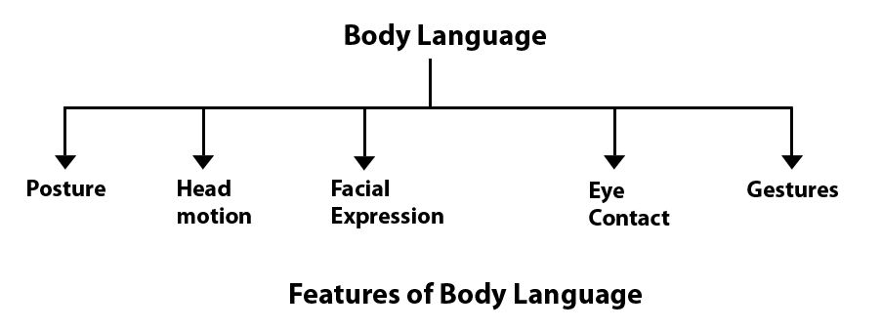
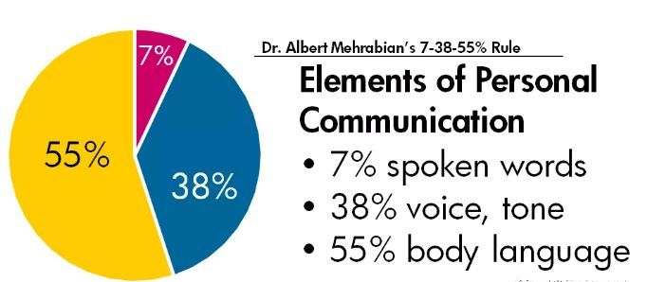
Notes:
do you believe it? let’ have an experiment!

Slide 11
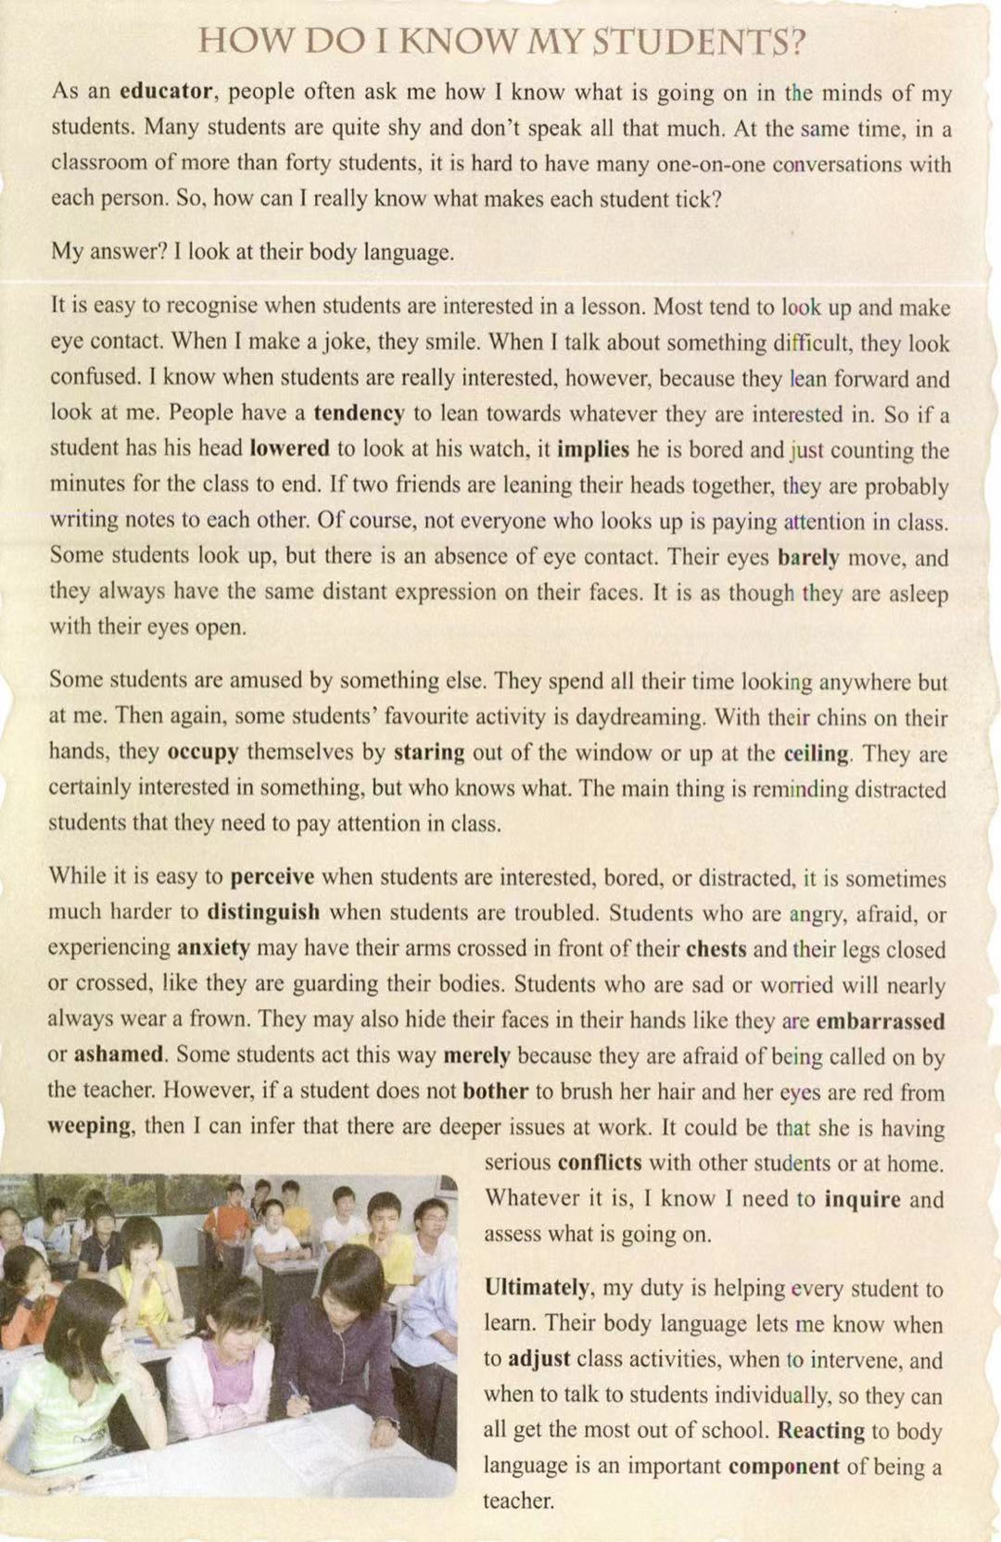
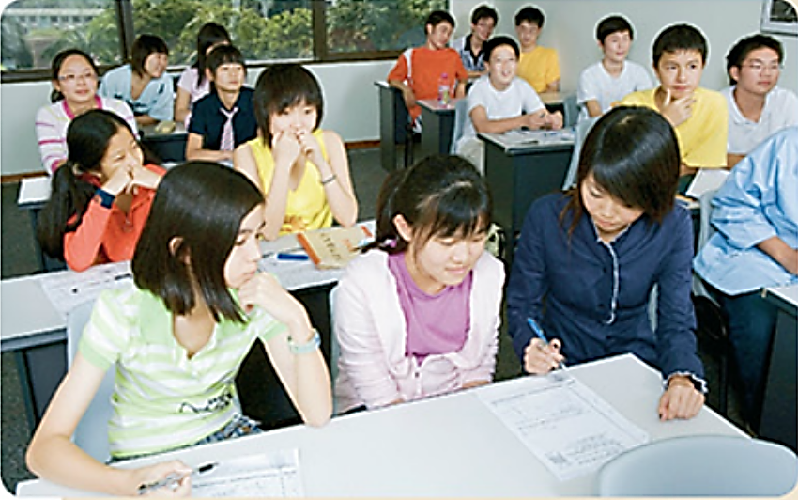
Pre-reading ：Prediction
How do teachers tell their students’ performance in class?
By reading students’ classroom body language.

Slide 12
Fast reading
Find the topic sentence of each paragraph.
Para.1
Para.2
Para.3
Para.4
Para.5
Para.6
How do I really know what makes each student tick?
I look at their body language.
It is easy to recognise when students are interested in a lesson.
Some students are amused by something else.
While it is easy to perceive when students are interested, bored or distracted, it is sometimes much harder to distinguish when students are troubled.
Reacting to body language is an important component of being a teacher.

Slide 13
Part 1
Part 2
Part 3
Divide the passage into several parts.
Part 2
Part 1
Paragraph 1-2
Part 2
Paragraph 3-5
Part 3
Paragraph 6

Slide 14
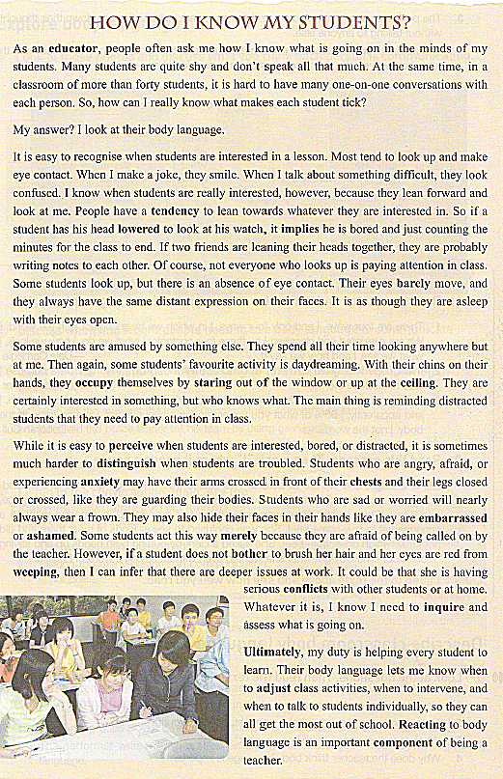
Study the structure
Introduction
(Para 1&2)
Part 1
general
Para.3: Recognize when students are interested or bored
Body
(Para 3-5)
Part 2
specific
Para.4: Recognize when students are distracted
examples of body language
& what they imply
Para.5: Distinguish when students are troubled
Conclusion
(Para 6)
general
Part 3

Slide 15
Match the body language with the meanings. Write the letters A-F on the lines.
A. very interested
B. bored
C. sad or worried
D. serious problems
E. daydreaming
F. angry, afraid, or
experiencing anxiety
___ 1. Leaning over to look at one's watch
___ 2 Leaning forward and looking at the teacher
___ 3. Chin on hand, staring out of the window
___ 4. Looking down, arms or legs crossed
___ 5. Frowning
___ 6. Hair not brushed, red eyes
B
A
E
F
C
D
Tip：Description of body language is based on the use of various verbs.

Slide 16
Detailed reading
Read Para 3 to Para 5 carefully and fill in the blanks with verbs.
Para 3: Recognise when students are interested or bored.
1. look up and make eye contact
2.______ forward and _____ at the teacher
3. have one’s head _____ to look at his/her watch, ________ the minutes
4. look up, but no eye contact, no expression
5. eyes barely ______
Para 4: Recognise when students are distracted.
1. look everywhere
2. rest one’s chin on one’s hand
3. _____ out of the window or up at the ceiling
Para 5: Distinguish when students are troubled.
1. have one’s arms _____
2. have one’s legs _____ _____
3. _____ a frown
4. _____ one’s face in his/her hands
crossed
lean
look
closed or crossed
lowered
stare
wear
hide
count
move

Slide 17
Make inferences
Is body language important in classroom?
What should the teacher do when students are bored, distracted, or troubled?
Body language in classroom helps the teacher know what is going on in the minds of students.
When students are bored, the teacher should adjust class activities.
When students are distracted, the teacher should remind them to pay attention.
When students are troubled, the teacher should talk to students individually.

Slide 18

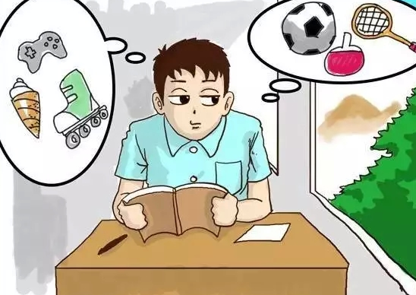
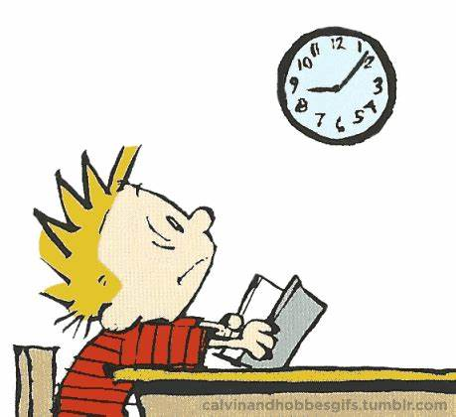

Post-reading: Learn to describe body language
hold his book up
daydream
distracted
bury his head in the book
turn…upside down
sleepy
The boy is…
It seems he is…
Maybe he is/feels…
look at the clock
count the minutes
bored
sit straight up
take notes
focused

Slide 19
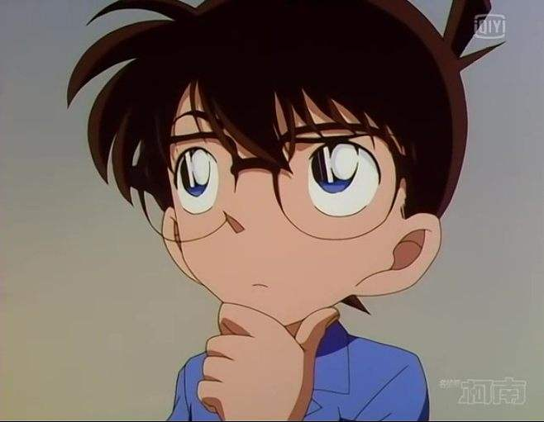

Writing
Write a passage to describe the body language of the person, and explain his/her body language. Try to give your impression of the feelings and personality of the person.

Slide 20

Example:
body language+ meaning+ impression of the person
Looking forward with a smile, the boy is raising his fist to show his determination to achieve a goal. He holds a pencil with the other hand. I think he is a confident and hard-working student. I want to make friends with him.

Slide 21
body language+ meaning+ impression of the person
chin on his hand
eyes sparkling
show
seem
indicate
…
smart
confused
good at thinking
upset/ in sorrow
helpless
…
sob/weep
tears roll down her cheek
teeth clenched

Slide 22
Assessment
Share your writing. Others use the checklist to give marks.
✓ Is the person properly identified?(2 points)
✓ Is the description clear?(5 points)
✓ Does the writer give his/her impressions of the feelings and personality of the person in the drawing, and also explain why he/she has these impressions?(3 points)
✓ Does the writer use correct grammar, punctuation, and
spelling?(5 points)
character identified (2 points)
clear description (5 points)
impression + explanation (3 points)
correct grammar, spelling (5 points)

Slide 23
Share your work
character identified (2 points)
clear description (5 points)
impression + explanation (3 points)
correct grammar, spelling (5 points)

Slide 24
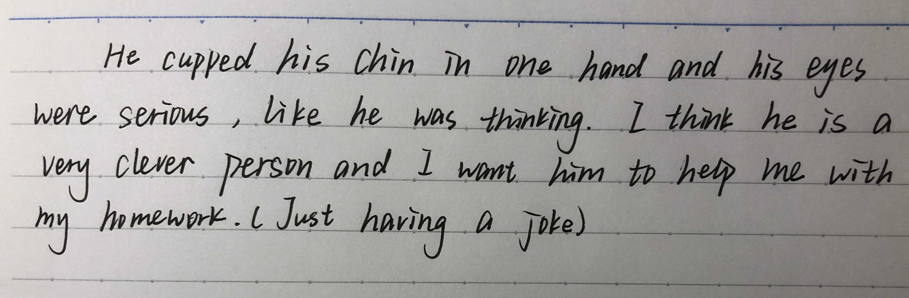
Share your work
character identified (2 points)
clear description (5 points)
impression + explanation (3 points)
correct grammar, spelling (5 points)

Slide 25
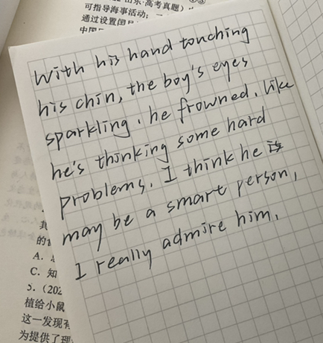
Share your work
character identified (2 points)
clear description (5 points)
impression + explanation (3 points)
correct grammar, spelling (5 points)

Slide 26
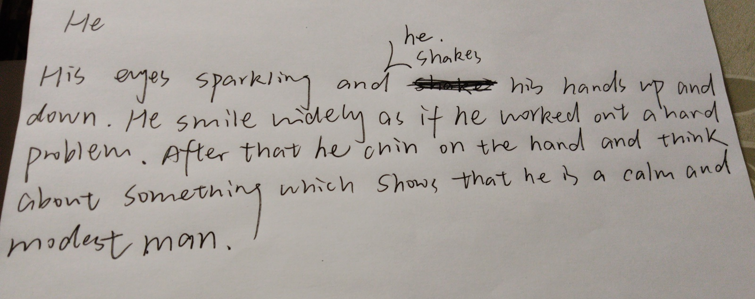
Share your work
character identified (2 points)
clear description (5 points)
impression + explanation (3 points)
correct grammar, spelling (5 points)

Slide 27
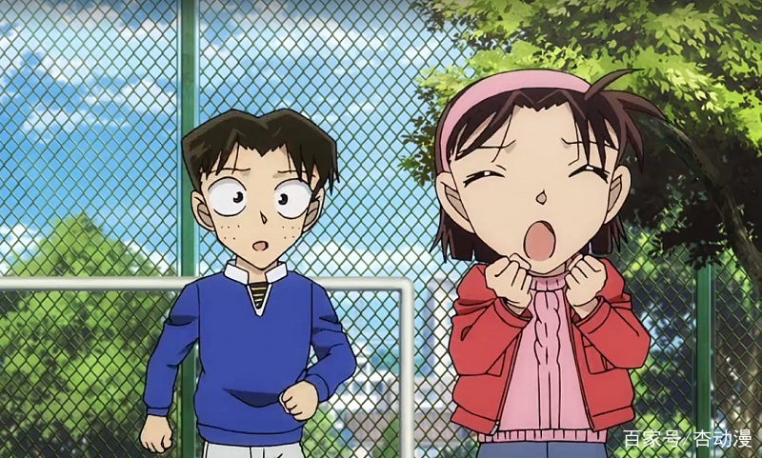
Homework
Write a passage to describe the picture. Focus on the body language of the characters, and explain their body language.
writing

Slide 28
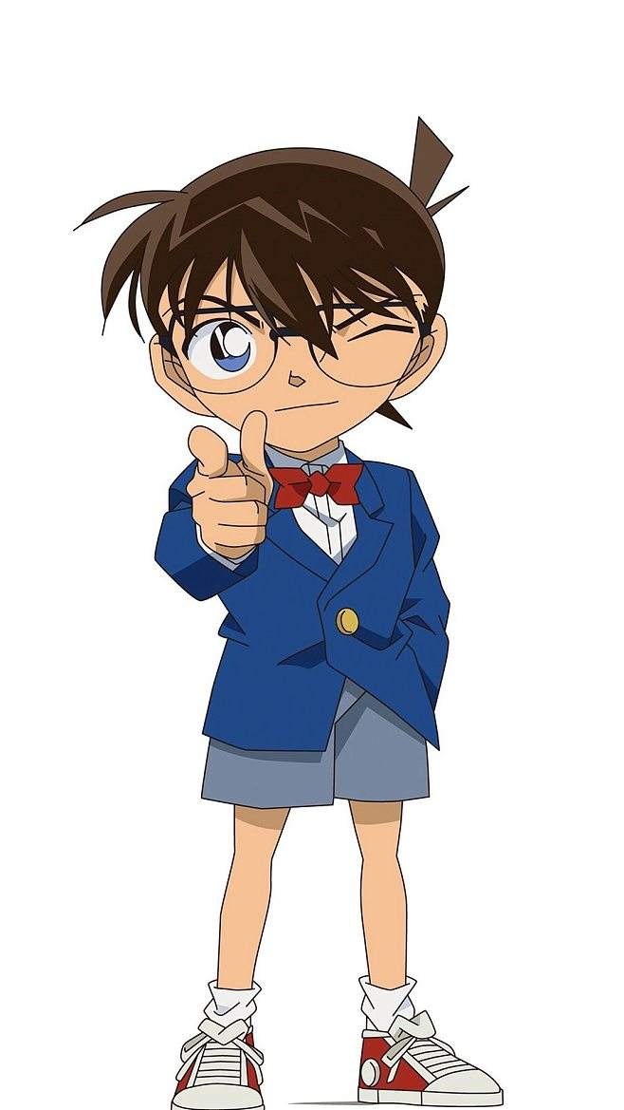
Apply what you learn to your writing.
Apply what you learn to your life.

Slide 29
Your teacher may seem strong most of the time.

Slide 30
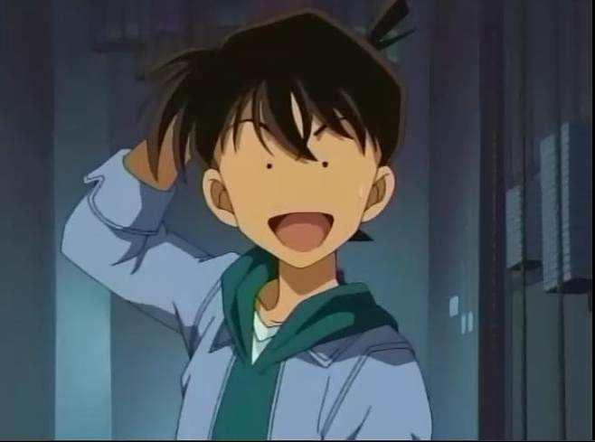
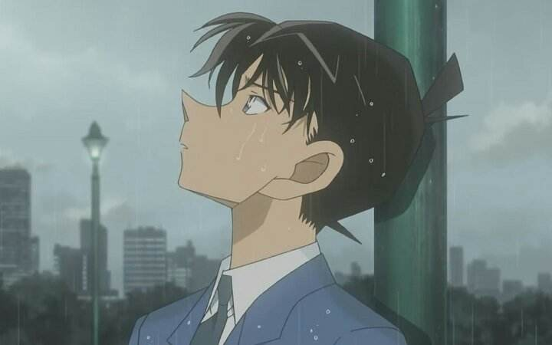
But sometimes he can also get into trouble.

Slide 31
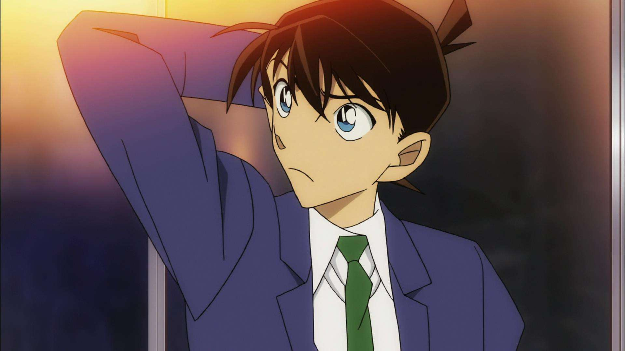
If you notice it from his body language,

Slide 32
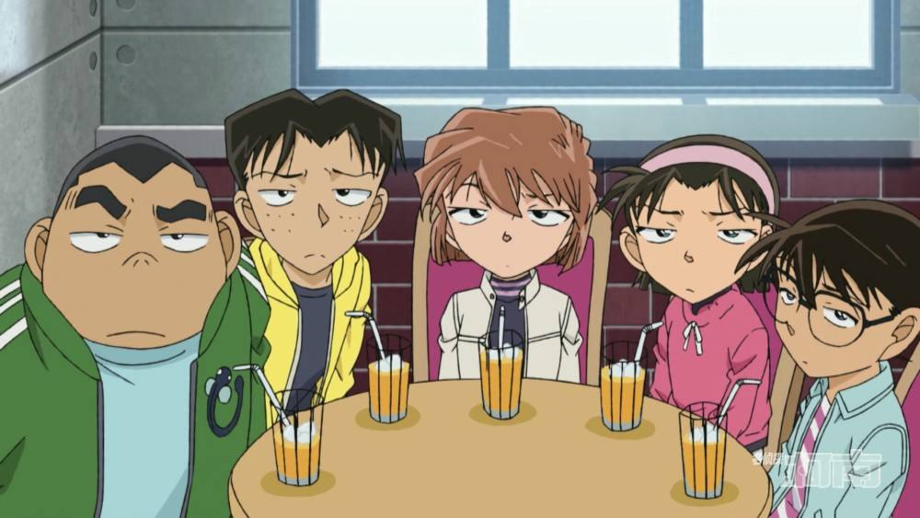
do not be mean or ignore it!

Slide 33
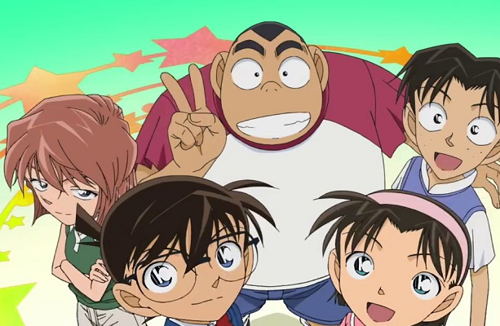
Give him a smile or a friendly eye contact!

Slide 34

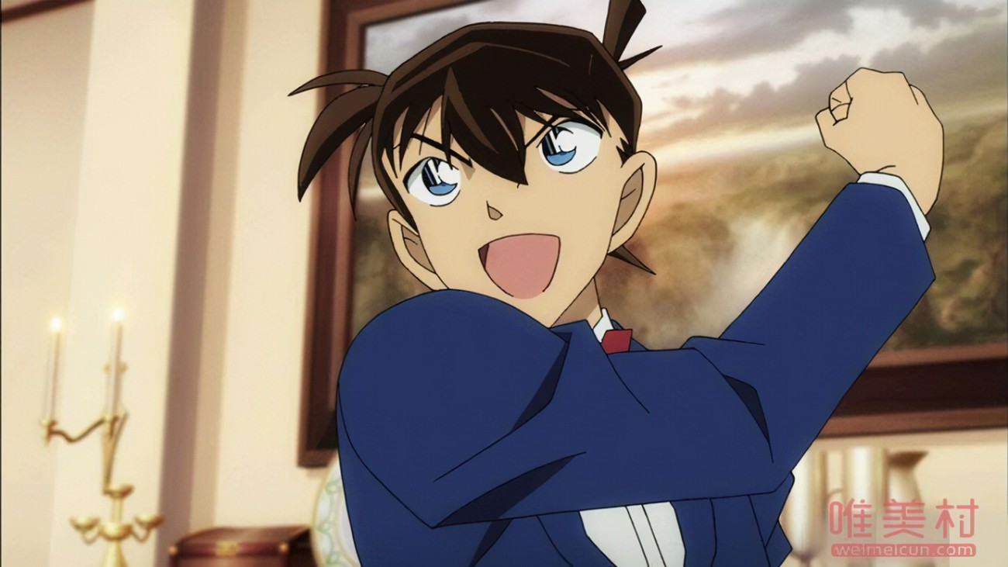
Your encouragement means a lot to your teacher!

Slide 35

Thank you for listening!

