Slide 1

感恩遇见，相互成就，本课件资料仅供您个人参考、教学使用，严禁自行在网络传播，违者依知识产权法追究法律责任。
更多教学资源请关注
公众号：溯恩高中英语
知识产权声明

Slide 2
Unit 3 The Internet
Reading for Writing
How to write a blog post

Slide 3
文本分析 What：文本是一篇新媒体语篇——博客文章.
Why：引导同学们理智健康地使用网络，注意网络安全。
How：文章分为博文区和评论区，博文区分为三个部分：介绍、主体和结尾，主旨明确，结构完整，简明扼要。
第一段，作者提出了要谈论的问题--安全上网，表明了自己的身份，表明这是个人的经验之谈。
第二段是作者的三个建议，用first of all、second、third来衔接，读起来一气呵成，连贯性很强。
最后一段邀请读者分享经验和发表评论。
在评论区展示了两位网友补充了网络挑事者（troll）和网络恶霸（cyberbully）的具体案例，与文章内容相呼应。

Slide 4

1.Figure out the organization and language feature of a blog post.
2.Identify the useful patterns and expressions to make suggestions from the reading text.
3.Write a blog about online safety by using the language in the reading text.

Slide 5



What benefits or convenience does Internet bring us?
● Communicate with friends
Easy to
● Go shopping
● Find resources
● ...
What else？

Slide 6

What problems does the boy meet online?
Danger of sharing personal information online

Slide 7
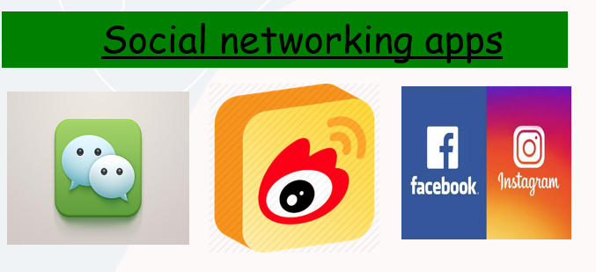
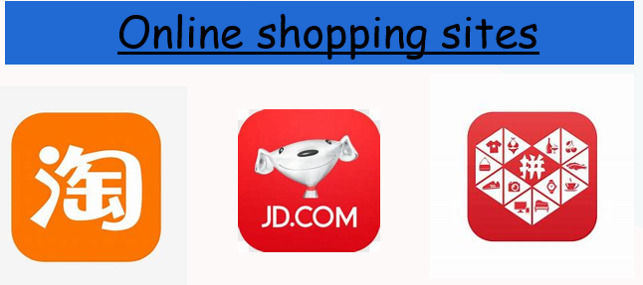

Online safety problems
….
What can we do to avoid these problems online ?

Slide 8
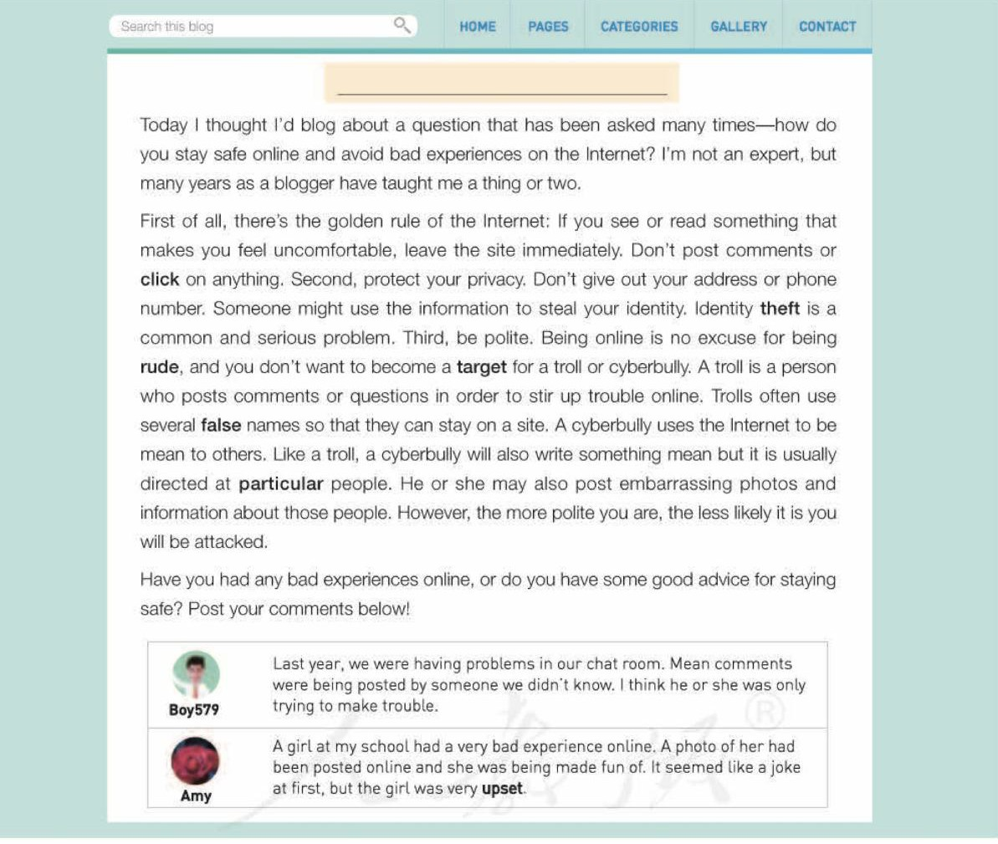
1. Where does the passage come from?
2. What type of passage is it?
3. What is discussed in the passage?
Online safety
Internet.
A blog post
How to stay safe online and avoid bad experiences on the Internet.
comments

Slide 9
Tick what the writer tells the reader in Para. 1.
Para. 1
Introduction
definition of online safety
background information
the writer's knowledge
the topic of the post
“How do you stay safe online and avoid bad experiences on the Internet?”
√
√
How?
Tip 1: Ask a question to introduce and go straight to the topic.

Slide 10
Para. 2
Body
How does the author answer the question?
Body
rules
by giving 3 golden _____
guidelines

Slide 11
Para. 2
What are the guidelines?
Common?
dos | don'ts
*leave the site immediately
*post comments/click on anything
*protect your privacy
*give out your address/
phone number
*be polite
Tip2： Use imperative sentences(祈使句) to make the language powerful, concise and persuasive.

Slide 12
Para. 2
How are the guidelines connected?
first of all, to begin with, firstly, first, in the first place, on top of the list, for a start,
First of all
Second
besides, in addition, additionally, moreover, what's more, furthermore
Third
lastly, finally, in the end, consequently, last but not least
Tip3： Use linking words to express ideas clearly, logically and coherently (连贯地).

Slide 13




Para. 2
Whom should you be aware of online?
How did the author explain new words or key terms?
Identity Theft
It is a problem...steal your identity.
explanation
A Troll
A troll is a person ... stir up trouble online.
definition
A Cyberbully
Like a troll, a cyberbully will use ... .
comparison
Tip 4: Add details and use skills such as explanation、definition and comparison to make the information clear and understandable.

Slide 14
What does the author ask the readers to do?
Para. 3
Asking for comments
“Have you had any bad experience online, or do you have some good advice for staying safe? Post your comments below!”

Slide 15
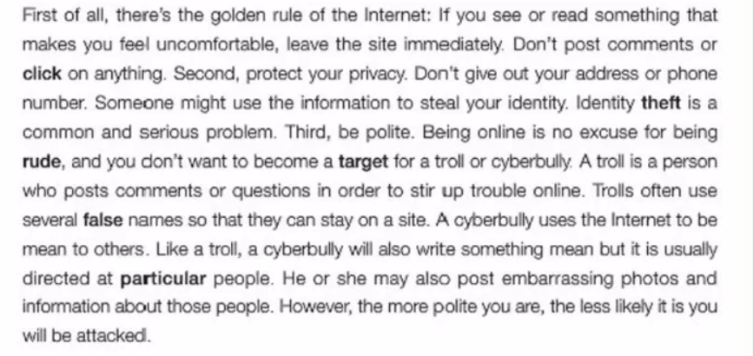
A summary of the structure and writing tips
Introduction
Tip 1: Ask a question to introduce the topic.
Background inf. and
the topic of the post
Tip2： Use imperative sentences to make the language powerful.
Tip3：Use linking words to express ideas clearly, logically and coherently (连贯地).
Tip 4: Add details. Such as explanation, definition and comparison to make the information clear and understandable.
Body
Tell the reader what they should do or keep in mind.
Define new words or key terms.
Ending
End by asking the readers to write comments and
give feedbacks.

Slide 16
Let's write.
Use what you have learnt to write a blog post about “Online Shopping Safety”
请根据以下要点以“ Online Shopping Safety”为题写一篇关于如何安全地网上购物的帖子并发表在你的博客上。词数100左右。
1.挑选你熟悉的购物网站；
2.使用较为复杂的密码；
3.勿使用公共电脑购物……

Slide 17
You may use these phrases:
download …APP
register account
install …APP
brand
be familiar with
shopping account
Shopping online
quality
enter our daily life
app
be concerned about
……

Slide 18
You may use these sentence patterns:
When it comes to doing sth./sth., I’m sure that I know one thing or two.
Here are some tips /suggestions
/advice for…
Shopping online
Do/Never do sth.
Have you had any good tips/ suggestions/advice about…
Your ideas are welcomed below!

Slide 19
Let's polish the passage.
√ Does the writer tell the reader what he/she knows about the topic?
√ Are the tips and suggestions well organized?
√ Has the writer defined the new words?
√ Does the author include examples, comparisons, or explanations?
√ Does the writer end by asking readers to leave comments and/or suggestions?
√ Can you find any grammar or spelling mistakes?

Slide 20
Suggested version
Shopping online safely
When it comes to shopping online safety, I’m sure that I know one thing or two. My net age is 10 years. Here are some tips for you.
First, use the shopping websites you are familiar with. Download familiar app or software like taobao. Second, when registering a shopping website, use a strong password and keep it well. Third, never use public computers to shop online, or your privacy will be recorded in the computers. Last, install a firewall to watch over your information. A firewall is a kind of software to protect your using Internet.
Have you had any good tips about shopping online safely？Your ideas are welcomed below!

