Slide 1

感恩遇见，相互成就，本课件资料仅供您个人参考、教学使用，严禁自行在网络传播，违者依知识产权法追究法律责任。
更多教学资源请关注
公众号：溯恩高中英语
知识产权声明

Slide 2
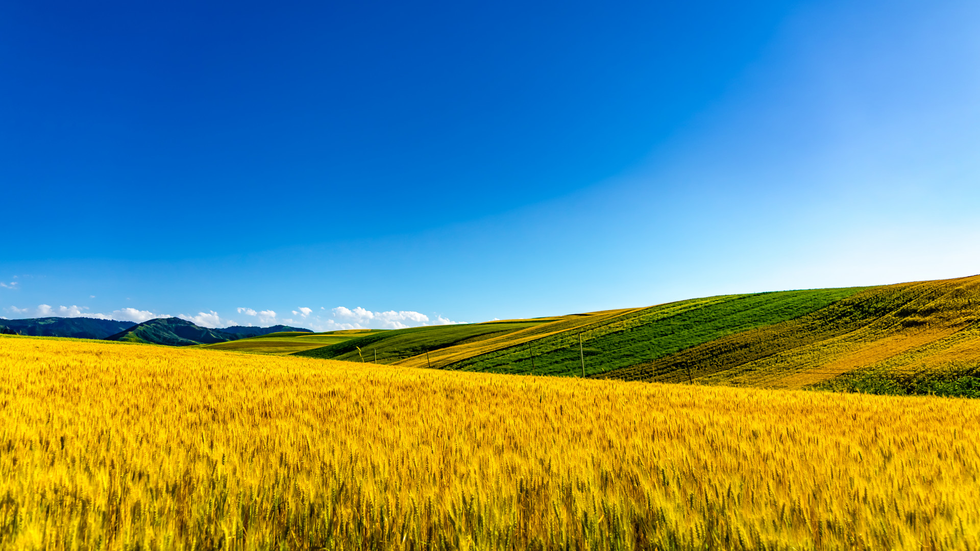
高考听力专题突破
Guidance to Inference Questions
推理判断类题
湖北十堰东风高级中学 刘彦麟

Slide 3
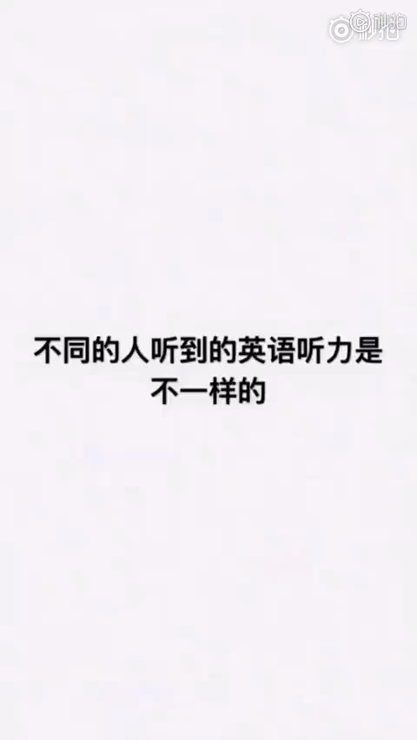

Slide 4
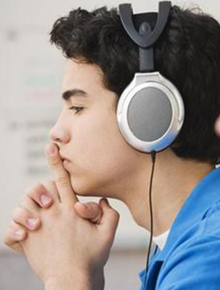

Analysis on examination outline（考试说明）
What does the examination outline ask us to do?
要求考生能听懂所熟悉话题的简短对话和独白。
考生应能: 1、理解主旨和要义；
2、获取具体的、事实性信息；
3、对所听内容作出推断；
4、理解说话者的意图、观点或态度。
04

Slide 5
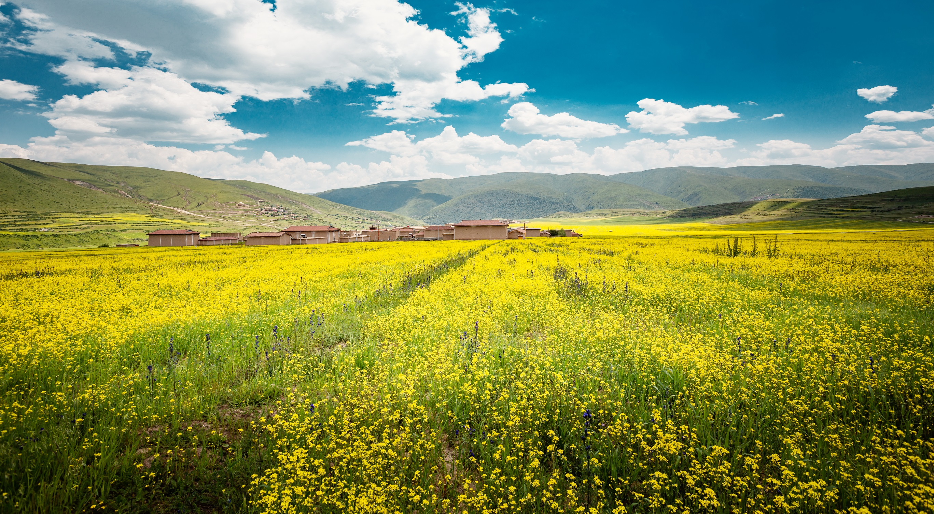
Learning Objectives (学习目标)
1.数字推测
2.地点推测
3.人物身份及关系推测

Slide 6
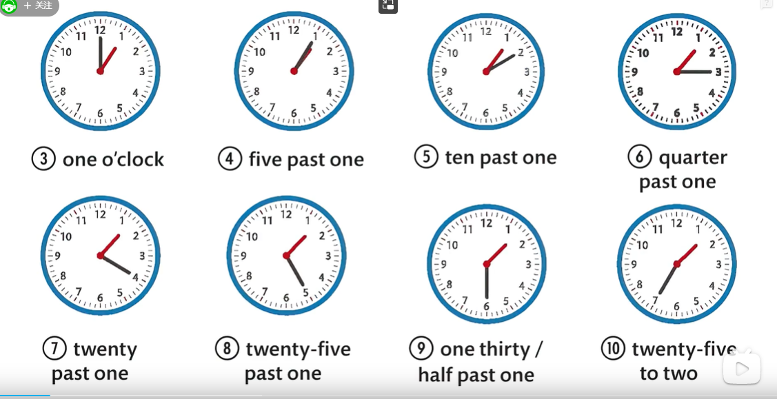

01
时间推测
Warming up (热身)
1. Try to write down the numbers you hear.
2. Can you read the clock?
3. How to read the year?
4. More related words.
1971
nineteen seventy-one
1809
eighteen O nine
1900
ninteteen hundred
2002
two thousand and two/ twenty O two
Guidance to Inference Questions
in the sixteen hundreds
在十七世纪
in the nineteen thirties
在二十世纪三十年代
in the 1600s
in the 1930s
weekdays
weekend
fortnight
gain/lose
put off/postpone

Slide 7
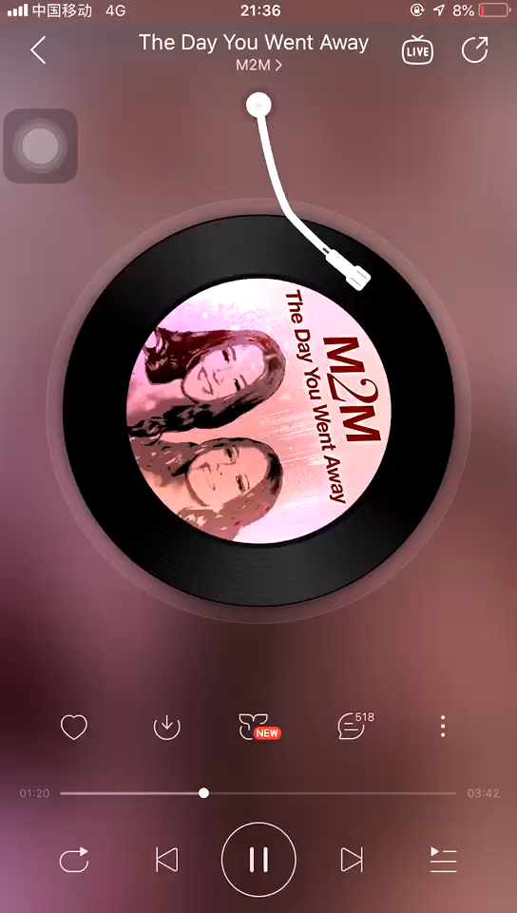

Listen to the song
The day you went away
I remember date and time.
September______________
Sunday___________after_____________
In the doorway …
twenty-second
twenty-five
nine

Slide 8
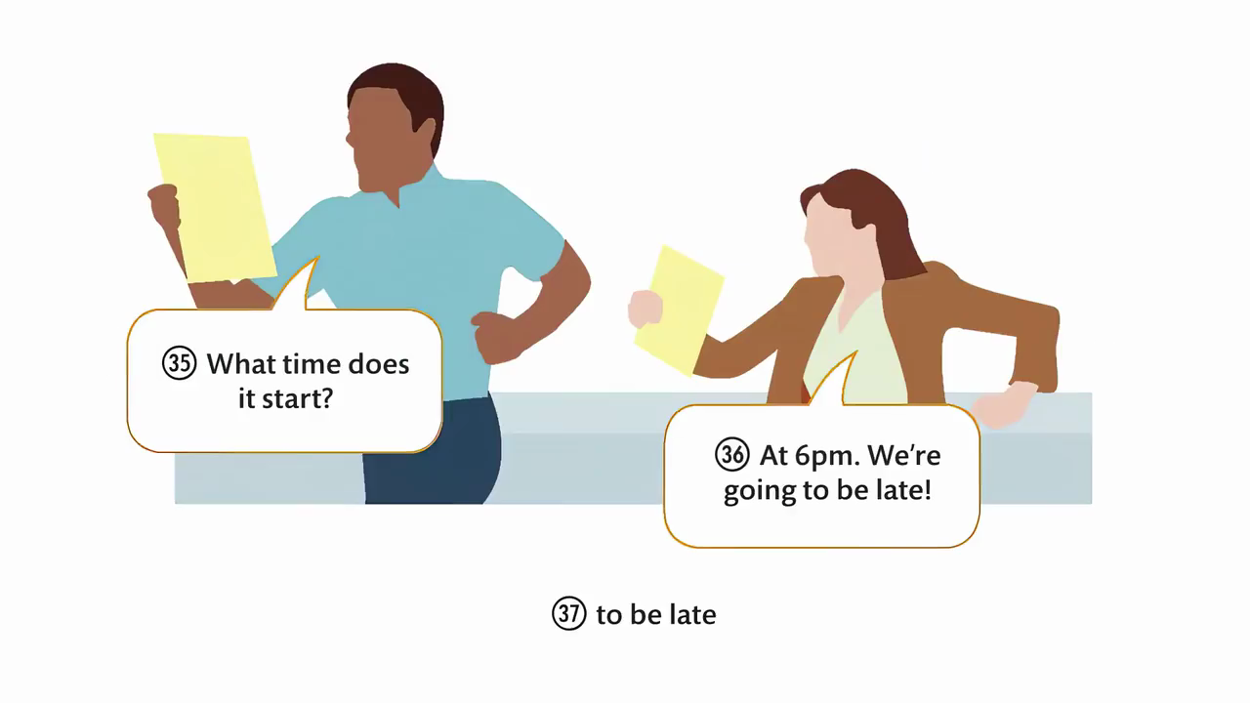

例题1（短对话）
What time is it now?
A. It is at 6 p.m.
B. It is past 6 p.m.
C. It is almost 6 p.m.
Guidance to Inference Questions
短对话，即听即选即错
注意逻辑推算
Tips

Slide 9
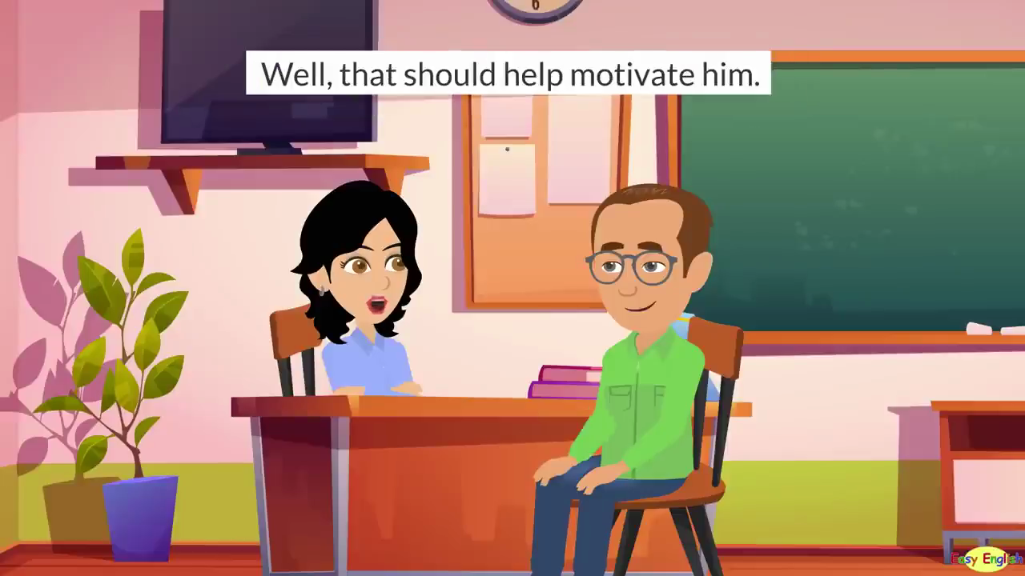
例题2（长对话）
When will the man get his son to school?
A. Mondays or Thursdays at 8:15 p.m.
B. Mondays or Thursdays at 8:50 a.m.
C. Mondays and Thursdays at 8:15 a.m
Tips
Guidance to Inference Questions
长对话，即听即选即大概率对
但要注意上下文合并

Slide 10
Practice
1. What time is it now?
A. 9:25 a.m.
B. 9:35 a.m.
C. 9:45 a.m.
W: What time is it?
M: You just asked me that
ten minute ago, at 9:25 a.m. Is there something wrong with your memory?
W: I don't have a watch and it's important for me to know the time.

Slide 11
Practice
2. When should the meeting have started?
A. at 9:00 a.m.
B. at 11:00 a.m.
C. at 10:00 a.m.
M: When is Jennifer? It's 11:00 a.m. The meeting should have started an hour ago.
W: She called earlier. All the subway trains have been canceled, so she had to take a taxi. But it's stuck in traffic?
M: Really---this city.

Slide 12
Practice
3. How long will the flight take?
A. about five hours.
B. about three hours.
C. about four hours.
W: Hi Dad, it's 5:30a.m., and the plane is taking off.
M: I'll meet you at the airport. What time is your flight due to arrive?
W: It's supposed to get there at 8:30 a.m.

Slide 13
Practice
4. What time should Daisy start work?
A. at 8:55.
B. at 9:00.
C. at 9:05.
M: Is this going to be the first day Daisy will be late for work?
W: Looks like it. It's 8:55. Only five minutes to go.
M: Oh no, here she comes, as usual.

Slide 14

高考真题
（2020全国I卷）
4. When will Henry start his vacation?
A. This weekend. B. Next week. C. At the end of August.
7. When is Pete going to see Lucy?
A. At 6:00 pm. B. At 6:45 pm. C. At 8:00 pm.
7. When are the students going to the museum?
A. On Friday. B. On Saturday. C. On Sunday.
（2020全国I卷）
（2022全国II卷）
DEVELOPMENT OF

Slide 15
价格推测
Warming up (热身)
美元 dollar
欧元 euro
打折 discount
/on sale
30% off七折
美分 cent
英镑 pound
便士 penny
钞票 bill
硬币 coin
零钱 change
Guidance to Inference Questions
两倍 double
三倍 triple
便宜货 bargain
半价 half price

Slide 16
Make a calculation
1.The regular price of the book is 50 yuan, but now it
is 20%off. What is the price now ?
2.The production of apples in the fruit garden was 20
tons last year, and it has increased by 10% this year.
What is the production of this year?
3.It is $45 for a handbag and belts cost $55 each. You will enjoy 15% off on your second purchase. What will you pay for one handbag and a belt?
40 yuan
22 tons
$ 85

Slide 17
例题
What was the normal price of the T-shirt?
A. $ 15 B. $ 30 C. $ 50
How much will the speakers pay for the match?
A.￡24 B.￡42 C.￡48
What’s the regular price of the pork?
A. $ 7. B. $14. C. $21.
Guidance to Inference Questions
观察选项中数字关系，预测可能的答案
注意题干问题是原价还是折后价
做必要笔记简单运算
Tips

Slide 18
高考真题
（2017全国卷）
How much more does David need for the car?
A．$ 5,000. B．$20,000. C．$25,000.?
How much will the man pay?
A. $20. B. $80 C. $100.
How much would the man pay for the second camera?
A. 950 euros B. 650 euros C. 470 euros
How much did the man pay for the football game last time?
A. $20 B. $25 C. $50
（2019全国II卷）
（2020全国II卷）
（2021年全国I卷）
DEVELOPMENT OF

Slide 19
More practice
W: The hotel will stand at 200 feet tall and include 350 guest rooms, five restaraunts, three pools and a gym.
M: It sounds like a good opportunity to invest. I'll invest half.
W: So we're looking for a total of £10 million investment, but the maximum any party can invest is 25%.
M: OK, so if I bring in another investor, we can both put in 25%?
W: That's correct. But the investors have to be from the UK. We are only allowed a maximum of 20%investment from non-UK sources.
M: I'm originally from England and still live here for business purpose. However, the other investor I have in mind is in German.
W: Then he would only be able to invest a maximum of 20%. However, if we get another overseas investor, the 20% will be split between them.
M: And what are the projections in term of profits?
W: Well, we're aiming to break ground in 2022, and the hotel is expected to be completed by 2024 and opened by 2025. From the point of opening, we expect to turn a profit in year four.
M: OK, let me think about the numbers.
1. How many swimming pools will the hotel have?
A. one.
B. three
C. five.
2. How much can the man invest?
A. £2.5 million
B. £5 million
C. £10million
3. When will the hotel probably turn a profit?
A. in 2024
B. in 2025
C. in 2029

Slide 20
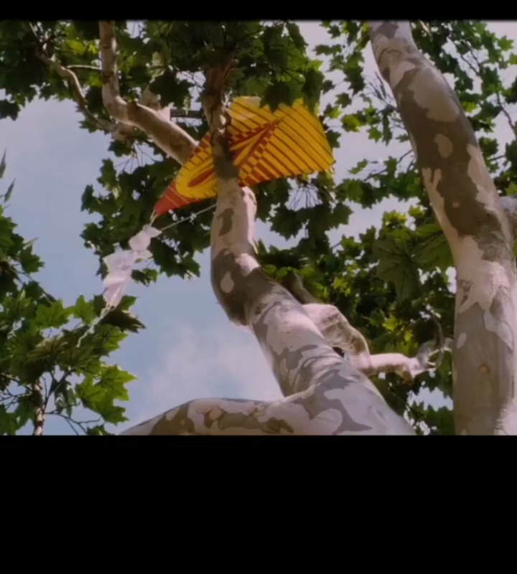
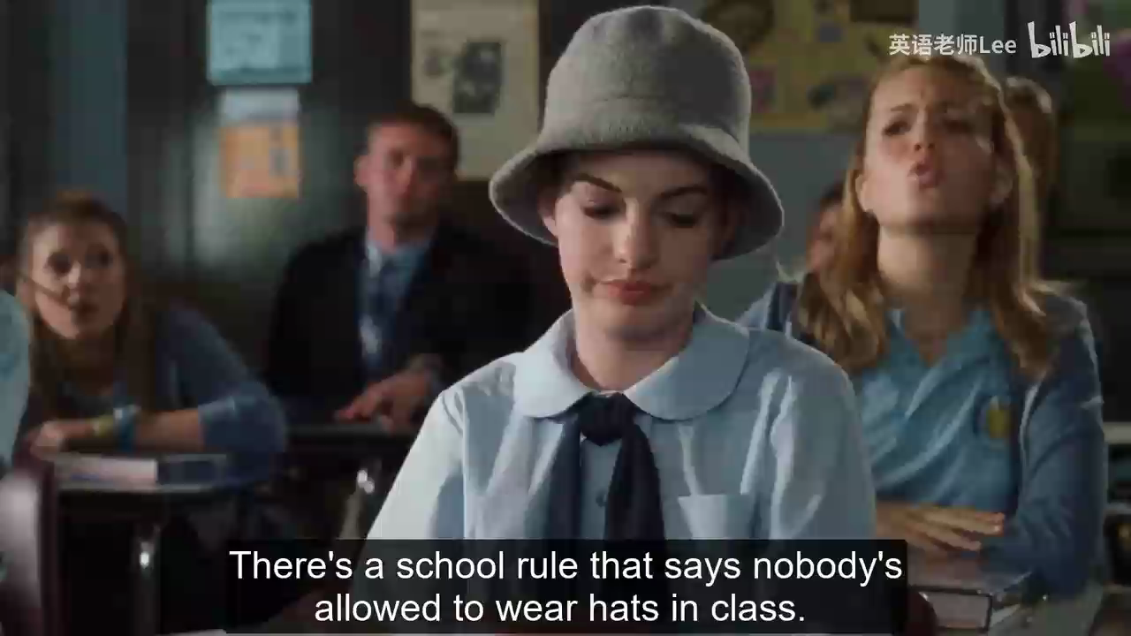
02
地点推测
breeze; sunshine; wild grass
school rule; class
Tips
关注特定场景下的关键词
Guidance to Inference Questions

Slide 21
Can you guess where the place is?
1.___________________: examine,headache,cold and flu,
pill,blood pressure……
2.________: family,parents,kid,relative,housework,wife,husband…
3.________：room key,book a room,a single/double room……
4.___________：menu,order,bill,beer, wine, waiter, waitress
5._________：book,magazine,bookshelf……
6.__________：cash,check, draw/deposit money……
7.___________：flight,take off, airway, departure time, boarding card……
8.___________：size,color,style, discount ,on sale,bargain
in the hospital/at the clinic
at home
at a hotel
at a restaurant
in the library
in the bank
at the airport
at a shop

Slide 22
牙医
dentist
外科医生
surgeon
内科医生
physician
治疗
treatment
手术
operation
打针
injection
探视时间
visiting hours
重症监护室
ICU (intensive care unit)
阿斯匹林
aspirin
药丸 /药片
pill/tablet
药方
prescription
体检
physical examine
抓药
fill the prescription
预约
have an appointment
吃药
take the pill/ medicine
实施心肺复苏术
perform CPR
医院 Hospital
医疗中心
health center
急诊室
emergency room
小诊所
clinic
校医院
infirmary
候诊室
waiting room
病房
ward
救护车
ambulance

Slide 23
发票
invoice
收据
receipt
退款
refund
二手的
second-hand
流行的
popular/fashionable
过时的
out of fashion
品牌
brand
廉价出售
on sale
脱销/缺货
out of stock
有货
in stock
分期付款
pay by installment
用现金支付
pay in cash
用支票支付
pay in check
信用卡
pay by credit card
打五折
50% off
打七折
a 30% discount
购物 Shopping
商店
store
食品杂货店
grocery
百货商店
department store
超市
supermarket
大型购物中心
shopping mall
店员
shop assistant/ salesclerk
柜台/ 收银员
counter/ cashier

Slide 24

银行 Bank
支票
check
信用卡
credit card
信用卡
Visa
现金
in cash
存户
depositor
客户
client
银行工作人员
banker
出纳员
teller
存款单
a deposit form
开户
open an account
申请个人贷款
apply for a personal loan
汇款
make a transaction
定期还是活期?
A deposit or current account?
利率
interest rate
存折
bankbook
取钱
draw /withdraw money
存钱
deposit
透支
overdraw/overdraft
余额
balance
自动取款机
ATM

Slide 25

高考真题
1. Where are the speakers?
A. At a canteen.
B. At a hospital.
C. At a bank.
(2021年全国乙卷)
M: Now, what seems to be the trouble, Mrs. Stevens?
W: I’ve been very dizzy lately, and last night I had some chest pain.
M: Don’t worry. Let me have a look.
07

Slide 26
高考真题
(2021年1月山东卷)
2. Where does the conversation probably take place?
A. In an office.
B. At home.
C. At a gas station.
M: Come on. It’s time to go. We promised Mom not to be late.
W: Just hold your horses. What’s the hurry anyway?
M: Well. I’ve got to stop and put gas in the car first.
W: That won’t take long.
M: Well, it won’t if there is no line there.
W: But, I’m not quite ready.
M: I’ll give you five more minutes. Then I’m going on without you.
W: You wouldn’t do that to me.
M: Oh yes, I would.

Slide 27
03
人物推测
relationship人物关系
identity 人物身份
Pay attention to the tone
1. 陌生人关系语调一般较_________；
朋友关系语调一般较__________；
家人(夫妻/亲子)关系语调一般较__________；
师生或上司与员工关系语调一般较_________；
2. 把说话人的语调和其_______________________结
合起来判断人物关系及身份。
客气
亲切
Guidance to Inference Questions
随意
严肃正式
职业涉及的词汇

Slide 28
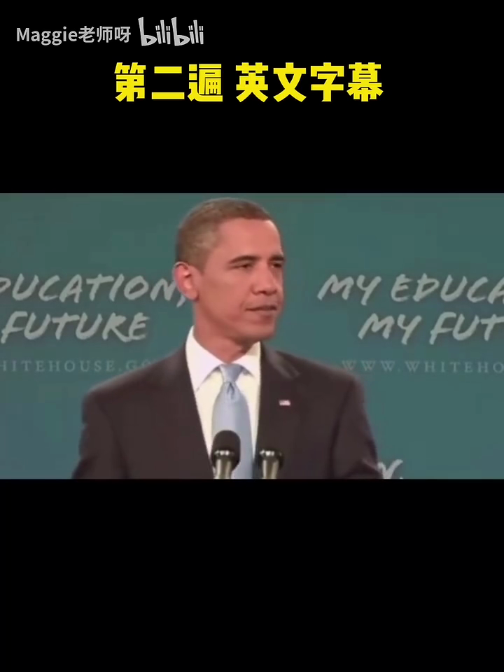
1. What is the man?
A. He is a dentist.
B. He is a lecturer.
C. He is an interviewer.
2. Who is the speaker
talking to?
A. students
B. tourists
C. customers

Slide 29
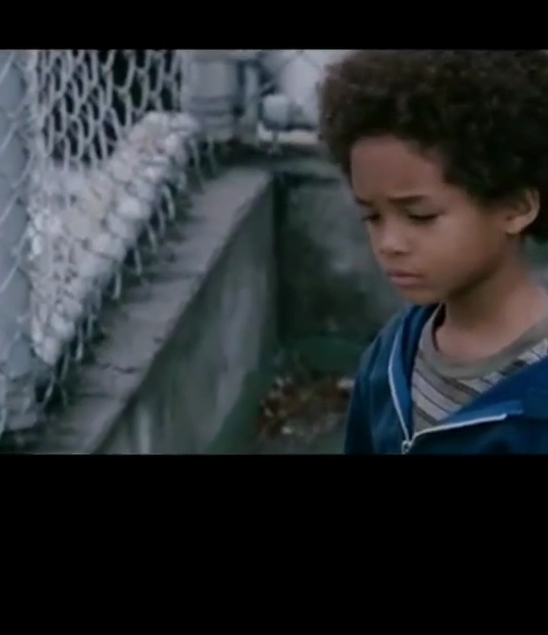
What's the most probable relationship between the two speakers?
A. Neighbors.
B. Doctor and patient.
C. Father and son.

Slide 30
职业与人物间的关系
Key words | relation
dear, darling, sweetheart,my love, cook, TV, dinner
size, color, try on, discount, Can I help you?
trouble, check, pain, fever, prescription处方, dentist
professor,subject, essay, homework, questions, major, hand in,
husband and wife
assistant and customer
doctor and patient
teacher and student
office;hire; employ; employer; employee; position; promotion
Excuse me; next door; garden; yard
colleagues; boss
neighbors

Slide 31
高考真题
(2021年浙江1月)
6. What is the probable relationship between the speakers?
A. Husband and wife.B. Hostess and guest.C. Chef and customer..
2. What is the man?
A. A teacher. B. A doctor. C. A chef.
18. Who is the speaker talking to?
A. Sports club members. B. International tourists.
C. University students.
9. Who is Clara?
A. The man's wife. B. The man's sister. C. The man's daughter.
(2021全国乙卷)
(2022年全国II卷)
(2022全国II卷)

Slide 32
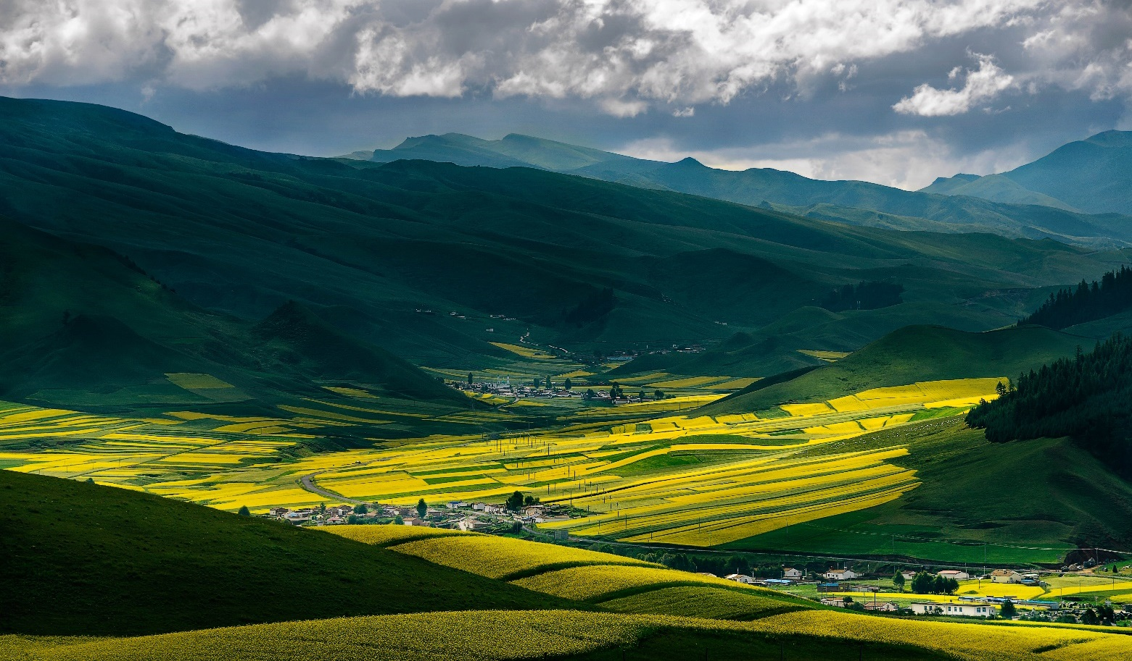
Conclusion
综合训练

Slide 33
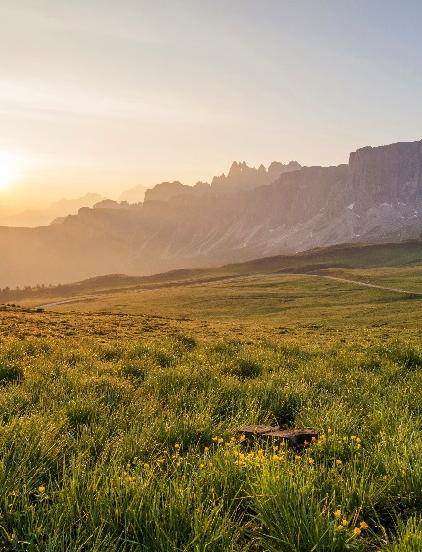
1. How many green and blue sweets are there in each bag?
A. 6.
B. 11.
C. 13.
2.Where does the conversation probably take place?
A. In a gym.
B. On a mountain.
C. At the speakers’ home.

Slide 34
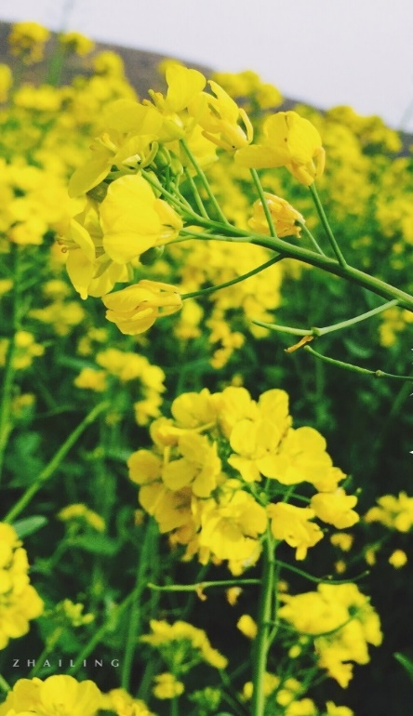
3. What is the probable relationship between the speakers?
A. Mother and son.
B. Husband and wife.
C. Teacher and student.
4. How long will the flight take?
A. About five hours.
B. About three hours.
C. About four hours.

Slide 35
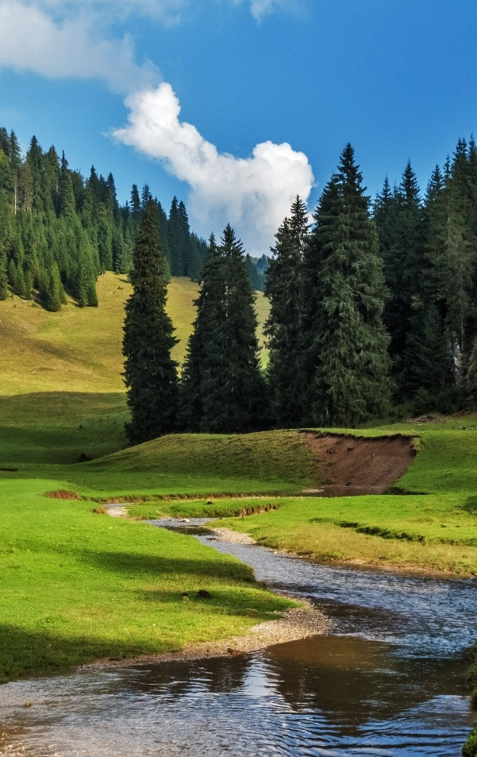
5. What time is it now?
A. 9:25 a.m.
B. 9:45 a.m.
C. 9:35 a.m.
6.What does the man do for a living?
A. He is a police officer.
B. He is a cinema worker.
C. He is a security guard.

Slide 36
听第9段材料，回答第15至17题。
15. Where is Sarah now?
A. In Brighton. B. At her home. C. At the Shelton Hotel.
16. What time is Michael leaving his place tomorrow morning?
A. At 7：40. B. At 8：00. C. At 8：20.
17. What is the probable relationship between John and Sarah?
A. Neighbors. B. Fellow workers. C. Husband and wife.
(2021年全国I卷)

Slide 37
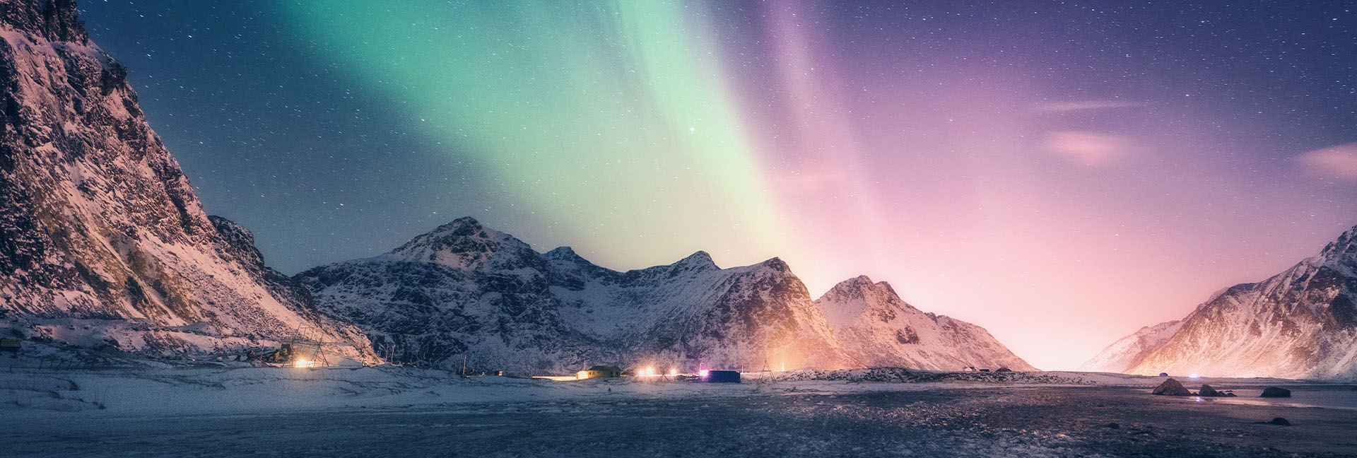
Thank You!
Notes:
刘老师的案例分析和总结十分好，就这样已经是很完整的体系。两个小意见，不一定在此课件中进行改动和添加：1. 数字的推理，其中时间肯定是最常见的一块，还有一种常见题型，比如对数字的计算，如购物打折后的价格总数，人数和单价之后的总价格等；2. 人物关系中，同事之间，同学之间，父母和孩子之间，老板和员工之间等等，也是常见考题。

