Slide 1

感恩遇见，相互成就，本课件资料仅供您个人参考、教学使用，严禁自行在网络传播，违者依知识产权法追究法律责任。
更多教学资源请关注
公众号：溯恩高中英语
知识产权声明

Slide 2
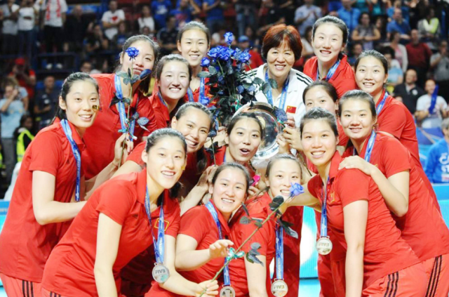
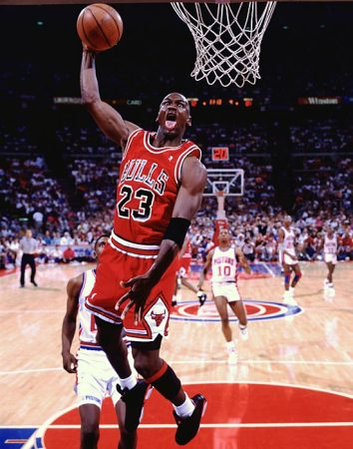

Unit 3 Sports & Fitness
Reading and Thinking
Choose your favourite athlete

Slide 3
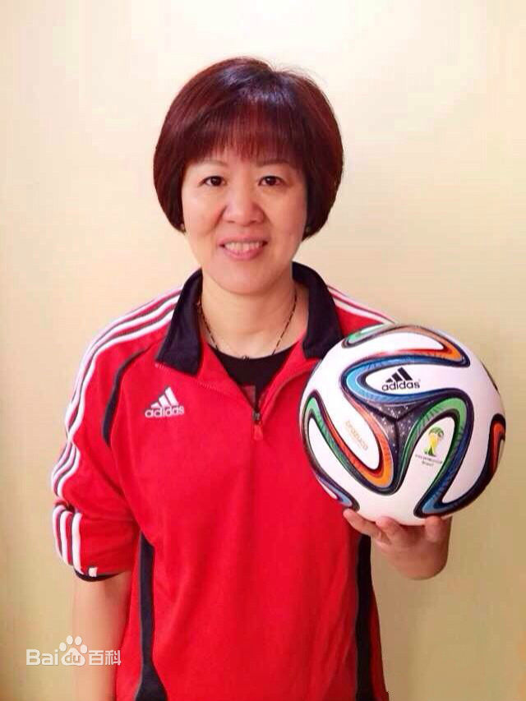
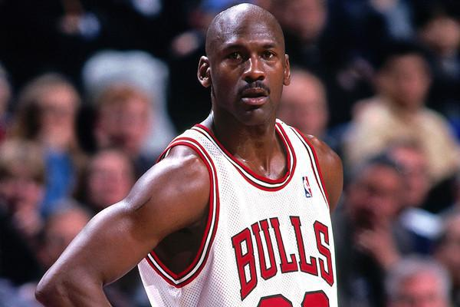
learning aims
In this class, you will
1. get the main idea of the passage “living legends”;
2. figure out the achievements and qualities of two “living legends” and form your own opinions about successful athletes;
3. use the words and expressions you’ve learnt to introduce another living legend you admire.

Slide 4
Lead-in
Guessing game
Who do you think is my favorite sports star?
Why？

Slide 5

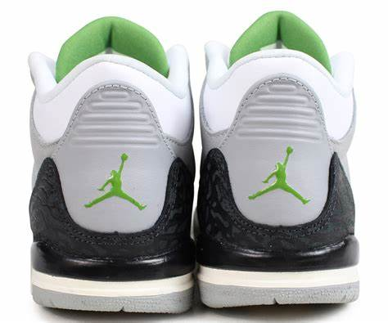
Guessing game
Who is he /she?
Lang Ping
Basketball
NBA player
A shoe brand named after him
Michael Jordan
Volleyball player/captain
Coach of Chinese volleyball team
Nickname: “the Iron Hammer”
铁榔头

Slide 6
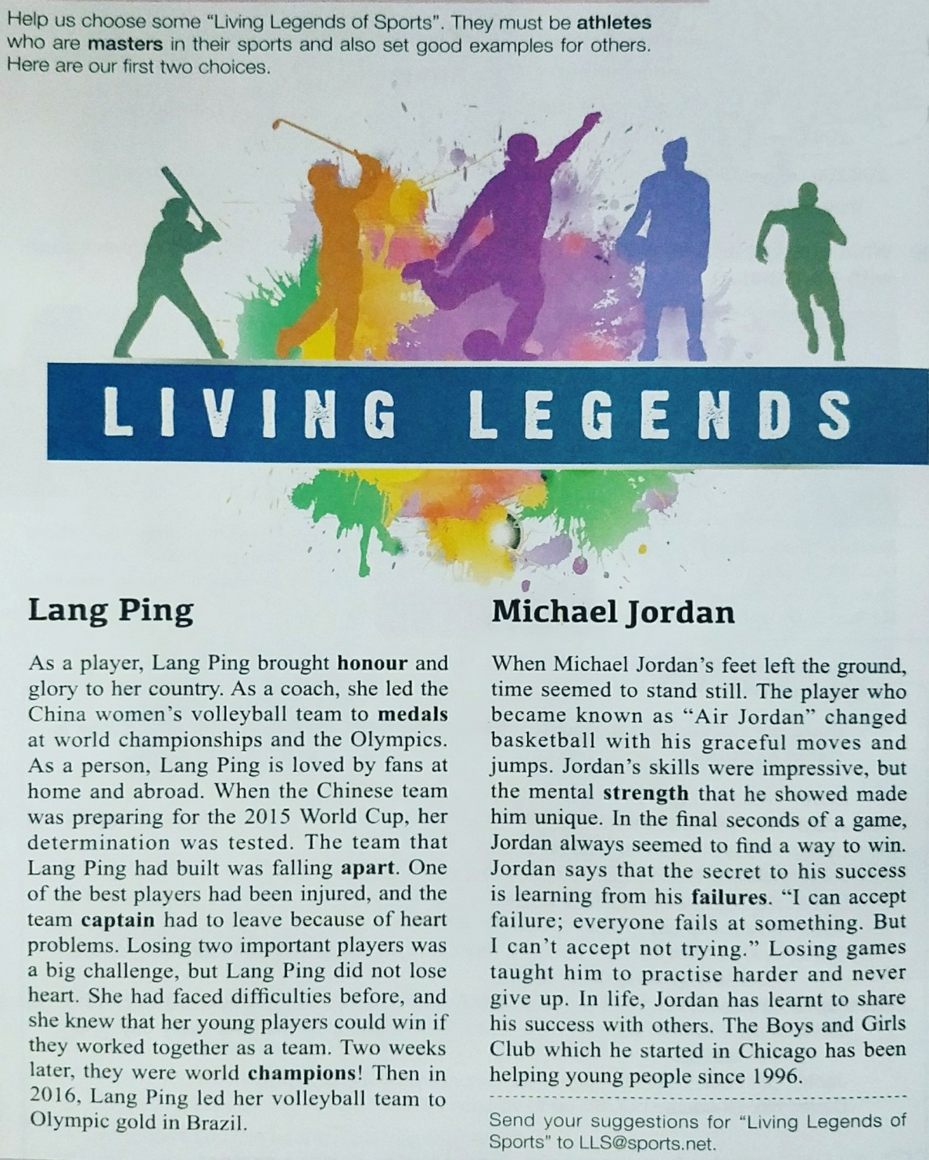

Structure Analysis
P38
Summary/lead paragraph
Title
Subtitle
Body
Additional information

Slide 7


Pre-reading
P38
Look at the picture and titles, and make predictions.
1.What’s the main idea of the text?
A. It’s about living legends, Lang Ping and Michael Jordan.
B. It’s about volleyball games.
C. It’s about basketball games.
D. It’s about the Boys and Girls Club.
sports
famous players
alive today

Slide 8
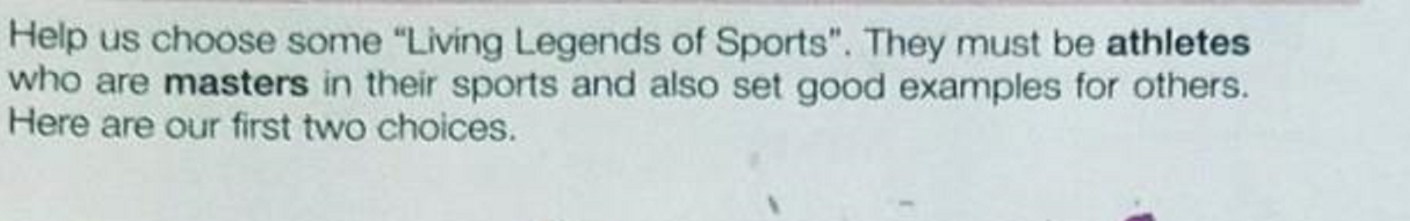
P38
What kind of people can be legends of sports？
lead paragraph
Two standards(标准) of legends of Sports:
1. masters in their sports
2. set good examples for others

Slide 9
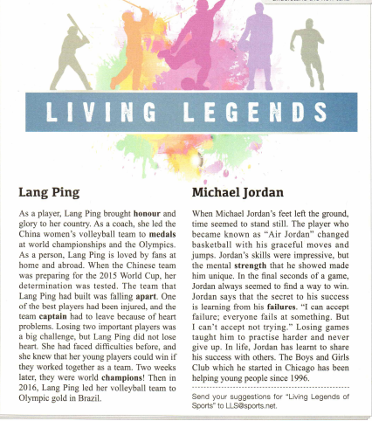
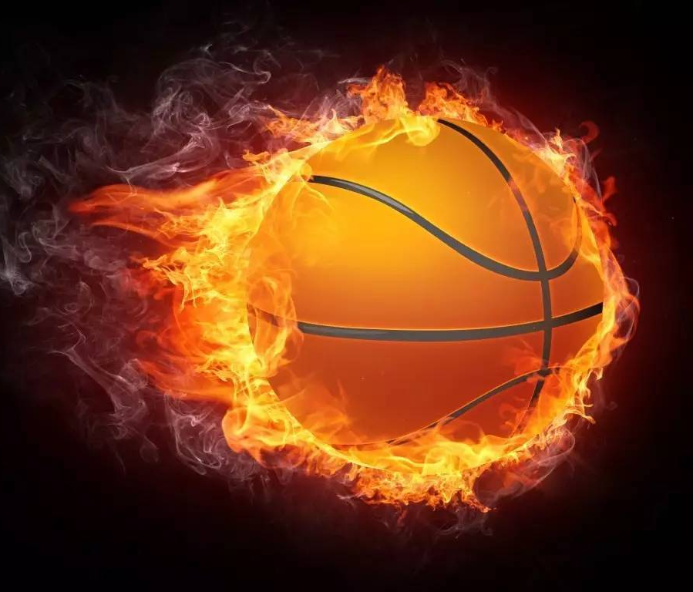
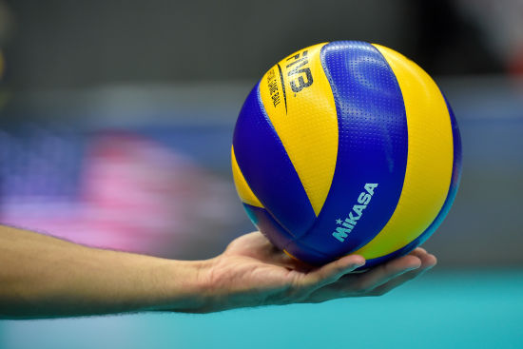
Fast reading
Read the body of the passage and match the main idea with each paragraph.
Para.1 Faced with ___________, Lang Ping led her
volleyball team to _________
Para.2 Jordan’s _______ in basketball and________
big challenges
success
achievements
his belief

Slide 10
Structure Analysis
P38
Summary/lead paragraph
what’s the writing purpose of the passage?
To encourage students to choose the living legends
Additional information

Slide 11

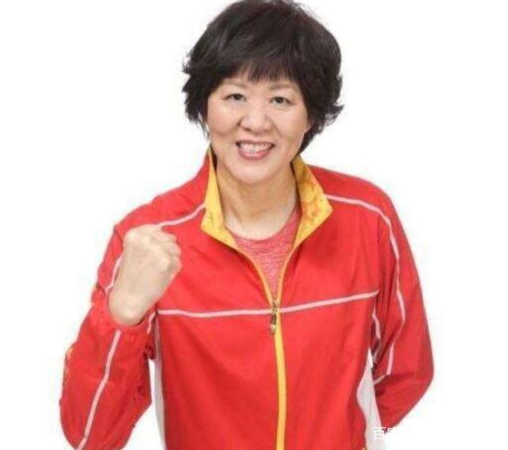
Story about Lang Ping

Slide 12
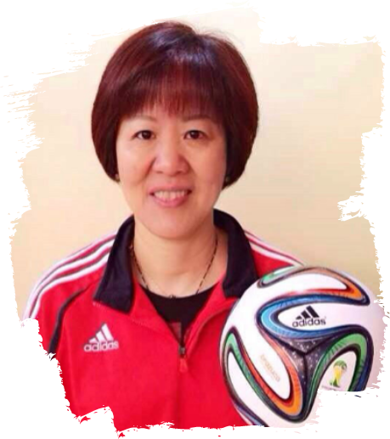
Lang Ping
As a player, Lang Ping brought honour and glory to her country. As a coach, she led the China women’s volleyball team to medals at worldchampionships and the Olympics. As a person, Lang Ping is loved by fans at home and abroad. When the Chinese team was preparing for the 2015 World Cup, her determination was tested. The team that Lang Ping had built was falling apart. One of the best players had been injured, and the team captain had to leave because of heart problems. Losing two important players was a big challenge, but Lang Ping did not lose heart. She had faced difficulties before, and she knew that her young players could win if they worked together as a team. Two weeks later, they were world champions! Then in 2016, Lang Ping led her volleyball team to Olympic gold in Brazil.
Please match the four parts.
solutions
解决方案
introduction
challenges
resultts 结果

Slide 13
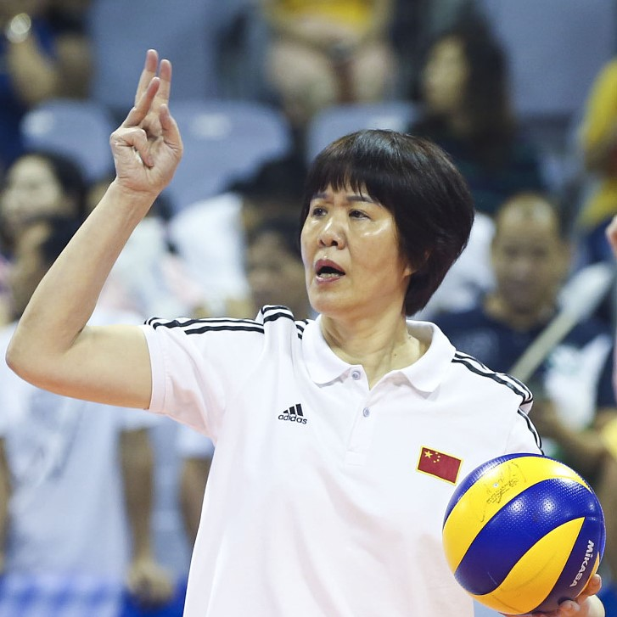
What outstanding achievements did Lang Ping make?
Living legends | Masters | Good examples
Lang Ping | As a _____ As a _____ As a _____ | She brought to China. She led the China women’s volleyball team to medals at . She is loved by fans .
player
honor and glory
coach
world champions and the Olympics
person
at home and abroad
Parallelism(排比)

Slide 14
Challenges: When the Chinese team was preparing for the 2015 World Cup, her determination was tested. The team that Lang Ping had built was falling apart. One of the best players had been injured, and the team captain had to leave because of heart problems. Losing two important players was a big challenge.
How was Lang Ping's determination tested in the 2015 World Cup?
Lang Ping was injured.
Lang Ping had to leave because of heart problems.
The volleyball team she had built was falling apart.
Lang Ping lost her heart.

Slide 15
Solution: but Lang Ping did not lose heart. She had faced difficulties before, and she knew that her young players could win if they worked together as a team.
How did Lang Ping face the big challenge?
It can be inferred from the passage that Lang Ping is a ________ person. A. stubborn B. determined C. friendly D. careful
She didn’t lose her heart, trust( 信任) her team and work together as a team.
√

Slide 16
Group work
Fill in the mind map and summarize the first part.
Introduction
coach
Lang Ping is a successful player, and person.
injured
One of the best players had been .
The Captain had to because of heart problems.
Challenges
leave
Lang
Ping
lose heart
Solutions
She didn’t , and had confidence in her players.
champions
results
They became world in 2015 and 2016.

Slide 17
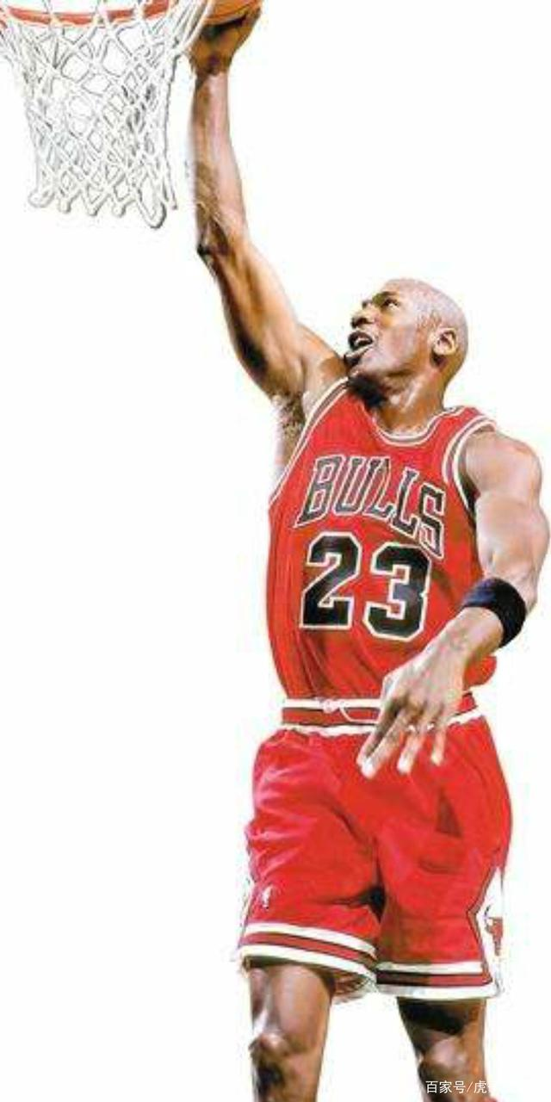
Story about Jordan

Slide 18
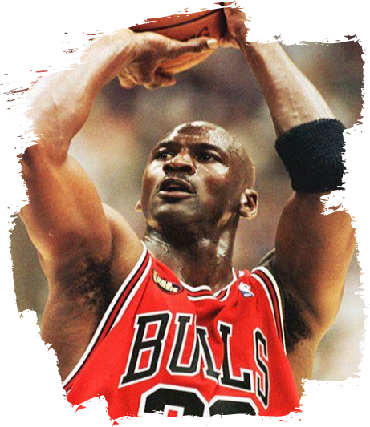
Michael Jordan
When Michael Jordan's feet left the ground, time seemed to stand still. The player who became known as "Air Jordan" changed basketball with his graceful moves and jumps. Jordan’s skills were impressive, but the mental strength that he showed made him unique. In the final seconds of a game, Jordan always seemed to find a way to win. Jordan says that the secret to his success is learning from his failures. "I can accept failure; everyone fails at something. But I can’t accept not trying. " Losing games taught him to practise harder and never give up. In life, Jordan has learnt to share his success with others. The Boys and Girls Club which he started in Chicago has been helping young people since 1996.
impressive skills
Divide this body into 2 parts.
Tip: Try to find transitional sentence.(过渡句)
mental strength

Slide 19
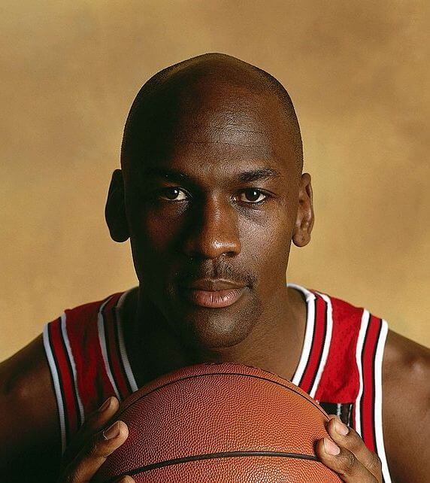
What outstanding achievements did Michael Jordan make?
Living legends | Masters | Good examples
Michael Jordan | As a . As a . | Changed basketball with his graceful_________________. Set up the Boys and Girls Club, which has been helping since 1996.
basketball player
moves and jumps
person
young people

Slide 20
Impressive skills: When Michael Jordan's feet left the ground, time seemed to stand still. The player who became known as "Air Jordan" changed basketball with his graceful moves and jumps.
What does the first sentence in the paragraph introducing Michael Jordan mean?
Jordan's determination in basketball field.
Jordan's success in basketball field.
Jordan's handsome figure (身材)．
Jordan's quick movement in playing basketball.

Slide 21
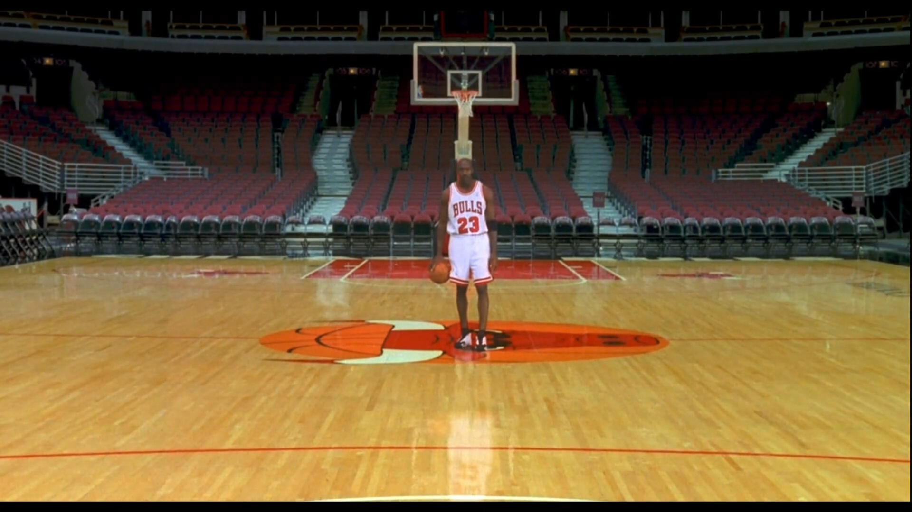

Slide 22
Impressive skills: When Michael Jordan's feet left the ground, time seemed to stand still. The player who became known as "Air Jordan" changed basketball with his graceful moves and jumps.
What does the first sentence in the paragraph introducing Michael Jordan mean?
Jordan's determination in basketball field.
Jordan's success in basketball field.
Jordan's handsome figure (身材)．
Jordan's quick movement in playing basketball.
√

Slide 23
Mental strength: Jordan’s skills were impressive, but the mental strength that he showed made him unique. In the final seconds of a game, Jordan always seemed to find a way to win. Jordan says that the secret to his success is learning from his failures. "I can accept failure; everyone fails at something. But I can’t accept not trying." Losing games taught him to practise harder and never give up. In life, Jordan has learnt to share his success with others. The Boys and Girls Club which he started in Chicago has been helping young people since 1996.
2. What made Michael Jordan unique.
A.His excellent moves.
B. His skilled jumps.
C. Setting good example for others.
D. His mental strength.
√

Slide 24
Mental strength: Jordan’s skills were impressive, but the mental strength that he showed made him unique. In the final seconds of a game, Jordan always seemed to find a way to win. Jordan says that the secret to his success is learning from his failures. "I can accept failure; everyone fails at something. But I can’t accept not trying." Losing games taught him to practise harder and never give up. In life, Jordan has learnt to share his success with others. The Boys and Girls Club which he started in Chicago has been helping young people since 1996.
What kind of person is Jordan ?
He is hard-working/ never gives up. (不屈不挠的精神)
He is helpful.

Slide 25
Pair -work
Work with your partner fill in the mind map .
Pair work
moves and jumps
He changed basketball with his graceful .
mental strength
As a player
His made him unique.
failures
His secret to success is learning from his .
Jordan
success
He has learnt to share his with others.
As a person
help
He set up a club in Chicago to young people.

Slide 26

What do they have in common?
1.Do not lose heart when facing difficulties.
2.To learn from failures.
3.To practice harder and harder.

Slide 27
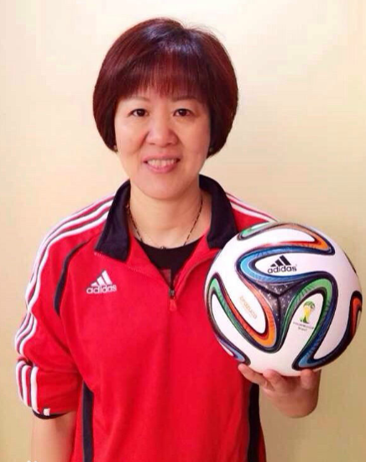
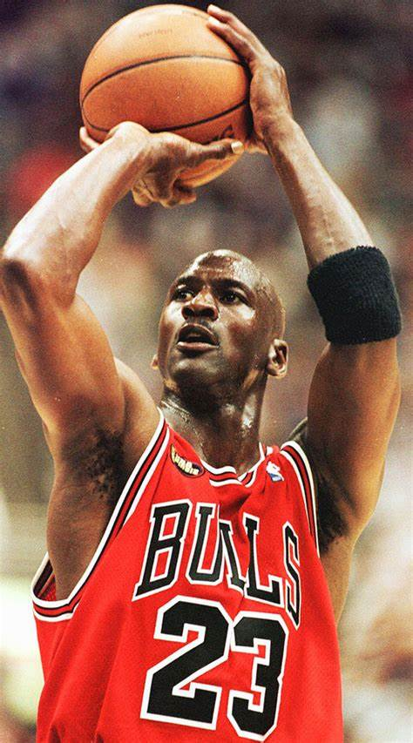


What makes a legend?
Learn from failures; Energetic; Go for their dreams;
Examples; Never give up; Determination…
L
E
G
E
N
D

Slide 28
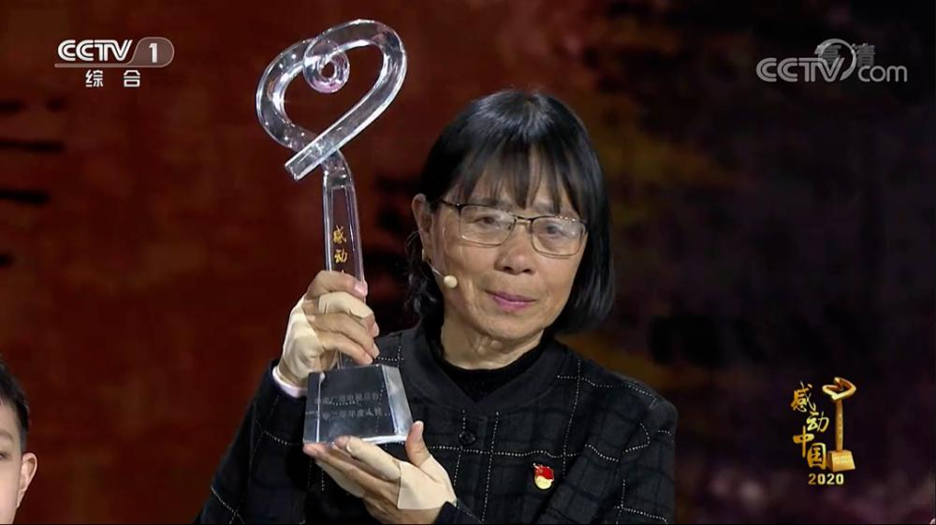
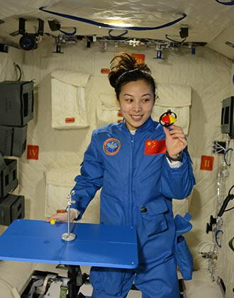
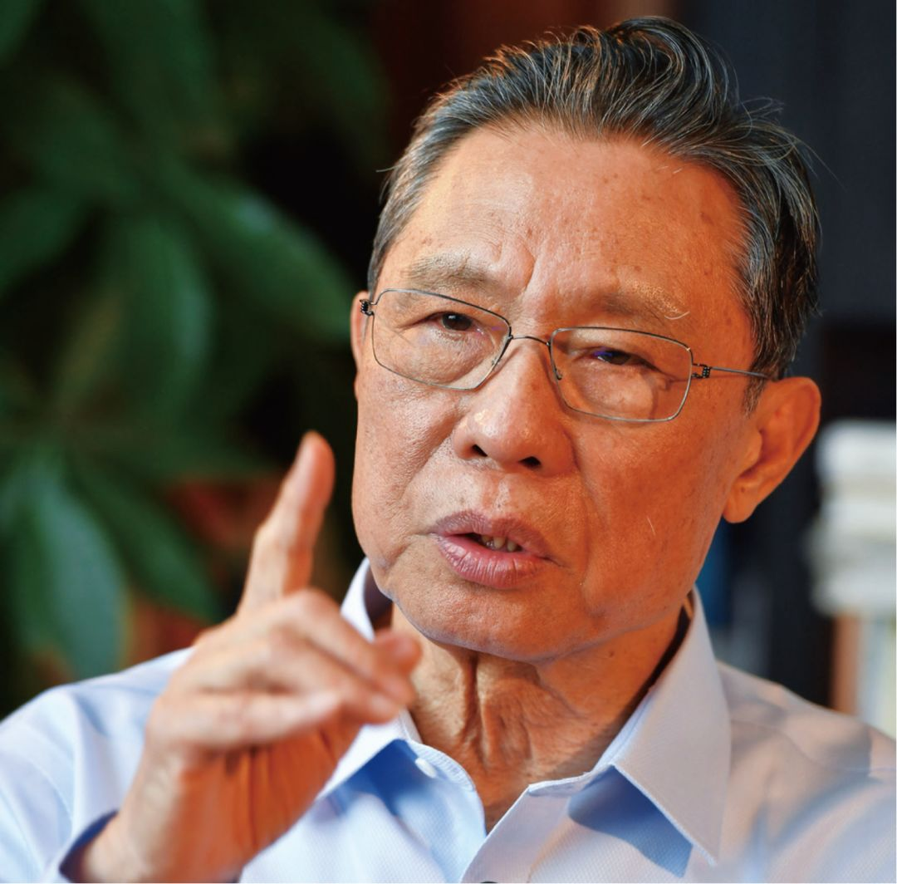
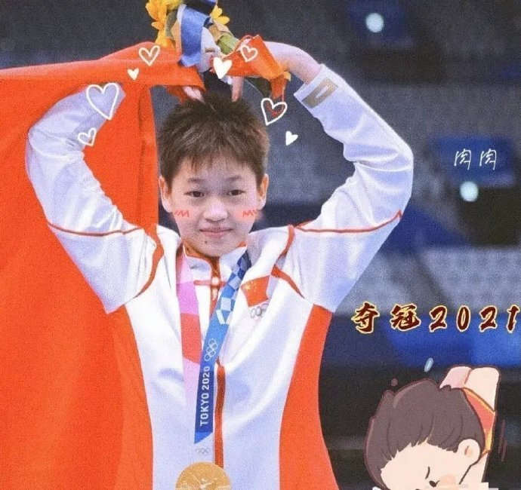
Post-reading
Who is the living legend in your heart？
master
set a good example
Quan Hongchan
The legend in my heart is beacause she is a master in
. She and to our country and our city. She said her secret to success was . She dives 400 times every day.
Besides, she is willing to .
diving
won many gold medals
brought honor and glory
practising harder
share her success with others

Slide 29
Homweork
Write a passage about a legend in your heart.

Slide 30
The Living Legend in My Heart
The legend in my heart is Wang Yaping, beacause she is a master in space technology.She was chosen as a taikonuat to do expeiments in the space station with her teammates, and especially the space-based lecture given by her has inspired lots of teenagers to learn more about space knowledge. She said her secret to success was hard training and knowledg of all subjects
Besides, she is willing to share her success .

Slide 32
Than you for listening!

