Slide 1

感恩遇见，相互成就，本课件资料仅供您个人参考、教学使用，严禁自行在网络传播，违者依知识产权法追究法律责任。
更多教学资源请关注
公众号：溯恩高中英语
知识产权声明

Slide 2

应用文的主题思维及其应用

Slide 3

Letter of Notification
告知信
Letter of Recommendation
推荐信
to inform
Purpose
to convince
complete
concise
accurate
objective
persuasive
complimentary
action-provoking
Language features
The city enjoys a high reputation for its abundance of ancient architecture, which represents the traditional local lifestyles. And there are also plenty of museums where precious relics of historical interest are waiting for you to explore. Besides, the exceptional Peking Opera performances are also what you can’t miss.
It was launched at 8:00 am last Saturday this year. All students set out from the school gate and then climbed up Mountain Nan, covering approximately 10 kilometers.

Slide 4

推荐信
类型
时态
人称
要点
一般现在时
审题
第一人称+第二人称+第三人称
（2023.1山东济宁模考卷）假定你是李华，得知你的英国朋友Erie对中国文化感兴趣，请你给他写封邮件推介短视频系列——英文动画版《西游记》（Journey to the West）。内容如下：
1. 写信目的；
2. 推荐理由；
3. 期待交流。
what
why
how
P1 （寒暄+）写作目的——推荐
P2 推荐理由
P3 希望喜欢推荐的内容+期待交流
主题一以贯之

Slide 5

推荐套话：
Beginning: I’m here to recommend you…
I’m writing to share with you…
Ending: Hope you’ll like it.
Hope it will suit you well.
结合内容：
请你给他写封邮件推介短视频系列——英文动画版《西游记》（Journey to the West）
a short video series—Journey to the West, an English animation/ cartoon adapted from…
an English cartoon/ animation of Journey to the West with 120 6-minute-long episodes
书名： Journey to the West (所有实词的首字母大写)
“Journey to the West”(加双引号)
Journey to the West（斜体，仅限印刷体）

Slide 6

为何推荐：
假定你是李华，得知你的英国朋友Erie对中国文化感兴趣，请你给他写封邮件推介短视频系列——英文动画版《西游记》（Journey to the West）。
是否请求推荐？
从何得知？
增加交际的真实性
Knowing/ Learning
that you are fascinated by/ are keen on/ take a fancy to Chinese culture, …
from your Facebook/ Twitter/ Wechat Moments/ Tiktok

Slide 7



推荐理由：
persuasive/ complimentary/ action-provoking
progressive
--supporting details in order of importance
假定你是李华，得知你的英国朋友Erie对中国文化感兴趣，请你给他写封邮件推介短视频系列——英文动画版《西游记》（Journey to the West）。
eg. Because I think this book is quite suitable for you.
Ask yourself the following questions:
书 vs 短片？
真人版 vs 动画版？
中文原版 vs 英文版？
其他中文名著 vs 西游记?
英文名著 vs 西游记?
general
specific
Classify the answers by listing the key words
1. 英文——英语母语，无语言障碍，理解没有困难
2. 短片——内容简单，随时观看，不占用太多时间
3. 动画片——有趣生动（画面、对话、情节）
4. 西游记——内容体现中国文化（宗教）；主人公展现中国精神（坚持不懈、勇敢）
——地位：中国四大名著之一
凸显文化意识

Slide 8
general
specific
表达彰显主题
英文 | The authentic English dialogues make it accessible to you native English speakers. There is no language barrier for you since the lines/ dialogues are made in English.
动 画 片 | 地位 | The cartoon/ animation was an instant hit/ made a sensation online and has been popular with youngsters/ teenagers since released. (满足交际性——人的从众心理)
 | 形式 | It is adapted from …(来源) With vivid scenes and interesting dialogues,…(制作——画面+对话) With English dubbing and bilingual subtitles,…(字幕配音) The 120 episodes together tells a long legendary story of…(集数) Each episode lasts only 6 minutes with lively and humorous plot. (短片)
 | 内容 | 情节主旨 | It narrates/ tells/ depicts/ portrays an imaginary tale/ story of Tangseng and his three apprentices going on a pilgrimage/ an expedition for Buddhist scriptures while overcoming 81 obstacles along the way.
 |  | 角色 | The hero-Monkey King is the embodiment (化身) of courage, commitment and perseverance, where the essence of Chinese value/ spirit lies.
西 游 记
 |  | 文化背景 | It unveils a mysterious world of ancient China, displaying the prosperity of Tang Dynasty and flourishment of Buddhism and Taoism then.
 | 地位 | As one of the Four Chinese Classics,… It has long been renowned as one of the four greatest literary treasures and popular with Chinese people.
小说、电视的剧情时态用一般现在时

Slide 9
general statements
Beginning sentence:
I recommend… for the following reasons.
The reason why I recommend… is as follows.
Concluding sentence:
All of the above-mentioned make … a perfect… to do sth.
the best choice to do sth.
eg. The authentic English dubbing, interesting cartoon style and plentiful Chinese cultural elements make this animation a perfect choice for you to quench your cultural thirst.
a gateway for you to learn about Chinese culture in a relaxed way.

Slide 10
Dear Erie,
How is everything going? Knowing that you are increasingly fascinated by Chinese culture, I’m here to recommend you a short video series—Journey to the West, an English animation/ cartoon adapted from one of the Four Chinese Classics/ a literary treasure of China.
It is an instant hit since released. The impressive special effects, vivid pictures and simple but authentic lines together make it accessible to native English speakers. When you watch it, you will soon be gripped by the four characters with distinct personalities—Master Tangseng and his three apprentices (徒弟), who display the Chinese value to the full. So it is quite worth watching, especially for people like you to quench your cultural thirst.
Hopefully you’ll like it and maybe we can exchange our ideas about the series later.
Yours,
Li Hua
(Nina 下水作文)
由浅入深
巧妙排序达成主题目的

Slide 11
学生习作1
Dear Erie,
Knowing your keen interest in Chinese culture, I’m writing to recommend a series of videos- Journey to the West to you.
As one of Chinese Four Classics, it tells the legendary life of Monkey King through its vivid pictures and delicate animation. The hero Monkey King, who is loved by most Chinese, symbolized insistence and courage -- the essence of Chinese spirit. Furthermore, the videos adopt English dubbing so there is no language barrier for you to catch on.
Hope you will like it and maybe we can exchange our ideas about it next time.
Yours,
Li Hua
诱人至深，扫除顾虑

Slide 12
学生习作2
Dear Erie,
Delighted to know your real passion for Chinese culture, I’m here to introduce a series of short videos called “Journey to the West”.
This hit, based on a Chinese legend, narrates a tale of four imaginary figures chasing for the “True Scripture” while fighting against devils along the way, namely the 81 obstacles. Newly released online as it is, the animation has already won wide recognition and countless likes. Besides, for a Chinese enthusiast like you, you won’t afford to miss such a good gateway to know traditional Chinese spiritual belief which is fully depicted in the videos.
The series is definitely worth watching, and we can have a word about the content afterwards.
Yours,
Li Hua

Slide 13
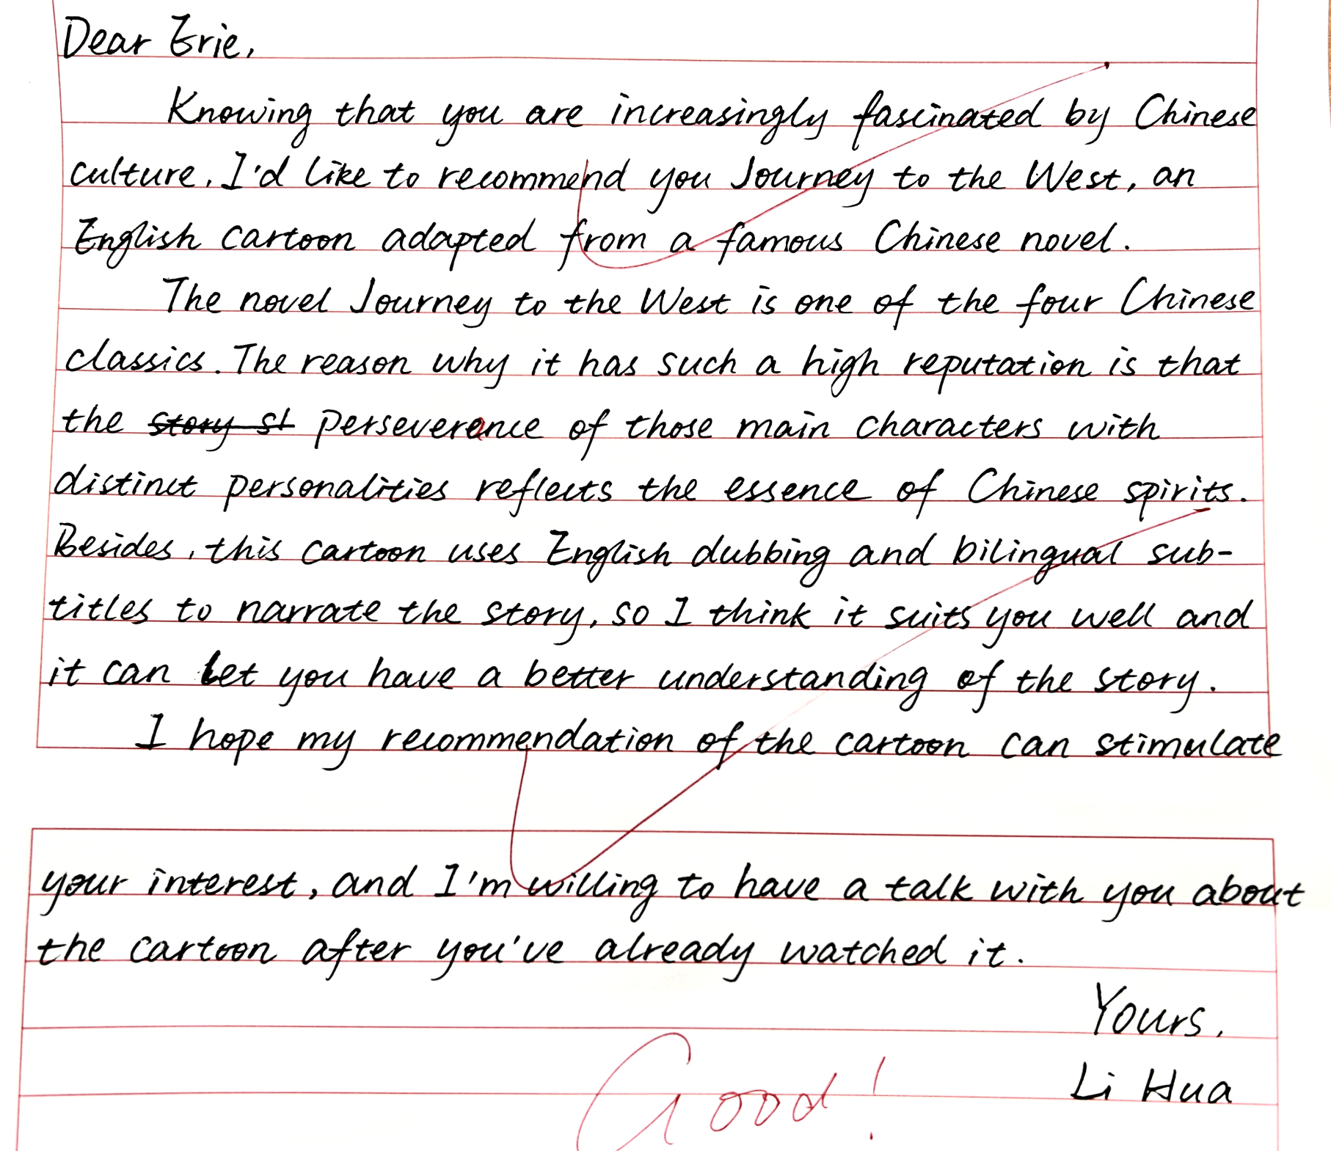
覆盖所有内容要点
语言丰富
文体适宜

Slide 14
The original version |  | A Revised Version
Dear Erie, Knowing that you are increasingly fascinated by Chinese culture, I’d like to recommend you Journey to the West, an English cartoon adapted from a famous Chinese novel. The novel Journey to the West is one of the Four Chinese Classics. The reason why it has such a high reputation is that the perseverance of those main characters with distinct personalities reflects the essence of Chinese spirits. Besides, this cartoon uses English dubbing and bilingual subtitles to narrate the story, so I think it suits you well and it can let you have a better understanding of the story. I hope my recommendation of the cartoon can stimulate your interest, and I’m willing to have a talk with you about the cartoon after you’ve already watched it. Yours, Li Hua (131 words) |  | Dear Erie, Knowing that you are increasingly fascinated by Chinese culture, I’d like to recommend you Journey to the West, an English cartoon adapted from a Chinese masterpiece. This legendary tale enjoys such a high reputation in that the perseverance of main characters portrayed reflects the very essence of Chinese spirit and has touched so many including Chinese culture lovers like you. Besides, with English dubbing and bilingual subtitles, this cartoon will surely help you understand the plot easily. I hope my recommendation can stimulate your interest and look forward to a relevant discussion with you afterwards. Yours, Li Hua (100 words)
覆盖所有内容要点
语言丰富
文体适宜
句式丰富
词数恰当
交际顺畅
(语言简洁，突出作品地位)
(替换增加高级词汇，体现作品地位)
(替换句式，简洁)
(增加信息，强调作品的内容和影响)
(增加交际性)
(删减重复信息，表达简洁)
重复内容过多
第二段第一个要点交际性不够

Slide 15
A possible Version
Dear Erie,
Guess what I’ve got to share? Since you show keen interest in Chinese culture, I’m writing to recommend an English short video series, Journey to the West.
Journey to the West, a Chinese literary classic, enjoys lasting popularity in China. The animation version series, integrating authentic English and amusing cartoon plots, has gained numerous favorable reviews worldwide.
By immersing yourself in its playful story of wisdom and virtues conveyed in the characters and the tale itself, you will definitely gain a glimpse into the profoundness of Chinese culture.
Looking forward to our further exchanges.
Yours,
Li Hua
(99 words)
(交际性强，引发好奇心)
(原作品地位高，值得看)
(动画版形式语言满足对方需求)
(动画版评价好，值得看)
(作品的内容、主人公和背后的文化外延，满足对方期待)
(意义的递进，无需重复说作品)

Slide 16
Polish your writing based on the given standards
覆盖所有内容要点
语言丰富
文体适宜
句式丰富
词数恰当
交际顺畅
结构、内容、语言体现主题

