Slide 1

感恩遇见，相互成就，本课件资料仅供您个人参考、教学使用，严禁自行在网络传播，违者依知识产权法追究法律责任。
更多教学资源请关注
公众号：溯恩高中英语
知识产权声明

Slide 2

Book 2 Unit 5 Music
Listening and Speaking--
Talk about music preferences
李吉 武汉光谷未来学校

Slide 3
Teaching objectives .
After the class, you will be able to:
1.Identify different types of music.
2.Listen and get information about students’ music preferences.
3.Talk about my music preference and give reasons.
4.Conduct an interview about music preferences of my classmates.

Slide 4

Music is the universal language of mankind.
音乐是人类的通用语言。

Slide 5
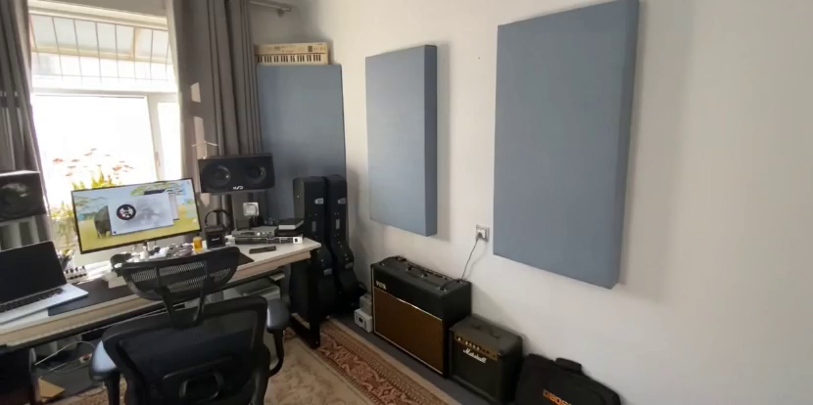


Welcome to Rickey’s music studio!
欢迎来到Rickey的音乐工作室！.
To be an interviewer of my studio!

Slide 6


Rickey’s Music Studio Training Handout
音乐工作室研学手册
Name:________
Age:__________

Slide 7

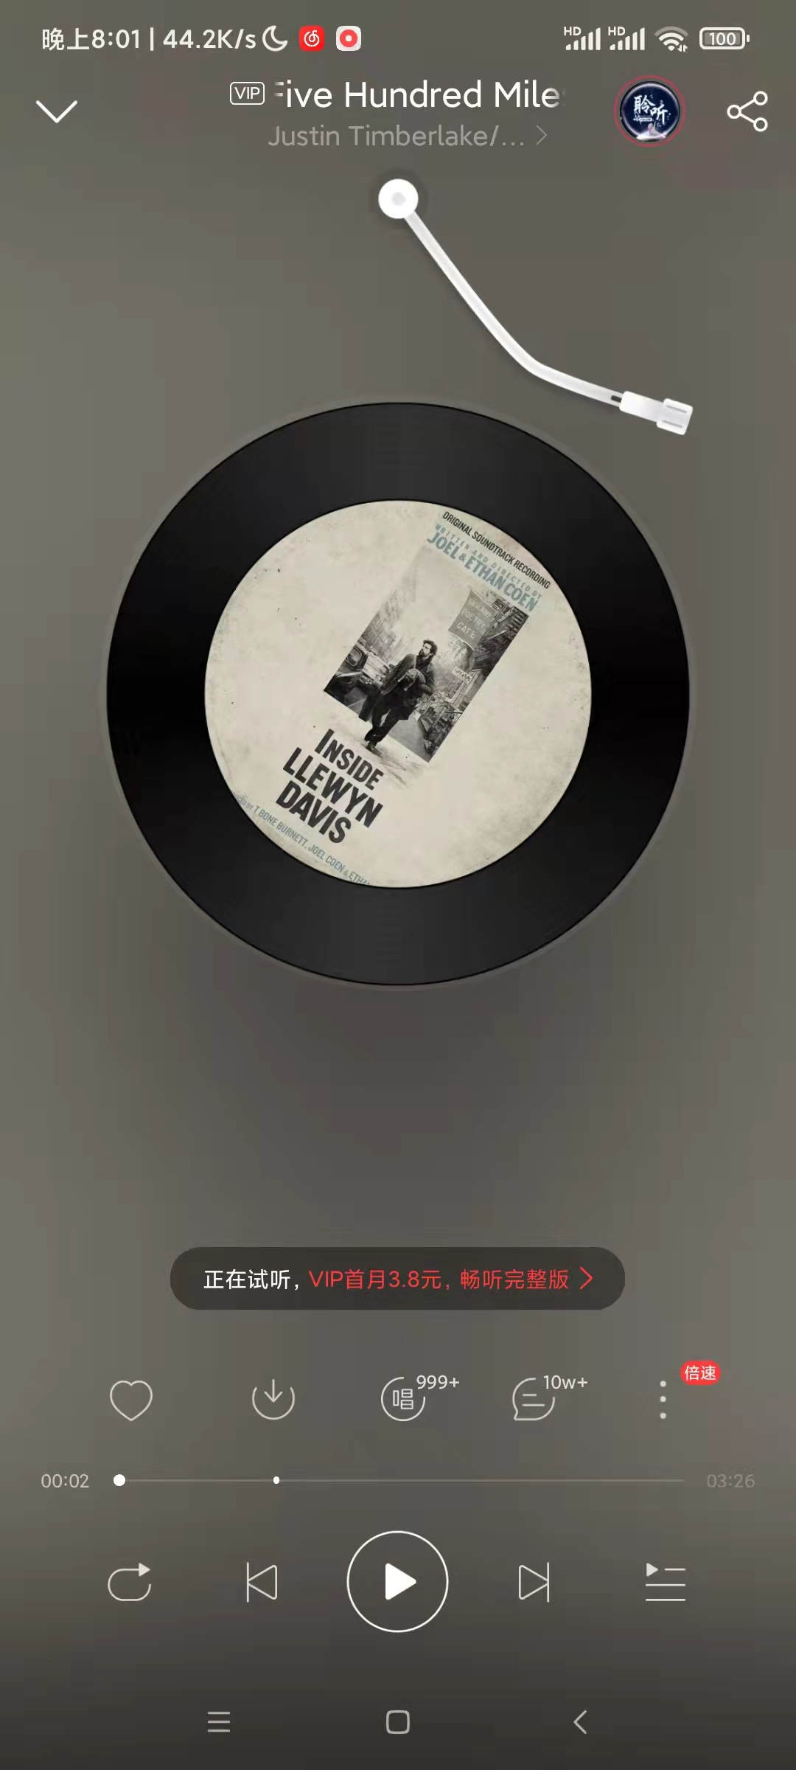

Know something about me and music.
Training Activity 1:Decide whether these statements are T or F.
1.Classical music is Rickey’s favorite type of music.
Ballad(民谣) is my favorite type of music.
When I listen to it, I am always moved to tears.
F
“Five Hundred Miles”
2.I much prefer country music to Chinese traditional music.

Slide 8
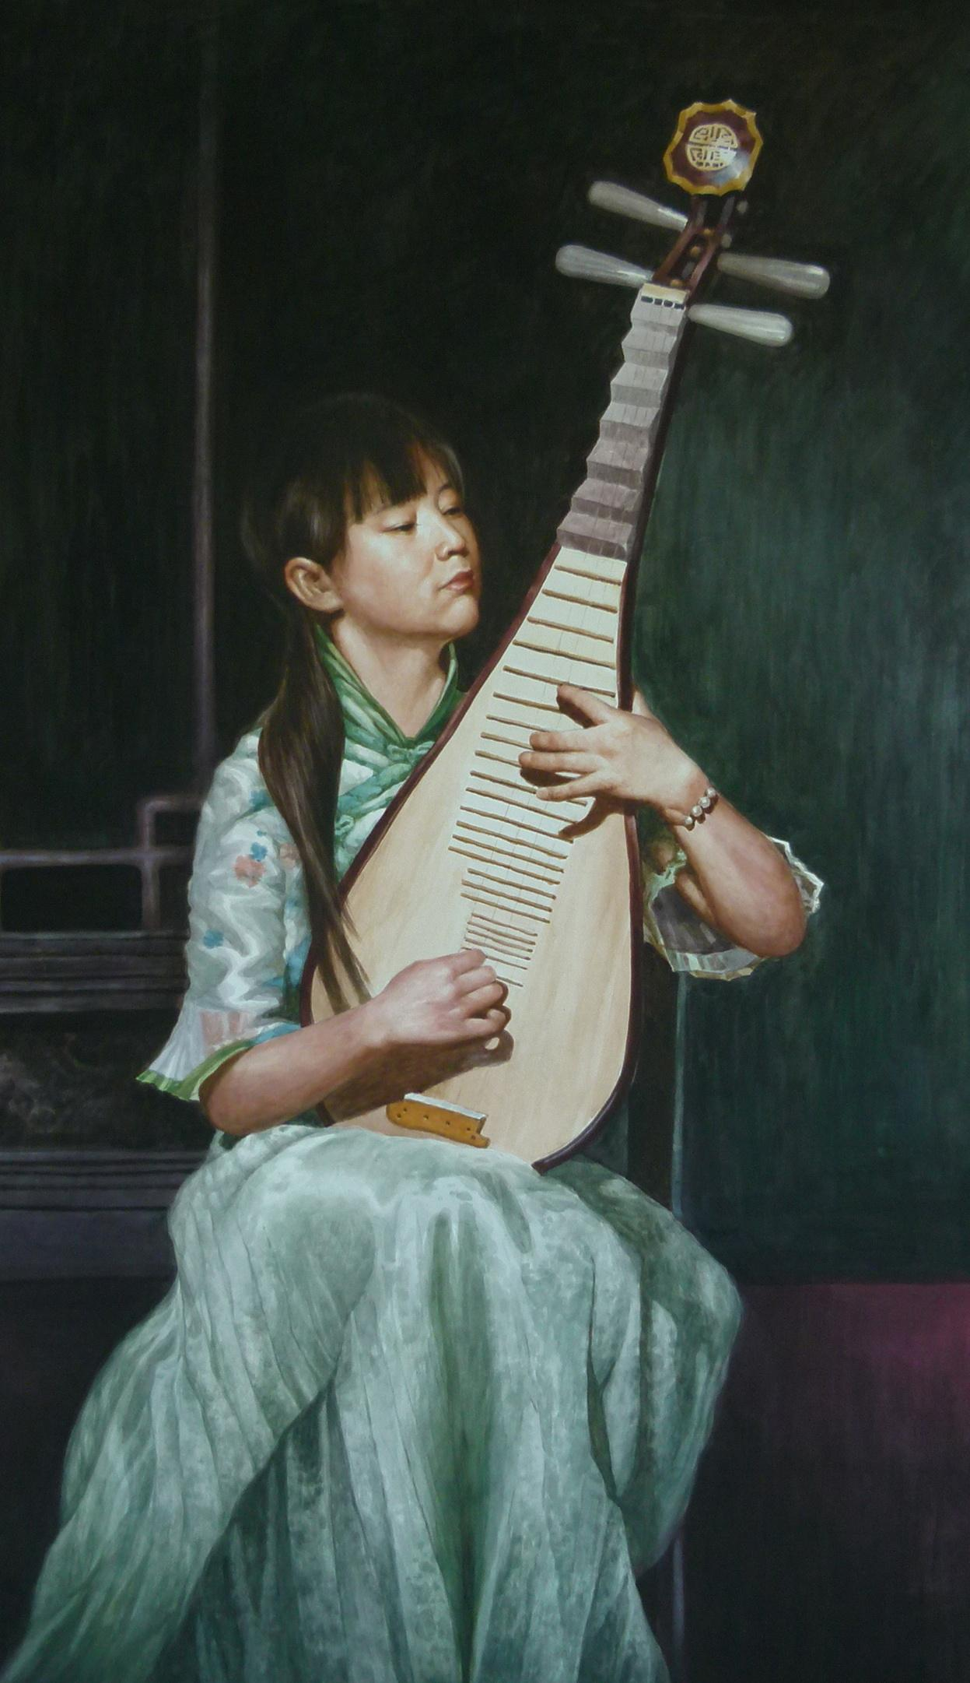
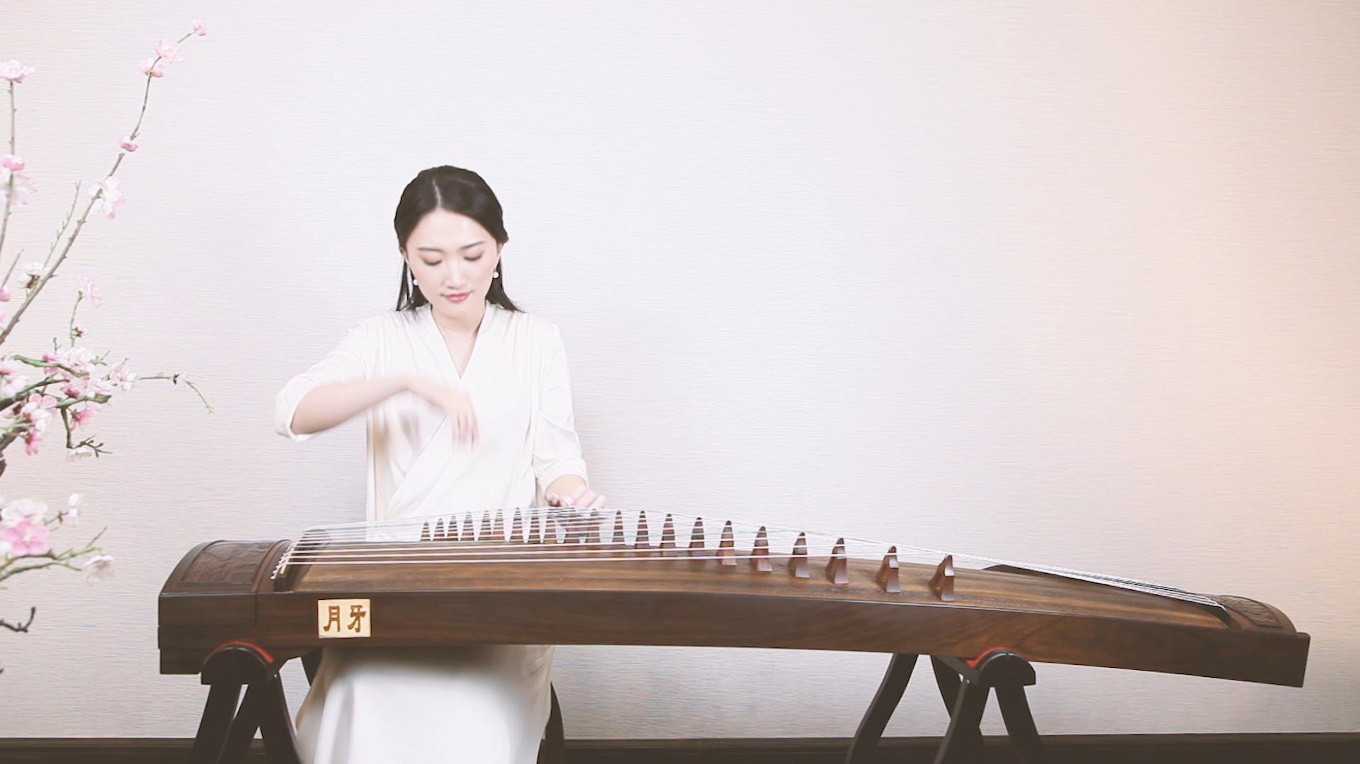
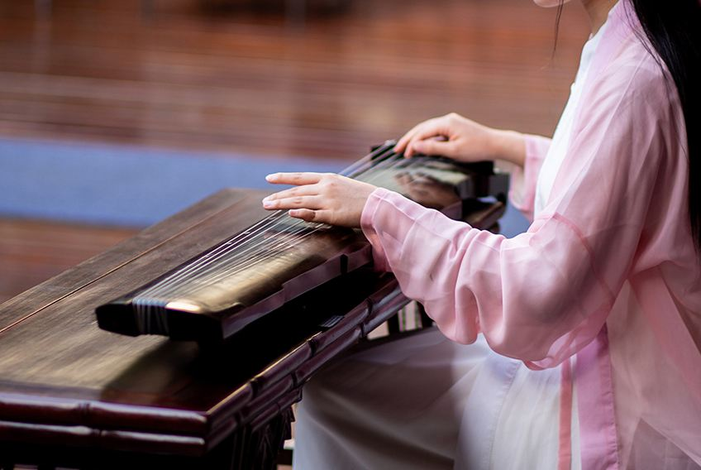
Know something about me and music.
Training Activity 1:Decide whether these stataments are T or F.
1.Classical music is Rickey’s favorite type of music.
Ballad(民谣) is my favorite type of music.
When I listen to it, I am always moved to tears.
“Five Hundred Miles”
2.I much prefer country music to Chinese traditional music.
T
Guzheng
Guqin
Pipa: a kind of stringed instrument (弦乐器)

Slide 9

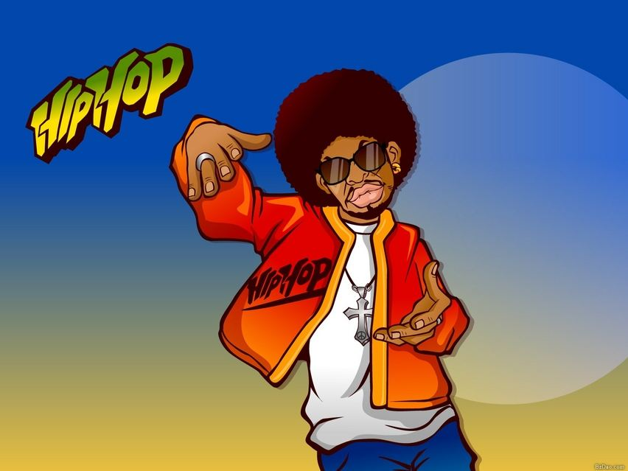
Know something about me and music.
Training Activity 1:Decide whether these statements are T or F.
3.I am also fond of hip-hop and when I listen to it, I get carried away.
F
•be/get carried away
get very excited or lose control of your feelings
4.“Love story” by Taylor Swift always touches my heart, and it reminds me of people I deeply love.

Slide 10
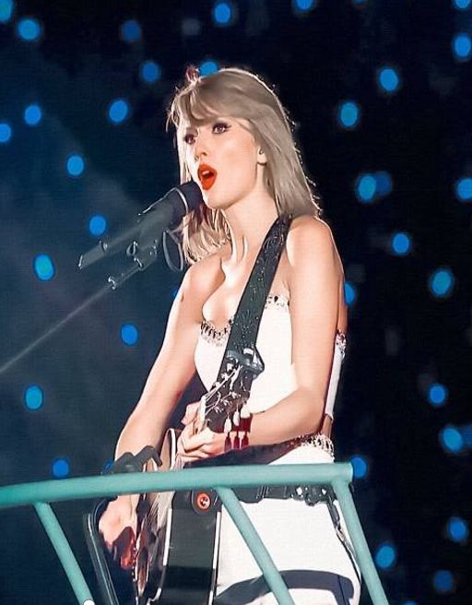
Know something about me and music.
Training Activity 1:Decide whether these statements are T or F.
3.I am also fond of hip-hop and when I listen to it, I get carried away.
F
•be/get carried away
get very excited or lose control of your feelings
4.“Love story” by Taylor Swift always touches my heart, and it reminds me of people I deeply love.
T

Slide 11
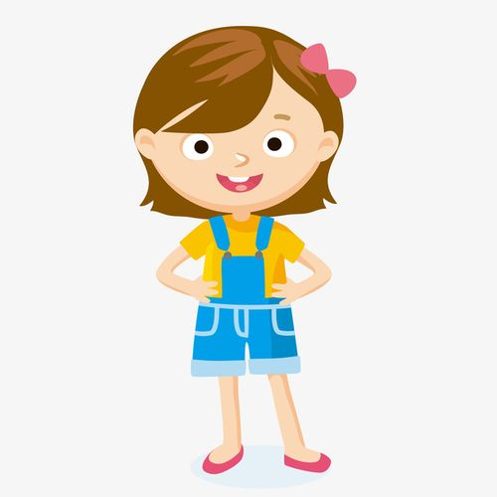
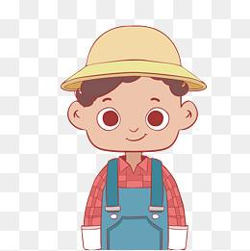

Listen to an interview about students’ music preference.
Training Activity 2:Listen and write down what kinds of music they like.
country music
The first student likes to listen to ______________.
hip-hop
The second student likes to dance to ___________.
classical music
The third student likes to play _______________.

Slide 12
Listen to an interview about students’ music preference.
Training Activity 3:Listen again for the reasons or feelings for music.
Students | Preferences | Reasons or feelings
Student 1 | country music | Country music__________ ____ ___________.
Student 2 | hip-hop | _______ ___ ______ ____ hip-hop, I just _______ ____ _______.
Student 3 | classical music | When I play, I get _______ _____, I ____ ____ I’m _______ ______ __ _____ ______ and ________ _____.
touches my
heart
When I listen to
have to move
carried away
feel like
sitting beside a
quiet stream
enjoying nature

Slide 13

Express my music preferences and give reasons.
Training Activity4:Talk about music preferences and reasons or feelings
Chinese traditional
touches my heart/soul
classical
gives my energy/hope
helps me
exercise / study
hip-hop
rap
country music
reminds me of
home/people I love
sounds peaceful
/beautiful
jazz
ballad
pop music
rock and roll
makes me happy/ want to dance

Slide 14
Listen to an interview about students’ music preference.
Training Activity5:Listen once more and paraphrase the answers from the students.
Paraphrase
Using easier words with the same meaning
Circle the words paraphrased by the interviewer.
Preferences | Reasons or feelings
country music | Interviewee1: Country music touches my heart. Interviewer: So you like music that’s______________?
hip-hop | Interviewee2: I just have to move. Interviewer: So it makes you want to____________?
classical music | Interviewee3: I feel like I’m sitting beside a quiet stream and enjoying nature. Interviewer: So to you, it’s_______________________?
full of feeling
dance
peaceful and beautiful

Slide 15

Training Activity 6:Interview three students about music and make a report in front of the class.
pay attention to the questions the interviewer asked.
Interviewer:
For asking music preferences:
•What kind/type of music do you like/prefer?
•Do you like/prefer...?
For asking reasons or feelings:
•why?
•What makes it special to you?
•what do you like about it?

Slide 16


Training Activity 6:Interview three students about music and make a report in front of the class.
Interviewer: (For asking music preferences)
What kind/type of music do you like/prefer? What kind/type of music are you fond of? Do you like/prefer...?
Interviewee 1 / 2 / 3:
I like/prefer.../ I’m fond of...，because...
Interviewer: (For asking reasons or feelings)
What makes it special to you?/what do you like about it?/...
Interviewee 1 / 2 / 3:
When I listen to..., I feel....

Slide 17
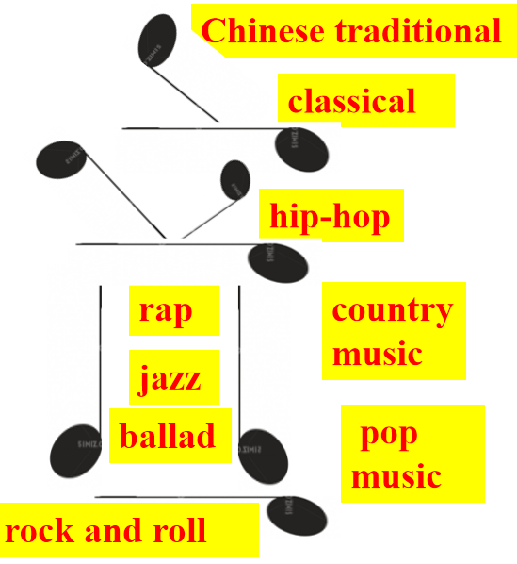
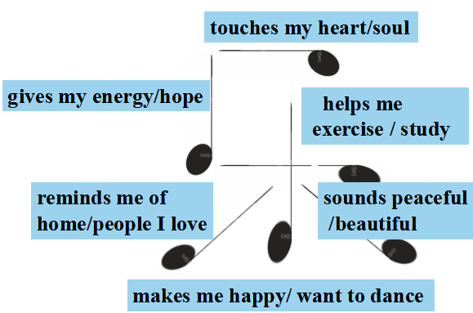
Reports of the music training project .
I’m glad to be here to make a report on music preferences of my classmates.
XXX likes/prefers/
is fond of/...
(the type of music
--music preferences)
because
(reasons or feelings)
That’s all of my report,
Thanks for your attention.
Students | Preference | Reasons or feelings
Student 1
Student 2
Student 3

Slide 18
Music is the medicine of the breaking heart.
The true beauty of music is that it connects people.

Slide 19

Reflect on my music training performance
Can I...?
4.Conduct
an interview about music preferences of my classmates.
3.Talk about
my music preferences
and give
reasons.
2.Listen and get
information about students’ music preferences.
1.Identify
different types
of music.

Slide 20
Homework
Make a video to attract more memers to join Rickey’s music studio and post it on TikTok. In your video:
you should introduce different types of music;
you should ask why they want to join our studio.
You can refer to the reading materials(P_{51, 56}) and the videoTime(P₆₀) in this unit .

Slide 21
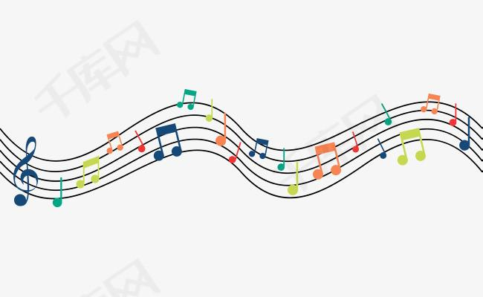

Thank you for your listening!

