Slide 1

感恩遇见，相互成就，本课件资料仅供您个人参考、教学使用，严禁自行在网络传播，违者依知识产权法追究法律责任。
更多教学资源请关注
公众号：溯恩高中英语
知识产权声明

Slide 2

The World
February 1st-15th, 2023

Slide 3
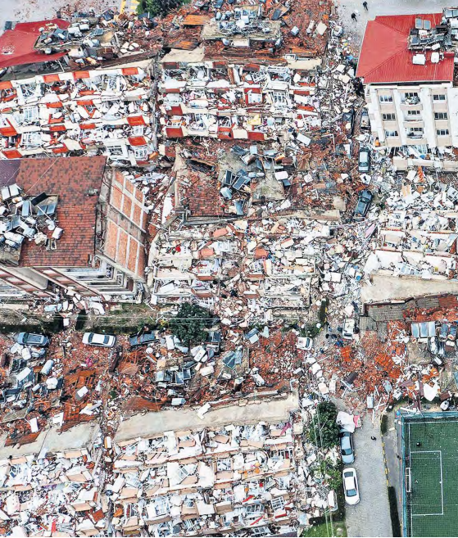
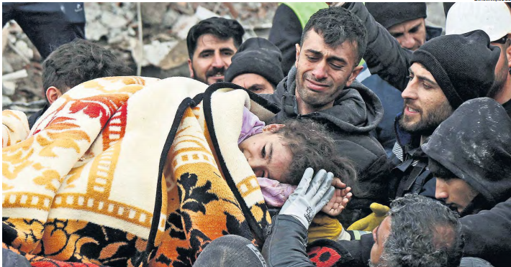
1. Giant earthquake kills thousands in their sleep
大地震导致数千人在睡梦中死亡

Slide 4
语篇填空
（《泰晤士报》2023年2月7日 1&12页）
was expected
The death toll in Turkey and northern Syria ___________ (expect) last night to rise by many thousands after a devastating earthquake struck a region already suffering war and a refugee crisis.
Offers of aid poured in from around the world as the Turkish authorities said that more than 2,300 of its people _________________ (confirm) dead, and more than 1,400 were reported dead in Syria. The figures were ________ (steady) increasing as bodies were pulled from collapsed buildings in villages, towns and cities. The World Health Organisation said the total could rise eight fold.
Near by, rescuers carried a newborn girl to _______ (safe). They said she had been born beneath the rubble but that her mother had died, along with her father and ____ rest of her family. Britain is sending 76 search-and-rescue __________ (special), four dogs and a medical assessment team. The US, China, Russia and several European countries and Gulf states also offered aid.
The 7.8-magnitude quake hit at 4.17am local time, ______ most people were asleep. The focus was 11 miles ______ ground and its epicentre was between the cities of Gaziantep and Kahramanmaras in southwestern Turkey. The country ____ (sit) at a meeting point of tectonic plates, but this was its most powerful quake in modern times.
President Erdogan ordered seven days of national __________(mourn). He faces an election this year.
had been confirmed
steadily
safety
the
specialists
when
below
sits
mourning

Slide 5
词汇讲解
1. devastating: causing a lot of damage and destruction 破坏性极大的；毁灭性的
Oil spills are having a devastating effect on coral reefs in the ocean.
海上溢油对海洋里的珊瑚礁有着毁灭性影响。
2. rubble: broken stones or bricks from a building or wall that has been destroyed or damaged 碎石；碎砖
A gang of workmen were shovelling rubble onto a truck. 一帮工人正用铁锹往卡车上装碎石。
翻译句子
他在这次事故中受到致命伤害。
He received devastating injuries in the accident.
翻译句子
炸弹把那片房子炸成了一堆瓦砾。
The bomb reduced the houses to rubble.

Slide 6
与地震相关的词汇
表示与地震相关的动词
地震学相关词汇
hit 袭击，使遭受
strike 侵袭
shake 急剧晃动（使）震动
jolt（使）震动，（使）颠簸
rock 剧烈摇摆，猛烈晃动
roll across 波动翻滚
rip through 裂开；突进
seismology 地震学
seismological 地震学上的
seismograph 地震仪；地动仪
seismographer 地震学者seismesthesia 振动觉；震动觉
aftershock 余震
epicenter 震中；中心
magnitude 震级
Richter Scale 里氏震级
表示地震破坏程度的动词
damage 损坏，损害
destroy 破坏，毁灭
shatter （使）破碎；摧毁
devastate 毁坏，破坏
level 使平整；推倒，夷平
flatten（使）变平；摧毁，夷平
其他
pay silent tribute to静默志哀
national mourning全国哀悼
fly at half-mast降半旗致哀
rescue team救援队

Slide 7
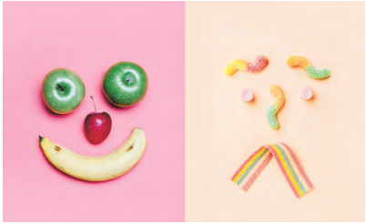
2.Probing the gut-depression link
探索肠道与抑郁的联系

Slide 8
语篇填空
（《华盛顿邮报》2023年2月7日 E1&E4版面）
Research has long suggested a link between our diet and our mental health. The gut microbiome — the ___________ (collect) genome of trillions of bacteria that live in the intestinal tract that are created ________ (large) by what we eat and drink — appears to influence our mood and mind-set.
But human studies large enough to pinpoint what bacteria matter, if they matter at all, have been missing. That’s slowly changing. The largest ________ (analyse) of depression and the gut microbiome to date, _________ (publish) in December, found several types of bacteria notably increased or decreased in people _____ symptoms of depression. “
“This study provides some real-life evidence _____ you are what you eat,”said study author Andre Uitterlinden, who researches genetics at Erasmus medical Centre in Rotterdam. Or to be exact, _____ you feel is closely related to what you consume.
Anxiety ____________ (tie) to a heightened risk of nausea, heartburn, diarrhea and constipation. The link between food and mood is there even when we reach for macaroni and cheese to comfort us during a stressful time.
Change your diet ___________ (improve) your mood. An individual who does not consume enough fiber, for example, may experience a decrease in butyrate-producing bacteria, ________ (lead) to stress and inflammation and, potentially, symptoms of depression.
collective
largely
analysis
published
with
that
how
has been tied
to improve
leading

Slide 9
词汇讲解
1. pinpoint: to find and show the exact position of sb/sth or the exact time that sth happened 明确指出，确定（位置或时间）
He was able to pinpoint on the map the site of the medieval village. 他能在地图上准确找出那个中世纪村庄的位置。
2. notably: used for giving a good or the most important example of sth. 尤其；特别
The divorce would be granted when more important problems, notably the fate of the children, had been decided.
当更重要的问题，尤其是孩子们的命运被决定时，离婚就会获得批准。
翻译句子
几乎不可能确定死因。
It was almost impossible to pinpoint the cause of death.
翻译句子
这房子有很多缺陷，尤其是它的价格。
The house had many drawbacks, most notably its price.

Slide 10
句子翻译
The largest analysis of depression and the gut microbiome to date, published in December, found several types of bacteria notably increased or decreased in people with symptoms of depression.
翻译
去年12月发表的一项迄今为止对抑郁症和肠道微生物组的最大分析发现，有抑郁症症状的人体内几种细菌显著增加或减少。
An individual who does not consume enough fiber, for example, may experience a decrease in butyrate-producing bacteria, leading to stress and inflammation and, potentially, symptoms of depression.
翻译
例如，一个没有摄入足够纤维的人，产生丁酸盐的细菌可能会减少，导致压力和炎症，并可能出现抑郁症状。

Slide 11
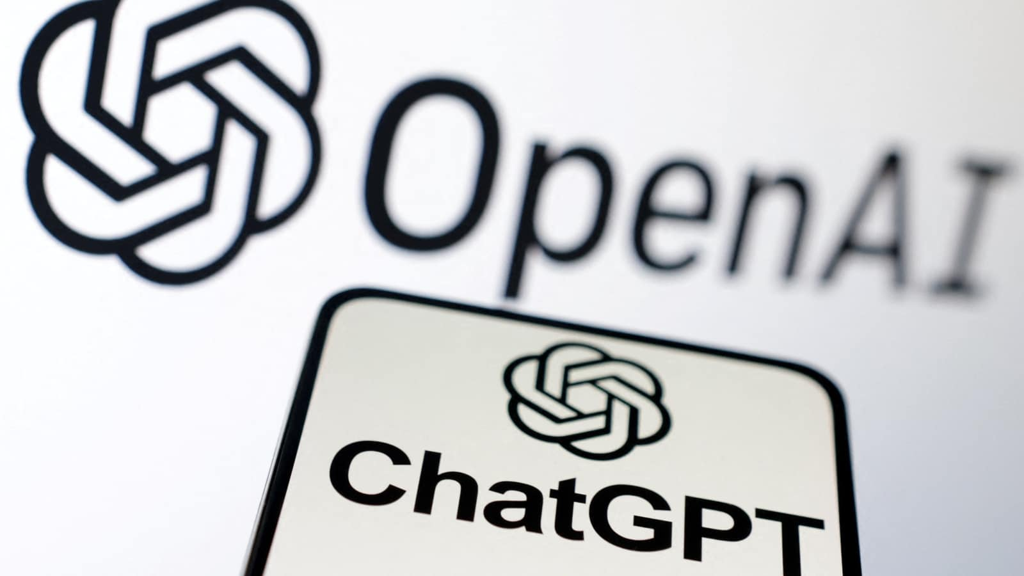
3. ChatGPT can find and fix the bugs in computer code
ChatGPT可以发现和修复计算机代码中的错误

Slide 12
阅读理解
（《新科学家》 2023年2月4日刊 26页）
A CHATBOT developed by tech company OpenAl can find and fix bugs in software just as well as standard machine learning approaches can and beats them when aided by follow-up questions.
A number of tools exist that use artificial intelligence to check programming code to ensure there are no mistakes. Dominik Sobania at Johannes Gutenberg University in Mainz, Germany, and his colleagues sought to see how well ChatGPT could do this compared with other Al-powered coding support tools. They first asked ChatGPT to answer questions taken from the QuixBug benchmark dataset, which is a series of small but challenging programming problems. For example, they gave the Al a small snippet of code and asked:“Does this program have a bug? How do you fix it?”
ChatGPT managed to correctly answer 19 out of 40 queries put to it-comparable with two other deep learning-based code fixing approaches, called CoCoNuT and Codex. That roughly 50 per cent success rate was considered state-of-the-art for such tools before ChatGPT.
The researchers then utilised ChatGPT’s conversational interface to ask follow-up questions that a user would pose if they tried to insert the corrected code into a programming tool.
This approach highlighted where ChatGPT’s solution was incorrect and meant that in 31 of the 40 queries, ChatGPT solved the issue (arXiv,doi.org/jtxf). “That was really surprising, because we haven’t seen it before,“ says Sobania. “That’s something new.” Sobania expects ChatGPT or similar systems to be deployed as an additional trouble shooting tool for programmers in the future.
This is a good idea, but human oversight is still needed, says Alan Woodward at the University of Surrey in the UK. “We don’t want to rely totally on the Al as it is not infallible.”

Slide 13

阅读理解
1. What does paragraph 2 focus on?
A. The test about how well ChatGPT works
B. The popularity of ChatGPT in Germany
C. The procedures to developing ChatGPT
D. The various functions of ChatGPT
细节理解
2.What does the underlined word “utilise” mean in Paragraph 2?
A. make use of B. break away from
C. catch up with D. get hold of
词义猜测
3. What’s the Alan Woodward’s attitude towards the application of AI?
A. indifferent B. approving C. objective D.opposing
推理判断

Slide 14
词汇讲解
1. benchmark: something which can be measured and used as a standard that other things can be compared with 基准
Her outstanding performances set a new benchmark for singers. 她的精彩表演为全世界歌手树立了新典范。
2. comparable: similar to sb/sth else and able to be compared 类似的；可比较的
Inflation is now at a rate comparable with that in other European countries. 现在通货膨胀率已经和欧洲其他国家的差不多了。
翻译句子
卡车产业是衡量经济发展的基准。
The truck industry is a benchmark for the economy.
翻译句子
美国的情况与英国的不能直接相比。
The situation in the US is not directly comparable to that in the UK.

Slide 15
词汇讲解
3. interface: a connection between two pieces of electronic equipment, or between a person and a computer 接口；界面
The system uses an impressive graphical interface. 这一系统采用了特别好的图形界面。
4. infallible: never wrong; never making mistakes 永无过失的；一贯正确的
Public schools are often viewed as infallible sacred cows. 公立学校常被认为是批评的禁区。
翻译句子
该程序的新版本具有更好的用户界面。
The new version of the program comes with a much better user interface.
翻译句子
尽管他经验丰富，却并非不会出错。
Although he was experienced, he was not infallible.

Slide 16
句子翻译
The researchers then utilised ChatGPT’s conversational interface to ask follow-up questions that a user would pose if they tried to insert the corrected code into a programming tool.
然后，研究人员利用ChatGPT的对话界面来询问用户在试图将正确的代码插入编程工具时会提出的后续问题。
翻译
Sobania expects ChatGPT or similar systems to be deployed as an additional trouble shooting tool for programmers in the future.
Sobania希望ChatGPT或类似的系统在未来被部署为程序员的附加问题解决工具。
翻译

Slide 17
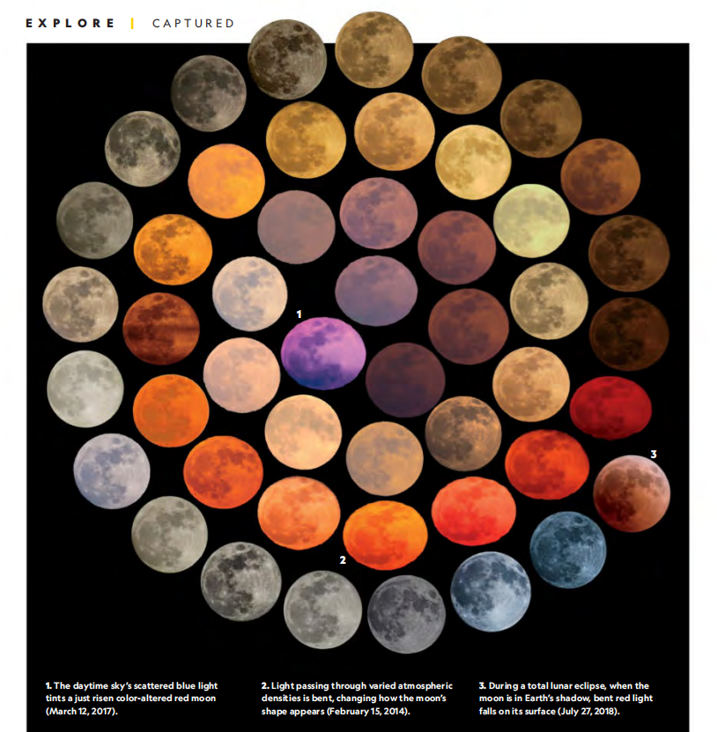
4. Moon Views in Rainbow Hues 彩虹色的月亮

Slide 18
语篇填空
（《国家地理》2023年2月刊 EXPLORE | CAPTURED 版面）
The moon’s actual color is ___ off-white brown-gray when its dusty surface is sunlit. ____ Earth’s atmosphere modifies our views of the moon, altering colors and shape. Italian photographer Marcella Giulia Pace, _____ has captured lunar variations for 10 years, chose 48 of her images to compare in this spiral montage.
The varied colors appear when the moon is seen or photographed through stratified and irregular gas layers of Earth’s atmospheric blanket. Tiny air _________ (molecule) in the layers scatter light __________ hits them, and their structure causes blue light to scatter ___________ (ready) than red or orange. When, for example, Pace photographs the moon through the densest air—as it rises and as it sits just above the horizon—this phenomenon is especially intense, ________ (glow) more red or orange. Other materials in the atmosphere—water droplets, dust, wildfire smoke—also influence the path of light and affect the moon’s hue, and those colors are specific to the _________ (suspend) materials themselves.
The moon’s apparent shape also is altered as the light it emits _______ (travel) through the stratified air. Because the atmosphere nearest Earth’s surface is much denser than high above, the path of light traveling those varied densities will bend. The result: The ______ (light) source appears as a squished ellipse instead of a lunar disk.
an
But
who
molecules
that / which
more readily
glowing
suspended
travels
light’s

Slide 19
词汇讲解
1. hue: a color; a particular shade of a color 颜色；色度；色调
Her paintings capture the subtle hues of the countryside in autumn.
她的油画捕捉住了秋天乡村的微妙色调。
2. squish: if sth soft squishes or is squished, it is crushed out of shape when it is pressed （被）压坏，挤坏
It felt like squishing a grape in your hand. 感觉就像在手里压一颗葡萄。
翻译句子
同一颜色在不同的光线下看起来会有所不同。
The same hue will look different in different light.
翻译句子
别坐在那个袋子上，你会把三明治压扁的。
Don’t sit on that bag — you’ll squish the sandwiches.

Slide 20
句子翻译
Tiny air molecules in the layers scatter light that hits them, and their structure causes blue light to scatter more readily than red or orange.
翻译
大气层中的微小空气分子会散射照射到它们的光，它们的结构使蓝光比红光或橙光更容易散射。
Other materials in the atmosphere—water droplets, dust, wildfire smoke—also influence the path of light and affect the moon’s hue, and those colors are specific to the suspended materials themselves.
翻译
大气中的其他物质——水滴、灰尘、野火烟雾——也会影响光的路径和月亮的色调，而这些颜色是悬浮物质本身所特有的。
Because the atmosphere nearest Earth’s surface is much denser than high above, the path of light traveling those varied densities will bend.
翻译
因为离地球表面最近的大气层密度比高空要大得多，光在这些密度不同的地方传播的路径会弯曲。

Slide 21
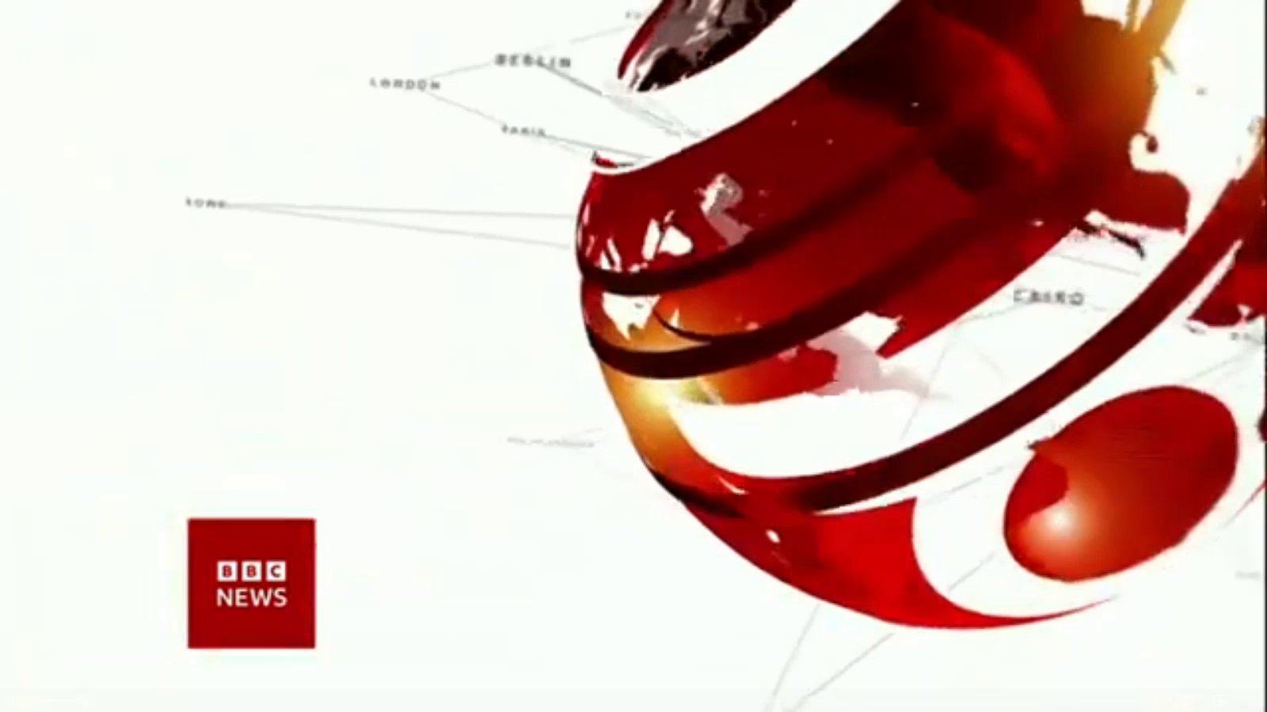
5. BBC One-minute World 02/08/2023

Slide 22

听力填空
Hello, this is BBC world news, our top and breaking story today.
More than 640 people are reported to have been killed in Turkey and northern Syria following a powerful earthquake which ____________ residential buildings across a wide area. The ________ of the 7.8 magnitude quake was in the southern Turkish province of Gaziantep, but _______ hundreds of miles away.
Turkish government officials say a full emergency disaster response is _________. In some areas, people have been digging through the rubble with their _________ in their attempts to reach survivors.
Witnesses in rebel-held parts of northern Syria describe _____________. Many buildings have _________ with emergency services, saying they are ____________ in their rescue efforts.
Turkey has declared a state of emergency and the European Union, the United States and NATO have all ___________.
Syria’s government is also ___________ an emergency response although it’s not clear if that will include those in rebel-held areas.
brought down
epicenter
was felt
underway
bare hands
a disaster zone
collapsed
overwhelmed
offered help
coordinating

Slide 23
词汇讲解
magnitude
1) the size or extent of something such as a star, earthquake, or explosion
星等（指星的亮度）；震级；（爆炸的）强度
The San Francisco earthquake of 1906 had a magnitude of 8.3.
1906年旧金山地震的震级为8.3级。
2) the great size of importance of sth; the degree to which sth is large or important
巨大；重大；重要性
America and Russia do not face a problem of the same order of magnitude as Japan.
美俄两国所面临问题的重要性与日本的不可同日而语。
翻译句子
当地时间下午2点28分发生了一场里氏7.8级地震。
The 7.8 magnitude quake struck on Monday, at 1428 local time.
翻译句子
我们没有意识到这个问题的严重性。
We did not realize the magnitude of the problem.

Slide 24
句子翻译
More than 640 people are reported to have been killed in Turkey and northern Syria following a powerful earthquake which brought down residential buildings across a wide area. The epicenter of the 7.8 magnitude quake was in the southern Turkish province of Gaziantep, but was felt hundreds of miles away.
翻译
据报道，土耳其和叙利亚北部发生强烈地震，导致大片地区民居倒塌，超过640人遇难。这次7.8级地震的震中在土耳其南部的加济安泰普省，但数百英里外都有震感。
Turkish government officials say a full emergency disaster response is underway. In some areas, people have been digging through the rubble with their bare hands in their attempts to reach survivors.
翻译
土耳其政府官员表示，全面的紧急救灾工作正在进行中。在一些地区，人们一直徒手在废墟中挖掘，试图找到幸存者。

