Slide 1

感恩遇见，相互成就，本课件资料仅供您个人参考、教学使用，严禁自行在网络传播，违者依知识产权法追究法律责任。
更多教学资源请关注
公众号：溯恩高中英语
知识产权声明

Slide 2
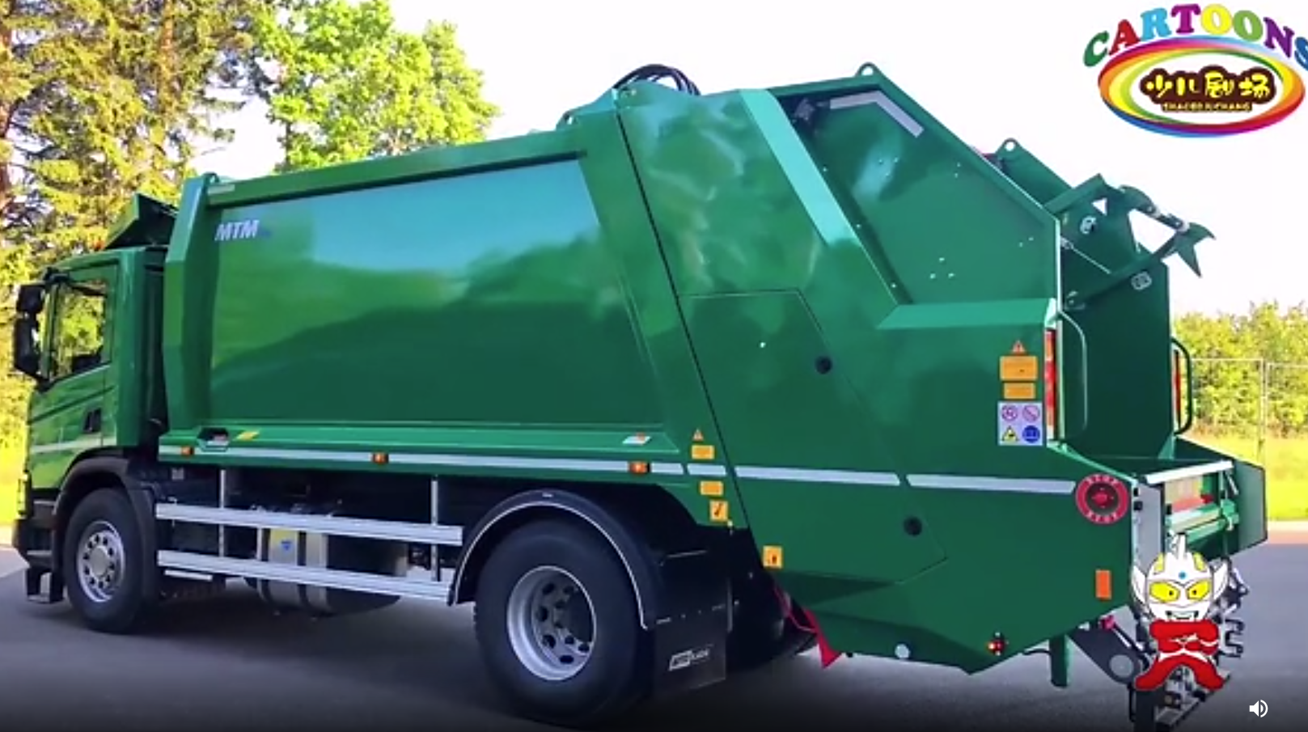
基于情节合理设计的读后续写训练课
喜欢环卫车的小Oliver
杭州二中 许丽君

Slide 3
题文示例
第二节 读后续写（满分25分）
阅读下面短文，根据所给情节进行续写，使之构成一个完整的故事。
Life is really made up of little moments that are full of meaning and pleasure. Here’s a heartwarming story that will bring a bit of joy and sweet into a world where it often feels like there is only bad news going on.
Oliver Burrow was just 3 years old when he became absolutely fascinated by the garbage truck. His father, Rob Burrow, shared a story that had been going on “since about the age he could walk.”
Public Services workers Lawrence Smith and Gad Asher were the garbage men in the community. They were just going about their business as usual when suddenly, they experienced a truly unusual encounter with Oliver.
Lawrence Smith and Gad Asher knew clearly how much the little boy loved the truck because each Friday when he heard the truck approaching, he climbed to the window and waved to the man driving. In response, they waved back.

Slide 4
Oliver told his parents that every day when he looks at the window, the garbage man always waves at him. At first, his parents thought that he was just imagining this, not thinking much of it.
However, his parents then looked out the window one day when he was looking at the garbage men. They said: “We didn’t believe it. We laughed at his imagination, and then we looked out the window and there, the garbage man was waving! I couldn’t tell you how long ago it started and why they would wave to my little boy.”
Realizing how much joy seeing the garbage truck gave his son, the father came upon an idea. One day, when the garbage truck pulled up, he asked Oliver if he wanted to greet his friends.
Paragraph 1:
Hearing this, the little boy smiled.
Paragraph 2:
Oliver got nervous when the loud truck was right there in front of them.

Slide 5
1
读内容 Read for the plot
2
读线索 Read for the clue
3
读文章大意和主旨 Read for the main idea and theme
Read
4
读主人公的情感 Read for emotion
5
探索主题要旨 Explore the theme
6
预测故事结尾 Predicting the ending

Slide 6

Read
01
读内容：Read for the plot 为续写的融洽性奠定基础
Life is really made up of little moments that are full of meaning and pleasure. Here’s a heartwarming story that will bring a bit of joy and sweet into a world where it often feels like there is only bad news going on.
Oliver Burrow was just 3 years old when he became absolutely fascinated by the garbage truck. His father, Rob Burrow, shared a story that had been going on “since about the age he could walk.”
Public Services workers Lawrence Smith and Gad Asher were the garbage men in the community. They were just going about their business as usual when suddenly, they experienced a truly unusual encounter with Oliver.
总起句：生活的真谛
故事的总述，背后的涵义
heroes
伏笔和故事的起因
伏笔：后文要体现和Oliver的不寻常的邂逅

Slide 7
Read
01
读内容：Read for the plot 为续写的融洽性奠定基础
Lawrence Smith and Gad Asher knew clearly how much the little boy loved the truck because each Friday when he heard the truck approaching, he climbed to the window and waved to the man driving. In response, they waved back.
Realizing how much joy seeing the garbage truck gave his son, the father came upon an idea. One day, when the garbage truck pulled up, he asked Oliver if he wanted to greet his friends.
伏笔：与续文情节相连
要在续文中体现父亲想到的好主意
应该是面对面地和环卫工打招呼

Slide 8
Read
02
读线索：Read for the clue为思维逻辑发展指明方向
Life is really made up of little moments that are full of meaning and pleasure. Here’s a heartwarming story that will bring a bit of joy and sweet into a world where it often feels like there is only bad news going on.
Oliver Burrow was just 3 years old when he became absolutely fascinated by the garbage truck. His father, Rob Burrow, shared a story that had been going on “since about the age he could walk.”
Public Services workers Lawrence Smith and Gad Asher were the garbage men in the community. They were just going about their business as usual when suddenly, they experienced a truly unusual encounter with Oliver.
Lawrence Smith and Gad Asher knew clearly how much the little boy loved the truck because each Friday when he heard the truck approaching, he climbed to the window and waved to the man driving. In response, they waved back.
故事开端（总述）：
故事背后的涵义，生活的真谛
Oliver’s Personality：kind, sweet and generous
起因：3岁男孩Oliver打心眼里喜欢环卫车。
情节推进：每周五Oliver隔着窗和环卫工人挥手招呼，他们之间的友情。

Slide 9
Read
02
读线索：Read for the clue为思维逻辑发展指明方向
Oliver told his parents that every day when he looks at the window, the garbage man always waves at him. At first, his parents thought that he was just imagining this, not thinking much of it.
However, his parents then looked out the window one day when he was looking at the garbage men. They said: “We didn’t believe it. We laughed at his imagination, and then we looked out the window and there, the garbage man was waving! I couldn’t tell you how long ago it started and why they would wave to my little boy.”
Realizing how much joy seeing the garbage truck gave his son, the father came upon an idea. One day, when the garbage truck pulled up, he asked Oliver if he wanted to greet his friends.
Paragraph 1:
Hearing this, the little boy smiled.
_________________________________________________________
Paragraph 2:
Oliver got nervous when the loud truck was right there in front of them. ___________________________________________________________
故事发展：
喜欢环卫车的Oliver有机会与环卫工见面，Oliver喜出望外。
Garbagemen’s Emotion：Passionate，friendly
Oliver’s father’s Emotion: delighted，joyful
故事高潮：
Oliver和父亲一起面对面地与工人交流，他们成了好朋友，给环卫工带来了快乐。
故事结局：
Oliver见识和体验了梦寐以求的环卫车。同时他对环卫车的热爱消除了工人的疲劳和烦躁。

Slide 10
Read
03
读故事中心大意和主旨：read for main idea and theme
快速解码其主旨大意，挖掘出隐藏信息，才能写出融合度高的故事来。
What's the main idea of the story?
3岁男孩Oliver打心眼里喜欢环卫车，每周五隔着窗子和两位作业的环卫工人挥手打招呼，两位环卫工也非常愿意与可爱的Oliver挥手致敬，他们之间有了一种默契。喜欢环卫车的Oliver有机会与每周五打招呼的环卫工见面。Oliver喜出望外。他不仅见识了梦寐以求的环卫车，还和环卫工结交成了好朋友。

Slide 11
Read
03
读故事中心大意和主旨：read for main idea and theme
语篇表达的意图：why---故事主题
最能体现故事主题的词：（体现人性美好的一面的词）
Kindness， heartwarming， joy, sweet, pleasure
What's the theme of the story?
孩子的笑声给环卫工人带来了快乐，他们感激Oliver每次的挥手。他们的疲劳和枯燥因为Oliver对环卫车的热爱而消失了。父亲看到了3岁儿子对环卫工挥手的魔力。笑声消除了工人内心的辛酸和劳累，笑声给这个世界带来了美好的每一天。

Slide 12
Read
04
理情节情感线Read for the emotion of character
故事结构分析
情节发展线：
Oliver喜欢环卫车→父亲Rob提议与环卫工见面→与父亲一起见环卫工→与环卫车面对面→ 体验当环卫车司机。
情感变化线：
Pleasant→delighted→heartwarming → nervous → happy and satisfied。
原文展示了故事的“起因、经过，发展”部分，续写两段分别为故事的“高潮”和“结局”部分。

Slide 13
Read
04
读主人公的情感Read for the emotion of character
Oliver’s Emotions
(情感线）
Climax
heartwarming（与父亲一起见环卫工）
Process
delighted
(提议与环卫工人见面)
nervous（与环卫车面对面）
Happy，satisfied (体验当司机)
Pleasant
(喜欢环卫车)
Beginning
Ending

Slide 14
Read
05
续情节：为上下文连贯性提供依据
Plot for Paragraph 1：
父亲的提议得到了Oliver的赞同
Oliver找出自己最喜欢的玩具环卫车
Oliver和父亲一起见环卫工，挥手
环卫工挥手致意
送出礼物
环卫工感激男孩，提议Oliver亲身体验当一回驾驶员
最后这句与第二段首句上下衔接

Slide 15
Read
05
续情节：为上下文连贯性提供依据
Plot for Paragraph 2：
环卫车就在眼前，紧张，与原来想象的不吻合
没过多久，在父亲和工人的鼓励下爬进驾驶座
握住方向盘
体验一回当司机的经历
可爱的Oliver的举动感染了两位工人
给他们带来了欢乐
尾句：与段首呼应，生活充满着意义和快乐的点点滴滴

Slide 16
Read
05
Coherence with the given sentence 与段首句的衔接
第二段衔接的问题：
Paragraph 2:
Oliver got nervous when the loud truck was right there in front of them. The father rolled down the window, smiled and gestured as though he had something to say.
这段应该描写孩子在见到庞大的环卫车就在他眼前时，感到紧张、胆小、害怕的心情，但马上因为激动，加上父亲和两位工人的鼓励，孩子希望能亲自爬上环卫车有切身体验，经历一番当环卫车司机的过程。
第一段中父亲应该和孩子说好去见环卫工人和环卫车，怎么可能在第二段才和环卫工人商量？

Slide 17
Read
06
Predicting the ending(预测故事结尾）
Trends/ending in the story’s development
Para 1：
Q1: What did Oliver do to convey his love to the garbage men?
Q2: How did Oliver go where the garbage men stayed?
Q3: What did the garbage men do to show their gratitude to the boy?
情节构思思路:
Para. 1：听到这话，男孩笑了。父亲的提议一定得到了Oliver的拍手赞同。紧接着发生的事应该呼应前文提到的小男孩和环卫工人挥手致意。Oliver对garbage truck由衷的喜爱，男孩也许为了表达对环卫工人的热爱，送出了有纪念意义的自己最喜欢的玩具环卫车，两位工人欣然接受。 紧接着提议让小男孩亲自体验一下做在环卫车驾驶座上的感受。（最后一句需与第二段首句上下衔接）

Slide 18
Read
06
Predicting the ending(预测故事结尾）
Trends/ending in the story’s development
Para 2：
Q4: How did Oliver feel when facing the big garbage truck?
Q5: What did Oliver do with the help of the garbage now?
Q6: How did the garbage men feel with the amusement brought by Oliver?
情节构思思路:
Para. 2：当庞大的环卫车矗立在Oliver前时，这一定与他想象的有出入。一阵紧张过后，Oliver因为真心喜欢环卫车靠近并爬进了车中驾驶座。在Lawrence的指导下，Oliver模仿着握住方向盘，有模有样地驾驶环卫车。正是这个可爱的Oliver给艰辛工作、苦累缠身的Gad和Lawrence带来了快乐。

Slide 19
Writing
Predict the plot -1
Trace the hidden clues in the given sentences
Paragraph 1:
Hearing this, the little boy smiled.
Paragraph 2:
Oliver got nervous when the loud truck was right there in front of them.
problem
Oliver’s reflection:
excited
inspired
father’ s reflection
confused
delighted
further problem

Slide 20
Predict the plot-2
Writing
Trace the hidden clues in the given sentences
Paragraph 2:
Oliver got nervous when the loud truck was right there in front of them.
Oliver’s activity after being encouraged by father and garbage men.
Resolution
result?
His simple kind act also lit up the workers’ otherwise boring day.

Slide 21
Writing
07
精彩结尾点主题：promoting the theme
从父亲的视角提炼主题
主题提炼式结尾：
The father showered the warm-hearted men in string of thanks and he was well aware that this joyful moment, little as it was, had stirred sparkling ripples and lighted up what seemed to be a dull world.
父亲对两位热心人表示了一连串的感谢， 他很清楚，这个快乐的时刻虽然不大，却激起了闪闪发光的涟漪，照亮了一个似乎沉闷的世界。

Slide 22
Writing
07
精彩结尾点主题：promoting the theme
从作者的视角提炼主题
情感升华式结尾：
Oliver hugged them and expressed his deep love to them. In Oliver’s mind, they did what they could to help others. Standing aside, the father learned what his three-year-old son taught him-every worker deserves to be respected.
奥利弗拥抱了他们，向他们表达了深深的爱。在奥利弗看来，他们尽了自己所能去帮助别人。站在一旁，这位父亲学到老他三岁儿子教给他的东西---每个工人都应该收到尊重。

Slide 23
Writing
07
精彩结尾点主题：promoting the theme
从作者的视角提炼主题
画面定格和情感升华结合结尾：
Oliver clapped his hands and chuckled. Hearing the giggles, the garbage men felt their fatigue and boredom melted away. The father was astounded to learn that his son brought them so much joy, they were appreciated for his everyday wave. Eyes moistening, the father hugged his son affectionately, savoring the taste of friendship between strangers.
奥利弗拍着手，咯咯地笑了起来。听到咯咯的笑声，环卫工觉得他们的疲劳和无聊都消失了。父亲惊讶地发现他的儿子给他们带来了这么多的快乐。他们很感激他每天挥手。父亲热泪盈眶，深情地拥抱着儿子，品尝着陌生人之间友谊的滋味。

Slide 24
Writing
07
精彩结尾点主题：promoting the theme
从作者的视角提炼主题
主题提炼式结尾：
The garbage truck drove away, but what remained was Oliver’s joy and gratification. And what Oliver didn’t know was that his simple kind act also lit up the workers’ otherwise boring day.
垃圾车开走了，但留下的是奥利弗的喜悦和满足。奥利弗不知道的是， 他这简单友好的举动也点亮了两位工人原本无聊的一天。

Slide 25
Writing
07
精彩结尾点主题：promoting the theme
从作者的视角提炼主题
情感升华式结尾：
It was little Oliver’s love that turned this stinking garbage truck into a pleasing job truck, brightening our world.
是小奥利弗的爱让这辆恶臭的垃圾车变成了一辆令人愉悦的工作车，照亮了我们的世界。

Slide 26
Possible Version 1:
Paragraph 1
Hearing this, the little boy smiled. Every cell in his body woke up as he longingly pictured himself getting close to that magnetic giant- the garbage truck. Right away, he struggled to get down from the window before dashing forward to the door, clumsily but swiftly. No sooner had he succeeded in putting on his little shoes than he flew out like an agile little bird. Immature face glowing with sheer exhilaration, the 3-year-old headed directly for his destination, leaving his parents behind, and here it was-the truck was lying before the family, just within their reach.

Slide 27
Possible Version 1:
Paragraph 2
Oliver got nervous when the loud truck was right there in front of them. In the tedious sound made by this big machine, he was nailed to the spot, eyes widened with amazement. At that moment, the truck door cracked open. Out came the two garbage men with beaming smiles in their faces, “Nice to meet you, little man!” then, much to great astonishment, Oliver returned his friends a big smile and gave them a big hug. Mild sunshine washed over his cheeks, dying them somewhat reddish. This unusual encounter, which spoke volumes about innocence and sincerity, brought sunshine into everyone’s heart.

Slide 28
Possible Version 2:
Paragraph 1:
Hearing this, the little boy smiled. Without any momentary hesitation, an affirmative answer escaped his lips. It was just a long-awaited dream that kept playing in his mind. The metallic sound from the chattering engine may be considered as the most melodious note to him. So fascinated was he by the mysterious garbage truck that he utterly soaked up the fantastic imagination amid children’s pure curiosity and pleasure. Then like a shot, Oliver pulled his father and dashed to take a closer look at his friends.

Slide 29
Possible Version 2:
Paragraph 2:
Oliver got nervous when the loud truck was right there in front of them. After all, it was the first time that he had just truly approached the big guy which aroused his sheer interest. After his father informed the two workers of Oliver’s intention, still thunderstruck, the two garbage men couldn’t envision such an endearing kid who was willing to learn about their dirty and smelly job. With the young hands clutched in the rough hands tenderly, they instilled enough patience and enthusiasm to unfold the overall perspective of the truck as well as narrating their routine jobs. “You’re the great heroes!” Oliver yelled. With unshed tears brimming in their eyes, they knew clearly, it was just the little angel’s simple words that became the best salute to their obscure dedication.

Slide 30
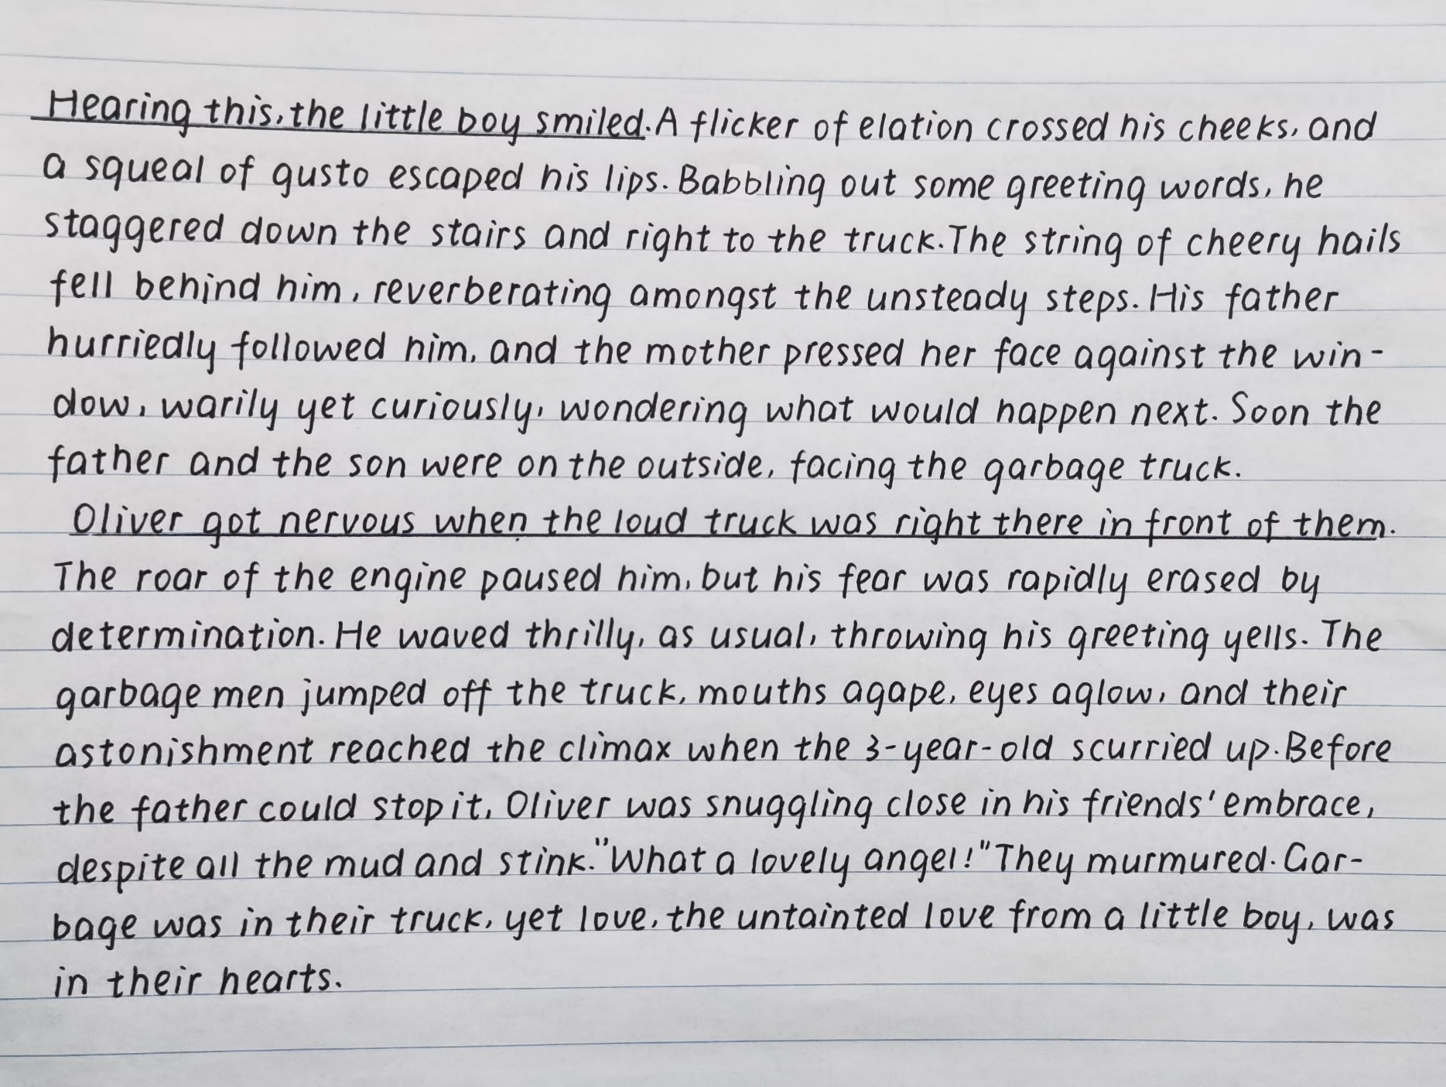
Writing Sample 1:
文中出现了许多表达孩子急切看到环卫车的心情的描写类用语，该生词汇量大，用词非常丰富

Slide 31
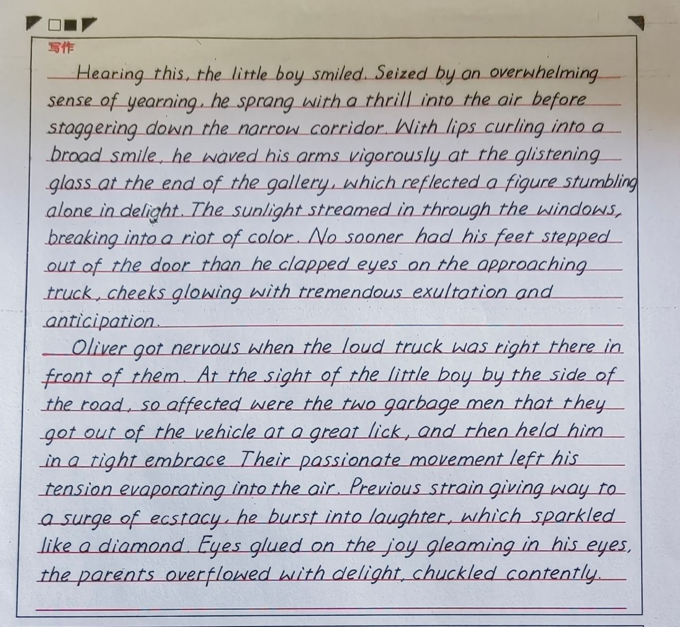
Writing Sample 2:
丰富准确的动词表达孩子动作的同时，还通过非谓语动词表达伴随或方式作状语等形式，描写孩子可爱且热情的一面。句式表达丰富。

Slide 32



Thanks For Your Attention!

