Slide 1

感恩遇见，相互成就，本课件资料仅供您个人参考、教学使用，严禁自行在网络传播，违者依知识产权法追究法律责任。
更多教学资源请关注
公众号：溯恩高中英语
知识产权声明

Slide 2
浙江省十校联盟2023届高三第三次联考应用文
“乡土中国”
摄影展

Slide 3

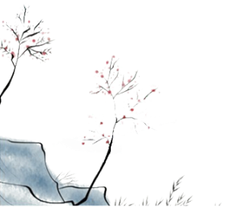
假设你是李华，本周末你校将要举办以“乡土中国（Rural China）”为主题的摄影展，请你写一封邮件给交换生James，邀请他来参观这次展览。
内容包括：
1. 展览的时间和地点；
2. 展览的内容和意义。
第一步：审题与构思
类型
框架
时态
语气(对象)
要点
次要点

Slide 4
para 1. background+purpose
tip1：不建议用简单主动句（如句2）
An exhibit featuring photographs themed on “Rural China” taken by all students will open in our shcool hall on weekends.
Our school will hold/organize a photograph exhibition this Saturday morning....
Glad to know that there will be a photo exhibition themed on “Rural China”, I’m writing to....
Exceedingly delighted to know that a...exhibition themed on... will be held by our school,....
Good news! A photo exhibition themed on “Rural China” is around the corner.
Learning that you’re passionate about..., I can’t wait to invite you to visit the photograph exhibition, which is scheduled to be held at....
With the approaching of the most-awaited photographic exhibition whose theme is “Rural China”, I’m writing to invite you...

Slide 5
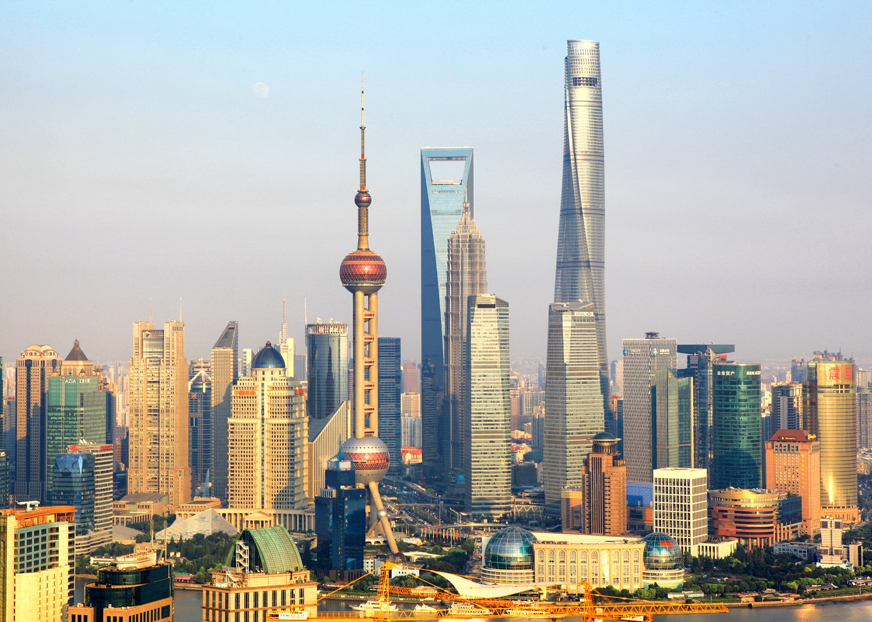

What Rural China is Like?

Slide 6
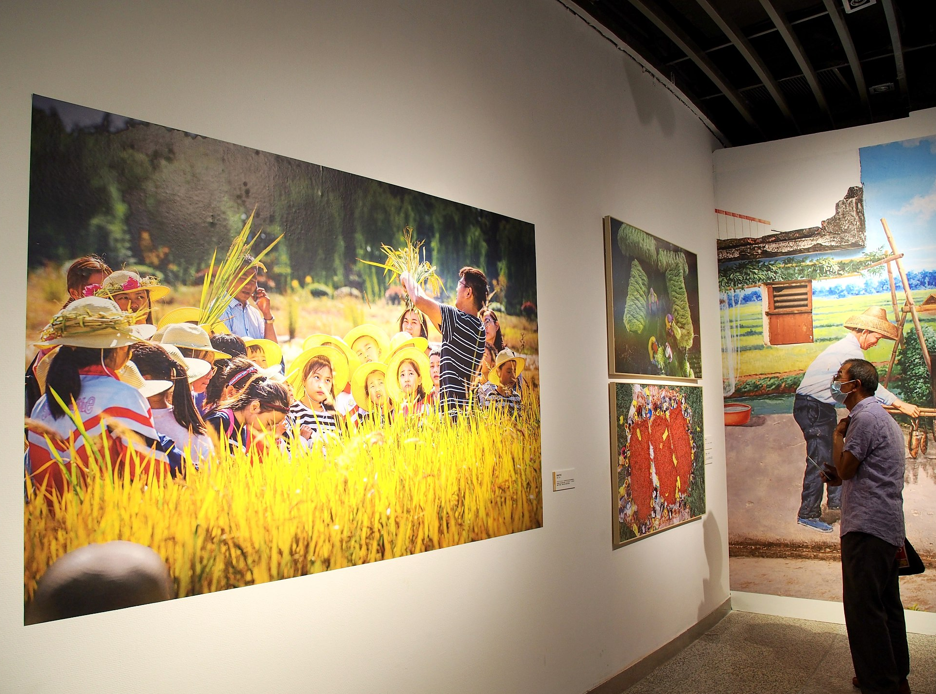
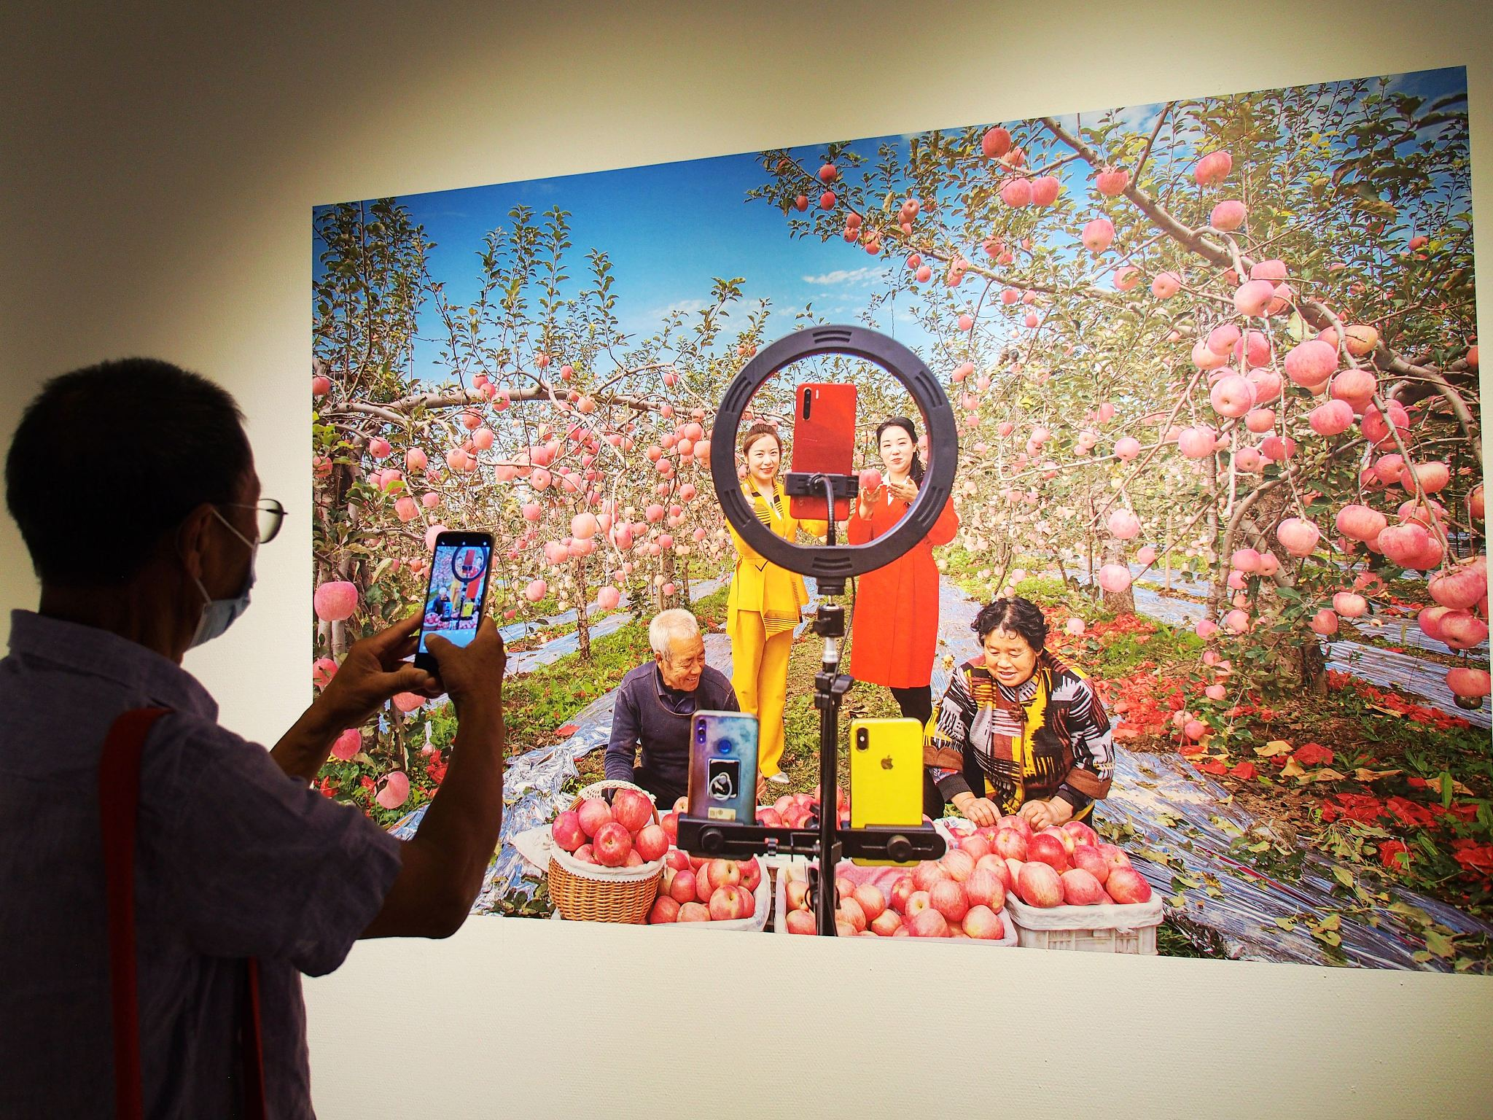
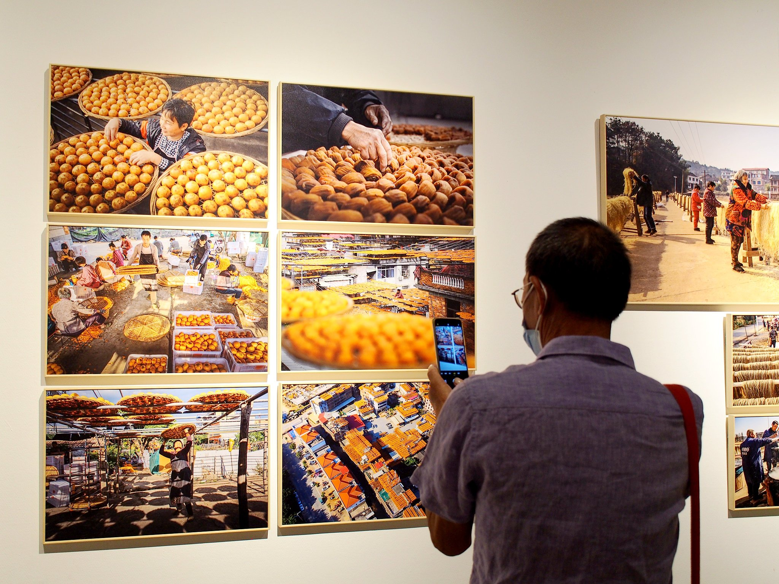
问题1：不会写内容
What Rural China is Like?
人 景 物
outside of the big mega-cities
rural：in, of, or like the countryside（land not in towns, cities, or industrial areas, that is either used for farming or left in its natural condition 农村，乡下；郊外）
a good harvest
farmers selling produce via livestream
food products sold at a rural market
Notes:
['meɡə]

Slide 7
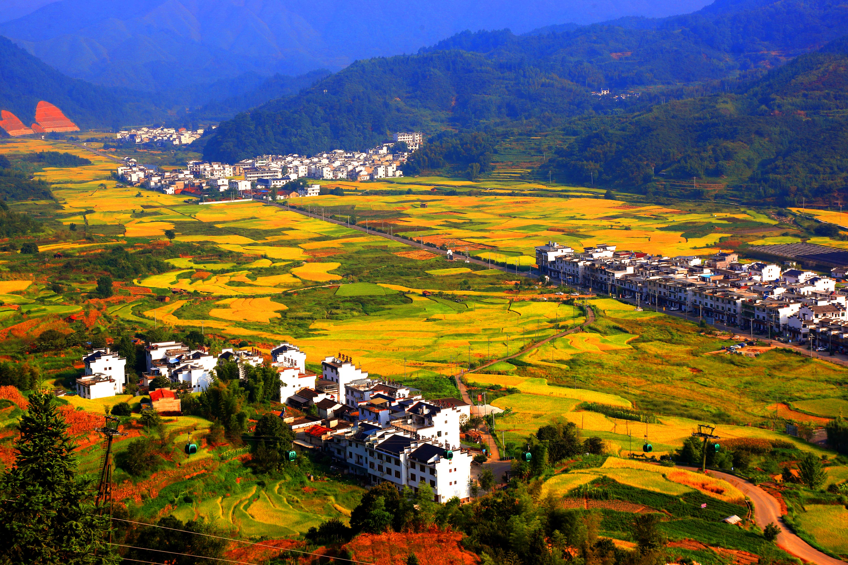
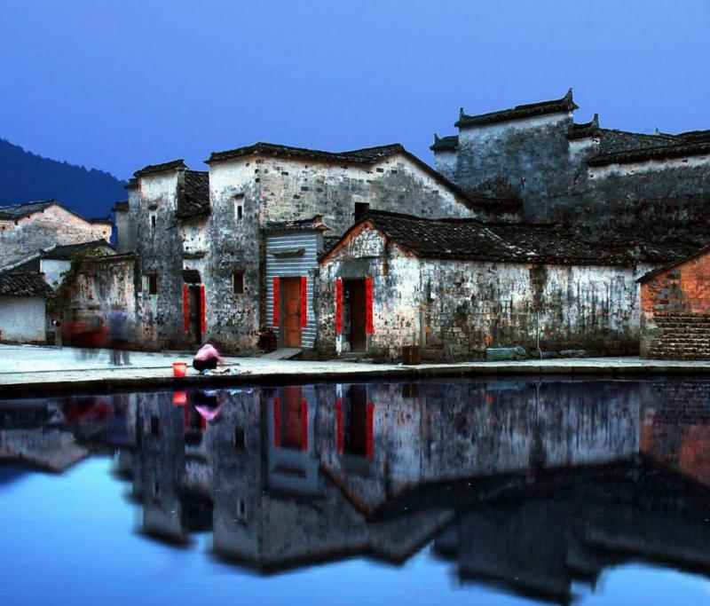
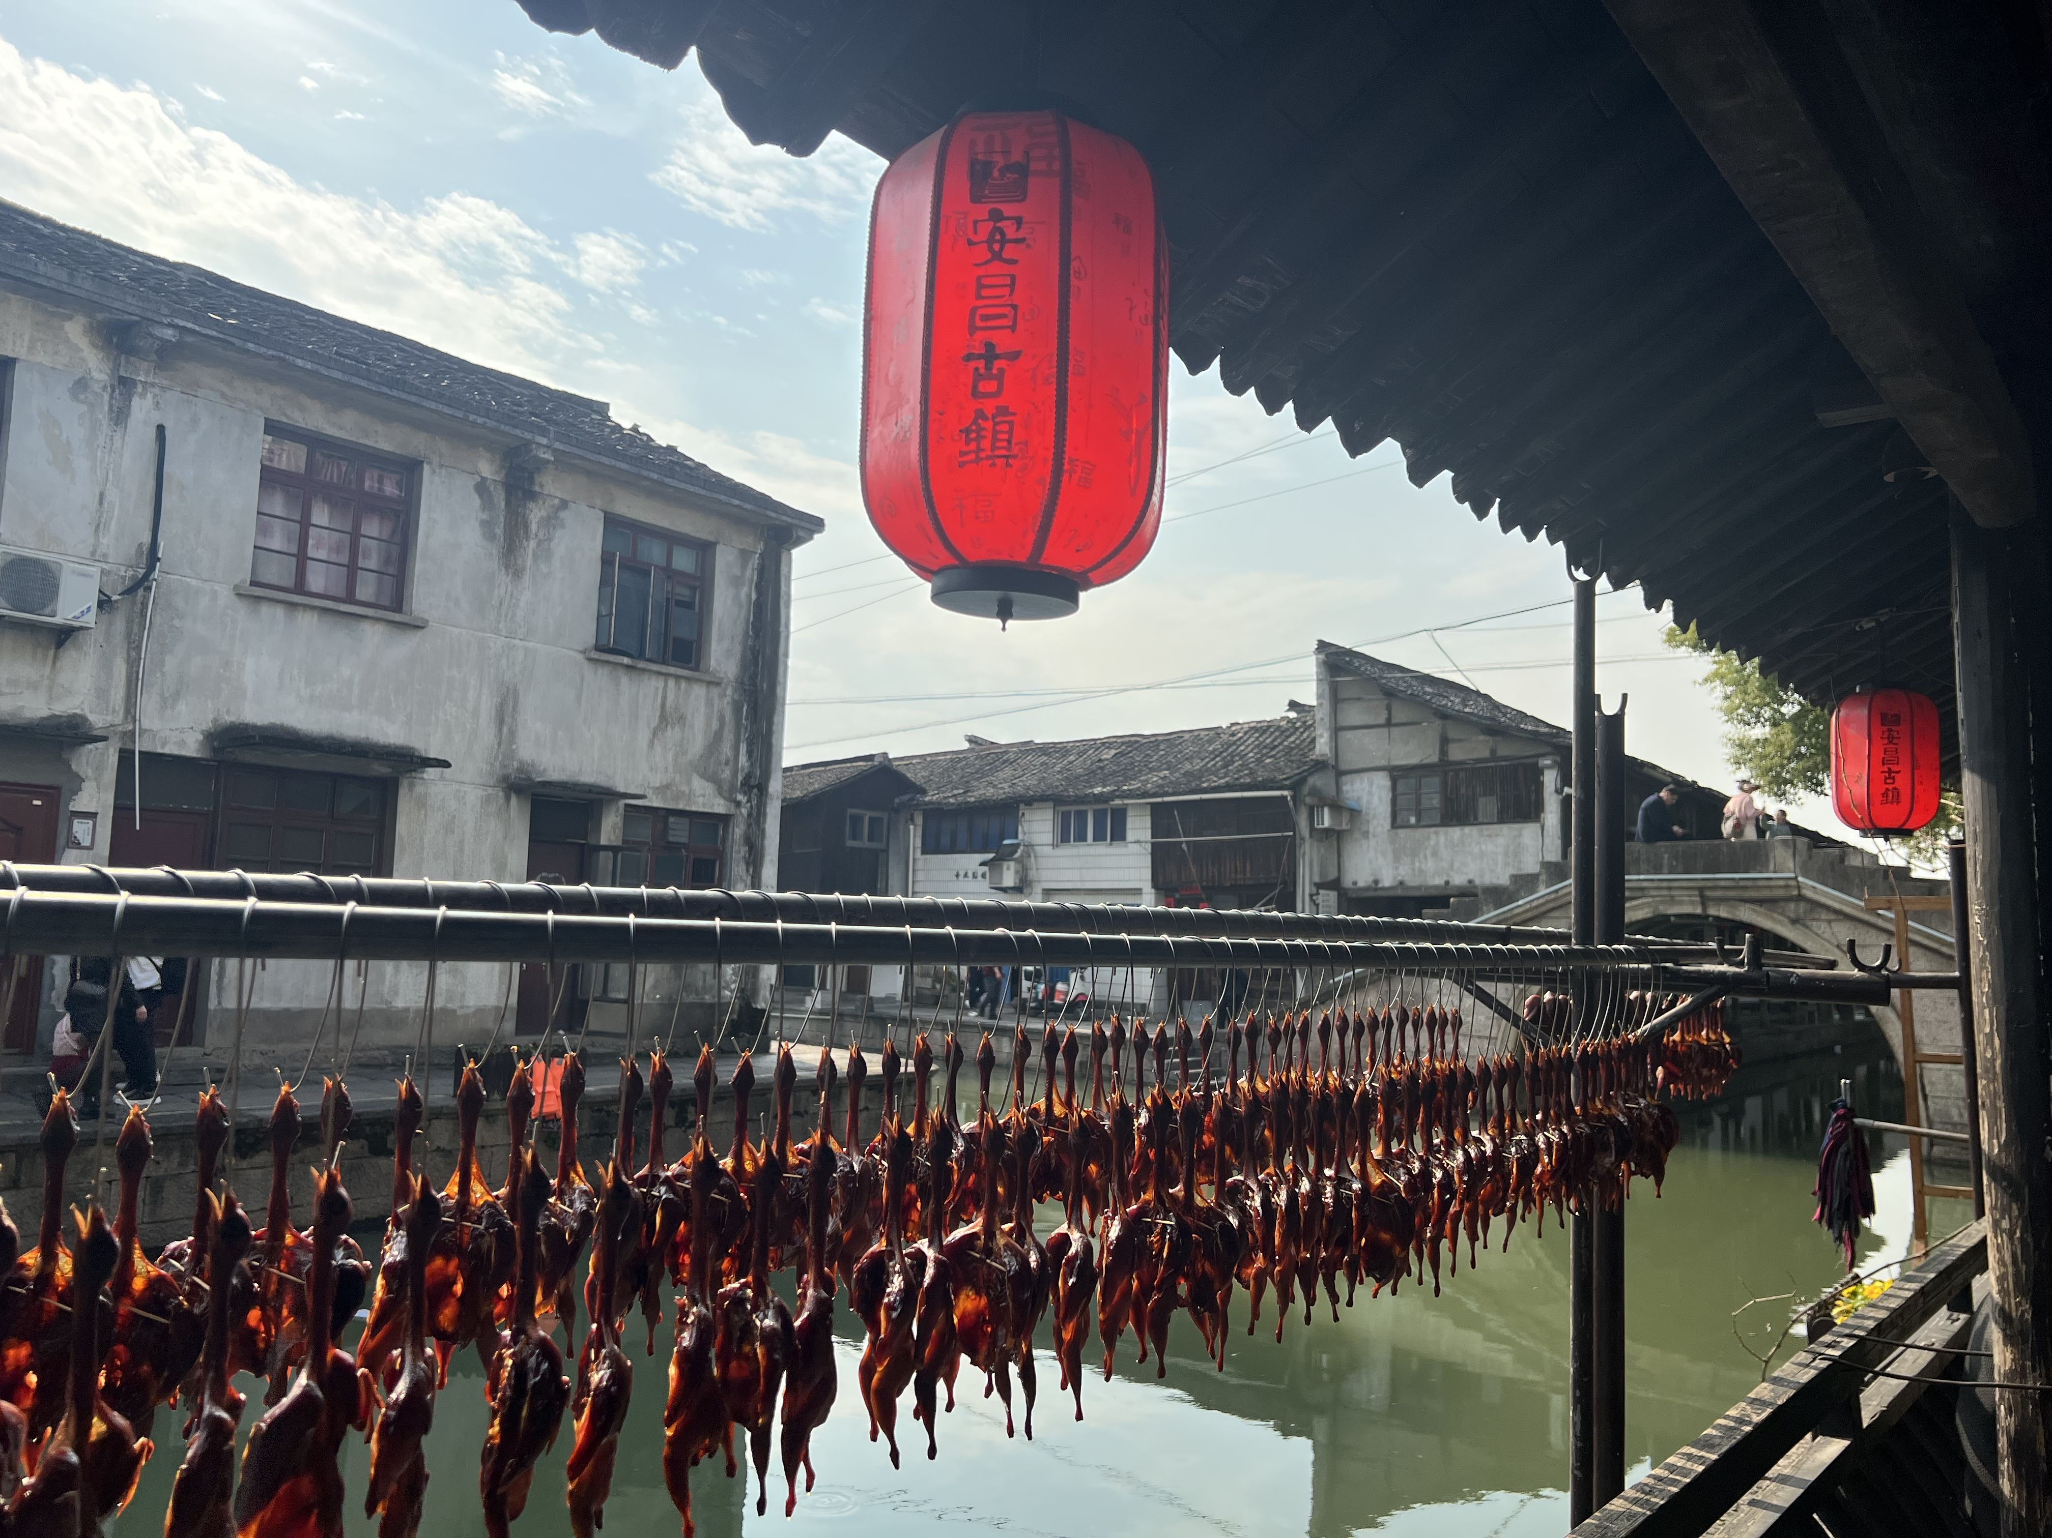
diverse natural beauty in rural China
idyllic (/aɪˈdɪl.ɪk/田园诗般的，田园风光的) village
idyllic scenes of life in rural China
historical town
historical buildings with regional characteristics
oriental architectural features
unique and time-honored tradition
diverse customs

Slide 8
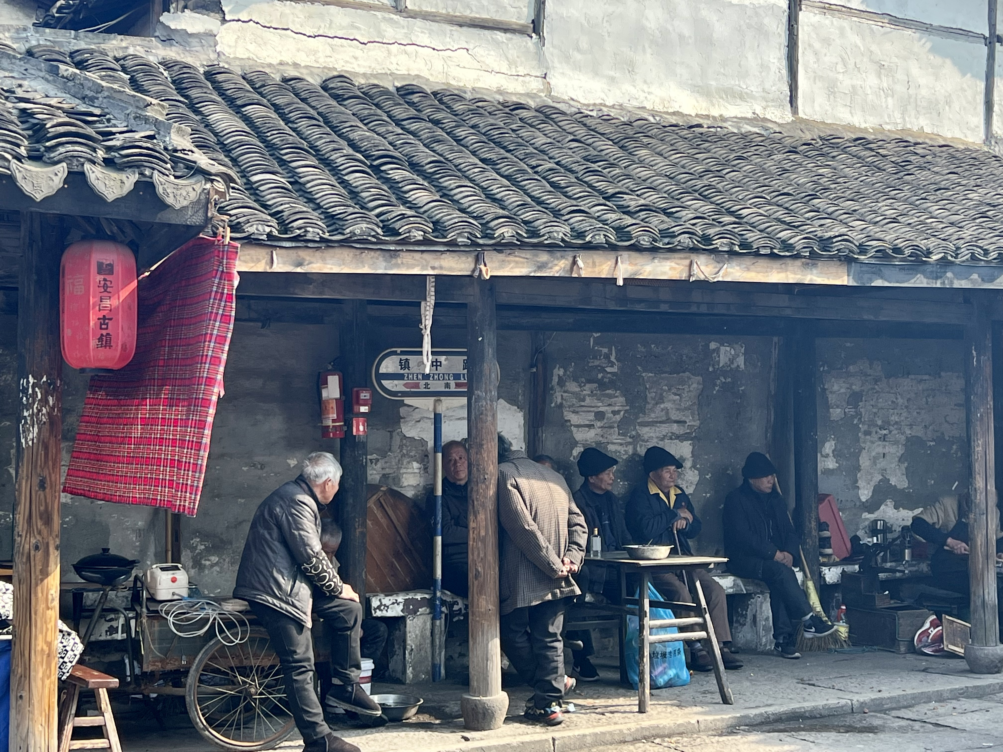
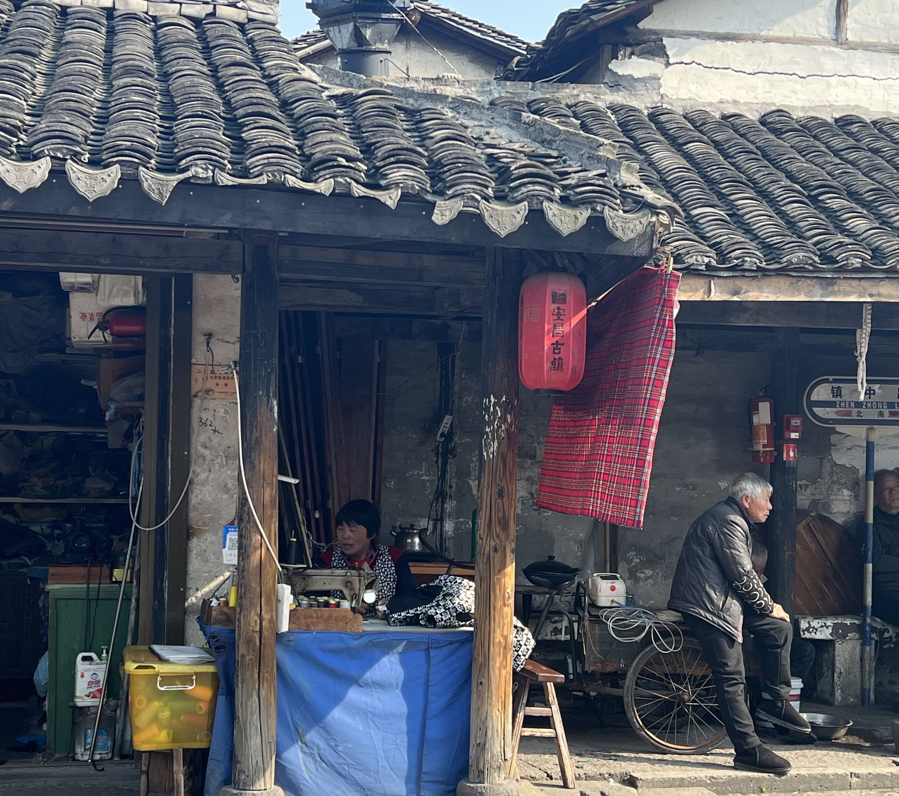
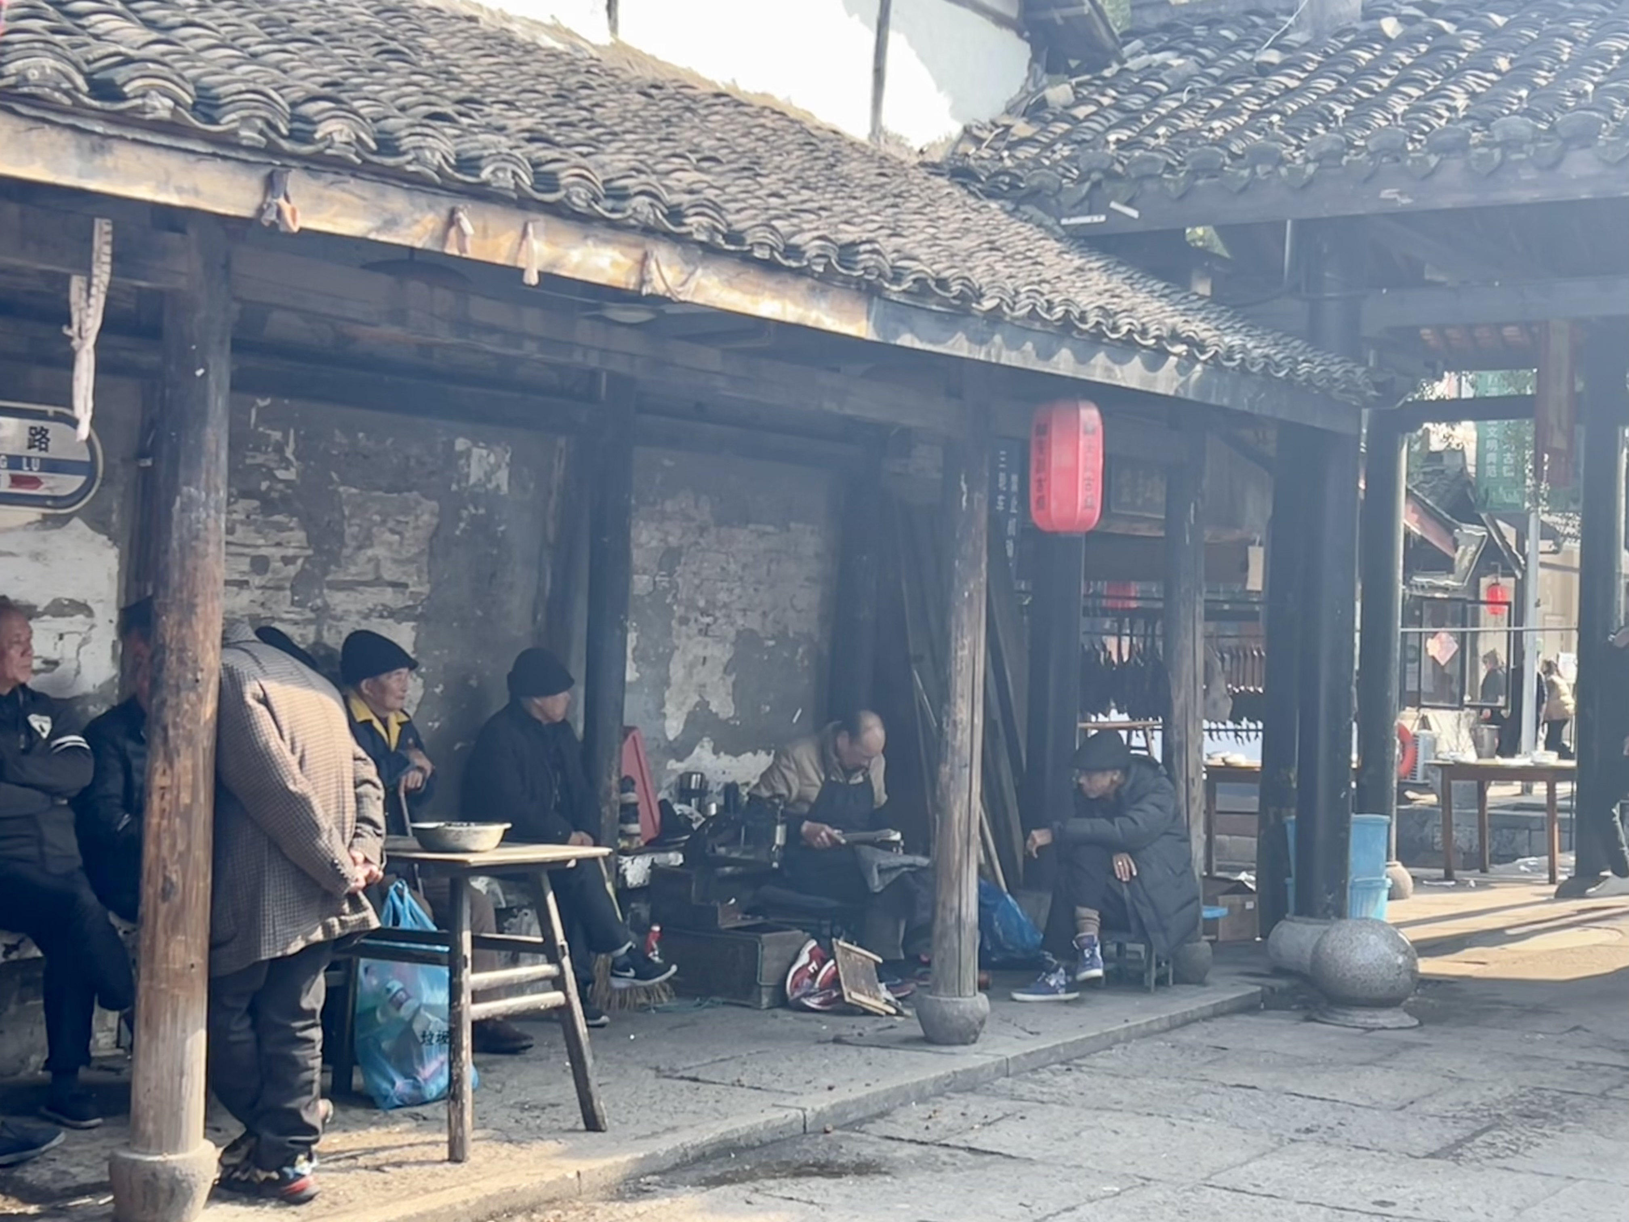
traditional craft
performing arts
folk culture 民间文化/folk art 民间艺术/folk dancing 民间舞蹈

Slide 9
para 2.
exhibition/display/show
v. show/display
e.g. The exhibition displays changes to people’s livelihood in rural areas over the years.
these works
(photographs will be exhibited/will also be on display to) v. capture (（用文字或图象）表现，描绘，刻画)/present/describe/tell Chinese stories
e.g. A total of 111 photos will be selected for display, recording the great changes that have taken place in China’s rural areas over the years.

Slide 10
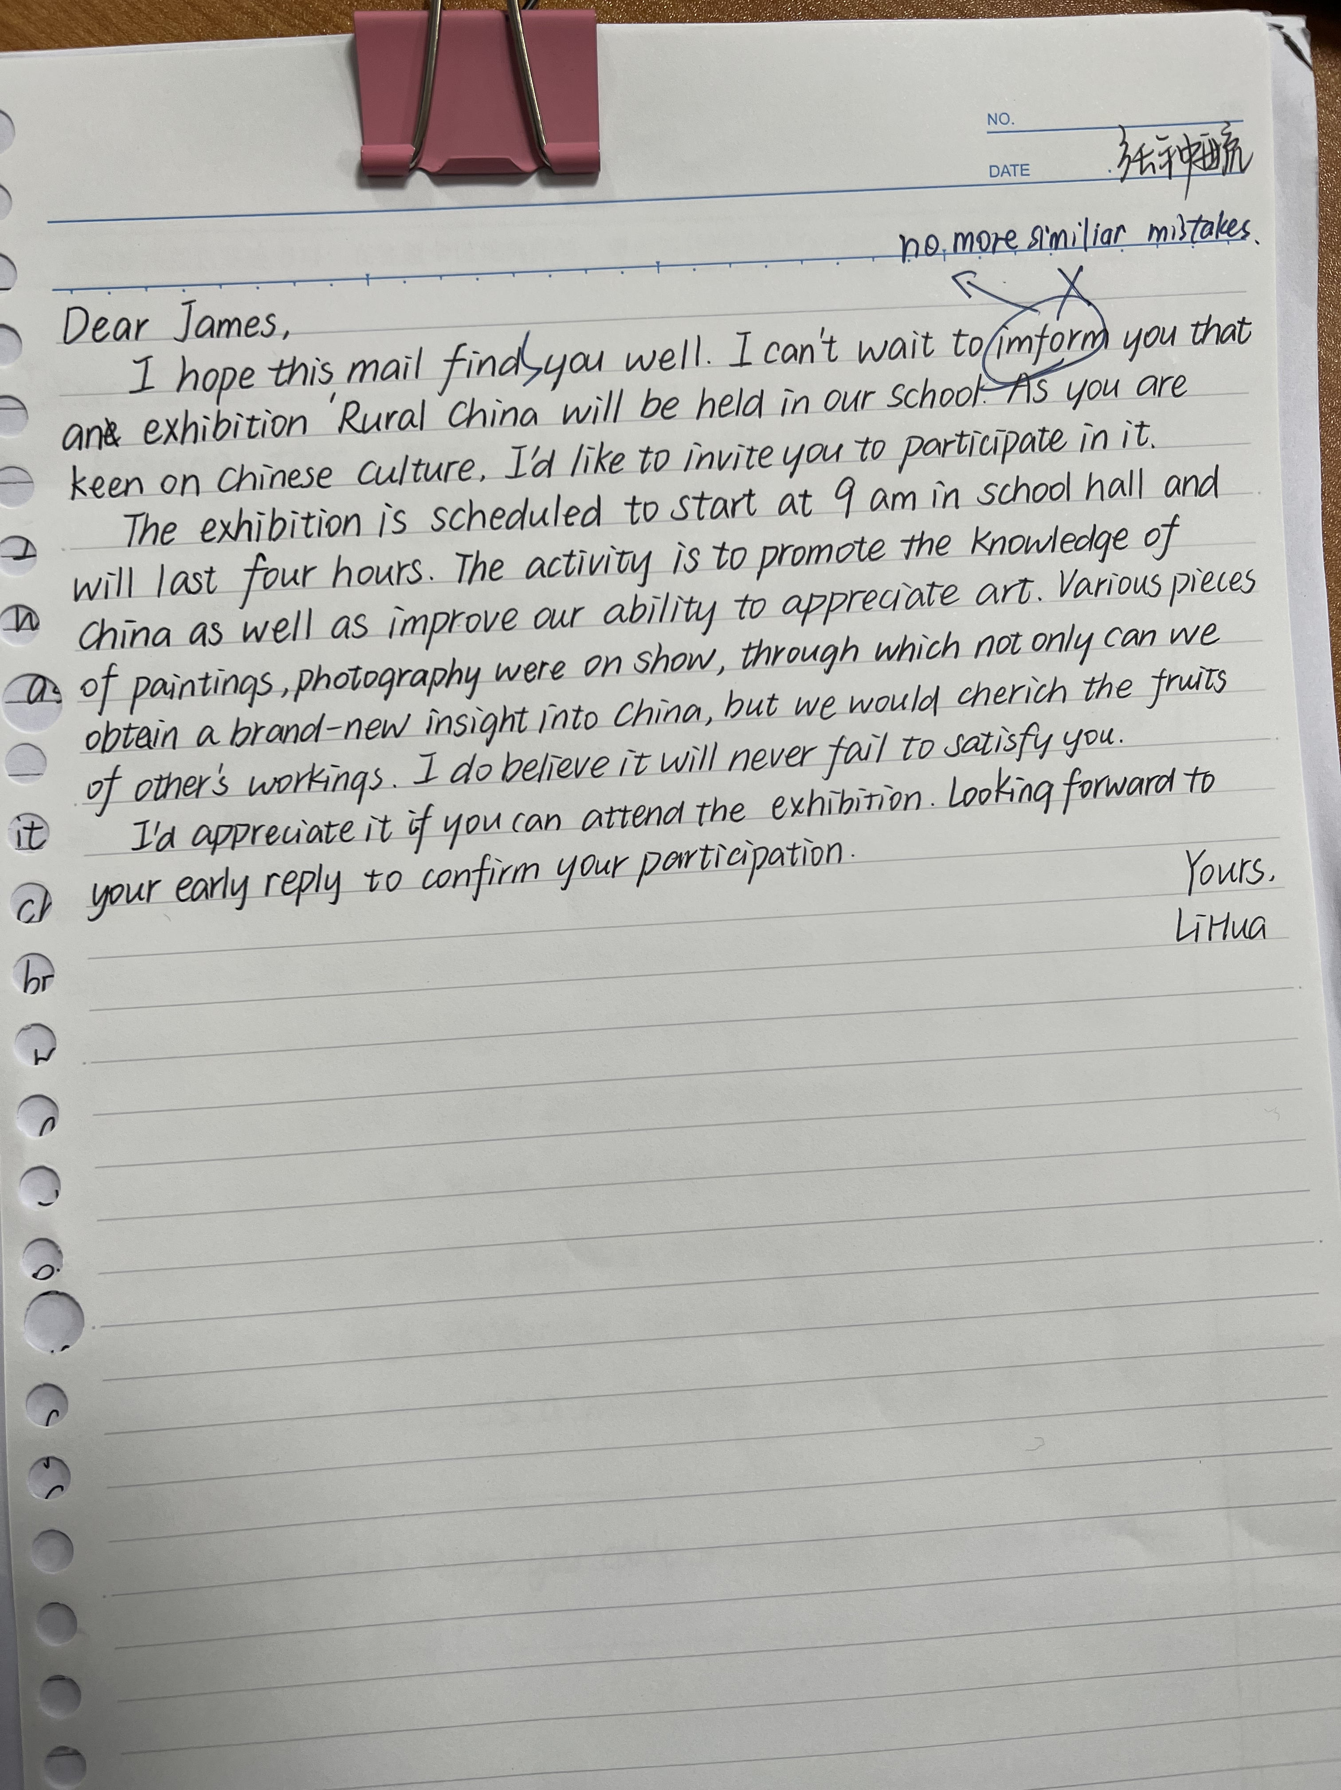
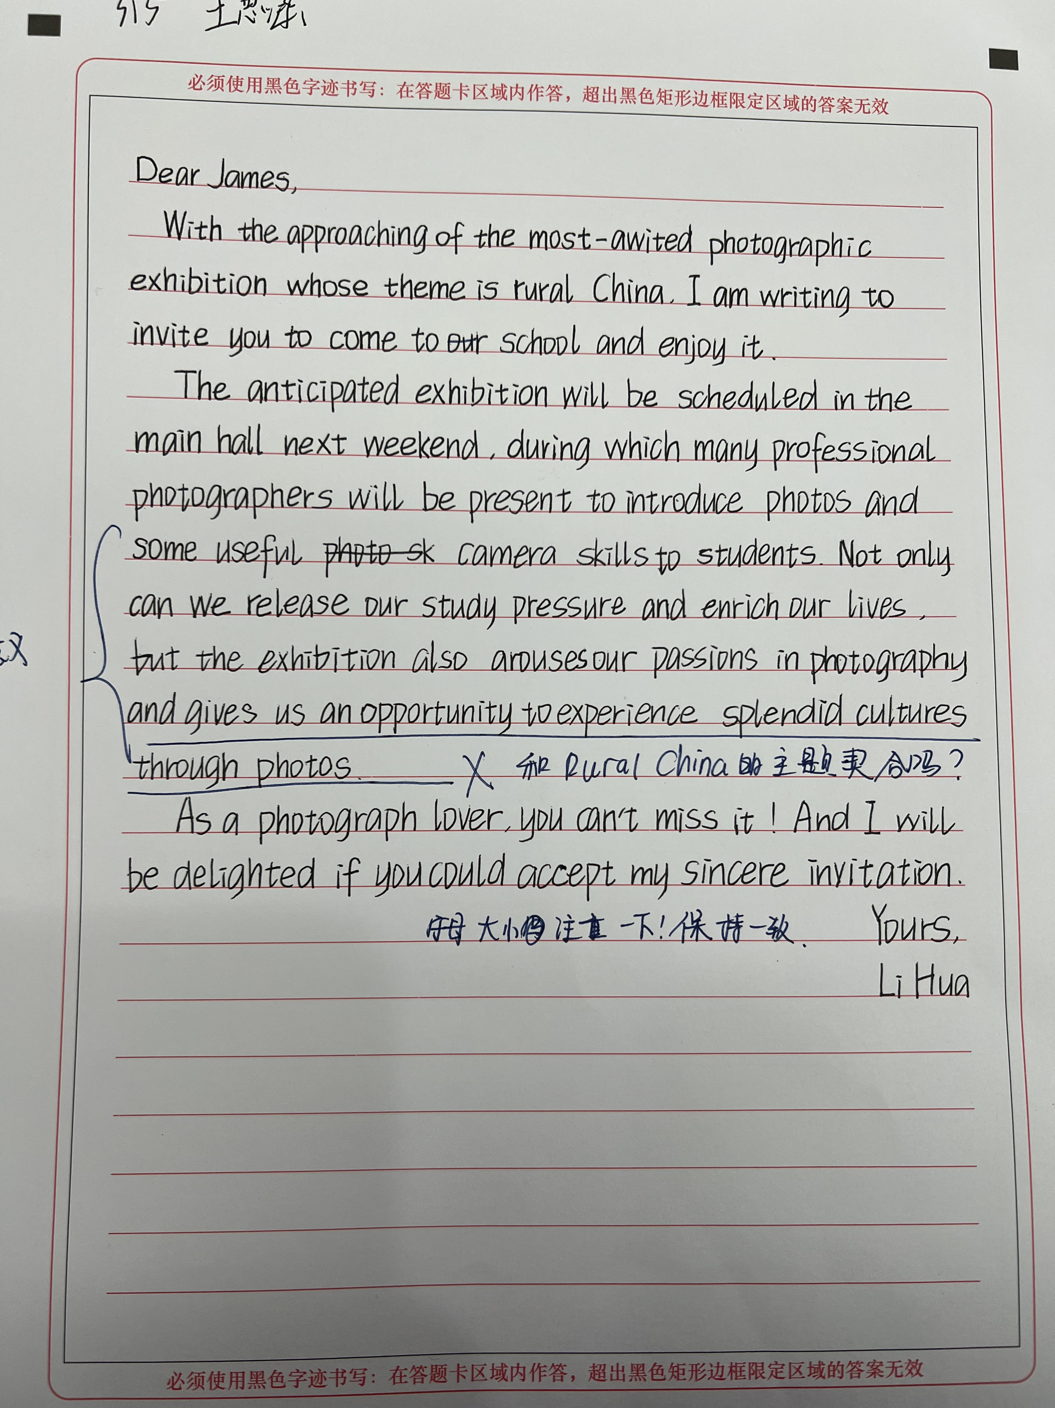
para 2. meaning（学生习作，辩证地分析）

Slide 11
meaning:
The activity is to promote the knowledge of China as well as improve our ability to appreciate art.
...through which not only can we obtain a brand-new insight into China, but we could cherish the fruits of other’s workings.
Not only can we release our study pressure and enrich our lives, but the exhibition also arouse our passions in photography and gives us an opportunity to experience splendid cultures through photos.
问题2：展览的意义和“乡土中国”联系不大
如何修改？

Slide 12
para 2. meaning
para.3 收获与感想：
结合（2023 浙江高考）（共通之处）
认知方面
deepen one’s insight into/understanding of...
raise one’s awareness of...
catch a glimpse of...
expand one’s scope of knowledge of...
cast light on sth...
情感方面
immerse sb in the charm of...
arouse/boost one’s enthusiasm for sth/for doing sth...
fuel/ignite one’s passion for sth...
enrich one’s school life/bring color to...
stimulate one’s interest in...
evoke (/ɪ’vəʊk/勾起) our love for...

Slide 13
para 2. meaning
This exhibition will become a welcome opportunity/precious chance/platform to....
have a glimpse of Chinese folk cultures
deepen understanding of...
lead students to a splendid rural world
encourage us young people to love the ...of the motherland
enhance our cultural confidence
improve aesthetic (美感的；审美的) taste to art
tip2：注意抽象和具体的结合（针对不同主题具体活动具体分析意义）

Slide 14
单词辨析
photograph
1. n. a picture produced using a camera 照片，像片
2. v. to take a picture using a camera 摄影，照相
photography noun [ U ]
the activity or job of taking photographs or filming 摄影；摄影业
e.g. The film won an award for its photography. 该影片获得了一项摄影奖。
photographic /ˌfəʊ.təˈɡræf.ɪk/ adj.
relating to, used for, or produced by photography 摄影的；照相的
e.g. photographic skills 摄影技术

Slide 15
参考范文
Dear James,
News comes that a photography exhibition on “Rural China” is scheduled for this weekend in students’ center. I’m writing to invite you to visit it.
As is advertised, there will be more than 150 exhibits, most of which record and present the unique charm of the landscape as well as traditions in the countryside. Thus, the exhibition serves as a platform, especially for someone so fond of Chinese culture like you, to learn more about the village life and folk culture in China.
This is absolutely a great opportunity you can’t miss. Looking forward to your reply.
Yours,
Li Hua

Slide 16
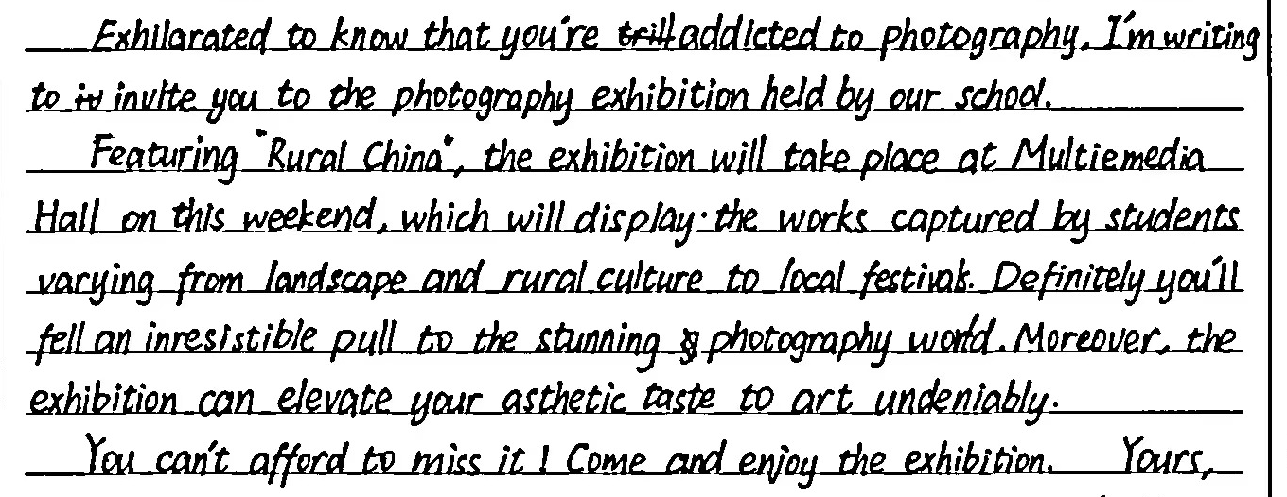
t评析：本篇作文结构层次清晰，要点齐备。应用了现在分词作状语、定语从句、被动语态等多种语法结构，长短句结合，表达自然且多样化。善于运用形容词和副词，如definitely/undeniably, irresistible/stunning/aesthetic，有较强的语言驾驭能力，虽然有个别单词拼写错误，但不影响阅读。

Slide 17
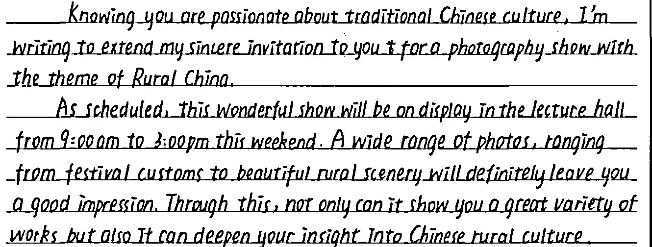
t评析：开头段开门见山，目的清晰明白；主体段语言自然流畅，各种句式运用得心应手；隐形连接运用得体，文本读起来一气呵成。书写优美，印象分加成。

Slide 18
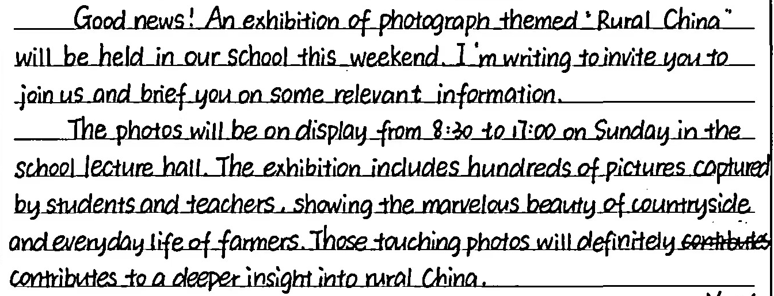
t评析：Para.1 要点全面(背景+目的)；Para.2①要点全面且准确(时间、地点、内容和意义)；②结构紧凑(总起介绍照片来源，现在分词做状语表达照片内容)；总体来说属于中等偏上。

