Slide 1

感恩遇见，相互成就，本课件资料仅供您个人参考、教学使用，严禁自行在网络传播，违者依知识产权法追究法律责任。
更多教学资源请关注
公众号：溯恩高中英语
知识产权声明

Slide 2

The World
February 16th-28th, 2023

Slide 3
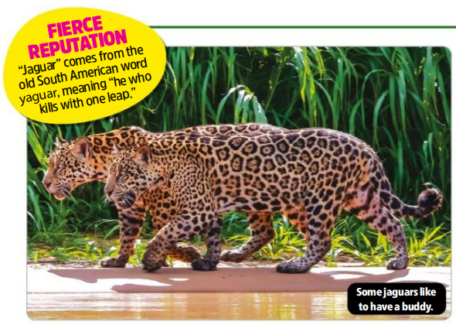
1. Male jaguars become friends
雄性美洲虎竟成好友

Slide 4
语篇填空
（《青少年周刊》 2023年2月17日刊 11页）
Scientists have observed adult male jaguars, who usually like to be alone, forming friendships that can last for ______ (year). Male jaguars don’t usually interact with other jaguars _______ they are mating or fighting over territory. But a recent study found _________ (evident) of the big cats patrolling territories, resting, and eating together.
Researchers gathered information about jaguars across South America ______ (use) tracking devices and camera traps —a camera that ______ (take) a picture when a sensor detects movement. They found two jaguar friendships. One pair in Brazil stayed together from 2006 to 2014. Another pair in Venezuela spent time together from 2013 to 2018. No one knows if they are still together. Other pairs ____________ (spot) too but each was seen only once.
The scientists think these friendships could be a response ___ jaguar habitats being destroyed by humans, which forces more of the animals into _______ (small) areas. The theory is _____ some male jaguars prefer to share territory and potential mates, rather _____ risk losing it all to another male.
years
unless
evidence
using
takes
were spotted
to
smaller
that
than

Slide 5
词汇讲解
1. patrol: to go around an area or a building at regular times to check that it is safe and that there is no trouble 巡逻；巡查
Troops patrolled the border day and night. 军队日夜在边境地区巡逻。
2. sensor: a device that can react to light, heat, pressure, etc. in order to make a machine, etc. do sth or show sth （探测光、热、压力等的）传感器
The electronic sensor has been adapted to fit on a newborn baby. 电子传感器已被改装以适应新生儿。
翻译句子
到处都能见到保安人员在巡逻。
Guards can be seen patrolling everywhere.
翻译句子
保安装置中有一个热传感器，能探测人的存在。
The security device has a heat sensor which detects the presence of people.

Slide 6
句子翻译
Scientists have observed adult male jaguars, who usually like to be alone, forming friendships that can last for years. Male jaguars don’t usually interact with other jaguars unless they are mating or fighting over territory.
科学家们观察到，通常喜欢独处的成年雄性美洲虎，建立了可以持续多年的友谊。雄性美洲虎通常不与其他美洲虎互动，除非他们在交配或争夺领土。
翻译
The scientists think these friendships could be a response to jaguar habitats being destroyed by humans, which forces more of the animals into smaller areas. The theory is that some male jaguars prefer to share territory and potential mates, rather than risk losing it all to another male.
科学家们认为，这种友谊可能是由于人类破坏了美洲虎的栖息地，迫使更多的动物搬到更小的地方。理论是，一些雄性美洲虎更喜欢分享领土和潜在的配偶，而不是冒险把它全部输给另一个雄性。
翻译

Slide 7
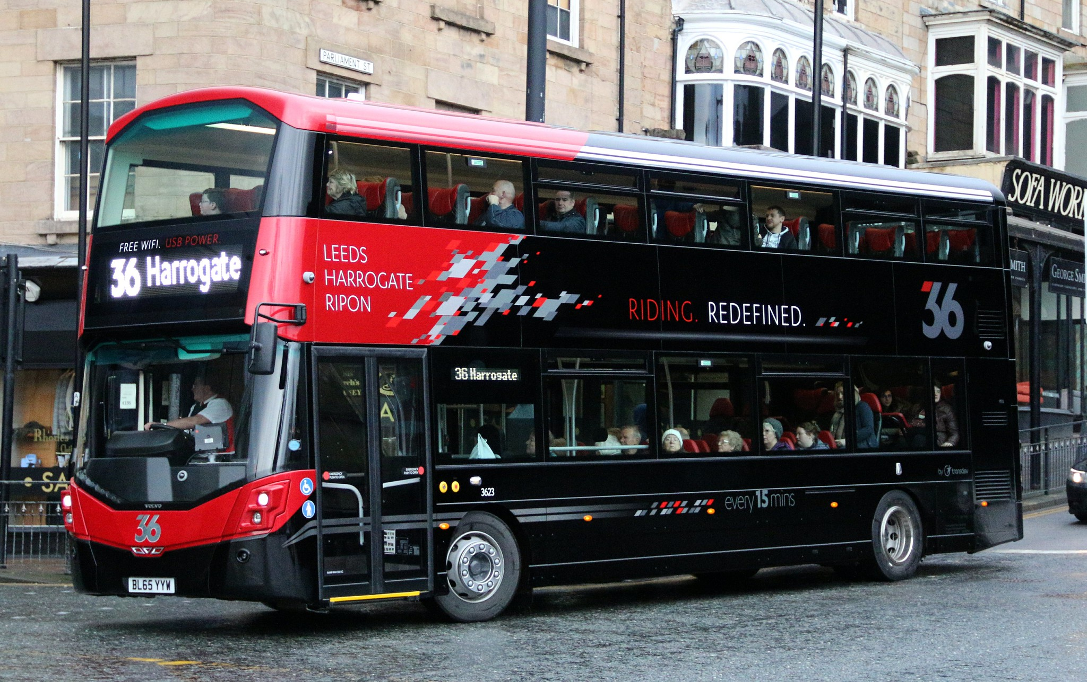
2. Bus fare cap kept at £2 for next three months to support services
未来三月公共汽车票价上限保持在2英镑

Slide 8
语篇填空
（《卫报》 2023年2月18日 12页）
The government has extended a £2 cap on local bus fares in England for another three months, amid concerns ___________ operators would be forced to slash the number of routes on offer without the subsidy. The fare cap, __________ (introduce) initially from January to March, will continue to run from 1 April to 30 June, the Department for Transport said yesterday.
The cap was brought in to encourage people back on to public transport, after passenger numbers ________ (drop) to as low as 10% of 2019 levels during the lockdowns. The first three months of the scheme were expected to prevent 2m car journeys and _____ (they) associated pollution.
Passenger numbers have recovered to about 85% to 90% of pre-Covid-19 levels, ____ government said. ________, that still leaves some bus operators with significant shortfalls in ticket revenues, particularly on less busy routes. Those less lucrative routes are often crucial links for less connected ____________ (community), particularly in rural areas. Campaigners have __________ (previous) raised concerns that they could come under threat when the €2 cap ends.
The _________ (extend) of the cap outside London will cost up to £75m, while the government will spend another £80m _________ (ensure) companies continue to operate routes otherwise threatened with closure.
that / which
introduced
dropped
their
the
However
communities
previously
extension
to ensure

Slide 9
词汇讲解
1. slash: to reduce sth by a large amount 大幅度削减；大大降低
The workforce has been slashed by half. 职工人数裁减了一半。
2. subsidy: money given as part of the cost of something, to help or encourage it to happen 补助金；津贴，补贴
The government is planning to abolish subsidies to farmers. 政府正计划取消对农场主的补贴。
翻译句子
汽车制造商可能会被迫大幅度降价。
Car makers could be forced to slash prices.
翻译句子
他们计划增加对穷人的住房补贴。
They are planning in increase housing subsidies for the poor.

Slide 10
词汇讲解
3. revenue: the money that a government receives from taxes or that an organization, etc. receives from its business 财政收入；税收收入；收益
The company’s annual revenues rose by 30%. 公司的年收入增加了30%。
4. lucrative: producing a large amount of money; making a large profit 赚大钱的；获利多的
Thousands of ex-army officers found lucrative jobs in private security firms. 成千上万的退役军官在私人保安公司找到了薪水丰厚的工作。
翻译句子
日本市场占该公司收入的35%。
The Japanese market accounts for 35% of the company's revenue.
翻译句子
他们在利润丰厚的海外市场上生意很多。
They do a lot of business in lucrative overseas markets.

Slide 11
句子翻译
The government has extended a £2 cap on local bus fares in England for another three months, amid concerns that operators would be forced to slash the number of routes on offer without the subsidy.
政府将英国本地公交票价上限2英镑再延长3个月，原因是担心在没有补贴的情况下，运营商将被迫削减提供的路线数量。
翻译
However, that still leaves some bus operators with significant shortfalls in ticket revenues, particularly on less busy routes. Those less lucrative routes are often crucial links for less connected communities, particularly in rural areas.
然而，这仍使一些公交运营商的票务收入严重不足，尤其是在不太繁忙的线路上。那些利润较低的路线往往是联系较少的社区的关键纽带，尤其是在农村地区。
翻译

Slide 12
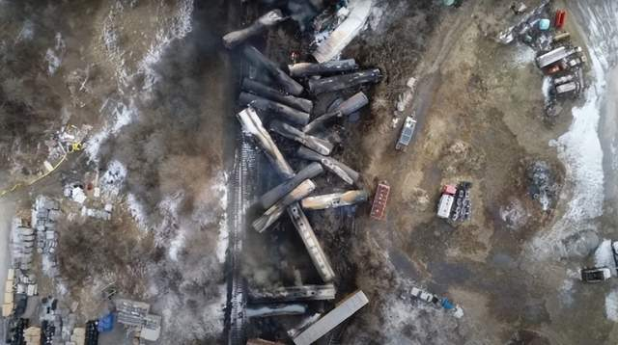
3. Buttigieg to pursue increased maximum fines for railroad safety breaches
布蒂吉格要求提高铁路安全违规的最高罚款

Slide 13
语篇填空
（《华盛顿邮报》2023年2月20日 A5 版面）
Transportation Secretary Pete Buttigieg said in a letter Sunday to Norfolk Southern chief executive Alan Shaw that he would call on Congress ________ (raise) the cap on fines for railroad safety breaches, saying _____ increase was needed to serve as a deterrent to the huge companies __________ dominate the industry.
The current maximum fine is $225,455, according to federal rules. Norfolk Southern’s revenue last year was $12.7 billion.
Buttigieg said the Biden administration ______________(propose) in coming days other rail safety measures in the wake of the derailment of a Norfolk Southern train in East Palestine, Ohio.
“Norfolk Southern and your industry must demonstrate that you will not seek to supercharge
profits by _________(resist) higher standards that could benefit the safety of workers and the safety of American communities,” Buttigieg wrote.
Past rail _________ (incident) have spurred efforts to tighten federal oversight of the industry, steps that major railroads have _________ (typical) lobbied against and often been able to resist, including rules on braking systems and crew size requirements. Buttigieg pointed to that record in his letter, saying it was time for Norfolk Southern to be a _______ (safe) leader. He called on it to adopt “a posture that focuses ____ supporting, not thwarting” safety efforts. Norfolk Southern said it ______________ (review) the letter.
to raise
an
that/which
would propose
resisting
incidents
typically
safety
on
was reviewing

Slide 14
词汇讲解
1. dominate: to control or have a lot of influence over sb/sth, especially in an unpleasant way 支配；控制；左右；影响
he big companies dominate the lower price points.
大公司在低端价格领域占主导地位。
2. revenue: the money that a government receives from taxes or that an organization, etc. receives from its business 财政收入；税收收入；收益
This contract represents 20% of the company's annual revenue. 这份合约相当于公司20%的年收入。
翻译句子
这本书预期将占据畅销书榜首的位置。
The book is expected to dominate the best-seller lists.
翻译句子
如果他们过高地估算，就会损失收入。
If they overestimate, they lose revenue.

Slide 15
词汇讲解
3. spur: to encourage sb to do sth or to encourage them to try harder to achieve sth 鞭策；激励；刺激；鼓舞
This has forced airlines to discount fares heavily in order to spur demand.
这已经迫使多家航空公司对机票大幅打折以刺激需求。
4. lobby: to try to influence a politician or the government and, for example, persuade them to support or oppose a change in the law 游说（从政者或政府）
Farmers will lobby Congress for higher subsidies. 农民将游说国会提高对农业的补贴。
翻译句子
让群众的欢呼声激励你前进。
Let the cheers from the crowd spur you on.
翻译句子
妇女组织在对政府进行游说，要求增加对儿童的拨款。
Women's groups are lobbying to get more public money for children.

Slide 16
句子翻译
Transportation Secretary Pete Buttigieg said in a letter Sunday to Norfolk Southern chief executive Alan Shaw that he would call on Congress to raise the cap on fines for railroad safety breaches, saying an increase was needed to serve as a deterrent to the huge companies that dominate the industry.
翻译
交通部长皮特·布蒂吉格周日在给诺福克南方公司首席执行官艾伦·肖的一封信中说，他将呼吁国会提高铁路安全违规罚款的上限，并表示需要提高罚款来威慑主导该行业的大公司。
Past rail incidents have spurred efforts to tighten federal oversight of the industry, steps that major railroads have typically lobbied against and often been able to resist, including rules on braking systems and crew size requirements.
翻译
过去的铁路事故促使联邦政府努力加强对铁路行业的监管，而主要铁路公司通常会游说反对这些措施，而且往往能够抵制这些措施，包括对制动系统和人员规模的要求。

Slide 17
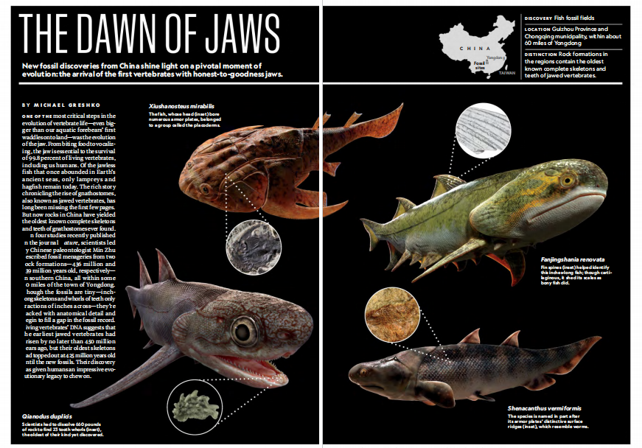
4. The Dawn of Jaws 颌骨的起源

Slide 18
语篇填空
（《国家地理》2023年2月刊 EXPLORE | DECODER 版面）
One of the most critical steps in the evolution of vertebrate life—even bigger than our aquatic forebears’ first waddles onto land—was the evolution of the jaw. From biting food to vocalizing, the jaw is essential to the _______ (survive) of 99.8 percent of living vertebrates, including us humans. Of the jawless fish __________ once abounded in Earth’s ancient seas, only lampreys and hagfish remain today. The rich story chronicling the rise of gnathostomes, also known ___ jawed vertebrates, has long been missing the first few pages. ____ now rocks in China have yielded the oldest ______ (know) complete skeletons and teeth of gnathostomes ever found.
In four studies recently published in the journal Nature, scientists led by Chinese paleontologist Min Zhu described fossil menageries from two rock formations—436 million and 439 million years old, __________ (respective) —in southern China, all within some 60 miles of the town of Yongdong. Though the fossils are tiny—inch-long skeletons and whorls of teeth only fractions of inches across—they _________ (pack) with anatomical detail and begin to fill a gap in the fossil record. _______ (live) vertebrates’ DNA suggests that the earliest jawed vertebrates had arisen by no later than 450 million years ago, but their oldest skeletons had topped out at 425 million years old _____ the new fossils. _____ (they) discovery has given humans an impressive evolutionary legacy to chew on.
survival
that/which
as
But
known
respectively
are packed
Living
until
Their

Slide 19
词汇讲解
1. vocalize: to say or sing sounds or words 说（话）；唱（歌）；哼；发声
In India and Bali students learn to vocalize music before ever picking up instruments.
在印度和巴厘岛，学生们在开始学习乐器之前要先学习唱歌。
2. chronicle: to record events in the order in which they happened
把……载入编年史；按事件发生顺序记载
The series chronicles the everyday adventures of two bachelors. 这个剧按照时间顺序记述了两个光棍每天的奇遇。
翻译句子
你的宝宝在会说话前很早就要开始咿呀发声了。
Your baby will begin to vocalize long before she can talk.
翻译句子
她的成就已载入本周出版的一本新传记中。
Her achievements are chronicled in a new biography out this week.

Slide 20
句子翻译
In four studies recently published in the journal Nature, scientists led by Chinese paleontologist Min Zhu described fossil menageries from two rock formations—436 million and 439 million years old, respectively —in southern China, all within some 60 miles of the town of Yongdong.
翻译
在最近发表在《自然》杂志上的四项研究中，由中国古生物学家朱敏领导的科学家描述了来自中国南方两个岩层的化石动物园——分别是4.36亿年前和4.39亿年前，它们都在永东镇60英里范围内。
Living vertebrates’ DNA suggests that the earliest jawed vertebrates had arisen by no later than 450 million years ago, but their oldest skeletons had topped out at 425 million years old until the new fossils.
翻译
现存脊椎动物的DNA表明，最早的下颚脊椎动物出现在不晚于4.5亿年前，但新化石出现之前，发现的最古老的骨架只在4.25亿年前。

Slide 21
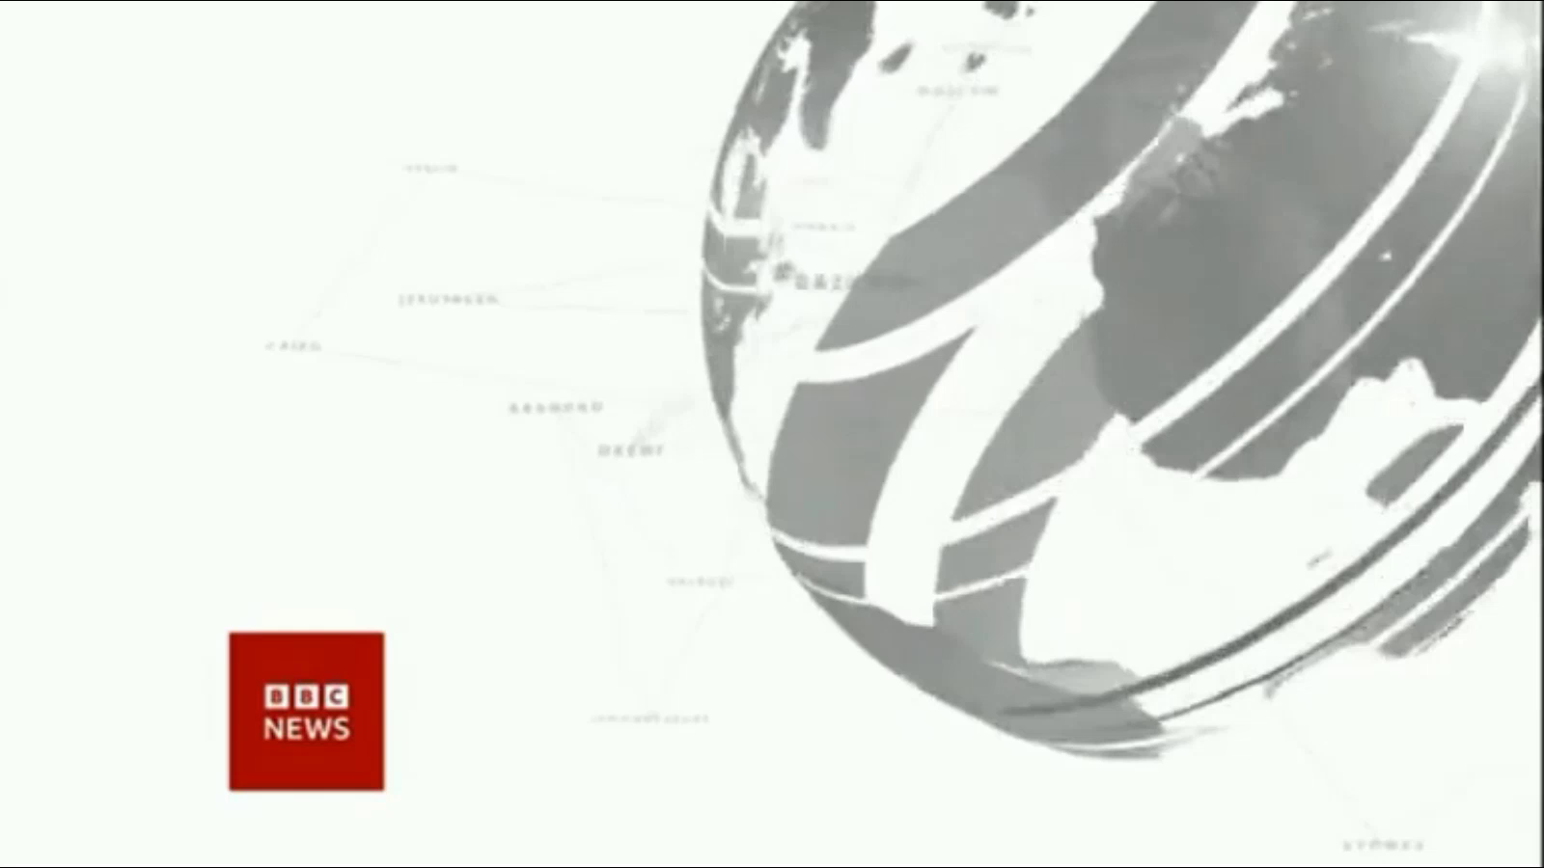
5. BBC One-minute World 02/20/2023

Slide 22

听力填空
This is BBC world news, the headlines.
U.K. Prime Minister Rishi Sunak is to urge world leaders to ___________ on military support for Ukraine in a speech to the Munich Security Conference. He’ll say allies must give the country advanced NATO standard __________.
Rishi Sunak has flown to that conference from Belfast as __________ grows that a deal is close on post-Brexit trading arrangements in Northern Ireland after well over a year of ___________ between the U.K. and the EU.
Rescue teams pull three people out _____ from under collapsed buildings in Turkey, almost two weeks after the quakes that killed more than 45,000 people, leaving millions homeless and sparking a huge __________.
A Qatari consortium has _________ a bid to buy Manchester United.
BBC Sport understands that a _____ bid was also tabled by INEOS owned by the British billionaire Sir Jim Ratcliffe.
double down
capabilities
speculation
negotiations
alive
relief effort
submitted
rival

Slide 23
词汇讲解
1. double down (on sth): to continue to do something in an even more determined way than before 做某事更顽强，更坚定
The administration needs to double down on the call for political reform.
政府需要在政治改革的呼吁上加倍努力。
2. speculate: (about/on sth) to form an opinion about sth without knowing the details or facts 推测；猜测；推断
Critics of the project speculate about how many hospitals could be built. 对该项目持批评态度的人在推测不知可以建多少所医院。
翻译句子
我们应该加倍努力鼓励储蓄。
We should double down on efforts to encourage saving.
翻译句子
我们大家都推测过她辞职的原因。
We all speculated about the reasons for her resignation.

Slide 24
句子翻译
Rishi Sunak has flown to that conference from Belfast as speculation grows that a deal is close on post-Brexit trading arrangements in Northern Ireland after well over a year of negotiations between the U.K. and the EU.
翻译
在英国和欧盟进行了一年多的谈判后，越来越多的人猜测北爱尔兰的后脱欧贸易安排即将达成协议，此时里希·苏纳克从贝尔法斯特飞往会议现场。
Rescue teams pull three people out alive from under collapsed buildings in Turkey, almost two weeks after the quakes that killed more than 45,000 people, leaving millions homeless and sparking a huge relief effort.
翻译
土耳其地震发生近两周后，救援队从倒塌的建筑物下救出三人，地震造成超过4.5万人死亡，数百万人无家可归，引发了大规模的救援工作。

