Slide 1

感恩遇见，相互成就，本课件资料仅供您个人参考、教学使用，严禁自行在网络传播，违者依知识产权法追究法律责任。
更多教学资源请关注
公众号：溯恩高中英语
知识产权声明

Slide 2
2023届十校联考
读后续写
April Fools’ Day

Slide 3
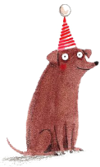
April Fools’ Day
Nat woke early and jumped out of bed. Today was the best day of the year for him. Nat loved to play tricks, and today was April Fools’ Day.
Some of Nat’s tricks were big hits. Last year, he short-sheeted his sister’s bed. She couldn’t understand what was going on and started to think that her legs must have grown much longer during the day. When she realized what had happened, she laughed her head off.
Some of Nat’s tricks were not so successful. Mom didn’t think finding a furry toy mouse in the fridge was humorous at all. After she calmed down a bit, she said, “That’s it! There’s a ban on Nat tricks for two weeks.”
Nat was also the class clown. He was always making jokes in class. He liked it when he made the other kids laugh. Since it was April Fools’ Day, he felt like he had to come up with something really good to provide his classmates with some really good entertainment.
For that, Nat thought long and hard before he came up with his brilliant idea. He bought two toy frogs which were made out of green plastic and looked very realistic. Nat knew just the trick he would play on his classmates.
Nat arrived at school early. To succeed in his plan, he needed to get into the classroom before anyone else. Nat's class had a rainforest terrarium (饲养皿). It had plants, insects, and three frogs in it. Nat's idea was to pretend that the frogs had escaped. He knew that Ms. Lopez, his teacher,wasn't afraid of frogs but several of his classmates, including himself, were.
Nat slipped into the classroom. Good! There was nobody here. He put one of the toy frogs on the floor, near the terrarium and the other on his friend Stacey’s desk. Nat knew that Stacey really didn’t like frogs. Also, she played a great trick on him last April Fools’ Day. To make his trick more convincing, Nat pushed the lid of the terrarium open. Then he rushed off to morning gathering.
para1. When the students got back to class, no one noticed the toy frogs at first.
para2. Nat realized that he had opened the lid of the terrarium.

Slide 4
Questions
Nat woke early and jumped out of bed. Today was the best day of the year for him. Nat loved to play tricks, and today was April Fools’ Day.
Nat was also the class clown. He was always making jokes in class. He liked it when he made the other kids laugh. Since it was April Fools’ Day, he felt like he had to come up with something really good to provide his classmates with some really good entertainment.
For that, Nat thought long and hard before he came up with his brilliant idea.
He knew that Ms. Lopez, his teacher,wasn't afraid of frogs but several of his classmates, including himself, were.
Nat knew that Stacey really didn’t like frogs. Also, she played a great trick on him last April Fools’ Day.
1. 本文的主要人物有哪些？从原文对人物的描述可以推出他们的性格是什么？有任何伏笔吗？
2. 文中一共出现几只青蛙？几只真几只假？
3. 从第一段段首句可以推出第一段的情节是什么？
4. 原文最后一段“Nat pushed the lid of the terrarium open”和第二段段首句可以推出第一段结尾应该停在什么地方？
5. 班级里这场恶作剧是如何收场的？
6. Nat通过这次事件明白了什么？/ending？
伏笔：
himself：最后“弄巧成拙”，搬起石头砸自己的脚
Ms. Lopez：不怕青蛙，可以安排收拾残局

Slide 5
Questions
1. 本文的主要人物有哪些？从原文对人物的描述可以推出他们的性格是什么？有任何伏笔吗？
2. 文中一共出现几只青蛙？几只真几只假？
3. 从第一段段首句可以推出第一段的情节是什么？
4. 原文最后一段“Nat pushed the lid of the terrarium open”和第二段段首句可以推出第一段结尾应该停在什么地方？
5. 班级里这场恶作剧是如何收场的？
6. Nat通过这次事件明白了什么？/ending？
He bought two toy frogs which were made out of green plastic and looked very realistic.
Nat’s class had a rainforest terrarium (/təˈreə.ri.əm/饲养皿). It had plants, insects, and three frogs in it.

Slide 6
Questions
1. 本文的主要人物有哪些？从原文对人物的描述可以推出他们的性格是什么？有任何伏笔吗？
2. 文中一共出现几只青蛙？几只真几只假？
3. 从第一段段首句可以推出第一段的情节是什么？
4. 原文最后一段“Nat pushed the lid of the terrarium open”和第二段段首句可以推出第一段结尾应该停在什么地方？
para1. When the students got back to class, no one noticed the toy frogs at first.
para2. Nat realized that he had opened the lid of the terrarium.
para1. main plots
Stacey was scared.
Nat with a smug expression
shoot himself in the foot
停留在scared的那一刻，意识到不对劲的那一秒
“惊悚定格”
....“A toy?” Everyone stopped laughing after noticing it, including Nat.

Slide 7
plots in para2.
para2. main plots
Nat was scared.
Ms. Lopez appeared as if she was a savior (Nat was tricked by Stacey again也可,注意描写的合理性)
ending/theme
主题不可忽视，不可虎头蛇尾
较少有续写无主题

Slide 8
Questions
Nat woke early and jumped out of bed.
He liked it when he made the other kids laugh. Since it was April Fools’ Day, he felt like he had to come up with something really good to provide his classmates with some really good entertainment.
1. 本文的主要人物有哪些？从原文对人物的描述可以推出他们的性格是什么？有任何伏笔吗？
2. 文中一共出现几只青蛙？几只真几只假？
3. 从第一段开头句可以推出第一段的情节是什么？
4. 原文最后一段“Nat pushed the lid of the terrarium open”和第二段段首句可以推出第一段结尾应该停在什么地方？
5. 班级里这场恶作剧是如何收场的？
6. Nat通过这次事件明白了什么？/ending？
出发点是好的
happy ending or bad ending?
what’s the role of the teacher? (a role to apply punishment?)
是否能和前文进行协同？
On this April Fools’ Day, everyone gained a wonderfully playful experience...
“Ha, what a magic!” Ms. Lopez smiled, realizing what had happened.
“It was still a successful trick, though a bit terrifying.” Nat thought....

Slide 9
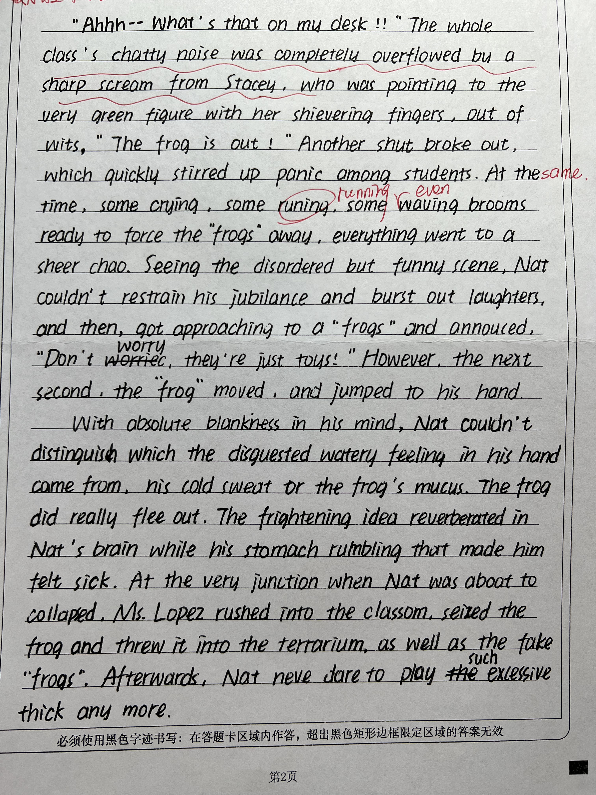
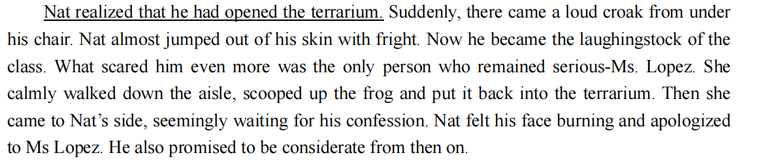
How does the story end?
一颗冉冉升起的开心果星在此陨落
Some of Nat’s tricks were not so successful. Mom didn’t think finding a furry toy mouse in the fridge was humorous at all. After she calmed down a bit, she said, “That’s it! There’s a ban on Nat tricks for two weeks.” （可参照原文）
How do you think of the ending above?

Slide 10
problems
1. 重点描写放在某一无名的学生
Suddenly the toy frog that on the floor was noticed by a cowardly little girl.
2. Mr. Lopez出场的过早（形象过差）
para1. Looking at the chaoic classroom, the teacher sighed, walked into the classroom with great courage. She calmed girls who were crying...
“Who opened the lid of the....?” full of anger in her voice.
3. 两段之间的衔接
4. plot设计(原文没有给出任何线索)
Stacey也准备了假青蛙吓Nat

Slide 11
词汇小积累
搞恶作剧
play/pull a (funny) prank
be up to sth.
be off doing sth. (be off pulling a funny prank) 不做...
突然大笑起来：
burst into laughter/laughing?
burst out laughter/laughing?
burst into laughter/tears/song
burst out laughing/crying

Slide 12
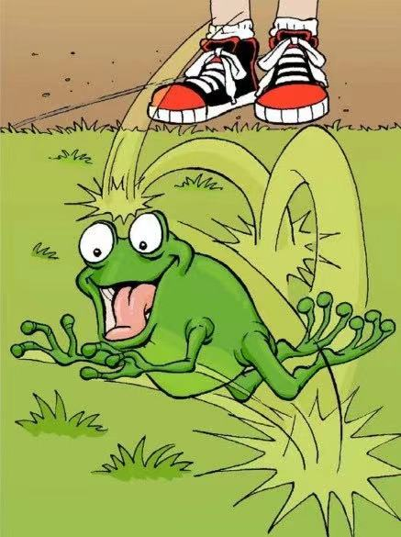
词汇小积累
hop away -pp
1.（鸟、兽或昆虫）蹦跳
The rabbit/bird hopped across the grass. 兔子／鸟蹦跳着穿过草地。
2. to jump on one foot or to move about in this way 单脚跳
I tried to hop on my good foot while holding onto Jim. 我抓住吉姆，并用我的那只好脚努力向前跳。

Slide 13
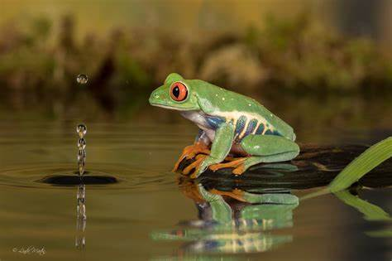
词汇小积累
扑通一声跳回水中
plop into the water
-pp
呱呱叫
croak n./v /kroʊk/
Thousands of frogs croaked in the reeds (芦苇) by the riverbank.
...the guttural ( /ˈɡʌt.ər.əl/喉咙里发出的) croak of the frogs

Slide 14
青蛙小常识
1. A frog has smooth, moist skin and big, bulging ([ˈbʌldʒɪŋ]鼓起的；隆起的) eyes.
e.g. Suddenly, Nat touched something smooth, something different, something unexpected!
2. A frog catches prey by flicking out (猛然伸出) its long, sticky tongue.

Slide 15
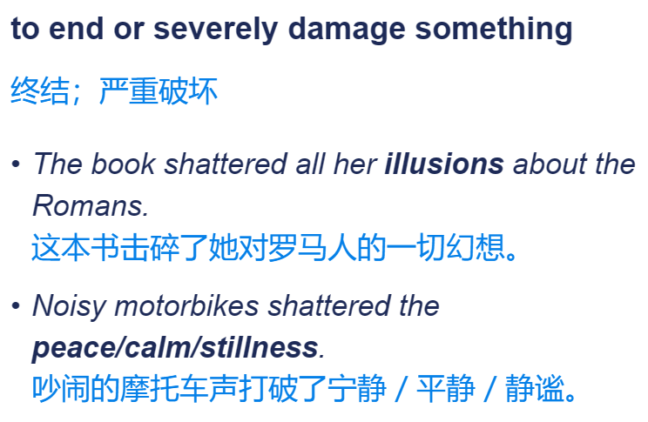
possible version
When the students got back to class, no one noticed the toy frogs at first. “OH MY GOD!” A screaming from Stacey shattered (打破) the students’ laughing and talking, after which another scream arrived from the direction where the other frog was. Immediately, the whole classroom was tossed in an uproar(骚动). Looking at the big play he directed, Nat beamed with a wicked (顽皮的；恶作剧的) glint (/ɡlɪnt/光芒) in his eyes, and then he shouted satisfactorily, “Happy April Fools’ Day!” “Nat, it’s coming to you!” Stacey’s voice answered him. “No way! This is your trick for me this year?” Just then, he saw something greenish streaking away. Eyes following, finally he met a pair of bulging eyes, whose owner then greeted him with a croak. “OH MY GOD!”

Slide 16
possible version
Nat realized that he had opened the lid of the terrarium. It was Nat’s turn to scream. Some “frog-resistant” students had begun their “pursue and capture” while some ran for their savior, Ms. Lopez. After a great work, Ms.Lopez closed the lid of the terrarium in which all the three frogs were taking a rest. The “survivors” turned to the “culprit”(/ˈkʌl.prɪt/肇事者，罪魁祸首), who lowered his head like a wilted flower. “What are you thinking?” Stacey’s voice sounded strange due to the former scream. “I just want to make everyone laugh.” Ms. Lopez paused, and said, “But you should place the trick within the safe line.” Then Nat apologized for his misbehavior. Stacey waved her hand generously, “What a ‘Frogs’ Day’!” They looked at each other, and then burst into laughter simultaneously, “Happy April Frogs’ Day!”

Slide 17
参考语料及句型
一声尖叫(high-pitched scream) 刺破了教室的安静(pierce)，伴随着大家的视线都被吸引到(with...arrested to) 惊慌失措的(panic)Stacey身上。
A high-pitched scream pierced the silence of the room, with everyone’s attention/ sight arrested to the Stacey who was in a total panic.
僵了(stiffened/ rooted to the spot like a statue)几秒钟之后，人群因惊恐而爆发出(explode)大叫声，整个班级处于一片混乱(in chaos)。
Stiffened to the spot like a statue for several seconds, the crowd exploded with a burst of cry, the whole class being in a total chaos.
Nat难以置信地(in disbelief)快速扫了一眼(cast a quick glance at)乱糟糟的教室，不敢相信自己的恶作剧竟然如此成功。他立即咬住(nibble)自己的下唇，以抑制即将爆发的笑声(threaten to erupt)。
Nat cast a quick glance at the messy room in disbelief, unable to convince himself of the success. He nibbled at his lower lip right away to hold back the laughter that was threatening to erupt.

