Slide 1

感恩遇见，相互成就，本课件资料仅供您个人参考、教学使用，严禁自行在网络传播，违者依知识产权法追究法律责任。
更多教学资源请关注
公众号：溯恩高中英语
知识产权声明

Slide 2
Unit 2 Morals And Virtues 道德与美德
Part 1 Listening and Speaking

Slide 3

Brainstorm
1. What do you think the teenagers in the picture are ding?
They are doing teamwork.
2. What qualities do you think are most important when people are doing teamwork?

Slide 4
2.What qualities do you think are most important when people are doing teamwork?
generosity
____________
responsibility
___________
friendship
____________
___________
hope
trust
_______________
Qualities
giving
_______________
helpfulness
___________
______________
kindness
caring
________________
_______________
thankfulness

Slide 5

lead-in
The best portion of a good man’s life is his little, nameless, unremembered acts of kindness and love.
-William Wordsworth
一个好人一生中最美好的部分就是他那小小的、无名的、不为人知的善良和爱的行为。
-威廉.华兹华斯
virtue---the best portion
portion n. 部分; (食物的)一份，一客; 分享的部分; 分担的责任;

Slide 6
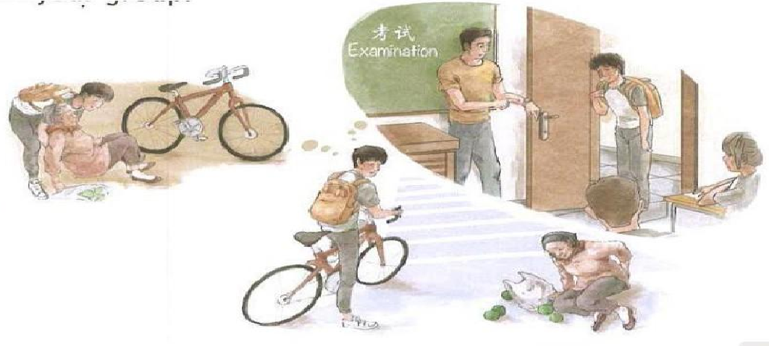
What happened?
Pre-listening: make a story
Work in pairs and try to tell your partner the story

Slide 7

Pre-listening
The boy sees an old woman who has fallen down on the street. She needs help getting up, but if he stops to help her, he might be late for school and get scolded by his teacher.

Slide 8

If you were the boy, would you help the old woman?
Pre-listening: discussion
Moral Dilemmas
道德困境

Slide 9
Pre-listening: discussion
Moral Dilemmas
道德困境
A situation in which you have two or more difficult choices to make. If you choose one, you might get in trouble for not choosing the other(s).
Now we will watch a video and discuss the moral dilemmas in the video.

Slide 10
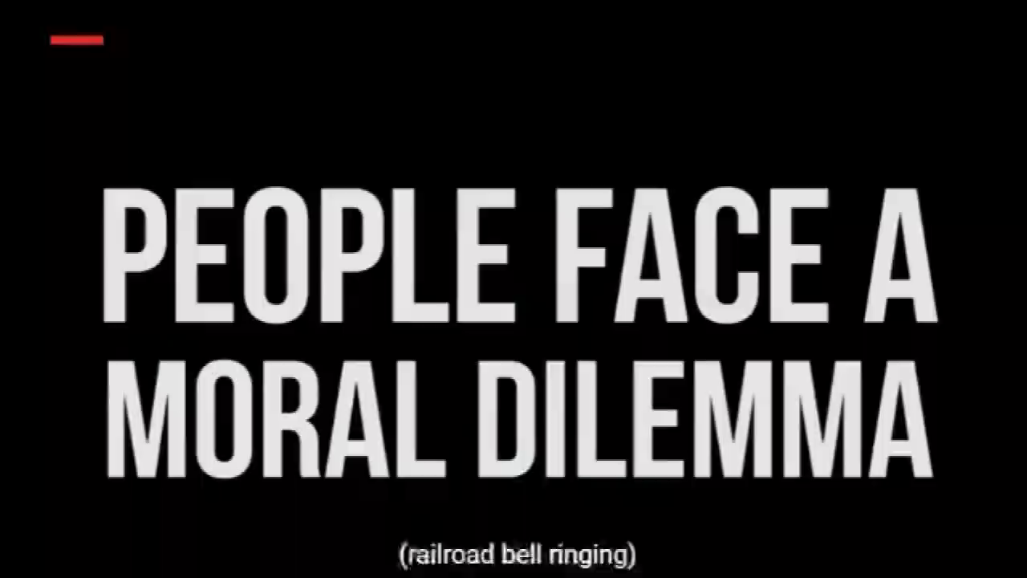

Slide 11

P14 E2: Listen to the conversation and complete the table to describe the moral dilemma that Jane is talking about.
Situation | The girl is taking the entrance examination for ____________ ________________ in Beijing. During the exam, the student next to her fainted.
The girl’s choices | She can ____________. | or | She can __________________.
Possible results | ______________________________, but ____________________________________. |  | ________________________________________, but ____________________________________________.
a famous
medical university
finish the exam
stop and help the girl
She will get into medical university
She can put the needs of the other person first
the girl might not get the help she needs
give up her chance to get into the medical university

Slide 12
P14 E3: Listen again and decide whether the statements are T or F.
1. Jane is eager to share the magazine article with Luke.
2. Luke doubts that young people face moral dilemmas
all the time.
3. Jane admires what the girl in the story did.
4. Luke doesn’t believe anybody would do what the girl
in the story did.
5. Jane wonders how the girl became a doctor later.
T
T
T
T
F

Slide 13
1. Jane is eager to share the magazine article with Luck.
2. Luck doubts that young people face moral dilemmas
all the time.
3. Jane admires what the girl in the story did.
4. Luck doesn’t believe anybody would do what the girl
in the story did.
5. Jane wonders how the girl became a doctor later.
be used to describe attitudes

Slide 14
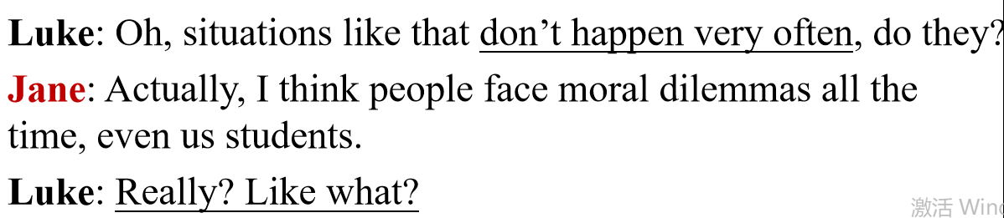
Tips:
1. Pay attention to the words speakers use (passive
or positive or objective).
2. Pay attention to HOW the speakers is talking.
1. Jane is eager to share the magazine article with
Luck.
2. Luck doubts that young people face moral dilemmas
all the time.
T
T

Slide 15
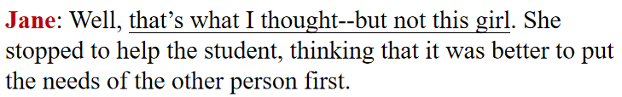

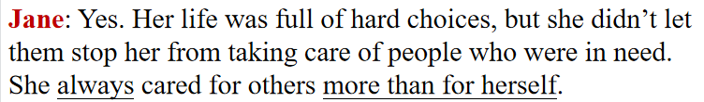
T
3. Jane admires what the girl in the story did.
4. Luck doesn’t believe anybody would do what the girl in the story did.
5. Jane wonders how the girl became a doctor later.
T
F

Slide 16
P15 E4: Listen to the conversation carefully and answer the questions.
1) What did the girl do to help the student?
looked after
carried the student
She ____________ to a safe place and ______________ her. Then she went to _________________ with the student and called her sister.
the hospital
2) What was the girl's name? What was she famous for?
Lin Qiaozhi
Her name was _____________. She later became_______________. She was famous for caring for tens of thousands of ____________________.
a great doctor
women and their babies
3) What did Jane say about the girl's life?
hard choices
Her life was full of _______________ but she didn't let them stop her from taking care of people who were ___________. She always ______________ others more than for herself.
in need
cared for

Slide 17
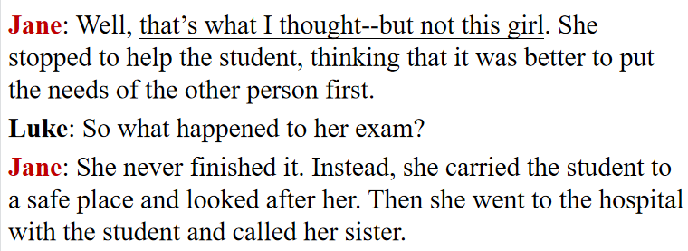
P15 E4: Listen to the conversation carefully and answer the questions.
What did the girl do to help the student?

Slide 18

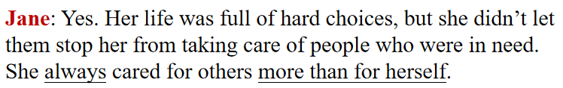
What was the girl’s name? What was she famous for?
What did Jane say about the girl’s life?

Slide 19
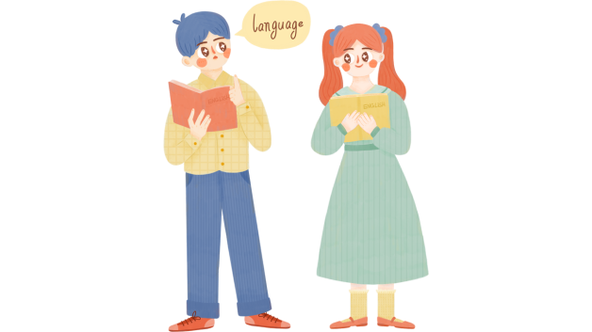
Group Work： Speaking
P15 Exercise5: Talk about what you would do if you were ever faced with the same situation as the girl. Then share your thoughts with your group, and explain the reasons for your choice.
EXAMPLE
A: If I were ever in a situation like the girl faced, I think I would
choose to …
B: Why? Are you sure?
A: Because I think that … is most important. What about you?
B: I think I would …

Slide 20
Group Work： Speaking
Apart from helping the student and finishing the exam, is there a third choice?Can you think of better ways to handle the dilemma?
In my opinion/view ...
Generally speaking, ….
Personally, I don't have the faintest idea about ...
To my mind ...
I'd just like to say ...
As far as I'm concerned ...
To be honest/frank ...
If you ask me ...

