Slide 1

感恩遇见，相互成就，本课件资料仅供您个人参考、教学使用，严禁自行在网络传播，违者依知识产权法追究法律责任。
更多教学资源请关注
公众号：溯恩高中英语
知识产权声明

Slide 2


Rhetorical Devices & Vocabulary
浙江省临安中学 王瑛

Slide 3

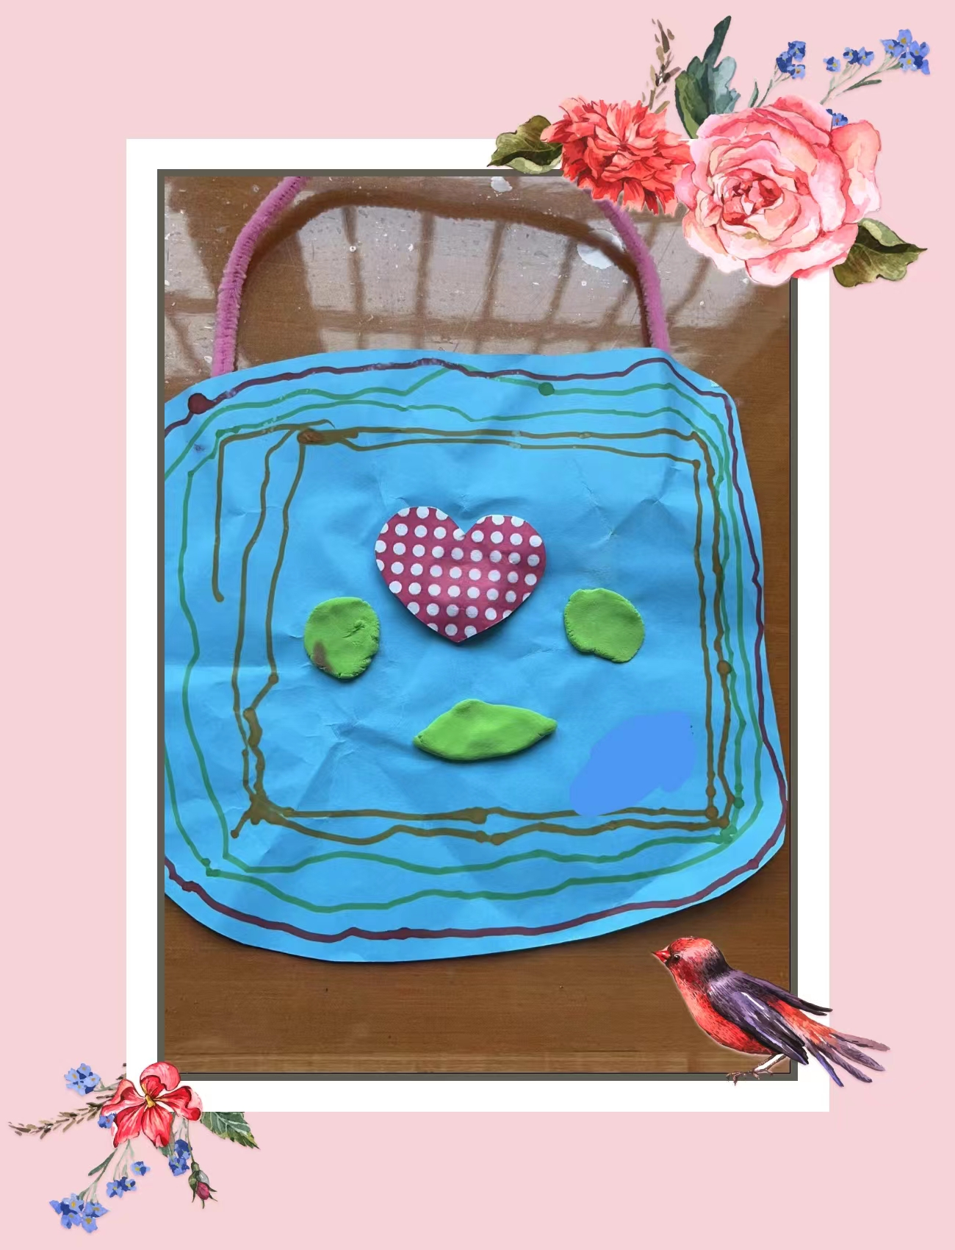
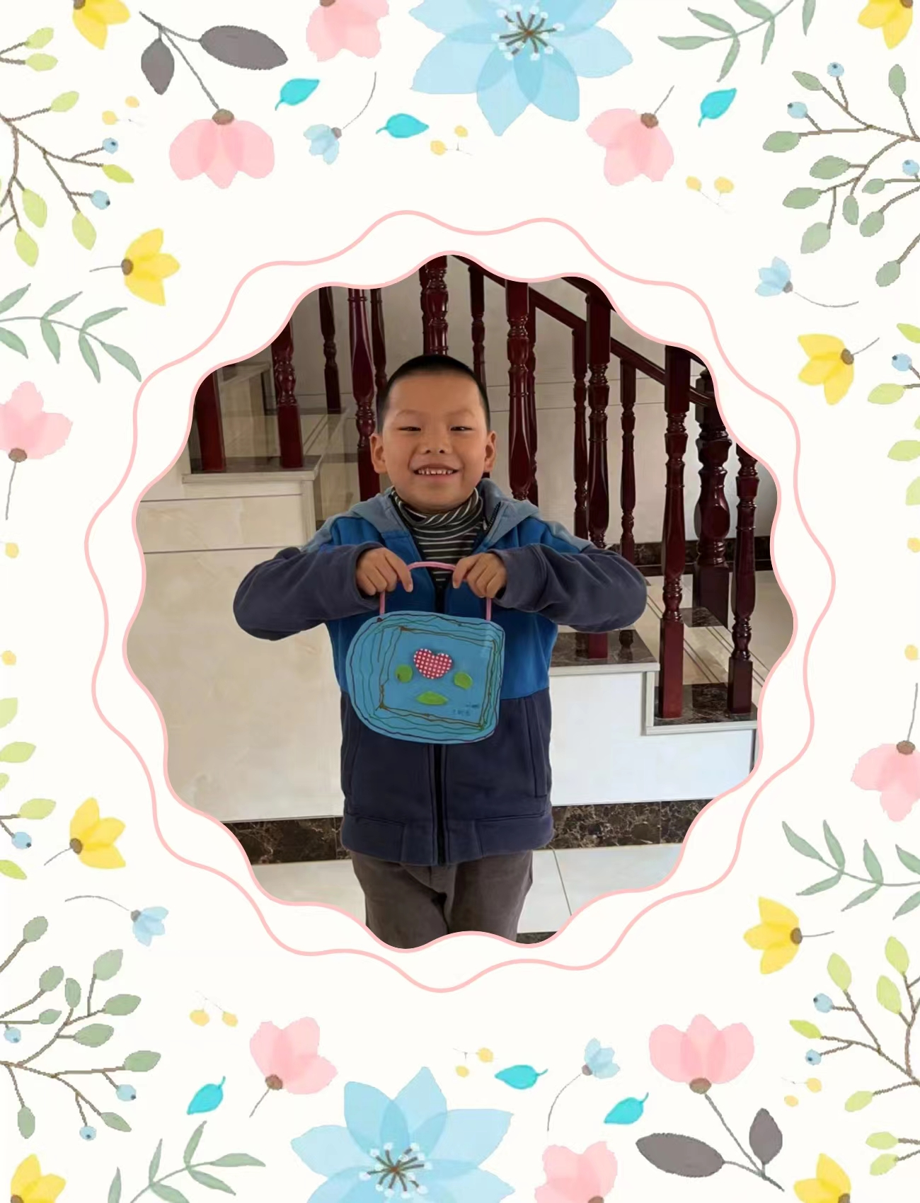
delighted; touched
merry; moving
warm my heart and day

Slide 4
delighted
thrilled, disappointed,
concerned, amused, scared, satisfied, etc.
-ed
touched
......
Rhetorical Devices
(修辞)
thumb
th-
theory, thrill, throat,
through, thunder, etc.
theme
......
the class
warm
my day
......

Slide 5
Appreciation
What do the sentences have in common in each group? (A--D)
Group A:
1. She has a pair of big bright eyes, blinking as if they can speak.
2. A breeze brought him the smell of clover--the sweet-smelling world beyond his fence.
......
Group B:
1. Things went as planned and as usual, cheerfully but not surprisingly.
2. Once the helicopter landed, we got onto it in no time, excited and relieved.
......
Group C:
1. The first wealth is health.
2. No pains, no gains.
......
Group D:
1. It was a pleasant and memorable trip, full of giggles along the way because of my
forgetful mom.
2. With an angry roar, the bear ran to the lake to wash his eyes.
......

Slide 6
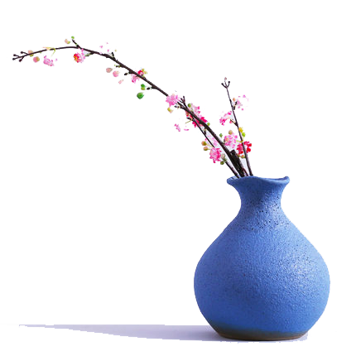
Alliteration (头韵)
Group A:
1. She has a pair of big bright eyes, blinking as if they can speak.
2. A breeze brought him the smell of clover—the sweet-smelling world
beyond his fence.
3. It was a pleasant and memorable trip, full of grins and giggles along
the way because of my forgetful mom.
4. Finding his friends safe and sound, Mac finally breathed a sigh of
relief.
5. As Elli and I cooked dinner, a young male polar bear who was playing
in a nearby lake sniffed and smelled our garlic bread.
6. When the first gosling poked its grey green head through the goose’s
feathers and looked around, Charlotte made the announcement.
big bright blinking
breeze brought
sweet smelling
grins giggles
safe sound
sniffed smelled
grey green

Slide 7

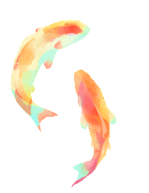
Consonance (尾韵)
Group B:
1. Things went as planned and as usual, cheerfully but not surprisingly.
2. Once the helicopter landed, we got onto it in no time, excited and relieved.
3. Tom hugged Jane tightly and kissed her lovingly, apologizing for his huge
mistake.
4. So I approached our uninvited guest slowly and cautiously, through the
fence, sprayed him in the face.
5. This was almost more than Wilbur could stand: on this dreary, rainy day
to see his breakfast being eaten by somebody else.
6. The spider, however, stayed wide awake, gazing affectionately and mildly
at Wilbur and making plans for his future.
cheerfully surprisingly
excited relieved
tightly lovingly
slowly cautiously
dreary rainy
affectionately mildly

Slide 8
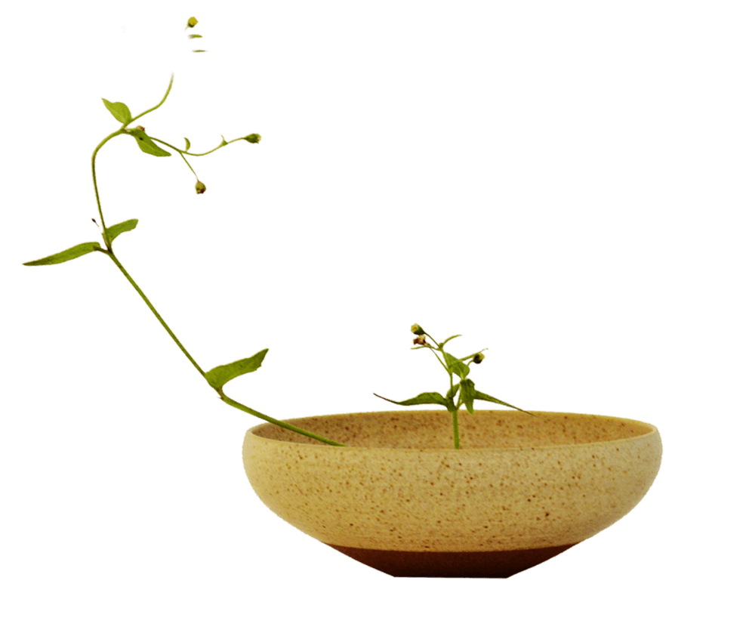
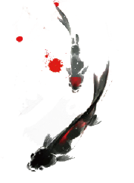
Assonance (半协音/元韵)
Group C:
1. The first wealth is health.
2. No pains, no gains.
3. As you sow you shall mow.
4. All roads lead to Rome.
5. The little dog held his head out of the box to take a fresh breath.
6. Spending the night in the farm house listening to the frogs and
water rolling down the river nearby is quite different from the
hustle and bustle of city life.

Slide 9
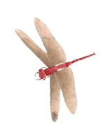
Group D:
1. It was a pleasant and memorable trip, full of giggles along the way
because of my forgetful mom.
2. Charlotte laughed a tinkling little laugh.
3. With an angry roar, the bear ran to the lake to wash his eyes.
4. The bird again looked directly into my eyes, then let out a squeaking
call and was gone.
5. She could hear water trickling somewhere at a distance. Quickly she
followed the sound to a stream.
6. The car abruptly stopped in front of him. Mac crashed into the car
with a loud bang.

Slide 10
Onomatopoeia (拟声)
1. It was a pleasant and memorable trip, full of giggles along the way
because of my forgetful mom.
2. Charlotte laughed a tinkling little laugh.
3. With an angry roar, the bear ran to the lake to wash his eyes.
4. The bird again looked directly into my eyes, then let out a squeaking
call and was gone.
5. She could hear water trickling somewhere at a distance. Quickly she
followed the sound to a stream.
6. The car abruptly stopped in front of him. Mac crashed into the car
with a loud bang.
flap, buzz, murmur, whisper, whistle, click, slam, pound, crack, ticktock, etc.

Slide 11
Zeugma (轭式修辞)
Group E:
1. Mother took a bite of the French toast and had some chicken
porridge, which warmed her stomach and her day.
2. The two dogs sniffed each other like old friends. The cute small
creature touched Poppy’s paw and its soul.
warm
stomach
day
touch
paw
soul
3. Unprepared and startled as he was, Poppy finally picked up his
ears and his courage, and inched towards the box, tail wagging.
4. With all the popcorn sold out, Bernard went home happily,
earning a bag of coins and confidence as well.
3. Unprepared and startled as he was, Poppy finally picked up his
ears and his courage, and inched towards the box, tail wagging.
4. With all the popcorn sold out, Bernard went home happily,
earning a bag of coins and confidence as well.

Slide 12
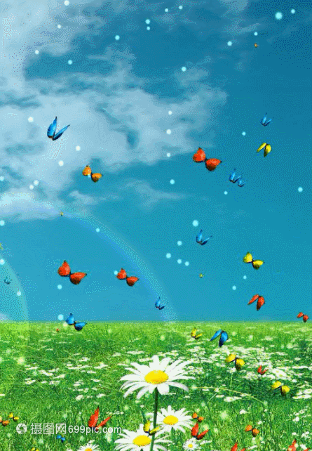
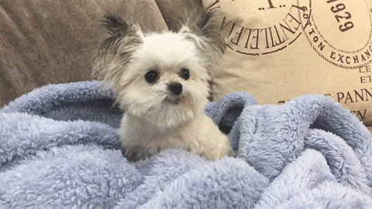
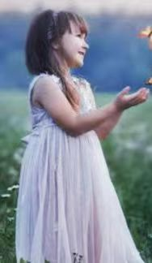
Practice
Describe the pictures by using Alliteration (头韵), Consonance (尾韵), Assonance (元韵), Onomatopoeia (拟声), or Zeugma (轭式).
Group 1 & 2:
◆ How to describe the surroundings?
◆ How to describe the flying of butterflies?
◆ How to descirbe her feelings?
Group 3 & 4:
◆ How to describe the puppy? (appearance/expression/action)
◆ How may you feel when it touches your hand?

Slide 13
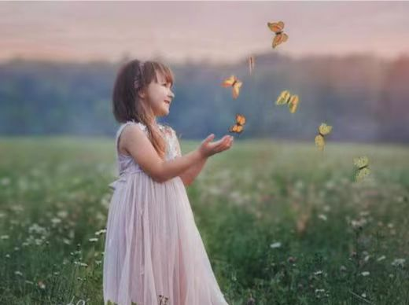
The little girl is playing with butterflies flapping (拟声) around her slowly and gracefully(尾韵). A breeze brings (头韵) the sweet smell (头韵) of flowers to them, spreading her giggles/tinkling laugh(拟声)far away.

Slide 14
My furry friend (头韵) picks up its ears and looks at me with the bright black eyes, blinking (头韵) as if they can speak. The cute small creature touched my hand as well as my heart (轭式).

Slide 15
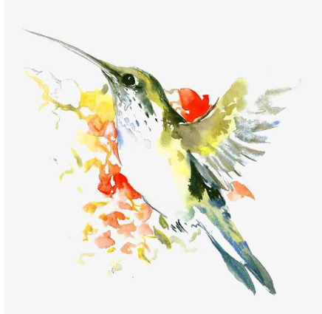
Consolidation
Polish para2, making good use of rhetorical devices.
I was invited to a cookout on an old friend's farm in western Washington. I parked my car outside the farm and walked past a milking house which had apparently not been used in many years. A noise at a window caught my attention, so I entered it. It was a hummingbird (蜂鸟), desperately trying to escape. She was covered in spider-webs(蛛网) and was barely able to move her wings. She ceased her struggle the instant I picked her up.
With the bird in my cupped hand, I looked around to see how she had gotten in. The broken window glass was the likely answer. I stuffed a piece of cloth into the hole and took her outside, closing the door securely behind me.
When I opened my hand, the bird did not fly away; she sat looking at me with her bright eyes. I removed the sticky spider-webs that covered her head and wings. Still, she made no attempt to fly. Perhaps she had been struggling against the window too long and was too tired? Or too thirsty?
As I carried her up the blackberry-lined path toward my car where I kept a water bottle, she began to move. I stopped, and she soon took wing but did not immediately fly away.
Hovering( 悬停), she approached within six inches of my face. For a very long moment, this tiny creature looked into my eyes, turning her head from side to side. Then she flew quickly out of sight.
During the cookout, I told my hosts about the hummingbird incident. They promised to fix the window. As I was departing, my friends walked me to my car. I was standing by the car when a hummingbird flew to the center of our group and began hovering. She turned from person to person until she came to me. She again looked directly into my eyes, then let out a squeaking call and was gone. For a moment, all were speechless. Then someone said, “She must have come to say good- bye.”
Para1: A few weeks later, I went to the farm again.
Para2: I was just about to leave when the hummingbird appeared.

Slide 16
Possible version:
I was just about to leave when the hummingbird appeared. Letting out a squeaking call (拟声), she dived towards me with its wings flapping (拟声) swiftly and vigorously (尾韵), and then hovered before my face, looking at me with her bright black(头韵) eyes. Finally she stopped on my left shoulder. I patted her on the back gently and affectionately (尾韵). She turned her head from side to side as if expressing her gratitude for saving her life. At that merry and moving moment (头韵), the little creature held up its small long beak and lovingly touched my fingers, and my soul as well. (轭式修辞).

Slide 17
Assignment
1. Further polish your writing.
2. Search for more information about retorical
devices online.

Slide 18
Thank You!

Slide 19
Zeugma (轭式修辞)
Group E:
1. Mother took a bite of the French toast and had chicken porridge,
which warmed her stomach and her day.
2. The two dogs sniffed each other like old friends. The cute small
creature touched Poppy’s paw and its soul.
warm
stomach
day
touch
paw
soul
3. Unprepared and startled as he was, Poppy finally picked up his
ears and his courage, and inched towards the box, tail wagging.
4. With all the popcorn sold out, Bernard went home happily,
earning a bag of coins and confidence as well.
3. Unprepared and startled as he was, Poppy finally picked up his
ears and his courage, and inched towards the box, tail wagging.
4. With all the popcorn sold out, Bernard went home happily,
earning a bag of coins and confidence as well.

