Slide 1

感恩遇见，相互成就，本课件资料仅供您个人参考、教学使用，严禁自行在网络传播，违者依知识产权法追究法律责任。
更多教学资源请关注
公众号：溯恩高中英语
知识产权声明

Slide 2

活用教材词汇，靶向高考写作
M2U3单词拓展
浙江省常山一中：吴俊峰

Slide 3


chat /tʃæt/ vi.聊天;闲聊
我们的家庭聚会将在2月18日晚上举行，对我们来说意味着舒适的团聚，包括我的祖父母，叔叔阿姨和他们的孩子。我们会一起吃一顿大餐，随意聊天。_{2017年11月浙江高考应用文“邀请老外过春节”}
Our family gathering, to be held on the night of February 18th, means cosy reunion for us, including my grandparents, uncles and aunts with their kids. We’ll have a big feast together, chatting casually.
许多学生自愿参加参观敬老院，帮助老人解决身心的问题。在我们到达时，我们向他们赠送了手工制作的礼物和良好的祝愿。他们见到我们是多么高兴啊! 然后我们忙着帮助这里的老人做饭，洗衣服，和他们聊天。
Many students volunteered to participate in visiting the Nursing House and help elderly people deal with their troubles both physical and psychological. On our arrival, we presented them with handmade gifts as well as best wishes. How happy they were to see us! Then we were engaged in helping the seniors here out by making their meals, washing their clothes and chatting with them.

Slide 4


stream /stri:m/ v.流播;流出;流动 n.小河
1. 在电视上/ 网上直播 / 现场直播的
stream_{流式传输} live on television / on the Web；/ live-streamed
2. 母亲紧紧地把儿子抱在怀里，幸福的泪水顺着脸颊流下来。
Mother hugged her son in her arms tightly, tears of happiness streaming down her cheeks_{独立主格结构}.
3. 夜风无情地咆哮着，无名的生物在黑暗中喃喃低语，月光微弱地照在地上。她满怀恐惧，拖着疲惫的身体慢慢向前挪动。最后，我坐在溪边，胳膊和腿都痛了。_{201610浙江高考读后续写“夫妻吵架”}
The night wind howled ruthlessly, nameless creatures murmured in the dark and the moonlight shone weakly on the ground. Filled with fright, She dragged her exhausted body inching forward. Eventually, She sat beside the stream, arms and legs aching.
Row row row your boat 泛舟于水
Gently down the stream 水流轻摇曳
Merrily merrily merrily merrily 我心多欢喜
Life is but a dream 人生就是一场追梦！

Slide 5
stream /stri:m/ v.流播;流出;流动 n.小河
4. 这条消息立即走红。仅仅在几个小时内，就有数百个点赞和有趣的评论出现，显示出他们的热情。好奇的人们络绎不绝地过来和我们以及我心爱的南瓜合影留念。Jason很兴奋，妈妈也很高兴她的视频能这么火，也因此对拍摄视频更加狂热了。_{（2021.01浙江高考读后续写“南瓜卡头”）}
It went viral immediately. Just within hours, hundreds of likes and funny comments appeared, showing their enthusiasm. Constant streams of curious people even came by to take photos with us and my prized pumpkin. Jason was really excited and Mom was glad that her video should become such a hit and thus grew even crazier about shooting videos.
5. 她一遍又一遍地听沃尔夫的录音，喜欢那些音符像奔流的山涧一样翻滚的样子。
She’d listened to Ms. Wolff’s recordings over and over again, loving the way the notes tumbled like a rushing mountain stream_{比喻}.
6. 毫无疑问，在线学习以其资源容易、成本低、方便等明显优势成为主流，这有助于提高学习效率。
Undoubtedly, online learning becomes mainstreamed for its obvious advantages such as easily resources, the low cost and great convenience, which contribute to high study efficiency.

Slide 6

identity /aɪˈdentəti/ n.身份;个性
1. 白色校服也需要以显示你的身份。
White school uniforms are also needed to show your identity.
2. 我发现我的钱包丢了，里面有身份证，签证和所有的现金。此外，它是祖母绿的，由皮革制成。_{2018年11月浙江高考应用文“钱包丢失的求助信”}
I found my wallet lost, inside which there is an identity card, my visa and all my cash. Besides, it is emerald green and is made of leather.
emerald /ˈemərəld/n.翡翠，绿宝石；祖母绿 adj.翠绿色的
3. 我们有责任尽我们所能帮助他们，这也激发了我们的民族认同感和自豪感。
We should take our responsibilities to give them whatever assistance we can, which also inspires our national identity and superiority.
superiority /suːˌpɪəriˈɒrəti/ n.优越，优势；优越感

Slide 7

convenient /kənˈvi:niənt/ adj.方便的;近便的
1. 只有这样，我们才能享受共享单车的乐趣和方便。_{（Only + 状语（从句）位句首）}
Only in this way can we_{部分倒装} enjoy the pleasure and convenience of the shared bikes.
2. 如果你方便的话， 我们上午8：30在校门外集合。
If it's convenient for you=If convenient, let's meet at 8：30a.m. outside the school gate.
3. 我想知道您你是否方便告知这项课程举办的时间和地点。
I wonder whether it is convenient for you to inform me when and where the course will be given.
★用法点睛：convenient作表语时，不能以“人”为主语，且在“It is convenient for sb to do sth”结构中介词for不能用介词of代替。

Slide 8

cash /kæʃ/ n.现金;金钱
Pay by credit card
用信用卡付款
Pay in check用支票付款
我的珊瑚粉色皮包是方形的，里面是我的信用卡和一些现金。_{2018年11月浙江高考应用文“钱包丢失的求助信”}
My coral-pink leather purse is of square shape, inside which is my credit card together with some cash.
Pay in cash 用现金支付
pay with Alipay/Wechat
支付宝/微信付款
scan the QR Code
扫描二维码付款

Slide 9


update /ˌʌpˈdeɪt/ vt.更新 n.更新;最新消息
1. 图书馆不久将对互联网系统进行更新。我想通知大家，在5月1日至10日期间，阅览室将被关闭，阅读系统将暂时停止。
The library will soon be carrying out an update/upgrade of the Internet system. I would like everybody to be informed that during the dates of 1st to 10th May, the reading room will be closed with the reading system temporarily stopped.
2. 每个人都认为有必要更新自己的知识以保持专业能力，否则将被社会抛在后面。
Everyone finds it necessary to update his knowledge to maintain their professional competence, otherwise he will be left behind the society.
database /ˈdeɪtəbeɪs/
n.数据库;资料库

Slide 10


stuck /stʌk/ adj.卡住;陷(入);困(于)
1. 每当我陷入困境时，我的父母总是尽最大努力激励我坚持我的梦想。
Whenever_{让步状语从句} I get stuck/ trapped/ caught in difficulties/ troubles, my parents always try their best to inspire me to stick to my dream.
2. 伊丽莎白张了张嘴。她用口型念了那个词，但没有发出声音。前排传来窃窃私语和零星的咳嗽声。伊丽莎白又试了一次，但话还是卡在了喉咙里。她低下头，试图阻挡内心爆发的悲伤。
Elizabeth opened her mouth. She mouthed the words, but no sound came out. Murmurs and scattered coughs came from the front row. Elizabeth tried again but the words felt stuck in her windpipe. She lowered her head, trying to block out the sadness erupting inside.

Slide 11


keep sb. company / ˈkʌmpəni/ 陪伴某人
1. 抽出时间陪伴留守儿童，减少他们的孤独感
spare time to keep the left-behind children company so that they may suffer from less loneliness
2. 正是您幽默而有启发性的教学，使英语学习成为一种有趣的、令人大开眼界的经历。没有您无私的奉献，我们不可能取得今天的巨大进步。谢谢你的陪伴。
It is your humorous and instructive teaching that_{强调句型} makes English learning an entertaining and eye-opening experience for us.Without your selfless devotion, we couldn’t have made_{虚拟语气} such great progress. Thank you for your company.

Slide 12

benefit /ˈbenɪfɪt/ n.益处 vt.使受益
cardiovascular/ˌkɑːdiəʊˈvæskjələ(r)/adj.心血管的
resistance /rɪˈzɪstəns/抵抗力，免疫力

Slide 13
benefit /ˈbenɪfɪt/ n.益处 vt.使受益
1. 摘水果的经历让我们获益良多，它教会我们劳动的重要性。
→This fruit­picking experience benefited us a lot and taught us the importance of working.
→We benefited a lot from this fruit­picking experience and it taught us the importance of labor.
→This fruit­picking experience was quite beneficial to us and taught us the importance of working.(beneficial)
2. 我相信这个（捐赠）活动会培养我们的责任感，这对我们以后的生活有很大的好处。大家积极地参与吧!
I'm sure the activity will cultivate our sense of responsibility, which will benefit us a lot in further life. Just take your active part in it !
3.《小王子》让我受益匪浅，这是一个老少皆宜的童话故事。王子对世界的态度深深打动了我，让我找回了内心的真诚和纯真。
I benefited a lot from The Little Prince, which is a fairy tale for both children and adults. I was deeply moved by the prince’s attitude towards the world, which brought my inner sincerity and pure innocence back.

Slide 14
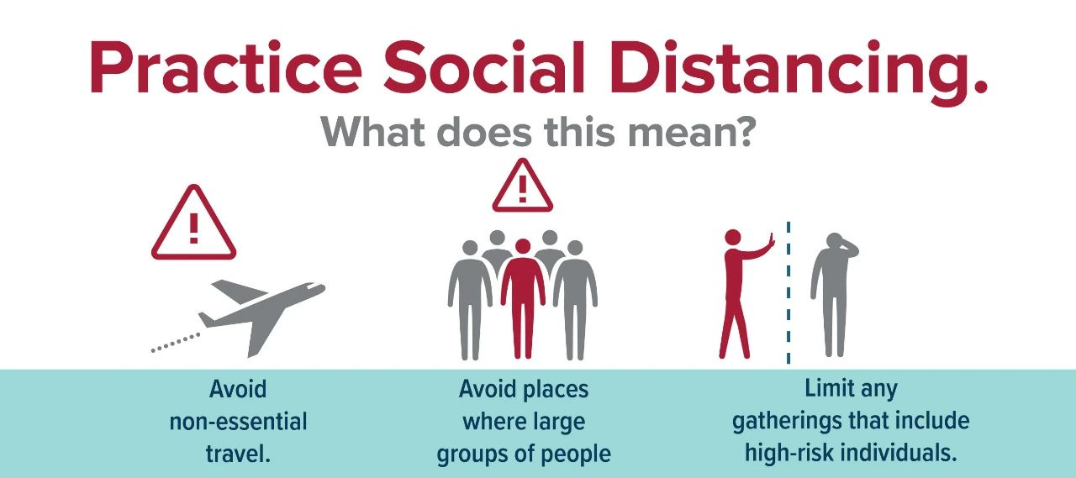
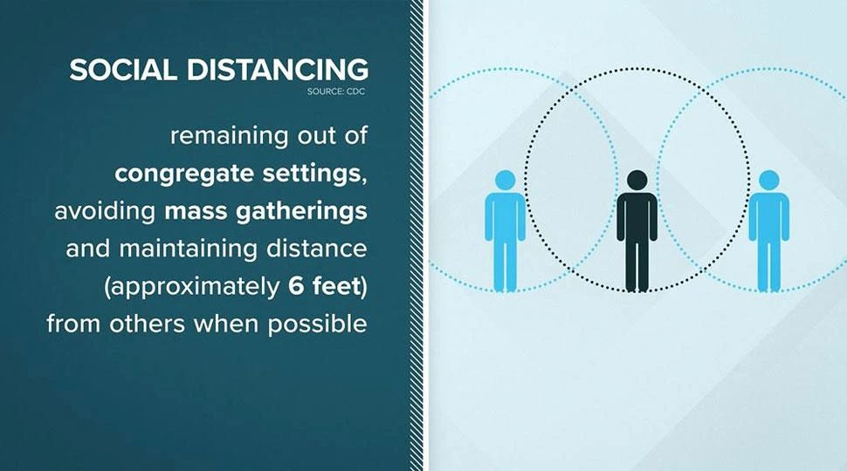
distance /ˈdɪstəns/ n.距离
1. 令我们高兴的是，远处的水声引起了我们的注意，把我们带到了河岸边。
Much to our delight，the sounds of water in the distance arrested our attention and drove us to the river bank.
2. 一家人在远处等着我们。看到这里，我们俩的脸上都露出了灿烂的笑容。
The family were waiting for us in the distance. Seeing this, a radiant smile lit up both of our faces._{2018年6月浙江高考读后续写“骑马追兔”}
3. 我能感觉到空气重重地打在我的脸上，从远处听到爸爸歇斯底里的叫声。
I could feel the air hitting my face heavily and hear my dad’s hysterical cry from a distance._{2018年6月浙江高考读后续写“骑马追兔”}

Slide 15

inspire/ɪnˈspaɪə(r)/ vt.鼓舞;激励;启发思考
1.有的人激励你，有的人消耗你。聪明地选择他们。
People inspire you or they drain you. Pick them wisely.——Hans F. Hansen
2.鼓励我们积极参与志愿者工作
inspire us to take an active part in voluntary work
3.被这些话鼓舞
feel inspired by the words
4.一个令人鼓舞的故事
an inspiring story
5.寻找灵感
look for inspiration

Slide 16


inspire/ɪnˈspaɪə(r)/ vt.鼓舞;激励;启发思考
1. 想到别人的处境，我就会受到激励，伸出援助之手。
Thinking about other people's situations_{动名词短语做主语} inspired me to offer help.
2. 为了在这个不断变化的“智能”世界中激发我们的科学创造力，我们正在举办一场科技创新大赛。
To inspire us with scientific creativity in this ever-changing “smarter” world, we have a Science and Technology Innovation Contest on the way.
3. 他一出现，观众就爆发出雷鸣般的欢呼声和掌声。受到热情和鼓励的鼓舞，大卫兴高采烈地加快了脚步。_{2022全国新高考I卷读后续写”越野跑赛”}
When he came into sight, the spectators burst into thunderous cheers and applause. Inspired by the enthusiasm and encouragement, David quickened his pace in high spirits.

Slide 17

now that /naʊ ðæt/ 既然;由于
既然你参与了打架，那么就要受惩罚。
Now that you are involved in a fight, you will be punished.
既然你在这里，不妨就和我们一起吃午饭吧。（may as well..不如/不妨...）
Now that you're here,you may as well come to have lunch with us！
now that引导原因状语从句，可以放在句首或者句中，不可以放在句末。
now that是表示一种推论，即因为出现了新情况、发生了一件事情，从而推论出一个结果。所以一般翻译成“既然”。
because单纯表示因果关系，所以翻译成“因为”。从because中无法得知这个情况是否是新出现的，或这件事情是否是新发生的。

Slide 18

access /ˈækses n.通道;机会 vt.进入;使用
〖构词巧记〗
[ac- (ad-) = to 到；cess = to go 走→ “going to some place 走到某处”→]
〖单词活用〗
① n. (approach) (接近的)方法；通路；进入手段
The only access to the farmhouse is across the fields.
去那农舍的唯一通路是穿过田野。
The facilities have been adapted to give access to wheelchair users.
这些设施已经过改装，使轮椅使用者们能够进入。
② n.可接近性；（使用或见到的）机会，权利
It is highly important to bridge the digital divide and make sure that everyone has access to the Internet and knows how to use new technology.
消除数字鸿沟、确保每人都能使用互联网并且知晓如何运用新技术，是非常重要的。 _{bridge （熟词生义 ）vt.弥合(差距)，消除(分歧)}

Slide 19

accessible /əkˈsesəbl/adj.
可到达的，可进入的；易得到的；可以理解的，易懂的；平易近人的，随和的
〖构词巧记〗
[ac-(ad-); cess; -ible]
〖单词活用〗
①adj.可到达的；可接近的；可进入的；可使用的
The remote desert area is accessible only by helicopter.
只有乘直升机才能进入 那遥远的荒漠地区。
The centre is easily accessible to the general public.
该中心对于广大公众来讲很便利。
②adj.容易理解的；易懂的
a programme making science more accessible to young people
一项使科学更容易为年轻人所了解的计划
③adj.易接近的；易相处的；易打交道的
I find Frantzen to be a very accessible artist.
我发现弗兰岑是一个非常平易近人的艺术家。

Slide 20


〖用法归纳〗access / accessible
(1)have/get/gain(no) access to
有(没有)……的机会；可以(无法)获取/进入/接近
(2) be accessible to
可接近；可靠近；可使用
★用法点睛：
access前通常不加冠词，且access和accessible短语中的to是介词。
〖佳句欣赏：一句多译〗
The development of the Belt and Road helps Chinese traders to 。
a broader market.
“一带一路”的发展帮助中国贸易商得以进入更广阔的市场。
have access to
/ be accessible to

Slide 21
〖链接高考〗access / accessible
语境辨义/单句语法填空：
①Many stations have wheelchair access from the car park or entrance to the station platforms. _{(2020·全国卷Ⅰ阅读A)}
②It will provide you with access University facilities such as University Libraries，the Sports Centre，and Computing Services._{(2020·天津5月卷阅读A)}
③Moran hopes to widen the audience for jazz，make the music more (access)，and preserve its history and culture._{(全国卷Ⅰ阅读C)}
可以使用轮椅
to
accessible
①许多车站的停车场或站台入口处都设有轮椅通道。
②它将为您提供通道进入大学的设施，如大学图书馆、体育中心和计算机服务。
③莫兰希望扩大爵士乐的听众，使音乐更容易获得，并保护它的历史和文化。

Slide 22
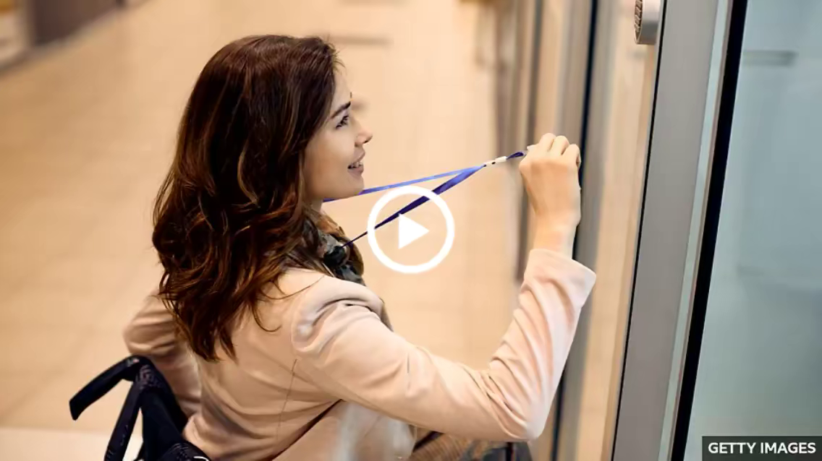
〖写作提能〗access / accessible一句多译：
1.在我看来，孩子们应该有上网的机会。
In my opinion，kids should the Internet.(access)
In my opinion，the Internet should kids.(accessible)
2.当地交通很方便。
Local transportation is .
=People can local transportation.
have access to
be accessible to
easily accessible/of easy access/very convenient
have easy access to

Slide 23
〖写作提能〗access / accessible
读后续写（两种动作和神态描写，形成鲜明对比，反映作者与父亲矛盾冲突）：
当我把119美元的薪水带回家时，爸爸想和我谈谈。知道他会谈论我的收入，我就拉长了脸，打算从他身边走过，溜回我的卧室。“来这里,儿子。”爸爸叫道，脸上带着平易近人的表情。我的心一沉。我一直期待的一套梦幻般的新足球队服终于要让位于家庭开支了。我不情愿地向前挪了挪，提交了薪水单。但是，爸爸把薪水还给我，温柔地说:“你长大了。”你完全有权决定如何处理这笔钱。(2021年6月高考 浙江卷读后续写“我的夏日薪水”)
When I brought my paycheck home--it was $119--my dad wanted to talk to me. Knowing that he would talk about my earnings, I and intended to simply walk past him and to my bedroom. “Come here, son.” Dad exclaimed, . My heart . What I had been looking forward to—a dreamy new football outfit would finally family expenses. , I and submitted the paycheck. However, Dad slid the paycheck back into my hand, saying , “You’ve grown up. You have every right to decide what to do with the money.”
pulled a long face
slip back
wearing an accessible expression
sank
give way to
Reluctantly
inched forward
in a tender voice

Slide 24

charity/ˈtʃærəti/ n.慈善;慈善机构(或组织)
1. 她的下一个目标是创建一个慈善网站，为贫穷国家的儿童募捐。
Her next goal is to start a charity website to raise money for children in poor countries．
2. 站在凛冽的寒风中，密密麻麻的雪花飘飘，只见他忙着热情地问候，说着“谢谢!”圣诞快乐!对着往慈善箱里扔钱的行人，脸上洋溢着幸福。
Standing in the hard blowing wind and fluttering dense snowflakes, he was seen busy warmly greeting and saying “Thank you! Merry Christmas!” to the pedestrians dropping money in the charity box, a face brimming with happiness_{独立主格结构}.
3. 一旦被录取，你将有机会体验各种活动，包括慈善义卖、参观养老院、为社区做清洁和一些环保活动，这些活动通常在周末和节假日进行。
Once admitted, you’ll have the opportunities to experience various activities, including charity sales, visiting nursing homes, doing cleaning for the community and some environmental protection activities, which are usually carried out on weekends and holidays.

Slide 25

go through /gəʊ θru:/ 经历;度过;通读
1. 在一起经历了许多磨难之后，这对夫妇更加相爱了。
Having gone through many hardships together, the couple love each other more.
2. 所有的候选人都要在下周一经过仔细的筛选，所以记得提前准备好你的表演。
All the candidates are required to go through a careful selection process next Monday, so remember to get your performance ready in advance.
你现在经历的一切，都是为了遇见更好的未来！
In order to get from what was to what will be, you must go through what is.

Slide 26

tough /tʌf/ adj.艰难的;严厉的
1. 艰难作出的决定
a tough decision to make
2. 我喘着粗气继续往前走。
Tough puffing and panting, I pushed on.
3. 强者之所以是强者，是因为在生活中不甘示弱，奋勇前进。弱者之所以是弱者，是因为在生活中犹豫不决，畏缩不前。（续）
The strong are not strong before they experience toughly, and the weak are always weak when they are full of fear and negativity.

Slide 27


conference /ˈkɒnfərəns/ n.会议;研讨会;正式会谈
1. 活动将于下星期五晚上7点在学校图书馆会议厅举行。
The activity will take place in the conference hall of our school library at 7：00 p.m. next Friday. _{(先地点后时间，先小后大)}
2. 在室内设施方面，有供讨论的会议桌和可使用的电脑，电脑提供屏幕和投影仪，以协助小组合作学习。_{2022年6月浙江高考应用文“邀请体验小组学习室”}
For indoor facilities, there are conference table for discussion and accessible computers which provides a screen and a projector to assist group cooperative learning.

Slide 28

plus /plʌs/ conj.而且;此外 n.加号
major/definite/big plus 主要 / 绝对 / 大的优势；有利因素
1. 做这份工作懂一些西班牙语绝对占优势。
Some knowledge of Spanish is a definite plus in this job.
2. 有些人喜欢在乡村环境工作，被植物和树木所环绕，尤其在一些你无需成天盯着电脑屏幕的工作，这对很多人来说绝对是一个极大的好处。
Some people like working in a rural setting, surrounded by plants and trees instead of buildings, especially in jobs where you're not sitting all day looking at a screen - a big plus for many people.
3. 我整个星期都在忙着准备期末考试。全神贯注的与所有的数学公式和英语语法项目，我的脑海完全忘这件事。另外，我爷爷上周突然生病了，我不得不在课后照顾他。
I’ve been super busy preparing for the final exams the whole week. My mind was so preoccupied _{/priˈɒkjupaɪd/adj.全神贯注的} with all the mathematical formulas_{/ˈfɔːmjələ/n.公式} and English grammar items that it totally slipped my mind_{我完全忘了}. Plus, my grandpa suddenly fell ill last week and I had to attend to him after class.

Slide 29









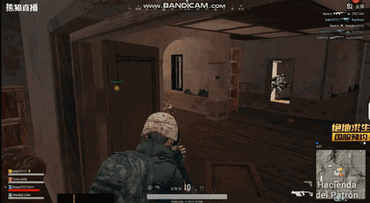
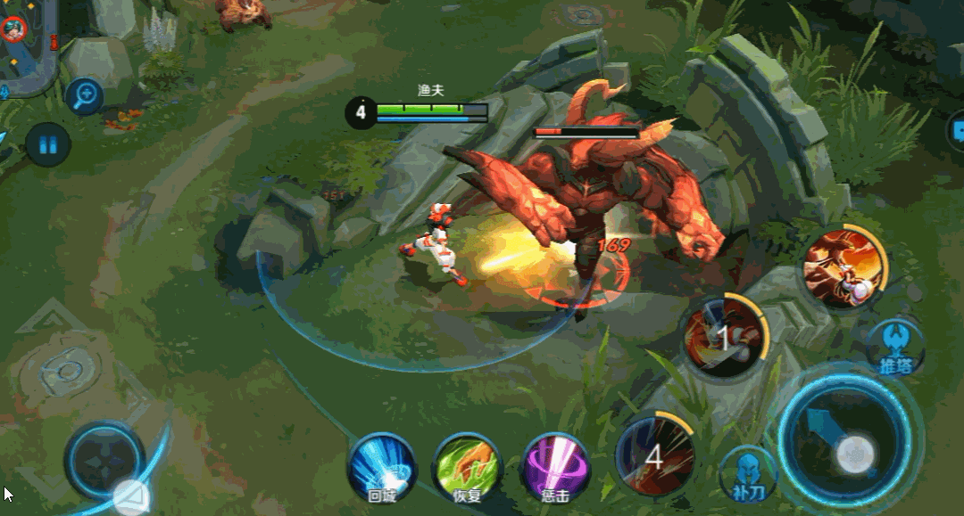
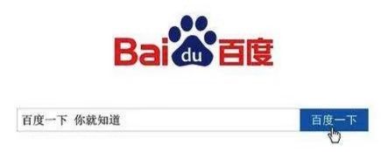

function /ˈfʌŋkʃn/ n.功能;作用 vi.起作用
What are the basic functions of of the internet?
chat online
online trade
write a blog post
use a search engine
online games
stream videos

Slide 30

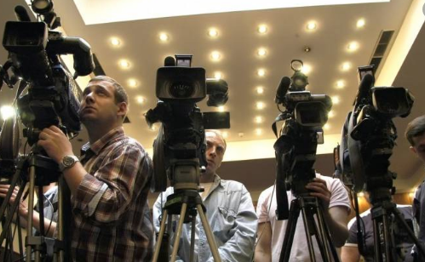
battery /ˈbætri/ n.电池
1. 一次性电池/可充电电池/太阳能电池
disposable /rechargeable/solar battery
2. recharge one's batteries “休整、养精蓄锐”
她是教书的材料。并且她也不需要休假来充电休整。
She has a vocation for teaching. And she doesn't need a vacation to recharge her batteries.
3.一堆记者和摄像机
a battery of journalists and television cameras

Slide 31

confirm /kənˈfɜ:m/ vt.确认;使确信
1.你确认Wi­Fi密码了吗？
Have you confirmed the Wi­Fi password?
2. 计划下个月组团到贵校参观，我写信确认一些信息。
Planning to take a group to pay a visit to your school next month, I'm writing to confirm some information.
3. 老师的鼓励坚定了我的信念，我一定能在中国诗歌比赛中获得冠军。
My teacher's encouragement confirms me in the belief that I will surely win the championship of Chinese Poetry Competition.
4. 起初，阿萨德想要保密，并惩罚了法赫德。在确认没有人后，他迅速掏出一些钱，把钱包放进口袋里，心猛地一跳。这是他第一次感到如此害怕。
At first, Asad wanted to keep it a secret and punished Fahad. Having confirmed that no one was there, he quickly took out some money and put the wallet into his pocket with his heart bumping fiercely. It was the first time that he had felt so frightened.

Slide 32
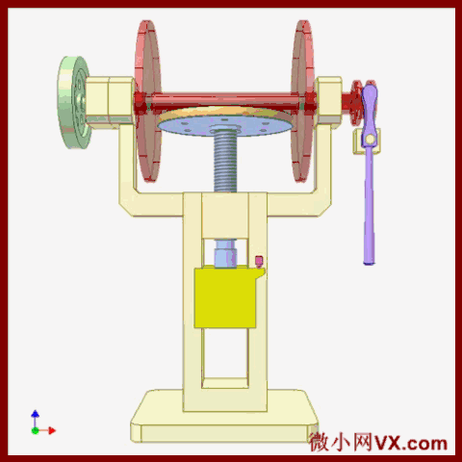
press /pres/ vt.按,压;敦促
1. 在父母的督促下，这个男孩决心不再玩电脑游戏。
Pressed from his parents, the boy is determined to stop playing computer games.
2. 她陷在里面，被一种折磨着她的肉体的疲惫压得喘不过气来，这种疲惫似乎深入了她的灵魂。_{2016年10月浙江高考读后续写“夫妻吵架”}
Into this she sank, pressed down by a physical exhaustion that haunted her body and seemed to reach into her soul.
haunt /hɔːnt/ v. 常出没于…；萦绕于…；出没；作祟

Slide 33

in shape /ɪn ʃeɪp/ 状况良好
1. 我必须保持良好的状态，否则我就会输掉比赛。
I must get in shape, or I will lose the game.
2. 你为了保持身材而不吃早餐是不对的。
It is wrong of you to skip breakfast in order to stay in shape.
3. 这句话听起来很简单，但却足以影响我成为什么样的人。
That phrase sounds simple, yet influential enough to shape who I am.
shape （名词动词化）vt.形成，影响；使成形，塑造

Slide 34



keep track of /ki:p træk əv/ 掌握……的最新消息
1. 记录下你的努力，写下你的感觉如何。
Keep track of your efforts and write down how you feel.
2. 这时我们才发现，最后一缕晨光正迅速地消失在众多的树林中，我们根本找不到我们的踪迹! 我们确实迷路了!_{2018年6月浙江高考读后续写“骑马追兔”}
Not until then did we realize that the last ray of twilight was quickly disappearing among the numerous trees and we couldn’t find our track at all! We did get lost!

Slide 35

account /əˈkaʊnt/ n.账户;描述
1. 由于突如其来的洪水，房屋被毁，人们无家可归，这需要整个国家的援助。
On account of the abrupt flood, houses are destroyed and people are homeless, which requires the whole nation's assistance.
2. 很多高中生几乎不参加课外活动，这是他们身体差的原因。
Nowadays, many senior school students hardly take part in after-class activities, which accounts for their poor health.
3. 我真诚地希望你能考虑我的建议。我期待着尽快收到你的回信。
I sincerely hope that you will take my suggestions into account/consideration．Looking forward to hearing from you as soon as possible.
4.你能告诉我如何联系这个男孩和他的家人的具体信息吗?如果可以，我可以自己联系他们，然后把钱打到他的家庭银行账户上吗?
would you please tell me the specific information of how to contact with the boy and his family? If possible, may I connect with them by myself and give the money to his family bank account?

Slide 36

click /klɪk/ vt.&vi.点击
1. 掌声越来越来响，照相机咔嚓咔嚓地不停拍照。
The applause rose to a crescendo and cameras clicked away.
2. 门咔嗒一声关上了。
The door clicked shut .
3. 他冲服务员打了个响指。
He clicked his fingers at the waiter.
4.波利烦恼地用舌头发出啧啧声。
Polly clicked her tongue in annoyance.
5. 到目前为止，点击率一直很高。
Click-through rates have been high so far.
6. 如果您在北京时间5月10日下午6点有空，请在Zoom上点击进入号码(1234)。
If you are available at 6:00 p.m. (Beijing Time), May 10th, click in the entry number (1234) on Zoom.
7. 收到商品后，点击“确认收货”按钮，支付宝就会把钱给卖家。
After you receive your goods and click the "confirm receipt" button, Alipay then gives the money to the seller.

Slide 37





troll /trɒl/ n.发挑衅帖子的人;巨怪，侏儒怪物；曳绳钓鱼法中用的曳绳或鱼饵；轮唱
v.拖捞，拖钓；搜寻，寻找；随便浏览，随便翻翻；<英>闲逛，游荡；（无缘由地在网际网路上某处）留下侮辱性的讯息；快乐地唱
他们慢慢地向敞开的门走去，紧张得口干舌燥，祈祷着巨怪不要从里面出来。哈利猛地一跳，抓住了钥匙，砰地一声关上门，锁上了。
They edged towards the open door, mouths dry, praying the troll wasn't about to come out of it. With one great leap, Harry managed to grab the key, slam the door and lock it. ( Harry Potter and the Philosopher’s Stone P187)
杠精、喷子、键盘侠 、爱恶搞的人

Slide 38

make fun of /meɪk fʌn əv/ 取笑; 戏弄
with the bullies and taunts
1.充满讥讽和嘲笑
2.伴随着嘲笑和窃笑
3.带着嘲讽和冷笑
with jeers and snickering
with a gibe and a sneer
4.嘲笑人的失败是不对的。
It is wrong to twit/ tease a man with (about) his failure.
5.你绝不应嘲笑陷人困境的同学。
You must never laugh at/make fun of a classmate who is in trouble.
6.士兵嘲笑他们的敌人。
The soldiers sneered at their enemies.
7.他是全村的嘲笑对象。
He was the scorn of the village.
8.我们不应嘲笑他的建议。
We must not ridicule his proposal.
9.他们嘲笑他的恐惧。
They mocked at his fears.

Slide 39

tip /tɪp/ n.忠告; 诀窍; 实用的提示; 小费；末梢，尖端
1.她踮着脚走到睡着的孩子床边。
She tiptoed to the bedside of the sleeping child.
2.她轻轻地走，以免惊醒孩子。
She trod lightly so as not to wake the baby.（tread过去式）
3.小偷溜进房间。
The thief slid into the room.
4.她消消溜走(溜出，溜过去)，没人看见。
She slipped away (out, past) without being seen.
5.他潜入了我的房间。
He stole into my room.
6.很轻的脚步
stealthy/silent/quiet /soft/noiseless footsteps
7.偷偷地走进（走出、走开、走回、走过等）
sneak in (out, away,back, past,etc.)
Tip toe walking
/ˈtɪptəʊ/n.脚尖
v.踮着脚走，蹑手蹑脚地走

Slide 40

tip /tɪp/ n.忠告; 诀窍; 实用的提示; 小费；末梢，尖端
1. 她大步走上前来迎接我。stride-strode-stridden vi大步走；阔步走
She came striding along to meet me.
2. 他有力地大步行走。
He walked with vigorous strides.
3. 他一个箭步出了房间。
In a big stride he came out of the room.
4. 一个穿晚礼服上装的宽肩男子仰首阔步自信地走上舞台。_{swagger 仰首阔步；神气十足}
A broad shouldered man wearing a dinner jacket swaggered confidently up to the stage.
Double bounce walk
双跳步 /baʊns/ 弹跳; 蹦蹦跳跳地活泼兴奋地走；
走一个循环身体要弹起落下两次，看着很欢快。
walked with a swagger
昂首阔步地走着

Slide 41

tip /tɪp/ n.忠告; 诀窍; 实用的提示; 小费；末梢，尖端
1.疲倦的孩子们没精打采地跟在他们父亲的后面。
The tired children trailed along behind their father.
2.他费力地穿过岸上杂草，然后涉过小河。
He waded through the weeds on the bank and then into and across the stream.
3.他在深雪中跋涉。_{trudge （因疲劳或负重而步履沉重地走）费力地走}
He was trudging through the deep snow.
4.我们的马沿着泥泞小路蹒跚而行。 _{plod - plodded 艰难吃力地行走}
Our horses plodded down the muddy track.
5.他在泥泞中费力地行进着。
He was ploughing (his way) through the mud.
Walk down in the dumps
垂头丧气地走
down in the dumps “情绪低落”
dump 垃圾场

Slide 42

familiar /fəˈmɪliə(r)/ adj.熟悉;熟知
1. 我们开始定期开会制定计划。起初，他似乎主导了我们的讨论，因为他熟悉这个话题，但我正相反。_{2022年1月浙江高考读后续写“与学霸做项目”}
We started to meet regularly to draw up plans. At first it seemed that he dominated our discussion for he was familiar with the topic, but I was the opposite.
2. 然后，熟悉的声音从我身边传来。那是我的家人!我立刻大声而急切地回答:“在这儿!在这里!”几分钟后，我的家人进入了我的视线。我冲向他们，扑向他们温暖的拥抱。
Then came familiar voices_{完全倒装} near me. That was my family! Instantly, I tried to respond loudly and urgently, “Here! Here!” Within minutes, my family came into my eyes. Rushing towards them, I threw myself to their warm hugs.

Slide 43

keep ... in mind /ki:p ɪn maɪnd/ 牢记
1. 你必须记住满嘴食物时说话是不礼貌的。
You must keep in mind that it is rude to speak with your mouth full.
2. 我的最大建议是戴口罩并保持社交距离，因为病毒可以在近距离的人之间传播。经常用肥皂彻底洗手也很重要，肥皂可以杀死病毒。请记住，现在不是恐慌的时候，而是准备的时候。在你的橱柜里储备一些额外的食物和清洁用品，以减少外出的频率。
My top tip is to wear face masks and maintain the social distance, because the viruses can spread from person to person in close proximity. It is also important to wash hands regularly and thoroughly with soap, which can kill viruses. Keep in mind that it’s not the time to panic, but a time to prepare. Do stock your cupboards with some extra food and cleaning supplies to lower the frequency of hangout.

Slide 44
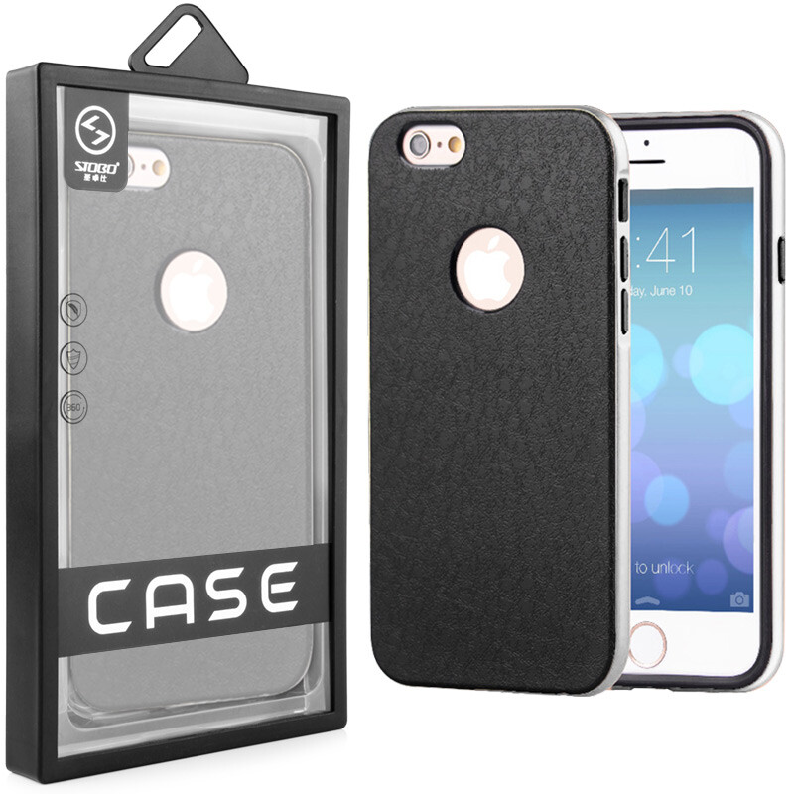
case /keɪs/ n.盒; 箱; 情况; 案件
1. 我从来没有遇到过这样的情况，所以我不知道该怎么办。
I had never encountered such a case, so I didn't know what to do.
2. 鉴于你的口才和对中文的巨大热情，我想知道你是否对这次比赛感兴趣，那么你应该在周三之前在我们学校的网站上提交你的申请。_{2020年1月浙江高考应用文“邀请参加外国学生中文演讲比赛”}
Given your superb eloquence and immense enthusiasm in Chinese, I'm wondering if the contest holds a fascination for you, in which case you are supposed to submit your application on our school website before Wednesday.
superb /suːˈpɜːb/ adj. 极好的；华丽的；宏伟的 eloquence /ˈeləkwəns/ n. 口才；雄辩
_{immense /ɪˈmens/ adj. 巨大的，广大的}
3. 在欣赏这些画作的同时，我也被那些才华横溢的同学们展现出来的高超绘画技巧所折服。 _{2021年6月浙江卷应用文“ 参观国画展的宣传报道”}
While admiring all those paintings, I was amazed at the excellent painting techniques showcased by those talented schoolmates.
showcase /ˈʃəʊkeɪs/展示（本领、才华或优良品质）

Slide 45


http://www.sunedu.com
Thank You!

