Slide 1

感恩遇见，相互成就，本课件资料仅供您个人参考、教学使用，严禁自行在网络传播，违者依知识产权法追究法律责任。
更多教学资源请关注
公众号：溯恩高中英语
知识产权声明

Slide 2
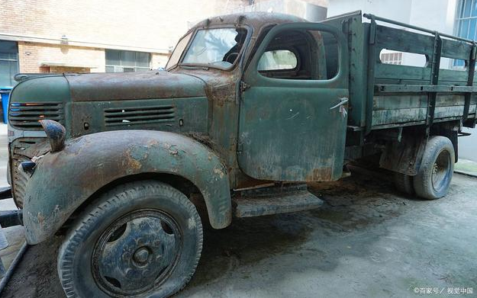
读后续写
——我的旧卡车
2022学年第二学期浙南名校/浙江七彩阳光联盟返校联考

Slide 3
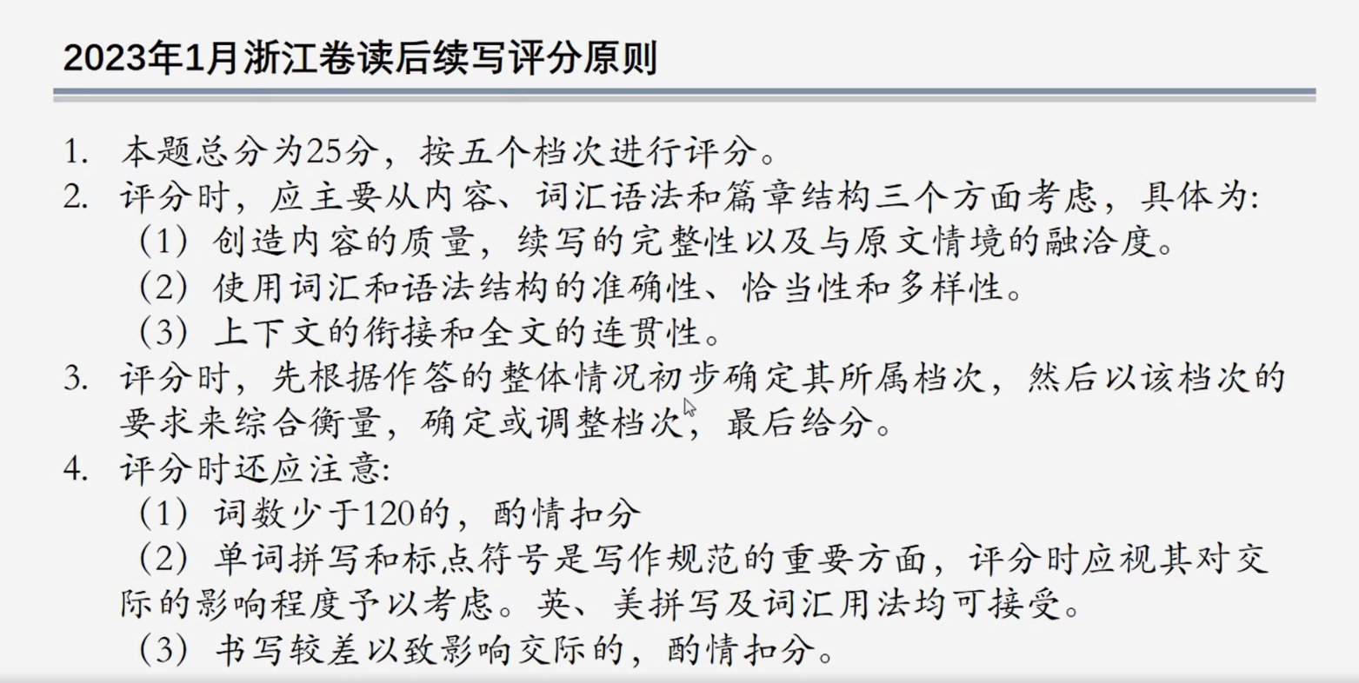

Slide 4
As I was driving to the airport last week the odometer(里程表) on my truck rotated to 100,000 kilometers. This led me to pause and think about selling the truck and buying a new one, but it also made me think about all the life I’d lived in this truck, and how my bulldog had accompanied me in it, leaving me hesitating about selling it.
When I returned to Canada after nine years overseas, what better way could I fit in with and immerse in rural culture than by buying a pickup?
The day I rolled out of the dealer(经销商) and hit the first gravel road(碎石马路) in my Toyota Tacoma was exciting, until I got very nervous as rocks hit my new purchase. But all that quickly evaporated when I received my first call through the truck’s Bluetooth phone. It was the doctor, to say that my Dad was hospitalized in a remote location. I immediately followed the truck’s GPS and got there quickly and safely. I was with Dad for his last two days. And so the first memories of my truck are images carved in my heart.
As the kilometers of my life rolled on, Lyon, my bulldog who came back to Canada with me from France, claimed the back seat as an area belonging only to her. It didn’t matter how short or long the trip was, she stared at me in the review mirror all the time. Most often, I would arrive at our destination and Lyon would stay in the back seat, bathed in the sun with the door open, knowing I would return. There was an overwhelming sense of comfort between us in that truck.
In the early days of truck ownership, I panicked at how dirty it became and any dent(凹痕) it put on. I
soon realized, though, that it was part of the truck’s character. Now I look at every dent and recall the story or adventure that put them there. I began to see it as character-building, much like wrinkles appearing on my face. The truck was simply aging gracefully and began, like humans, to display its experience and wisdom.
Para.1 I don’t think a vehicle is just for travelling from place to place.
Para.2 But as I approached the car dealer, I stopped.

Slide 5
1. Characters/Relationships
the car dealer(经销商)
I bought the truck when I returned to Canada after 9 years overseas because I __________________________________
wanted to fit in and immerse in rural culture.
I
When my father was hospitalized, I ______________ and got there _________________.
accompanied
Lyon always __________ me in the truck and there was an overwhelming sense of _______ between us in that truck.
drove the truck
quickly and safely
comfort
my father
my bulldog Lyon

Slide 6

2. Plot
As I was driving to the airport last week the odometer(里程表) on my truck rotated to 100,000 kilometers. This led me to pause and think about selling the truck and buying a new one, but it also made me think about all the life I’d lived in this truck and how my bulldog had accompanied me in it, leaving me hesitating about selling it.
When I returned to Canada after nine years overseas, what better way could I fit in with and immerse in rural culture than by buying a pickup?
The day I rolled out of the dealer(经销商) and the first gravel road(碎石马路) in my Toyota Tacoma was exciting, until I got very nervous as rocks hit my new purchase. But all that quickly evaporated when I received my first call through the truck's Bluetooth phone. It was the doctor, to say tha my Dad was hospitalized in a remote location.I immediately followed the truck's GPS and got there quickly and safely. I was with Dad for his last two days. And so the first memories of my truck are images(carved in my heart)
As the kilometers of my life rolled on, Lyon, my bulldog who came back to Canada with me from France,claimed the back seat as an area belonging only to her. It didn't matter how short or long the tripwas,she stared at me in the review mirror all the time. Most oft en, I would arrive at our destination and Lyon would stay in the back seat, bathed in the sun with the door open, knowing I would return. There was an overwhelming sense of comfort between us in that truck.
In the early days of truck ownership, I panicked at how dirty it became and any dent(凹痕) it put on. I soon realized, though,that it was part of the truck's character. No w I look at every dent and recall the story or adventure that put them there. I began to see it as character-b uilding, much like wrinkles appearing on my face. The truck was simply aging gracefully and began, like the humans, to display its experience and wisdom.
Para.1 I don’t think a vehicle is just for travelling from place to place.
Para.2 But as I approached the car dealer, I stopped.
承上
启下
• The reason for buying it
• Rush to my Dad’s hospital in the truck quickly and safely
3. What’s the theme?
• Happy time with Lyon in the truck
My bond and special relationship with the old truck which carries so many precious memories of my life.
• My attitude towards the dent on the truck changed over time

Slide 7
3. Good expressions
1. (现在分词作结果状语)This led me to pause and think about selling the truck and buying a new one, but it also made me think about all the life I’d lived in this truck, and how my bulldog had accompanied me in it, leaving me hesitating about selling it.
2. (反问与比较连用表最高级)When I returned to Canada after nine years overseas, what better way could I fit in with and immerse in rural culture than by buying a pickup?
3. (过去分词作定语)And so the first memories of my truck are images carved in my heart.
4. (定语从句，拟人，现在分词作定语)As the kilometers of my life rolled on, Lyon, my bulldog who came back to Canada with me from France, claimed the back seat as an area belonging only to her.
5. (过去分词、现在分词作状语)Most often, I would arrive at our destination and Lyon would stay in the back seat, bathed in the sun with the door open, knowing I would return.
6. (比喻, 前后呼应)Now I look at every dent and recall the story or adventure that put them there. I began to see it as character-building, much like wrinkles appearing on my face. The truck was simply aging gracefully and began, like humans, to display its experience and wisdom.

Slide 8
段首句
Para.1 I don’t think a vehicle is just for travelling from place to place.
Q1:
Q2:
Q3:
What else do I think is a vehicle for?
Why did I think so?
Why did I finally decide to sell it?
Para.2 But as I approached the car dealer, I stopped.
Q1:
Q2: Q3:
Why did I stop?
What did I think about the truck?
What is the theme/ending?

Slide 9
Para.1 I don’t think a vehicle is just for travelling from place to place.
Q1: What else do I think is a vehicle for? (注意和首句的衔接:意思上衔接;句式上衔接)
事实上，我常常把一辆交通工具想象(envision)成可以从一个生活事件到另一个生活事件的工具。
envisioned a vehicle as
Actually, I’ve always ___________________ going from _________________.
life event to event
学生佳作：
was more like
sheltering me
1) As to me, the truck ____________(更像是) a little home, _____________ _____________________(为我遮风挡雨), __________________________ of my heart(从我心底温暖我). It was also like an old friend, _____________(陪伴) me.
2) I ________________(也把它看做) my best friend ____________________ _________(总是支持我) and a container _____________________________ (充满珍贵的回忆) in my life.
from the rain and wind
warming me from the bottom
accompanying
also regarded it as
who was always right
behind me
brimmed with precious memories

Slide 10
Para.1 I don’t think a vehicle is just for travelling from place to place.
Q2: Why did I think so? (对前面这句话的解释,也是对卡车的回忆)
我的卡车带着我参加了许多葬礼、婚礼和其他许多我和我爱的人的重要活动。
navigated
funerals weddings
countless
My truck ________ me to many _______, ________, and other _________ _______________ of me and my _______ ones.
important events
beloved
它还指引我穿过平整的公路、蜿蜒的乡村小路、麦田、森林、烈日和暴风雪.(仿语法填空)
navigated
It also ________ me _______ _________________ , __________________, wheat fields, forests, _____________ and snowstorms.
through
well-paved highway
winding country roads
scorching sun
毫不夸张(exaggeration)地说，它见证了我生命中成千上万难忘的时刻，是我生命中最好的伴侣之一。
_______________________ that it _________ thousands of ____________ moments and _________ one of __________________ in my life.
It is no exaggeration to say
witnessed
unforgettable
served as
the best companions

Slide 11
Para.1 I don’t think a vehicle is just for travelling from place to place.
Q3: Why did I finally decide to sell it?
所有这些都让我犹豫要不要卖掉它。然而，事实是卡车太旧了，已经不太好了。似乎过了一个世纪，我轻轻地叹了口气，发动引擎，向汽车经销商出发。
left me hesitating about selling it
All these ____________________________. However, _______________ the truck was too old and _____________________________. After _______________________, I ____________, _________________ and _______________________.
the fact was that
was no longer in good condition
what seemed like a century
sighed lightly
started the engine
set out for the car dealer

Slide 12
Para.2 But as I approached the car dealer, I stopped.
Q1: Why did I stop?
我突然意识到我一点也不想卖掉我的卡车。(not in the least倒装)
It dawned on me that not in the least did I want to sell my truck.
__________________________________________________________
因为我离汽车经销商越近，我就越不愿意和卡车分离。就在那时，我突然意识到我之前是多么愚蠢，竟然说服自己卖掉我亲爱的朋友。(强调句)
the closer I was to the car dealer
Because _____________________________, _____________________ to ________________ the truck. And ______________________________ ______________ ____________________ to _________________________ my dear friend.
the more reluctant I felt
be separated from
it was exactly at that moment that
I came to realize
how stupid I had been
persuade myself into selling

Slide 13
Para.2 But as I approached the car dealer, I stopped.
Q2: What did I think about the truck?
虽然它看起来很老式，饱经风霜，但它承载了太多的回忆，它已经成为我和我生活的一部分。
Old-fashioned and weather-beaten as it looked like
____________________________________________, it ___________ so many memories ________________________________ me and my life.
held/carried
that it had already become a part of
这辆卡车拥有我生命中如此多的悲欢喜乐，与我建立了如此强烈的几乎无法切断的联系。我欣慰地叹了口气，然后掉头，Lyon安静地坐在后座上，享受着在卡车里的舒适感。
possessed so many joys and sorrows
built such
This truck _______________________________ of my life and _________ ____________ with me ___________________________. With eyes _________, I _______________ and _____________, Lyon ________ peacefully in the back seat and _________ the sense of comfort in the truck.
a strong bond
which could hardly be cut off
beaming
sighed with relief
did a U-turn
staying
enjoying

Slide 14
Para.2 But as I approached the car dealer, I stopped.
Q3: What is the theme/ending?
在阳光下，卡车就像一个优雅而宽容的老人，默默地陪伴着我回家。看了一眼旋转的里程表，我很确定我永远不会考虑卖掉它。
__________________, the truck ________ a ________________ and old ________ guy, ______________________________________. ________
___________________________, I _____________that I would never _____________________.
Bathed in the sun
was like
gracefully-aging
tolerant
accompanying me silently on our way home
Taking a
glance at the rotating odometer
was quite sure
think about selling it

Slide 15
下水作文
I don’t think a vehicle is just for travelling from place to place. As to me, the truck was more like a little home, sheltering me from the rain and wind, warming me from the bottom of my heart. It navigated me to many funerals, weddings and other countless important events of me and my beloved ones. It also navigated me through well-paved highway, winding country roads, wheat fields, forests, scorching sun and snowstorms. It is no exaggeration to say that the truck witnessed thousands of unforgettable moments and served as one of the best companions in my life. All these left me hesitating about selling it. However, the fact was that the truck was too old and was no longer in good condition. After what seemed like a century, I sighed lightly, started the engine and set out for the car dealer.
But as I approached the car dealer, I stopped. It dawned on me that not in the least did I want to sell my truck. Because the closer I was to the car dealer, the more reluctant I felt to be separated from it. And that’s when it suddenly occurred that how stupid I had been to persuade myself into selling my dear friend. Old-fashioned and weather-beaten as it looked like, it held so many memories that it has already become a part of me and my life. With eyes beaming, I sighed with relief and did a U-turn. Bathing in the sun, the truck was like a gracefully-aging and old tolerant guy, accompanying me silently on our way home. Taking a glance at the rotating odometer, I was quite sure that I would never think about selling it.

Slide 16
范文
I don’t think a vehicle is just for travelling from place to place. I’ve always envisioned a vehicle as going from life event to event. My truck navigated me to more funerals, weddings, through snowstorms, and quickly home from Florida when the government called everyone back to Canada because of COVID-19. Unfortunately, this summer Lyon had a stroke. My knees weakened as I lifted Lyon out of our truck into the vet’s office wrapped in her blanket, which still remains on the back seat to this day. This was a hard time. I didn’t know if I could bear to live with the memories, so I drove it to the dealer.
But as I approached the car dealer, I stopped. The warm memories with Lyon came flooding back. As the kilometers continued to roll on, Lyon could no longer jump into the back seat and had to be lifted in and out. Although it saddened me to see that the inevitable was coming, it warmed my heart to see her comfortable in the back seat. Thinking of these, my eyes blurred and tears started to flow. I took a deep breath. This truck possessed so much of the scar tissue of my life, so I did a U-turn. Once again, I’m putting my heart back into the truck and letting it navigate to accumulate more kilometers and memories on the highway of life.

