Slide 1

感恩遇见，相互成就，本课件资料仅供您个人参考、教学使用，严禁自行在网络传播，违者依知识产权法追究法律责任。
更多教学资源请关注
公众号：溯恩高中英语
知识产权声明

Slide 2
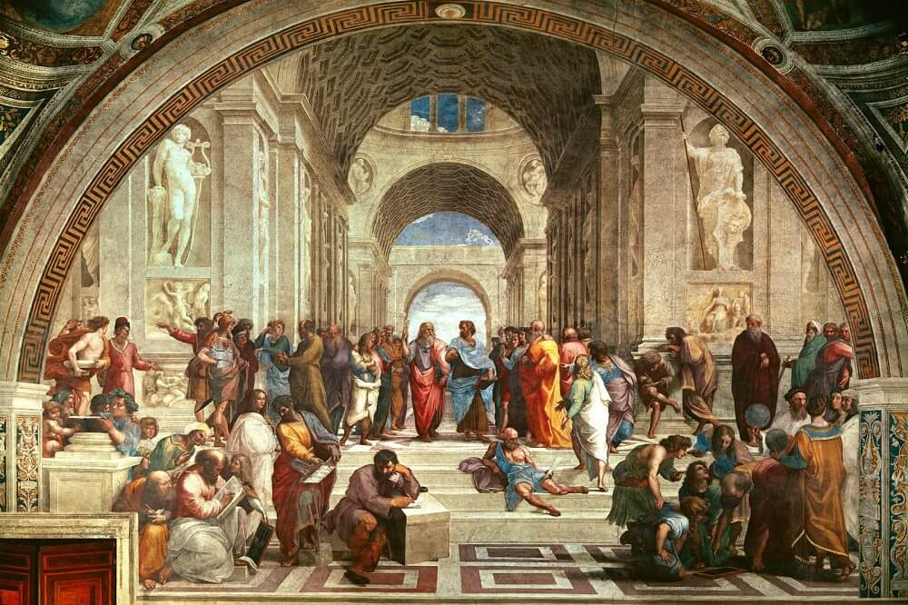
S3U1 ART
Reading and Thinking
A Short History of Western Painting
桐乡市高级中学 俞莺婕

Slide 3
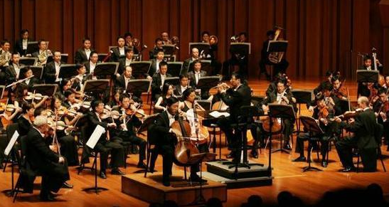
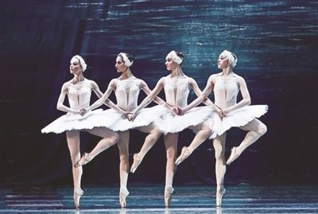
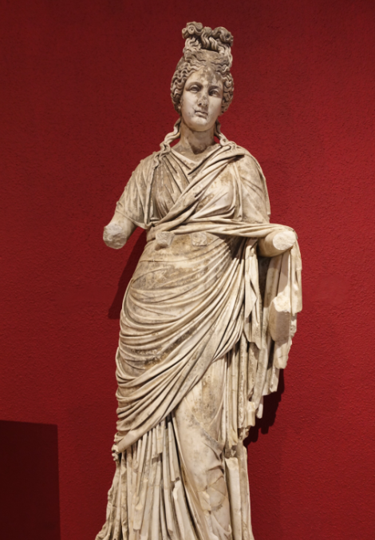
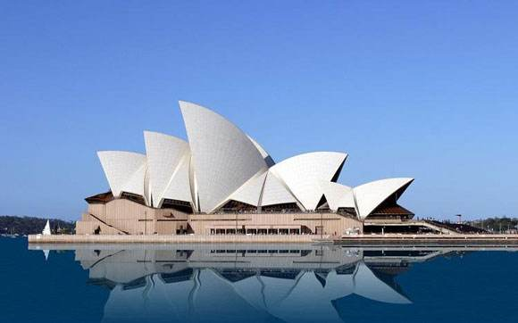
Activity 1 Get to know art and art forms
What do you think is art?
Can you list some art forms?
music
dance
sculpture
architecture

Slide 4
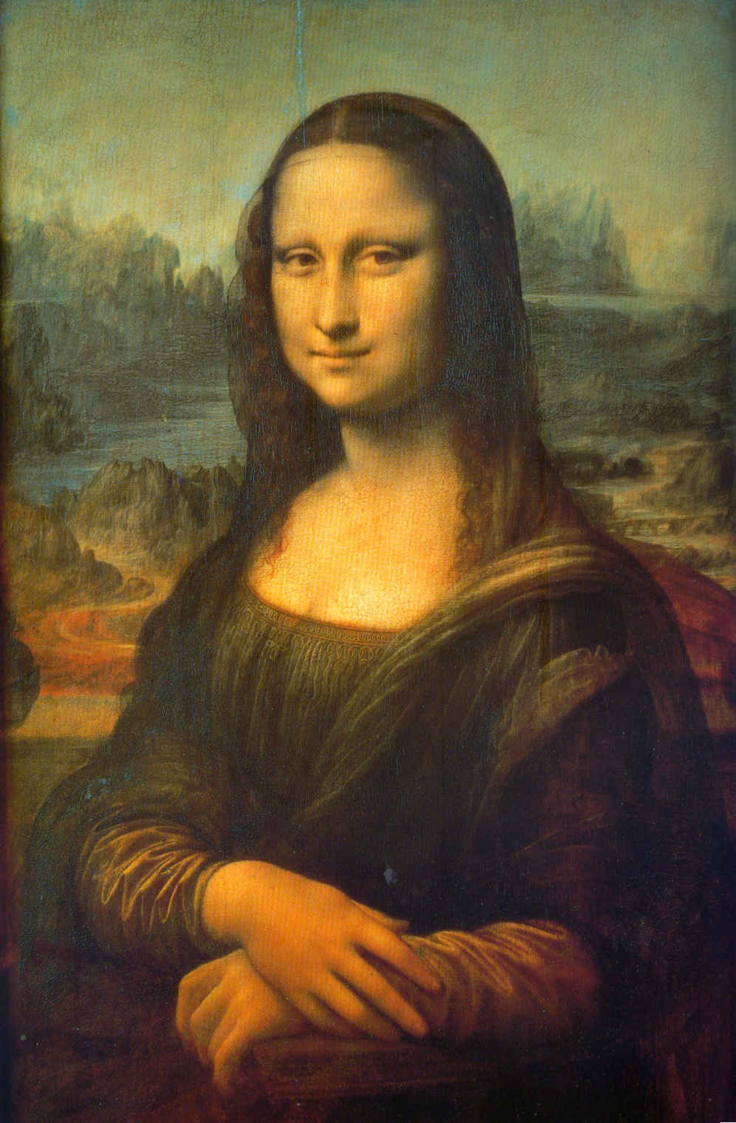
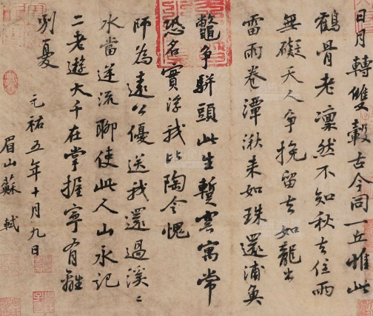



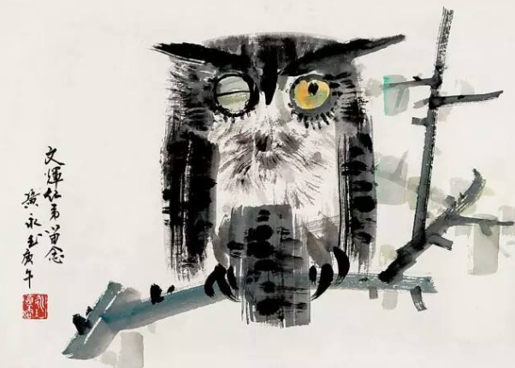
Activity 1 Lead in
painting
calligraphy
paper cutting
photography
Chinese-style Paintings
Western-style Paintings

Slide 5
Activity 2 Read the title and subtitles for main idea
The text mainly tells us _____ major styles of _______________ , showing the __________________ of it.
four
Western paintings
development/history
Part 1(Para.1) A．The Renaissance
Part 2(Para. 2) B．The Middle Ages
Part 3(Paras. 3～5) C．Introduction
Part 4(Paras. 6～7) D．Modern Art
Part 5(Para. 8) E．Impressionism
What functions do the subtitles serve?
To clearly show the structure of the text

Slide 6
Activity 3 Read for detailed information
Para1 Introduction
accurate
(1)What is western art?
(2)What is the best way to understand it?
It’s hard to give a precise definition.
There are many different styles of western art.
The best way to understand western art is to look at the development of it over the centuries.

Slide 7
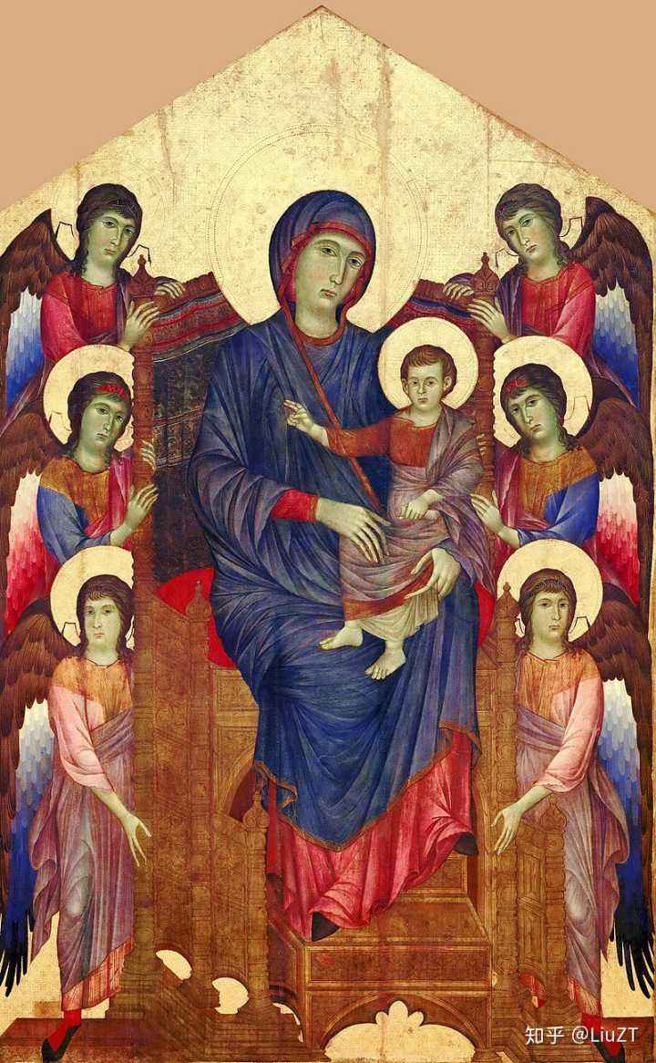
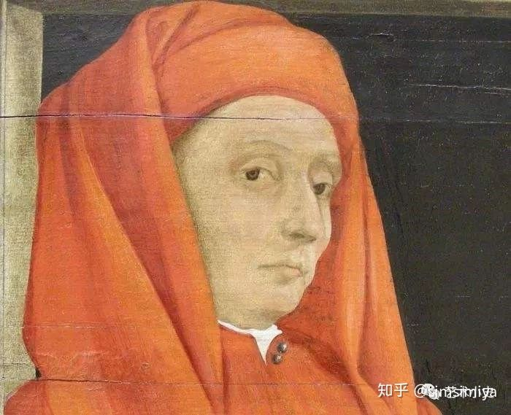
Activity 3 Read for detailed information
Para2 The Middle Ages
(1)What is the purpose of art in the Middle Ages?
(2)What are the features of the paintings at that time?
(3) Who is mentioned as a famous artist?
To teach people about Christianity
primitive and two-dimensional
main characters larger than everyone else
showing real people in a real environment with realistic human faces and deep emotional impact (in the 13th century)
Giotto di Bondone

Slide 8
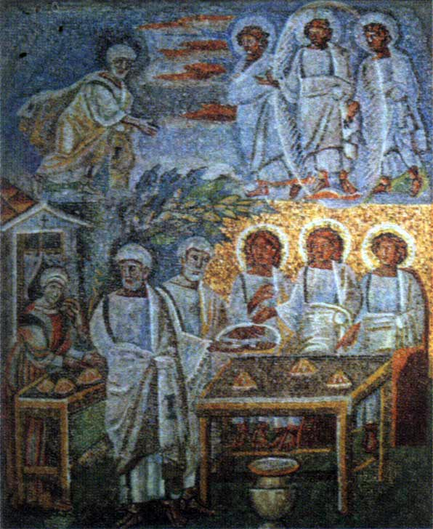
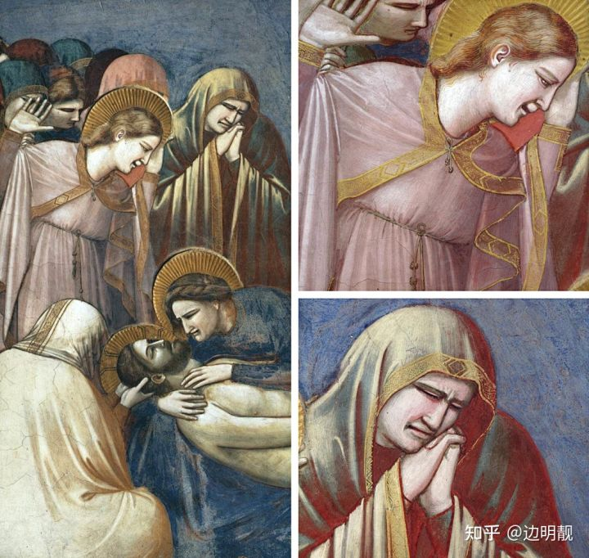
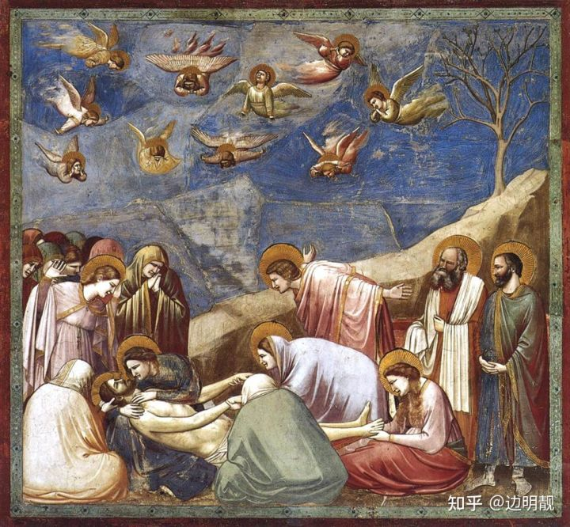

Which one is more realistic?
The Mourning of Christ (哀悼基督)

Slide 9
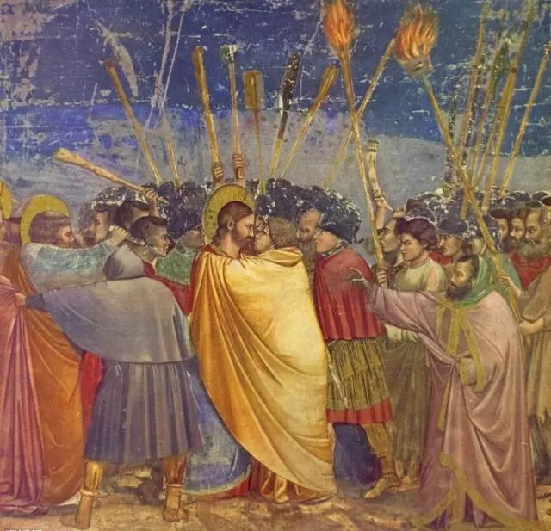
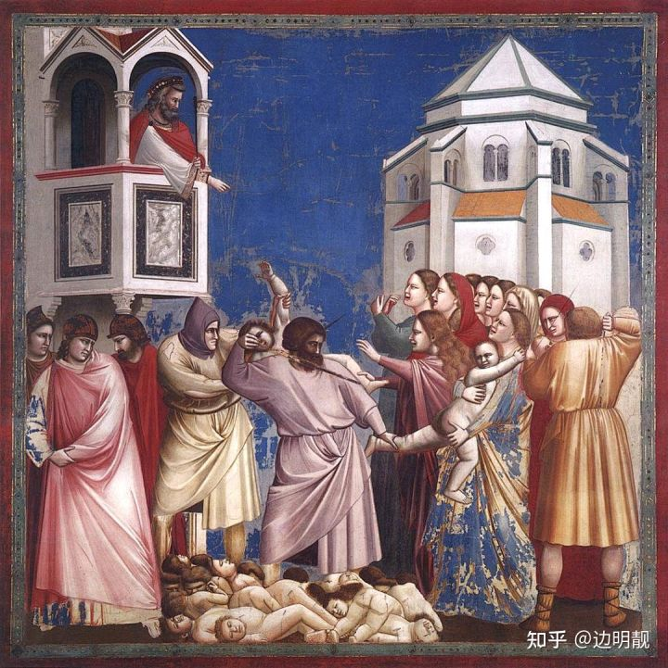
Works of Giotto di Bondone
Kiss of Judas
犹大之吻
The Massacre of the Innocents无辜者的大屠杀

Slide 10
Activity 3 Read for detailed information
Para3-5 The Renaissance
(1)Why didn’t painters focus more on religion at this period?
New ideas and values gradually replaced the old ones from the middle ages.
(2)What are the features of the paintings at that time?
subject: shifted from ________________ to ________________________________
adopt __________________________________
accurate pictures of people’s portraits and important _______ events
Two breakthroughs:________________________
religious themes
people and the world around us
a more humanistic attitude to life
historical
perspective
oil paints
(3)Who are mentioned as famous artists?
Masaccio，Leonardo da Vinci，Michelangelo，Raphael，Rembrandt

Slide 11
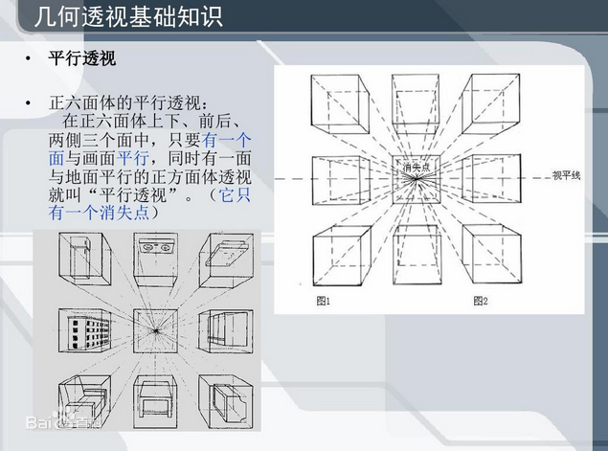
Perspective （透视法）
It is the technique of representing three-dimensional objects on a two-dimensional surface by presenting people and things as being smaller than those are nearer the front.
School of Athens by Raphael

Slide 12
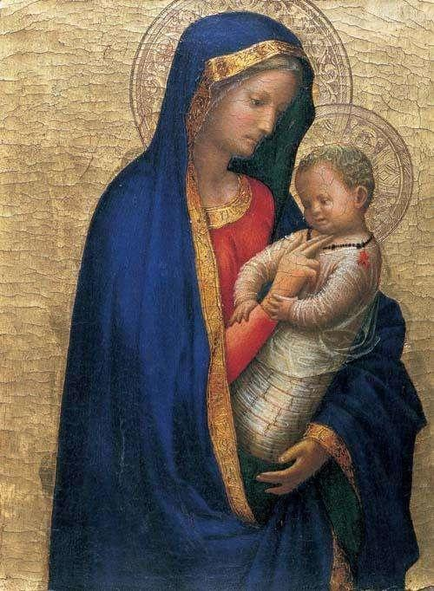
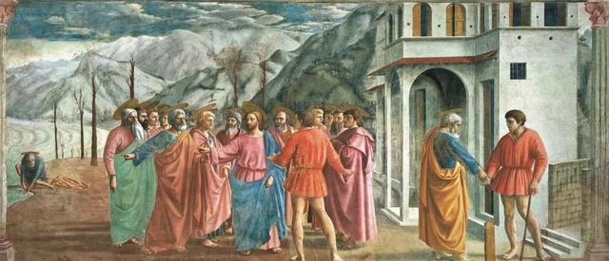
Works of Masaccio
The Tribute Money
纳税银
Madonna And Child
圣母子

Slide 13
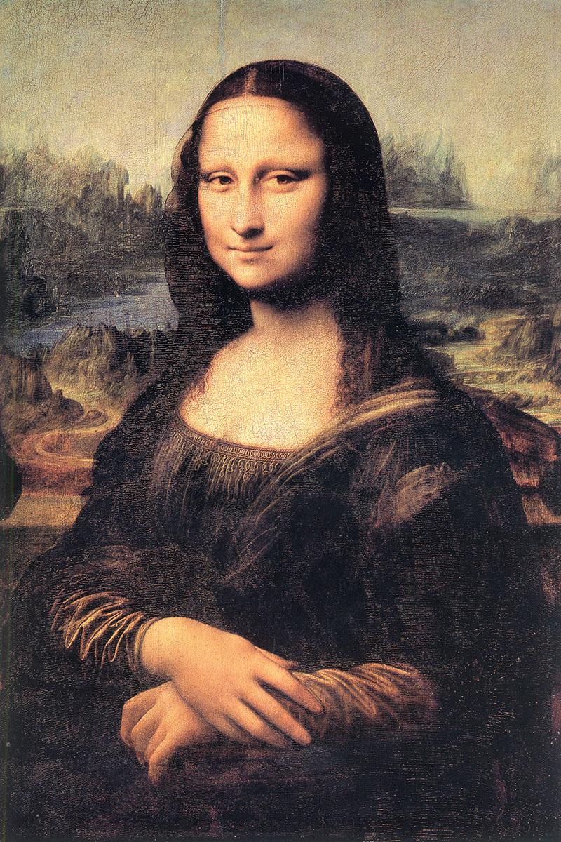
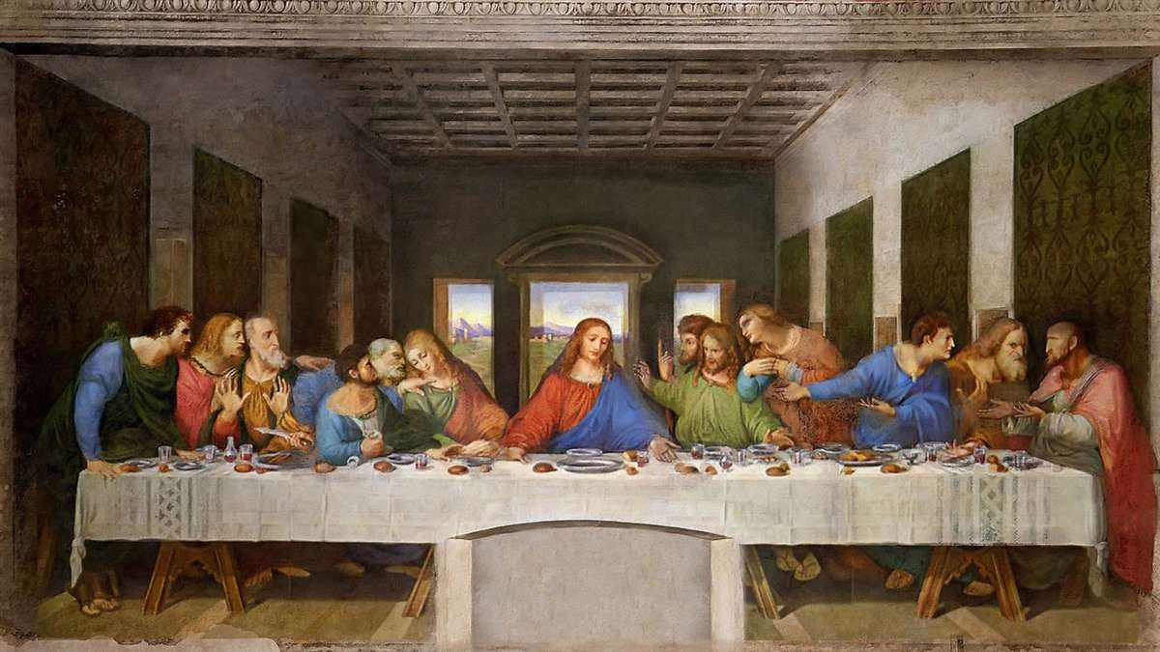
Works of Leonardo da Vinci

Slide 14
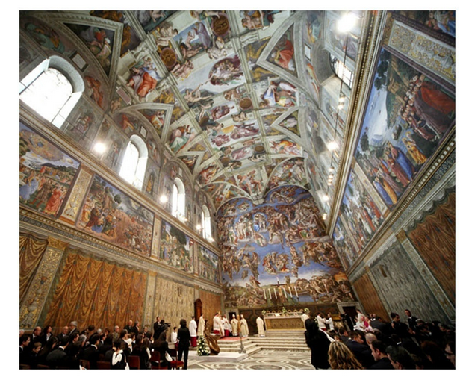
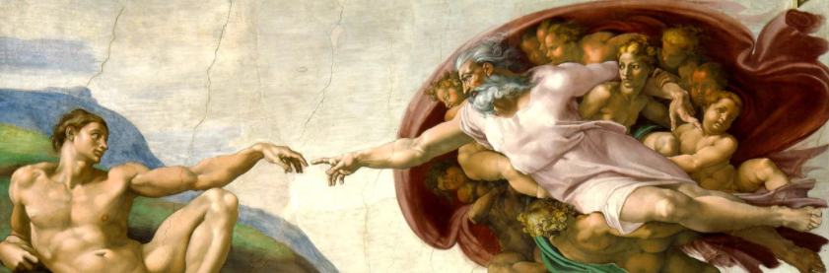
Works of Michelangelo

Slide 15
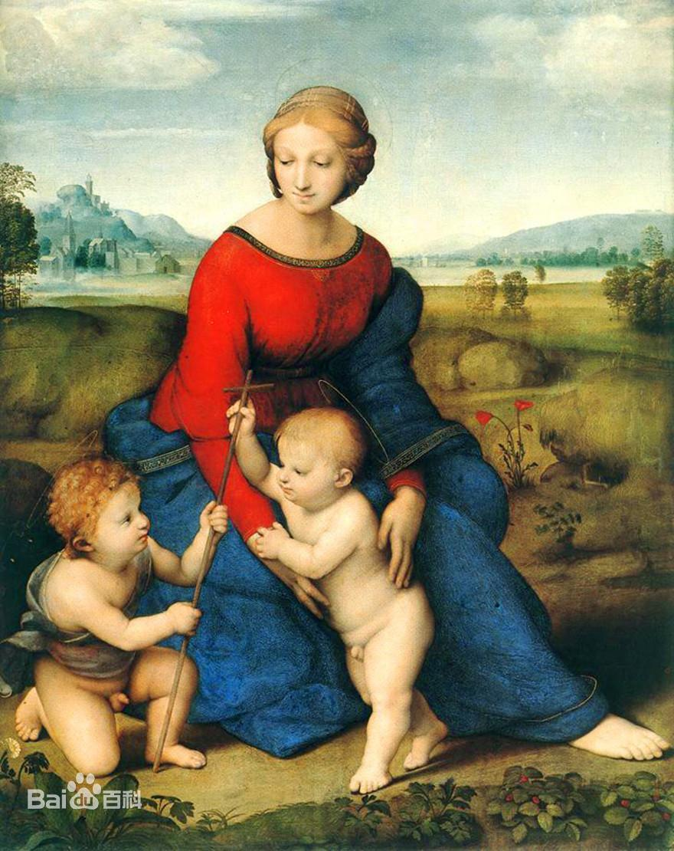
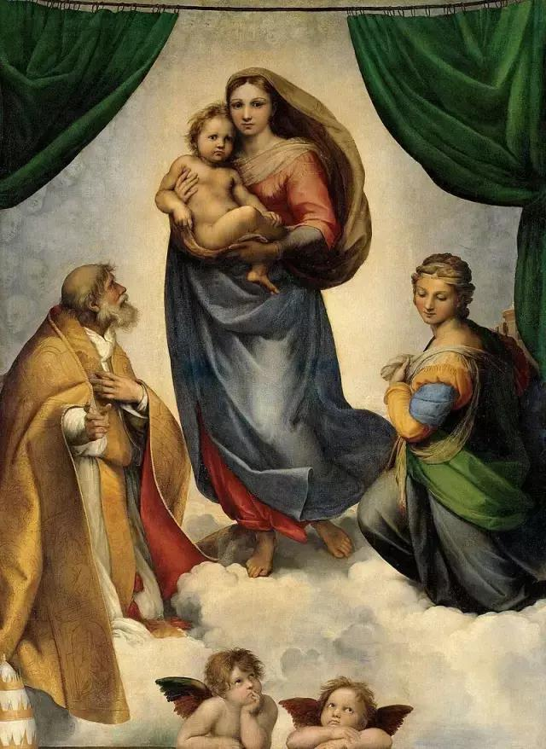
Works of Raphael
Madonna of the Meadow
草地上的圣母
Sistine Madonna
西斯廷圣母

Slide 16
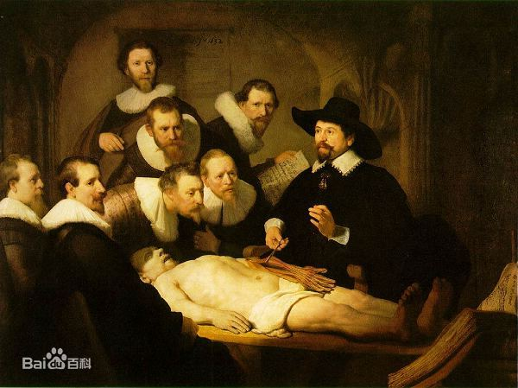
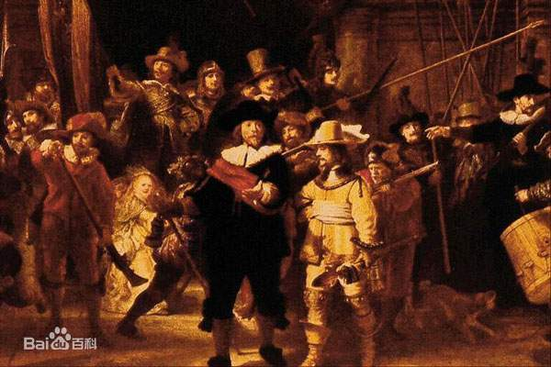
Works of Rembrandt
The Anatomy Lessonof Dr.Tulp
杜普教授的解剖学课
The Night Watch
夜巡

Slide 17
Activity 3 Read for detailed information
Para 6-7 Impressionism
(1)Why did painters find a new way of looking at their art?
(2)Where did Impressionism emerge and why was it called Impressionism?
(3)What are the features of the paintings during this period?
(4) Who are mentioned as famous artists?
Because of the invention of photography, there is no need to preserve what people and the world looked like.
France. The name came from Monet’s painting Impression, Sunrise.
Aim:
to convey the light and movement in the scene (light, shadow, color)
to show their inner warmth and humanity
Subject:
  nature, daily life,people
Claude Monet，Renoir

Slide 18
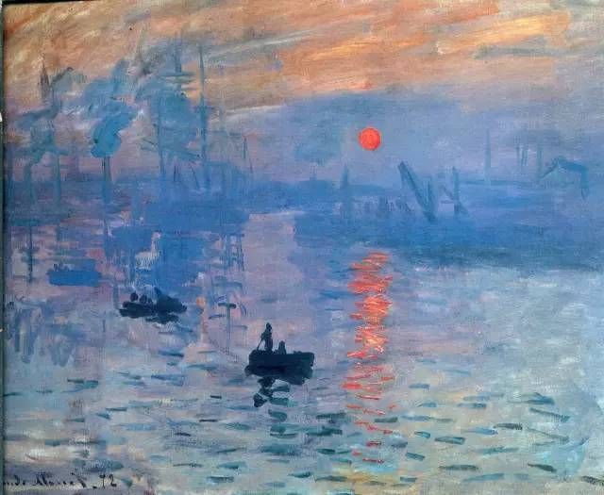
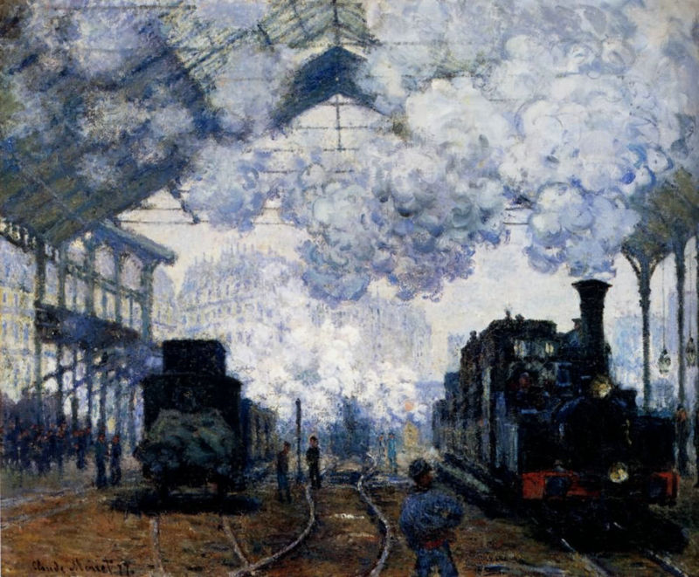
Works of Claude Monet
Impression,Sunrise
印象，日出
Arrival of the Normandy Train
圣拉扎尔火车站

Slide 19
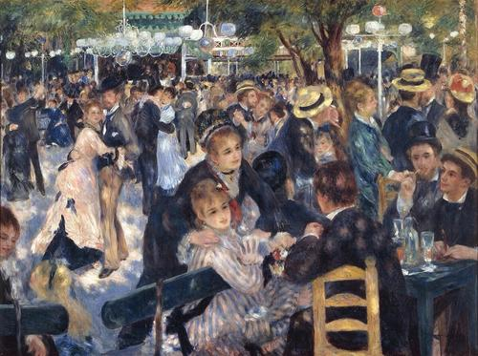
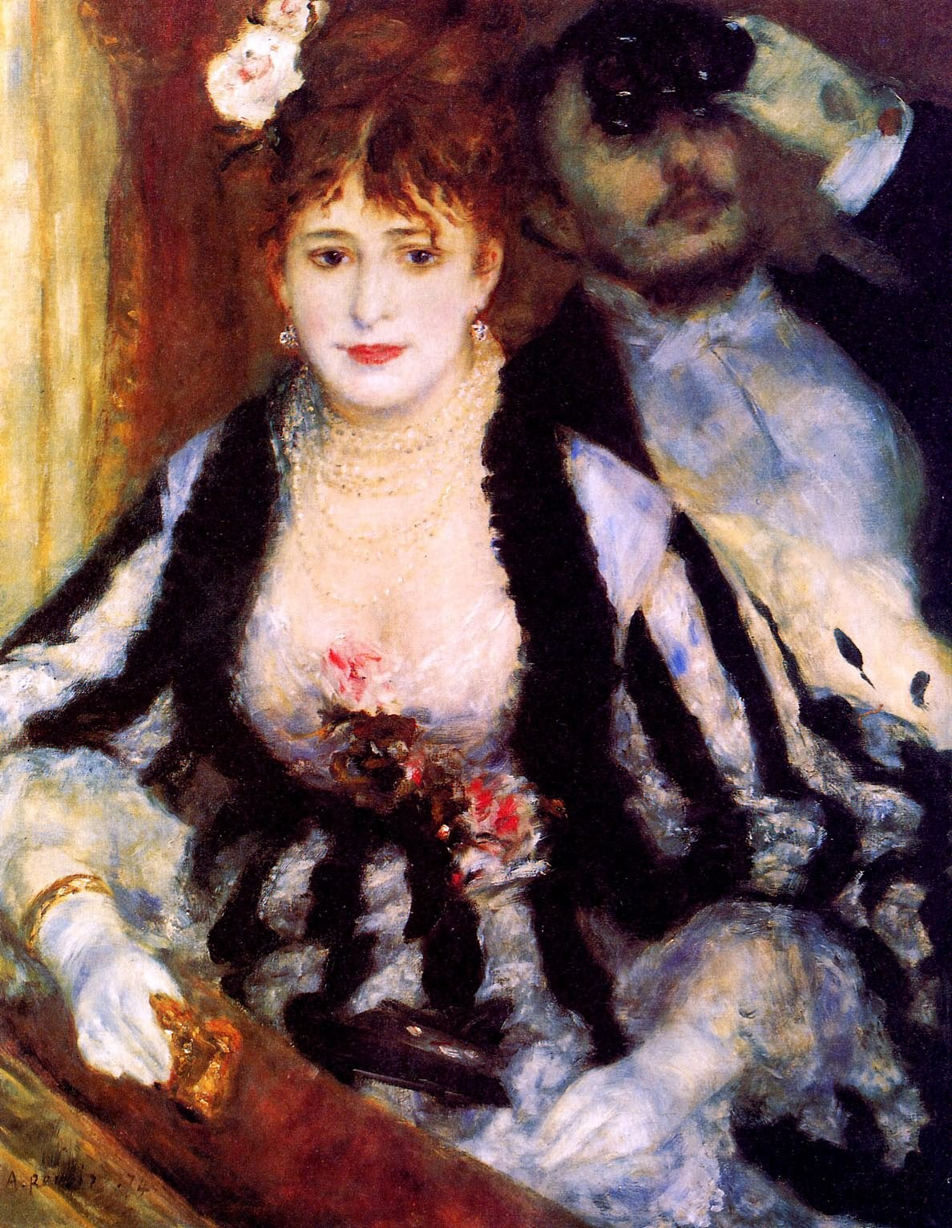
Works of Renoir
Dance at Le Moulin de la Galette
红磨坊街的露天舞会
The Loge
包厢

Slide 20
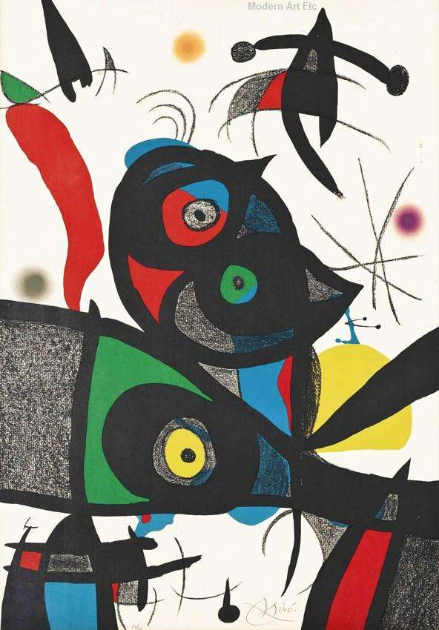
Activity 3 Read for detailed information
Para 8 Modern Art
(1)What are the styles and features during this period?
(2)Who is mentioned as a famous artist? Do you know some other modern artists?
Cubism: analyze the shapes in a new way
give paintings a realistic but dream-like quality
Abstract art: no longer show reality and explore what art is
Picasso

Slide 21
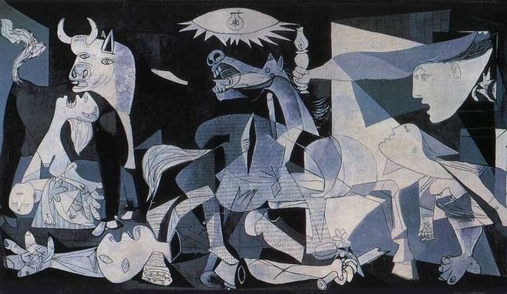
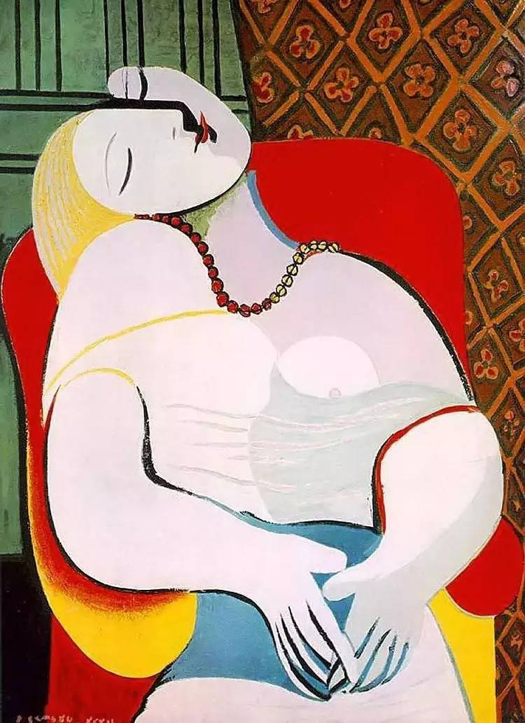
Works of Picasso
Guernica
格尔尼卡
Dream
梦

Slide 22
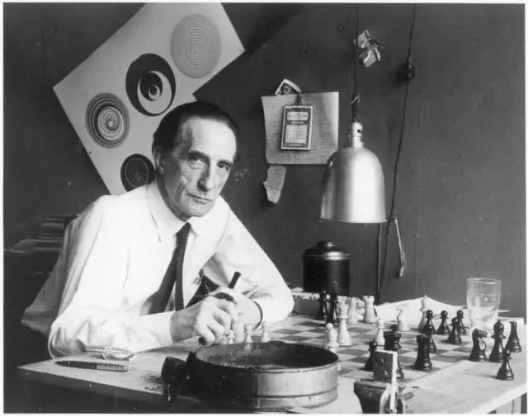
Marcel Duchamp
马塞尔·杜尚（1887－1968），法国艺术家，二十世纪实验艺术的先锋，对于第二次世界大战前的西方艺术有着重要的影响，是达达主义及超现实主义的代表人物和创始人之一。
Sad Young Man on a Train
In Advance of the Broken Arm

Slide 23
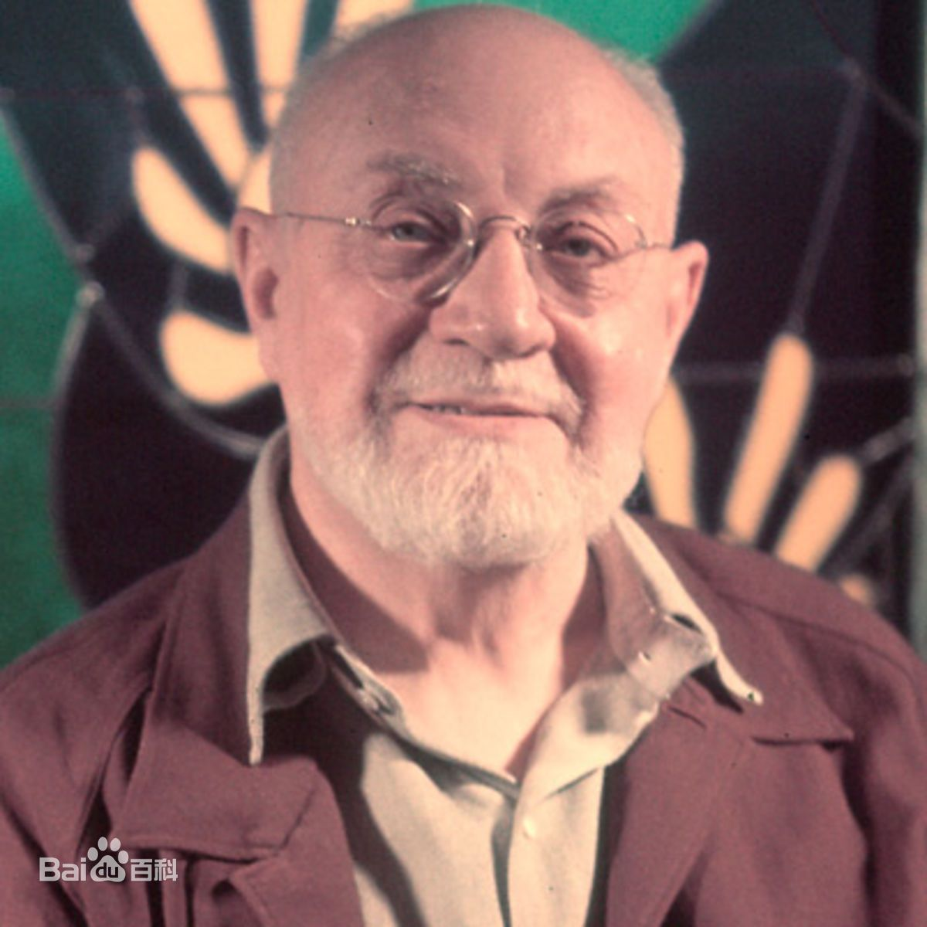
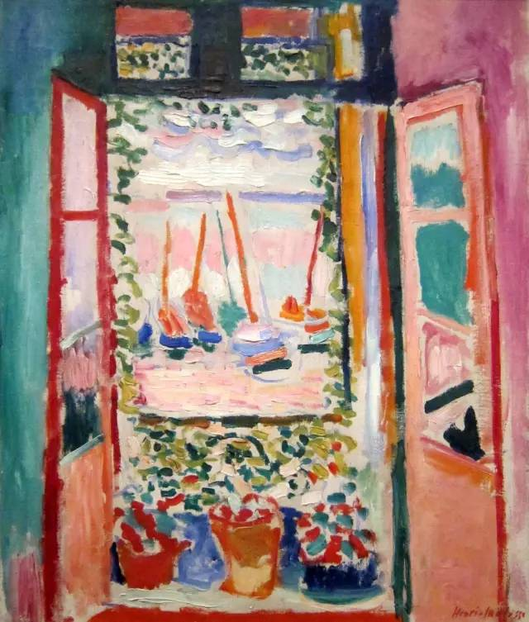
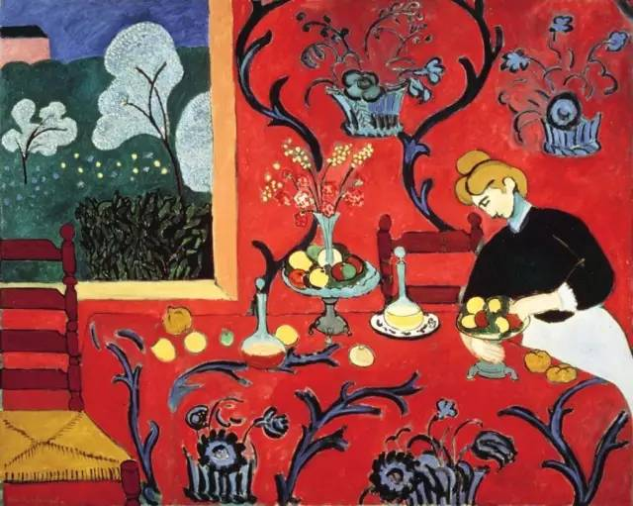
Henri Matisse
亨利·马蒂斯（1869 - 1954），法国著名画家、雕塑家、版画家，野兽派创始人和主要代表人物，以使用鲜明、大胆的色彩而著名。
红色中的和谐
开窗

Slide 24
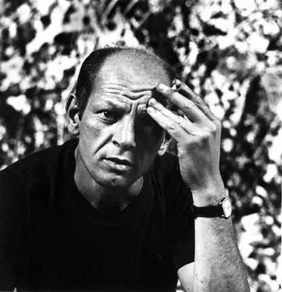
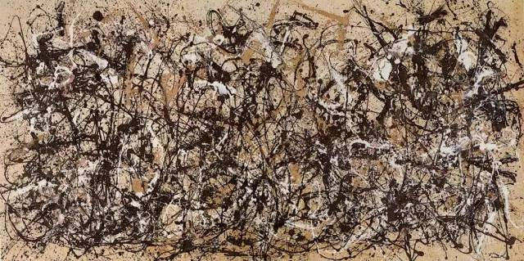
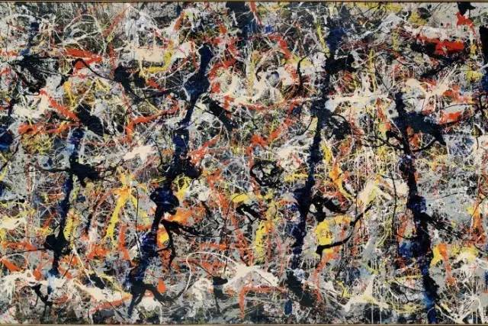
Jackson Pollock
杰克逊·波洛克（1912-1956），美国画家，抽象表现主义绘画大师，也被公认为是美国现代绘画摆脱欧洲标准，在国际艺坛建立领导地位的第一功臣。
秋韵5号
蓝杆

Slide 25
Activity 4 Summarize the history of west painting
humanistic
accurate portraits
perspective
oil paints
1. Draw a mind-map of the short history of the western paintings, add the features of each time period.
realistic, dream-like quality, abstract
The Renaissance
Modern Art
5th
14th
15th
17th
The Middle Ages
Impressionism
20th
19th
religious themes
primitive and 2D
Main characters were larger than everyone else
change in 13th century
subjective impressions of the scene
inner warmth and humanity

Slide 26
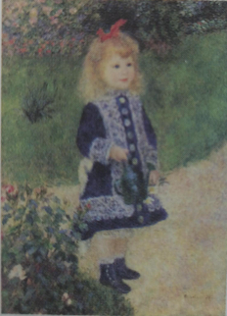
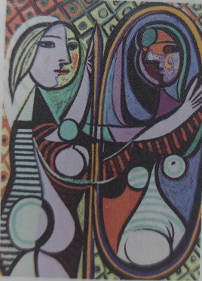
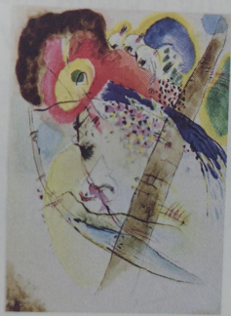
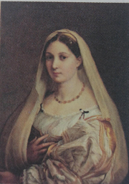
Activity 4 Summarize the history of west painting
2. In which period was each painting created?
Impressionism
Modern Art
Modern Art
The Renaissance
A Girl with a Watering Can (1876) by Renoir
Girl Before a Mirror (1932) by Picasso
Exotic Birds (1915)
by Wassily Kandinsky
The Woman with the Veil by Raphael

Slide 27
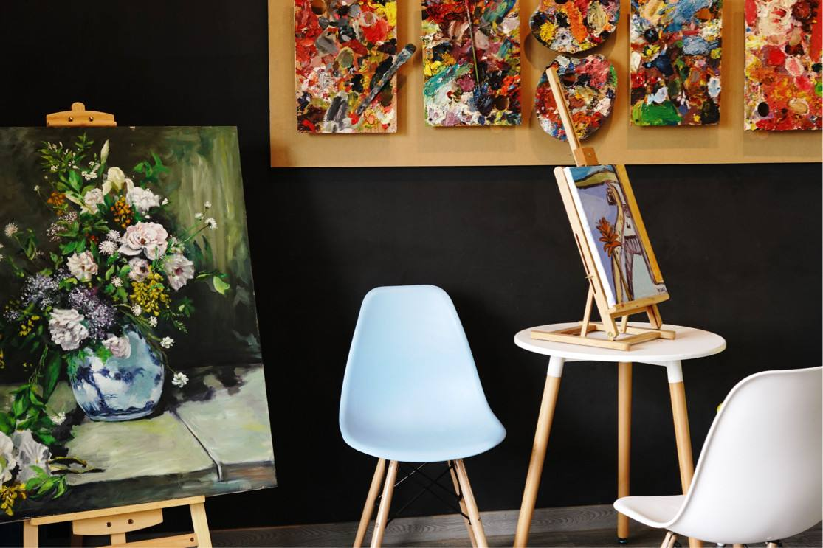
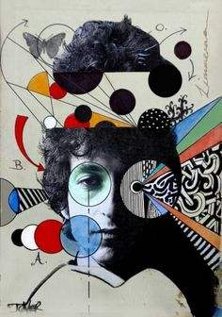
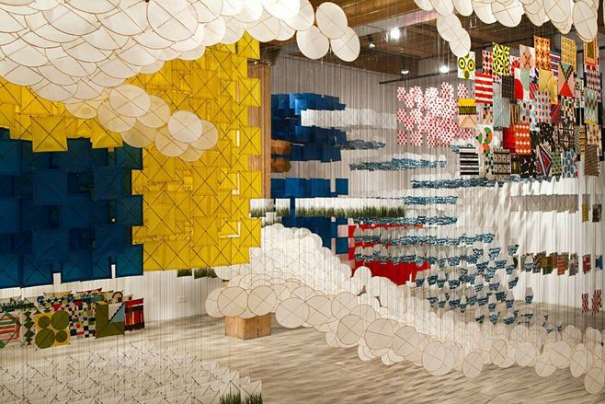
Activity 4 Summarize the history of west painting
3. Which period of Western art do you like most? Why?
4. What do you think promoted the change in western paintings?
5. Based on the text, what do you think is art?

