Slide 1

感恩遇见，相互成就，本课件资料仅供您个人参考、教学使用，严禁自行在网络传播，违者依知识产权法追究法律责任。
更多教学资源请关注
公众号：溯恩高中英语
知识产权声明

Slide 2

The World
March 1st-15th, 2023

Slide 3
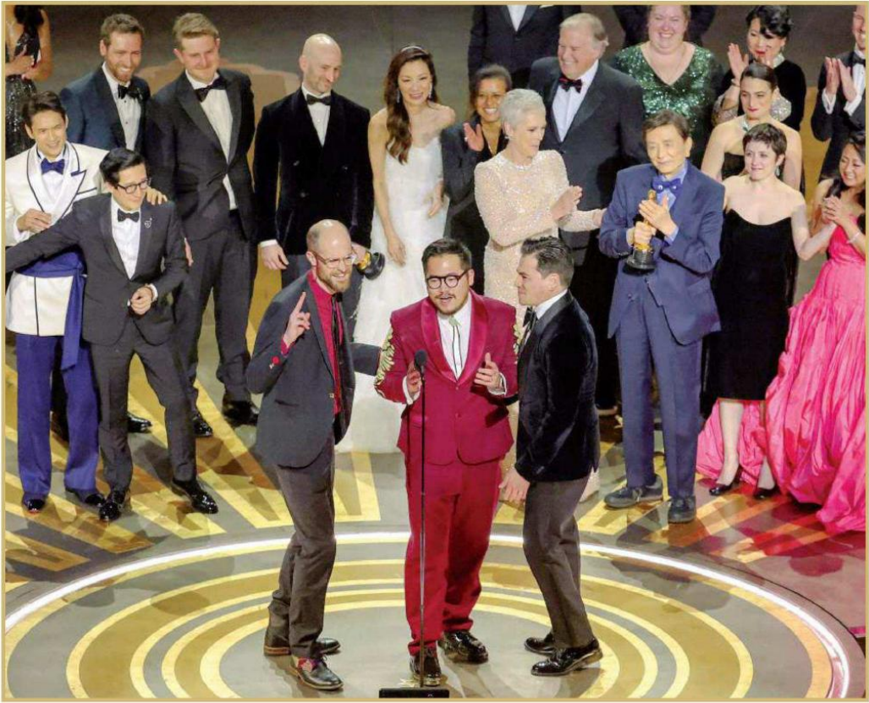

1. ‘Everything’ is celebratory at 95th Oscars
《瞬息全宇宙》赢得多项奥斯卡奖项

Slide 4
语篇填空
（《洛杉矶时报》2023年3月13日 A1&A12版面）
“Everything Everywhere All at Once,” a sci-fi-action-comedy mash-up about a Chinese American immigrant __________ traverses the multiverse to keep her family together, claimed best picture at the 95th Academy Awards on Sunday night, _______ (beat) out a diverse field that included massive blockbusters as well as intimate arthouse fare.
Leading the field with 11 ___________ (nomination), “Everything Everywhere” won seven, including lead actress for Michelle Yeoh, supporting actor for KeHuy Quan and supporting actress for Jamie Lee Curtis, along with ________ (origin) screenplay and directing wins for co-directors Daniel Kwan and Daniel Scheinert.
“Everything Everywhere”proved a sleeper hit, grossing more than $100 million worldwide and, _________ (power) by its combination of crazy filmmaking and poignant themes of familial love and generational unpleasant experiences, __________ (gradual) established itself as a genuine competitor.
____ awards season heated up, the film picked up momentum, steamrolling through the major Hollywood guilds to emerge as ____ Oscar front-runner.
Yeoh took home the lead actress award for her turn as the no-nonsense matriarch of “Everything Everywhere,” making the Malaysian-born action idol the first Asian performer ______ (win) that prize. “____ all the little girls and boys who look like me watching tonight, this is a beacon of hope and possibilities,” Yeoh said. “And ladies, don’t let anybody tell you you are past your prime.”
who / that
beating
nominations
original
powered
gradually
As
an
to win
For

Slide 5
词汇讲解
1. claim: to gain, win or achieve sth 获得；赢得；取得
Zhuang claimed the record in 54.64 seconds.
庄创造了54.64秒的纪录。
2. poignant: having a strong effect on your feelings, especially in a way that makes you feel sad moving 令人沉痛的；悲惨的；酸楚的
Her face was a poignant reminder of the passing of time.
她的容颜显示青春已逝，令人感伤。
翻译句子
她终于成了那支队的队员。
She has finally claimed a place on the team.
翻译句子
两个人之间心碎的情书后来得以出版面世。
Their poignant love letters were later published.

Slide 6
句子翻译
“Everything Everywhere All at Once,” a sci-fi-action-comedy mash-up about a Chin-ese American immigrant who traverses the multiverse to keep her family together, claimed best picture at the 95th Academy Awards on Sunday night, beating out a diverse field that included massive blockbusters as well as intimate arthouse fare.
翻译
周日晚，第95届奥斯卡金像奖(Academy Awards)的最佳影片奖在包括大型大片和亲密的艺术电影在内的众多奖项中摘得，这是一部科幻动作喜剧混搭片，讲述了一名华裔美国移民穿越多元宇宙，让家人团聚的故事。
As awards season heated up, the film picked up momentum, steamrolling through the major Hollywood guilds to emerge as an Oscar front-runner.
翻译
随着颁奖季的升温，这部电影势头迅猛，横扫好莱坞各大公会，成为奥斯卡的领跑者。

Slide 7
与奥斯卡相关的词汇1
Oscar winner 奥斯卡获奖者
Presenter 颁奖人
The Entrants 入围者
Nomination 提名
The Nominees 被提名者
Best Actor/Actress in a Leading Role 最佳男/女主角
Best Actor/Actress in a Supporting Role 最佳男/女配角
Best Director 最佳导演
Best Animated Feature 最佳动画长片
Best Picture 最佳影片奖
Best Original Song 最佳原创歌曲
Best Animated Feature Film 最佳动画长片
Best Foreign Film 最佳外语片
Best Makeup 最佳化妆奖

Slide 8
与奥斯卡相关的词汇2
Best Original Score 最佳配乐奖
Best Original Song 最佳音乐
Best Live Action Short Film 最佳真人短片
Best Sound Editing 最佳音效剪辑
Best Sound Mixing 最佳音响效果
Best Visual Effects 最佳视觉效果
Best Writing (Adapted Screen play) 最佳改编剧本
Best Art Direction 最佳艺术执导
Best Cinematography 最佳摄影
Best Costume Design 最佳服装设计
Best Film Editing 最佳剪辑
Best Documentary 最佳纪录片
Best Documentary Short Subject 最佳纪录短片
Honorary Academy Award 终身成就奖

Slide 9

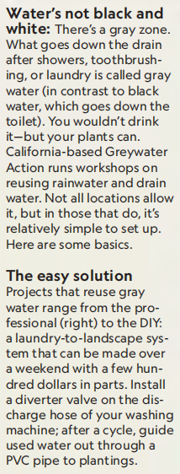
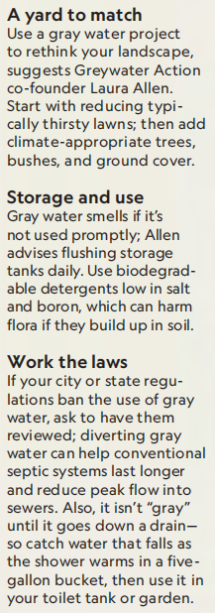
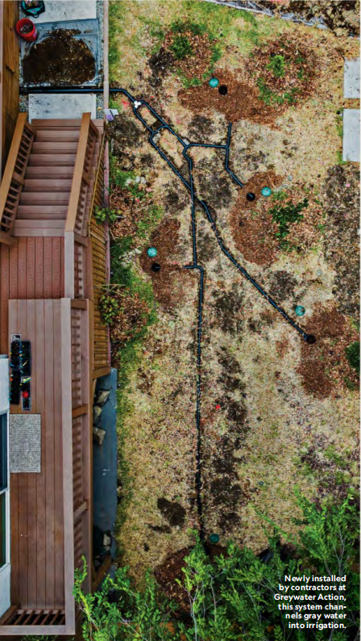
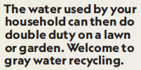
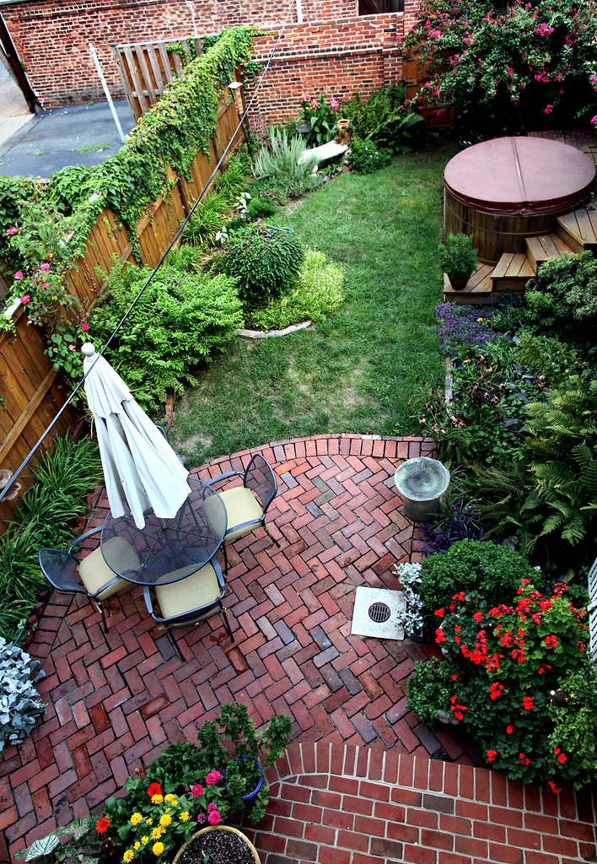

Slide 10

阅读理解
1. Which of the following statements about gray water is correct?
A. Water flushed by the toilet is gray water.
B. Gray water should not be used immediately.
C. People in all communities cannot recycle gray water.
D. Gray water facilities must be installed by professionals.
细节理解
2.What is the text maily about?
A. How gray water can be reused B. How gray water can be reduced
C. Why gray water smells D. Why gray water exists
词义猜测
3. Where is the text probably taken from?
A. An advertisement B. A biology textbook
C. A magazine D. A research paper
推理判断

Slide 11
词汇讲解
1. rinse: to wash sth with clean water only, not using soap （用清水）冲洗
It’s important to rinse the rice to remove the starch.
一定要淘米以洗掉淀粉。
2. discharge: the action of releasing a substance such as a liquid or gas; a substance that comes out from inside somewhere 排出（物）；放出（物）
All discharges and disposals of radioactive waste were within relevant limits.
所有放射性废料的排放和处理都在限定的范围之内。
翻译句子
每次用完洗发剂后都要用清水将头发冲洗几次。
After shampooing, always rinse the hair several times in clear water.
翻译句子
他们开始发烧，眼睛里分泌出一种水状物。
They developed a fever and a watery discharge from their eyes.

Slide 12
句子翻译
Water’s not black and white: There’s a gray zone. What goes down the drain after showers, toothbrushing, or laundry is called gray water (in contrast to black water, which goes down the toilet). You wouldn’t drink it—but your plants can.
水不是黑白分明的：有一个灰色地带。淋浴、刷牙或洗衣服后流进下水道的水被称为灰水(与黑水不同，黑水是马桶冲掉的水)。你不会喝，但你的植物可以。
翻译
If your city or state regulations ban the use of gray water, ask to have them reviewed; diverting gray water can help conventional septic systems last longer and reduce peak flow into sewers. Also, it isn’t “gray” until it goes down a drain—so catch water that falls as the shower warms in a five-gallon bucket, then use it in your toilet tank or garden.
如果你所在的城市或州禁止使用灰水，请他们重新审查；分流灰水可以帮助传统的化粪池系统持续更长的时间，并减少流入下水道的高峰流量。而且，直到水流进下水道才算“灰色”——所以等淋浴水变暖时，把掉下来的水放在一个5加仑的水桶里，然后用来冲马桶或倒在花园里。
翻译

Slide 13
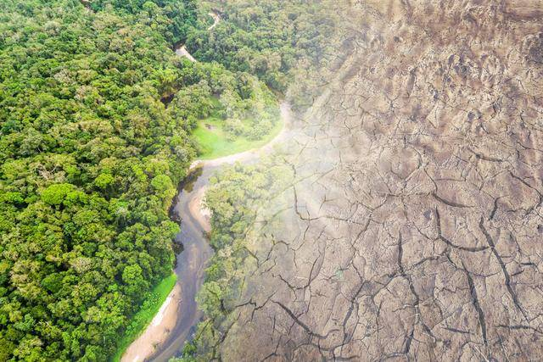
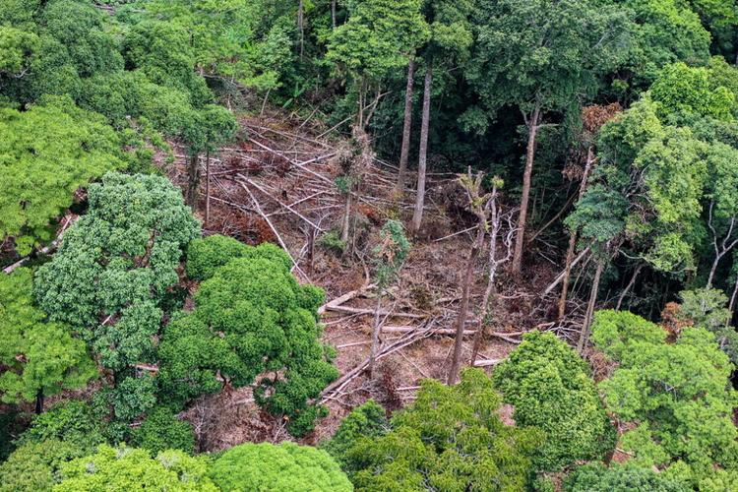
3. The root cause of less rain? Felling rainforests
降雨减少的根本原因是什么? 砍伐热带雨林

Slide 14
语篇填空
（《泰晤士报》2023年3月2日 18页）
Scientists claim to have proved _____ many of us thought — the more rain- forest you cut down, the less rain falls.
For every percentage point of forest cover lost, precipitation declined ____ 0.6 per cent in the wet season and 0.2 per cent the rest of the year, according to a new ________ (science) paper.
It estimates that with ___ projected 40 per cent decline in forest cover in the Congo during the next 80 years, the region can expect _____ (see) 10 per cent less rain. Callum Smith, from the University of Leeds, a co-author of the study, said ____ this finding alone was “compelling evidence” to protect forests.
He ______ (add) that too much deforestation could lead to a vicious cycle. “Tropical ______ (forest) themselves rely on moisture to survive and remaining areas of forest will be impacted by a drier climate.”
The study compared rainfall patterns with changes in forest cover across the Amazon, Congo and southeast Asia. The results, _________ (publish) in the journal Nature, demonstrated a clear link.
Professor Dominick Spracklen, another co-author, said: “There need to be renewed efforts to stop forests _________ (lose) and to regenerate lost and degraded areas.”
what
by
scientific
a
to see
that
added
forests
published
being lost

Slide 15
词汇讲解
1. precipitation: rain, snow, etc. that falls; the amount of this that falls 降水，降水量（包括雨、雪、冰等）
Precipitation is influenced by topography among other things.
除其他因素外，降水还受到地形的影响。
2. vicious: very bad or severe 恶劣的；严重的
It is a deliberate, nasty and vicious attack on a young man’s character.
这是对一位青年的人格蓄意的、下流的和恶毒的攻击。
翻译句子
其次，北极的大部分降水形式为雪。
Second, most of the precipitation in the Arctic is in the form of snow.
翻译句子
我们需要结束暴力和反暴力的恶性循环。
We need to break the vicious cycle of violence and counterviolence.

Slide 16
句子翻译
For every percentage point of forest cover lost, precipitation declined by 0.6 per cent in the wet season and 0.2 per cent the rest of the year, according to a new scientific paper.
翻译
根据一篇新的科学论文，森林覆盖每减少一个百分点，雨季的降水量就会下降0.6%，其余时间则下降0.2%。
It estimates that with a projected 40 per cent decline in forest cover in the Congo during the next 80 years, the region can expect to see 10 per cent less rain.
翻译
他估计，在未来80年里，刚果的森林覆盖率预计将下降40%，该地区的降雨量预计将减少10%。

Slide 17

4.WORLD OF MEDICINE
医学界新发现

Slide 18
语篇填空1
（《读者文摘》加拿大版 2023年3月刊 21页）
Help Your Pills Work Faster
If you want a pill to start bringing you relief as quickly as possible, try lying down on your right side. ______ (use) a computer simulation of a stomach, investigators at Johns Hopkins University in Maryland saw medications dissolve more than twice as quickly in this position, _________ (compare) to standing up or lying on the back. By contrast, lying on the left side was ______ (slow) than standing.
This ______ (make) sense if you think about gravity and the asymmetrical shape of your stomach: the opening that leads to the small intestine (肠), ______ pills are typically absorbed, is on the right side.
Using
compared
slower
makes
where

Slide 19
语篇填空2
（《读者文摘》加拿大版 2023年3月刊 21页）
Smartwatches Can Detect Atrial Fibrillation
Devices like the Fitbit and Apple Watch have an electrocardiogram (心电图) (ECG) app that looks ____ signs of atrial fibrillation (心房颤动) (AFib), the most common heart-rhythm __________ (regular). Catching AFib is valuable, since the condition can lead to a stroke if untreated. But are smartwatches _______ (rely) compared to a standard ECG?
A recent Chinese study involving 2.8 million participants suggests they can be __________ (reasonable) accurate if you have AFib. However, the devices can get thrown off when someone has a different heart issue, or more than one. In short, you can use a smartwatch for ___ initial screening, but you’ll want to follow up with a doctor for a medical test.
for
irregularity
reliable
reasonably
an

Slide 20
词汇讲解
1. simulation: a situation in which a particular set of conditions is created artificially in order to study or experience sth that could exist in reality 模拟
Training includes realistic simulation of casualty procedures. 训练包括伤亡处理程序的实际模拟。
2. screening: the testing or examining of a large number of people or things for disease, faults, etc. 筛查
Our country has an enviable record on breast screening for cancer. 我们国家在乳腺癌检查方面有着令人羡慕的纪录。
翻译句子
为使训练真实，模拟是实时运行的。
To make the training realistic the simulation operates in real time.
翻译句子
定期进行乳腺癌筛查是必要的。
It is necessary to have regular screening for breast cancer.

Slide 21
句子翻译
Using a computer simulation of a stomach, investigators at Johns Hopkins University in Maryland saw medications dissolve more than twice as quickly in this position, compared to standing up or lying on the back.
马里兰州约翰·霍普金斯大学的研究人员使用计算机模拟胃部，发现这种姿势下药物溶解的速度比站着或仰卧着快两倍多。
翻译
Devices like the Fitbit and Apple Watch have an electrocardiogram (ECG) app that looks for signs of atrial fibrillation (AFib), the most common heart-rhythm irregularity.
像Fitbit和Apple Watch这样的设备都有一个心电图应用程序，可以寻找房颤(AFib)的迹象，这是最常见的心律不规则。
翻译

Slide 22
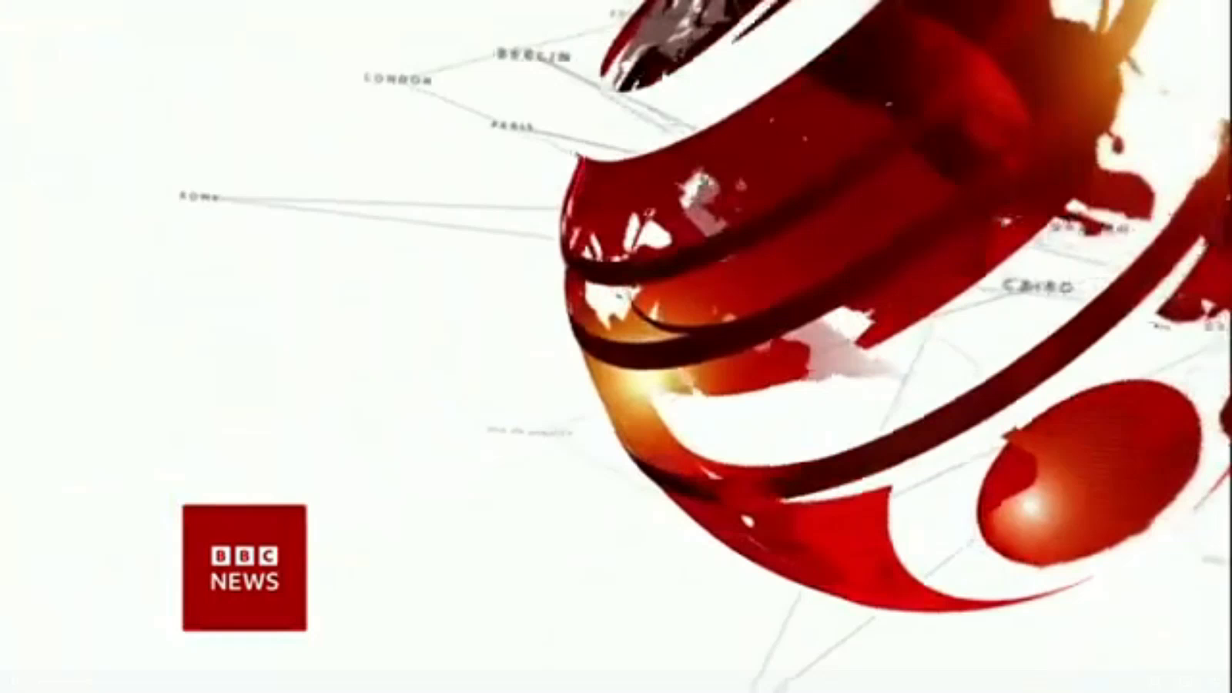
5. BBC One-minute World 03/13/2023

Slide 23

听力填空
This is BBC world news, here are the headlines.
U.S. regulators have _________ Silicon Valley Bank, a major lender to tech companies, after it ran into ______________, the largest banking failure in the U.S. since the financial crisis of 2008.
The BBC’s _______ football program is in disarray. On-air staff pull out of Saturday’s show ___________ presenter Gary Lineker, who was told to ________ after criticizing the government’s new asylum bill.
Officials in the German city of Hamburg say the gunman who ________ seven people at a Jehovahss Witness Meeting hall was a former member of the religious group and left on bad terms.
And one of the strongest storms ____________ in the southern hemisphere has _____________ Mauritius and Madagascar for a second time. It’s now heading back towards Mozambique again.
This is BBC news.
shut down
financial trouble
flagship
in support of
step back
shot dead
ever recorded
ripped through

Slide 24
词汇讲解
1. in disarray: If people or things are in disarray, they are disorganized and confused. 混乱；紊乱
12,000 crossed the border in one day alone, throwing evacuation plans into disarray. 仅一天中就有1.2万人越过边境，这使得撤退计划全被打乱了。
2. on bad terms: If two people are on bad terms, they are not friendly with each other. （与某人）关系不好
Madeleine is on bad terms with Sarah. 马德琳和萨拉相处不好。
翻译句子
我们的计划因她的到来而陷入一片混乱。
Our plans were thrown into disarray by her arrival.
翻译句子
我还不知道你和她的关系这么不好。
I had no idea that you and he were on such bad terms.

Slide 25
句子翻译
U.S. regulators have shut down Silicon Valley Bank, a major lender to tech companies, after it ran into financial trouble, the largest banking failure in the U.S. since the financial crisis of 2008.
翻译
美国监管机构关闭了科技公司的主要贷款机构硅谷银行，之前该银行陷入财务困境，这是自2008年金融危机以来美国最大的银行倒闭事件。
And one of the strongest storms ever recorded in the southern hemisphere has ripped through Mauritius and Madagascar for a second time. It’s now heading back towards Mozambique again.
翻译
南半球有记录以来最强的风暴之一第二次袭击了毛里求斯和马达加斯加。现在它又回到了莫桑比克。

