Slide 1

感恩遇见，相互成就，本课件资料仅供您个人参考、教学使用，严禁自行在网络传播，违者依知识产权法追究法律责任。
更多教学资源请关注
公众号：溯恩高中英语
知识产权声明

Slide 2
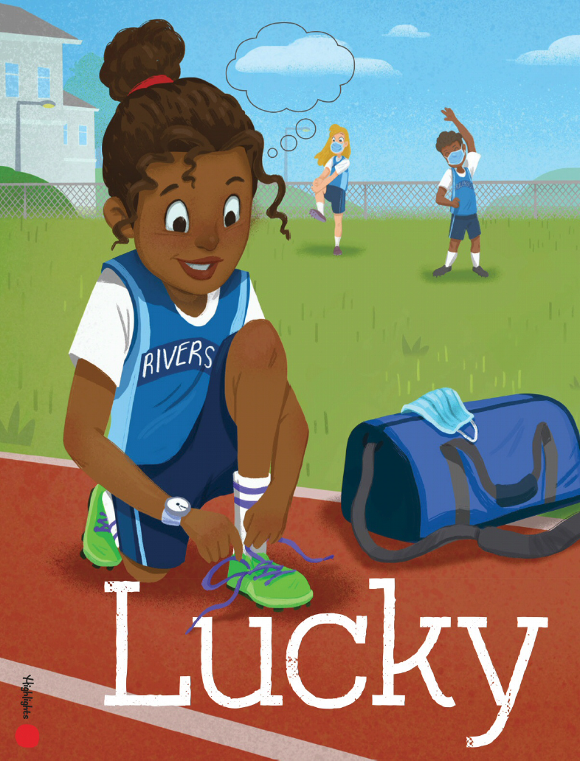
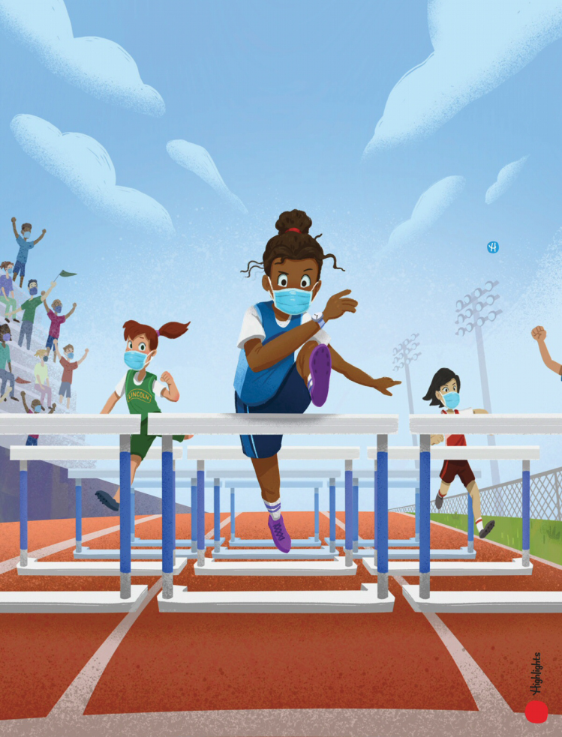

20230316宁波十校联考读后续写讲评
Lucky feet
陈星可
浙江省天台中学

Slide 3
I.文本呈现
“Number 7, Jobie Nymble, takes the lead,” cried the announcer. “Just one more hurdle (跨栏) and—” Cheers erupted. “Jobie Nymble from Riverside Middle School takes first place in the girls’ 100-meter hurdles!”
The crowd went wild as Jobie’s teammates screamed and yelled.
Determined to go all the way to County Championships, Jobie patted her worn neon-green track spikes (钉鞋). They were bursting at the seams (接缝处), but she didn’t care. They were her lucky shoes and she loved them. “Next Saturday, we’re taking home the gold,” Jobie whispered to her spikes, excitedly retying them.
“Don’t forget, guys,” said one of her teammates cheerfully. “My birthday party is next Friday at Hidden Park.”
“Beep. Party recorded in calendar,” joked Jobie in her best robot voice.
Jobie brimmed with excitement all week long. At track practice, she leaped over those hurdles faster than she’d ever leaped before.
The day of Marisol’s party, Jobie put on her favorite outfit: her fancy blue shorts, an old track T-shirt from her dad, and her lucky spikes.
The party was in full swing when Jobie arrived at Hidden Park. Music and the smell of grilled food filled the air. Two of Jobie’s teammates rushed toward her, breathless and barefoot, asking her to try the slide. Jobie’s eyes darted toward the party area. Suddenly, she saw it. The BIGGEST inflatable (充气的) slide she had ever seen was on the far side of the park. Smiling kids zoomed down the slide at unspeakable speeds.
Without thinking twice, Jobie took off her spikes and rushed toward the slide. Its ladder stretched to the sky like Jack’s magical beanstalk, but she reached the top in no time. She sat down, slipped to the edge, and closed her eyes as she let go. Jobie couldn’t get enough, conquering the slide over and over again. When it was finally time to go home, she reluctantly made her way back to the track where she’d left her shoes.
注意：
1．续写词数应为 150 左右； 2．请按如下格式在答题纸的相应位置作答。
Paragraph 1：As she eyed the area from a distance, panic set in.
Paragraph 2：The next day, without her lucky spikes, Jobie was among the best track teams gathering for the championships.

Slide 4
IA.文本解读--语言积累
1.领先 2.欢呼爆发了。 3.（气得或喜得）发狂
4.一直走到... 5.兴奋地闪闪发光
6.正在全力/如火如荼进行中 7.沿街疾驰而来8.(令人不快之物)开始，降临
1.take the lead
2.Cheers erupted.
3.go wild
4.go all the way to ...
5.brim with excitement
6.be in full swing
7.zoom along the street
8.set in

Slide 5
IB.文本解读--情节理解
Jobie Nymble took first place in the girls’ 100-meter hurdles. She s_________ with excitement, determined to go all the way to County Championships and _______(take) home the gold. She _________ all her success to her neon-green track spikes. Though the shoes were b________ at the seams, Jobie didn’t care, thinking that they would bring her good luck.
The following Friday was one of her teammates’ birthday and they had much fun in Hidden Park, They tried the slide, __________(slid) to the edge, and closing her eyes as she let go, leaving her lucky shoes on the track__________(unattend). When it was finally time to go home, Jobie made her way to where she had left the shoes, ________ set in....
swelled
take
owed
bursting
slidding
unattended
panic

Slide 6
IC.文本解读
climax
Jobie had much fun with the slide at Marisol’s birthday party, leaving her shoes unattended.
excited, dominant, adventurous,
reluctant
Jobie trained harder and better, with her worn but lucky neon-green track spikes.
falling action
rising action
excited, hopeful,
confident
As she eyed the area from a distance, panic set in.
panic,...?
Story
mountain
Jobie took first place in the hurdles, and decided to fo all the way to the county championship
resoltion
beginning
The next day, without her lucky spikes, Jobie was among the best track teams gathering for the championships.
excited, cheerful,
wild, determined, confident
...?

Slide 7
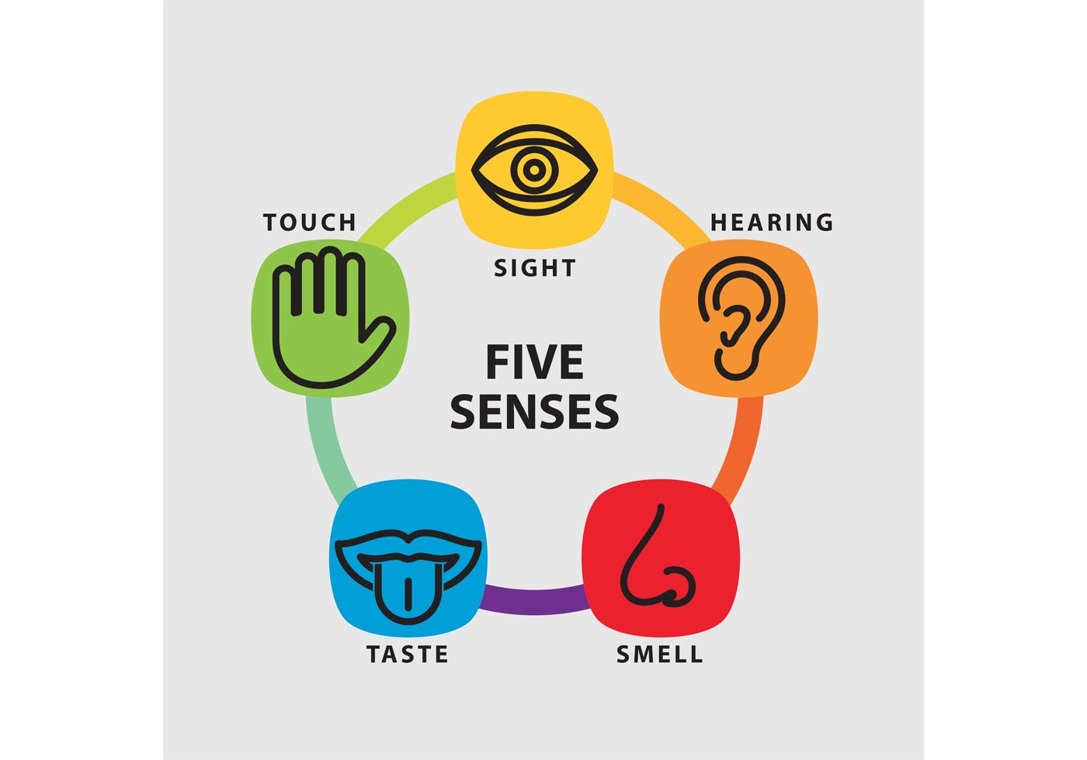
IC.文本解读
“Number 7, Jobie Nymble, takes the lead,” cried the announcer. “Just one more hurdle (跨栏) and—” Cheers erupted. “Jobie Nymble from Riverside Middle School takes first place in the girls’ 100-meter hurdles!”
The crowd went wild as Jobie’s teammates screamed and yelled.
Determined to go all the way to County Championships, Jobie patted her worn neon-green track spikes (钉鞋). They were bursting at the seams (接缝处), but she didn’t care. They were her lucky shoes and she loved them. “Next Saturday, we’re taking home the gold,” Jobie whispered to her spikes, excitedly retying them.
“Don’t forget, guys,” said one of her teammates cheerfully. “My birthday party is next Friday at Hidden Park.”
“Beep. Party recorded in calendar,” joked Jobie in her best robot voice.
Jobie brimmed with excitement all week long. At track practice, she leaped over those hurdles faster than she’d ever leaped before.
Jobie won the girls’ 100-meter hurdles, which made her excited and confident about the County Championships.
brim with excitement,
leap faster,
announcer cried cheers erupted, screamed, yelled, whisper
confident
pat spikes,
your description:
_________________
_________________
your description: __________________________________
kiss the hurdle,...
smell her lucky shoes...

Slide 8
IC.文本解读
The day of Marisol’s party, Jobie put on her favorite outfit: her fancy blue shorts, an old track T-shirt from her dad, and her lucky spikes.
The party was in full swing when Jobie arrived at Hidden Park. Music and the smell of grilled food filled the air. Two of Jobie’s teammates rushed toward her, breathless and barefoot, asking her to try the slide. Jobie’s eyes darted toward the party area. Suddenly, she saw it. The BIGGEST inflatable (充气的) slide she had ever seen was on the far side of the park. Smiling kids zoomed down the slide at unspeakable speeds.
Without thinking twice, Jobie took off her spikes and rushed toward the slide. Its ladder stretched to the sky like Jack’s magical beanstalk, but she reached the top in no time. She sat down, slipped to the edge, and closed her eyes as she let go. Jobie couldn’t get enough, conquering the slide over and over again. When it was finally time to go home, she reluctantly made her way back to the track where she’d left her shoes.
music and the smell of the grilled food filled the air
The party was in full swing.
the biggest inflatable slide she had ever seen
smiling kids zoomed down the slide at unspeakable speeds.
Robie enjoyed riding the slide.
rushed toward
reach the top
slip to the edge, close her eyes
over and ovr again
reluctantly

Slide 9
II.写作思路
1.Paragraph 1：As she eyed the area from a distance, panic set in.
思路：①（连接首句）为什么恐惧？鞋不见了（重要性）；
②寻找鞋，未果+队友一起寻找；
③没有找到鞋，只好赤脚回家(连接下段首句)；
2.The next day, without her lucky spikes, Jobie was among the best track teams gathering for the championships.
思路 :①没有幸运鞋+强队相逢，心里忐忑，不自信；
②队友鼓励，重新振作；新鞋没有阻止她的优秀，得了第一名；
③ 感悟：对lucky的理解

Slide 10
II.写作思路-情节构建（Q-A）
1.As she eyed the area from a distance, panic set in.
Q1:What made her panic? What happened to her shoes? (动作+心理活动)
Q2:What did she and her teammates do with the situation? (动作+心理活动）
Q3: Did she find her shoes? And what would she do?(下段首句)
2.The next day, without her lucky spikes, Jobie was among the best track teams gathering for the championships.
Q1:How did she deal with the two challenges facing her?（情感+心理活动）
Q2:How did she perform in the hurdle race? What was the result? （动作）
Q3: How did she reflect on her lucky shoes? What does “LUCKY” mean to her now? (感悟)

Slide 11
II.写作思路-表达
1.As she eyed the area from a distance, panic set in.
Q1:What made her panic? What happened to her shoes? (动作+心理活动)
Her lucky neon-green track spikes seemed not to be where they should be. Immediately Jobie quickened her pace.
She did not see her neon-green spikes. “Where can it have gone?” she wondered, her heart thumping faster.
“Where did I place my spikes?" Her mind was racing fast, desperately trying to work out the unexpected situation.
What greeted her was the empty track without any trace of her lucky spikes.

Slide 12
II.写作思路-表达
1.As she eyed the area from a distance, panic set in.
Q2:What did she do with the situation? (动作+心理活动）
Jobie picked up the pace, her heart pounding louder the closer she got. She was full-on sprinting now. When she reached the place she’d left them, her heart stopped.
Immediately Jobie quickened her pace and the closer she got to the point, the more unsettled she grew. When she finally confirmed the absence of her shoes, she couldn’t believe her eyes, her heart missing a beat.
Madly, Jobie searched every corner of the park for any sign of her spikes, with no success. Fear crept over her as she anxiously scanned for any sign of the neon-green.
Upon arrival, she looked for spikes, but they were nowhere to be found. She felt her mind went blank. “My lucky spikes are gone!” Jobie let out a scream, on the verge of breaking down.
“They’re gone!” she screeched. “My lucky spikes are gone.”

Slide 13
II.写作思路-表达
1.As she eyed the area from a distance, panic set in.
Q2:What did her teammates do with the situation? (动作+心理活动）
Her teammates also joined her, but the shoes were still nowhere to be found. At the moment the only thing they could do was comfort Jobie, saying, “Don’t worry, Jobie. Without the spikes, you still can be No. one!”
Jobie's teammates helped her search every corner of the park, trying to find any trace of the spikes but in vain. No lucky spikes.
At the sound of her cry, all her teammates immediately joined her in the search for the treasure. But everything seemed to be going against them: they did not spot any trace of spikes.

Slide 14
II.写作思路-表达
1.As she eyed the area from a distance, panic set in.
Q3: Did she find her shoes? And what would she do?(下段首句)
Sadly, poor Jobie had no alternative but to leave the park with her bare feet and tomorrow she would have to go without.
By nightfall, the poor girl had no choice but to drag her bare feet home. “So long, gold,” Jobie groaned.
Half encouraged and half discouraged, Jobie forced a smile, dragging her bare feet home.
After so many fruitless efforts, Jobie had to accept the fact that he had to join in the hurdle race without her lucks spikes.
Jobie mumbled sadly as she resigned herself to the fact that her lucky spikes were gone.

Slide 15
II.写作思路-表达
2.The next day, without her lucky spikes, Jobie was among the best track teams gathering for the championships.
Q1:How did she deal with the two challenges facing her?（情感+心理活动）
Squeak-squeak, squeaksqueak. Jobie’s feet danced a jittery two-step in her brand-new spikes.
Standing at the starting line, Jobie was still worried whether the new shoes might bring her good luck.
In her brand-new shoes, she was well aware that she must bring out the best in her. All her teammates gave her high fives as she slowly walked down to the starting line, which instilled great power in her.
Though still quite unconfident without the lucky shoes, she took a deep breath and decided to focus on the race.

Slide 16
II.写作思路-表达
2.The next day, without her lucky spikes, Jobie was among the best track teams gathering for the championships.
Q2:How did she perform in the hurdle race? What was the result? （动作）
Closer and closer she got. She was nearly there. Just one more hurdle and—“Number 52, Jobie Nymble, takes the gold for Riverside Middle School,” bellowed the announcer.
The whistle sounded, every athlete shot out like an arrow and Jobie was a little left behind. However, the new shoes seemed to hold magic. Jobie ran faster and faster, over one hurdle after another, caught up with one runner after another, got ahead and threw herself across the finish line! She made it again!
Starting buzzer going, Jobie was off in a flash. She set focus on the finishing line, leaving behind any self-doubt or worry until she finally breasted the tape earlier than anyone else.
She quickly forgot the crowd and focused on the race, hurdling with fiery focus. All too soon, she crossed the finish line first, breaking the record for the hurdles.

Slide 17
II.写作思路-表达
2.The next day, without her lucky spikes, Jobie was among the best track teams gathering for the championships.
Q3: How did she reflect on her lucky shoes? What does “LUCKY” mean to her now? (感悟)
After a minute, she looked down at her feet and smiled. No lucky spikes. Beaming with joy, Jobie whispered, “Lucky me.”
Accompanied by thunders of cheers from the audience, Jobie was really glad that she made it to the champion again! Looking down at her new shoes. Jobie seemed to realize that the secret to her success was not the neon-green track spikes, but...!
In the cheers and shouts, Jobie squatted to untie her spikes as usual, only to realize that there was no such thing as lucky spikes and that success was never a stroke of luck.

Slide 18
III.参考范文
As she eyed the area from a distance, panic set in. Jobie picked up the pace, her heart pounding louder the closer she got. When she reached the place she had left them, her heart almost stopped. “They’ re gone!” she screamed. “My lucky spikes are gone.” Fear crept over her as she anxiously circled the whole area and scanned for any splash of neon-green. Jobie's teammates helped her search the park, trying to find any trace of the spikes but in vain. No lucky spikes. By nightfall, the poor girl had no choice but to drag her bare feet home. “So long, gold,” Jobie groaned.
The next day, without her lucky spikes, Jobie was among the best track teams gathering for the championships. In her brand-new shoes, she accepted the reality that this was not a game of chance. Teammates patted her back as she slowly walked down to the starting line, which also instilled great power in her. Starting buzzer going, Jobie was off in a flash. She set focus on the finishing line, leaving behind any self-doubt or worry until she finally breasted the tape earlier than anyone else. In the cheers and shouts, Jobie squatted to untie her spikes as usual, only to realize that there was no such thing as lucky spikes and that success was never a stroke of luck.

Slide 19
III.下水作文
As she eyed the area from a distance, panic set in. Her lucky neon-green track spikes seemed not to be where they should be. Immediately Jobie quickened her pace and the closer she got to the point, the more unsettled she grew. When she finally confirmed the absence of her shoes, she couldn’t believe her eyes, her heart missing a beat. Without the lucky spikes for tomorrow’s Championships, things would go uncertain! Madly, Jobie searched every corner of the park for any sign of her spikes, with no success. Her teammates also joined her, but the shoes were still nowhere to be found. Sadly, poor Jobie had no alternative but to leave the park with her bare feet and tomorrow she would have to go without.
The next day, without her lucky spikes, Jobie was among the best track teams gathering for the championships. Standing at the starting line, Jobie was still worried whether the new shoes might bring her good luck. The whistle sounded, every athlete shot out like an arrow and Jobie was a little left behind. However, the new shoes seemed to hold magic. Jobie ran faster and faster, over one hurdle after another, caught up with one runner after another, got ahead and threw herself across the finish line! She made it again! Accompanied by thunders of cheers from the audience, Jobie was really glad that she made it to the champion again! Looking down at her new shoes. Jobie seemed to realize that the secret to her success was not the neon-green track spikes, but...!

Slide 20
III.原文本的故事
As she eyed the area from a distance, panic set in.
Jobie picked up the pace, her heart pounding louder the closer she got. She was full-on sprinting now. When she reached the place she’d left them, her heart stopped.
“They’re gone!” she screeched. “My lucky spikes are gone.”
Jobie’s teammates helped her search the park.
No lucky spikes.
“So long, gold,” Jobie groaned.
The next day, the best track teams in the county gathered at Hidden Park for the track-and-field championships.
Squeak-squeak, squeaksqueak. Jobie’s feet danced a jittery two-step in her brand-new spikes.
“Next up is the girls’ 100-meter hurdles,” said the announcer.
Jobie gulped.
“Go, Sweet Spikes!” Teammates patted her back as she slowly walked down to the starting line, her feet squishy with sweat.
Runners were ready now.
Jobie had just sneaked a peek at the packed bleachers when a familiar green glow at the end caught her eye.
“My spikes!” She gasped, eyeing the shoes dangling from the bleacher’s edge. Someone must have found them and set them there.
Buhhhhh went the starting buzzer.
In a flash, Jobie was off. She set fiery focus on her lucky spikes as she cleared hurdle after hurdle.
Closer and closer she got. She was nearly there.
Just one more hurdle and—“Number 52, Jobie Nymble, takes the gold for Riverside Middle School,” bellowed the announcer.
Jobie grabbed her lucky spikes and rushed over to her roaring teammates.
As Jobie squatted to untie her shoes, Marisol cried out, “Jobie, you broke a record for the hurdles!” Then she added, “Lucky you.”
“Lucky me?” Jobie froze at first. Then, after a minute, she looked down at her feet and smiled.
No lucky spikes.
Beaming with joy, Jobie whispered, “Lucky me.”

Slide 21
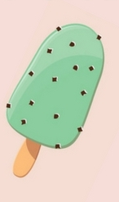
类似话题巩固练1-202204 杭二中 Mike’s Lucky Charm
Mike licked the last of the mint chocolate chip ice cream. It was time to leave. He jumped into the car with his parents and headed off to the Olympic-sized pool for the big swim meet.
When his race came up, Mike was confident. He was strong and swift. Mike climbed out the pool, smiling. He had just won first place, making him the fastest boy in his age group.
“Congratulations, son,” his father said. His mom gave him a hug, even though he was soaking wet.
A week later, it was time for another swim meet. Like before, Mike decided to enjoy his favorite ice cream flavor. Mike remembered that the last time he had won a race, he also ate mint chocolate chip ice cream first. Maybe he'd win again.
He's taken first place again in his race. Mike was feeling pretty good. As it turned out, Mike decided to have some mint chocolate chip ice cream before every one of the next few swim meets. He began to think of it as his lucky charm. After several months of placing in the top positions of every race he swam, Mike was feeling unbeatable.
And he wouldn't admit it, but all that ice cream was adding a few pounds to his athletic swimmer's build.
It didn't take long after that for Mike to start coming in second place – and then third – and then last place in his races. The lucky mint chocolate chip ice cream had lost its magic.
On the day of his next swim meet, his mother sat down at the table with him. "Mike, we all love ice cream, but it's not healthy for your body to eat so much of it. Maybe it's time to quit the sweet treats for a while, especially before you go swimming.”
Mike unwillingly agreed. He went to the swim meet, and didn't perform well. His father offered to go running with him a few days a week to help him feel better and strengthen his muscles. The extra weight soon disappeared, and Mike found himself breathing easier at swim practices.
Para1:As he dove into the water, he kicked his legs and stretched his arms as far as he could. __________________________
Para2:His jaw dropped as he realized he had beaten his own best time, and everyone else's too._________________________

Slide 22
参考范文-202204 杭二中 Mike’s Lucky Charm
As he dove into the water, he kicked his legs and stretched his arms as far as he could. With the hope of winning back the swim race, he made every effort to swim on. However, the previous failure still cast a shadow on him, leaving him not so confident. Looking left and right, he found the other swimmers quite close, leaving him no edge at all. Not wanting to let his efforts go in vain, he gathered speed and swam forward like an arrow. Faster and faster, he got ahead of one after another and the next moment his hand touched the edge of the pool, indicating the end of his race. Anxiously, he looked up, his eyes fixed on the score board.
His jaw dropped as he realized he had beaten his own best time, and everyone else's too. He climbed out of the pool and what greeted him were the warm hugs from his teammates and friends, who gathered to congratulate him on his successful return to No. 1. And his father, who had been standing by, patted him on the back and jokingly suggested treating him to some chocolate ice cream, which was instantly refused by Mike. He clearly learned from the experience that the ice cream had never been, and would never be his lucky charm! But the constant practice and going without ice cream would always be!

Slide 23
佳句集锦-202204 杭二中 Mike’s Lucky Charm
1.It struck endless energy and motivation into his body. Mike could feel himself swimming faster than before. But others seemed to have prepared better.
2.At that critical moment, a familiar voice suddenly came into his mind. “come on! You’re still at first place.”
3.He used up all his power to march on . 200 meters, 100 meters, 50 meters... Finally he reached the finish line and found his parents were applauding for him.
4.Just then, he thought of his sweat and father’s encouragement. Had it not been for his hard training, he wouldn’t have performed so well in the race.
5.So dynamic was he that he swam swifter than ever.

Slide 24
佳句集锦-202204 杭二中 Mike’s Lucky Charm
6.In an attempt to pick up his previous glory, he gritted his teeth and flapped his arms constantly. So flexible was he that Mike was like a dynamic dolphin swimming in the pool.
7.Not until then did he realize that the true magic was a person’s devotion. It was his perseverance and diligence that enabled him to succeed. Immersed in the deafening applause, a mixture of confidence and satisfaction was infused to the boy’s inner heart.
8.And the last 200 meters witnessed the boy struggling, his teeth clenched and his eyes fixed on the finish line.
9.On the way back home, Mom joked, “some ice-cream?” “No more ice-cream.” Mike smiled, “The effort is the magic to success and you are my lucky charm.”

Slide 25
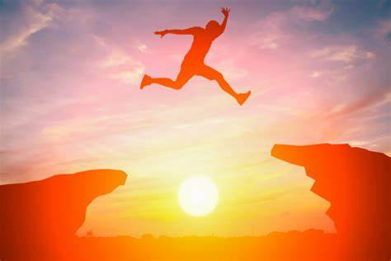
Thank you!
I am not a prisoner of honor, and by energy and confidence I can overcome the greater obstacles.
我不是荣誉的俘虏，我有力量和信心可以克服更大的艰难险阻。

