Slide 1

感恩遇见，相互成就，本课件资料仅供您个人参考、教学使用，严禁自行在网络传播，违者依知识产权法追究法律责任。
更多教学资源请关注
公众号：溯恩高中英语
知识产权声明

Slide 2
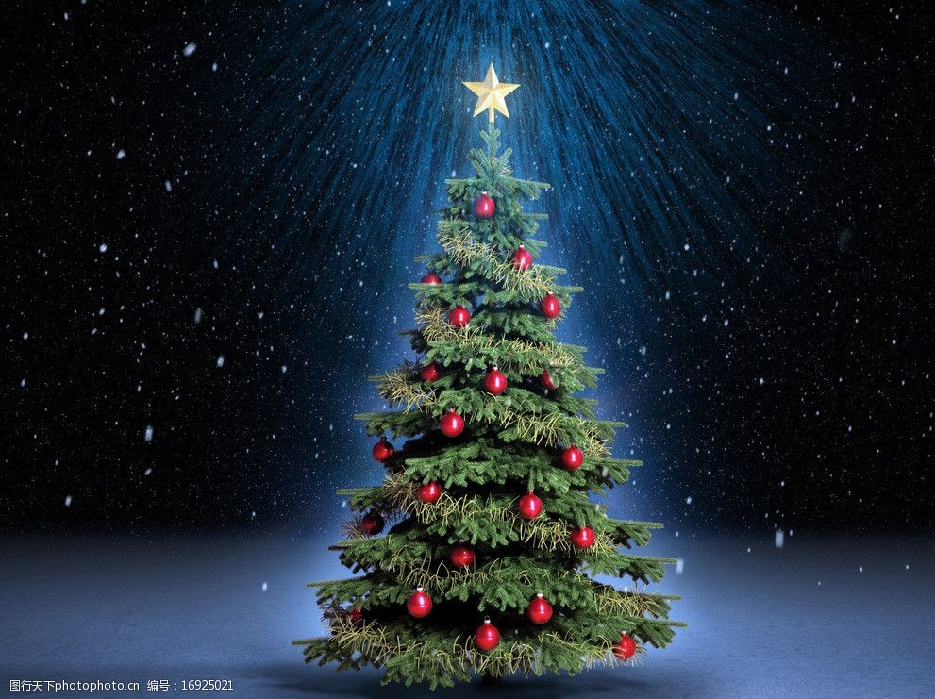
金华十校高二期末联考
续写讲评
A Special Christmas
浙江省龙游中学 Yan Yunzhen

Slide 3

Activity 1 Understanding The Characters and The Given Information
Read the given text and answer these questions.
Q1: Who are the main characters?
Q2: What happened to “me ” before Christmas?
Q3: What was my life like at that moment? How do you know?
Q4: To my surprise, who came to help me?
Q5: What kind of person do you think Asther Heffeman is?
Q6: Why did she come over to my house on such a snowy day?

Slide 4
❶ On a Friday evening in December,two weeks bsfore Christmas, I lost my job. I hadn'tseen it coming. I was excited for the weekend, when my daughter, Kristil, then 12, and I planned to get our Christmas tree.Then I listened to my voicemail,“We're sorry, but your work assignment has ended." My heart sank.
❷ I wasn't just a I struggled to be cheerful as I eyed the Christmas tree prices. Kristil a good life, but there were some things my love couldn't fix. The next day as we searched for our tree, I struggled to be cheerful as I eyed the Christmas tree prices. Empty-handed, we returned home.
❸ Over the next week, I furiously applied for jobs as my bank account grew smaller. All applications ended in vain. I felt as if the worid was closing in on me. On a weekend afternoon, I dropped Kristil in a wealthy gated community for a birthday party of her classmate.I watched as she went in, surrounded by all the nice things we couldn't afford. I drove home defeated.
❹ Back at home, I glanced out the window. It had been snowing on and off all morning. I noticed a small woman with short white hair struggling to open her car door against the wind. She got out, I realized it was my old professor, Esther Heffeman. I hadn't seen hersince we'd met for lunch three months ago. I'd first met Esther 10 years earlier, when I was her student at Edgewood College in Madison, Wisconsin. Kristil was 3 at the time, and I sometimes took her to class. Esther was understanding and would bring coloring books to occupy Kristil After I graduated, she kept in touch, meeting me for lunch every few months. I had grown to love her like family.
I lost my job. And I felt gloomy and hopeless.
To my surprise, who come to my help ?
What kind of person do you think Asther Heffeman is?
I struggled to be cheerful as I eyed the Christmas tree prices
as my bank account grew smaller
applications ended in vain
What happened to “me ” before Christmas?
What was my life like at that moment?
Asther Heffeman is kind and understanding/ considerate, whom I treat as a family member.
Why did she come over to my house on such a
snowy day?
She might have known my situation.

Slide 5
What information can you get from these two given sentences?
Activity 2 Predict The Ending
gloomy /hopeless
Para1 : I rushed out of the house, waving my hands. ____________________________________________________________________________________________________
__________________________________________________
Para2 : When I opened the envelope, inside I found some money and a note. ______________________________________________________________________________________________________________________________________________________
happy to meet
Q1: What did I do/ say when I met my professor?
Q2: How did I feel?
With the help of the professor , I become …
Q3: Did she notice my embarrassment / poor situation ?
be deeply touched
Q1: What was written on the note ?
be thankful
Q2: How did I feel when I found the money and the note ?
Q3: What happened in “my ”life later ?
hopeful for the future
What does the author want to convey in the passage?

Slide 6
Activity 3 Wave The Plots With Vivid Language
Para 1: I rushed out of the house, waving my hands.
Q1: What did I do/ say when I met my professor?
Q2: How did I feel?
Q3: Did she notice my embarrassment / poor situation ?
Version 1 of para 1 . Please fill in the blanks to make it coherent.
I rushed out of the house, ________________ (朝她挥舞着双手). “What are you doing out in this weather?” I asked ______________(当我们拥抱的时候). “Well, it‘s Christmas,” Esther said and _______________________________ (递给我一些礼物）.I invited her inside, made her a cup of tea, and we talked beside the fireplace. What warmed me in this freezing winter was not only her gifts, but also her presence which gave me hope _______________________(一切都会变好的). As she got up to leave, she handed me an envelope. “This is for you,"she said as she kissed me on the cheek.
happy to meet
V-ing 做状语
V1，V2 and V3
waving my hands
状语从句
as we hugged
handed a couple of gifts to me
主语从句
not only …but also 句型
定语从句
同位语从句
that things would be all right.
状语从句

Slide 7
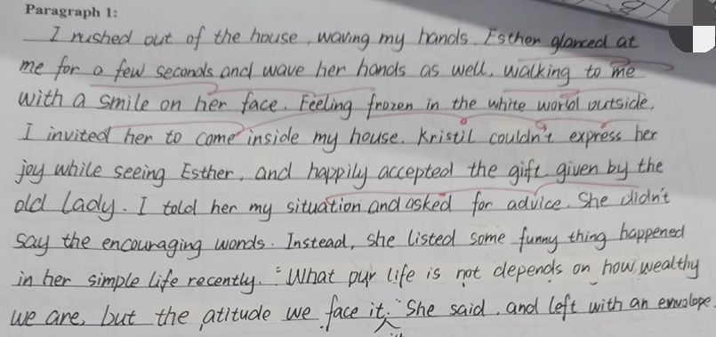
Key 1 The characters’ behaviour, the settings
and the plots must be logical.
Version 2 of para 1 . Please find out the good points and some mistakes in it .
Two main logical problems in para 1 :
1. Kristil presented in para1, but actually she was at her classmate’s house for a birthday party at that moment.
2. The professor’s words and deeds should be considerate,
not being too direct (She is understanding ).
waved
Where was Kristil at that moment?
things
any
doesn’t depend on
is like
the attitude that we
hold towards life
Key 2 Try to reduce grammar mistakes and write
authentic expressions.
优点如： 动作描写比较流畅。

Slide 8
Para 2: When I opened the envelope, inside I found some money and a note.
Q1: What was written on the note ?
Q2: How did I feel when I found the money and the note ?
Version 1
When I opened the envelope, inside I found some money and a note. Hardly had I caught the first sight of the money I realised my professors’ purpose and kindness. Excited yet astonished, gratitude almost deprived me of all power of speech. Then, with trembling hands picking up that note, I went through the content,"Life is not just living through the storms, but dancing in the rain. Never lose heart to look forwand. ” With the wind beginning to cease its roar and sunshine took on the gloden color, warmth flooded over me.
Key 3 Use appropriate advanced vocabulary
and sentence patterns to express the theme
倒装句 / 复合句 / with的复合结构 / 非谓语等
优点
创造了丰富、合理的内容，有逻辑性，与原文融洽度高；
使用了多样且恰当的词汇和语法结构，有些许错误，但完全不影响理解。
3. 有效地使用了语句间衔接手段，全文结构清晰，意义连贯。
4. 最后的环境描写不错，烘托了人物的心情。
请你来评价此段的优缺点。
be deeply touched
when
I felt (that)
不足
Hardly had … when “一…就… ”和非谓语结构使用有误。
结尾时以环境描写烘托作者重获希望、感到温暖，但与前文买不起圣诞树没有形成有效的呼应；
若能恰当补充女儿Kristil回家后看到已经买来的圣诞树的反应，和我们后来重拾信心、乐观生活的描写，能更好地回应前文，使全文浑然一体，突出主题。
be thankful

Slide 9
Version 2 of para2:
When I opened the enrelope, inside I found some money and a note. I gasped in shock. Tears of gratitude puddled in my eyes as I counted the dollar bills. $1.000 in total ! “I knew your situation, and just enjoy your Christmas with Kristil.” I was on the edge of crying out. I will. I promised to Esther in my heart. After buying a Christmas tree in a supermarket, I picked up Kristil and drove home. Her face lit up on seeing so beautiful a Christmas tree with shining stars. At that moment, the snow stopped. Some sunlight penetrated the clouds, bringing me warmth and hope.

Slide 10

Activity 4 Practice and Improve Yourselves
Scene 1: 描写老友相见
Scene 2: 描写 “我的尴尬” 和“她的安慰”
Scene 3: 描写 深受感动
Scene 4: 描写环境 烘托主题

Slide 11
Activity 4 Practice and Improve Yourselves
Scene 1 描写老友相见的
a. 她也看见了我，并朝我挥挥手，脸上带着欢欣的微笑。
She noticed me, waving me back with a broad smile on her fece.
b. 自从三个月前共进午餐之后，今天才再次见到教授, 我是如此的高兴和激动。
It has been more than three months since we met last time, so I was thrilled and delighted.
I was more than delighted and excited to see my dear professor after three months, who…
c. 她在大雪中艰难地朝着我走过来，还朝我挥手。 我紧紧地拥抱了她，邀请她进来 喝一杯热咖啡。
She inched towards me, waving at me. I hugged her tightly, invited her to enter my house and presented her a cup of hot coffee immediately.

Slide 12
Activity 4 Practice and Improve Yourselves
Scene 2 描写“我的尴尬 ” + “她的安慰”
a. 她温柔地询问我近况如何，我却嗫嚅着说不出话来。 （murmur ）
She tendly asked how everything was going with me. However, I just murmured without clear words.
b.我是如此的沮丧以至于我不敢看她的眼睛。
So frustrated was I that I dared not to look in her concerned eyes.
c. 她轻轻地抚摸着我的肩膀，低声说：“一切都会好起来的，别担心。”
She patted me gently on the shoudler, whispering, “ Everything will be ok. Don’t worry.”

Slide 13
Activity 4 Practice and Improve Yourselves
Scene 3 描写深受感动
a. 一看到这些，我就抑制不住我的泪水。
Seeing this, I could hardly hold back my tears.
On seeing this, tears of gratitude puddled in my eyes .
b. 就在那时，一股感激的情绪涌上我的心头，我泪眼朦胧。
At that moment, a ripple of gratitude welled up inside me and my eyes were misty.
c. 我心里涌起温暖又感激的情绪，这让我深深明白了所谓“家人”的意义。
My heart was filled with feelings mixed with warmth and gratitude, which made me better undersand the meaning of “being a family.”

Slide 14
Activity 4 Practice and Improve Yourselves
Scene 4 描写环境 烘托主题
a. 雪渐渐地停了，阳光透过云层照射过来，我的心里感到有了希望和力量。
Gradually, the snow stopped. Some sunlight penetrated the clouds, which
gave me more hope and power.
b. 我坚定地相信我一定可以再找到工作，因为有人关心我并点亮了我的世界。
I firmly believed that I could find another job because there was someone caring about me, lighting up my world.
C. 风儿停止了咆哮，太阳呈现出金色的光芒，温暖洒在我身上，洒在每个人的身上。
With the roar of the wind dying down, the sun took on some golden colour, pouring some warmth on me, on everyone.

Slide 15
Another version
I rushed out of the house, waving my hands. Esther obviously notice me and waved back. I strode towards her and scooped this kind professor into my arms. After inviting her inside, I offered her a cup of hot coffee. Giving me some presents, she tendly asked how everything was going with me. My face turned red. She patted gently on my shoudler, whispering, “ Everything will be ok.” It was her words and encouragement that eased my depression. Before she left, she insisted on giving me an envolope, which she asked me to open later.
When I opened the envelope, inside I found some money and a note. Hardly had I caught the first sight of the money when I realised my professors’ kindness. Excited yet astonished, I felt gratitude almost deprived me of all power of speech. Then, with trembling hands picking up that note, I went through the content,"Life is not just living through the storms, but dancing in the rain. Never lose heart. ” With the wind dying down and the sunshine taking on some gloden color, warmth flooded over me.

Slide 16
Activity 5 Summary
How to write good scenes in continuation writing?
Key 1 The characters’ behaviour, the settings and the plots must be logical.
Key 2 Try to reduce grammar mistakes and write authentic
expressions.
Key 3 Use appropriate advanced vocabulary and sentence patterns to express the theme.

Slide 17

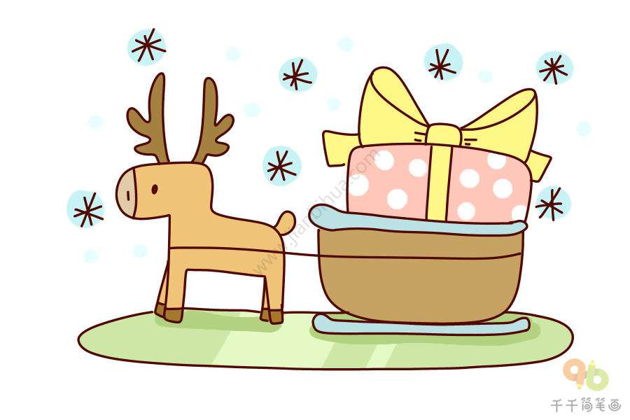
Merry Christmas!

