Slide 1

感恩遇见，相互成就，本课件资料仅供您个人参考、教学使用，严禁自行在网络传播，违者依知识产权法追究法律责任。
更多教学资源请关注
公众号：溯恩高中英语
知识产权声明

Slide 2


Unit 2 Bridging Cultures

Slide 3

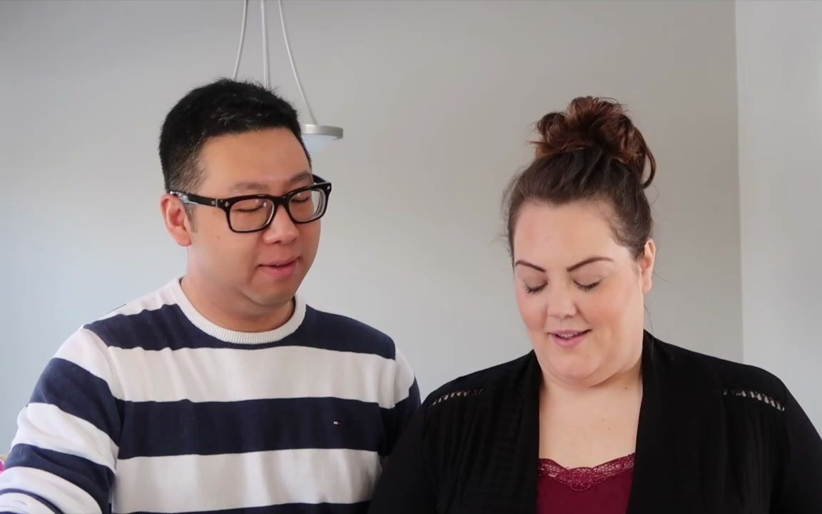
From China to the USA- Zheng's PhD overseas study experience
Notes:
After watching the video, do you want to study abroad? Why? What challenges do you expect to meet? How would you feel then? Do you think you can overcome them?
Let’s learn another story about an overseas student

Slide 4

Before reading: share your ideas
After watching the video, do you want to study abroad? Why?
What challenges do you expect to meet? How would you feel then?
Do you think you can overcome them? How?

Slide 5

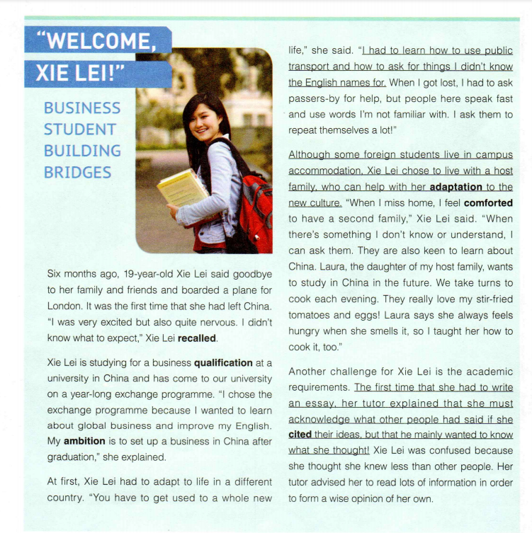
Where might you read this article?
The newspaper of a university in London
Xie Lei, an exchange student majoring in business, is building bridges between ____________ and ___________.
What information can you get about the girl?
British culture
Chinese culture
/…is bridging British culture and Chinese culture
Notes:
look at the title and the picture, What information can you get? Major in business How do you understand building bridges? A link and connection Bridge between what and what ? The Chinese and the British EDITION : a particular newspaper or magazine

Slide 6


To bridge Chinese culture and British culture, Xie Lei may need to _________ the British culture as well as _______ the Chinese culture.
adapt to
spread
Adaption to the British culture
Spreading the Chinese culture
Notes:
So in summary,xie’s overseas study experience may include two parts:

Slide 7
While reading: content analysis
Which paragraphs talk about Xie Lei’s adaption to the British culture?
How did the writer describe it?
By introducing __________
__________
__________
challenges
solutions
feelings
Notes:
So in summary,xie’s overseas study experience may include two parts:

Slide 8
Adaption to the British culture
Challenges
Solutions
(What Xie Lei did)
(had to)
(had to)
learn to_________________;
learn to____________________________;
ask for ____________________________
use public transport
adaptation to a whole new life
ask for things she didn't know the English names for
Daily life
help from passers-by when got lost
loneliness/ homesickness
lived with a host family
writing an essay
got help from her tutor ; read a lot to prepare
(another)
Academic
requirements
(had to; must)
(also)
gave presentation on traditional Chinese art
new approaches to teaching and learning
(need to)
Notes:
Remember to write down the expressions showing It is a challenge as well as the signal words to show the logic between the information.
What other challenges do you think students studying abroad might face?
Did Xie lei expereice mixed feelings while adapting to the british culture?
How can students prepare to handle these challenges before going abroad?

Slide 9
What other challenges do you think students studying abroad might face? Can you give some advice to help them handle these challenges?
Expressions for reference:
adapt to; academic pressure; had to/ must/ need to; have no idea; be not familiar with; have difficulty doing sth…
engage in; be involved in; expose sb/ oneself to…; participate in; cooperate with sb…

Slide 10
Challenges
Feelings involved in bridging cultures
Circle the words to trace Xie Lei’s feelings..
feelings
excited but nervous
feel at home
It was the first time that she had left China.
be involved
in social activities
nervous/
anxious
Xie Lei is experiencing culture shock!
surprised and confident/ proud
adaptation to a whole new life
Her presentation on Chinese art was a great success.
lonely/ homesick
homesickness
confused
comforted
at a loss
living with
a host family
writing an essay
new approaches to teaching and learning
Solutions
Notes:
Pay attention, for some of the stages you can’t directly find the words to describe her feelings ,then you may summarize it based on the given information.
The changes of xl’s feelings are in the shape of U. IN the early stages, …

Slide 11
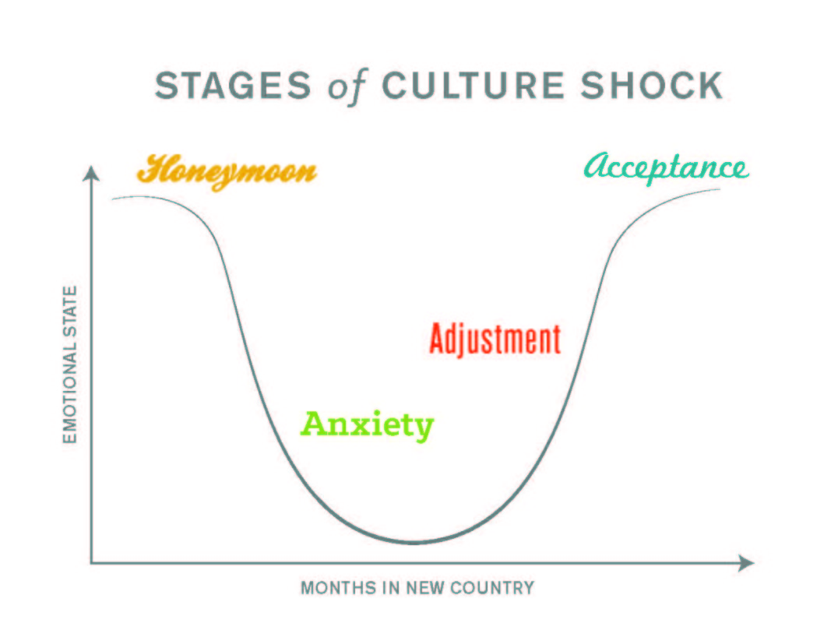
Culture shock refers to feelings of uncertainty, confusion, or anxiety that people may experience when moving to a new country or experiencing a new culture or surroundings.
Notes:
From xl’s case we could see as time goes by, all of these negative feelings will give way to some positive feelings.
Culture shock is a condition that affects people who travel to a country different from their own. The term describes a traveler's feelings of bewilderment when the environment and culture change from the one that he or she is familiar with. The unfamiliar surroundings, foreign language and strange habits of a new country can all contribute to a feeling of uneasiness and confusion.

Slide 12
Spreading the Chinese culture
What Xie Lei did to spread the Chinese culture
taught the daughter of her host family how to cook Chinese cuisine
gave a presentation on traditional Chinese art
engaged herself in social activities and share Chinese culture with them
Besides Chinese cuisine and art, what else can we introduce to foreign friends to spread our profound culture?
Adaption to the British culture
A cultural messenger bridging cultures!
Spreading the Chinese culture
Notes:
So by learning xie lei’s …. We can see indeed she is…
Besides Chinese cuisine and art, what else can we introduce to foreign friends to spread our profound culture?
As an exchange student, are there any innovative ways to better spread Chinese culture?

Slide 13
Group work: Critical thinking
1. If you have an opportunity to get involved in an experience programme like Xie Lei, will you grasp it?
2. As a high student, how can we better prepare ourselves to act as a cultural messenger building bridges between cultures?
Expressions for reference:
adapt to; engage in; be involved in; expose sb/ oneself to…; participate in; give sb an insight into sth; gain a global perspective/ angle; improve competence; cooperate with sb…

Slide 14


Slide 15
Thank You.

