Slide 1

感恩遇见，相互成就，本课件资料仅供您个人参考、教学使用，严禁自行在网络传播，违者依知识产权法追究法律责任。
更多教学资源请关注
公众号：溯恩高中英语
知识产权声明

Slide 2
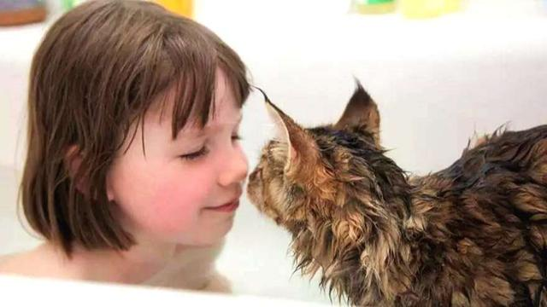
读后续写解析
Thula
—Adapted from a real story猫咪

Slide 3
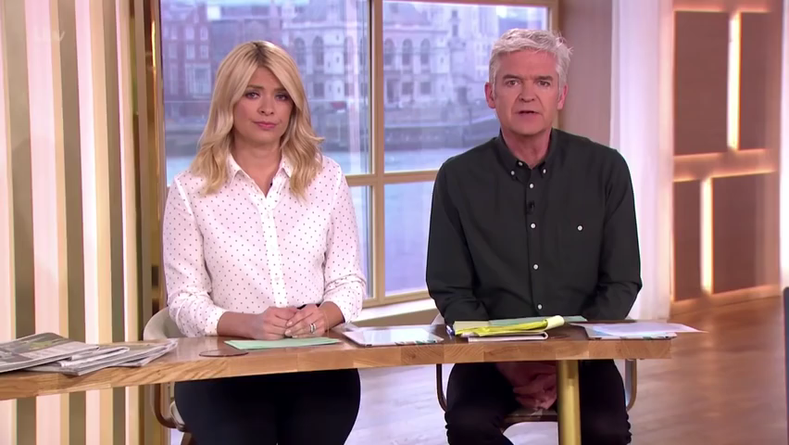

Slide 4
Analyze the article 文本解读
Not until recently have I known that a little pet can be such a helpful assistant to a helpless mom. This is all due to what our new family member, a little kitten named Thula, has done. She seems to understand exactly what Iris needs at any given time.
Within a year of my daughter's birth, I already suspected that something was wrong. Even by babies' standards, Iris was a frighteningly bad sleeper. She also appeared unmistakably distant. Besides, after saying “dada” when she was eight months old, she stopped talking. Finally, aged two, she was diagnosed as autistic患自闭症的.
In fact, after a long process of trial and error反复试验, I found activities that obviously did help her, including music and riding on the back of her dad's bike. Above all, Iris showed a remarkable talent for art: producing large multi­layered Impressionist­style paintings that took her several days and that once led to the Leicester Mercury headline, “Top artist aged 3.”
Iris did make progress, but by no means steadily, with promising developments often followed by periods of regression(退步).
One night, Iris refused to sleep. As her frustrations mounted(增加), she started to cry, and her sobs filled the quiet room. I felt so hopeless as I held her close. Nothing seemed to comfort her apart from her favorite book and I longed for some help, but she pushed away all who tried except me, making me on the edge of breaking down.
Downstairs, my husband looked at Thula in surprise who had suddenly got up off his lap. Her eyes focused on the door and she had one foot raised perfectly poised in the air. Something had grabbed her attention—the crying of Iris. Then her legs were moving fast. Zooming round the corner, she flew up the stairs into Iris‘s bedroom and jumped onto the bed. She curled up next to Iris, ignored the crying and started grooming理毛 herself, licking her paws舔爪子 and rubbing摩擦 them over her ears.

Slide 5
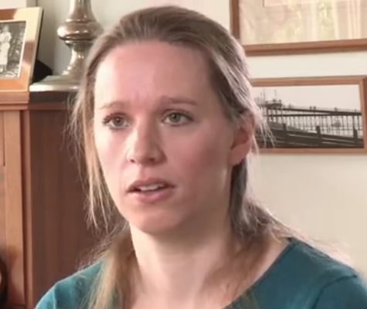
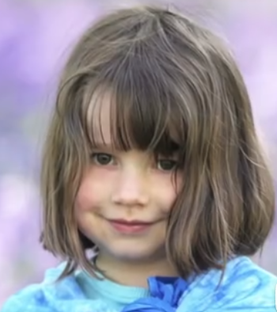
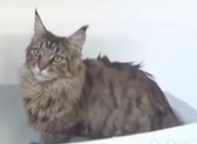
Read for main characters
Iris
Thula
I
a helpless mom
Aged two, she was diagnosed as autistic.
a helpful assistant
a frighteningly bad sleeper
was diagnosed as autistic
showed a remarkable talent for art
refused to sleep and cried
Something had grabbed her attention—the crying of Iris. Then her legs were moving fast. Zooming round the corner, she flew up the stairs into Iris‘s bedroom and jumped onto the bed. She curled up next to Iris, ignored the crying and started grooming理毛 herself, licking her paws舔爪子 and rubbing摩擦 them over her ears.
I felt so hopeless as I held her close. Nothing seemed to comfort …and I longed for some help, but she pushed away all who tried except me, making me on the edge of breaking down.
a helpless mom
on the edge of breaking down
One night, Iris refused to sleep. As her frustrations mounted, she started to cry, and her sobs filled the quiet room.

Slide 6
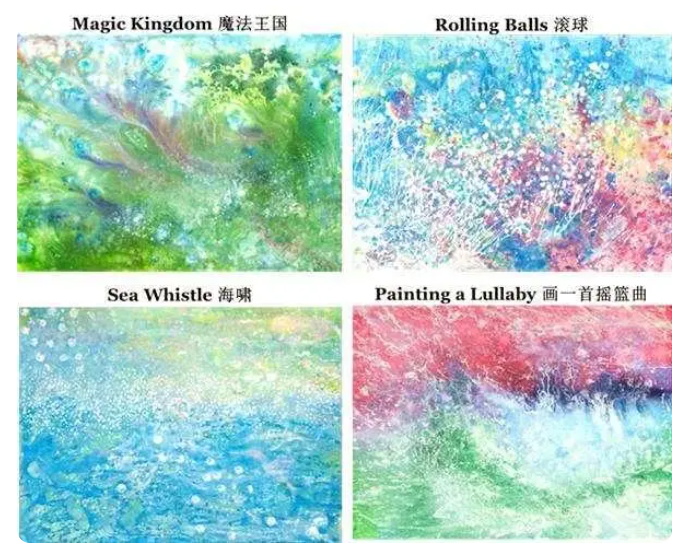
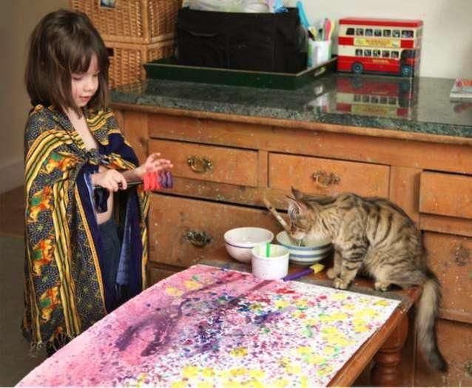
Above all, Iris showed a remarkable talent for art: producing large multi­layered Impressionist­style paintings

Slide 7
Appreciate the language
As her frustrations mounted(增加), she started to cry, and her sobs filled the quiet room.
Nothing seemed to comfort her apart from her favorite book and I longed for some help, but she pushed away all who tried except me, making me on the edge of breaking down.
“无灵”主语句描写写人物的哭泣sob
非谓语动词短语作状语，描写“我”无助绝望即将痛哭的情感
…Thula who had suddenly got up off his lap. Her eyes focused on the door and she had one foot raised perfectly poised in the air. Something had grabbed her attention—the crying of Iris. Then her legs were moving fast. Zooming round the corner, she flew up the stairs into Iris‘s bedroom and jumped onto the bed. She curled up next to Iris, ignored the crying and started grooming理毛 herself, licking her paws舔爪子 and rubbing摩擦 them over her ears.
大量动作细节描写， 把一只可爱猫咪的形象呈现在读者面前。具体动作如上！

Slide 8
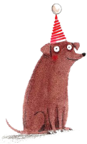
Predict the plot预测情节
P1
Almost immediately, Iris's mood changed.
What kind of state did her mood change to?
How did Iris react?
What did Thula react?
How did I get out of the room?
What was the situation in the room before I returned to the room?
stop crying/calm down/relaxed/joyful
look at the cat/smile
try to amuse/accompany Iris
steal/slide/slip out of the room溜出
The room was silent.
P2
I was curious about the silence, and then returned to the door of Iris's room and looked in.
What did I see?
What’s my reaction ?
What’s my reflection (反思) on Thula/this incident?
a silent and harmonious scene
relieved/touched
magical cat/hopeful/grateful

Slide 9
哭声减弱
停止哭泣，嘴唇上扬微笑着。
Iris放松，放下书，开心的看着猫咪。
Write details
Iris
Her sobs gradually died down.
She stopped crying and her lips curved into a smile.
Iris relaxed, put down her book and looked at the kitten with great joy.
I
溜出房间
我感到放松（无灵主语）
这只神奇的小猫正改变我们的生活，而这仅仅是个开始。
我甚至不需要问，但她本能地知道该做什么，也知道如何提供帮助。
stole /slid
Relieved, I slipped out of the room ，waiting downstairs
Relaxation and relief took hold of/ swept over/ flooded over me.
This magical kitten was changing our lives and this was just the beginning.
I didn't even need to ask, but she knew instinctively what to do and how to help.

Slide 10
Write details
Thula
1.the contented purrs of a cat
2.a fluffy little kitten
3.The kitten made a soft meow and curled itself into a furry little ball.
4.The cat nuzzled up to my leg, meowing happily.
5.The cat arched its back when it heard the sound.
6.started grooming herself, licking her paws and rubbing them over her ears
猫咪满足的呼噜声
毛茸茸的小猫
小猫轻轻叫了一声, 蜷成了一个毛茸茸的小球。
猫咪在我的腿边蹭来蹭去, 高兴地喵喵叫着。
猫听到声音就拱起了背。
她开始洗脸，舔爪子，在耳朵上揉来揉去

Slide 11
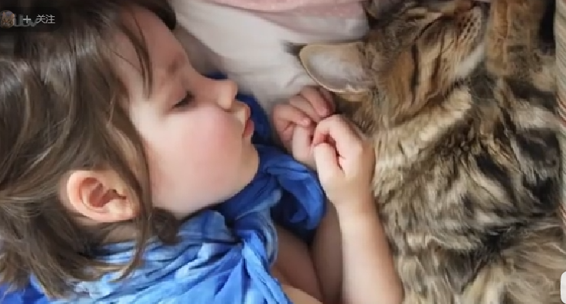
Write details
1. Iris伸出手，抚摸小猫蓬松的毛毛。
2. Iris 放下书看着小猫,双眸满是好奇。
3.爱瑞丝睡着了，小猫就在她身边。
4.Iris的手放在苏拉的肩上，我听到了轻轻的咕噜声。
1.Iris reached out her hands，running her fingers through the puffy fur of the kitten.
2.Her eyes glittering(闪耀) with curiosity, Iris put down her book ,looking at the kitten.
3.Iris had fallen asleep/had fallen a deep sleep/had a sound sleep with her kitten by her side.
4.Iris's hand rested on Thula's shoulders and I could hear a gentle purr.

Slide 12
P1
Sample writing
Almost immediately, Iris’s mood changed. Her sobs gradually died down. Then as if by magic, she giggling at Thula’s huge ears as they were folded down forward and then pinged back(弹回). Her eyes glittering with curiosity, Iris put down her favorite book, looking at the kitten with great joy. The little creature made a soft meow, curling itself into a furry little ball. Iris reached out her hands, running her fingers through the puffy fur of the kitten. Feeling the burden on my shoulders taken off, I tiptoed out , waiting at the bottom of the stairs uneasily for the inevitable crying that would force me back. Moments later, there was silence: no giggling, no pages being turned, and no cries.
咯咯笑
她的哭声减小
她的眼睛闪着好奇的光
小猫轻轻叫了一声, 蜷成了一个毛茸茸的小球
抚摸小猫蓬松的毛
感觉卸下了肩上的重担
点着脚尖
不安地等待着不可避免的迫使我回去的哭声
不可避免的unavoidable
Seizing the opportunity, I slipped out of the room and waited uneasily at the bottom of the stairs.

Slide 13
P2
I was curious about the silence, and then returned to the door of Iris's room and looked in. Iris had a sound sleep with her kitten by her side. Iris's hand rested on Thula's shoulders and I could hear a gentle purr. Although still a tiny kitten and a new member of our family, Thula was already caring for Iris, her faithful companion. For me, a helpless mother, she was also a friend, stepping in and helping when I longed for it the most. I didn't even need to ask, but she knew instinctively what to do and how to help. This magical kitten was changing our lives and this was just the beginning.
睡得很香had fallen into a deep sleep/had fallen asleep
轻微的（猫咪发出的）咕噜声
照顾
忠诚的伙伴
同位语desperate
渴望
本能地

Slide 14
Thank you!

