Slide 1

感恩遇见，相互成就，本课件资料仅供您个人参考、教学使用，严禁自行在网络传播，违者依知识产权法追究法律责任。
更多教学资源请关注
公众号：溯恩高中英语
知识产权声明

Slide 2

The World
March 16th-31st, 2023

Slide 3
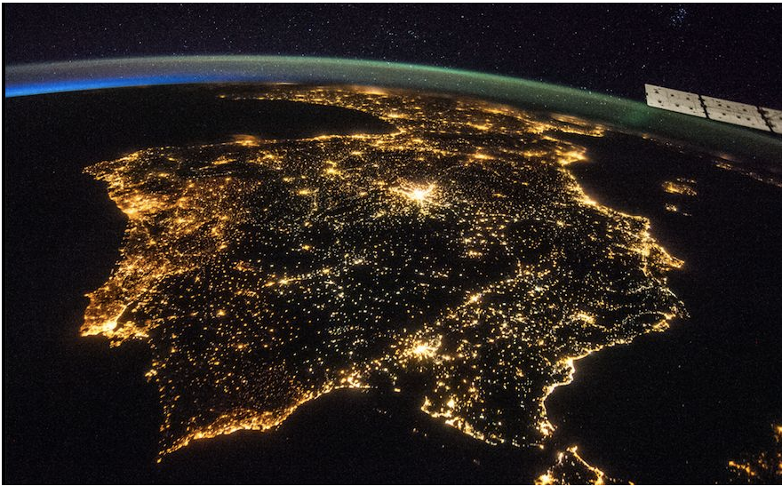
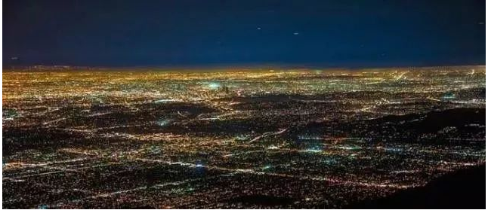
1. Satellites and light pollution blocking astronomers’ view
卫星和光污染挡住了天文学家的视线

Slide 4
语篇填空
（《泰晤士报》2023年3月21日 22页）
to build
Astronomers are struggling to find places dark enough _______ (build) telescopes as light pollution and a growing swarm of satellites block the stars. Scientists warned that a push by “big light” — a term coined to describe the world’s ______ (large) lightbulb manufacturers — to protect profits had contributed ___ climbing levels of “sky glow”, a kind of artificial twilight that prevented people from seeing the stars.
“Due to the rise of light pollution, there are almost no more remote ______ (place) available on Earth that meanwhile meet all the characteristics needed to install an observatory,” a team of experts ____ (lead) by Fabio Falchi, of the University of Santiago de Compostela in Spain, ______ (write) in the journal Nature Astronomy. Large observatories need an absence of light pollution, a high number of clear nights and “good seeing” — when the air is still.
A recent report found that even observatories beyond our planet _______________ (affect), with about one in every 23 pictures taken by the Hubble Space Telescope, ______ is around 535km (332 miles) above the Earth, marred by streaks caused by passing satellites.
“Given the paucity of sites, it should be expected _____ we all fight tooth and nail to preserve the night sky darkness of actual and potential future sites,” ____ report said.
largest
to
places
led
wrote
were being affected
which
that
the

Slide 5
词汇讲解
1. coin: to invent a new word or phrase that other people then begin to use 创造
Jaron Lanier coined the term “virtual reality” and pioneered its early development.
加隆·雷尼尔首创“虚拟现实”一词，并率先进行早期开发。
2. mar: to damage or spoil sth good 破坏；毁坏；损毁；损害
The grandmother remained silent, not to mar the happiness of the child.
奶奶保持沉默，不想破坏孩子的幸福。
翻译句子
人们创造了一词，用来指无家可归者的居住区。
The term was coined to describe communities of homeless people.
翻译句子
这场比赛被醉酒球迷的行为破坏了。
The game was marred by the behaviour of drunken fans.

Slide 6
句子翻译
Scientists warned that a push by “big light” — a term coined to describe the world’s largest lightbulb manufacturers — to protect profits had contributed to climbing levels of “sky glow”, a kind of artificial twilight that prevented people from seeing the stars.
科学家们警告称，“大光”——这个词是用来形容世界上最大的灯泡制造商的——为保护利润而采取的行动，导致了“天空辉光”的水平不断攀升。“天空辉光”是一种人造的微光，阻止人们看到星星。
翻译
“Given the paucity of sites, it should be expected that we all fight tooth and nail to preserve the night sky darkness of actual and potential future sites,” the report said.
报告称：“鉴于遗址的稀缺，我们应该竭尽全力保护实际和潜在的未来遗址的夜空黑暗。”
翻译

Slide 7
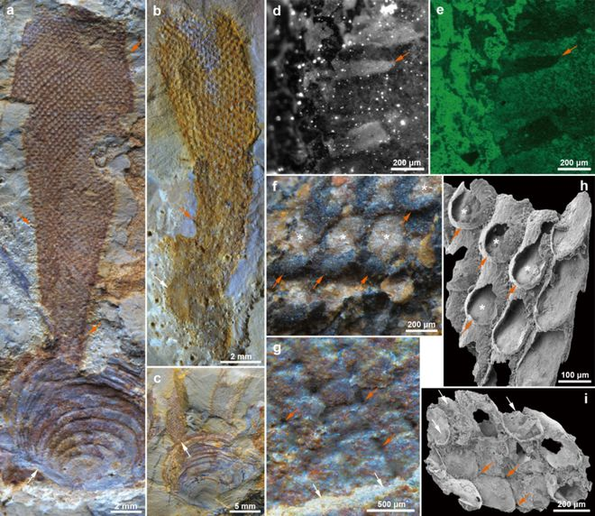
2. Surprising “animal” fossil may actually be a bit of seaweed
苔藓虫？还是绿藻？

Slide 8
阅读理解
（《新科学家》 2023年3月18日刊 20页）
A fossil once thought to be the earliest known animal from a group called the bryozoans (苔藓虫) might actually be a seaweed.
Nearly all major animal groups first appear in the fossil record between 541 and 520 million years ago during an evolutionary event known as the Cambrian explosion (寒武纪爆发). Until two years ago, the bryozoans — tiny, coral-like creatures that live in colonies in oceans and freshwater — were the only animal group missing from that event, with their earliest fossil traces not showing up until 40 million years after it.
But in 2021, Paul Taylor at the Natural History Museum in London and his colleagues identified the 515-million-year-old Cambrian fossil Protomelission gatehousei as a bryozoan, suggesting these animals arrived on the scene not long after other groups after all.
Now, Martin Smith at Durham University, UK, and his team have studied 12 new Protomelission-like fossils from Kunming in China. They had all been preserved in a way that maintained their soft tissues.
The researchers found clumping formations of individual tube-like structures in a honeycomb pattern, which can occur in both plants and animals. But they saw no tentacles nor any regularly shaped holes for tentacles to pass through-the telltale signs in later bryozoan fossils, says Smith. Instead, the researchers noticed long projections emerging from the honeycomb that look like flanges, structures that are typical of certain kinds of green algae (绿藻类) that make up seaweed.
Taylor, who wasn’t involved in the new study, isn’t convinced. He questions whether the new fossils are truly Protomelission, especially since there are significant differences in the sizes of the specimens’ structures.

Slide 9

阅读理解
1.What does the underlined word “it” in Paragraph 2 refer to?
A.the fossil B. oceans and freshwater
C. the Cambrian explosion D. coral-like creatures
词义猜测
2. What’s the author’s attitude towards the new discovery?
A. positive B. indifferent C. doubtful D. objective
推理判断
3. In which section of the magazine might the text appear?
A. Environment B. Psychology C. palaeontology D. Agriculture
推理判断

Slide 10
词汇讲解
1. colony: a group of plants or animals that live together or grow in the same place （同地生长的植物或动物）群，群体，集落
Many behavioural patterns have been identified in the chimp colony. 在黑猩猩群落中已经发现了许多行为模式。
2. specimen: a small amount of sth that shows what the rest of it is like 样品；样本；标本
Astronauts have brought back specimens of rock from the moon. 宇航员从月球带回了岩石标本。
翻译句子
这些岛屿因有成群的海鸟居住而闻名。
The islands are famed for their colonies of sea birds.
翻译句子
他收集了很多稀有昆虫的标本。
He has a collection of rare insect specimens.

Slide 11
句子翻译
The researchers found clumping formations of individual tube-like structures in a honeycomb pattern, which can occur in both plants and animals. But they saw no tentacles nor any regularly shaped holes for tentacles to pass through-the telltale signs in later bryozoan fossils, says Smith.
研究人员发现了蜂窝状的单个管状结构的结块形成，这种情况在植物和动物中都有发生。但是他们没有看到触须，也没有看到任何规则形状的孔让触须穿过——这是后来苔藓动物化石的迹象，史密斯说。
翻译
Instead, the researchers noticed long projections emerging from the honeycomb that look like flanges, structures that are typical of certain kinds of green algae that make up seaweed.
相反，研究人员注意到蜂巢中出现的长投影，看起来像凸缘，这是组成海藻的特定种类绿藻的典型结构。
翻译

Slide 12
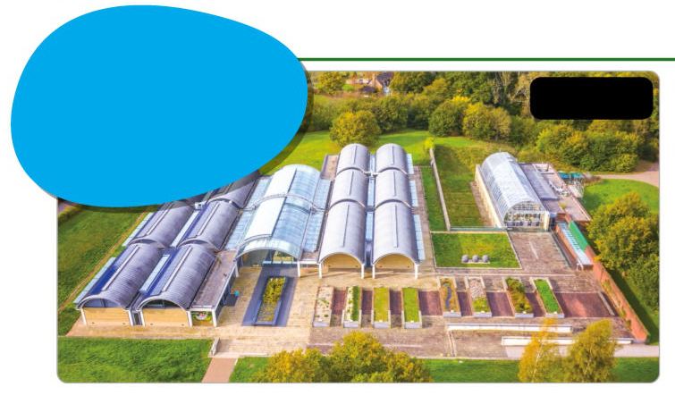
3. A living library of global plants
世界最大的种子银行
LIGHT AS AIR
The smallest seeds in the MSB are of the orchid Aerides odorata - they measure no more than 0.2 millimetres across.
The seed bank from the air.

Slide 13
语篇填空
（《青少年周刊》英国版 2023年3月25日 11页）
largest
The world’s ______ (large) seed bank, at the Wakehurst wild botanic garden in West Sussex, England, has announced that it now holds more _____ 40,000 wild plant species.
The Millennium Seed Bank (MSB) __________ (create) by researchers from London’s Kew Gardens more than 20 years ago, to preserve rare, threatened and important wild plants. Nicknamed “the Noah’s Ark for plants”, around 2.4 billion individual seeds from 190 ________ (country) are stored in its underground vaults.
Any seeds that arrive at MSB are dried, cleaned, X-rayed for signs of pests and then stored at -20℃. They can survive for hundreds of years like this ____ scientists remove the seeds every 10 years to see if they can still grow into plants, and to develop new ways of _______ (help) wild plants survive.
The bank _______ (ensure) that if plants in the wild become extinct, they can be regrown from MSB seeds. Scientists estimate that two-fifths of all wild plants are threatened with _________ (extinct). Seeds in the vaults include the world’s smallest water lily, __ rare Australian pea and Antarctic hair grass, one of only two flowering plants __________ grow in Antarctica.
than
was created
countries
but
helping
ensures
extinction
a
which / that

Slide 14
词汇讲解
1. vault: a room with thick walls and a strong door, especially in a bank, used for keeping valuable things safe （尤指银行的）金库，保险库
The walls of the vault were plated with steel. 保险库的墙壁都装了钢板。
2. pest: an insect or animal that destroys plants, food, etc. 害虫；害兽；害鸟
Each year ten percent of the crop is lost to a pest called corn rootworm. 每年有10%的作物受损于一种叫做玉米根虫的害虫。
翻译句子
这笔钱的一大部分是存放在银行保险库中的。
Most of the money was in storage in bank vaults.
翻译句子
那位科学家研发了一种防治害虫的新方法。
The scientist developed a new strategy for pest control.

Slide 15
句子翻译
The world’s largest seed bank, at the Wakehurst wild botanic garden in West Sussex, England, has announced that it now holds more than 40,000 wild plant species.
翻译
世界上最大的种子银行位于英格兰西苏塞克斯的韦克赫斯特野生植物园，它宣布现在拥有4万多种野生植物。
Any seeds that arrive at MSB are dried, cleaned, X-rayed for signs of pests and then stored at -20℃. They can survive for hundreds of years like this but scientists remove the seeds every 10 years to see if they can still grow into plants, and to develop new ways of helping wild plants survive.
任何到达MSB的种子都要经过干燥、清洗、x光检查是否有虫害，然后在零下20℃下储存。它们可以像这样存活数百年，但科学家每10年就会取出种子，看看它们是否还能长成植物，并开发帮助野生植物生存的新方法。
翻译

Slide 16
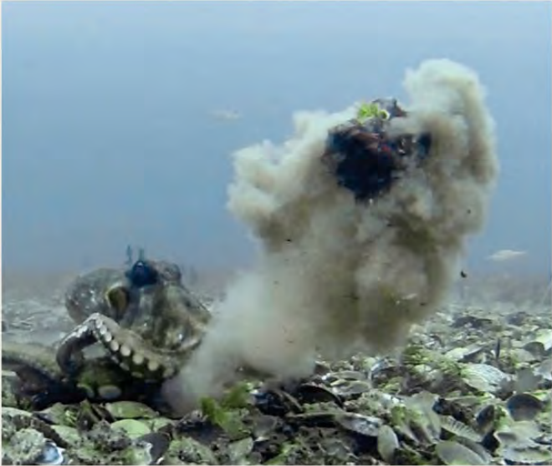
4. Octopuses arm themselves in their first reported ‘throwing’ behavior
新知：章鱼的特殊防身术

Slide 17
语篇填空
（《国家地理》2023年3月刊 BREAKTHROUGHS版面）
For its novel way of maintaining boundaries, consider Octopus tetricus, also ______ (know) as the gloomy octopus and the common Sydney octopus. If another creature gets too close, it may respond by throwing things, according to a study published _______ (recent) in the journal PLOS One. The cephalopods, native to seas off New Zealand and eastern Australia, were caught on camera ________ (throw) shells, silt, and algae, which sometimes hit animals ____ came too near their dens. The recipients included various fish, other gloomy octopuses—____ even the underwater cameras. This is the first time a throwing behavior _______________ (report) among octopuses. Though scientists aren’t certain of the motivation, it may have something to do with “the octopus equivalent of ________ (person) space,” says the study’s lead author, Peter Godfrey-Smith, ___ professor at the University of Sydney. To execute their throws, gloomy octopuses scoop up debris with their arms and propel it with powerful jets from their siphons, tubular structures that pump water _____ their bodies. The technique can shoot materials up to several body _______ (long) away.
known
recently
throwing
that
and
has been reported
personal
a
from
lengths

Slide 18
词汇讲解
1. equivalent: a thing, amount, word, etc. that is equal to sth else
相等的东西；等量；对应词
The car costs the equivalent of 5 years’ salary for a government worker.
这辆车的价格相当于一个公务员5年的薪水。
2. execute: to successfully perform a skillful action or movement
成功地完成（技巧或动作）
The landing was skilfully executed. 熟练地完成了着陆。
翻译句子
呼吸污染这么严重的空气等同于每天抽十支烟。
Breathing such polluted air is the equivalent of smoking ten cigarettes a day.
翻译句子
飞行员完成了非常娴熟的着陆动作。
The pilot executed a perfect landing.

Slide 19
句子翻译
The cephalopods (头足类动物), native to seas off New Zealand and eastern Australia, were caught on camera throwing shells, silt, and algae, which sometimes hit animals that came too near their dens.
翻译
这种头足类动物原产于新西兰和澳大利亚东部海域，摄像机捕捉到它们投掷贝壳、淤泥和藻类，有时会击中离它们洞穴太近的动物。
This is the first time a throwing behavior has been reported among octopuses. Though scientists aren’t certain of the motivation, it may have something to do with “the octopus equivalent of personal space,” says the study’s lead author.
翻译
这是首次在章鱼中发现投掷行为。该研究的主要作者说，虽然科学家们不确定它们的动机是什么，但猜测可能与“章鱼的‘私人空间’”有关。

Slide 20
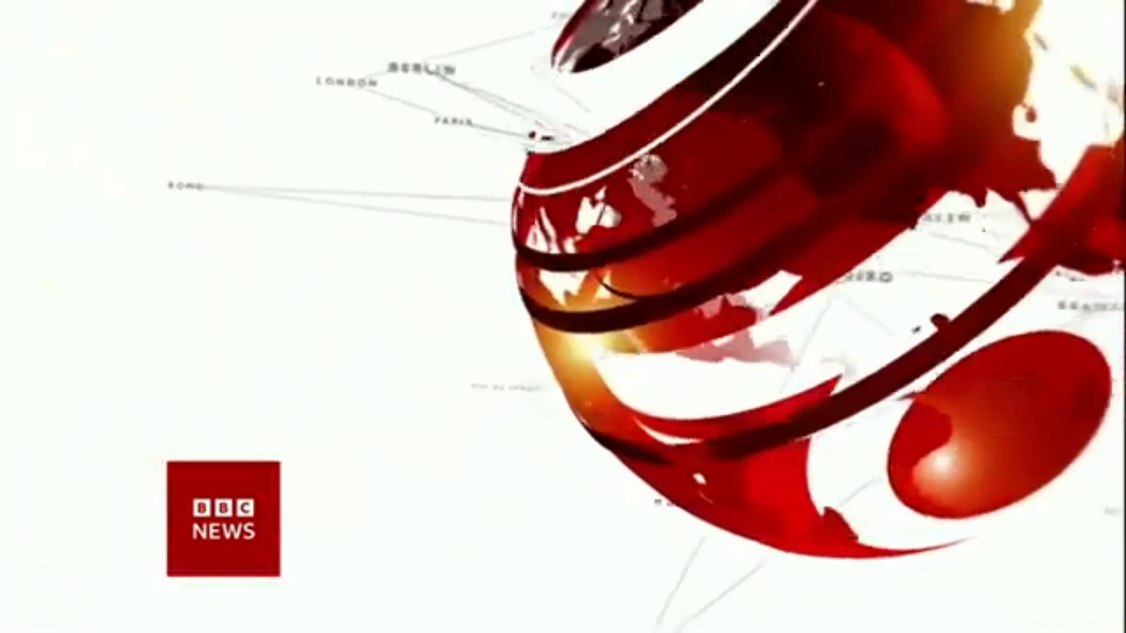
5. BBC One-minute World 03/22/2023

Slide 21

听力填空
This is BBC world news. Here are the headlines.
President Vladimir Putin visits Mariupol, the Ukrainian city, which ___________ by invading Russian forces last year. It’s his first trip to the Russian-occupied _________ of eastern Ukraine’s Donbas region since the start of the war.
A deal allowing the export of Ukrainian grain from Black Sea ports _______________ but it’s unclear for how long. The agreement _____________ after talks with Russia and Ukraine.
Former U.S. President Donald Trump says he _______ there are plans to arrest him on Tuesday. He’s called on his supporters ________. Prosecutors have been looking at a possible indictment of Mr. Trump.
Protests have __________ in Milan after Italy’s government instructed the city council to stop _________ the children of same-sex parents. Milan’s mayor says he will continue to fight for the rights of same-sex parents.
was captured
territories
has been renewed
was concluded
suspects
to protest
taken place
registering

Slide 22
词汇讲解
1. prosecutor: a public official who charges sb officially with a crime and prosecutes them in court 公诉人；检察官
Prosecutors are fully entitled to bring any number of offenses against a single defendant. 检察官完全有权对单一被告提出任何数量的罪行。
2. indictment: the act of officially accusing sb of a crime 控告；起诉
This led to his indictment on allegations of conspiracy.
这件事最终使他被控犯有共谋罪。
翻译句子
Mitchell是该县的前检察官。
Mitchell is a former prosecutor for the county.
翻译句子
没有人对她的起诉感到惊讶。
No one was surprised by her indictment.

