Slide 1

感恩遇见，相互成就，本课件资料仅供您个人参考、教学使用，严禁自行在网络传播，违者依知识产权法追究法律责任。
更多教学资源请关注
公众号：溯恩高中英语
知识产权声明

Slide 2

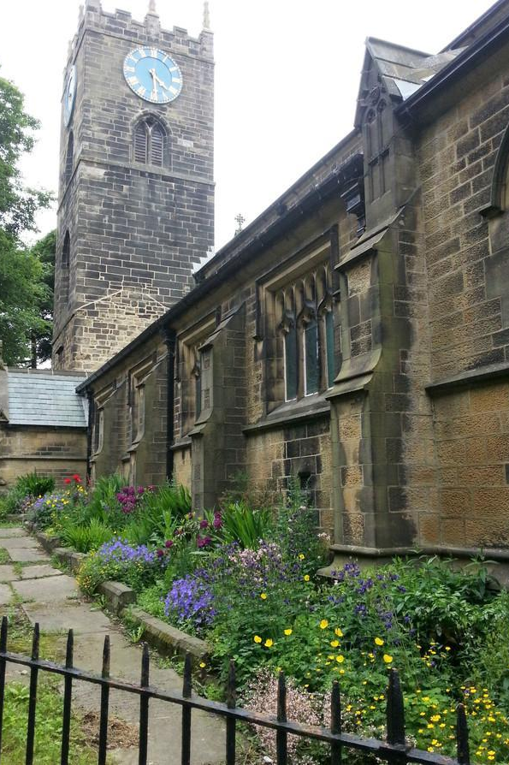

Lesson2
Thirteen equals one

Slide 3
Target vocabulary
1

Slide 4
Match each word with the best meaning.
1. _______ equal A. the light from a torch 2. _______ raise B. to show approval by clapping 3. _______ vicar C. to collect something, usually money 4. _______ torchlight D. to be the same as something 5. _______ applaud E. to hit something to make a sound 6. _______ strike F. a person who sells food and household items 7. _______ grocer G. a person, animal or character represented in
art or story 8. _______ figure H. a priest in the Anglican Church who is in
charge of an area
D
C
H
A
B
E
F
G

Slide 5
Reading the passage
2

Slide 6
Reading the passage
Our vicar is always raising money for one cause or another, but he has never managed to get enough money to have the church clock repaired. The big clock which used to strike the hours, day and night was damaged many years ago and has been silent ever since.
One night, however, our vicar suddenly woke up with a start: the clock was striking the hours! Looking at his watch, he saw that it was one o'clock, but the bell struck thirteen times before it stopped. Armed with a torch, the vicar went up into the clock tower to see what was going on. In the torchlight, he caught sight of a figure that he immediately recognized as Bill Wilkins, our local grocer.
“Whatever are you doing up here Bill?” asked the vicar in surprise.
“I’m trying to repair the bell,” answered Bill. “I’ve been coming up here night after night for weeks now. You see, I was hoping to give you a surprise.”
“You certainly did give me a surprise!” said the vicar. “You've probably woken up everyone in the village as well. Still, I’m glad the bell is working again.”
“That's the trouble, vicar,” answered Bill. “It’s working all right, but I’m afraid that at one o’clock it will strike thirteen times and there's nothing I can do about it.”
“We’ll get used to that Bill,” said the vicar. “Thirteen is not as good as one, but it’s better than nothing. Now let's go downstairs and have a cup of tea.”

Slide 7
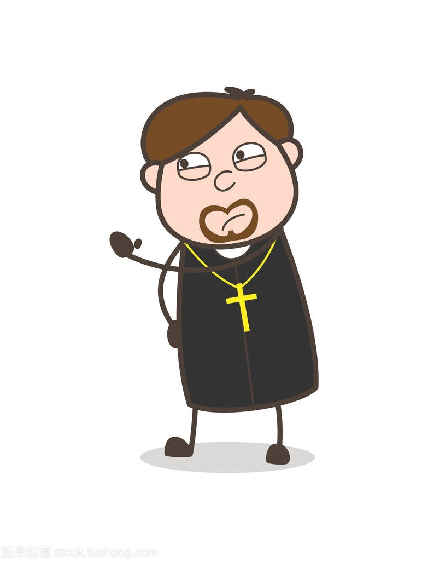
Was the vicar pleased that the clock was striking? Why?
Yes, because it had been silent for years.

Slide 8
Reading comprehesion
3

Slide 9
Reading comprehension
1. The church clock did not work because ______ .
A. it was too expensive to repair
B. it disturbed the vicar's sleep
C. Bill Wilkins only worked at night
D. the bell had been out of order for many years

Slide 10
Reading comprehension
2. The vicar was surprised to see Bill Wilkins in the clock tower
because ______ .
A. Bill Wilkins had been hoping to surprise him
B. it was an unusual time and place to find him
C. he had expected to find a figure
D. the clock had struck thirteen times

Slide 11
Reading comprehension
3. The vicar offered Bill Wilkins a cup of tea because ______ .
A. he thought that Bill Wilkins was thirsty
B. thanks to him, the clock would now strike once an hour
C. he was grateful for the trouble Bill Wilkins had taken
D. he was pleased to have been woken up for nothing

Slide 12
Structure imitation
4

Slide 13
Structure imitation
1. … be always doing, but have/has never managed to ….
Tom is always talking about his dream of becoming a successful entrepreneur, but he has never managed to start his own business.
Despite my passion for cooking, I am always struggling to create the perfect dish. I have never managed to find the right balance of ingredients and flavors that I desire.
Despite years of practice, he is always trying to hit the high note, but he has never managed to do it.

Slide 14
Structure imitation
2. … which used to … … and have/has been … ever since.
The old theater which used to host popular plays and musicals, and has been abandoned for decades, now stands as a relic of the past, untouched ever since.
This long-standing restaurant which used to sell traditional dishes, and and has been in the family for generations. It still uses the same secret family recipes, unchanged ever since.

Slide 15
Structure imitation
3. …, but I’m afraid that … and there’s nothing we can do about it.
The storm is approaching fast, but I'm afraid that the power will go out and there's nothing we can do about it.
The flight has been delayed again, but I'm afraid that we will miss our connecting flight and there's nothing we can do about it.
The bridge is closed for repairs, but I'm afraid that the detour will add hours to our travel time and there's nothing we can do about it.

Slide 16
Imitation
4. … be not as … as …, but … better than nothing.
Getting some exercise is not as good as a full workout, but it's better than nothing.
A short break is not as good as a long vacation, but it's better than nothing.
Online learning is not as effective as in-person classes, but it's better than nothing.
A temporary solution is not as good as a permanent fix, but it's better than nothing.
Small progress is not as significant as big progress, but it's better than nothing.

Slide 17
Story telling
5

Slide 18
Story-telling
1. church clock----used to strike the hours----damaged----silent ever since
2. one night----vicar woke up----clock striking
3. looked at watch---- one o'clock---- bell struck thirteen times
4. torch----clock tower----going on
5. caught sight----Bill Wilkins----local grocer
6. doing? ----Trying ---- repair the bell----night after night----surprise
7. did give me a surprise----woke up village----glad bell working
8. working----but one o'clock----thirteen times----nothing can do about it
9. get used to it----thirteen better than nothing----cup of tea

Slide 19
Summary writing
6

Slide 20
Answer the following questions with complete sentences.
1. What woke the vicar up?
2. What was the time?
3. How many times did the clock strike?
4. Where did the vicar go?
5. What did he take with him?
6. Whom did he see in the clock tower?
7. What did Bill Wilkins say he was trying to do?
8. Had Bill Wilkins succeeded in repairing the clock or not?
9. Was the vicar pleased or angry?
10. What did he offer the grocer?

Slide 21
1. What woke the vicar up? woke the vicar up?
The church clock striking the hours woke the vicar up.
2. What was the time?
It was one o’clock in the morning.
3. How many times did the clock strike?
The clock struck 13 times.
1+2+3:
At one o’clock in the morning, the church clock striking the hours woke the vicar up as it struck 13 times.

Slide 22
4. Where did the vicar go?
The vicar went up into the clock tower.
5. What did he take with him?
He took a torch with him.
4+5:
The vicar went up into the clock tower, taking a torch with him.

Slide 23
6. He saw Bill Wilkins, the local grocer in the clock tower.
He saw Bill Wilkins, the local grocer in the clock tower.
7.What did Bill Wilkins say he was trying to do?
He was trying to repair the clock.
8. Had Bill Wilkins succeeded in repairing the clock or not?
He hadn’t succeeded because at one o’clock it struck thirteen times.
6+7+8:
He saw Bill Wilkins, the local grocer there and Bill explained he was trying to repair the clock but hadn’t succeeded because at one o’clock it struck thirteen times.

Slide 24
9. Was the vicar pleased or angry?
The vicar was pleased the bell was working.
10. What did he offer the grocer?
He offered the grocer a cup of tea.
9+10:
The vicar was pleased the bell was working and offered the grocer a cup of tea.

Slide 25
A possible version:
At one o’clock in the morning, the church clock striking the hours woke the vicar up as it struck 13 times. The vicar went up into the clock tower, taking a torch with him. He saw Bill Wilkins, the local grocer there and Bill explained he was trying to repair the clock but hadn’t succeeded because at one o’clock it struck thirteen times. However/Still, the vicar was pleased the bell was working and offered the grocer a cup of tea.

Slide 26
Occasion describing
7

Slide 27
A sticky business
Introduction:
A small village----the church clock suddenly stopped----no one could explain why.
Development:
The vicar climbed into the clock tower----found that the clock had been invaded by bees----full of honey and wax.
Conclusion:
A bee keeper was called----removed the queen bee----the other bees followed----the clock was cleaned----working again.

Slide 28
Occasion describing
A sticky business
Introduction: A small village----the church clock suddenly stopped----no one could explain why.
We were used to hearing our church bell striking the hours in our small village. For as long as anyone could remember, the bell had struck the hours day and night. However, one night the church bell remained silent and the next morning we saw that the clock had stopped at exactly one a.m. Our clock was clearly damaged, but no one could explain how this had happened.

Slide 29
Occasion describing
Development: The vicar climbed into the clock tower----found that the clock had been invaded by bees----full of honey and wax.
Armed with a torch, our vicar climbed into the church tower to see what was going on. He heard a loud buzz as he went towards the clock and in the torchlight he found it had been invaded by bees. He was lucky they didn't sting him! He shone his torch into the great bell and saw that it was full of wax and honey. No wonder it wasn't working!

Slide 30
Occasion describing
Conclusion: A bee keeper was called----removed the queen bee----the other bees followed----the clock was cleaned----working again.
A bee keeper was called in to deal with the situation. He immediately removed the queen bee to one of his bee hives and the other bees followed. The clock was cleaned and was soon working again. We not only enjoyed hearing it strike the hours day and night, but we enjoyed eating the honey as well.

Slide 31
Occasion describing
A sticky business
We were used to hearing our church bell striking the hours in our small village. For as long as anyone could remember, the bell had struck the hours day and night. However, one night the church bell remained silent and the next morning we saw that the clock had stopped at exactly one a.m. Our clock was clearly damaged, but no one could explain how this had happened.
Armed with a torch, our vicar climbed into the church tower to see what was going on. He heard a loud buzz as he went towards the clock and in the torchlight he found it had been invaded by bees. He was lucky they didn't sting him! He shone his torch into the great bell and saw that it was full of wax and honey. No wonder it wasn't working!
A bee keeper was called in to deal with the situation. He immediately removed the queen bee to one of his bee hives and the other bees followed. The clock was cleaned and was soon working again. We not only enjoyed hearing it strike the hours day and night, but we enjoyed eating the honey as well.

Slide 32
Story development
8

Slide 33
Reading the passage
Our vicar is always raising money for one cause or another, but he has never managed to get enough money to have the church clock repaired. The big clock which used to strike the hours, day and night was damaged many years ago and has been silent ever since.
One night, however, our vicar suddenly woke up with a start: the clock was striking the hours! Looking at his watch, he saw that it was one o'clock, but the bell struck thirteen times before it stopped. Armed with a torch, the vicar went up into the clock tower to see what was going on. In the torchlight, he caught sight of a figure that he immediately recognized as Bill Wilkins, our local grocer.
“Whatever are you doing up here Bill?” asked the vicar in surprise.
“I’m trying to repair the bell,” answered Bill. “I’ve been coming up here night after night for weeks now. You see, I was hoping to give you a surprise.”
“You certainly did give me a surprise!” said the vicar. “You've probably woken up everyone in the village as well. Still, I’m glad the bell is working again.”
“That's the trouble, vicar,” answered Bill. “It’s working all right, but I’m afraid that at one o’clock it will strike thirteen times and there's nothing I can do about it.”
“We’ll get used to that Bill,” said the vicar. “Thirteen is not as good as one, but it’s better than nothing. Now let's go downstairs and have a cup of tea.”

Slide 34
Para 1：
Sitting around the table, tea in hand, Bill and the vicar discussed the bell.
Para 2：
After climbing the steep stairs of the church tower, Bill arrived at the bell.

Slide 35
Possible version 1:
Sitting around the table, with tea in hand, Bill and the vicar discussed the bell. “Do you think it's possible to fix the bell, vicar?” asked Bill. The vicar took a sip of his tea before answering. “It's worth a try. I'll speak to the church council and see if we can get a specialist to take a look at it.” Bill nodded, relieved that something could be done. He had been worried about the bell striking thirteen times ever since he had taken on the job of maintaining it.
As they finished their tea, the vicar added, “And in the meantime, we'll just have to enjoy the novelty of a thirteen o'clock bell.” They both chuckled and headed back down the stairs.
After climbing the steep stairs of the church tower, Bill arrived at the bell. He inspected it closely, trying to figure out why it was striking thirteen times instead of the usual one.
Suddenly, he noticed a loose screw that was causing the problem. He quickly tightened it and tested the bell. It rang out clearly, striking just once at one o'clock. Bill grinned triumphantly and made his way back down the stairs to tell the vicar the good news. From that day on, the bell rang out perfectly, and Bill felt proud of his handiwork every time he heard it strike.

Slide 36
Possible version 2:
Sitting around the table, with tea in hand, Bill and the vicar discussed the bell. The vicar suggested that they could perhaps use the striking of thirteen as a unique feature of their church bell, something that would make it stand out from all the others in the area. Bill was hesitant at first, but the more they talked about it, the more he warmed up to the idea. They could even use it as a way to attract visitors to the church, the vicar suggested. Bill smiled at the thought, feeling proud of his creation.
After climbing the steep stairs of the church tower, Bill arrived at the bell. He carefully checked the mechanism, making sure that everything was in order. As he looked out over the town from the high vantage point, he felt a sense of satisfaction. He had created something that would be a part of this community for years to come. As he descended the stairs, he couldn't help but feel a sense of pride in his work. The striking of thirteen would be a unique feature of their church bell, and he was glad that he had been a part of it.

Slide 37
Possible version 3:
Sitting around the table, with tea in hand, Bill and the vicar discussed the bell. “Why did you want to repair the church clock so urgently?” asked the vicar curiously. Bill’s face lit up as he began to recall the story of a restless night when he decided to take a walk around town. As he strolled through the empty streets, the moon cast an eerie glow that illuminated the clock and the bell. However, what caught Bill's eye was a dark figure standing next to the bell, partially obscured by shadows.
After climbing the steep stairs of the church tower, Bill arrived at the bell. Catching his breath, he asked the man what he was doing. The man said, “I’m attempting to fix this bell. But it’s useless; I’ve been working on it for weeks, and it’s irreparably damaged. Nothing I can do will help.” The man threw his tools on the ground and pushed past Bill out of annoyance. Bill said, “That’s why I fixed the bell.” He continued by saying that this was the reason for fixing the bell because he had never wanted to hear someone declare something was impossible.

Slide 38
Vocabulary reiforcement
9

Slide 39
A. Word spelling
1. Two plus two e____ four.
2. S____ the iron while it is hot.
3. Though knowing the truth, he remained s_____.
4. What’s the c____ of the big forest fire in California?
5. The central f______ in the painting is the artist’s daughter.
quals
trike
ilent
ause
igure

Slide 40
A. Word spelling
6. The hiker used a t_______ to navigate through the dark forest.
7. After the collision, he examined the considerable d______ to his car.
8. Although I hadn’t seen her for five years, I made her out in the crowd i__________.
9. Many people are a____ complaining, but they seldom do anything practical.
10. It wasn’t until I saw the expression on her face that I
r_______ how much my words had hurt her.
orchlight
amage
mmediately
lways
ealized

Slide 41
B. Gap filling
go on strike as well raise money managed to do do something about
with a start be armed with get used to catch sight of be recognized as
1. John is an excellent engineer, and he is a great project manager ______________.
2. It took some time, but I eventually ______________ the spicy food in Thailand.
3. Despite the challenging circumstances, she _____________ do well on her final exams.
4. As I was walking down the street, I ______________ my old friend from high school.
5. The police officer __________________ a gun and a taser to ensure his safety while on duty.
as well
got used to
managed to
caugt sight of
was armed with

Slide 42
B. Gap filling
go on strike as well raise money managed to do do something about
with a start be armed with get used to catch sight of be recognized as
6. ____________, she woke up from her deep sleep and realized it was already morning.
7. The workers decided to ____________ to demand better wages and working conditions.
8. The non-profit organization is trying to ___________ to support its charitable programs.
9. We need to __________________ about the pollution in our city and start taking action to protect the environment.
10. The judges recognized her talent and skill, and she __________________ the winner of the singing competition.
With a start
go on strike
raise money
do something about
was recognized as

