Slide 1

感恩遇见，相互成就，本课件资料仅供您个人参考、教学使用，严禁自行在网络传播，违者依知识产权法追究法律责任。
更多教学资源请关注
公众号：溯恩高中英语
知识产权声明

Slide 2

基于提升学生语用迁移能力的
同话题应用文的变式训练
2023.3 苏北七市&浙江9+1联盟二调
应用文“世界水日”

Slide 3

新闻报道
每年的3月22日是“世界水日”（World Water Day），上周日上午你校学生会组织部分青年志愿者走上街头开展公益宣传活动。假定你是李华，请你为校英文报写一篇报道，内容包括：
1.活动目的；
2.活动内容；
3.活动反响。
注意:
1.词数80左右；
2.可适当增加细节，
以使行文连贯。
类型
时态
人称
语气
要点
一般过去时
审题
第一人称 We
或第三人称 They （the youth volunteers）
formal
标题 Headline- theme/ topic- eyecatching
P1 导语 Lead- 5W (who when where what why)
- concise & informative
P2 正文 Body- process & highlight
- time order & theme-related
P3 结语 Conclusion- comment/ gains/ reflection
-general- specific; theme-related
要点一Why 活动目的
要点二What 活动内容
要点三How 活动反响

Slide 4
eyecatching
“慈善义卖”参考范文
A Successful Charity Sale
Last Sunday in our school auditorium, the Student Union launched a grand Charity Sale for the impoverished and needy dwelling in the local community.
To provide those in need with affordable things, all the students and teachers were called upon to collect unwanted but still serviceable items for sale, such as second-hand books and stationery, as well as furniture and kitchen stuff. During the fair, customers could purchase bargains at heavily discounted prices and all goods were snapped up within hours. All those engaged spoke highly of the activity.
This Charity Sale proved successful and meaningful. By contributing to such a charitable cause, we avoided waste and gained a sense of satisfaction of doing good deeds as well.
“慈善义卖”参考范文
A Successful Charity Sale
Last Sunday in our school auditorium, the Student Union launched a grand Charity Sale for the impoverished and needy dwelling in the local community.
To provide those in need with affordable things, all the students and teachers were called upon to collect unwanted but still serviceable items for sale, such as second-hand books and stationery, as well as furniture and kitchen stuff. During the fair, customers could purchase bargains at heavily discounted prices and all goods were snapped up within hours. All those engaged spoke highly of the activity.
This Charity Sale proved successful and meaningful. By contributing to such a charitable cause, we avoided waste and gained a sense of satisfaction of doing good deeds as well.
“慈善义卖”参考范文
A Successful Charity Sale
Last Sunday in our school auditorium, the Student Union launched a grand Charity Sale for the impoverished and needy dwelling in the local community.
To provide those in need with affordable things, all the students and teachers were called upon to collect unwanted but still serviceable items for sale, such as second-hand books and stationery, as well as furniture and kitchen stuff. During the fair, customers could purchase bargains at heavily discounted prices and all goods were snapped up within hours. All those engaged spoke highly of the activity.
This Charity Sale proved successful and meaningful. By contributing to such a charitable cause, we avoided waste and gained a sense of satisfaction of doing good deeds as well.
concise but informative
theme/ topic
Headline
5 W (when where who what why)
Lead
How is a news report organized? (format)
What information should a news report include? (content)
What is the tone of a news report? (lingustic features)
process + highlight
Body
time order/ theme-related
conclusion
comment/ gains/ reflection
general- specific; theme-related

Slide 5

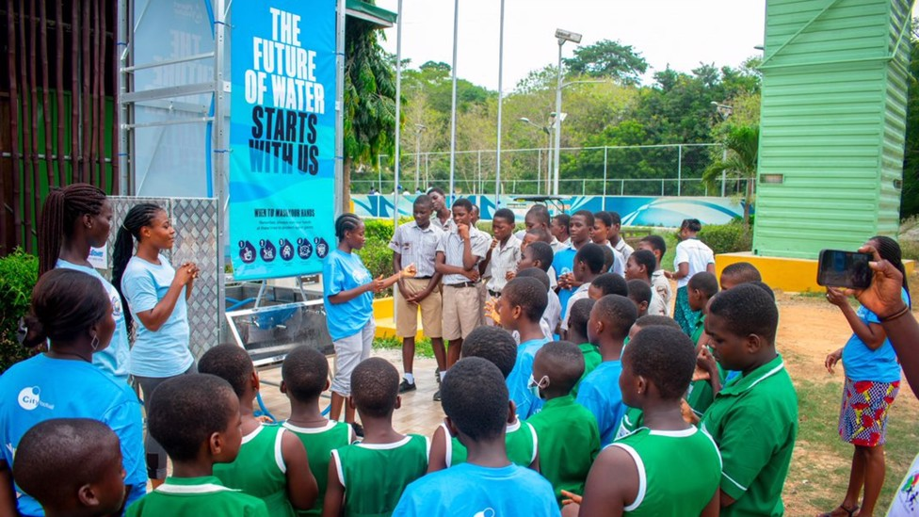
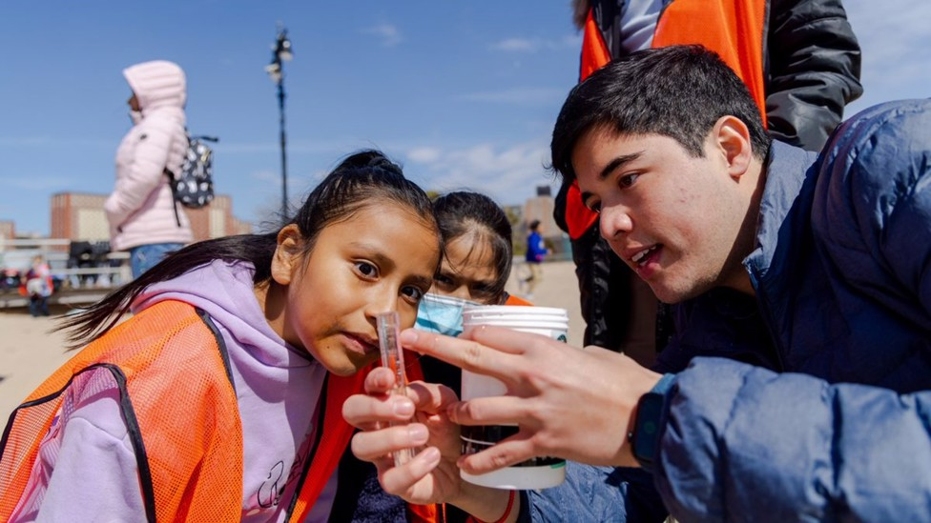
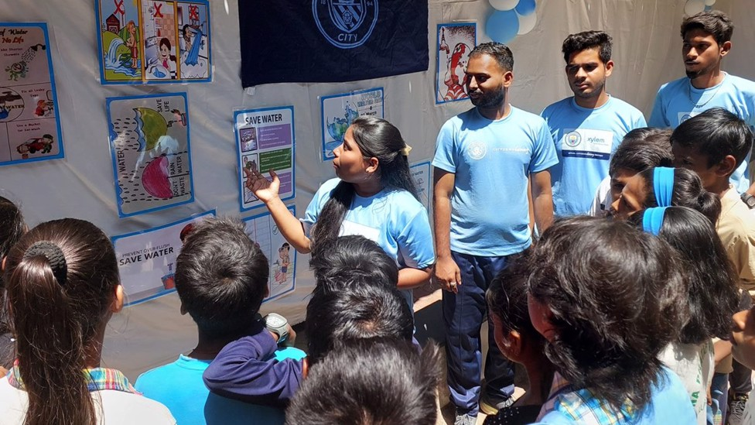
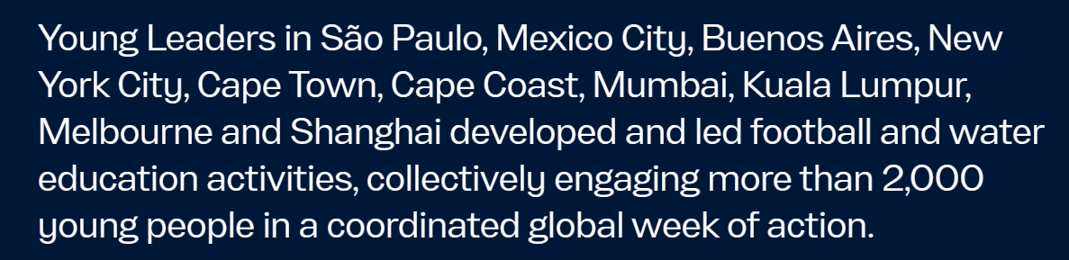

Slide 6






theme-related information
Why
What
to celebrate/ in celebration of/ to mark the World Water Day
to publicize/ advocate the importance of preserving water
deliver an inspiring speech to call on people to...
put up self-designed posters on the billboard/ wall to draw the public attention to the serious issue of water shortage and pollution; alarm the public about…; alert the citizens to the urgent situation of water waste and scarcity
give out/ distribute leaflets/ brochures to share some feasible/ workable/ practical approaches to saving water, such as taking shorter showers and not letting the tap run while washing teeth; to harnessing water pollution in a scientific way
hold a Q&A part to activate the public interest and participation; familiarize/ acquaint the local residents with knowledge about water and water conservation.
A
Youth Volunteer Activity
Celebrating
World Water
Day

Slide 7
The event was well-received by local residents/ the public/ the netizens.
was spoken highly of by ...
won/ earned/ received favorable feedbacks/ welcome from...
Once posted online, the event has earned a considerable number of likes on the school official account/ website because...
This event was praised to have done... and was hailed to have done....
comment
A
Youth Volunteer Activity
Celebrating
World Water
Day
arouse/ raise/ enhance/ cultivate/ foster public awareness/ consciousness of conserving water (saving water and preventing water pollution) ;
enable us/ students to step out of the campus to do something beneficial for the local community and the planet as well;
help us/ students appreciate that even small acts can also make a big difference to the planet/ the Earth.
boost our/ students’ social responsibility.
How
gains
/reflection
由浅入深；
对不同主体的影响

Slide 8
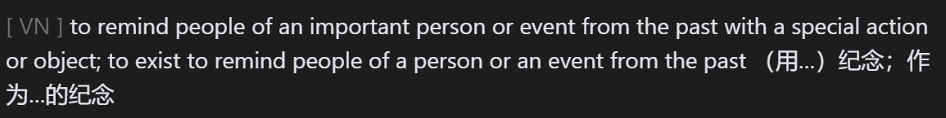
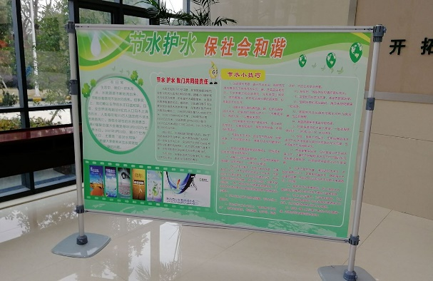
参考范文
A Youth Volunteer Activity Celebrating World Water Day
To mark/ celebrate/ observe (纪念) World Water Day, which falls annually on March 22, the Students’ Union of our school organized/ launched/ initiated a publicity campaign (宣传活动) in the downtown area last Sunday morning.
Exhibition (foam) boards were set up showcasing water’s critical importance to human survival and prosperity, as well as China’s progress in water resource protection and water pollution prevention and control. Youth volunteers also distributed leaflets to the passers-by, popularizing knowledge about how to save water in everyday life.
The campaign has not only enhanced people’s awareness of water conservation and protection, but also further added our sense of social responsibility and historic mission (历史使命).
commemorate
活动内容 （动宾结构）+ 伴随状语/ 结果状语

Slide 9
下水作文
A Youth Volunteer Activity Celebrating World Water Day
To mark the World Water Day held on 22 March every year since 1993, the Student Union organized the youth volunteers in our school and initiated a campaign to publicize the significance of water and water conservation last Sunday morning.
Youth volunteers hosted/ led a series of funfilled activities, collectively engaging more than 300 people of all ages on the streets. Some took turns to deliver water education to instruct locals on water challenges and solutions, ranging from the importance of good sanitation and hygiene to tackling water pollution; others dedicated their time and energy to distributing leaflets to passers-by on how to save water in daily life.
The event made a sensation online since posted on the social platform, for it only only served as an important reminder of the critical water challenges facing communities around the world, but also highlighted/ emphasized the enormous opportunity we humans have to make a difference.
主体
内容
（动宾结构）
客体

Slide 10

Assignment
Choose one to write a passage of no less than 80 words.
（题目一）假定你是校学生会主席李华，你校拟在3月22日“世界水日” （World Water Day）组织学生走上街头开展公益宣传活动，请你写一份通知，内容包括：
1. 活动目的和内容；
2. 期待参与。
（题目二）3月22世界水日即将到来，你校想以此为契机，呼吁同学们节约用水、防治水污染。假定你是学生会主席李华，请你代表学生会写一份倡议书。内容包括：
1. 倡议原因；
2. 具体措施；
3. 发出倡议。
notice | text type | an initiative/ appeal
future | tense | present
2nd | person | 2nd
formal | tone | formal
text type
tense
person
tone

Slide 11
Notice
In a bid to raise the public awareness of water conservation, our school has planned to initiate a publicity campaign in the local community on the World Water Day, which falls on March 22 every year. (活动目的、时间、地点)
On that day, an inspiring speech will be delivered about the urgency of saving water and preventing water pollution, then followed by a Q&A session where the locals can get souvenirs. Other activities inlude setting up exhibition boards and distributing leaflets to the passers-by, which aim to change how people use, consume and manage water. (活动内容：时间顺序；详略得当)
Looking forward to your active participation./ Come and join us in the profound cause of preserving our lifeline. (期待参与)
the Student Union

Slide 12
Dear students，
As we all know, water is the source of life. Without water, there would be nothing alive on the earth. (重要性) However, the freshwater available on the earth is becoming less and less. (必要性) Facing/ Confronting such a serious water shortage/ scarcity problem, we should take immediate action./ It's high time we took action. (倡议目的)
First of all, we are supposed to recycle the water we use every day. Besides/ Plus, when we wash up, we shouldn't leave the water running. And the tap must be turned down and turned off in time after a bath. Last but not least, to arouse the puclic awareness of water conservation, we should spread/ deliver the knowledge of saving water and preventing water pollution to people around us. (具体措施)
Save water, save life. Don't let our tears become the last drop of water on our planet./ The actions you take, no matter how small, will help solve the water crisis./ With your help we can achieve great things. Every positive action you take, no matter how small, has the power to make a difference./ Play your part and do what you can to protect water on our planet. (呼吁)
the Student Union

Slide 13
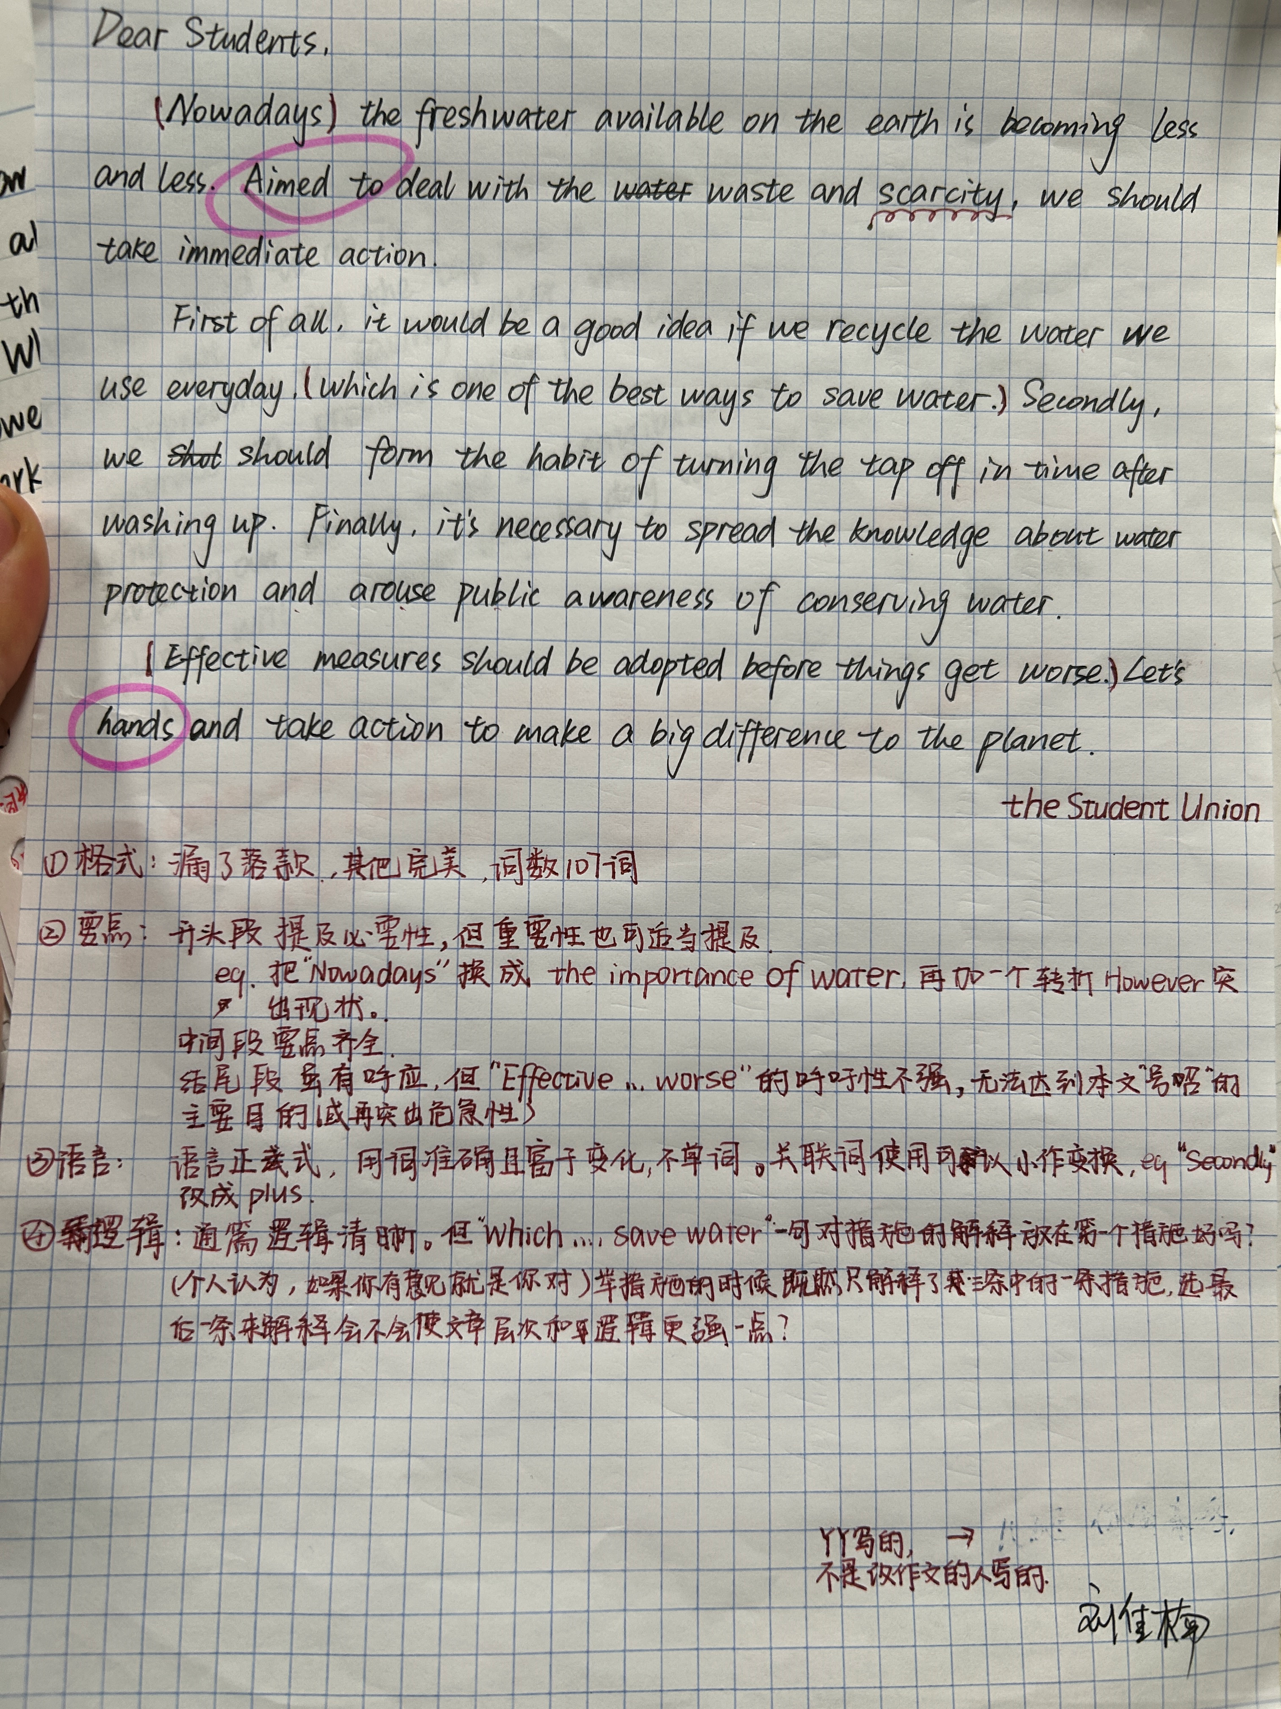
同伴互批

Slide 14
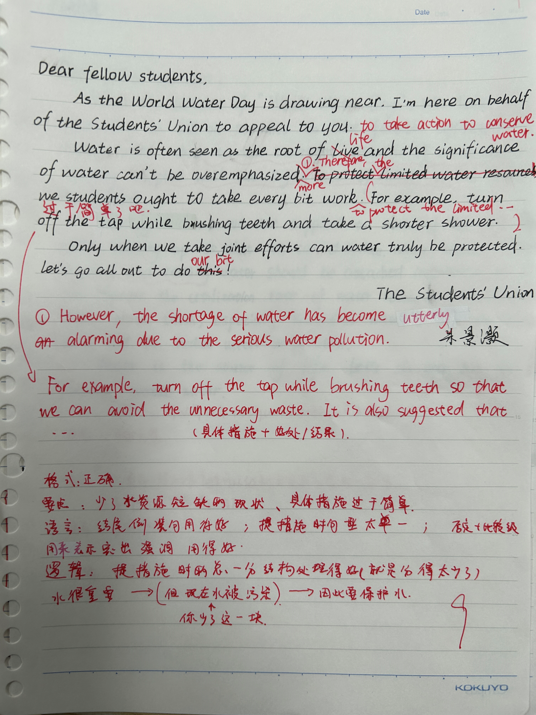
Learn from your peers!

