Slide 1

感恩遇见，相互成就，本课件资料仅供您个人参考、教学使用，严禁自行在网络传播，违者依知识产权法追究法律责任。
更多教学资源请关注
公众号：溯恩高中英语
知识产权声明

Slide 2


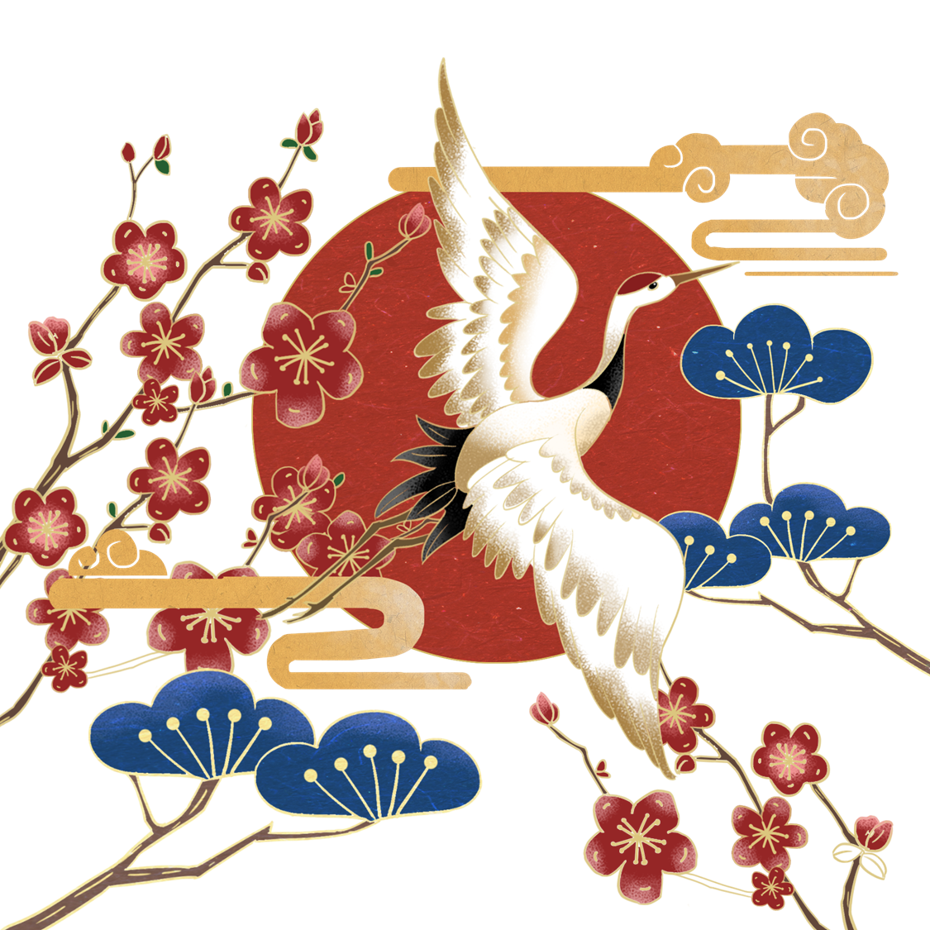
中国文化
农历新年和十二生肖
应用文---介绍信

Slide 3

审题
2022-2023学年第二学期杭州地区（含周边）重点中学
假定你是李华，春节前你的英国网友Linda来信向你了解农历新年（兔年）和十二生肖的知识，请你给她写封回信，内容包括：
1.十二生肖知识;
2.免年寓意
参考词汇：十二生肖the Chinese zodiac
写信对象
体裁：介绍信(email)
语气：causal & warm
要点
次要点

Slide 4
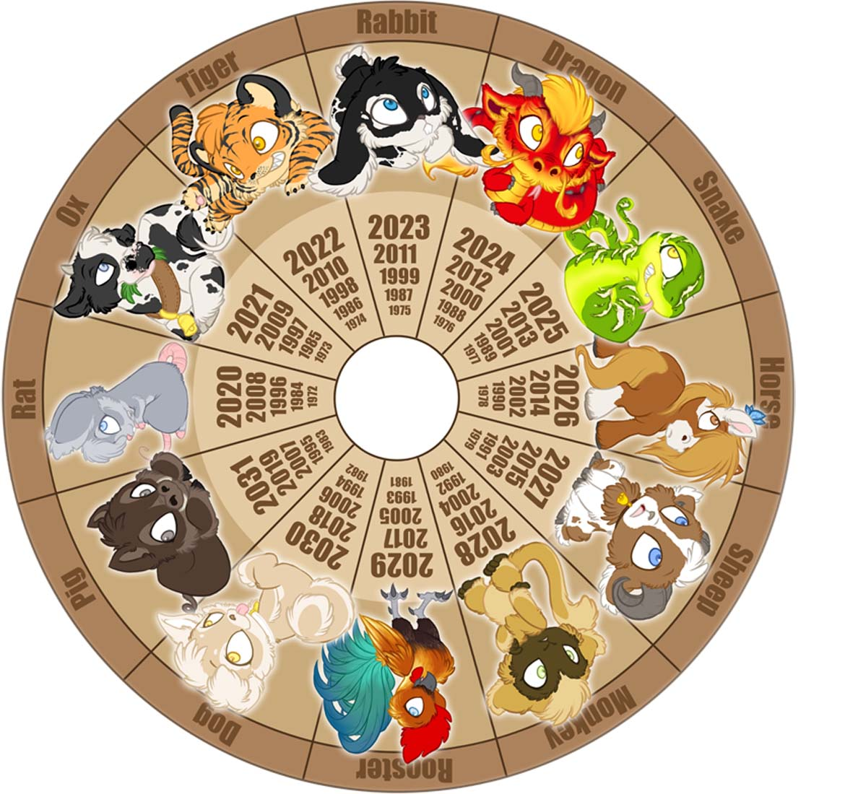
要点一：十二生肖知识
Thinking:
如何取舍内容？（需要涵盖哪些重点？）
如何有逻辑地用1-2句话把内容准确表述出来？
e.g.
What is Chinese zodiac?
What’s the origin of Chinese zodiac?
What’s its symbolic culture?

Slide 5
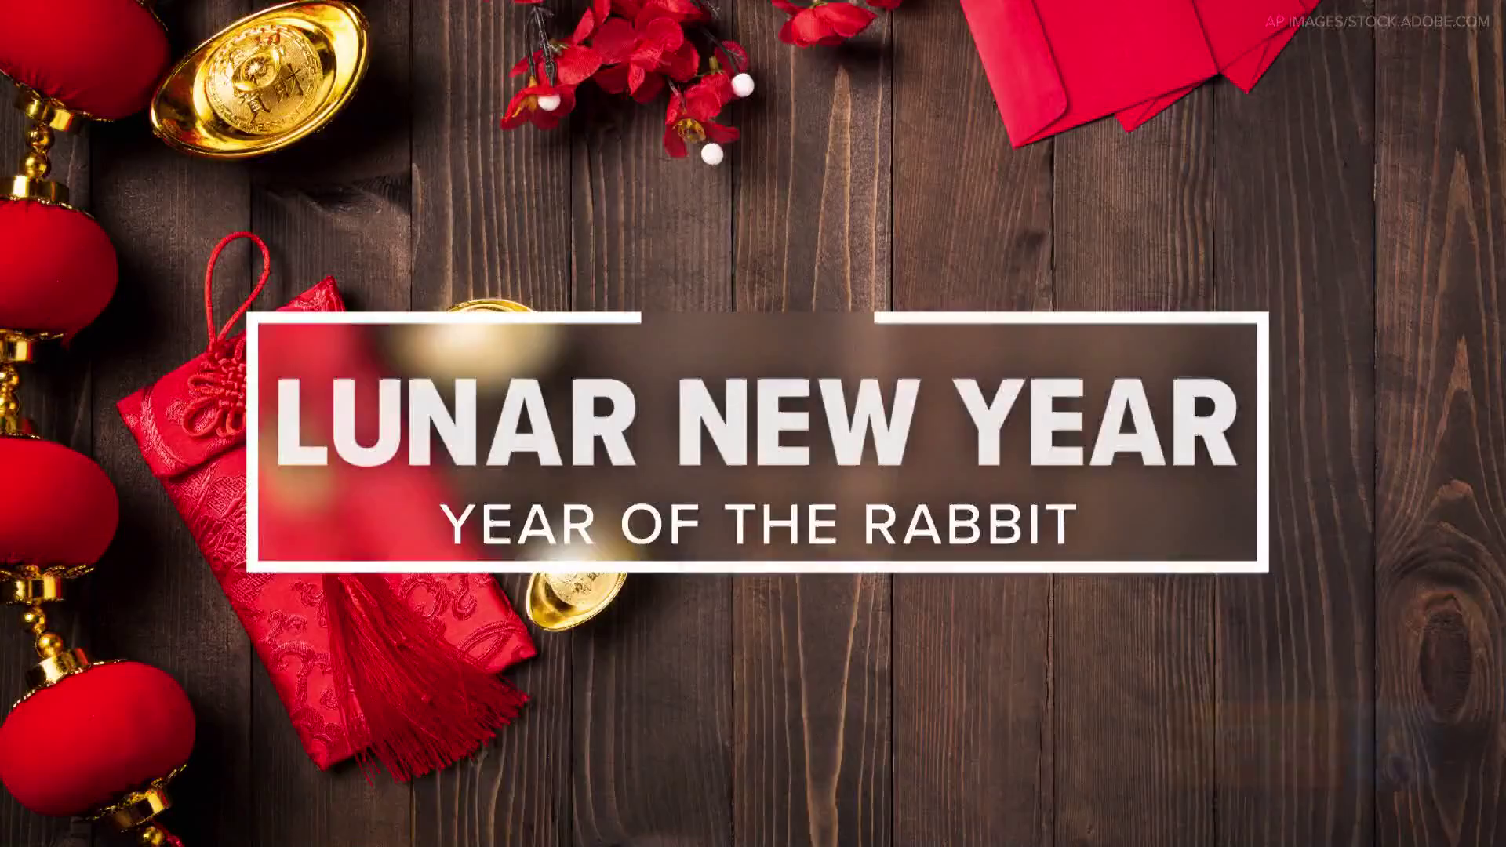

Slide 6
填空并思考应如何介绍十二生肖
Lunar New Year 2023: Year of the Rabbit
W: Well, happy Lunar New Year Eve, everyone. Such an exciting time. Today is the start of a new lunar year.
M: Yeah. So people from East and Southeast Asian cultures across the world 1. a new year of prosperity, hope and calm. So the new year is 15 days of celebrations. The festivities
2. and bring in luck for the new one. The holiday originally focused on bringing good fortune for farming and harvest. Banquets and festivals are typically held featuring fireworks and dancing dragons. The fireworks are believed to 3. monsters and bad luck away. Gotta scare away those monsters.
W: No monsters.
Now, 2023 is also the Year of the Rabbit. The Chinese zodiac dictates which animal represents a given year, so each animal repeats every 12 years. The animals are given characteristics and are thought to represent the personalities of people born in that year. The rabbit 4. be gentle in spirit, approachable, good-humored and expressive. So people born in the years 1963, 75, 87 and so on and so forth are thought to have the
5. .
are ringing in
usher out the old year
scare off
is characterized to
traits of the rabbit

Slide 7
M: There are several Lunar New Year traditions, including no showering on the first day for fear of washing away good luck. So, Jeremy, no shower. You did that last year. Children receive 6. in a red envelope, also called red packets, representing good luck. And there are lots of red decorations,
7. meant to bring good fortune. New clothes are also seen as a fresh beginning, bringing good luck. So, Jenny, there’s your excuse.
W: OK. I love go shopping.
M: Here’s a closer look at the significance of Lunar New Year around the globe.
Lunar New Year is a major holiday, especially for people in China, which is why it’s often called Chinese New Year. The 16-day celebration also goes by the name the Spring Festival. This is a time for family, friends and feast, and to honor family ancestors – all to help bring in that good luck in the new year.
One of the 12 zodiac animals represent each year of the lunar calendar and 2023 8. the Year of the Rabbit, which represents 9. . There are so many traditions tied to this festival, like 10. , and firecrackers, and paper lanterns, and of course, the food. Let me tell you, throughout the New Year’s festival season, certain dishes have symbolic meaning and bring good luck: fish for prosperity, dumplings for wealth, and noodles for longevity, and so much more.
The Lunar New Year season ends with the Bang and the Lantern Festival.
crisp money
a symbolic color
marks
longevity, peace and prosperity
scrolls with good-luck messages

Slide 8
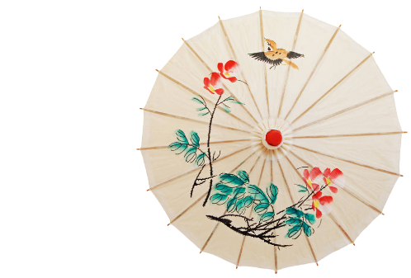
词汇、短语积累
ring in the new year 迎接新年
usher out the old year 辞旧
bring in luck for the new one 迎新
scare off monsters and bad luck away 吓跑怪物和厄运
scroll with good-luck messages
The Chinese zodiac dictates (支配；决定) which animal represents a given year, so each animal repeats every 12 years. The animals are given characteristics and are thought to represent the personalities of people born in that year. The rabbit is characterized to be gentle in spirit, approachable (和蔼可亲的), good-humored (好脾气的) and expressive.
One of the 12 zodiac animals represents each year of the lunar calendar and 2023 marks the Year of the Rabbit, which represents longevity, peace and prosperity.
★lunar calendar首字母不大写

Slide 9


Slide 10
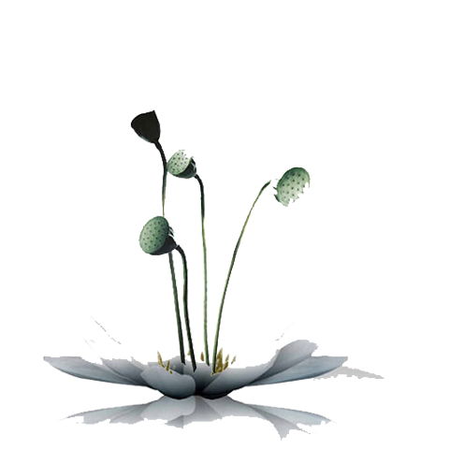
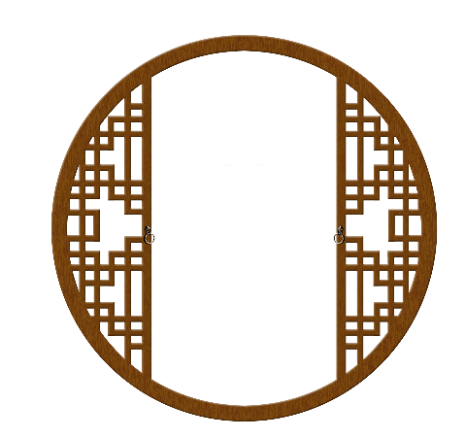
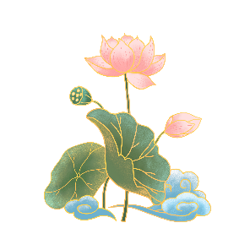
What expressions can be learned from the video?
Europe has 12 constellations, while China has 12 animals symbolizing the 12 branches used to designate years.
The 12 animals finish a cycle every 12 years and each of them guards one year.
Chinese believe that those who are born in a certain year would inherit the traits of the animal guarding that year.
...are.../...are endowed with...
Do you know what your symbolic animal denoting the year of your birth?
要点1：Compared to 12 constellations in the West, China has 12 animals symbolizing the 12 branches used to designate years. These animals, including rat, ox and 10 other ones, finish a repeating cycle every 12 years and each of them guards one year. We believe people who are born born in a certain year would inherit the traits of the animal guarding that year.
para3：
Do you know what your symbolic animal denoting the year of your birth? If you are curious more about it, I’m willing to tell you.
Is it interesting and meaningful? what’s your symbolic animal denoting the year of your birth?

Slide 11

要点一：十二生肖知识
The Chinese zodiac is a method of chronology ([krəˈnɑlədʒi]年表) based on the Chinese lunar calendar. The twelve years are represented by twelve animals in a fixed order, namely the mouse, ox, tiger, rabbit, dragon, snake, horse, goat, monkey, rooster, dog and pig.
十二生肖是基于中国农历的一种纪年方法。以十二年为一个轮回，分别用十二种动物进行代表，且彼此间有固定的顺序，它们分别是鼠、牛、虎、兔、龙、蛇、马、羊、猴、鸡、狗、猪。
The Chinese zodiac is an interesting classification scheme assigning an animal to each year in the Chinese lunar calendar involving a repetitive 12-year cycle.
The 12 zodiac animals are, in order: Rat, Ox, Tiger, Rabbit, Dragon, Snake, Horse, Goat, Monkey, Rooster, Dog, and Pig.

Slide 12
十二生肖随着历史的发展逐渐融合到相生相克的民间信仰观念，成为民间文化中的形象哲学，如婚配上的属相、庙会祈祷、本命年等。现代更多人把生肖作为春节的吉祥物，成为娱乐文化活动的象征。
Zodiac is a key constituent of traditional Chinese culture, for they are mascots of the Spring Festival and symbolic of Chinese New Year culture.
As an important part of the traditional Chinese Culture, the Zodiac culture has long been recognized, accepted and penetrated into the daily lives of the Chinese people.
Everyone, from the date of birth, has his unique animal sign accompanying him with the life long time. It is the birth symbol affecting their behaviours, characters and destiny. As each animal sign has unique personality traits, Chinese people like to predict people’s relations according to this.
属相/生肖 - Chinese zodiac sign
A: 你属什么？ What’s your Chinese zodiac sign?
B: 我属兔。I was born in the Year of the Rabbit.
本命年 - Zodiac Year of Birth

Slide 13
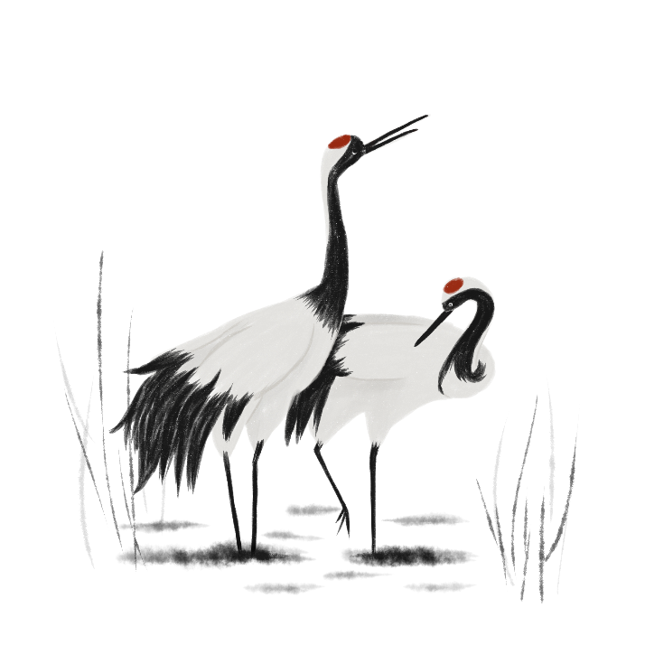

要点二：兔年寓意
Thinking:
“2023是兔年”有哪些不同表达方式？
2023 is the year of Rabbit according to Chinese zodiac. Rabbit is the fourth in the 12-years cycle of the Chinese zodiac sign.
Under the Chinese zodiac, 2023 marks the Year of the Rabbit.
As for the up-coming Year of the Rabbit, ...
On the 22nd of January, 2023, the Chinese lunar calendar will welcome the year of the rabbit.
With the arrival of the Spring Festival, we will enter the Year of the Rabbit.

Slide 14

要点二：兔年寓意
People born in a year of the Rabbit are vigilant ( [ˈvɪdʒɪlənt]谨慎的), quick-minded, and ingenious (心灵手巧的；机敏的).
The rabbit, which is cute and lively, denotes auspiciousness（寓意吉祥）and vitality.
Each zodiac represents their own character. For example, the rabbit signifies/symbolizes/represents that people are...
Chinese like the rabbit as it has the symbolic meaning of fast development and being promoted step by step.
As a symbol of ..., the rabbit enjoys wide popularity among Chinese people.

Slide 15
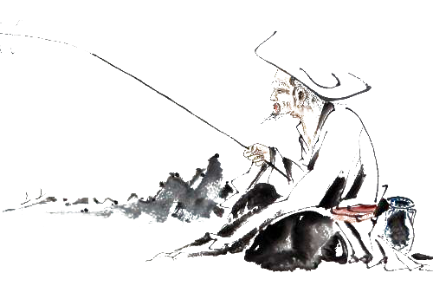
Para. 3 结束段
★重点关注：是否达到交际目的？
what main points can be included at the end of the letter?
希望“我”的介绍能对Linda有所帮助；
如果Linda还想知道更多内容，“我”很愿意介绍更多内容；
询问Linda的属相；询问英语是否有类似的文化；
春节即将来临，询问Linda迎接春节的活动/表达新年祝福
随信附上一张剪纸兔子/兔年邮票的照片；
....
e.g.
If you want to know more about the Chinese zodiac, feel free to ask.
I hope this letter will help you know more about Chinese zodiac and Chinese traditional culture.
Are there any similar customs in your country? Anticipating your sharing.
The Spring Festival is coming soon. Hope you can come to China and celebrate it with me. I’m sure you will have an unforgettable experience here./Wish you happiness and prosperity in the coming year!

Slide 16
参考范文
Dear Linda,
Knowing that you are greatly interested in the Chinese zodiac, I’m delighted to share something that you may find helpful.
In the Chinese lunar calendar, the Chinese zodiac has a twelve-year cycle: rat, ox, tiger, rabbit, dragon, snake, horse, goat, monkey, rooster, dog and pig. Every year matches a corresponding animal sign. The year 2023 is “the Year of the Rabbit”, which symbolizes mercy, elegance and beauty, since rabbits are recognized as a kind of intelligent and lucky animal in Chinese culture.
If you want to learn more about that, I sincerely invite you to my home to observe the Spring Festival in person.
Yours,
Li Hua

Slide 17
Dear Linda,
Knowing that you’re curious about Chinese New Year and Chinese zodiac, I’m willing to share some details with you here.
The Chinese zodiac, a shinning pearl in the treasure house of Chinese traditional culture, is a method of chronology based on the Chinese lunar calendar. It consists of twelve animal signs in a fixed order. We Chinese believe people would inherit the traits of the animal guarding his year of the birth. For example, The rabbit is characterized to be gentle in spirit, approachable and vigorous. The up-coming year is the Year of the Rabbit, which symbolizes longevity, peace, prosperity and fertility.
The Spring Festival is coming soon. Wish you happiness and prosperity in the coming year!
Yours,
Li Hua

Slide 18


补充知识：Some idioms about animals
paper tiger
snake oil
dark horse
top dog
black sheep
cold fish
goose flesh/bumps
eager beaver
纸老虎
万金油、骗人的东西
黑马
优胜者/佼佼者、权威、身居要职的人
Though still a yound man, he is already top dog in his firm.
害群之马，败类，败家子
冷冰冰的人，不动感情的人
鸡皮疙瘩
做事特别卖力气的人（特指做事过于卖力气以讨好上司的人）

Slide 19
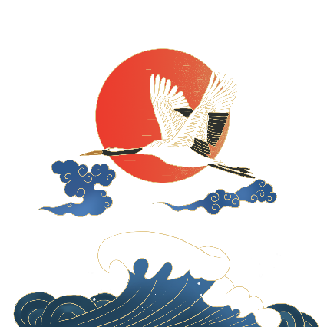
Some idoms about animals
as merry as a cricket
as poor as a church mouse
as slippery as an eel
eat crow
for the birds
keep the wolf from the door
let sleeping dogs lie
like a cat on hot bricks
like a bull in a china shop
非常高兴，快活 very happy and carefree
一贫如洗
奸诈狡猾
被迫收回自己说的话，被迫认错并因此感到丢脸
不重要；没有意思 not important or interesting
免受饥饿或贫困之苦
让睡着的狗好好躺着吧——不要自找麻烦
如热锅上的蚂蚁；局促不安；如坐针毡
像瓷器店里的公牛——笨手笨脚的，莽撞的

Slide 20

Homework
（2022·浙江·高三开学考试）阅读下面材料，在空白处填入适当的内容（1个单词）或括号内单词的正确形式。
China Post issued a set of special stamps for the Year of the Tiger on Wednesday. Unlike last year, where there was only one stamp, this time there are two, each 1__________(describe) a different scene. The first stamp is named “Guo yun Chang long”, 2________means “national fortune and prosperity”. It describes a strong tiger peering into the distance, 3__________(artistic) displaying the determination and ambition of China to develop itself in the new year. The stamp 4________(name) “Huyun Jixiang” shows a heartwarming picture where a gentle mother tiger tends 5________her two baby tigers, extending the best wishes for family harmony and reunion to people all over the country.
Stamp designer artist Feng Dazhong said stamp design is not only an artistic 6________(create) but also bears a part of social responsibility 7________ as an artist, he is obligated to bravely undertake this work.
“Stamps are works of art on paper. Through 8________square inch stage, the light of art can bloom infinitely,” said Lu Xiaobo, Dean of the Academy of Arts & Design at Tsinghua University.
“Zodiac stamps 9______________(consider) as representative stamp art in China. We 10_________________(invite) famous artists to create stamps with cultural concepts to send New Year’s blessings to Chinese people.” he said.
describing
which
artistically
named
to
creation
the
and
are considered
have been inviting

Slide 21
Homework 听力 (磨耳朵)
TED | The Chinese zodiac, explained
Have you ever been asked by your Chinese friend, “What is your zodiac sign?” Don’t think they are making small talk. If you say, “I’m a Monkey,” they immediately know you are either 24, 36, 48 or 60 years old. Asking a zodiac sign is a polite way of asking your age.
By 1. , you are also being evaluated. Judgments are being made about your 2. , your personality, career prospects and how you will do in a given year. If you share you and your partner’s animal signs, they will paint a picture in their mind about your private life. Maybe you don’t believe in the Chinese zodiac. As a quarter of the world population is influenced by it, you’d be wise to do something about that.
So what is the Chinese zodiac, exactly? Most Westerners think of Greco-Roman zodiac, the signs divided into 12 months.
The Chinese zodiac is different. It’s a 3. animals, starting with a Rat and ending with a Pig, and has no association with constellations (星座). For example, if you were born in 1975, you are a Rabbit. Can you see your zodiac sign there? Our Chinese ancestors 4. based on yin and yang, the five elements and the 12 zodiac animals. Over thousands of years, this popular culture has affected people’s major decisions, such as 5. , marriage, giving birth and attitude towards each other. And some of the implications are quite amazing.
The Chinese believe certain animals get on better than the others. So parents choose specific years to give birth to babies, because they believe the team effort by the right combination of animals can 6. families. We even refer to the zodiac when entering into romantic relations. I’m a Pig; I should have 7. Tigers, Goats and Rabbits. Chinese people believe some animals are natural enemies. As a Pig, I need to be careful with a Snake. Raise your hand if you are a Snake. Let’s have a chat later.

Slide 22
We believe some animals are luckier than the others, such as the Dragon. Unlike the Western tradition, the Chinese Dragon is 8. . It’s everyone’s dream to have a Dragon baby. Jack Ma’s parents must have been very proud. And they are not the only ones. In 2012, the Year of the Dragon, the birthrate in China, Hong Kong and Taiwan increased by five percent. That means another one million more babies. With a traditional preference to baby boys, the boy-girl ratio that year was 120 to 100. When those Dragon boys grow up, they’ll face much more 9. love and job markets.
According to BBC and the Chinese 10. , January 2015 saw 11. Cesarean (剖腹产) sections. Why? That was the last month for the Year of the Horse. It’s not because they like horses so much, it's because they try to avoid having unlucky Goat babies. If you are a Goat, please don’t feel bad. Those are Goat babies. They don’t look like losers to me.
Tiger is another undesirable animal, due to its volatile (易变的) temperament. Many Chinese regions saw a sharp decline of birthrate during those years. Perhaps one should 12. , as those Tiger and Goat babies will face much less competition. Maybe they are the lucky ones. I went through the Forbes top 300 richest people in the world, and it’s interesting to see the most undesirable two animals, the Goat and Tiger, are at the top of the chart, even higher than the Dragon. So maybe we should consider, maybe it’s much better to have less competition.
One last but interesting point: many Chinese people make their investment decisions based on the zodiac sign index. Although the belief and tradition of the zodiac sign has been over thousands of years, the trend of using it in making major decisions did not really happen until the past few decades. Our ancestors were very busy surviving poverty, drought, famine, riot (暴乱), disease and civil war.
And finally, Chinese people have the time,wealth and technology to create an ideal life they’ve always wanted. The collective decision made by 1.3 billion people has 13. in economics and demand on everything, from health care and education to property and consumer goods. As China plays such an important role in the global economy and geopolitics, the decisions made based on the zodiac and other Chinese traditions end up impacting everyone around the world.
Are there any Monkeys here? 2016 is the Year of the Monkey. Monkeys are clever, curious, creative and mischievous.

Slide 23
参考答案
1.revealing your zodiac sign
2.fortune or misfortune
3.12-year cycle labeled with
4.constructed a very complicated theoretical framework
5.naming
6.give prosperity to
7.perfect romance with
8.a symbol for power, strength and wealth
9.severe competition in
10.government’s press release
11.a peak of
12.consider zodiac in reverse
13.caused the fluctuation

Slide 24
谢
谢

