Slide 1

感恩遇见，相互成就，本课件资料仅供您个人参考、教学使用，严禁自行在网络传播，违者依知识产权法追究法律责任。
更多教学资源请关注
公众号：溯恩高中英语
知识产权声明

Slide 2
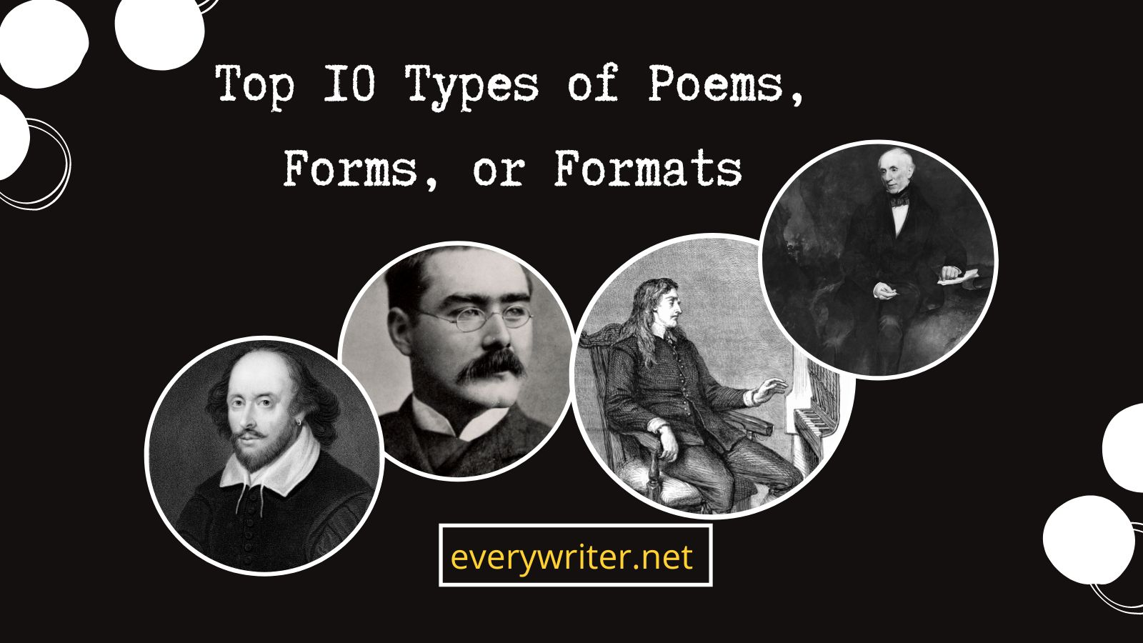

Slide 3
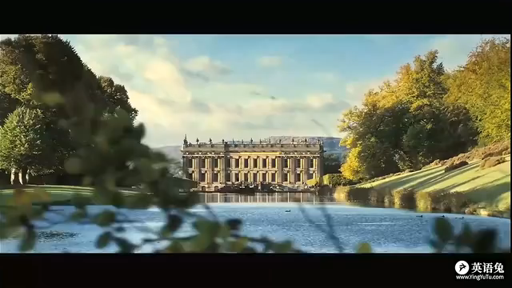
Sonnet
14行诗
Sonnet 18
William Shakespeare
Shall I compare thee to a summer's day?
我能把你比作夏日吗？
Thou art more lovely and more temperate:
尽管你更可爱、更温和；
Rough winds do shake the darling buds of May,
夏日的狂风可能会摧残五月的花儿，
And summer's lease hath all too short a date:
季节的限制又减少了可拥有的日光；
Sometime too hot the eye of heaven shines,
天空的巨眼有时过于灼热，
And often is his gold complexion dimm'd;
常使自身的辉煌无故湮没；
And every fair from fair sometime declines,
每一种美都会消逝，
By chance, or nature's changing course untrimm'd;
不管愿意或是无奈；
But thy eternal summer shall not fade,
然而你这盛夏将永存不朽，
Nor lose possession of that fair thou ow'st;
连你所有的美都不会褪去；
Nor shall Death brag thou wander'st in his shade,
死神不忍逼近，
When in eternal lines to time thou grow'st:
生命只会长存；
So long as men can breathe, or eyes can see,
只要人类能呼吸，能看见；
So long lives this and this gives life to thee
我的诗就会存在，而你的生命也会延续。

Slide 4
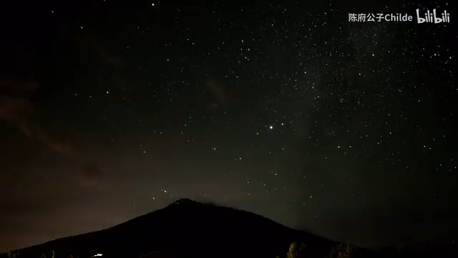
19行诗
Villanelle
The form is a 19-line poem that has five 3-line stanzas. ending in a quatrain.
Do not go gentle into that good night
Do not go gentle into that good night,
不做黑夜的顺民
Old age should burn and rave at close of day;
长者应对夕阳咆哮
Rage,rage against the dying of the light.
怒起，怒起反抗光明的灭亡
Though wise men at their end know dark is right,
即使智者明白黑夜不可阻挡
Because their words had forked no lightning they
因为他们的语言没能击出电光，但他们
Do not go gentle into that good night.
不做黑夜的顺民
Good men, the last wave by, crying how bright
最后的海浪歌颂着，善良的人们
Their frail deeds might have danced in a green bay,
他们弱小的力量也曾在绿湾中迸发出光芒
Rage, rage against the dying of the light.
怒起，怒起反抗光明的灭亡
Wild men who caught and sang the sun in flight,
狂野的人们飞向太阳企图为之歌唱
And learn, too late, they grieved it on its way,
意识到为时已晚，不免悲叹
Do not go gentle into that good night.
（但他们）不做黑夜的顺民
Grave men, near death, who see with blinding sight
掘墓者，与死者为邻，双眼被刺痛
Blind eyes could blaze like meteors and be gay,
瞽者的眼睛如流星般闪耀
Rage, rage against the dying of the light.
怒起，怒起反抗光明的灭亡
And you, my father, there on the sad height,
而你，天父，在悲哀的高处
Curse, bless, me now with your fierce tears, I pray.
Do not go gentle into that good night.
Rage, rage against the dying of the light.

Slide 5
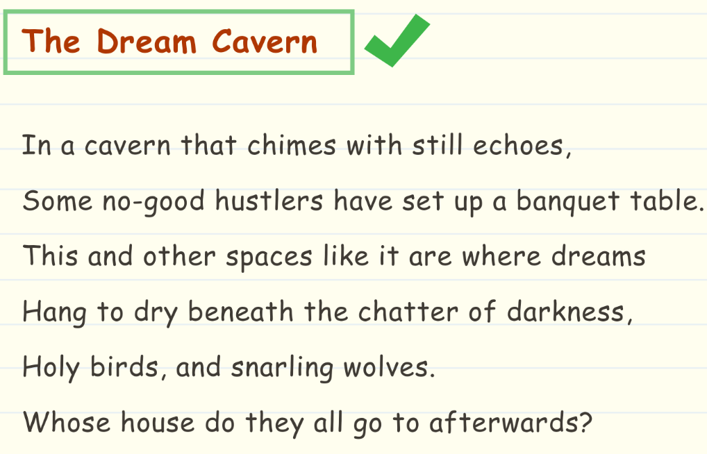
Sestina
A sestina is a unique poetic form that utilizes repetition. It has six, six-line stanzas that use a complex pattern that can be hard to utilize.
六行诗
September rain falls on the house.
In the failing light, the old grandmother
sits in the kitchen with the child
beside the Little Marvel Stove,
reading the jokes from the almanac,
laughing and talking to hide her tears.

Slide 6
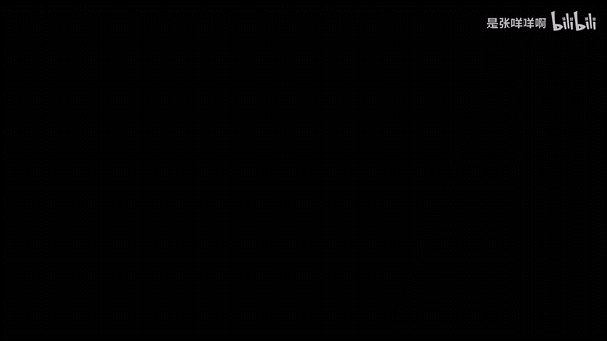
Ode
颂歌
It is written in praise of a particular person, thing, or event.
Ode to the West Wind
Shelley, Percy Bysshe
Make me thy lyre, even as the forest is:
What if my leavers are falling like its own!
The tmult of thy mighty harmonies
Will take from both a deep, autumnal tone,
Sweet though in sadness. Be thou, Spirit fierce,
My spirit! Be thou me, impetuous one!
Drive my dead thoughts over the universe
Like witheered leaves to quicken a new birth!
And , by the incantation of this verse,
Scatter, is from an unextinguished hearth
Ashes and sparks, my words among mankind!
Be through my lips to unawakened earth
The trumpet of a prophecy! O Wind,
If Winter comes , can Spring be far behind?
把我当作你的琴，当作那树丛，
纵使我的叶子凋落又何妨？
在你怒吼咆哮的雄浑交响中，
将有树林和我的深沉的歌唱，
我们将唱出秋声，婉转而忧愁。
精灵呀，让我变成你，猛烈、刚强！
把我僵死的思想驱散在宇宙，
就像一片片枯叶，以鼓舞新生；
请你听从我这诗篇中的符咒，
把我的话传播给全世界的人，
犹如从不灭的炉中吹出火花！
请向未醒的大地，借我的嘴唇，
像号角般吹出一声声预言吧！
如果冬天来了，春天还会远吗？

Slide 7
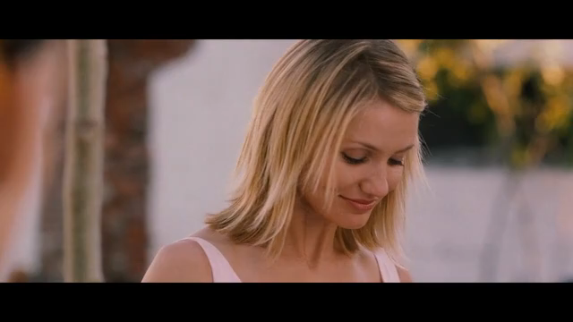
Free Verse
The favored poetry form for many contemporary poets, in large part because they can make their own rules — and break them if they wish.
i carry it in my heart
自由诗
Edward Estlin Cummings
i carry it in my heart
i am never without it
anywhere i go you go, my dear;
and whatever is done by only me is your doing,
my darling
i fear no fate
for you are my fate, my sweet
i want no world for beautiful
you are my world, my true
and it’s you are whatever a moon has always meant
and whatever a sun will always sing is you
here is the deepest secret nobody knows
here is the root of the root
and the bud of the bud
and the sky of the sky
and of a tree called life;
which grows higher than the soul can hope
or mind can hide
and this is the wonder that’s keeping the stars apart
i carry your heart
i carry it in my heart

Slide 8
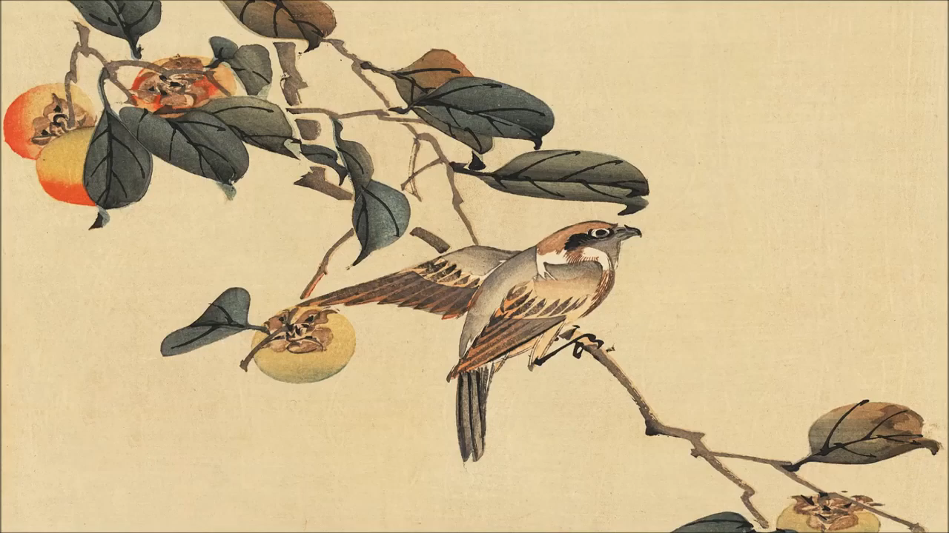
Haiku
The only poem that rivals free verse these days. The haiku is a three-line poem, with a 5-7-5 syllable structure, originating in seventeenth-century Edo-period Japan.

Slide 9
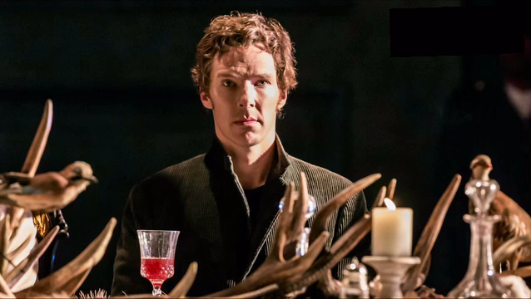
blank verse
无韵诗
To be or not to be
from Hamlet
A poem written in Iambic pentameter but does not rhyme.

Slide 10
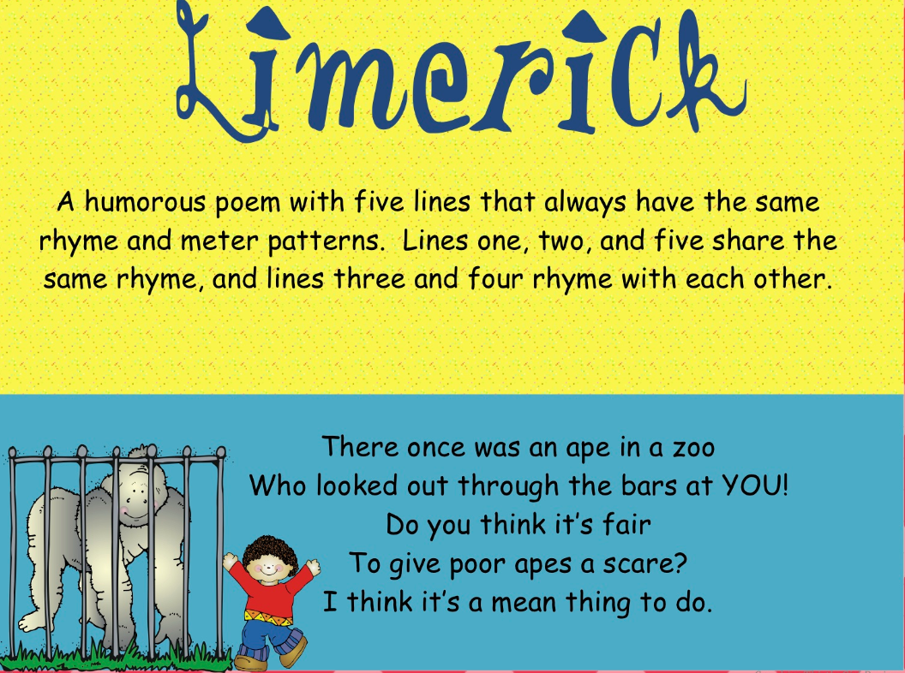
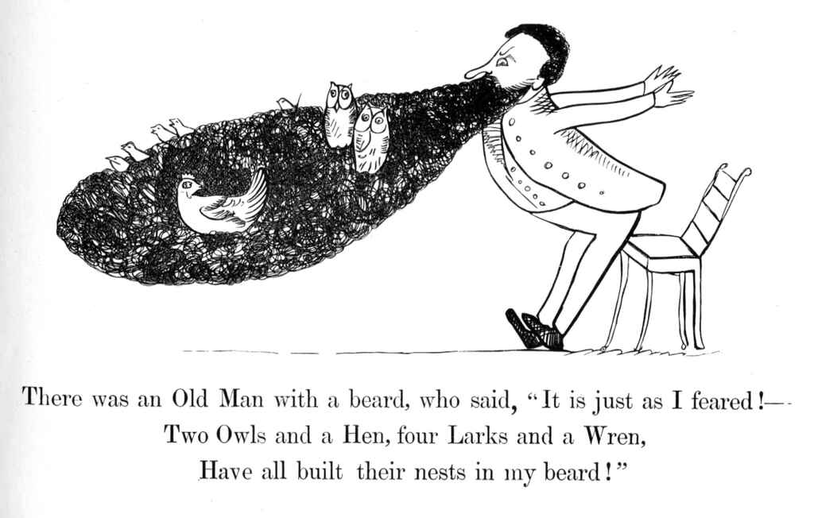
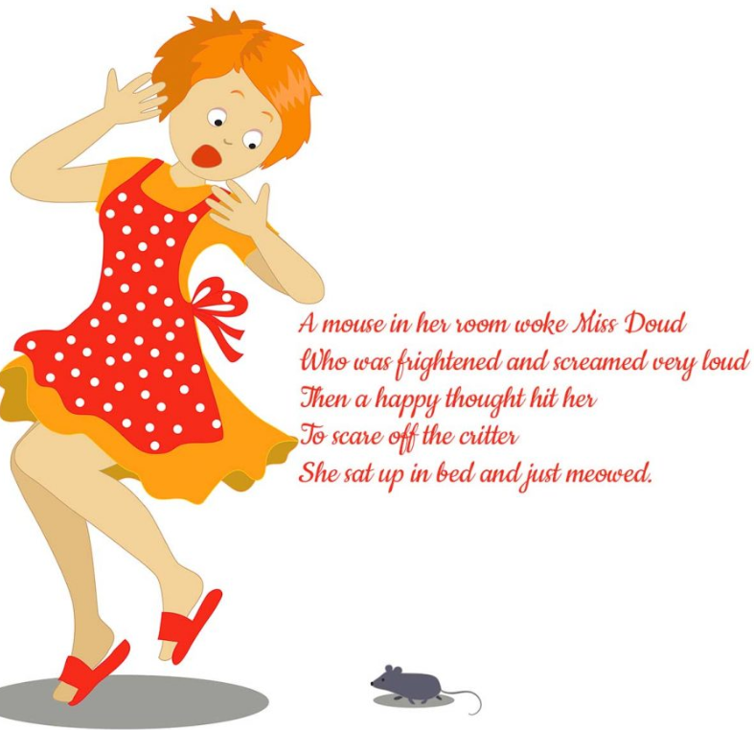
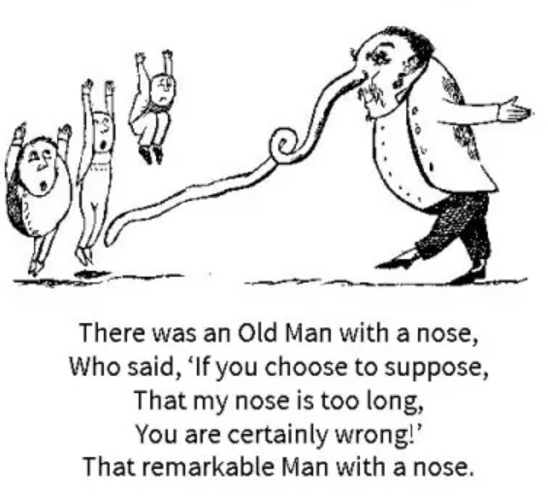
limerick
A type pf poetry always has 5 lines. It is funny and memorable.
五行打油诗

Slide 11
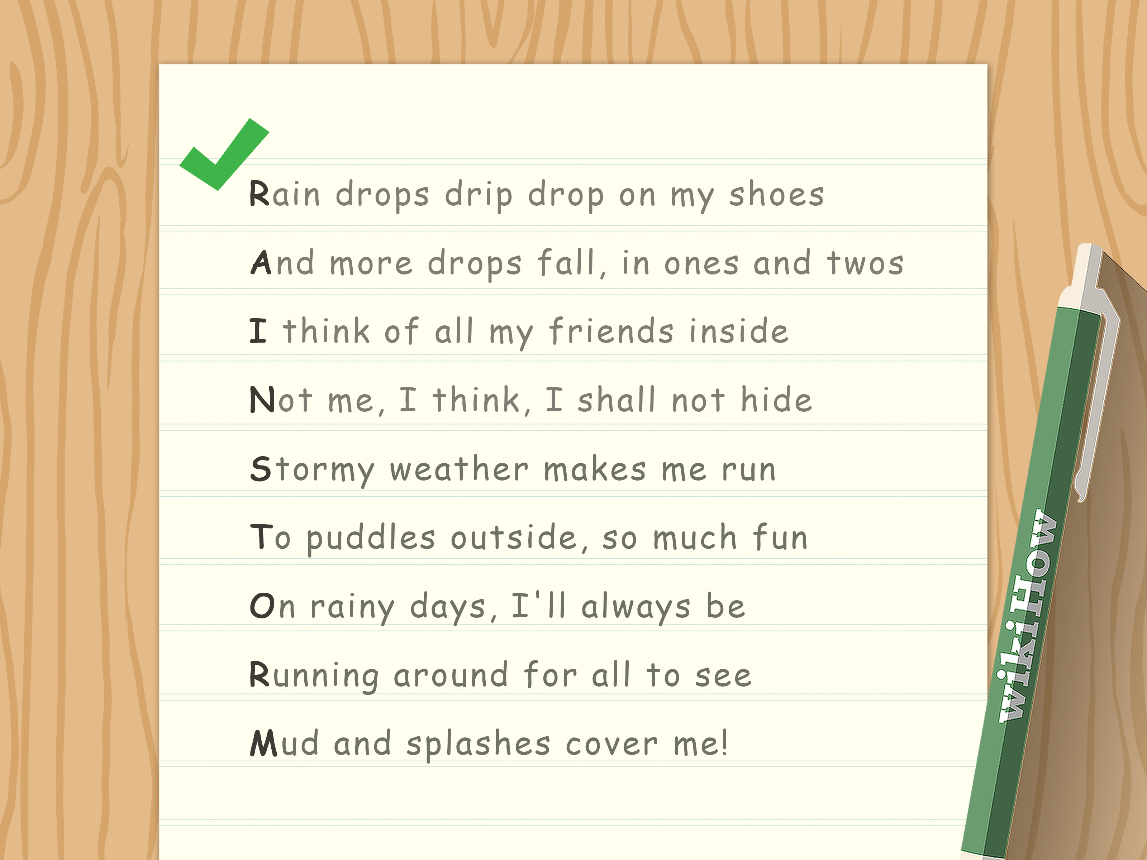

Acrostic
spells out a secret meaning, often using the first letter of each new line, stanza, or any other recurring feature.
离合诗

Slide 12

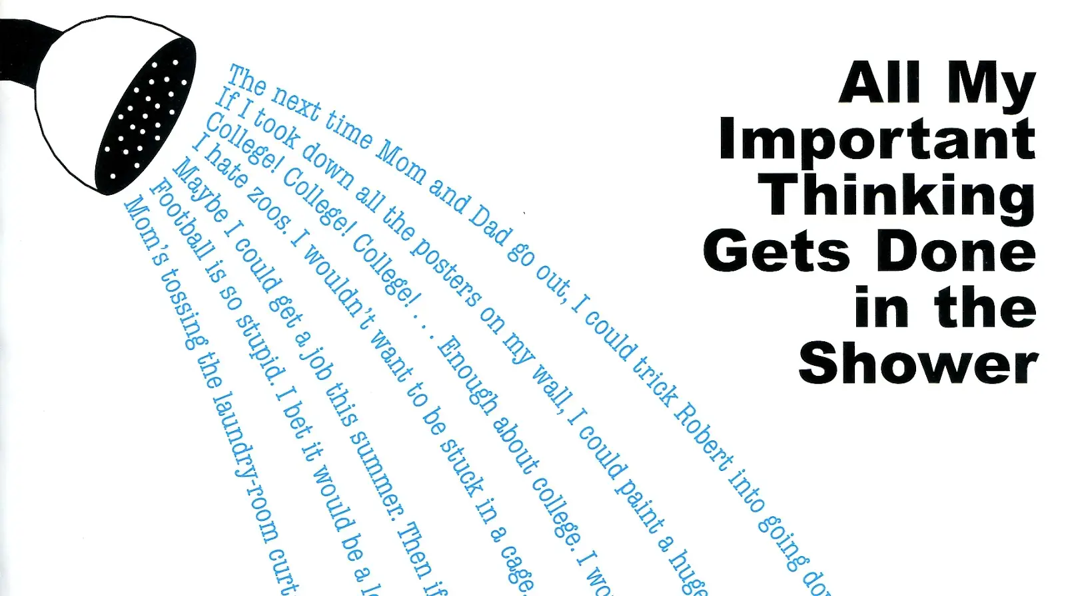

Concrete
Concrete is given its name because, like concrete in a mold, it changes shape to fit the artist’s purpose.
有形诗

Slide 13
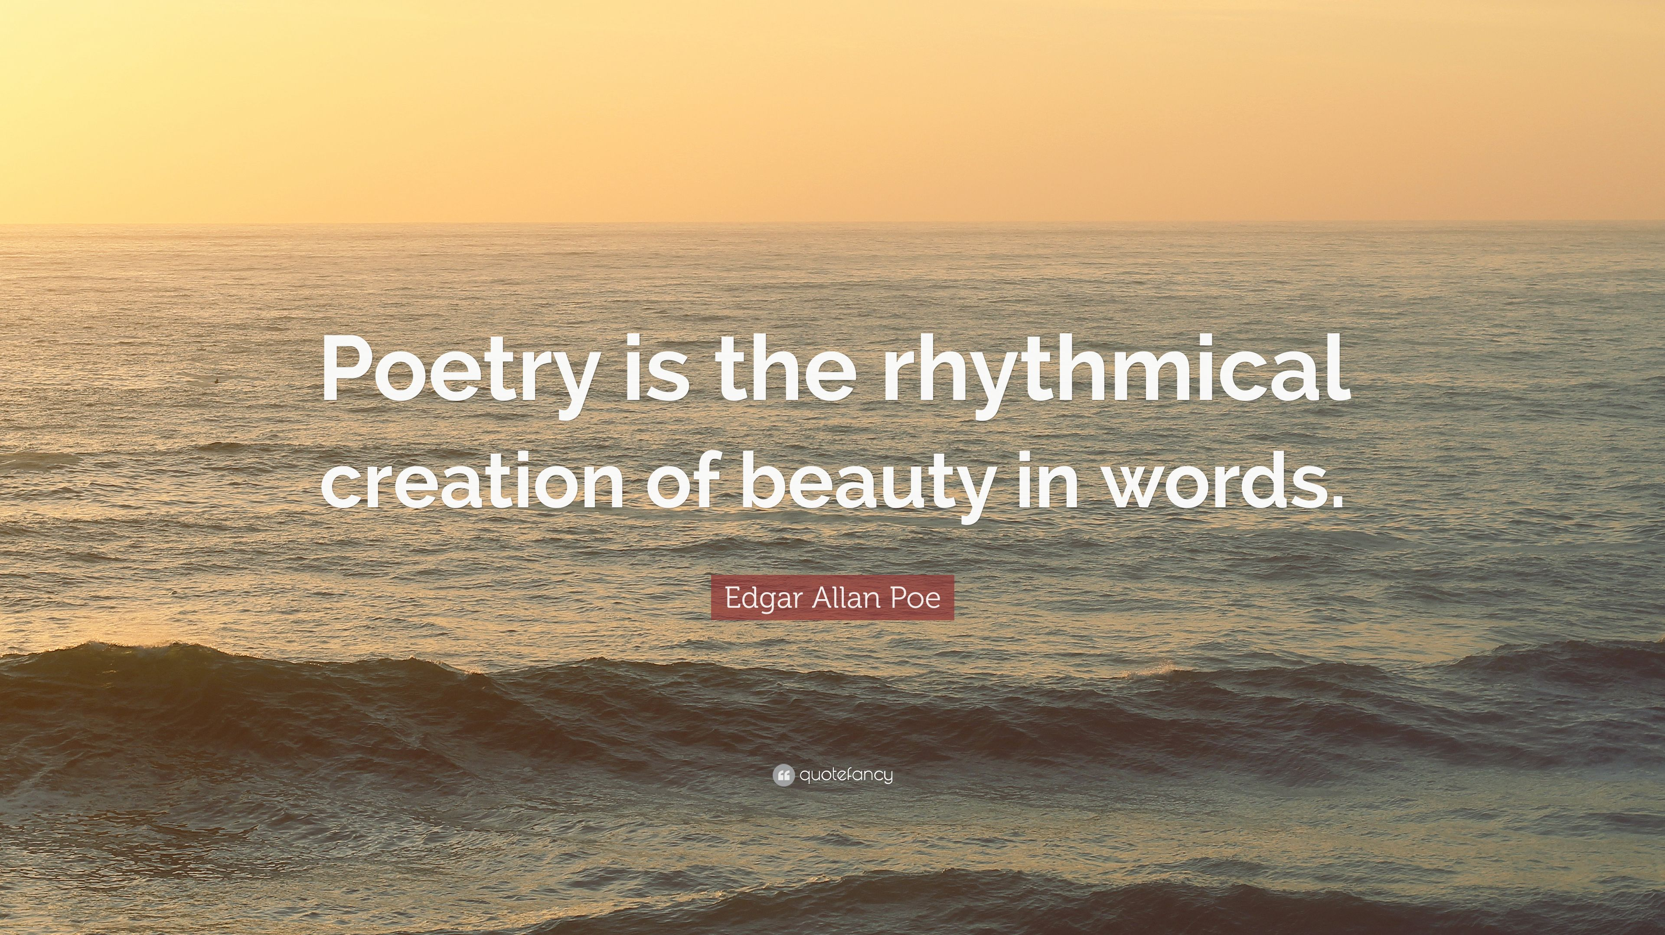
Fay

