Slide 1

感恩遇见，相互成就，本课件资料仅供您个人参考、教学使用，严禁自行在网络传播，违者依知识产权法追究法律责任。
更多教学资源请关注
公众号：溯恩高中英语
知识产权声明

Slide 2

Create with Fay
I AM…

Slide 3

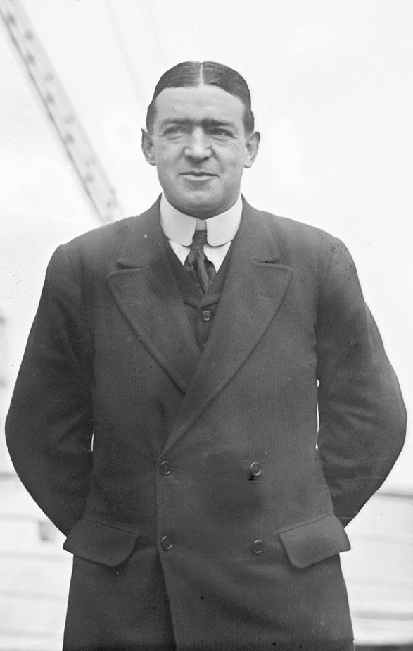
I AM
P a t t e r n p o e m
I am
an innocent and confident girl
Two special characteristics you have
a determined and committed Captain
I wonder
Something you are curious about
if My dream can be achieved
If My dream man exists
I see
An imaginary sight
stars in the swinging seaweed
A Prince in the stars
I want
my crew all rescued
An actual desire
A string of diamonds
I am
a determined and committed Captain
The first line of the poem repeated
an innocent and confident girl

Slide 4
What is a poem?
Poems paint pictures with words.
Poems &Poetry
Elements of poems
A poem can be written down or spoken aloud. It is a collection of ideas and emotions in a creative way.
It is the fundamental unit of poetry.
The combination of differentpoems is poetry
The basic elements of poetry:
meter
rhyme
scheme
verse
stanza

Slide 5
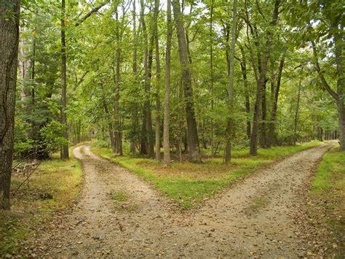

Poems paint pictures with words.
Two roads diverged in a wood, and I ---
I took the one less travelled by,
And that has made all the difference.
－Robert Frost
Unit 5 Poems
A Few Simple Forms Of English Poems
Reading and Thinking

Slide 6

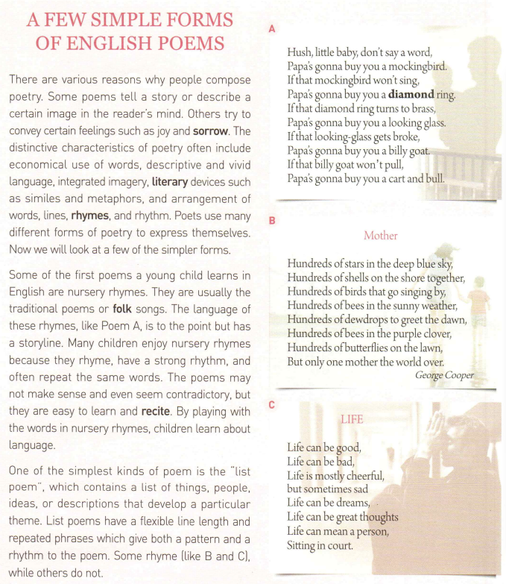

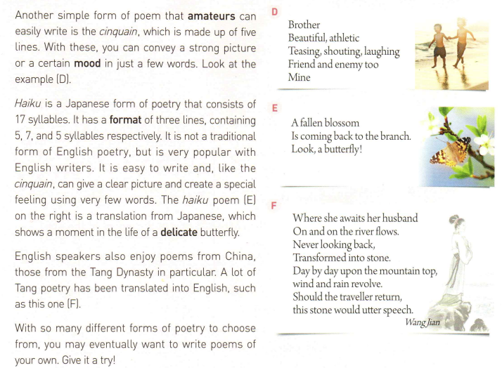
Read for the structure
Introduction
Reasons
characteristics
Another ...
Forms of English poems
Some of...
Forms of English poems
..also...
One of...
Conclusion

Slide 7
A Few Simple Forms of English Poems
The reasons
Characteristics
Tell a story
economical use of words
a small amount of words
Describe a certain image
descriptive &vivid language
integrated imagery
Convey certain feelings
Use words to create a picture combining many dimensions in your mind
literary devices
arrangement of words

Slide 8



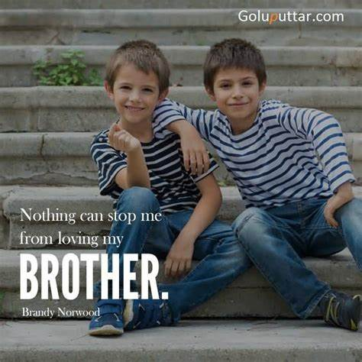
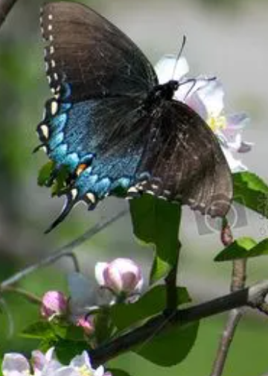
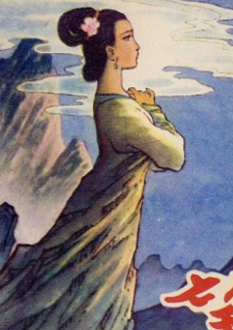
A Few Simple Forms of English Poems
A few of simpler forms
The reasons
Characteristics
Nursery rhymes
List poems
Cinquain
Haiku
Tang Poem

Slide 9

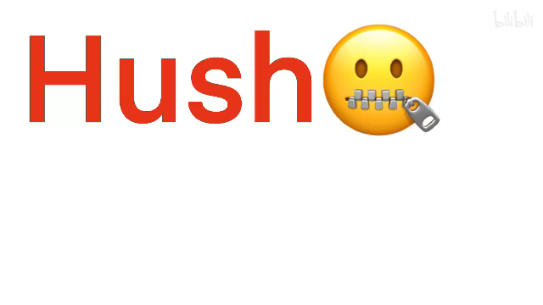
Hush, little baby, don’t say a word,
Papa’s gonna buy you a mockingbird.
If that mockingbird won’t sing,
Papa’s gonna buy you a diamond ring.
If that diamond ring turns to brass,
Papa’s gonna buy you a looking glass.
If that looking-glass gets broke,
Papa’s gonna buy you a billy goat.
If that billy goat won’t pull,
Papa’s gonna buy you a cart and bull.
Literary devices
Characteristics
Rhymes
Repetition
Rhythm
To the point & a story line
A strong rhythm
Repeat the same words
may not make sense & even contradictory
Easy to learn and recite
Nursery rhymes

Slide 10


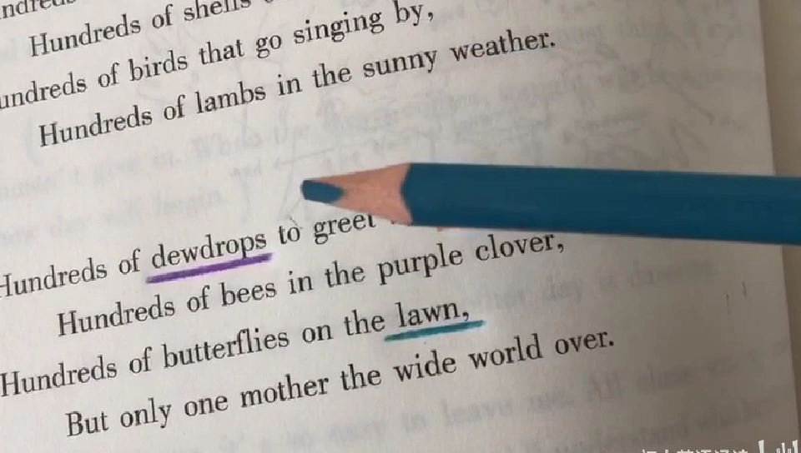
characteristics
Have a flexible line length and
Repeated phrases
contain a list of things, people, ideas or..
that develop a particular theme
List poem
Literary devices
repetition rhymes metaphors parallelism
Only One Mother
Hundreds of stars in the deep blue sky,
Hundreds of shells on the shore together,
hundreds of birds that go singing by,
Hundreds of bees in the sunny weather,
Hundreds of dewdrops to greet the dawn,
Hundreds of bees in the purple clover,
Hundreds of butterflies on the lawn,
But only one mother the world over.
Life
Life can be good,
Life can be bad,
Life is mostly cheerful,
but sometimes sad,
Life can be dreams,
Life can be great thoughts,
Life can mean a person,
Sitting in court.

Slide 11
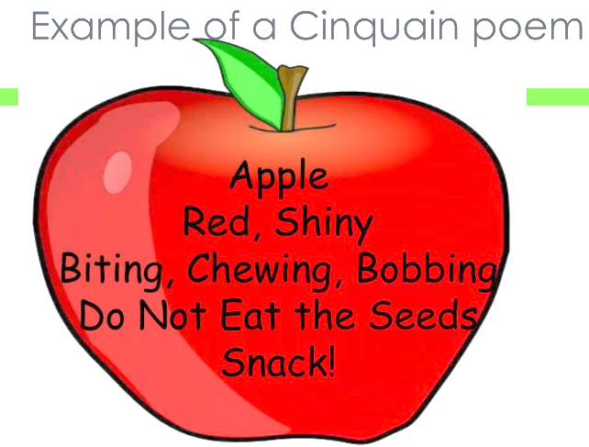
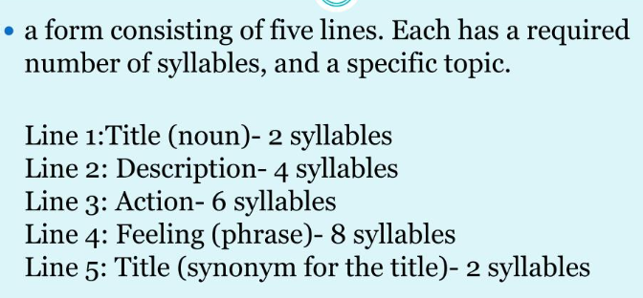
Brother
Beautiful, athletic
Teasing, shouting, laughing
Friend and enemy too
mine
topic
One noun to tell ________
adjectives
two _________ to describe the topic
v-ings
actions
three _______to express _______
words
relationship
four _______ to show the _________
one _______ to rename the topic
pronoun
Cinquain

Slide 12
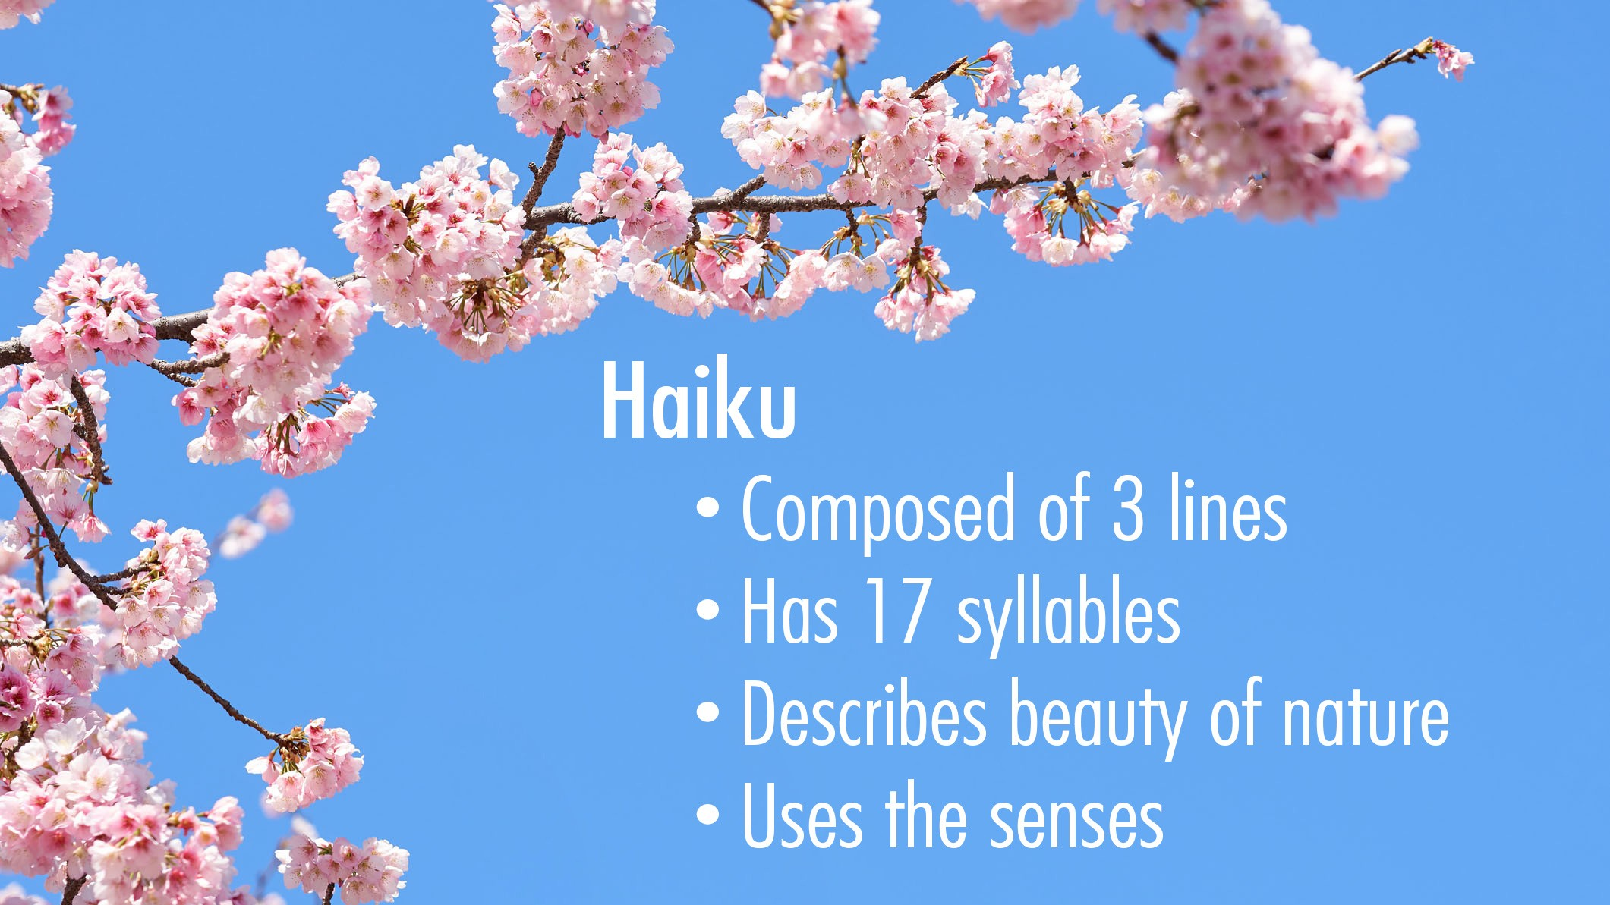
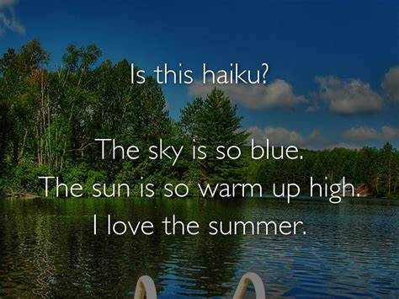

blossom
A fallen blossom
Is coming back to the branch.
Look, a butterfly!
(metaphor)
characteristics
______ lines made up of ______syllables to give a ______ picture.
3
Haiku
17
clear

Slide 13
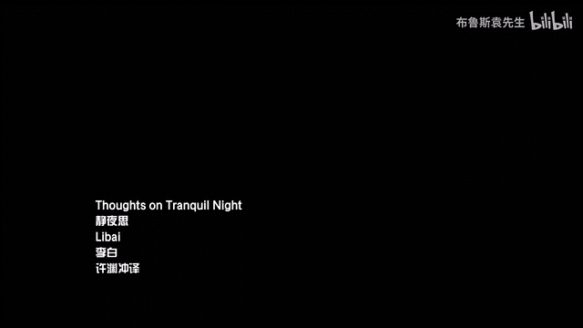
Poems convey certain feelings
望夫处，
江悠悠,
化为石，
不回头。
山头日日风复雨，
行人归来石应语。
Where she awaits her husband,
On and on the river flows
Never looking back,
Transformed into stone.
Day by day upon the mountain top,
wind and rain revolve.
Should the journey return,
this stone would utter speech.
loneliness
sorrow
Full of love
patient
Tang Poem
……
Tang Poetry was generally composed in the Tang Dynasty and represents Chinese cultural history.

Slide 14

Types
of
English Poems

Slide 15
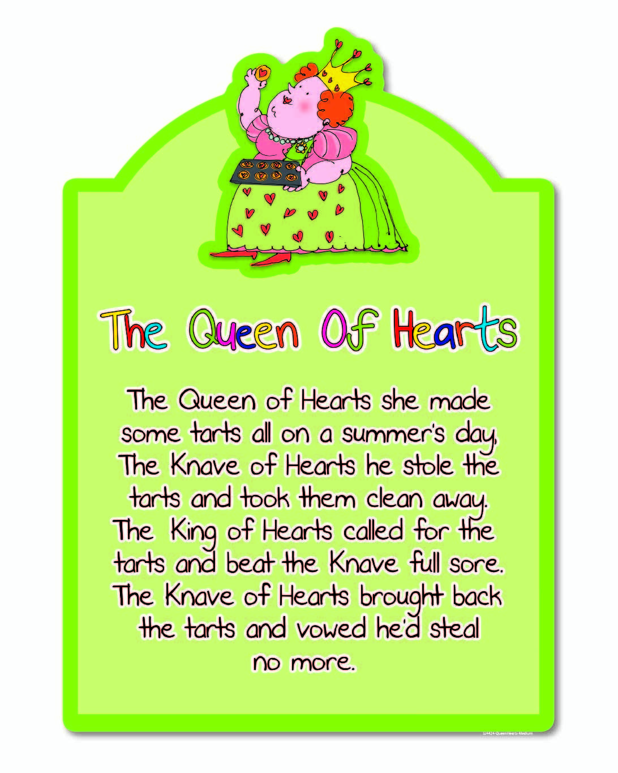
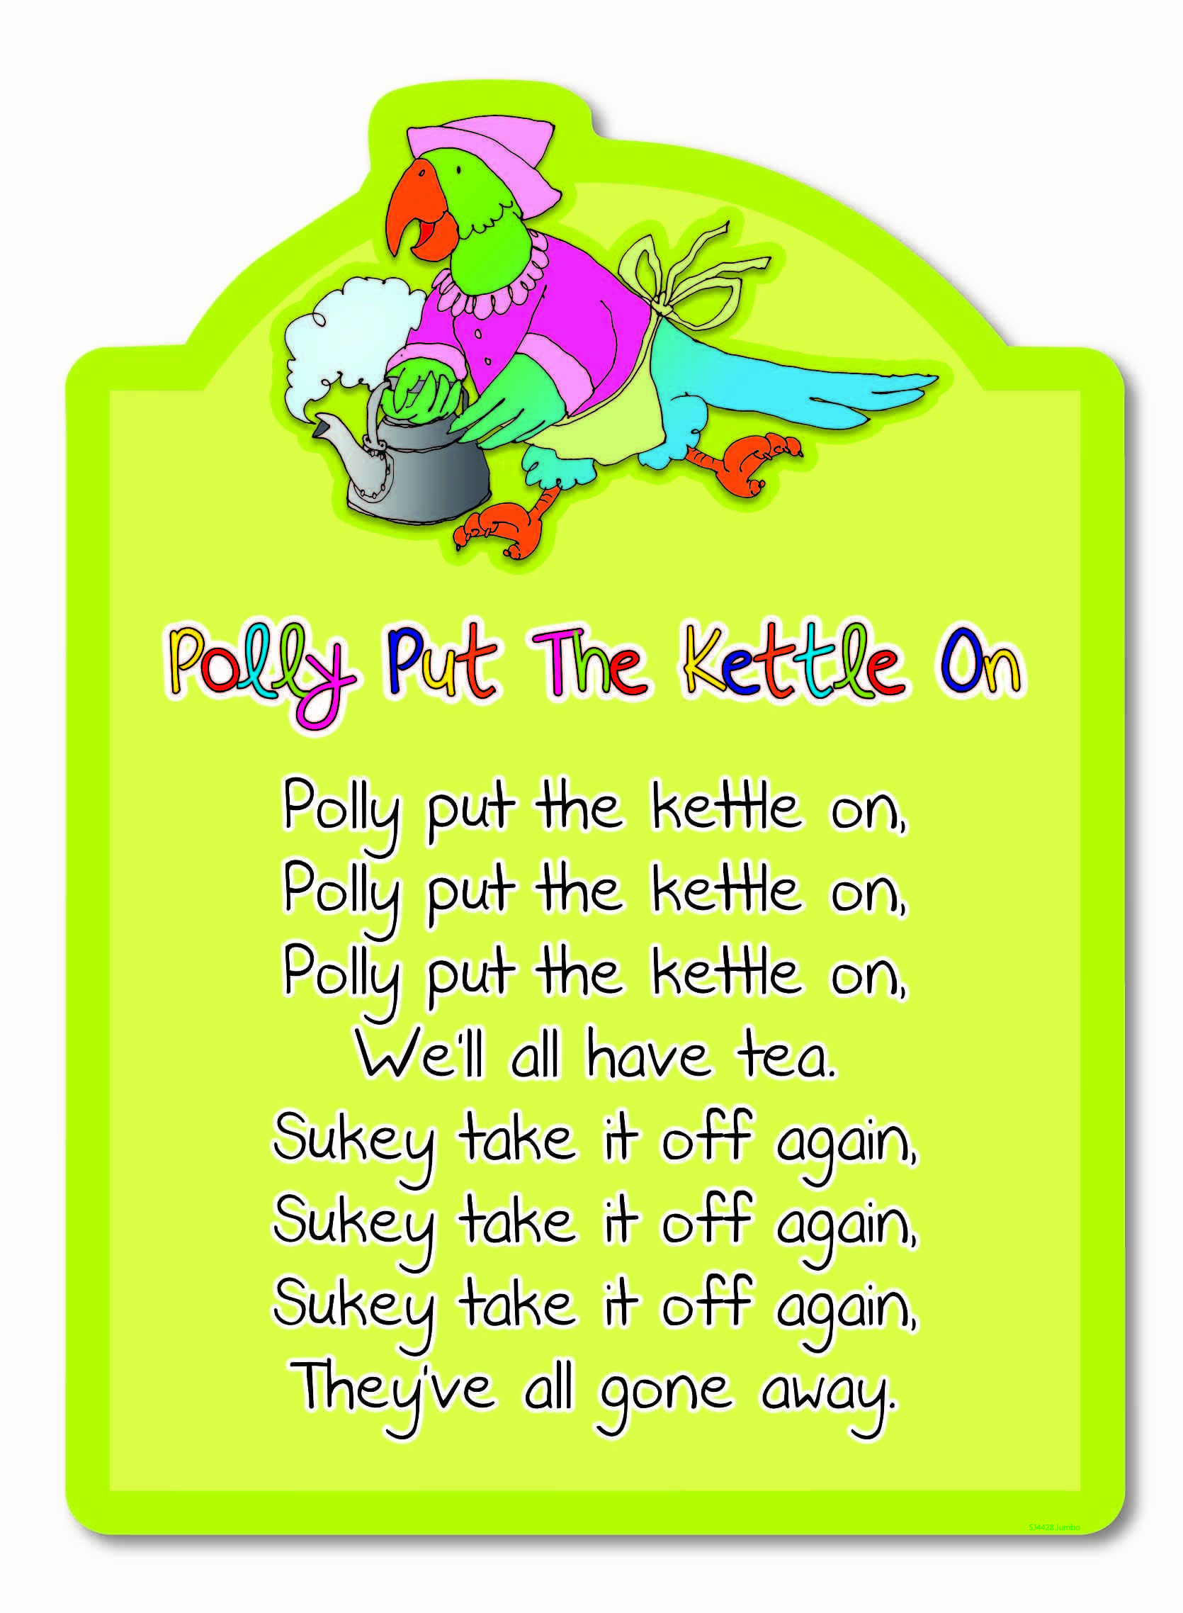
Nursery rhymes

Slide 16
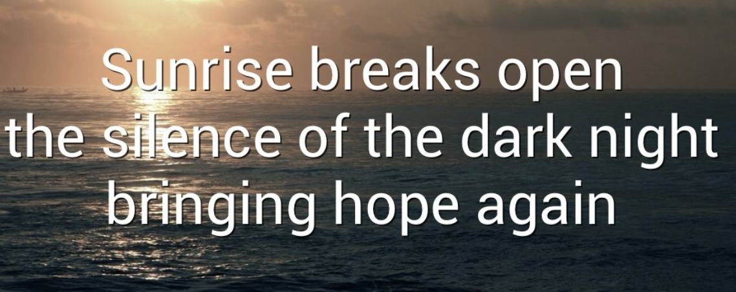
Haiku

Slide 17
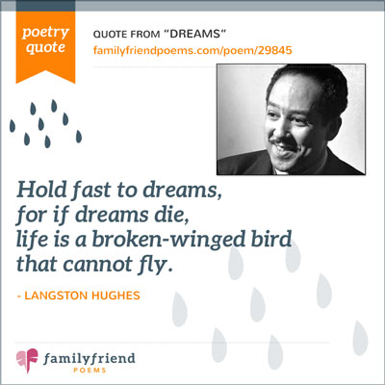
List poems
Hold fast to dreams
For if dreams die
Life is a broken-winged bird
That cannot fly.
Hold fast to dreams
For when dreams go
Life is a barren field
Frozen with snow.

Slide 18
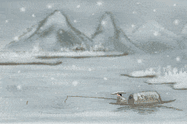
From hill to hill no bird in flight;
From path to path no man in sight.
A lonely fisherman afloat,
Is fishing snow in lonely boat.
Tang Poem

Slide 19

Snow
Lovely, white
Falling, dancing, drifting
Covering everything it touches
Blanket
Cinquain

Slide 20
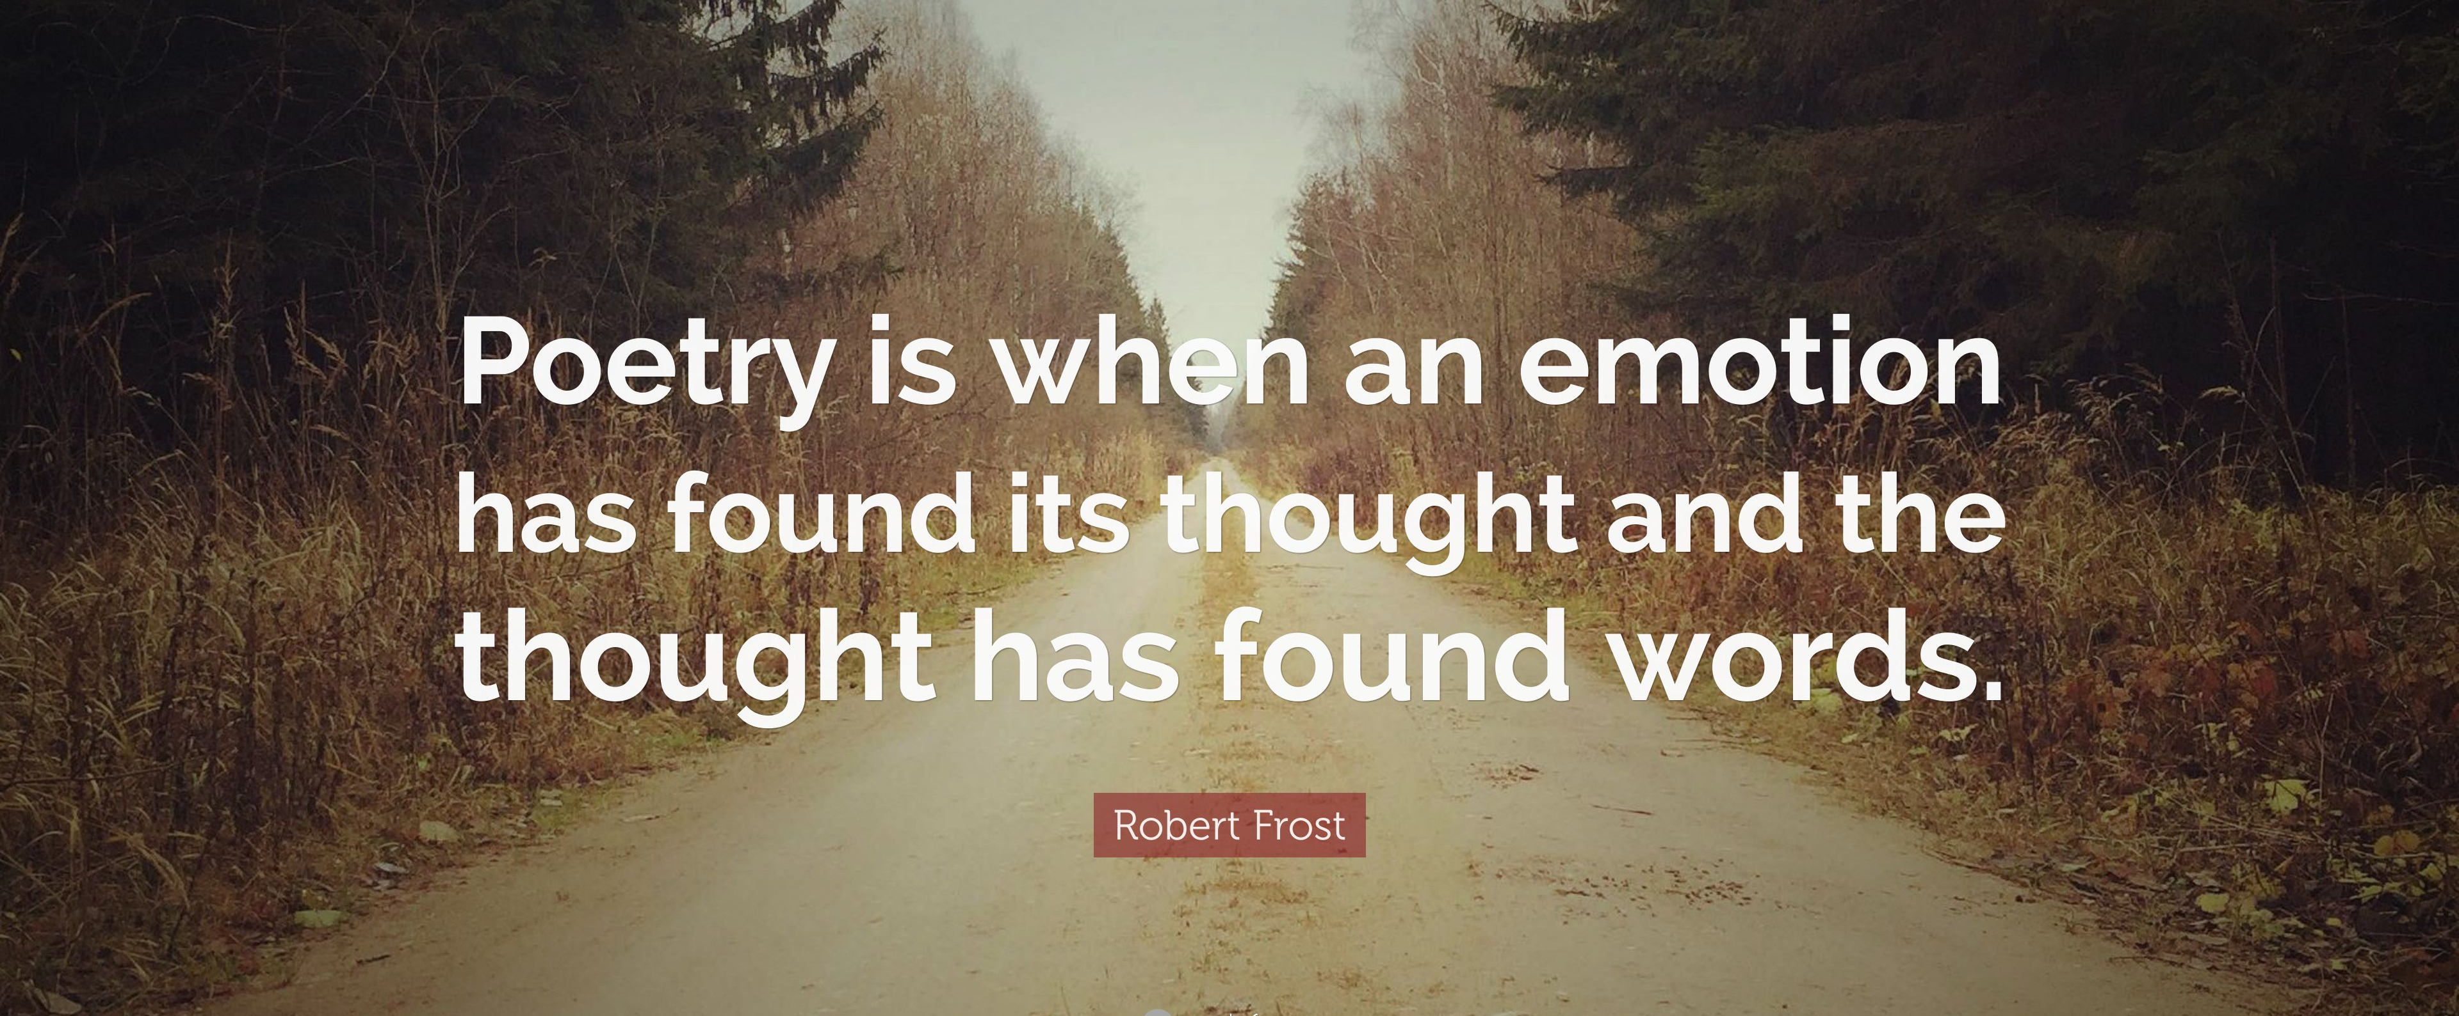
Poems
A poem is a piece of writing, usually using some kind of rhyme scheme or metrical pattern, that expresses a writer’s feelings (or the feelings of a person). They can tell stories, record memories, express desire, and share information.

Slide 21
Have a try

Slide 22

Brother
Beautiful, athletic
Teasing, shouting, laughing
Friend and enemy too
mine
topic
One noun to tell ________
adjectives
two _________ to describe the topic
v-ings
actions
three _______to express _______
words
relationship
four _______ to show the _________
one _______ to rename the topic
pronoun
GIRL
________, ________
______, _______, ______
_____ ____ _____ ___
_______
Cinquain

Slide 23
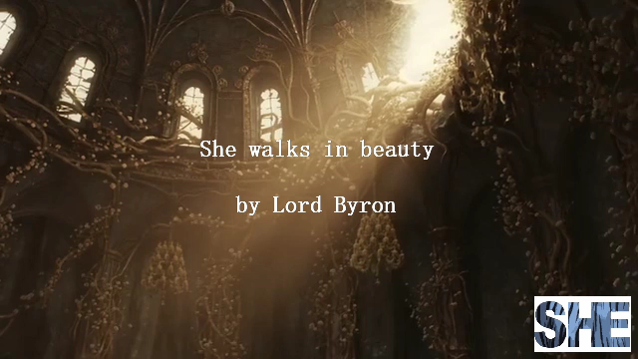
T
H
A
N
K
S
English with Fay
2023.4

Slide 24
