Slide 1

感恩遇见，相互成就，本课件资料仅供您个人参考、教学使用，严禁自行在网络传播，违者依知识产权法追究法律责任。
更多教学资源请关注
公众号：溯恩高中英语
知识产权声明

Slide 2
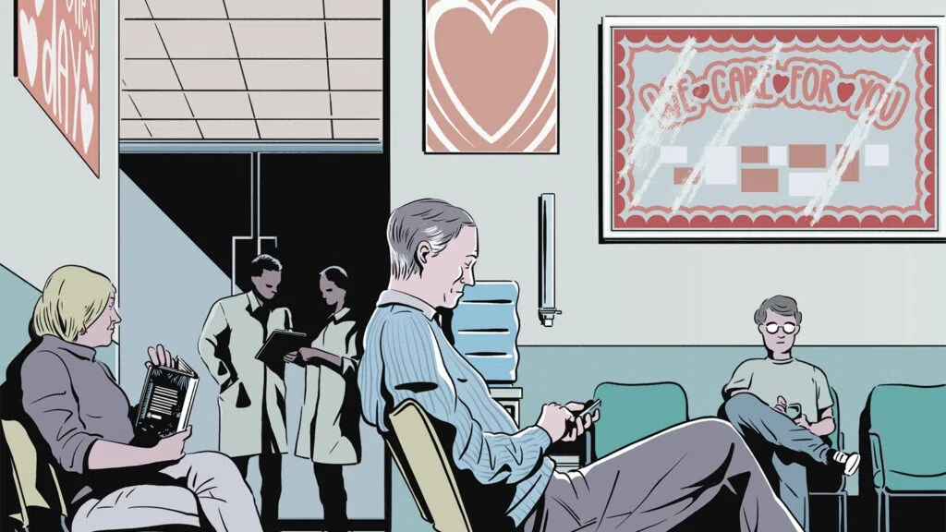
金华十校二模
读后续写讲评

Slide 3

Read for the Plot:
[1]I looked around at the other patients waiting to see the doctor. Maybe they all had more romantic plans for the evening on this Valentine’s Day, but for now the group seemed anti-social. Three people had their heads down, staring at cell phones. Another was absorbed in a magazine. The receptionist tapped at her computer. Everyone was in their own little world.
[2]But I couldn’t judge them for it. I would probably be buried in my cell phone too --if I hadn’t forgotten to charge it before I left home. It would have been nice to strike up a conversation to pass the time on this day, a day of love and friendship. Instead I sat patiently in my plastic chair as a couple of new people took distant seats.
[3]“Roberta? The doctor’s ready for you,” the nurse called. At least I’ll have some kind of human connection, I thought.
[4]My checkup went well, and I breezed out of the office to my little Honda in a space right out front. I got in and turned the key. Nothing. Oh, no. Not again. I’d sent the car to the garage several times already for this very problem and thought it had finally been fixed.
[5]I reached for my cell phone to call AAA -- then remembered. It was dead, like my car. I would have to use the phone inside. A few people glanced up when I came back into the waiting room, then quickly went back to what they were doing. I went straight to the reception desk, but the receptionist was not there. So I turned back to the people in the waiting room.
[6]“I wouldn’t normally do this,” I said to the group, hoping that I sounded apologetic. Several people turned toward me to listen. “But my car won’t start...”
[7]The nurse popped her head into the room. “You in trouble, Roberta?” she said. “I’ll go and take a look.” I followed the nurse outside. As I passed through the door, I felt someone was behind me.

Slide 4


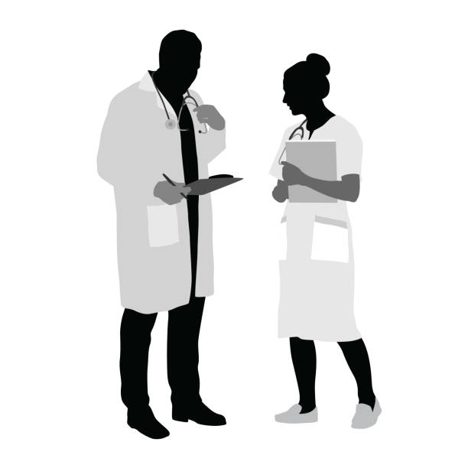
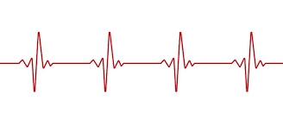
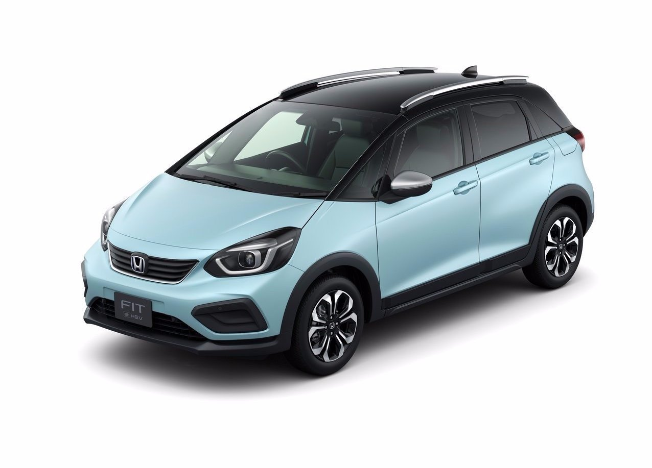
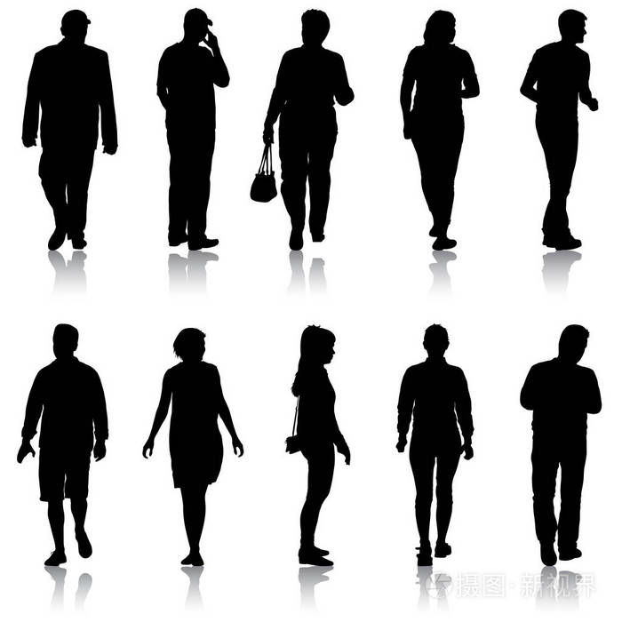
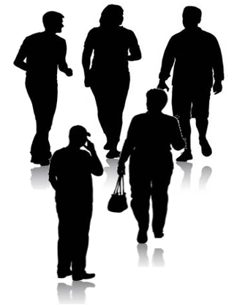

When:
Where:
Who:
What:
the Valentine’s Day
a clinic/ hospital
I, nurse, receptionist, doctor and other patients
“My little Honda won’t start...”
love& friendship
Roberta
won’t start

Slide 5


isolated
Everyone was in their own little world.
It would have been nice to strike up a conversation to pass the time on this day, a day of love and friendship. Instead I sat patiently in my plastic chair as a couple of new people took distant seats.
At least I’ll have some kind of human connection, I thought.
A few people glanced up when I came back into the waiting room, then quickly went back to what they were doing.
I went straight to the reception desk, but the receptionist was not there. So I turned back to the people in the waiting room.
Several people turned toward me to listen.
As I passed through the door, I felt someone was behind me.
Para. 1: I turned to see all the other patients following me.
Para. 2: I said a quick prayer and turned the key.
thirst for connection
tend to be connected
connected
“loved”
An Indication of the solution to the problem

Slide 6

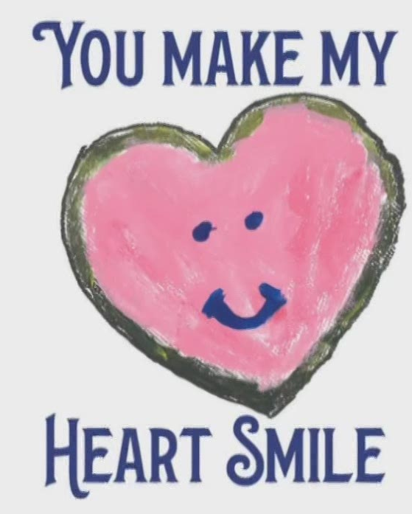
see
Para. 1: I turned to see all the other patients following me.
Para. 2: I said a quick prayer and turned the key.
following me
Why did they follow me?
What’s my feeling/thinking/reaction?
Did we solve the problem?
Curious? Stunned? Be helpful?
Upset? Doubtful? Appreciative?
By the nurse/one patient/AAA? Together?
How?
Connection?
After the repair, I was asked to start the car.
said a quick prayer
turned the key
What’s the result?
What were everyone’s reaction?
What’s my feeling/ thinking/ reflection?
Failed? Successful?
Cheerful
Grateful, Connected, Be Loved
Echo the theme

Slide 7
How I Felt& Discovered the Reason:
On their face, I read concerns, worries and curiosity ,which made me overwhelmed by surprise.
Surprised as I was, I asked them why they followed me instead of waiting for treatment. They said they just wanted to see if they could be of some help.
A mixed feeling of surprise and gratitude welling up in my heart, I led them to my little Honda, slid in and demonstrated my problem.
Hardly had I asked the reason when one of the patient said softly that they could also give a hand.
Spotting the confusion on my face, one of the patient uttered “Maybe we can assist as well.”
Confusion mapping on my face, a middle-aged patient smiled “I think we can help.”
It seemed as if they had sensed my puzzlement. Casting me a smile, one patient blurted out “We also would like to help you.”
Actively
Passively

Slide 8

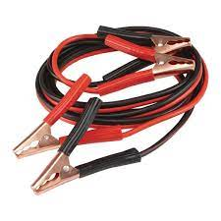
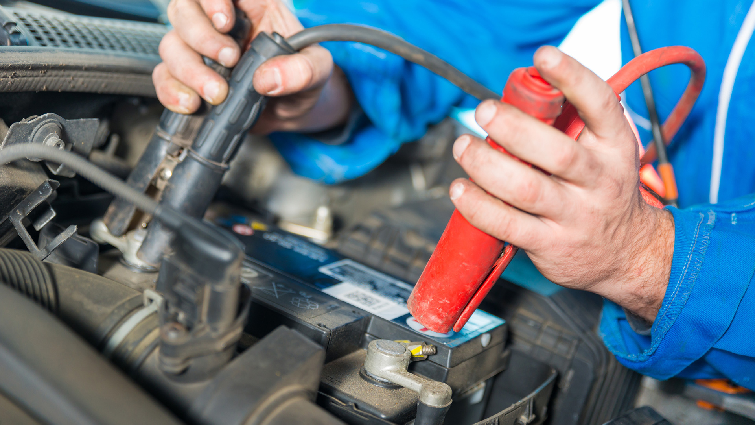
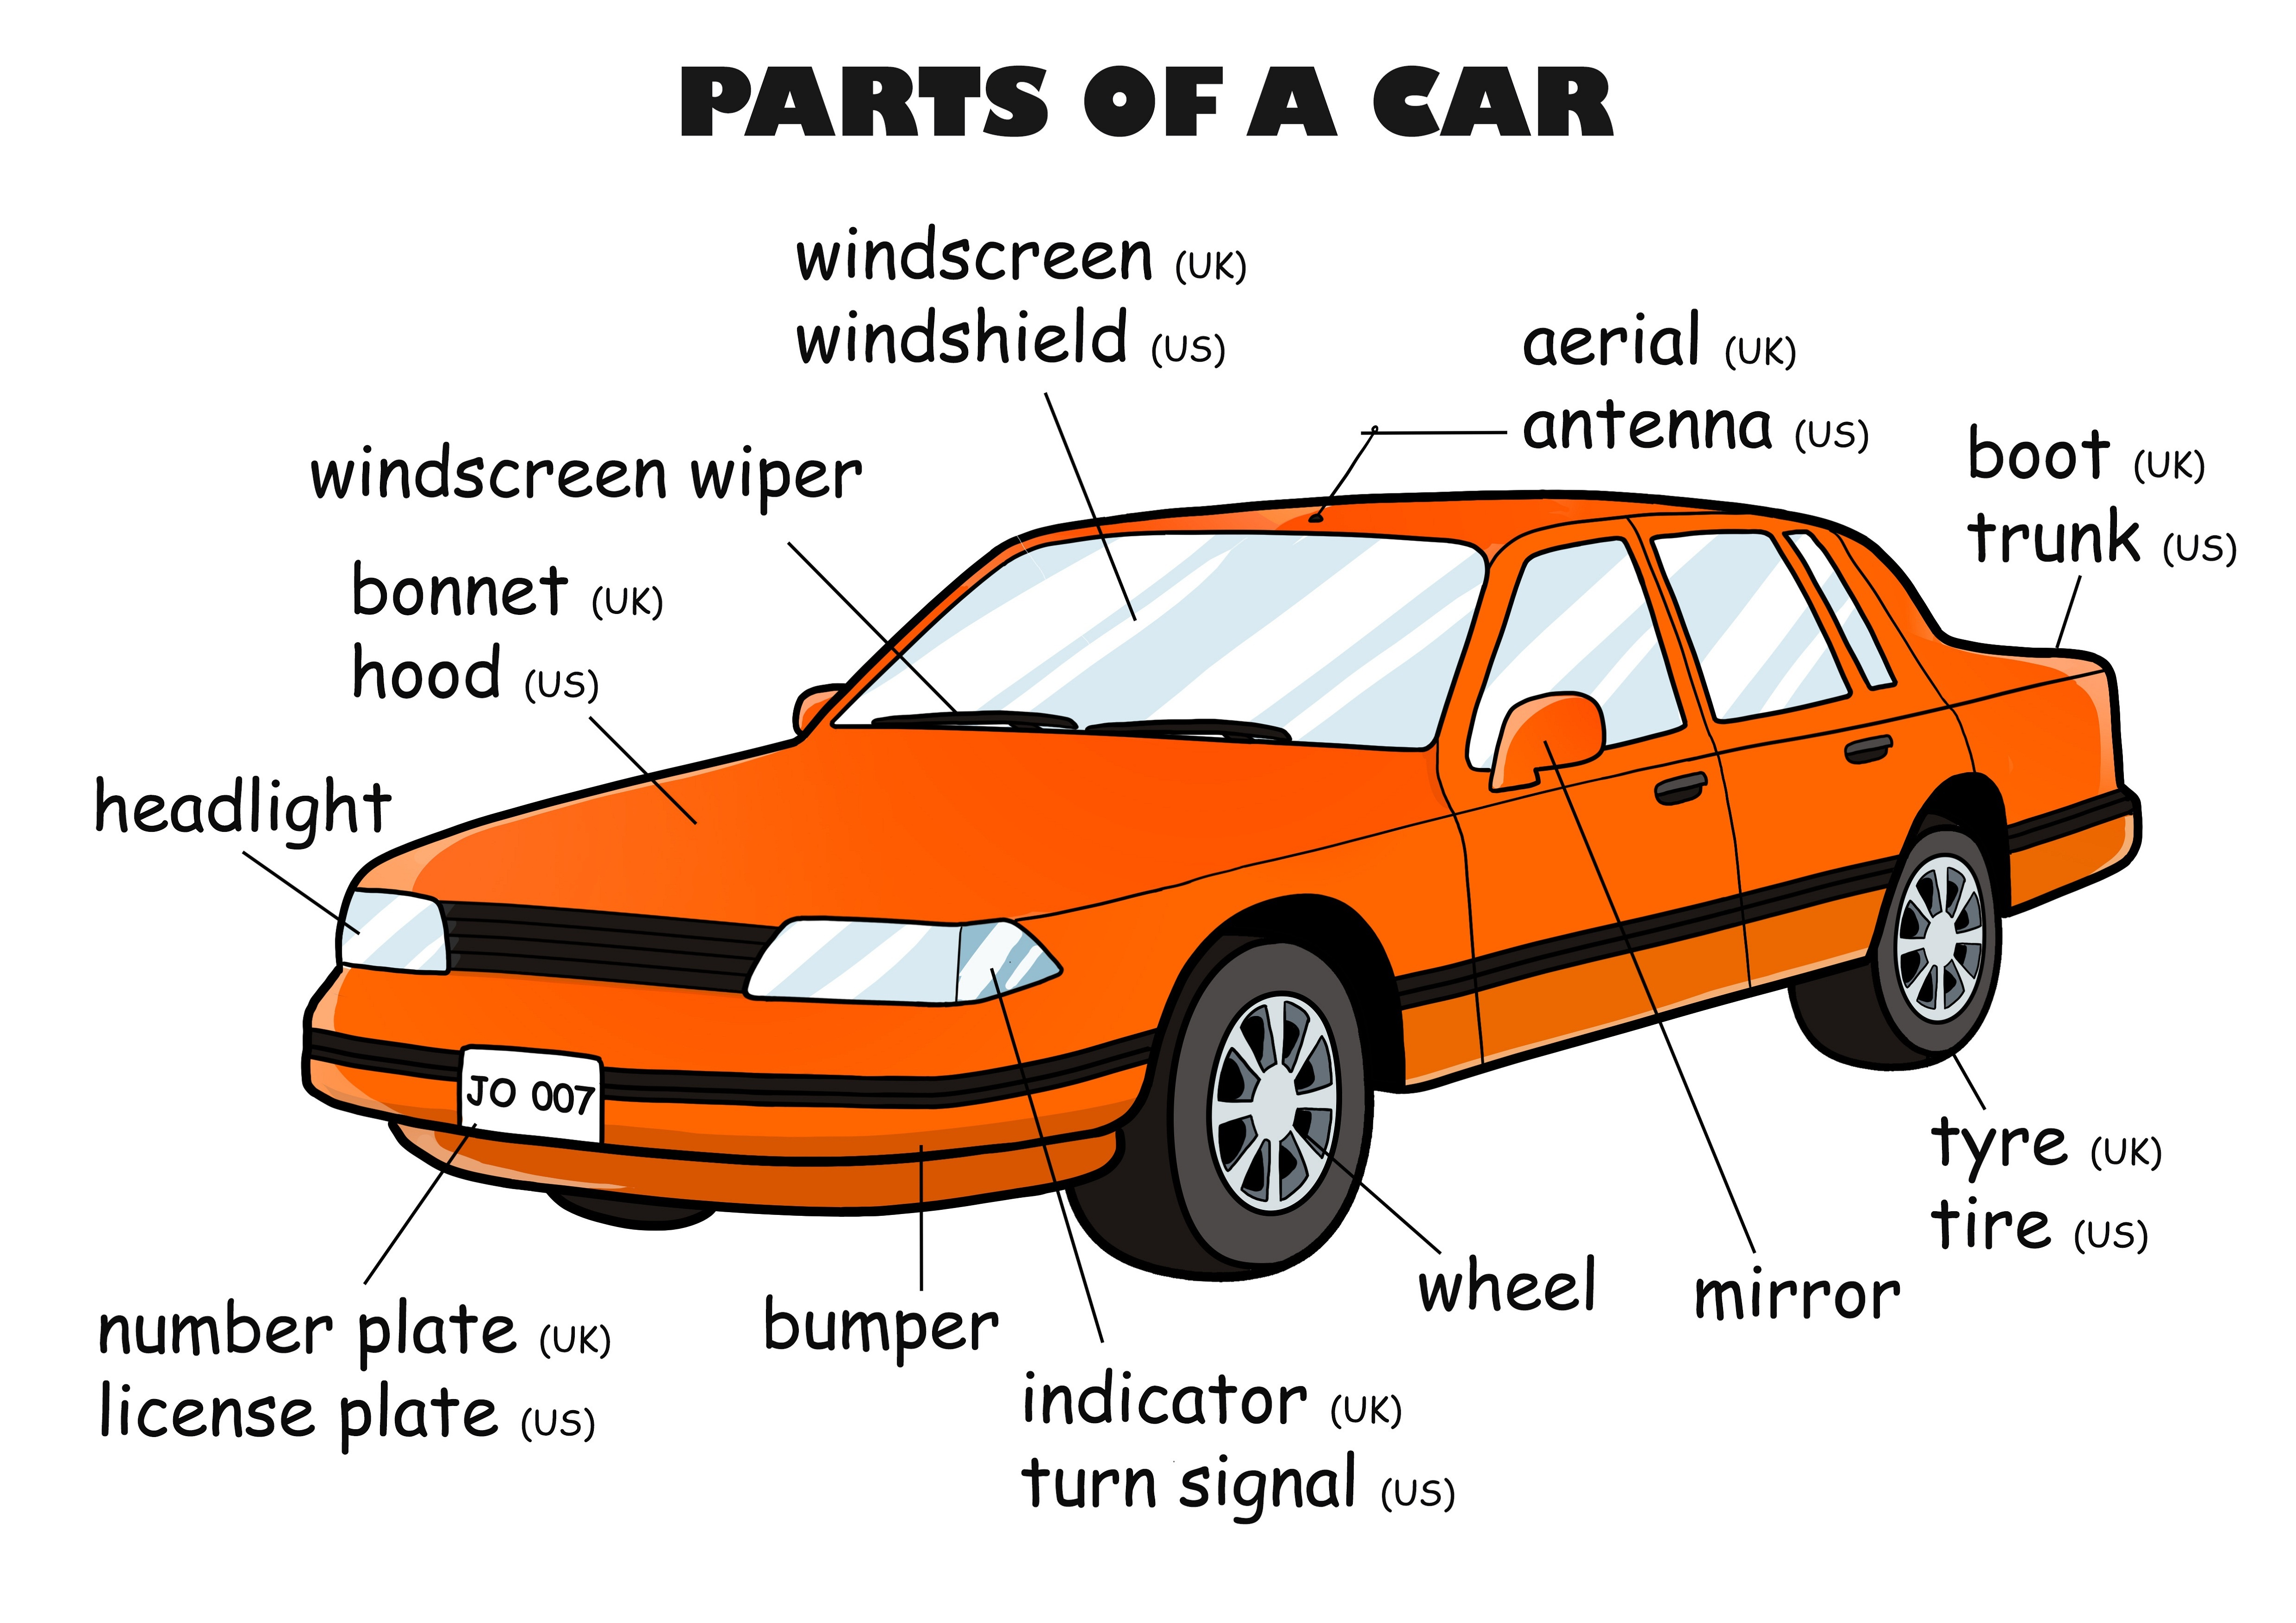
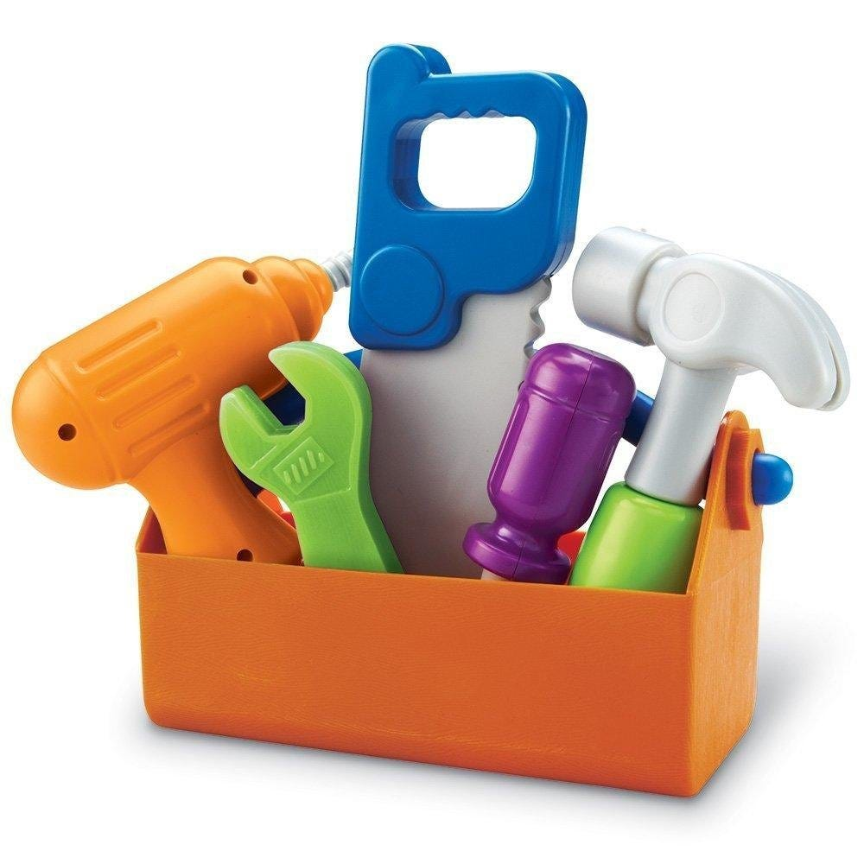
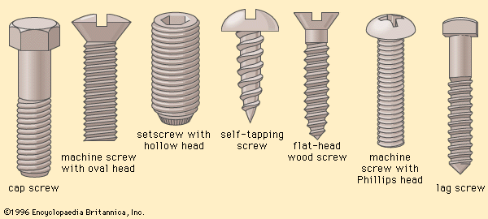
How to solve the problem?
Who solved the problem?
A green hand/A rookie?
A handyman? A mechanic?
A technician? A repairman?
jumper cables
a dead battery
a tool kit
screws
open the hood/ trunk
fetch the tool kit
check the parts
tight the screws
screw up the loose parts
twist the wire
connect the jumper cable with...

Slide 9
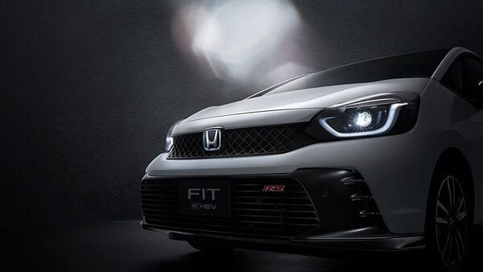
The car roared in a thrilling voice and my heart finally found its normal beat.
Surrounded by many concerned eyes, the engine worked. My car survived!It seemed to be a miracle that my car could start again.
The car started. The moment the car’s headlights lit up, thunderous applause arose.
Fortunately, the sound of the engine yelled out the triumph, tearing the silence of ground into pieces.
Ears filled with the boom of the engine, I was in rapture when I found my little Honda was successfully fixed.
“Resuscitation”
of the Car

Slide 10

Everyone was in their own little world.
Maybe they all had more romantic plans for the evening on this Valentine’s Day.
It would have been nice to strike up a conversation to pass the time on this day, a day of love and friendship.
At least I’ll have some kind of human connection, I thought.
Everyone’s little worlds integrated into a merry big one.
Nothing is more romantic than receiving the love and kindness from strangers on this Valentine’s Day.
The setting sun wreathing the parking lot, piles of smiles exposed me and my new friends in a tranquil and romantic evening.
Reflecting on my way home, I knew the strangers’ kindness fueled this Valentine’s Day with tender love and precious friendship.
The world out of the phone was more fascinating and the Valentine’s Day finally became full of love and friendship.

Slide 11
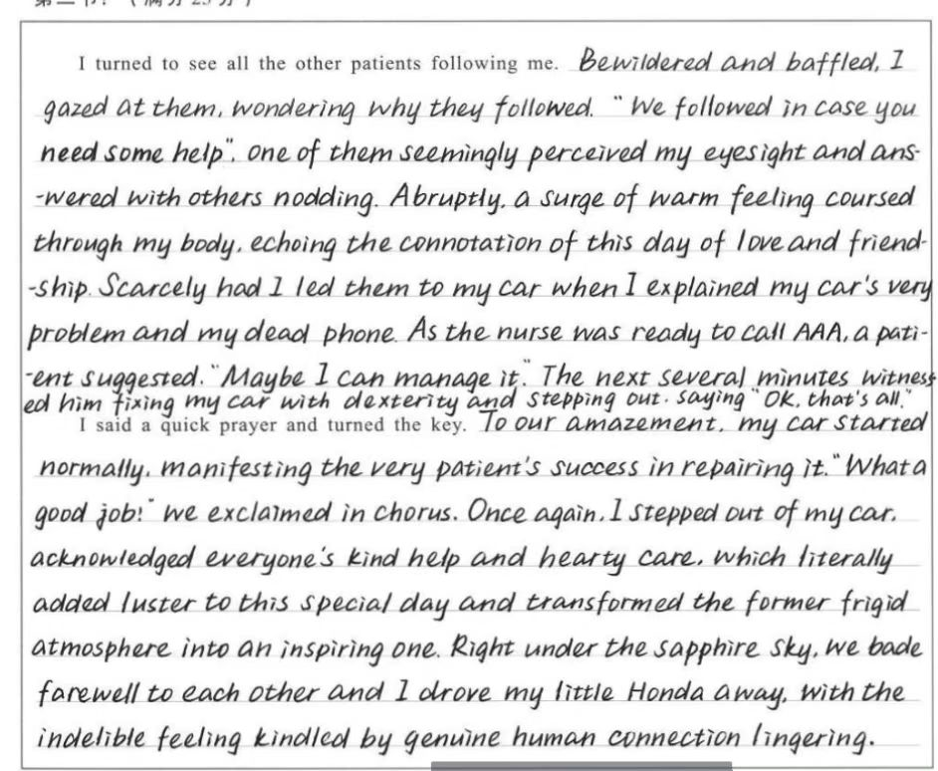
学生佳作：
20分
情绪心理描写,承接首句
呼应前文及主题
动作语言描写,推进情节
无灵主语,衔接下段
承接首句,感叹句烘托氛围
动作细节呼应,推进情节，铺垫下文
环境动作描写，完整故事
引出主题

Slide 12
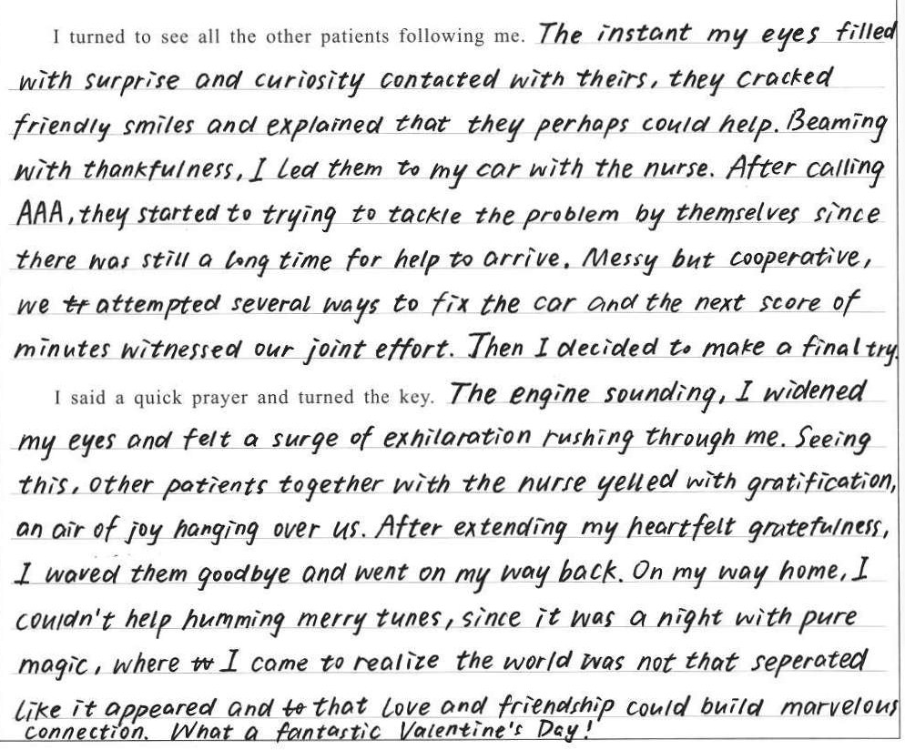
学生佳作：
20分
自然承接
描写到位
句式丰富
细节呼应
情节合理
紧扣主题

Slide 13
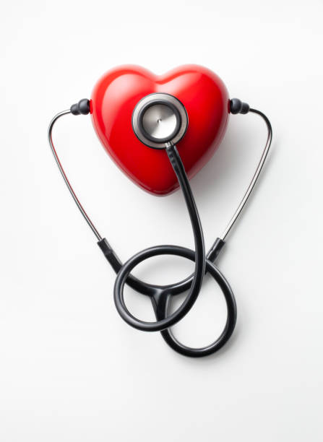
参考范文：
I turned to see all the other patients following me. A bit puzzled, I went to my car and slid into the driver's seat.(承接首句, 推进情节) One of them called “Pop your hood!” So I pressed the button. (自然过渡, 衔接人物) Several others bent at the hip, presumably leaning in to check the engine. (铺垫下文)“The screw is loose,” one assured me, “Trust me. I used to be a mechanic”. Having fetched the tool from his car, he began to twist it. It was not long before he straightened up to rest, rubbing his back. Unexpectedly, the other patients just volunteered to take his turn despite their own health condition. (细节描写,情节推进) When the “mechanic” gave a thumbs-up, everyone called out in unison, “Try it now!” (衔接下文)
I said a quick prayer and turned the key. The engine turned over immediately. A cheer went up. (承接首句,推进情节)Several hands shut the hood. “Don’t make any stops on the way home,” the “mechanic” said. “Keep the car running till the battery gets a good charge.” (语言描写,丰满人物,铺垫主题) I backed my car out of the space, then paused to wave at the crowd of people who’d saved the day. (完整故事)My Honda never stalled again. It turns out that my waiting room team had done a better job than my garage ever did. I guess that’s just what happens when people come together. And there’s no better valentine than that.(引出主题,呼应前文)

Slide 14

下水作文：
I turned to see all the other patients following me. Before I uttered my confusion, a male patient smiled, “We may also lend a helping hand.” Nodding at him appreciatively, I turned round, paced forward and unlocked the car. As I settled on the seat, a young man drove his car towards unexpectedly, waving a lead in his hand out of the window. No sooner had I responded than he boomed out that I probably got a flat battery. Some other patients around turning on the flashlights of their cell phones spontaneously, the young man checked the parts and connected the lead shortly. Startling and gratefully, I was asked to give a try.
I said a quick prayer and turned the key. With the familiar humming of the engine coming back to my ears, the cheering swelled from the assemble patients. “Safe drive!” the nurse and the couple enjoined me, while others all fanned out, bidding farewell with brisk whistles and waving arms. Their figures stood out starkly against the yellow headlights of my little Honda, like the golden stars in the dark sky. Though what lay on my front passenger seat was some “gifts” from the doctor rather than chocolates on this Valentine’s Day, my heart was definitely crammed full of sweetness and satisfaction.

Slide 15

Accumulation& Apply:
I would probably be buried in my cell phone too --if I hadn’t forgotten to charge it before I left home. It would have been nice to strike up a conversation to pass the time on this day, a day of love and friendship. Instead I sat patiently in my plastic chair as a couple of new people took distant seats.
My checkup went well, and I breezed out of the office to my little Honda in a space right out front. I got in and turned the key. Nothing. Oh, no. Not again. I’d sent the car to the garage several times already for this very problem and thought it had finally been fixed.
tapped at the computer
strike up a conversation
pass the time
distant seat
breezed out
turned the key
glanced up
sounded apologetic
popped her head into
said a quick prayer
敲电脑
搭讪、攀谈
消磨时间
远处的座位
轻盈而自信地走
转动钥匙
抬头看
听起来很抱歉
探头到...
快速祈祷
虚拟语气对比现实,表达内心遗憾
前后情形好坏对比, 长短句结合, 否定词/副词表达强烈情绪

Slide 16

Accumulation& Apply:
如果不是出乎意料的发动机故障，我不会在这特别的一天感受到陌生人的关爱。原本能和我心爱的人一起度过这传统的粉红色夜晚是很好的。然而，哼着欢快的曲子和着我的小本田沙哑的旋律，我心想没有什么更好的能替代这个情人节我所收获的了。
I wouldn’t have tasted the caring and love of strangers this exceptional day--If the engine failure hadn’t taken place out of the expectation. It would have been nice to spend the conventional pink evening with my beloved people. Yet, humming a merry tune to the hoarse melody of my little Honda, I thought there would not be any better substitute of what I attained on this Valentine’s Day.

