Slide 1

感恩遇见，相互成就，本课件资料仅供您个人参考、教学使用，严禁自行在网络传播，违者依知识产权法追究法律责任。
更多教学资源请关注
公众号：溯恩高中英语
知识产权声明

Slide 2


2022学年第二学期
杭二模应用文
开幕辞---
Bring Cultural Relics to Life

Slide 3
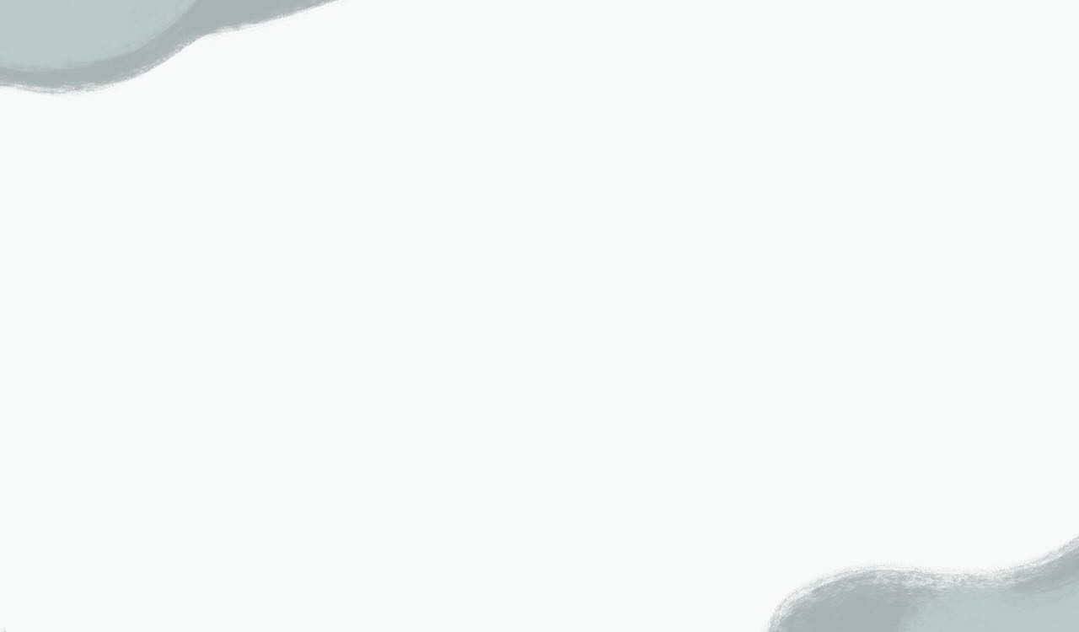
01
题目
你是某国际学校学生会主席。你校准备组织一次“让文物活起来”（Bring Cultural Relics to Life）的活动，请你用英语写一篇开幕辞，欢迎参加活动的师生。内容包括：
1．表示欢迎；
2．活动目的；
3．活动内容。
注意：
1．写作词数应为80左右。
2．参考词汇：手工艺品artifact。

Slide 4
你是某国际学校学生会主席。你校准备组织一次“让文物活起来”（Bring Cultural Relics to Life）的活动，请你用英语写一篇开幕辞，欢迎参加活动的师生。内容包括：
1．表示欢迎；
2．活动目的；
3．活动内容。
02
审题
体裁？
开幕辞
格式？
无标题，有呼语，无落款，最好分三段（结构清晰）
对象？
参加活动的老师和学生（以及嘉宾）
语气？
热情+正式
时态？
一般现在时+一般将来时
结构：
P1：问候，自我介绍，欢迎，
P2：活动目的+内容
P3：（再次欢迎）+祝福/美好期许
要点？

Slide 5
共创开放繁荣的美好未来
——在第五届中国国际进口博览会开幕式上的致辞
（2022年11月4日）中华人民共和国主席 习近平
尊敬的各位国家元首、政府首脑，
尊敬的各位国际组织负责人，
尊敬的各代表团团长，
各位来宾，
女士们，先生们，朋友们：
Your Excellencies Heads of State and Government,
Your Excellencies Heads of International Organizations,
Your Excellencies Heads of Delegations,
Distinguished Guests,
Ladies and Gentlemen,
Friends,
大家好！我谨代表中国政府和中国人民，并以我个人名义，向出席第五届中国国际进口博览会的各位嘉宾，表示热烈的欢迎和诚挚的问候！
Good evening! I would like to extend, on behalf of the Chinese government and people and also in my own name, a warm welcome and hearty greetings to all our guests attending the fifth China International Import Expo (CIIE).
Essential elements
称呼语
问候
欢迎

Slide 6

03
表示欢迎
要素 | 例句
问候/开头语
自我介绍
欢迎
Good afternoon,.../First of all,...
On behalf of our school,...
As the president of Students’Union, I...
Representing our school, I...
I would like to (take the opportunity to) express/convey our warm welcome/extend a warm greeting to all of you.
I feel greatly honored/privileged/delighted/overwhelmed to...
I have the great honor/privilege to...
Please allow me/Permit me to...

Slide 7
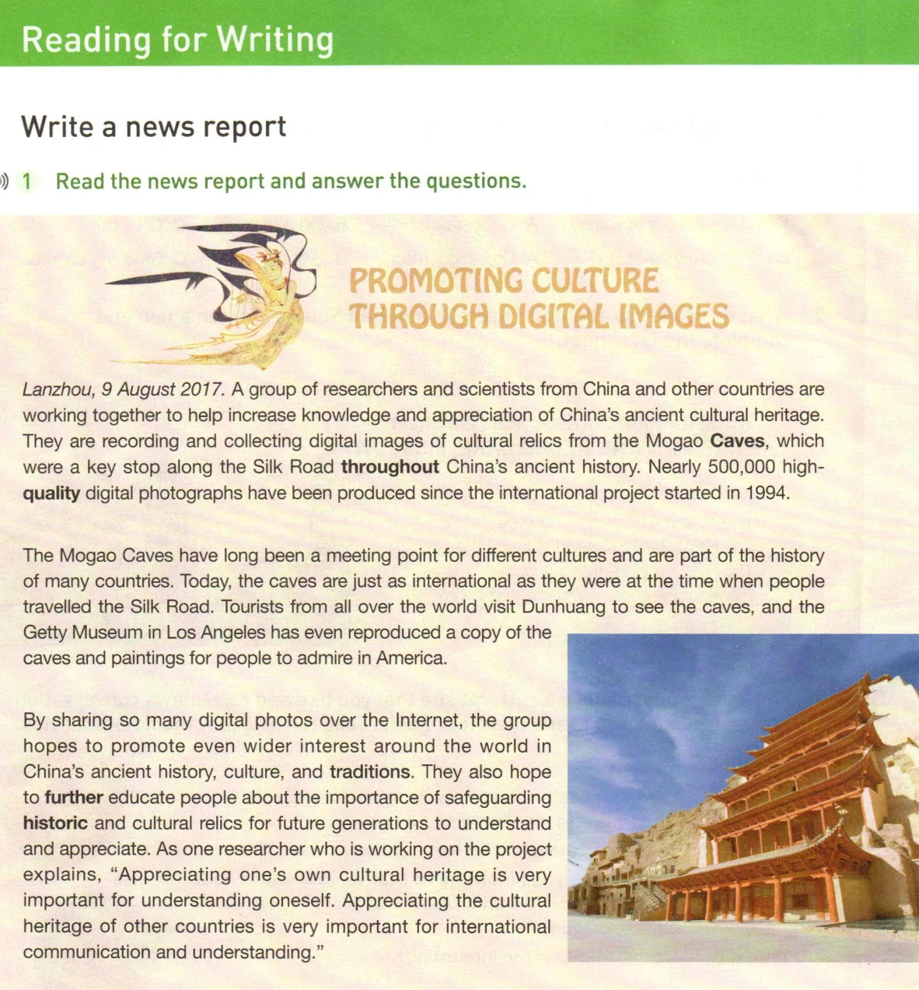
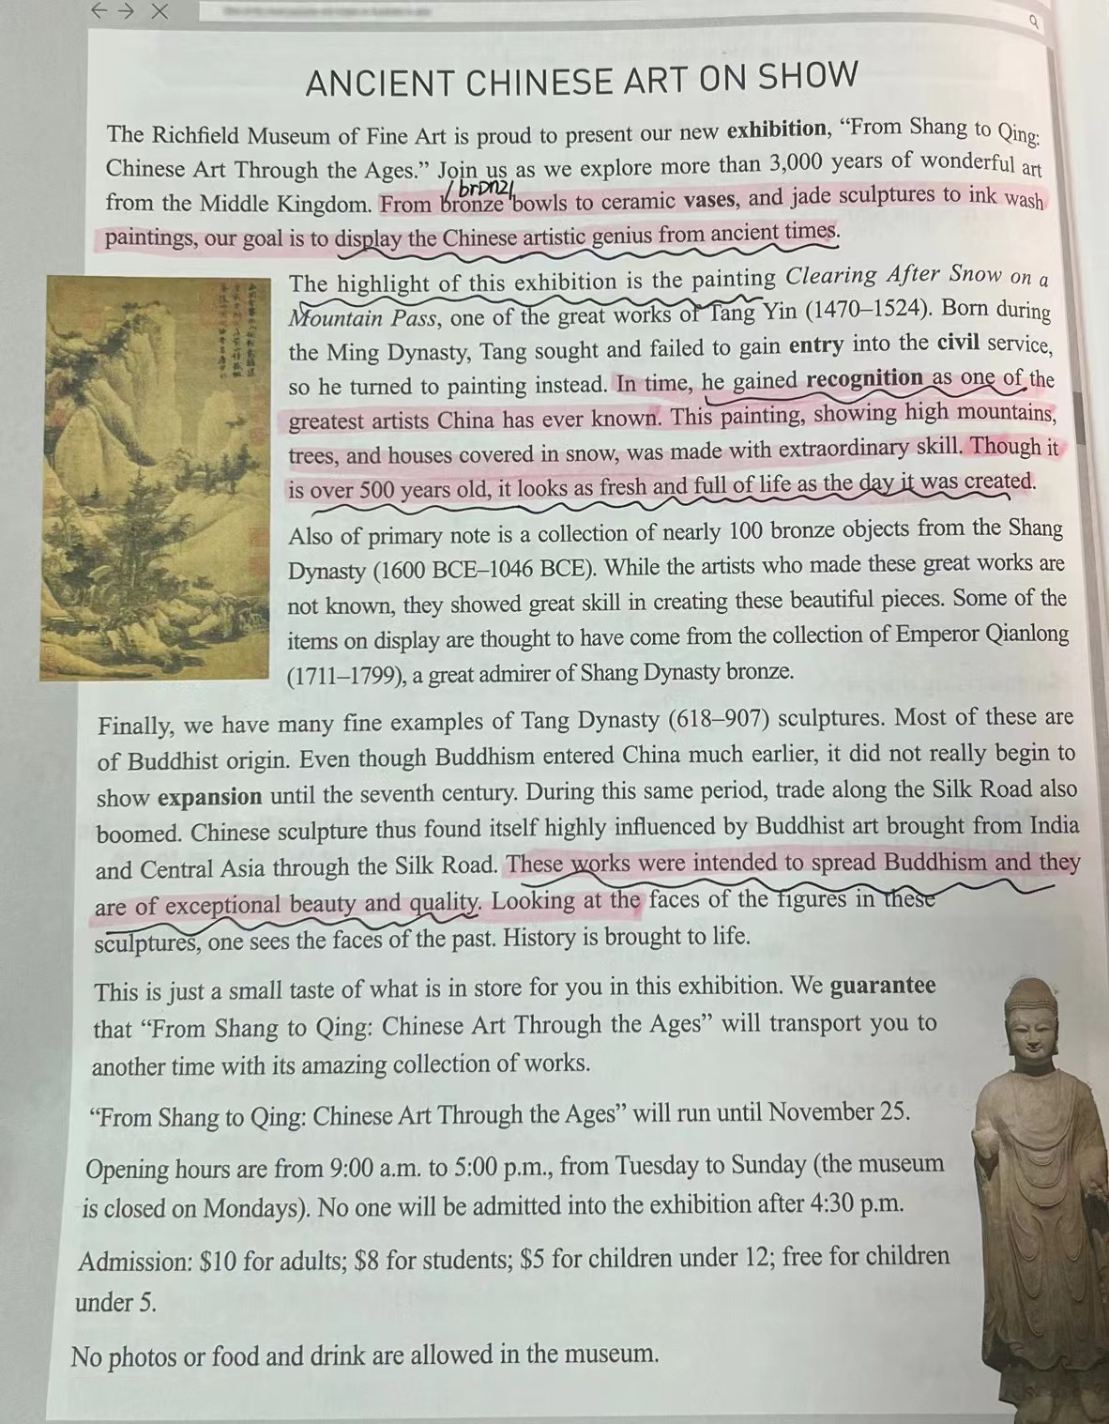
04
联系教材
Inspiration:
record, collect digital images of cultural relics and share them on Internet/on display; （让文物活起来的方式）
reproduce copies of relics;
recreate according to cultural relics.
目的
方式
教材中精彩的语言：
The highlight of today’s activity is...
...which is a small taste of the exquisite culture
display the Chinese artistic genius from ancient times
I’m fully convinced that the activity will help you admire historic and cultural relics with amazing collection of works.
目的、意义

Slide 8

05
活动目的
丰富校园文化生活
一次对艺术和文化的探索
保护优秀传统文化
传播和弘扬中国文化的精髓
体验/探索/沉浸于中国历史文化的魅力
enrich school life
实践层次
an artistic and cultural endeavour
protect splendid traditional culture
spread and promote the essence of Chinese culture
experience/explore/be immersed in/be exposed to the charm of...

Slide 9
05
活动目的
Key: 目的/意义要和活动内容对应
appreciate the time-honored development of Chinese culture
欣赏中国文化悠久的发展历史
广泛且深刻地了解中国历史文化
赞叹灿烂的中华文明/中国人民的智慧
激发文物创作的兴趣
增进文化认同，坚定文化自信
感受文化多样性和创造性
明白文物和文化遗产保护传承的重要性
have an extensive and profound knowledge of...
be amazed by the brilliance of Chinese civilization/the wisdom of Chinese people
意识层次
inspire interest in recreating/designing on cultural relics
enhance sense of cultural identity ;
strengthen cultural confidence
have a deep understanding of cultural diversity and creativity
protection and transmission of cultural relics and cultural heritage

Slide 10
06
活动内容
重难点：什么样的活动能让文物“活”起来？
文物资源向社会开放，让广大公众接触到文物资源。
---2017年3月3日，国家文物局局长在“两会部长通道”答记者问
数字互联的引擎一旦打开，文物保护利用的发展边界和趋向将得到极大拓展。
---2020年9月，《探索文物保护利用数字互联新格局》，《人民论坛》
我们要善于从文化遗产资源中去挖掘、提炼和创造新的优质的内容产品，形成自身文化产业的优势与特色。
---2023年1月7日，中国文物保护基金会理事长在第二十届中国文化产业新年论坛题上的演讲

Slide 11
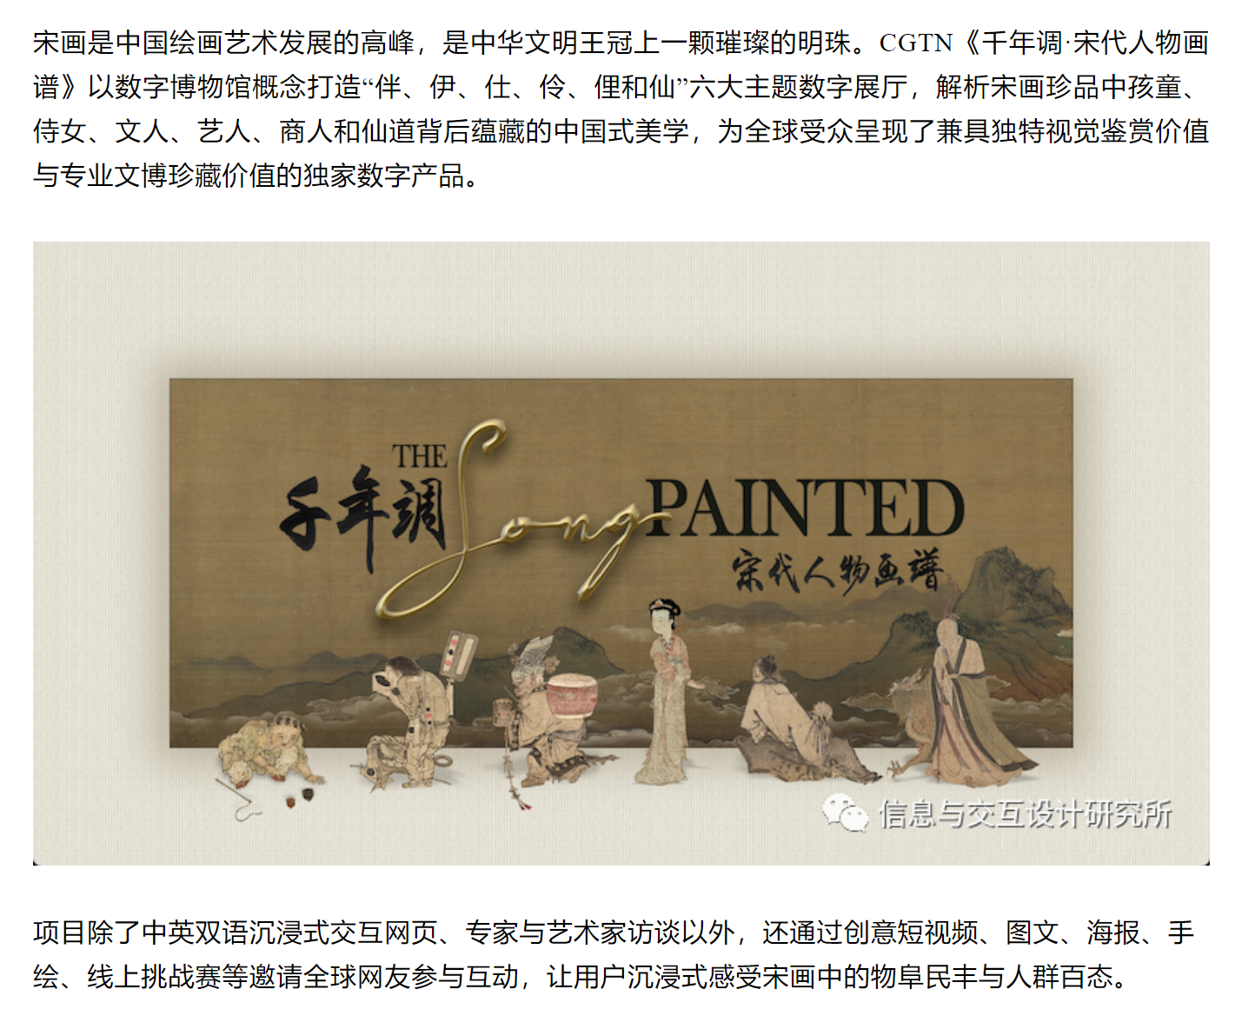

06
活动内容

Slide 12
06
活动内容
专家/艺术家访谈、讲座
讲述了博物馆馆藏文物（具有代表性的文化艺术瑰宝cultural treasures）及其背后悠久的历史文化知识
文物实物、图片、视频展览/沉浸式交互体验展
a display of cultural relics through sci-tech means;
present a true, three-dimensional and full picture of hundreds of pieces of cultural relics, including pottery, porcelain, jade sculptures and painting artworks.
the gallery is equipped with an interactive game themed on...
travel back to 3,000 years ago to explore...through VR glasses
direct interactions with ancient artifacts
文创比赛、制作手工艺品
cultural and creative products based on the collections
design competition
make own artifacts

Slide 13
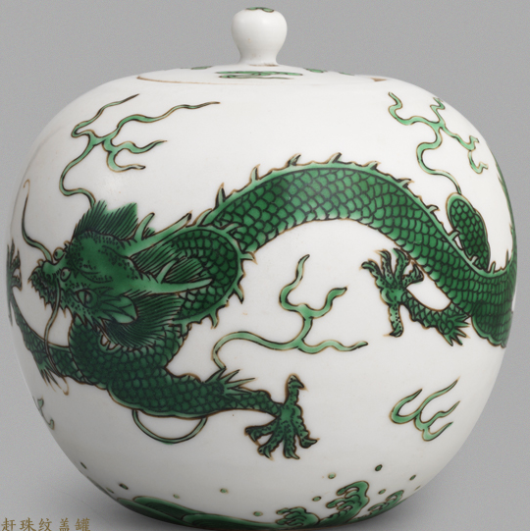
07
（再次欢迎）+ 祝福/对活动的美好期许
再次欢迎：
Welcome again! （简洁有力即可）
祝福
I sincerely hope you can enjoy yourself here.
Wish you a pleasant experience/time.
May you have a rewarding and memorable time/afternoon.
对活动的美好期许
All of us will be bound to harvest meaningful and valuable memories!
I believe it will be a treasured memory for us all.
I’m fully convinced that this activity will give/offer you a great experience/splendid cultural journey.

Slide 14
08
参考范文
Dear teachers and fellow students,
Welcome to our “Bringing Cultural Relics to Life” event. As president of the Student Union, I’m honored to have the opportunity to open this wonderful occasion.
The purpose of this event is to encourage everyone to explore the history and culture behind the artifacts and appreciate their beauty. There will be an exhibition featuring various cultural artifacts brought by students which have been passed down through their families. Also, we will be holding a workshop where students are encouraged to create their own cultural artifacts that look like cultural relics in ancient times.
Thank you for your attendance, and I wish you all a meaningful and enjoyable experience.

Slide 15
08
参考作文
Dear teachers and fellow students,
Good afternoon! On behalf of Students’ Union, I’m here to extend warm welcome to all of you attending this grand activity themed “Bring Cultural Relics to Life” in our school.
Cultural relics, a shining pearl in the treasure house of world culture, are worth attention and protection. Thus, in order to help students to fully understand the value of cultural relics and make efforts to spread the essence of Chinese culture, a prestigious museum curator will give a lecture to illustrate some represtensive relics, along with cultural meanings behind them. Then, a special exhibition with artifacts and replicas, designed and crafted by our students, will definitely offer you a glimpse of the charm of cultural relics.
Welcome again and hope you will have an enjoyable and inspiring experience!

Slide 16
09
相似类型作文
广东省一模应用文
假定你是李华，校英语学习俱乐部负责人。你们邀请到了Smith教授在线作主题为“How to Write and Enjoy Poems”专题讲座。请你在讲座前作简要发言，内容包括：
1. 表示感谢；
2. 相关介绍；
3. 对听众的要求。
注意：
1. 词数80左右；
2. 请在答题卡的相应位置作答。

Slide 17
09
相似类型作文
（2021年1月浙江英语首考应用文）
假定你是李华，下周新西兰学生来你校访问。你将作为学生代表致欢迎辞，请为此写一篇发言稿，内容包括：
1.表示欢迎；
2.介绍活动安排；
3.表达祝愿。
注意：
1. 词数80左右；
2. 请在答题卡的相应位置作答。

Slide 18
感谢聆听！

