Slide 1

感恩遇见，相互成就，本课件资料仅供您个人参考、教学使用，严禁自行在网络传播，违者依知识产权法追究法律责任。
更多教学资源请关注
公众号：溯恩高中英语
知识产权声明

Slide 2
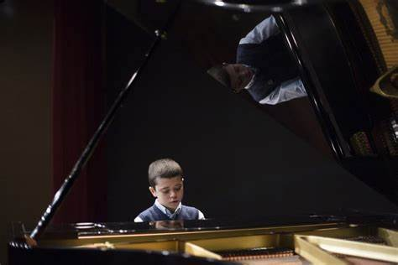
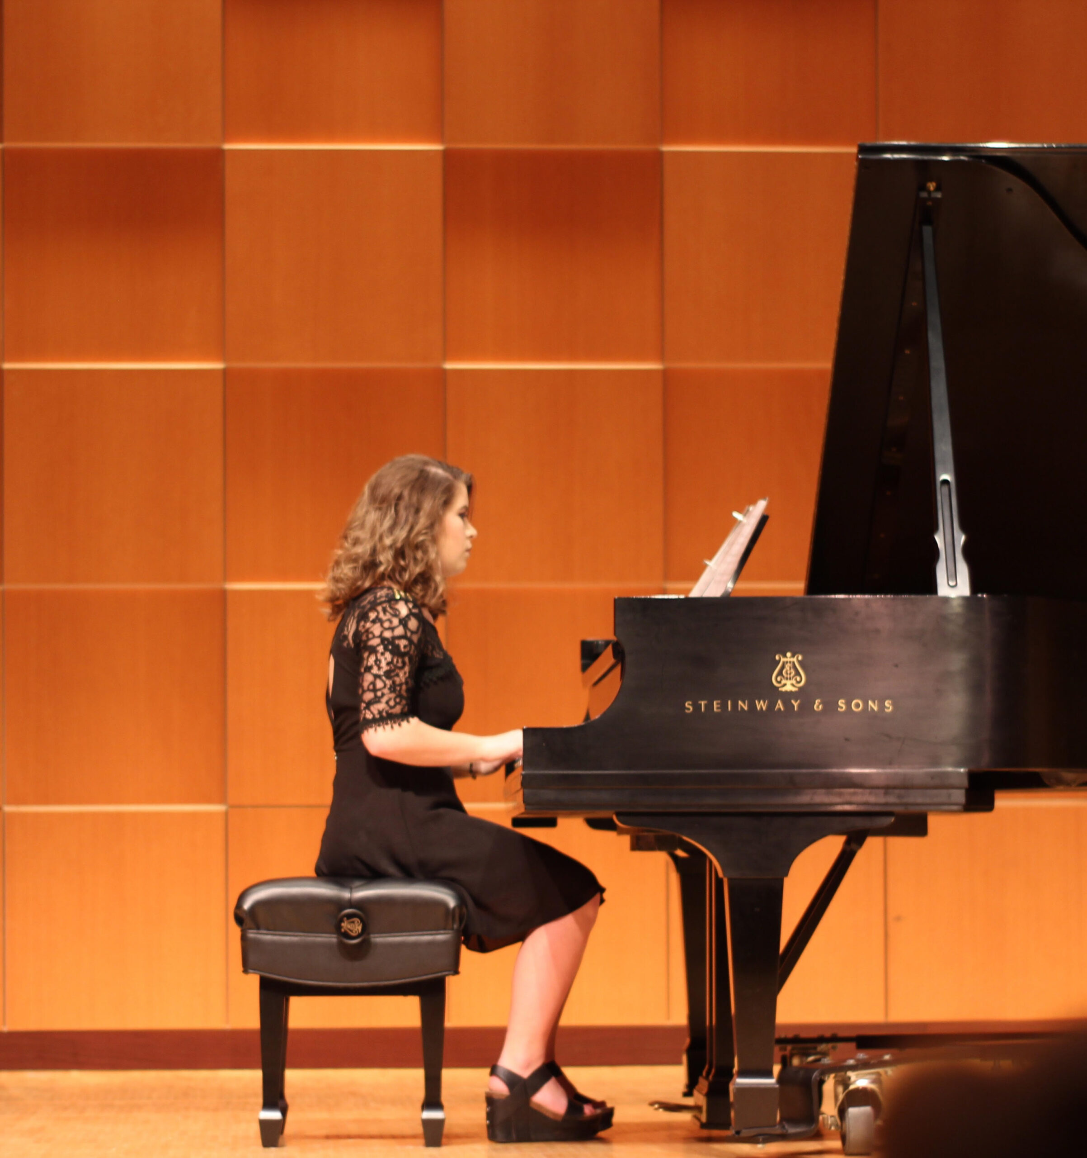
2022学年第二学期
杭二模读后续写
A Special Recital

Slide 3
Textual analysis
We were in our late 20s with a child when my husband, Ralph, finally graduated from college.
“OK, now I deserve a piano,” I blurted out when he sat down for lunch just before the graduation ceremony. A look of surprise crossed his face.
“We could never afford a piano. After so many years of hard work, we got you through school. Now I deserve a piano,” I repeated.
Several months later, Ralph, with help, moved the upright piano we bought for $ 100 into our cottage's tiny arched dining room. It smelled a little musty, but had great tone.
Ralph started graduate school, leaving no money for private piano lessons. The first thing that came to my mind was Santa Monica City College ------ maybe it offered piano lessons. Skimming the catalog, I danced around the room when I found a class at the same time the boys were at preschool.
Practicing, however, was not so easy. Four-year old redheaded Denny crawled out of bed in the evening on a regular basis, That was my time to practice. He'd pad out of the bedroom in his sleeper and climb up on the bench with me. Soon he began plinking（发出叮铃声）on the high keys. I tried to ignore him. He listened to the echoes of the keys and plinked some more. Doing all I could do to keep focused on my own practicing, I continued to ignore him.
This practice pattern became an evening routine, After a while, I didn't even hear him anymore. Ralph studied. Denny plinked on the high keys, and I focused on my piece for the end-of-the-term recital（独奏会）.
That evening came. However, Ralph said he was busy preparing for the midterms and coudn't watch Denny.
Pacing back and forth, I shook my head trying to figure out what to do. Time was running out. I bundled up Denny-with his sleeper on-and drove off to the recital with him.
“We'll sit in the front row, Denny,” I whispered. “You have to be very quiet and listen when I am playing.” He nodded, said “Uh-huh,” and we sat down.

Slide 4
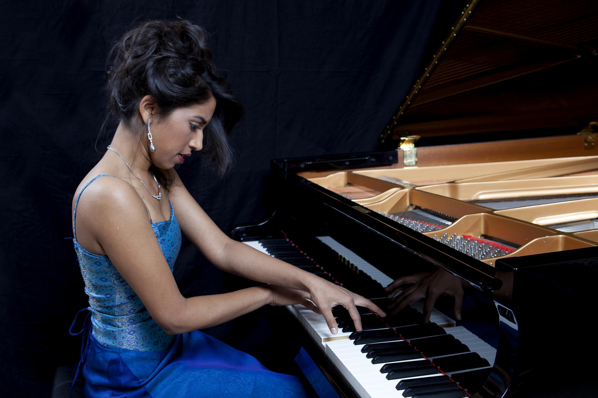
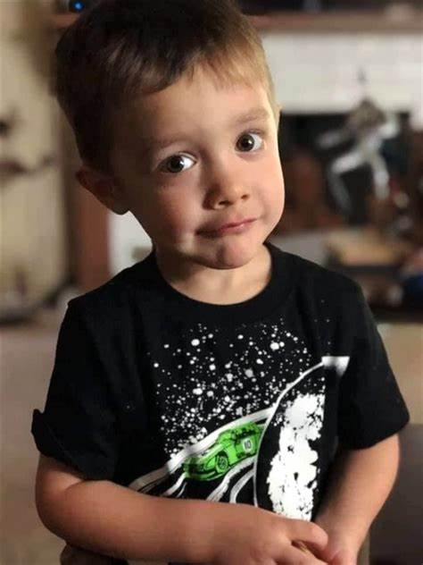
Read for elements of the stroy
character
time
place
event
theme
I
Denny
Ralph (minor character)
in the evening
in the recital hall/on the stage
I practice hard for my piano recital, but that evening Ralph, my husband could’t watch Denny. So I brought him to the recital with me.
company and love between mum and son;
unexpected joy in life/unexpected moments can lead to great experiences;
persistence in the pursuit of dream and hard work can pay off .

Slide 5
Plot the story---What kind of character do “I” have?
为什么需要分析人物性格？
情节和性格互为表里，人物性格是情节发展的内在根据，情节是性格的外在表现；
人物的言行要与他们的性格特征相吻合。
We were in our late 20s with a child when my husband, Ralph, finally graduated from college.
“OK, now I deserve a piano,” I blurted out when he sat down for lunch just before the graduation ceremony. A look of surprise crossed his face.
“We could never afford a piano. After so many years of hard work, we got you through school. Now I deserve a piano,” I repeated....
Skimming the catalog, I danced around the room when I found a class at the same time the boys were at preschool.
...Doing all I could do to keep focused on my own practicing, I continued to ignore him.
This practice pattern became an evening routine, After a while, I didn't even hear him anymore....
Pacing back and forth, I shook my head trying to figure out what to do. Time was running out. I bundled up Denny-with his sleeper on-and drove off to the recital with him.
determined/persevering
brave to chase after dream
optimistic; proacitve
loving mother
concentrative; attentive
adaptable; quick-thinking
flexible

Slide 6
Plot the story---Any clues from Denny’s descriptions?
Practicing, however, was not so easy. Four-year old redheaded Denny crawled out of bed in the evening on a regular basis, That was my time to practice. He'd pad out of the bedroom in his sleeper and climb up on the bench with me. Soon he began plinking（发出叮铃声）on the high keys. I tried to ignore him. He listened to the echoes of the keys and plinked some more. Doing all I could do to keep focused on my own practicing, I continued to ignore him.
This practice pattern became an evening routine,...Time was running out. I bundled up Denny-with his sleeper on-and drove off to the recital with him.
“We'll sit in the front row, Denny,” I whispered. “You have to be very quiet and listen when I am playing.” He nodded, said “Uh-huh,” and we sat down.
clues: Denny has his own sense of music and he may create melodious music.
clues: 这种练习模式已经成为“我”和Denny的evening routine: 为后面Denny爬上钢琴凳（以及在琴键上弹奏）做出合理的解释

Slide 7
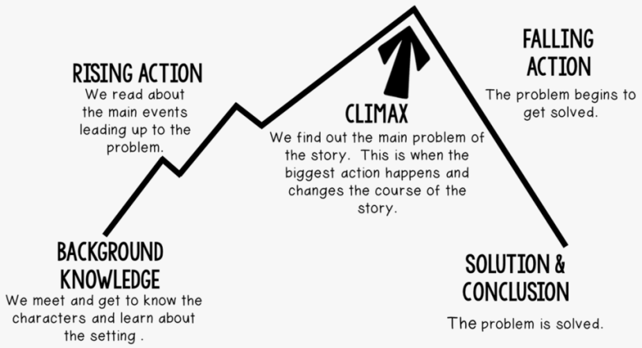
startled/shocked
nervous
be at a loss
Read for emotions
？
expectant
excited
？
surprised, relief
give me strength
fully engaged/be
devoted to practicing
Emotions

Slide 8
How to design logical plots?
注意：特别关注“三衔接”
Para.1 Denny held my hand, but then my turn came.
Para. 2 A small body climbed onto the piano bench next to me.
衔接1
What did I do and what did I say to Denny?
What’s Denny’s reaction?
How did I perform and what’s my feeling?
(What’s the reaction of audience?)
How to link para1 and 2?
vs Denyy climbed onto the piano bench next to me.
衔接2
衔接3
揭示smally body是谁
What’s my reaction and feeling at that moment?
What did Denny do?
What’s the result of this unexpected event？
What’s the theme?

Slide 9
para1最后一句---Which one is appropriate? (素材来自考场作文)
I heard some audience were whispering.
I noticed someone left the front row.
I had a glimpse of the front row but to find that Denny was not there. Where was he?
Throwing a sideways glance in the direction of my adorable Denny, I suddenly tunned. There was absolutely no sign of him!
All of a sudden, I heard some high notes beside me.
I sat down, immersing myself in playing, elegant notes pouring down, like a rushing mountain stream.
Suddenly, I felt there was something strange.
para1结尾
已经听到高音音符；
停在沉浸于音乐中
都是无法顺利衔接的

Slide 10
How to write?
Improper plots:
Para1.
一直尝试让Denny安静（用各种方法，反反复复，大段笔墨）
第一次演奏失败，没有任何解决办法，只能让Denny上台和“我”一起演奏
Para2.
“我”发现Denny在钢琴演奏上是个天才
Denny询问我是否可以加入“我”，“我”开心地同意了
“我”在舞台上教Denny如何弹奏
“我”赶紧完成演奏然后拉着Denny谢幕，ending: What a unique and unforgettable performance!

Slide 11

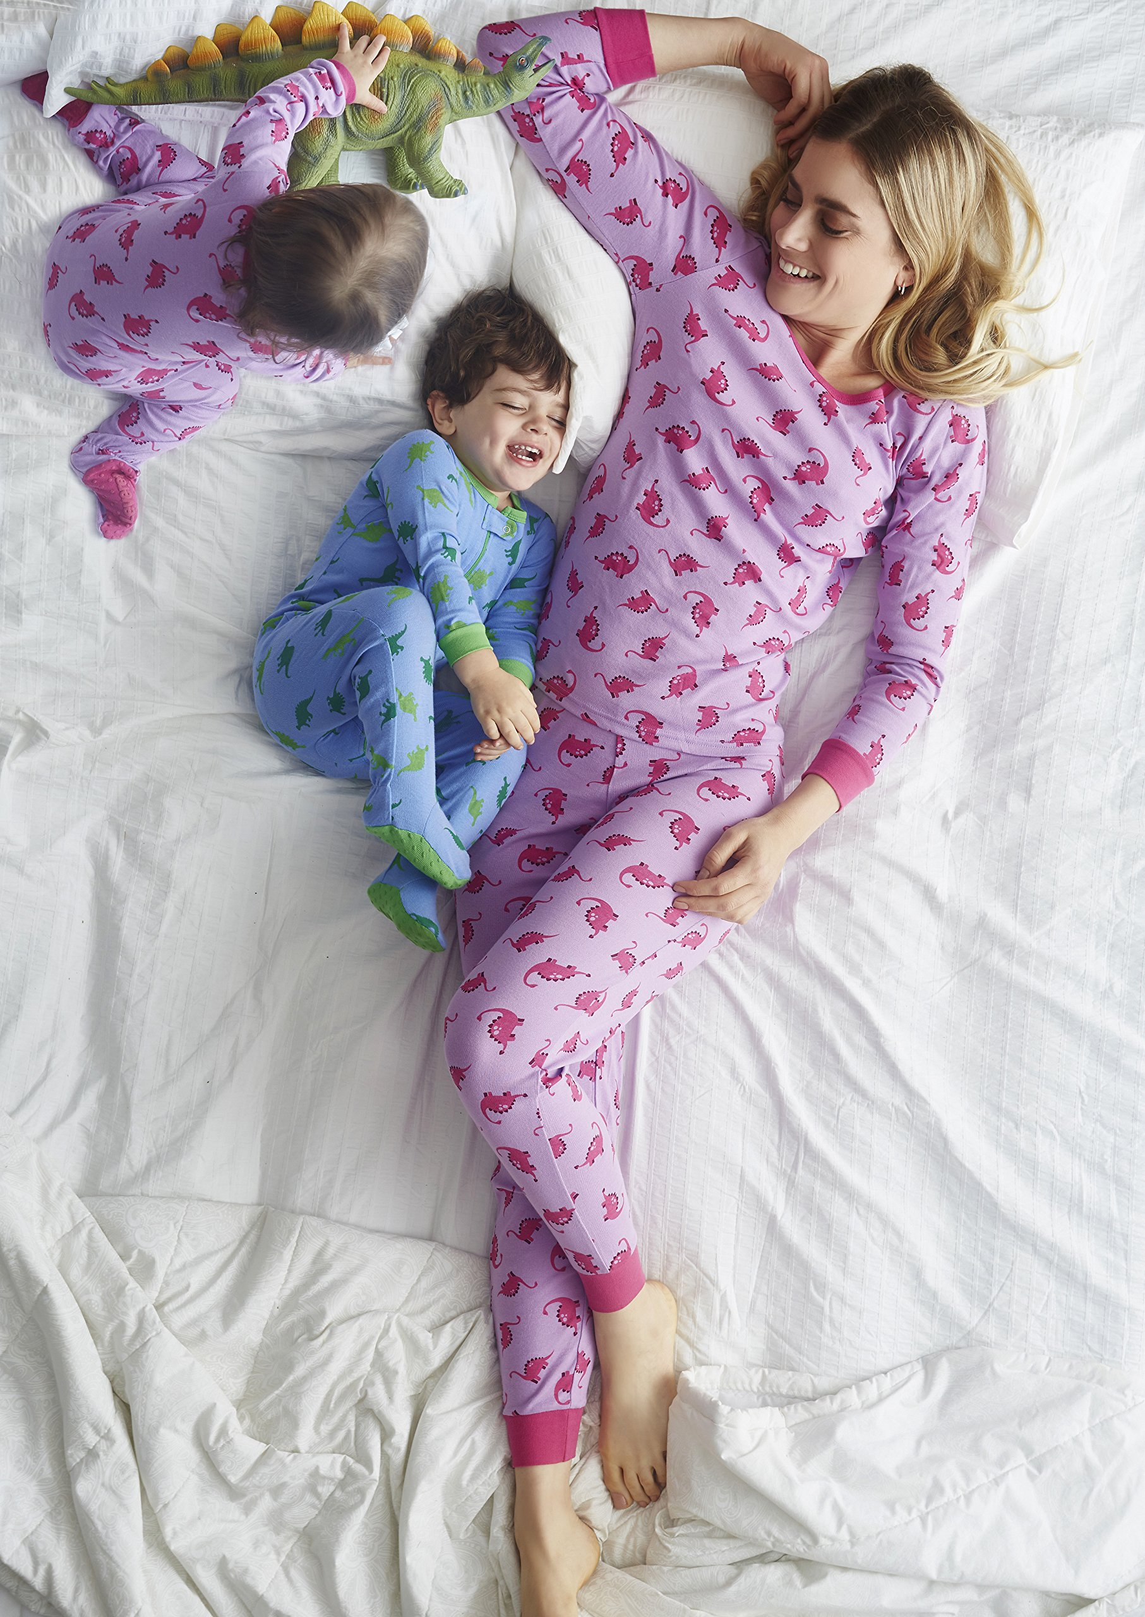
Accumulate the language
[ I + adv/prep ]
to walk without making a noise 无声地行走
She pads around the house in bare feet. 她光着脚在屋子里无声地踱步。
pad
bundle
sleeper
recital
[ I or T, + adv/prep ]
to push or put sb. or sth. somewhere quickly and roughly 推搡；匆匆送走；乱塞
She was bundled into the back of the car. 她被匆匆推进了车后座上。
a piece of clothing for a baby that covers the whole body, worn especially at night 婴儿全身睡衣
a performance of music or poetry, usually given by one person or a small group of people（通常指单人或一小群人表演的）独奏会，朗诵会

Slide 12

How to write?
叮嘱Denny保持安静
1. 松开手
2. 蹲在他面前
3. 轻声说
4. 示意他安静
let go his hand
squatted (down)
whispered (in his ears)/said sb softly/sb breathed/murmured under one’s breath
signed him to keep quiet
母子之间的互动
rested his cheek on her shoulder
held/took one’s hand; walked hand in hand
He reached for her hand and held it tightly.
put his arm around my shoulder
nestle themselves against each other/cuddle up against each other
1. 把脸靠在她的肩上
2. 牵手/手牵手走
3. 他伸手抓住她的手并紧紧握住。
4. 搂着我的肩膀
5. 依偎在一起

Slide 13
How to write?
在台上表演时
1. 颤抖地站起来
2. 意识到所有观众的目光都聚集在我身上，我顿时涨红了脸。
3. 忐忑不安夹扎着激动
4. 尽管很紧张，我告诉自己在这样的情况下别无选择只能镇定下来。
5. 聚光灯和观众的注视加剧了我的紧张感。
6. 手指在黑白琴键上跳舞。
7. 手指向下按压琴键
8. 均匀地敲击琴键
9. 欢快的旋律飘荡在演奏厅中，所有人都沉浸在美妙的音乐中。
got shakily to my feet
Color rushed/flooded/rose to my cheeks when I realized all the eyes were focused on me.
restlessness mingled with excitement
Quivering as I was, I told myself I had no other alternative but to collect myself under such circumstances.
My fingers danced upon the black and white piano keys.
The bright spot lights and sea of faces staring back at me intensified my nerves.
push finger down straight
strike the keys with even strength
Cheerful melody floating in the hall, everyone was absorbed in the beauty of the music.

Slide 14
How to write?
音乐相关词汇All about music
measure（美）/ bar （英）
rhythm
metre / time
pitch
note
melody
scale
8. 音程
9. 音高
10. 音色
11. 和弦
12. 和声
13. 交响曲
14. 速度
1. 小节
2. 节奏
3. 节拍
4. 音高
5. 音符
6. 旋律
7. 音阶
interval
pitch
color
chords
harmony
symphony
tempo

Slide 15
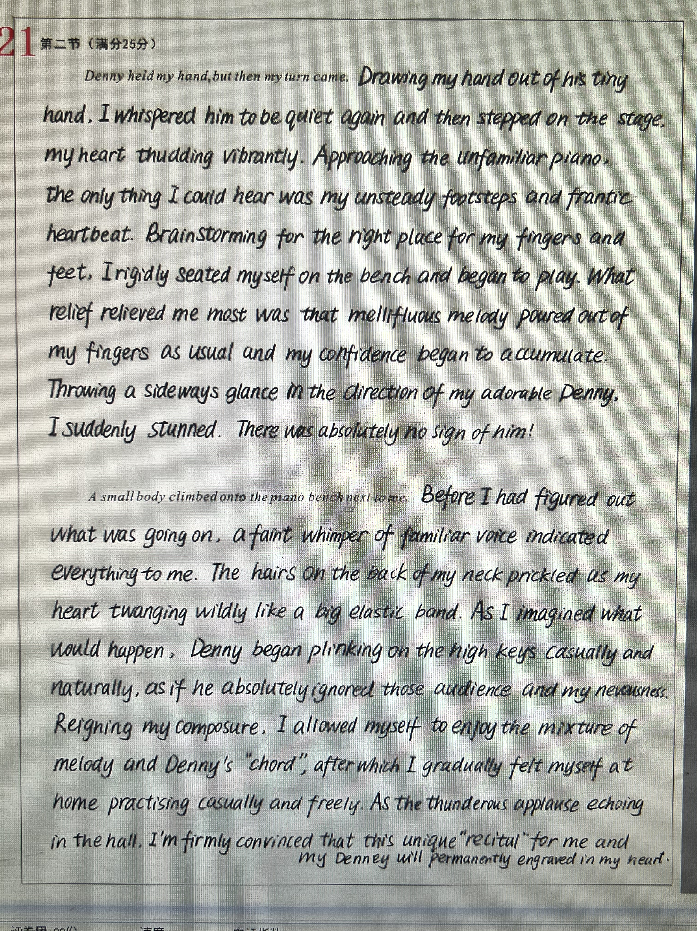

Peer revision
评析：
看得出本篇作文是一篇真实的考场作文，是在时间较紧张的情况下完成的写作，有一些不影响理解的小错误；
情节设计较合理，语言自然流畅，能够生动地描绘场景，如：What relieved me most was that mellifuous melody poured out of my fingers as usual.
存在的小问题：演奏和瞥见一眼Denny之间缺少了一点衔接。

Slide 16
Peer revision
评析：
升华部分有些没升上去，如：“I gradually felt myself at home practising”；
结尾稍微仓促了一点，“My Denny will engraved in my heart”不合理

Slide 17
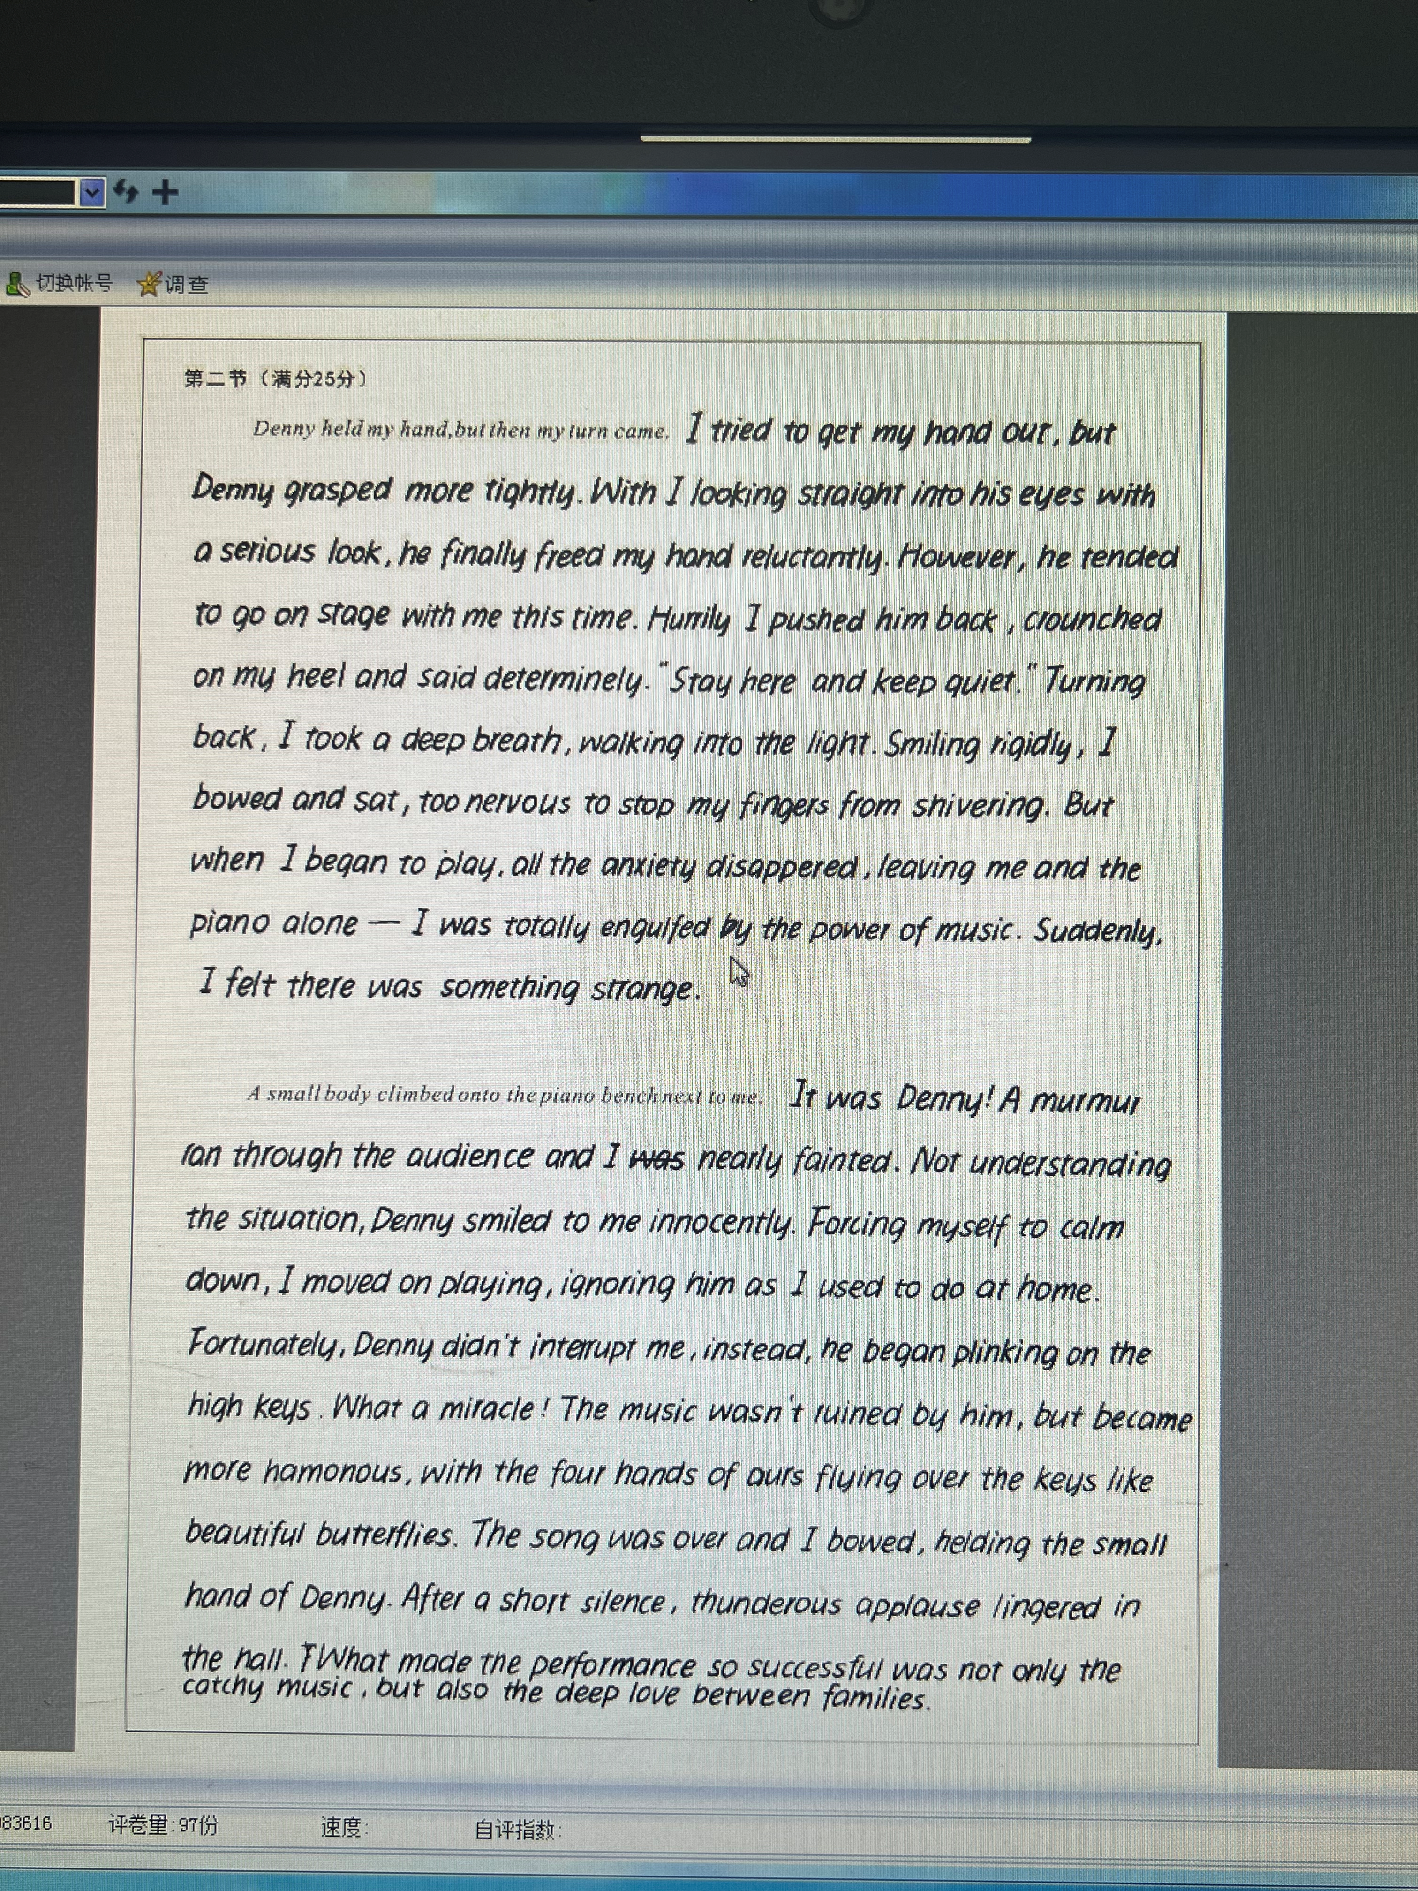
Peer revision（考场作文）

Slide 18
Peer revision
评析：
第一段情节分配不合理，花了过多的笔墨在叮嘱Denny保持安静上，可修改；
第二段情节能够自圆其说，语言自然；
使用了现在分词作状语、状语从句、被动语态等多种语法结构，长短句结合，表达自然且多样化，有较强的语言驾驭能力。

Slide 19
Possible vesion
Paragraph 1:
Denny held my hand, but then my turn came. Turning to Denny and letting go of his hand, I put my finger to my lips and stood up, leaving him sitting there in the front row. I stepped up on to the small stage and the bench loomed before me. Slowly, I sat down. “My childhood dream will come true.” I murmured to myself and started to play. All the practice and effort I put in for six months paid off. My fingers danced over black and white keys as if they had a mind of their own. Suddenly, I heard quiet snickering from the audience.
Paragraph 2:
A small body climbed onto the piano bench next to me. It’s Denny! My body almost froze but I kept right on playing. I heard tinkling on the high keys. Almost over, I thought: last phrase, last measure, and last note. Whew! I glanced over at Denny plinking. “OK, we’re done,” I told him. Taking my hand, he slid off the bench. We stood at the front of the platform, and I leaned down. “Bow with me,” I whispered. We bowed, and the class applauded. Someone in the back stood up. Before long, others joined her. Together with my little boy, I finished the recital by receiving a standing ovation.

Slide 20
THANK YOU

