Slide 1

感恩遇见，相互成就，本课件资料仅供您个人参考、教学使用，严禁自行在网络传播，违者依知识产权法追究法律责任。
更多教学资源请关注
公众号：溯恩高中英语
知识产权声明

Slide 2

The World
April 1st-15th, 2023

Slide 3
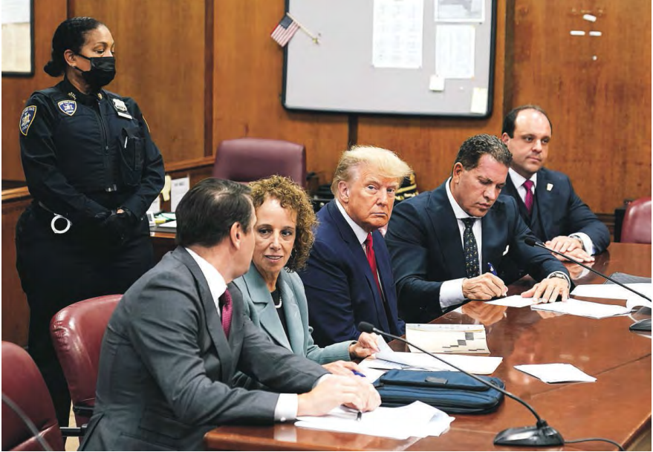
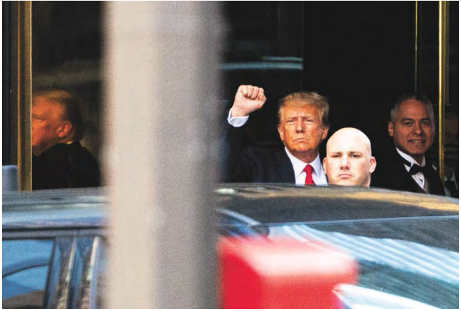
1. Trump Pleads Not Guilty to 34 Counts
特朗普纽约出庭应诉，否认34项重罪指控

Slide 4
语篇填空
（《华盛顿邮报》2023年4月5日 A1版面）
Donald Trump appeared in a Manhattan courtroom Tuesday for a moment unprecedented in American history, pleading not guilty to 34 felony counts related to payments ________ (intend) to silence an adult-film actress during his 2016 presidential campaign — a scheme that prosecutors said amounted to an ______ (legal) conspiracy to win the White House. He is the first former or sitting U.S. president to be criminally charged.
Dressed in his trademark blue suit and red tie, Trump _____ (wear) a subdued expression as he sat at the defense table in the courtroom of New York Supreme Court Justice Juan Merchan, flanked by four lawyers. He did not speak to _______ (wait) cameras or members of the public as he entered or exited the Manhattan criminal court building, _______ he raised a clenched fist as he left Trump Tower on the way to the courthouse. Trump left New York immediately after the arraignment (提审) and flew to Mar-a-Lago, his Florida home and private club, ______ he spoke Tuesday night.
In ___ meandering speech, Trump ticked through a litany of grievances and exaggerated or false ______ (claim), as he sought to discredit the case _______ him and declared it “an insult to our country.” “I never thought anything like this could happen in America. Never thought it could happen,” he said. “The only crime that I have committed is to _________ (fear) defend our nation from those who seek to destroy it.”
intended
illegal
wore
waiting
though
where
a
claims
against
fearlessly

Slide 5
词汇讲解
1. subdued: (of a person) unusually quiet, and possibly unhappy
闷闷不乐的；抑郁的；默不作声的
He faced the press, initially, in a somewhat subdued mood.
他最初面对媒体时情绪有点忧郁。
2. flank: (be flanked by sb/sth) to have sb/sth on one or both sides
侧面（或两侧）有
Bookcases flank the bed. 床的两侧有书柜。
翻译句子
我觉得他当时有点闷闷不乐。
He seemed a bit subdued to me.
翻译句子
她在武装警卫的护送下离开法庭。
She left the courtroom flanked by armed guards.

Slide 6
句子翻译
He did not speak to waiting cameras or members of the public as he entered or exited the Manhattan criminal court building, though he raised a clenched fist as he left Trump Tower on the way to the courthouse.
翻译
在进出曼哈顿刑事法院大楼时，他没有对等待的摄像机或公众讲话，但在离开特朗普大厦前往法院时，他举起了紧握的拳头。
In a meandering speech, Trump ticked through a litany (枯燥冗长的陈述) of grievances and exaggerated or false claims, as he sought to discredit the case against him and declared it “an insult to our country.”
翻译
在一段枯燥冗长的演讲中，特朗普列举了一连串的不满和夸大或虚假的说法，试图抹掉针对他的案件，并宣称这是“对我们国家的侮辱”。

Slide 7
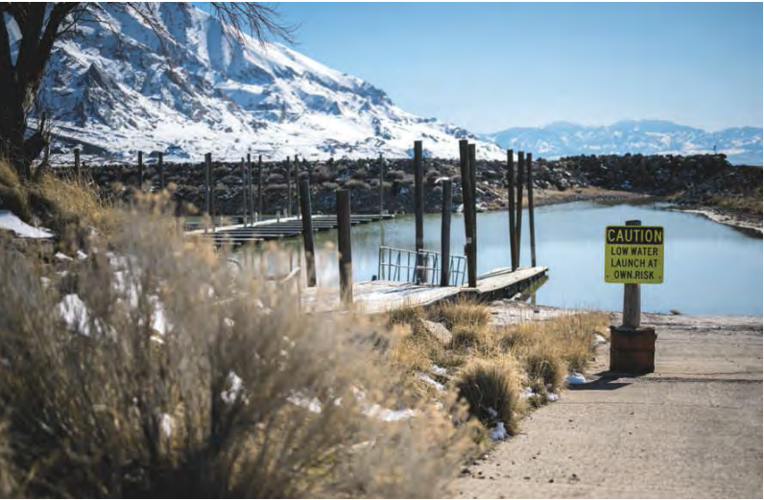
2. “Miraculous” snowfall delivers a glimmer of hope for the Great Salt Lake
“奇迹般”的降雪给大盐湖带来了一线希望

Slide 8
语篇填空
（《华盛顿邮报》2023年4月10日 A6版面）
Just three months ago, scientists _______ (issue) a report with a dire warning: Utah’s Great Salt Lake, after decades of drying that had only accelerated in recent years, was on track to disappear in five years. Now a record snowpack, ______(fuel) by more than 800 inches of snow during the season in some locations, offers a glimmer of hope for the Wester Hemis-phere’s largest saltwater lake and an important economic driver for the state.
The Great Salt Lake reached its record low in November when it dipped to 4,188.6 feet above sea level, ___________ (lose) more than 70 percent of its water since 1850, according to the report published in January by researchers at Brigham Young University. As of Wednesday, ________ , the lake had risen three feet in a little more than five months, primarily because of snow and rain dumped ________ (direct) into the lake by a season-long series of waterloaded _______ (storm). Salt Lake City has seen its seventh-snowiest season on record and among the most snow of any major U.S. city, _____ 87.3 inches.
The rising lake level is cause for both celebration and caution. “ ___________we celebrate our progress, we must continue to prioritize water conservation efforts and make __________ (sustain) water management decisions for the future of this vital ecosystem and for water users throughout the basin,” Candice Hasenyager, director of the Utah Division of Water resources, said in ____ email.
issued
fueled
having lost
however
directly
storms
with
While/When
sustainable
an

Slide 9
词汇讲解
1. dip: to go downwards or to a lower level; to make sth do this（使）下降，下沉
Sales for this quarter have dipped from 38.7 million to 33 million.
本季度销售额从3 870万下降到3 300万。
2. prioritize: to treat sth as being more important than other things 优先处理
The organization was formed to prioritize the needs of older people. 这个机构是为优先满足老年人的需要而成立的。
翻译句子
太阳落到地平线下了。
The sun dipped below the horizon.
翻译句子
比起数学和科学，他们更重视文科。
They prioritize arts subjects over maths and sciences.

Slide 10
句子翻译
The Great Salt Lake reached its record low in November when it dipped to 4,188.6 feet above sea level, having lost more than 70 percent of its water since 1850, accord-ing to the report published in January by researchers at Brigham Young University.
翻译
杨百翰大学研究人员今年1月发表的报告显示，去年11月，大盐湖的水位降至海拔4188.6英尺，创下历史新低。自1850年以来，大盐湖的水量已经流失了70%以上。
“While we celebrate our progress, we must continue to prioritize water conservation efforts and make sustainable water management decisions for the future of this vital ecosystem and for water users throughout the basin,” Candice Hasenyager, director of the Utah Division of Water resources, said in an email.
翻译
犹他州水资源部主任坎迪斯·哈森耶格(Candice Hasenyager)在一封电子邮件中说:“在庆祝我们取得进展的同时，我们必须继续优先考虑水资源保护工作，并为这个重要生态系统的未来和整个盆地的用水用户做出可持续的水资源管理决策。”

Slide 11
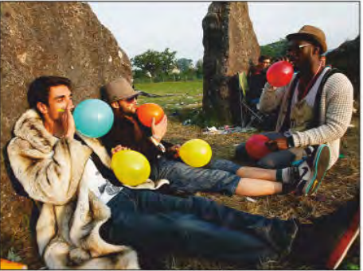
3. United Kingdom: An unfunny laughing-gas problem
笑气不好笑

Slide 12
语篇填空
（《周刊报道》2023年4月14日 14页）
Britain is hooked on laughing gas, said Jennifer Savin in Cosmopolitan UK. Nitrous oxide—or, if you prefer, “hippy crack”—has become the party drug of choice for 16- to 24-year-olds, _____ get a cheap though fleeting high by “huffing” it. Parks and streets are littered with the discarded silver canisters that nitrous oxide comes in and the _________ (balloon) people fill to inhale it.
Laughing gas has legitimate uses ____ an anesthetic for dental work and labor pains, and the U.K. Prime Minister Rishi Sunak decided _______ (take) action, and his government just made possession a crime.
You don’t need “a time machine” to see _______ where this will lead, said Owen Jones in The Guardian. Prohibition never ______ (work). Outlawing nitrous oxide will ______ (simple) hand the lucrative job of “meeting the demand” to criminal gangs.
Nitrous oxide isn’t benign, said Lucy Dunn in The Spectator. The gas blocks how nerve signals are sent, and frequent ____________ (consume) “can have devastating consequences,” _________ (include) neurological and brain damage. The damage starts with “tingling and numbness” in the feet and hands, and can progress to “paralysis, and, in extreme (and rare) cases, death.” Last year in London alone, more than 200 overdoses ___________ (rush) to the hospital by ambulance.
who
balloons
as
to take
where
works
simply
consumption
including
were rushed

Slide 13
词汇讲解
1. lucrative: producing a large amount of money; making a large profit 赚大钱的；获利多的
Thousands of ex-army officers have found lucrative jobs in private security firms.
成千上万的退役军官在私人保安公司找到了薪水丰厚的工作。
2. devastating: causing a lot of damage and destruction 破坏性极大的；毁灭性的
Oil spills are having a devastating effect on coral reefs in the ocean. 海上溢油对海洋里的珊瑚礁有着毁灭性影响。
翻译句子
他们在利润丰厚的海外市场上生意很多。
They do a lot of business in lucrative overseas markets.
翻译句子
他在这次事故中受到致命伤害。
He received devastating injuries in the accident.

Slide 14
句子翻译
Laughing gas has legitimate uses as an anesthetic for dental work and labor pains, and the U.K. Prime Minister Rishi Sunak decided to take action, and his government just made possession a crime.
翻译
笑气作为牙科手术和分娩疼痛的麻醉剂是合法的，英国首相里什·苏纳克决定采取行动，他的政府刚刚将持有笑气定为犯罪。
The damage starts with “tingling and numbness” in the feet and hands, and can progress to “paralysis, and, in extreme (and rare) cases, death.”
翻译
这种损害开始于手脚的“刺痛和麻木”，并可能发展为“瘫痪，在极端(和罕见)情况下，甚至死亡。”

Slide 15
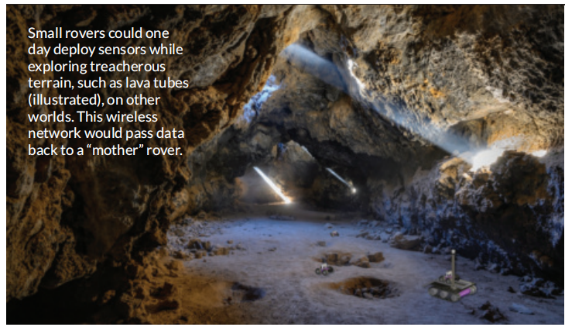
4. How Hansel and Gretel could help space rovers
童话人物赋予太空探测车灵感

Slide 16

语篇填空
（《科学新闻》2023年4月8日刊 5页）
walking
In the classic fairy tale, Hansel and Gretel dropped bread crumbs while _______ (walk) through a treacherous forest so they wouldn’t lose their way. Rovers may one day use a similar trick to traverse other planets _______ losing their data.
________ (typical), if a rover permanently loses ______________ (communicate) during a mission, any information that it has not yet transmitted is lost. ________ (avoid) this, theoretical physicist Wolfgang Fink of the University of Arizona in Tucson and __________ (colleague) suggest using a multirover system in ______ a smaller rover piggybacks on a larger “mother rover.” The smaller rover would venture into uncertain territory, such as a cave or lava tubes, deploying sensors the size of an AirPods case like bread crumbs as it _____ (go). Sensors would then communicate with each other via ___ wireless network and funnel collected data back to the mother rover without the smaller rover having to backtrack, the scientists propose February 11 in Advances in Space Research. The technology could also be useful on Earth, Fink says, especially during search-and-rescue missions _____ an earthquake or other _______ (nature) disaster.
without
Typically
communication
To avoid
colleagues
which
goes
a
after
natural

Slide 17
词汇讲解
1. treacherous: dangerous, especially when seeming safe 有潜在危险的
The current of the river is fast flowing and treacherous. 河水的水流湍急而且变化莫测。
2. deploy: to use sth effectively 有效地利用；调动
The company is reconsidering the way in which it deploys its resources. 该公司在重新考虑其资源的使用之道。
翻译句子
路上的冰对驾车构成了隐患。
The ice on the roads made driving conditions treacherous.
翻译句子
这项工作将运用到各种专业技能。
A variety of professional skills will be deployed in this job.

Slide 18
句子翻译
In the classic fairy tale, Hansel and Gretel dropped bread crumbs while walking through a treacherous forest so they wouldn’t lose their way. Rovers may one day use a similar trick to traverse other planets without losing their data.
在经典的童话故事中，为了不迷路，汉赛尔和格莱特在穿越危险的森林时掉下了面包屑。有一天，外空探测器可能会使用类似的技巧在不丢失数据的情况下穿越其他行星。
翻译
Sensors would then communicate with each other via a wireless network and funnel collected data back to the mother rover without the smaller rover having to backtrack, the scientists propose February 11 in Advances in Space Research.
科学家们在2月11日的《空间研究进展》中提出，传感器将通过无线网络相互通信，并将收集到的数据漏斗传回母探测器，而不需要较小的探测器返回。
翻译

Slide 19
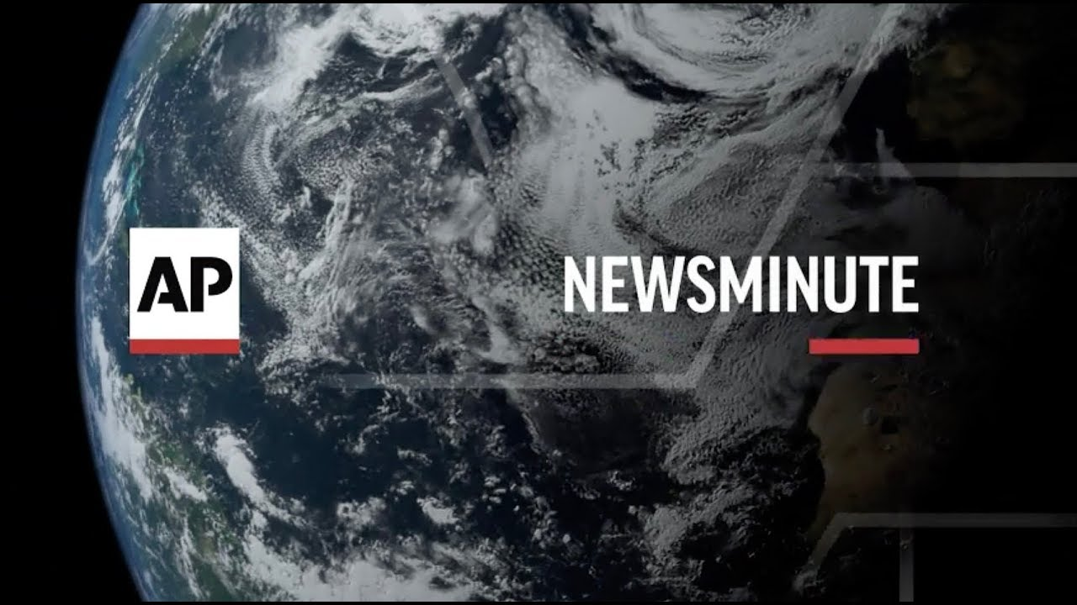
5. AP News Minute 04/11/2023

Slide 20

听力填空
This is AP News Minute.
Police say a gunman killed four people and ________ nine others in a shooting at a bank building in downtown Louisville. Police say the _______ was a bank employee who died after exchanging fire with officers who arrived ___________.
The Justice Department is appealing a Texas court ruling that would halt approval of the most _________ used method of abortion in the U.S. The request was filed just days after conflicting court rulings put in doubt ______ to a drug that has been widely ________ for more than 20 years.
Thousands of professors, part-time lecturers and graduate student workers have gone ________ at New Jersey’s flagship university. Classes were still being held Monday at Rutgers as picket lines were ______ at the school’s campuses across the state.
Thousands of children gathered on the White House lawn Monday for the annual Easter Egg Roll. President Joe Biden hinted at an ________ reelection bid, saying he plans to ___________ up to five more White House egg rolls.
wounded
suspect
on the scene
commonly
access
available
on strike
set up
expected
participate in

Slide 21
词汇讲解
1. file: ~ (for sth) to present sth so that it can be officially recorded and dealt with
提起（诉讼）；提出（申请）；送交（备案）
A number of them have filed formal complaints against the police.
他们中的许多人都对警方提出了正式控告。
2. hint at: to suggest sth in an indirect way 暗示；透露；示意
She suggested a trip to the shops and hinted at the possibility of a treat of some sort. 她建议去逛逛商店，并暗示可能要请客。
翻译句子
几个月后他提交了离婚申请书。
He filed for divorce a few months later.
翻译句子
你在暗示什么？
What are you hinting at?

Slide 22
句子翻译
Police say a gunman killed four people and wounded nine others in a shooting at a bank building in downtown Louisville. Police say the suspect was a bank employee who died after exchanging fire with officers who arrived on the scene.
翻译
警方表示，一名枪手在路易斯维尔市中心一家银行大楼开枪打死4人，打伤9人。警方说，嫌疑人是一名银行员工，他在与抵达现场的警察交火后死亡。
Thousands of children gathered on the White House lawn Monday for the annual Easter Egg Roll. President Joe Biden hinted at an expected reelection bid, saying he plans to participate in up to five more White House egg rolls.
翻译
星期一，上千孩子聚集在白宫草坪上参加一年一度的复活节滚彩蛋活动。美国总统拜登暗示将参加连任竞选，他说，他计划再参加五次白宫滚彩蛋活动。

