Slide 1


感恩遇见，相互成就，本课件资料仅供您个人参考、教学使用，严禁自行在网络传播，违者依知识产权法追究法律责任。
更多教学资源请关注
公众号：溯恩高中英语
知识产权声明

Slide 2








202304杭州二模应用文讲评
让文物活起来
Bring Cultural Relics to Life

Slide 3
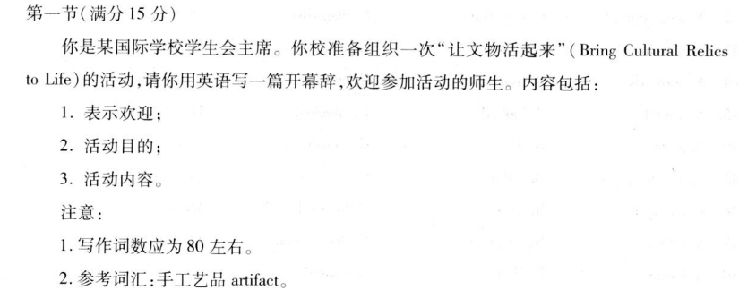


真题再现
行业PPT模板http://www.1ppt.com/hangye/
【2023年4月杭州二模】你是某国际学校学生会主席。你校准备组织一次“让文物活起来”（Bring Cultural Relics to Life）的活动，请你用英语写一篇开幕辞，欢迎参加活动的师生。内容包括：
1．表示欢迎；2．活动目的；3．活动内容。
注意：
1．写作词数应为80左右。2．参考词汇：手工艺品artifact。

Slide 4



Step 1:审题立意
体裁：
开幕词（演讲稿）
Bring Cultural Relics to Life
写作情境：
时态：
一般现在时&一般将来时
“我”作为学生会主席将在学校举行“让文物活起来”活动中致开幕词，表示欢迎并介绍活动
人称：
写作对象：
第一人称&第三人称
全校师生

Slide 5
Step 2:难点剖析
What’s the format of an opening speech？
Bring cultural relics to life
What are cultural relices？
How to make cultural relics alive？
Why does our school want to bring cultural relics to life?

Slide 6
What’s the format of an opening speech？
greeting, purpose and the topic of the speech
开门见山：表示欢迎
Begining
Opening Speech
活动目的&
活动主要内容
Body
contents
wishes and belessings
愿望和祝福
Ending

Slide 7


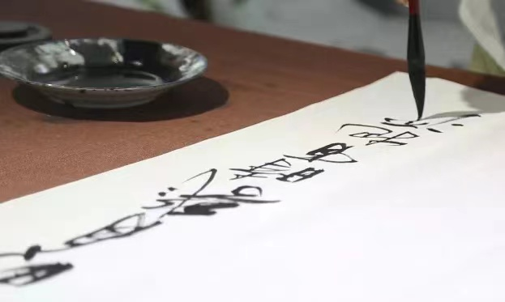
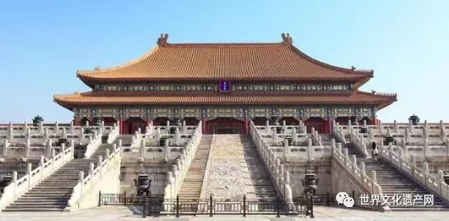

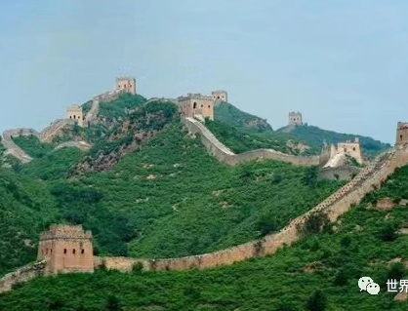
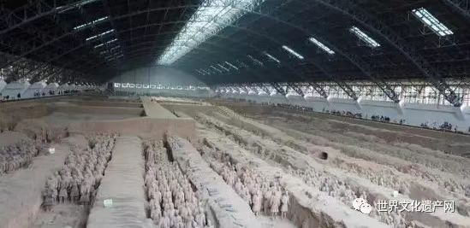
What are cultural relices？
Def： Cultural relics refer to relics left by mankind in the course of historical development, which carry historical, artistic and scientific value.
Category：Tangible Cultural Heritage(物质文化遗产)
Intangible Cultural Heritage(非物质文化遗产)
The Great Wall
The Forbidden City
Terra-Cotta Warriors
Calligraphy

Slide 8
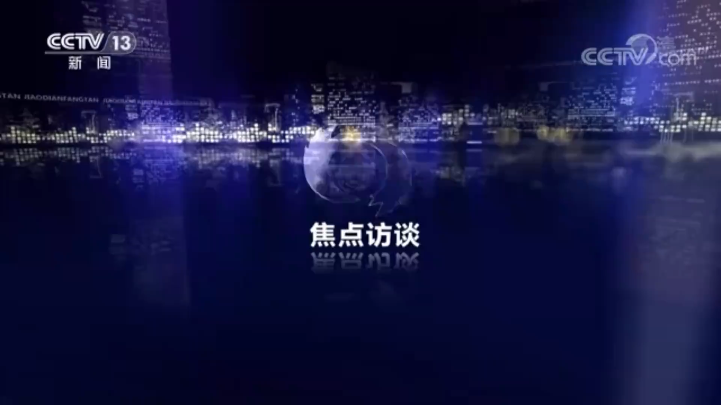

Slide 9
Why does our school want to bring cultural relics to life?
增强民族自信、文化自信
strengthen/improve/enhance national and cultural self-confidence
做文化的传承者和传播者
be the inheritor and transmitter of Chinese culture
/better carry forward Chinese culture to the whole world
4
更好的认识和了解中华文明
3
facilitate the understanding of Chinese civilization/explore the history and culture behind the artifacts and appreciate their beauty
2
Bring Cultural Relics to Life
培养/提高大家的文物保护意识
1
enhance/cultivate/foster/raise the awareness of cultural relics conservation/protection

Slide 10
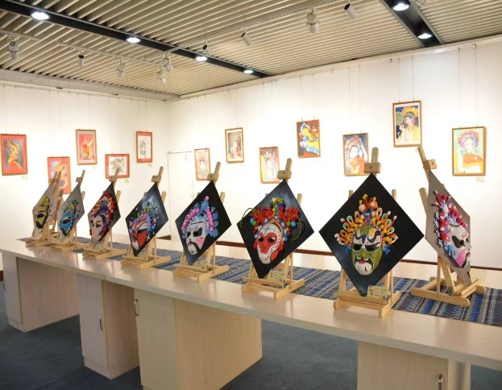
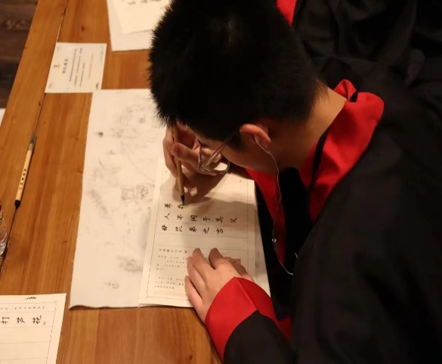
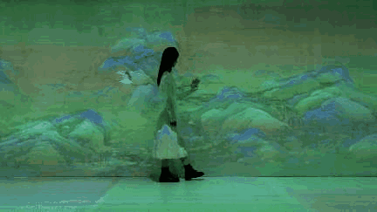
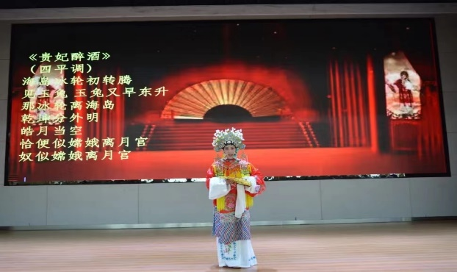
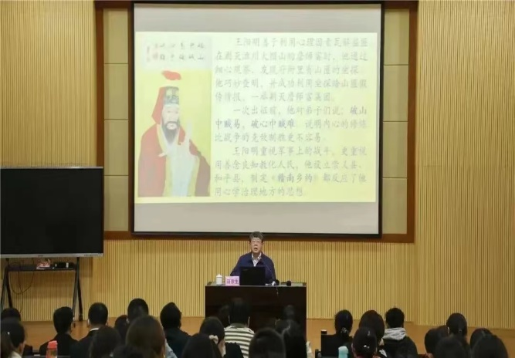
How to make cultural relics alive？
present interactive display screen which can play videos covering fun facts of artifacts if you press it
enjoy a live show
of folk dance and music performed by our talented students
invite exerts who can introduce some knowledge and detailed information about the cultural relics on display
hold an exhibition featuring various cultural relics such as calligraphy, paper-cutting, carved works, ink wash paitings and so on
set up hands-on workshop where students can create their own cultural relics

Slide 11
Step 3:谋篇布局
Para 1：开门见山：表示欢迎
As president of the Student Union, I’m honored to have the opportunity to welcome all of you to our "Bringing Cultural Relics to Life"event.
To begin with, please allow me to express my warm welcome on behalf of our school.
It's my greatest pleasure to represent our school to extend
our heartfelt welcome to you.
I am Li Hua, chairman of the Students' Union. I'm very
delighted to express my warm welcome to you
On behalf of our school, I’d like to extend our warmest welcome to you !

Slide 12
Para 2:活动目的&活动主要内容
Step 3:谋篇布局
The purpose of this event is to encourage everyone to explore the history and culture behind the artifacts and appreciate their beauty.
To enhance/cultivate/foster/raise the awareness of cultural relics conservation/protection, our school hold the "Bringing Cultural Relics to Life"event.
01
02
Aiming at facilitating students’ understanding of Chinese civilization, we invite all of you to attend the event, which can also help us better carry forward Chinese culture to the whole world
In order to strengthen
/improve/enhance national and cultural self-confidence of our students, the 3-day fair is composed of various activities related to cultural relics.
03
04

Slide 13
Step 3:谋篇布局
Para 2:活动目的&活动主要内容
2
3
1
There will be hands-on workshop where students can create their own cultural relics, through which you can have a deeper understanding of the significance of traditions.
Distinguished exerts will be invited, from whom you can learn some knowledge and detailed information about the cultural relics on display.
Thoughout the event, all of you will enjoy a live show of folk dance and music performed by our talented students
4
5
We will hold an exhibition displaying various cultural relics such as calligraphy, paper-cutting, carved works, ink wash paitings and so on.
One of the highlights of this event will be the interactive display screen which can play videos covering fun facts of artifacts whenever you press it

Slide 14
Step 3:谋篇布局
Para 3: 愿望和祝福
01
Thank you all for joining us today, and we hope you enjoy this exploration into cultural relics.
02
I hope you enjoy the event and gain a deeper understanding and appreciation of our cultural relics.
03
Wish your stay in this event memorable and rewarding! Thank you!
Sincerely hope that your stay here will be enjoyable and worthwhile!
04
In the end, I would like to extend my utmost respect to all of you who have devoted your time and efforts to make this event possible. Let's all work together to bring cultural relics to life, preserving and passing down the cultural heritage of our world.
05

Slide 15
Step 4:参考范文
Dear teachers and fellow students,
As chairman of the Student Union（表明身份）, I’m honored to have the opportunity to welcome all of you to our "Bringing Cultural Relics to Life"event. （要点1：表示欢迎）
Aiming at facilitating（非谓语，表达目的的固定句式） students’ understanding of Chinese civilization, we invite all of you to attend the event, which can also help us better carry forward Chinese culture to the whole world（非限制性定语从句，表示活动的意义）（要点2：活动的目的）. We will hold an exhibition displaying various cultural relics such as calligraphy, paper-cutting, carved works, ink wash paitings and so on. Moreover, there will be hands-on workshop where students can create their own cultural relics（定语从句，列举活动的内容）, through which you can have a deeper understanding of the significance of traditions（非限制性定语从句，表明活动的意义）. One of the highlights of this event will be the interactive display screen which can play videos covering fun facts of artifacts whenever you press it.（定语从句，列举活动的内容）（要点3：活动的内容）
I hope you enjoy the event and gain a deeper understanding and appreciation of our cultural relics. Thank you!（愿望和祝福）

Slide 16
Step 5:巩固训练
广东省一模应用文
假定你是李华，校英语学习俱乐部负责人。你们邀请到了Smith教授在线作主题为“How to Write and Enjoy Poems”专题讲座。请你在讲座前作简要发言，内容包括:
1.表示感谢;
2.相关介绍;
3.对听众的要求。注意:
1.词数80左右;
2.请在答题卡的相应位置作答。

Slide 17
参考范文
Dear fellow students,
We feel honored, and wish to express our heartfelt appreciation to Professor Smith for his graciously agreeing to give us this online lecture on "How to Write and Enjoy Poems”. So let’s show our warm welcome!
Prof. Smith is a well-known poet, and he will illustrate the connotations of poems in structure, imagery, and rhyme by sharing his own poems. Thus, it is a great opportunity to improve our writing procedures and skills and I am sure it will be of significant benefit to us all.
I hope all in attendance will participate positively and follow his instructions as requested. You may also take notes if necessary. There will be a five-minute question-and-answer session following the lecture, which will allow you an opportunity to ask questions and actively participate in the discussion.
That’s all, thank you.（132w)

