Slide 1

感恩遇见，相互成就，本课件资料仅供您个人参考、教学使用，严禁自行在网络传播，违者依知识产权法追究法律责任。
更多教学资源请关注
公众号：溯恩高中英语
知识产权声明

Slide 2

2023.3 温州二模
倡议 “送你一朵花”

Slide 3

倡议
类型
时态
人称
语气
要点
假定你是学校官网英语版学生编辑李华，校生会将举行送你一朵花（A Flower for You）活动，请你写一则倡议，内容包括：
1. 活动目的；
2. 活动内容；
3. 呼吁参加。
注意:
1.词数80左右；
2.可适当增加细节，
以使行文连贯。
Dear fellow students,
The Student Union
一般将来时
审题
第二人称
persuasive
Para. 1 活动目的
Para. 2 活动内容
Para. 3 呼吁参加
+时间地点+发出倡议
（形式+流程）

Slide 4







on the main avenue of the campus
in front of the canteen
on the first floor of the teaching building
all faculty/ teaching staff and students
all the teachers and students
a week-long activity starting from Mar. 10th
from 8:00 to 17:00 on April 8th

Slide 5


to enrich school life
to detach ourselves from the heavy school pressure for a while
related to the theme?
literal meaning
symbolic meaning
As long-expecting/ long-anticipated/ much-awaited spring comes with flowers in full bloom, ...
to feel the breath of spring and get closer to nature
to spread love and warmth
to create a warm and harmonious atmosphere
to help strike up stronger and longlasting friendships
to connect to strangers
to widen your social circle
to show gratitude/ thanks to...

Slide 6
Think and discuss:
How is the campaign organized? (Process)
What types or forms of flowers are gifted? (Items)
To whom are those flowers given? (Receivers)
What effect can this campaign have on people? (Benefits)
include the benefits?

Slide 7
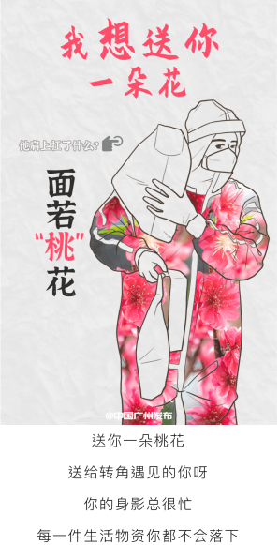

process
items
receivers
benefit
官网英语版
Our Student Union will set up stalls in front of the school canteen, where you can select/ choose one from a variety of flowers for free and then give it to whoever you think deserves it, such as friends, teachers, dustmen, or even strangers.
By the main avenue of the campus, we will hand out/ distribute fresh flowers like roses, lilies/ daisies/ sunflowers and carnations, which you can present to those you want to pay tribute to/ show appreciation to. They can be parents/ teachers who have dedicated time and energy to your growth, or people who have sacrificed themselves for human progress/ paramedic during the pandemic/ common people/ even strangers you encounter on the road.
We will decorate a flower wall where you can pick out one to....
/ You can also attach a card with your heartfelt words of gratitude or wishes on it/ make a paper flower on your own/ paint flowers to sustain their beauty.
/ Alternatively, we will provide/ roll out an online campaign/ initiative of presenting flowers.
+ All the heartwarming moments will be photographed and posted on the school website as a reminder for us to boldly voice and express love and appreciation.
It may surprise you how much merrier they might feel after receiving your present.
This seemingly small gesture will definitely brighten their days and yours as well.
Small gesture as it is, it can bring numerous delights to people who receive your gift.

Slide 8

What are you waiting for?
Come and join us!
related to the theme!
(What are you waiting for?) Come and experience the beauty of spring and the warmth gained from spreading love.
A flower for you, a warmer world we will have.
Let's chant a merry ode to spring and the people around as well.
+ Click here for more information.
/ For more detailed/ further information, click here.

Slide 9
下水作文
Dear fellow students,
As long-expecting spring comes with flowers in full bloom, our Student Union is to host a campaign of “A Flower for You” with the purpose of spreading love and warmth. (We are here to call upon/ appeal to you to participate.)
Stalls will be set up in front of the school canteen, where you can select one from a variety of flowers and then give it to whoever you want to show appreciation to, either for their dedication or contribution. Alternatively, you can attach a card with your heartfelt words of gratitude on it. This seemingly small gesture will definitely brighten their days and yours as well. To record the event, all the heartwarming moments will be photographed and posted on the school website for your further reference.
Come and let's chant a merry ode to spring and people around us. For more details, click here.
The Student Union
逻辑通顺流畅

Slide 10
参考范文
Dear fellow students,
To spread joy and kindness, we plan to launch an initiative - A Flower for You.
You can give flowers to whoever you believe deserves them - a friend, a family member, a teacher, or even a stranger. Your gesture can brighten their day and remind them that they are appreciated. You may either buy a bunch of flowers or just make artificial flowers/ preserved fresh flower (永生花) yourself. Small gesture as it is, it can make a difference to the person who receives your heartfelt gift.
Come and join us! Let's make the world a little bit brighter with flowers!
The Student Union

Slide 11
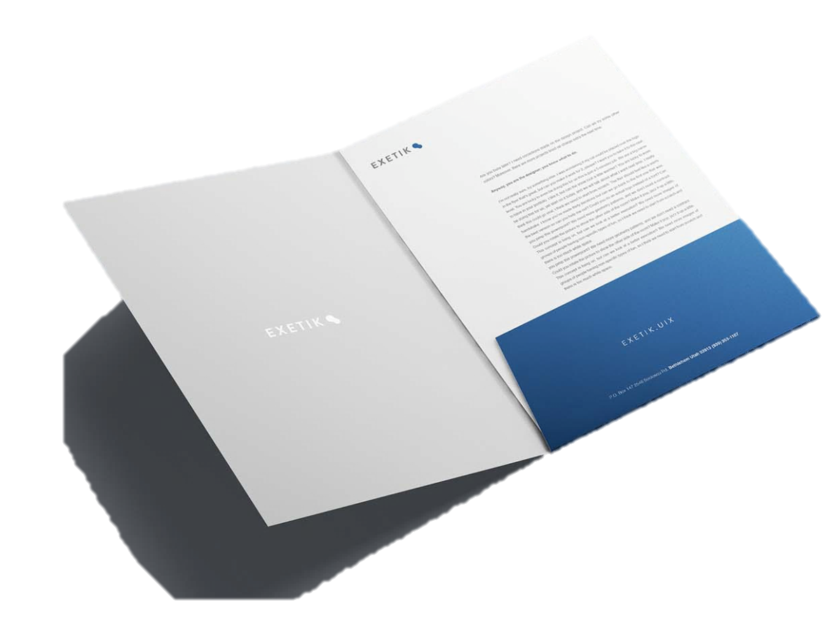
Assignment
假定你是李华，你校官网英语版计划举行送你一朵花（A Flower for You）活动，现向全校师生征集活动方案，请你给编辑写一封邮件，内容包括：
1. 介绍方案；
2. 说明理由；
3. 表达祝愿。

Slide 12

Dear editor / editor-in-chief (主编),
I'm Li Hua from Class 1. Knowing that you are taking soundings (征求意见) about the initiative of A Flower for You, I’d like to share my scheme (计划/方案). The details are as follows. [写作目的]
To begin with, I think nothing can match distributing flowers by the main avenue to all faculty and students. This way, all those receiving flowers can admire the beauty of spring flowers and gain a sense of warmth. Besides, the participants have a chance to purchase one more flower or make a paper one on their own, which can be presented to whoever they want to show love, appreciation or gratitude to. It would be better if those (衔接上述活动内容) heartwarming moments can be photographed and posted on the school website to spread the love and warmth (衔接上述活动意义). [具体活动内容+策划原因]
Hope you can take serious consideration of my plan and wish the event a complete success/ my plan would add luster to your activity. [表达祝愿]

