Slide 1

感恩遇见，相互成就，本课件资料仅供您个人参考、教学使用，严禁自行在网络传播，违者依知识产权法追究法律责任。
更多教学资源请关注
公众号：溯恩高中英语
知识产权声明

Slide 2
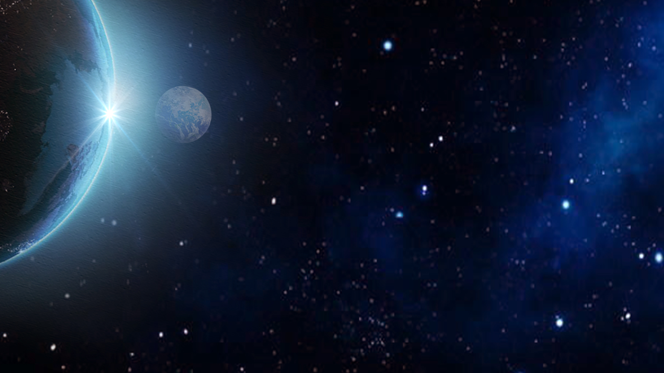
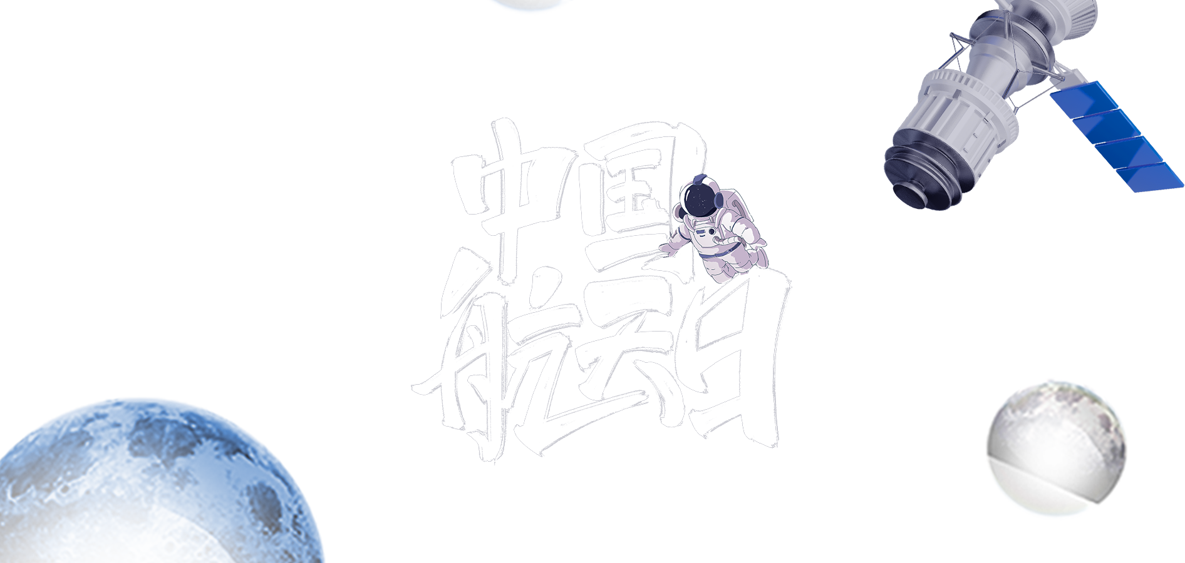

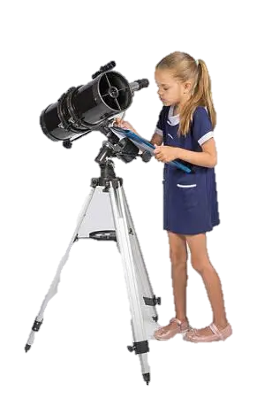
The Little Astronomer, Catalina
基于读思言教学模式下的
2023.3福州二检读后续写讲评
福州市闽侯八中 郭文昇

Slide 3
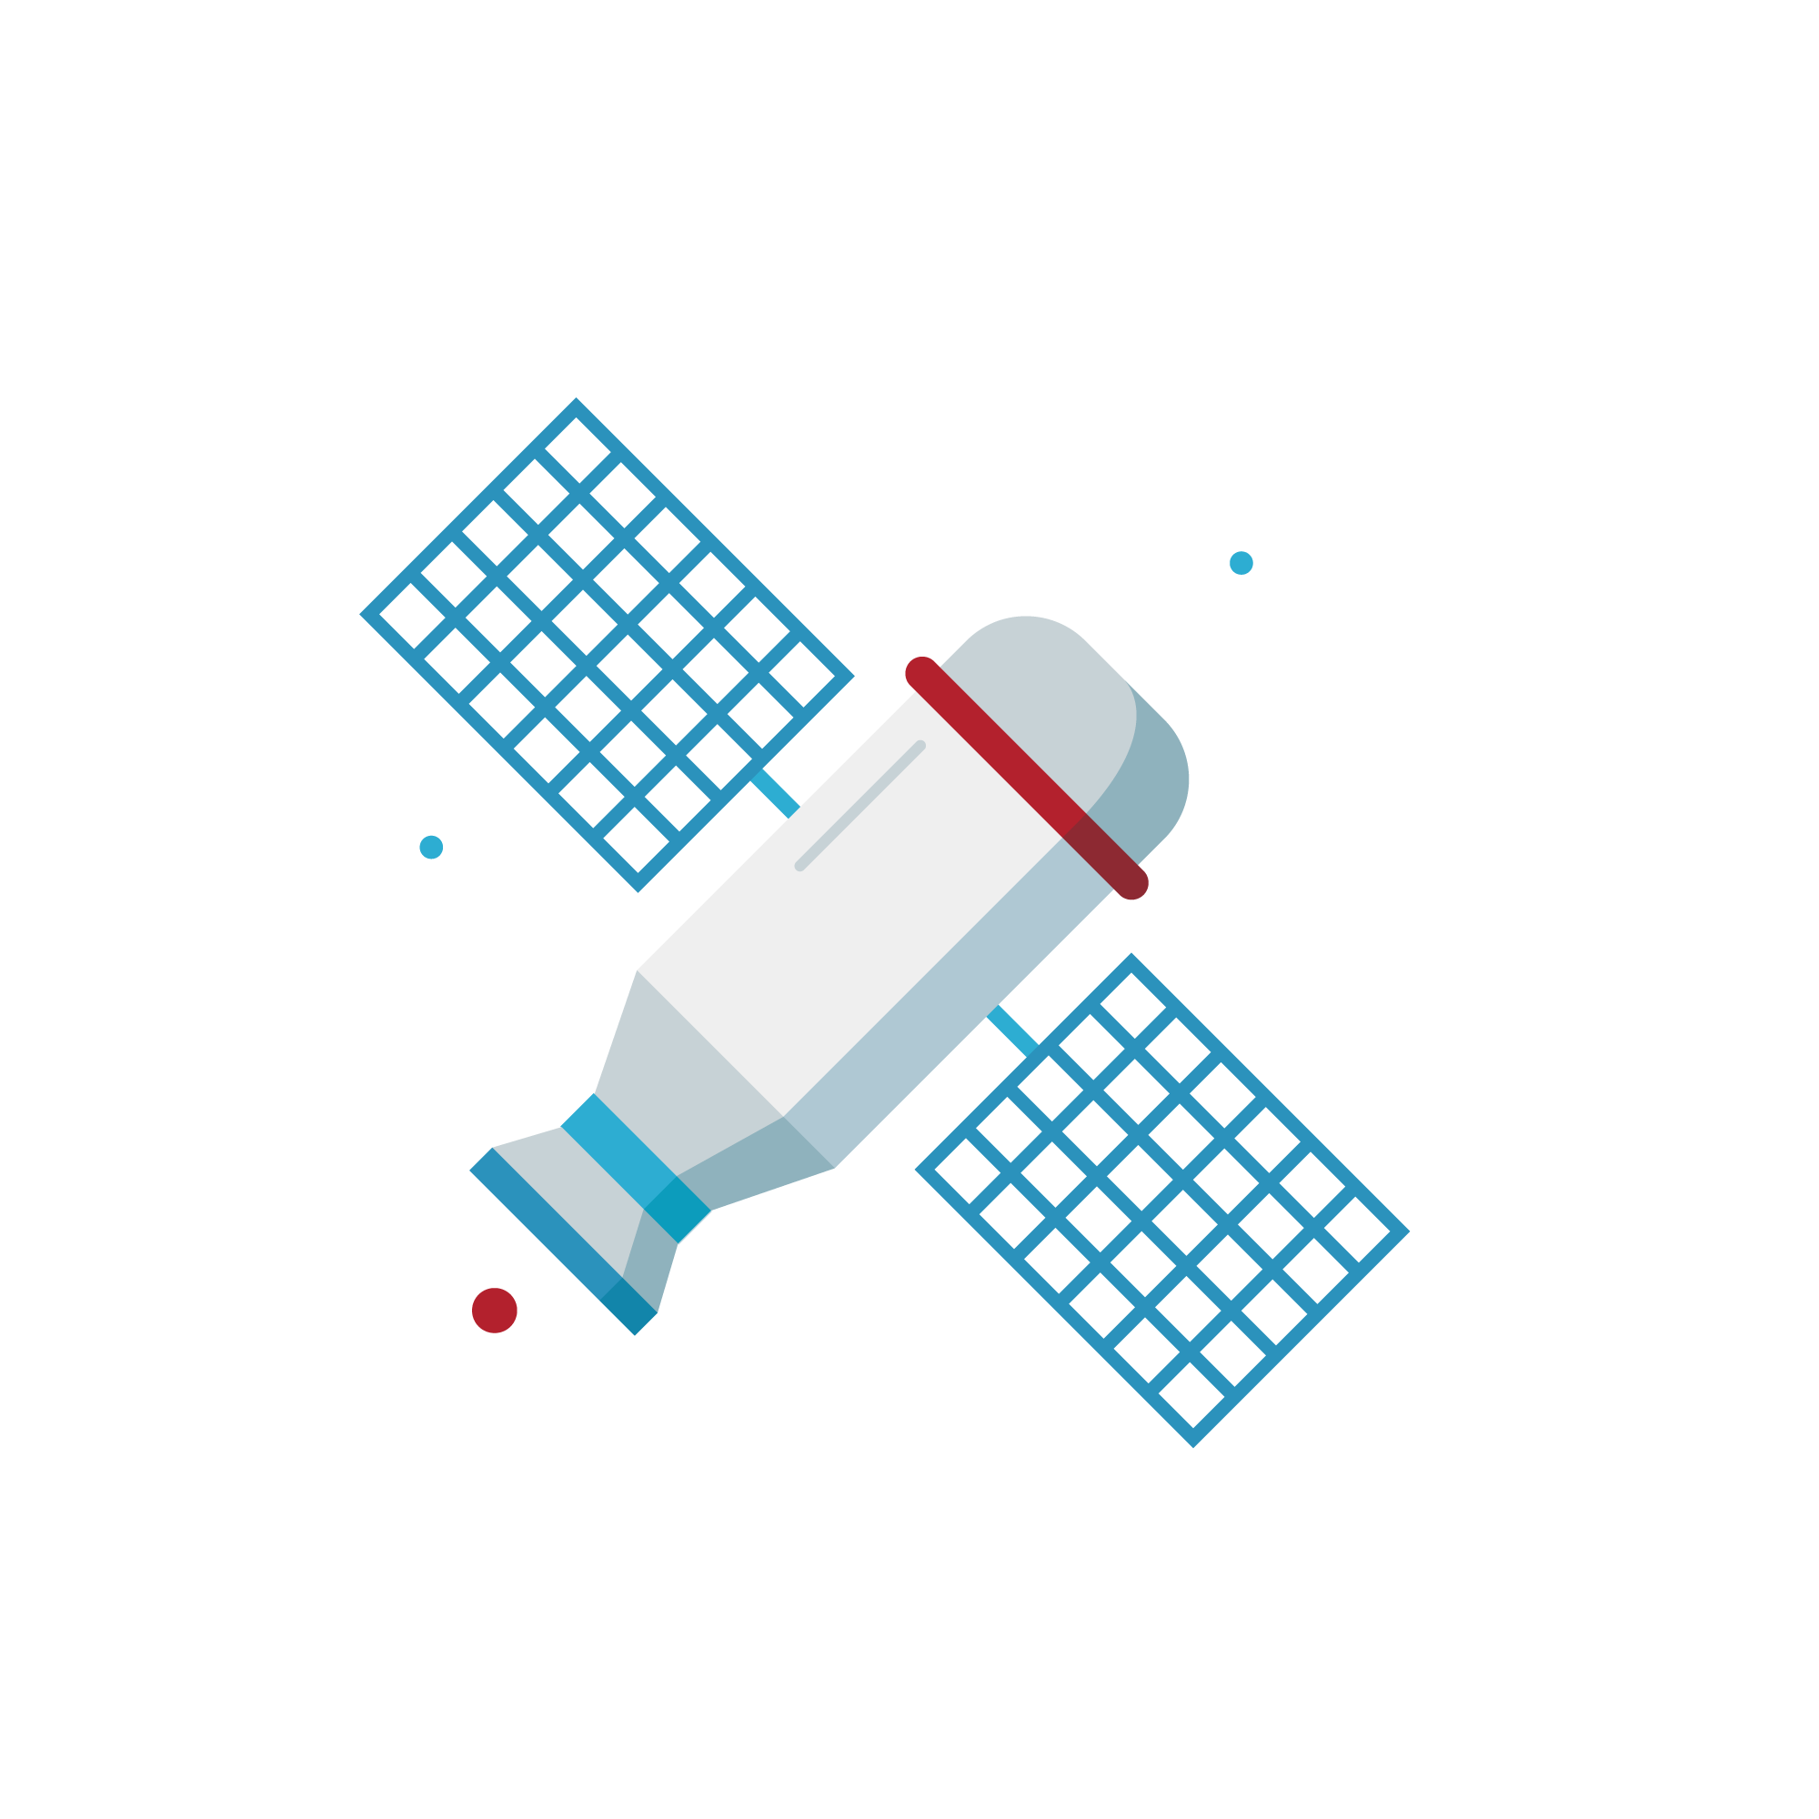
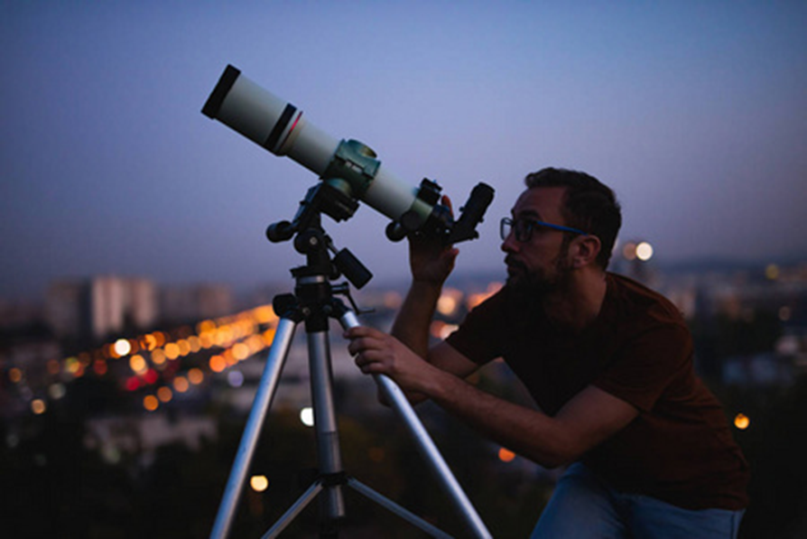
1. Lead-in
1. What is the man doing?
He is using the telescope to observe the sky.
2. What may be his job?
He may be an astronomer.
3. Did you know something about the astronomy?

Slide 4
2. Read for Background
Who are the main characters?
What happened (the conflict)?
When did the story happen?
Where did the story happen?

Slide 5
2. Read for Background
Every night as the whole family fell asleep, Catalina would slide from home to the Cerro Tololo observatory （天文台）. Papa was the mechanic （修理工）of the observatory, but during the day Papa would not allow her to get closer to the telescopes there. Only at night, Catalina was allowed in with the permission of the night staff.
Catalina loved helping to service the grand telescopes, the eyes that looked out into the universe. She wanted badly to be an astronomer someday. Adults never took her dream seriously. Even her father laughed, “Maybe you'll be hired to clean the offices. ”
One day in library, Catalina was reading a plant journal when she stopped at the picture of an unusual white flower. “It's called wild carrot. " A Spanish astronomer, who she saw several times in the observatory, stood behind her. “Pretty, isn't it? I’ve always liked that flower, because it looks like a galaxy. ”
“A spiral galaxy （漩涡星系）, ”she whispered. Blond eyebrows climbed the scientist＇s forehead. “Indeed. And what is your name, young lady?” he asked.
"I'm Catalina Solis. ”
“Eduardo Solis's daughter? The mechanic?”
Yes. ”She gave a look at him. “I want to be an astronomer when I grow up. "
Who are the main characters?
What happened?

Slide 6
2. Read for Background
He laughed kindly, no longer meeting her eyes, and patted her on the shoulder. “Yes, of course, my dear. Work hard in school, and it could happen. ”
One evening, Catalina eyescanned the top of the observatory as usual. Suddenly she noticed the angle of the one-meter telescope was unusual. The telescope was pointed down, lower than she had ever seen it. Catalina learned from Papa how dangerous it would be. If left like it was, the telescope would move past its limit and be damaged. So without hesitation she got inside the observatory.
注意：
1. 续写词数应为150左右；
2. 请按如下格式在答题卡的相应位置作答词
She saw the Spanish scientist buried in work there.
The scientist’s words meant a lot to her.
2. What happened?

Slide 7
2. Read for Background
He laughed kindly, no longer meeting her eyes, and patted her on the shoulder. “Yes, of course, my dear. Work hard in school, and it could happen. ”
One evening, Catalina eyescanned the top of the observatory as usual. Suddenly she noticed the angle of the one-meter telescope was unusual. The telescope was pointed down, lower than she had ever seen it. Catalina learned from1 Papa how dangerous it would be. If left like it was, the telescope would move past its limit and be damaged. So without hesitation she got inside the observatory.
注意：
1. 续写词数应为150左右；
2. 请按如下格式在答题卡的相应位置作答词
She saw the Spanish scientist buried in work there.
The scientist’s words meant a lot to her.
3. When did the story happen?

Slide 8
2. Read for Background
Every night as the whole family fell asleep, Catalina would slide from home to the Cerro Tololo observatory （天文台）. Papa was the mechanic （修理工）of the observatory, but during the day Papa would not allow her to get closer to the telescopes there. Only at night, Catalina was allowed in with the permission of the night staff.
Catalina loved helping to service the grand telescopes, the eyes that looked out into the universe. She wanted badly to be an astronomer someday. Adults never took her dream seriously. Even her father laughed, “Maybe you'll be hired to clean the offices. ”
One day in library, Catalina was reading a plant journal when she stopped at the picture of an unusual white flower. “It's called wild carrot. " A Spanish astronomer, who she saw several times in the observatory, stood behind her. “Pretty, isn't it? I’ve always liked that flower, because it looks like a galaxy. ”
…
One evening, Catalina eyescanned the top of the observatory as usual. Suddenly she noticed the angle of the one-meter telescope was unusual. The telescope was pointed down, lower than she had ever seen it. Catalina learned from1 Papa how dangerous it would be. If left like it was, the telescope would move past its limit and be damaged. So without hesitation she got inside the observatory.
4. Where did the story happen?

Slide 9
3. Read for Plot
Every night as the whole family fell asleep, Catalina would slide from home to the Cerro Tololo observatory （天文台）. Papa was the mechanic （修理工）of the observatory, but during the day Papa would not allow her to get closer to the telescopes there. Only at night, Catalina was allowed in with the permission of the night staff.
Catalina loved helping to service the grand telescopes, the eyes that looked out into the universe. She wanted badly to be an astronomer someday. Adults never took her dream seriously. Even her father laughed, “Maybe you'll be hired to clean the offices. ”
One day in library, Catalina was reading a plant journal when she stopped at the picture of an unusual white flower. “It's called wild carrot. " A Spanish astronomer, who she saw several times in the observatory, stood behind her. “Pretty, isn't it? I’ve always liked that flower, because it looks like a galaxy. ”
“A spiral galaxy （漩涡星系）, ”she whispered. Blond eyebrows climbed the scientist＇s forehead. “Indeed. And what is your name, young lady?” he asked.
"I'm Catalina Solis. ”
“Eduardo Solis's daughter? The mechanic?”
Yes. ”She gave a look at him. “I want to be an astronomer when I grow up. "
Nobody understood and believed her.
①
②
③ Catalina met a Spanish astronomer while reading

Slide 10
3. Read for Plot
He laughed kindly, no longer meeting her eyes, and patted her on the shoulder. “Yes, of course, my dear. Work hard in school, and it could happen. ”
One evening, Catalina eyescanned the top of the observatory as usual. Suddenly she noticed the angle of the one-meter telescope was unusual. The telescope was pointed down, lower than she had ever seen it. Catalina learned from1 Papa how dangerous it would be. If left like it was, the telescope would move past its limit and be damaged. So without hesitation she got inside the observatory.
注意：
1. 续写词数应为150左右；
2. 请按如下格式在答题卡的相应位置作答词
She saw the Spanish scientist buried in work there.
The scientist’s words meant a lot to her.
④ The Spanish astronomer encouraged her.
⑤ She found a danger in the telescope.
⑥ She asked for help.

Slide 11
4. Read for feeling
Every night as the whole family fell asleep, Catalina would slide from home to the Cerro Tololo observatory （天文台）. Papa was the mechanic （修理工）of the observatory, but during the day Papa would not allow her to get closer to the telescopes there. Only at night, Catalina was allowed in with the permission of the night staff.
Catalina loved helping to service the grand telescopes, the eyes that looked out into the universe. She wanted badly to be an astronomer someday. Adults never took her dream seriously. Even her father laughed, “Maybe you'll be hired to clean the offices. ”
One day in library, Catalina was reading a plant journal when she stopped at the picture of an unusual white flower. “It's called wild carrot. " A Spanish astronomer, who she saw several times in the observatory, stood behind her. “Pretty, isn't it? I’ve always liked that flower, because it looks like a galaxy. ”
“A spiral galaxy （漩涡星系）, ”she whispered. Blond eyebrows climbed the scientist＇s forehead. “Indeed. And what is your name, young lady?” he asked.
"I'm Catalina Solis. ”
“Eduardo Solis's daughter? The mechanic?”
Yes. ”She gave a look at him. “I want to be an astronomer when I grow up. "
Sad, sorrowful, frustrated, disappointed, upset…
①
②
Curious, enthusiastic
③

Slide 12
4. Read for feeling
He laughed kindly, no longer meeting her eyes, and patted her on the shoulder. “Yes, of course, my dear. Work hard in school, and it could happen. ”
One evening, Catalina eyescanned the top of the observatory as usual. Suddenly she noticed the angle of the one-meter telescope was unusual. The telescope was pointed down, lower than she had ever seen it. Catalina learned from1 Papa how dangerous it would be. If left like it was, the telescope would move past its limit and be damaged. So without hesitation she got inside the observatory.
注意：
1. 续写词数应为150左右；
2. 请按如下格式在答题卡的相应位置作答词
She saw the Spanish scientist buried in work there.
The scientist’s words meant a lot to her.
hopeful, delighted, confident, ambitious
④
⑤
Worried, anxious, nervous
⑥

Slide 13
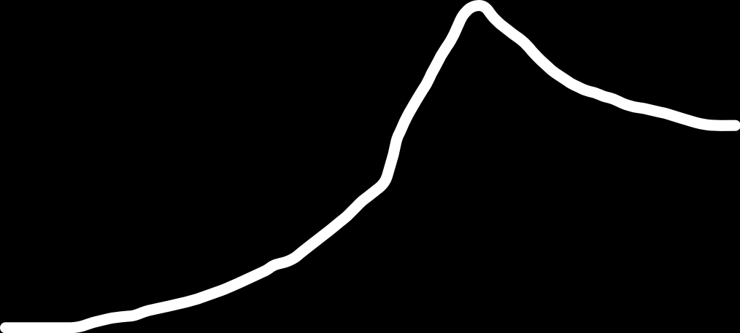
5. Draw the Structure
Plot
⑤ She asked for help.
④ She found a danger in the telescope.
hopeful, delighted, confident, ambitious
③ The Spanish astronomer encouraged her.
Worried, anxious, nervous
Curious, enthusiastic
Feelings
②Catalina met a Spanish astronomer while reading
Sad, sorrowful, frustrated, disappointed, upset…
①Nobody understood and believed her.
Time& Place
Every night & home
One day & library
One evening & observatory

Slide 14
6. Thinking
Para 1: ① What would she deal with it?
② What would the scientist do? What words did the scientist say?
③ How to connect Para 2?
⑤ She asked for help.
climax
Para 2: ① What would she think after listening to the scientist’s words?
② What would she do in the future?
③ What was the result?
④ She found a danger in the telescope.
Conflict
③ The Spanish astronomer encouraged her.
②Catalina met a Spanish astronomer while reading
Resolution
Development
①Nobody understood and believed her.
Beginning
Ending

Slide 15
6. Thinking & Discussion
Para 1: She saw the Spanish scientist buried in work there.
Para 1: ① What would she deal with it?
② What would the scientist do? What words did the scientist say?
③ How would her feelings change?
Feelings
Excited, hopeful,
Catalina
1. Catalina told the Spanish scientist the danger.
2. They repaired the telescope.
3. The Spanish scientist said thanks to her and praised her.
Plot
the Spanish scientist

Slide 16
6. Thinking & Writing
Para 1: She saw the Spanish scientist buried in work there.
Para 1: ① What would she deal with it?（动作+心理）
② What would the scientist do?
③ What words did the scientist say? How to connect Para 2?
Catalina told the Spanish scientist the danger with anxiety.
she summoned up all her courage and whispered, "one telescope was pointed down and might pass its limit.“
She approached him nervously, not wanting to disturb his work, but she had to ask.
They repaired the telescope.
Startled by Catalina's sudden appearance and her words, the Spanish scientist stopped his work and informed all his coworkers of this perilous situation.
The Spanish scientist said thanks to her and praised her.
The Spanish scientist said meaningfully, "Catalina, thank you for alerting us and you are right on the way to becoming a promising astronomer."

Slide 17
6. Thinking & Discussion
Para 2: The scientist’s words meant a lot to her.
Para 2: ① What would she think after listening to the scientist’s words?
② What would she do in the future?
③ What was the result?
1. Catalina thought she should pursue her astronomer dream.
2. She would study hard to achieve her dream.
3. She might be an astronomy.
Plot
Catalina
Feelings
Happy, satisfied, thankful

Slide 18
6. Thinking & Writing
Para 2: The scientist’s words meant a lot to her.
Para 2: ① What would she think after listening to the scientist’s words?
② What would she do in the future?
③ What was the result?
Catalina thought she should pursue her astronomer dream.
With those words, Catalina felt her passion for astronomy reignited.
With tears of gratitude flashing in her eyes, she felt grateful to him and said, “ Thank you. I will try my best.”
She became more determined and studied harder to realize her dream.
She was determined to work hard and one day, realize her dream. She continued to help out at the observatory every night, learning as much as she could from the scientists there.
She might be an astronomy.
And before long, she was no longer just the mechanic's daughter, but a promising young astronomer in her own right.

Slide 19
7. Writing
写好四句话
What is the theme of the story? 第二段最后一句（点题）
学生佳作
Catalina‘s astronomy dream would blossom in full盛开 like the unusual white flower on that plant journal!
Catalina became an astronomer because she dared to chase追求 her dream with diligence勤奋.
Catalina realized that sometimes simple words have a huge power to light up点亮 others 'dreams.

Slide 20
7. Writing
写好四句话
第一段第一句（衔接）She saw the Spanish scientist buried in work there.
学生佳作
She summoned up all her courage 鼓起勇气and whispered小声说, "one telescope was pointed down and might pass its limit.“
With her heart beating like a pump心跳加快, Catalina rushed straight to the scientist rapidly and told him the telescope was pointed down.
Rushing directly to him, Catalina patted his shoulder and told him what she had noticed名词性从句, the unusual angle.

Slide 21
7. Writing
写好四句话
第一段最后一句（衔接第二段第一句The scientist’s words meant a lot to her ）
学生佳作
Wearing the most radiant smile 带着容光焕发的微笑, the Spanish scientist said meaningfully, “Catalina, thank you for alerting 使警觉 us and you are right on the way to becoming a promising 有前途的 astronomer.“
Hugging her with a pleasant smile, he said, “Thank you so much. You are bound to 必定 be an outstanding出色的 astronomer one day.”
He was full of praise 高度表扬 for her and told her to chase her dream with efforts and diligence./ spare no effort不遗余力 to chase her dream.

Slide 22
7. Writing
写好四句话
The scientist’s words meant a lot to her 第二段第一句（衔接）
学生佳作
From that day on, Catalina stepped up her effort in pursuing her astronomer dream 加大了追求天文学家梦想的力度.
Catalina’s spirits were uplifted 情绪高涨 hugely by his words.
She placed her determination in heart deeply 下定决心, studying harder than before.

Slide 23
8. Sample
bury in sth埋头于
Summon up sth振作
She saw the Spanish scientist buried in work at the observatory. Catalina hated to disturb him but at the thought of the lowered telescope and the possible toll it might take on the observatory, she summoned up all her courage and whispered, "one telescope was pointed down and might pass its limit." Startled by Catalina's sudden appearance and her words, the Spanish scientist stopped his work and informed all his coworkers of this perilous situation. Soon, the lowered telescope was repaired. Wearing the most radiant smile, the Spanish scientist said meaningfully, "Catalina, thank you for alerting us and you are right on the way to becoming a promising astronomer.“
The scientist’s words meant a lot to her. From that day on, Catalina stepped up her effort in pursuing her astronomer dream: she paid more frequent visits to the library, immersed herself in all journals and magazines, and asked all sorts of questions to the scientists working at the observatory and teachers at school. She passed exams with flying colors and stood out in Geography, Physics and Chemistry, which would prepare Catalina, not only intellectually but also professionally, as an excellent astronomer. Adults, especially her father, stopped their tease and took Catalina's dream seriously. They knew, not long from now, Catalina's astronomy dream would blossom in full like the unusual white flower on that plant journal!
whisper v. 低语，小声说；
非谓语，表主动
衔接第二段
Inform sb of sth 告诉某人某事
step up effort in竭尽所能
immerse v. 使沉浸（于），使深陷（于）
定语从句
blossom in full绽放得淋漓尽致
主题升华
明喻

Slide 24
9. Self-evaluation and mutual-evaluation form
Specific item | Self-evaluation | Mutual-evaluation
1.你在读原文时画出哪些关键词词汇/词组/句子？有什么依据吗？
2.你在本篇写作中使用了多少种词汇衔接的方法使续文中哪些词汇/词组/句子与原文或续文的上下文有衔接？这些衔接是否促成了连贯? (在续文的相关表达下划线）
3.你是如何利用段首句信息，运用词汇衔接的三个“一定”，实现实现情节发展的严谨性？
4.你是如何对故事的起因、过程及结果进行渗透性评议，增强故事的感染力和思想性？
5.从词汇衔接的角度，文中有哪些词汇运用的失误？(将续文的相关不妥当的表达圈出）修改后，语篇各个部分与语义、主题和语境更关联?（用红笔修改）
—— 此 ”自评互评表“ 转自浙江省常山县第一中学 吴俊峰老师的课件

Slide 25
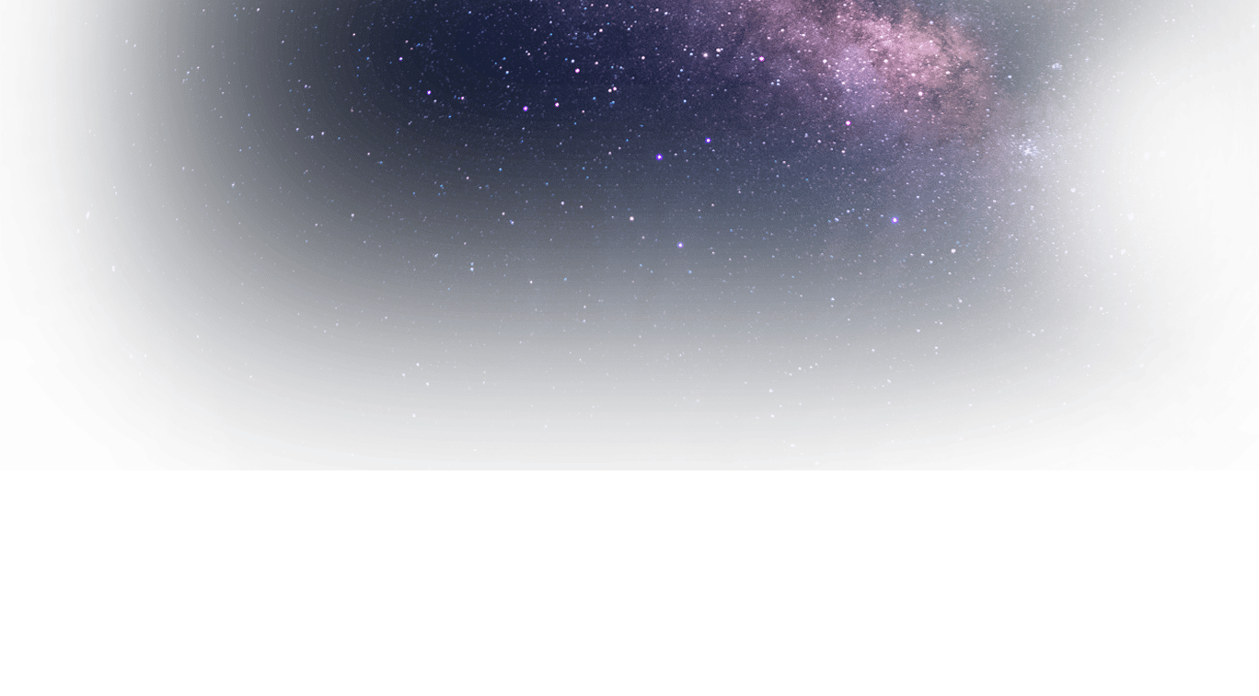
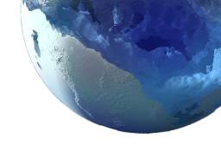


敢于有梦，勇于追梦， 勤于圆梦！

