Slide 1

感恩遇见，相互成就，本课件资料仅供您个人参考、教学使用，严禁自行在网络传播，违者依知识产权法追究法律责任。
更多教学资源请关注
公众号：溯恩高中英语
知识产权声明

Slide 2
Practical Writing
How to write about activities effectively
平湖中学
林思忆

Slide 3
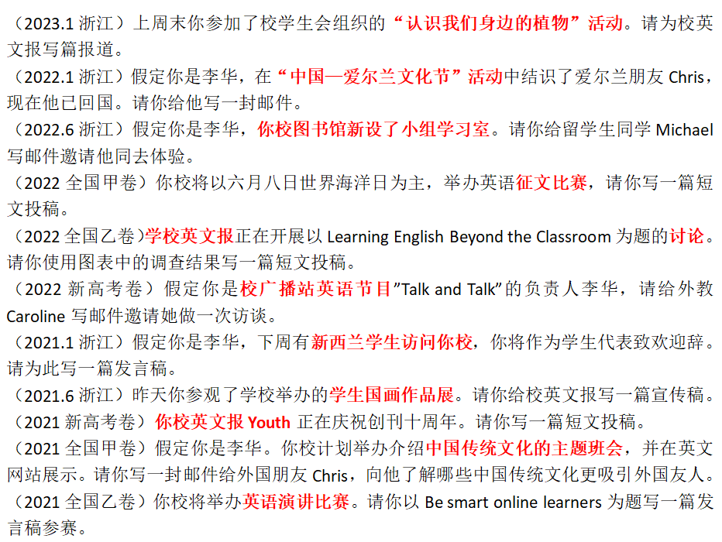
Lead in
Writing Tasks
in Recent Years

Slide 4
Lead in
School Events/
Activities

Slide 5
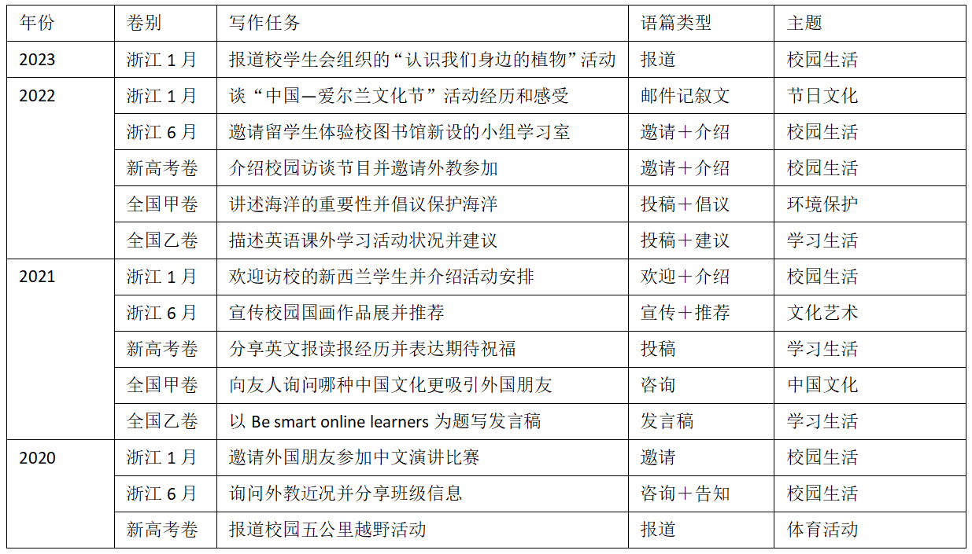
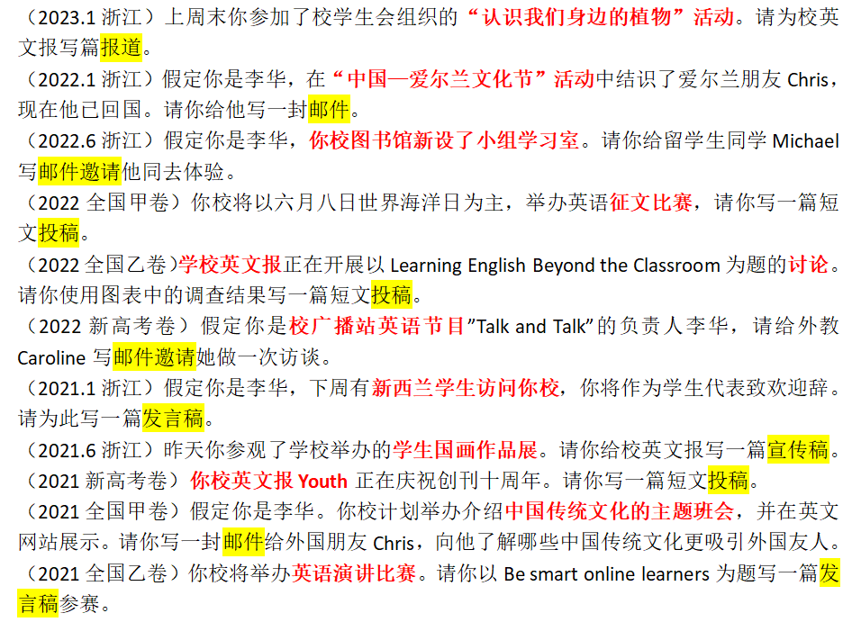
Lead in
Genres
(类型)

Slide 6
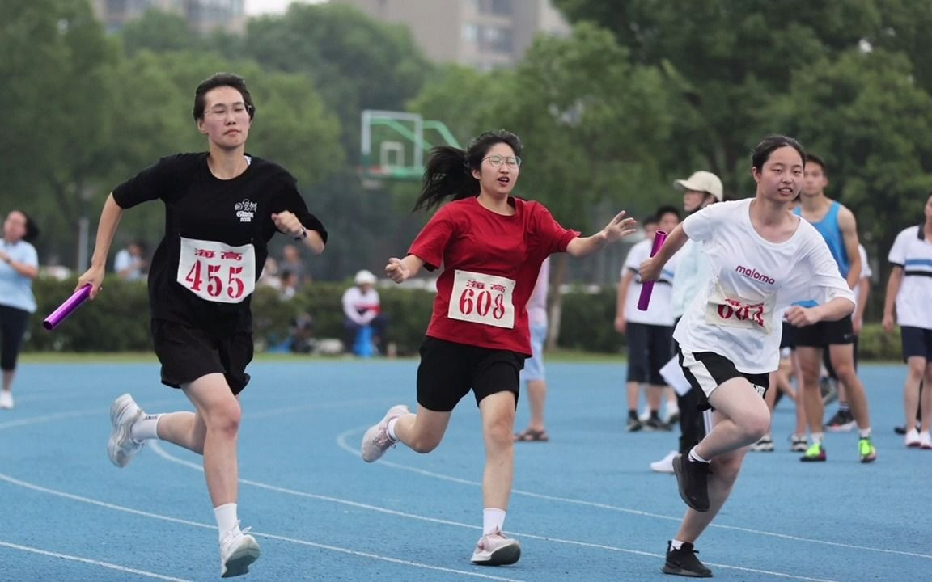
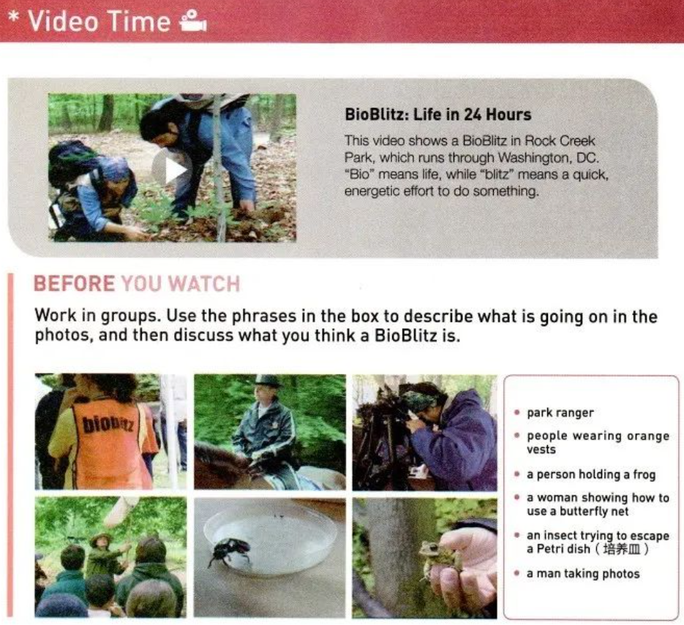
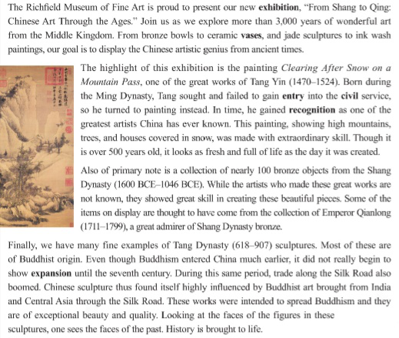
How can we “experience” as many activities as possible?

Slide 7
What can we write about an activity?
Organizer
who
where
Participant/Contestant/ Competitor
when
what
theme
purpose
events/process
results/significance/feelings

Slide 8
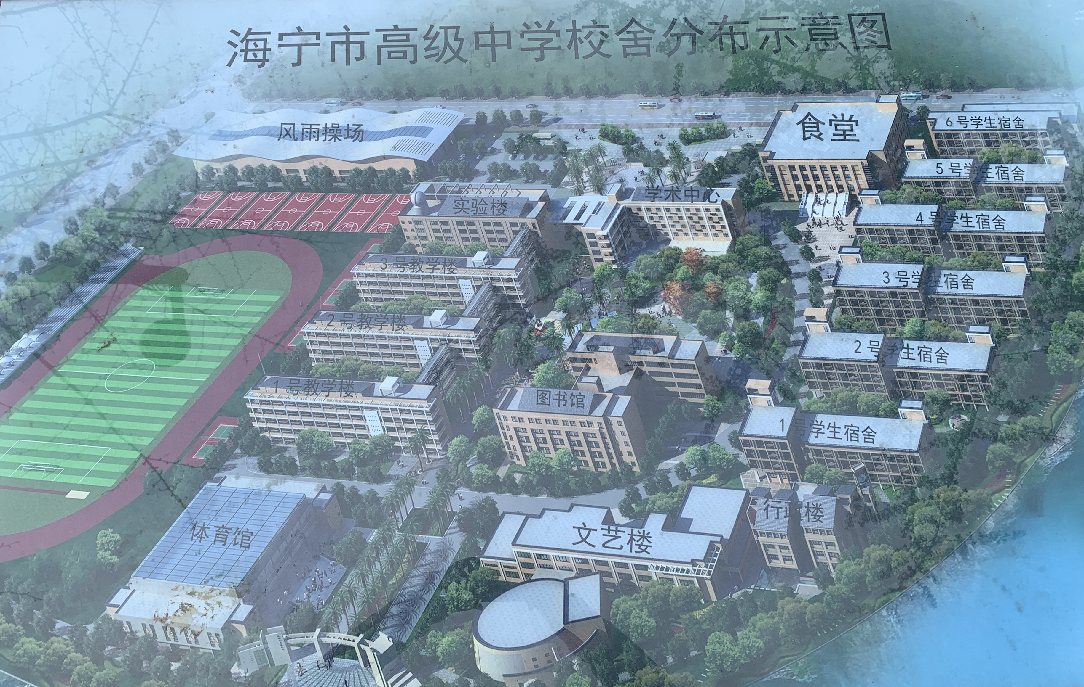
where
Campus Map
laboratory
canteen
academic center
dormitory
classroom building
calligraphy room
lecture hall/auditorium报告厅 exhibition hall
studio录音室 art gallery画廊
sports field
library
stadium/gym
art building
administrative building
(at) the school gate

Slide 9
when
what
Activity 1:
Let’s share some useful expressions
在具体某一天、持续几天、从...到...
计划、举/主办、组织、(报名)参加...
昨晚
在9月18日
在这/上/下周五下午三点钟
持续到11月25日(选必三P8)
持续大约三小时，从上午8:30到11点
last night
fall on September 18th
at 3 p.m. this/last/next Friday
run until November 25
last for approximately three hours, from 8:30 a.m. to 11 a.m.
plan/intend to do
be scheduled/arranged to do
hold/host/organize/launch
sign up for
take part in/participate in
engage in/compete in
be/get involved in
throw a farewell party
时间+witness+sth

Slide 10
Activity 2: Brainstorm expressions
about theme and purpose
theme
purpose
...entitled.../a lecture on...
to... /in order to/in an attempt to
on/with the theme of, on the topic of
A features B=A is characterized by B
relate to.../be centred on/around
with the purpose of
aim to do=be aimed at=aim at
be intended for/so that
Practice: Write complete sentences covering the following points 1.昨天我去参观学校举办的学生国画作品展；2.展览目的、时间、地点 (时态/语态)
In order to enrich students’ after-school life, an exhibition of students’ traditional Chinese paintings is being held by our school, which sparks a growing love for traditional art. The exhibition, is held on the first floor of the school library, lasting for two weeks.

Slide 11
significance
内容知识类
交流活动类
significance
能力获得类
兴趣意识类

Slide 12
significance
Activity 3: Fill in the form
broaden
内容 知识类 | 1.拓宽视野 2....的一瞥 3.让自己沉浸 | 1.__________horizons 2.a __________of 3.__________oneself in
交流 活动类 | 1.提供平台或机会 2.缓解学习的压力 3.给...增加色彩 | 1.offer/provide____________________ 2.__________students’ study pressure/stress 3.__________spice to
兴趣 意识类 | 1.激发某人兴趣 2.提高...的意识 3.对...有浓厚兴趣 | 1.___________________________one’s interest in 2.____________________people’s awareness of 3.have a __________interest in
能力 获得类 | 1.对...有深入理解 2.提高对英语的熟练度 3.具备以下的品质 | 1.gain deep__________ into acquire a deep______________of 2.enhance the__________ in English 3.be__________with the following qualities
glimpse
immerse
a platform/opportunities
relieve
add
arouse/spark/stimulate/stir up
enhance/strengthen
keen
insights
understanding
proficiency
equipped

Slide 13
structure
How to organize the paragraphs
Order of Importance
Logical Order
Order of Location
Time Order
My Amazing Naadam Experience
I experienced the Naadam Festival in China's Inner Mongolia Autonomous Region...
On the first day, I set off to the games early with my friend Burin. ...
After the opening ceremony and some amazing performances, the wrestling competition began. ...
I absolutely enjoyed the archery, too, but the horse races were my favourite part. ...
I'm finally back home now...
Beautiful Ireland and ItsTraditions
...Its beautiful countryside excites and inspires all, offering something for each of the senses. The peaceful landscape of “Emerald Isle” and its many green counties is a true feast for the eyes, with its rolling green hills dotted with sheep and cattle. And down by the sea, the roar of the ocean waves and cries of the seabirds make up the music of the coast. On a quiet morning in the mountains, feel the sun on your skin...

Slide 14
Order of Importance
Why do we need organizational patterns?
Logical Order
coherence(连贯)
Smart Homes to Make Life Easier
...In addition, your smart home will be monitoring your health for you every day. Your bed, for example, will record how well you sleep every night. It will also be checking your body weight. If you start to have sleep or weight problems, it will send a warning to your phone... Smart toilets will be keeping constant track of your health as well. They can warn you early on if there is something abnormal...
A World of Pure Thought
...So, what made Stephen Hawking a genius? Besides being brilliant, he was brave, though sometimes careless in what he said or did... Furthermore, he was quite determined. This had helped him even more in his fight against his disease. Above all, Hawking was willing to admit his faults. This odd combination of characteristics had made him one of the greatest thinkers of the 20th and 21st centuries.

Slide 15
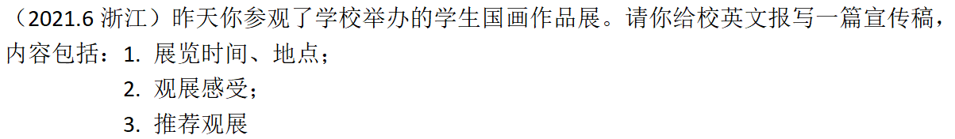
Activity 4: Create your own writing
Book 6 U1 P8
Tips:
1.experience the activity in the reading article in the Art Unit
2. the elements of writing an activity
3. coherence
4. handwriting

Slide 16
Possible version:
A Chinese painting exhibition hosted by our school is scheduled to run from June 8th to June 12th in the school art gallery.
I attended the exhibition yesterday, which displayed an elaborate selection of the original artworks of talented students. Deeply impressed by the great variety of Chinese paintings and the various artistic methods adopted, I immersed myself totally in the charm of the traditional Chinese art.
I highly recommend a visit to the exhibition, which will not only provide a taste of a unique Chinese art form, but also offer a deep insight into a culture of great diversity. You can’t afford to miss it!

Slide 17
How to write about activities effectively
who
where
when
what
purpose
theme
Elements
events/process
results/significance/feelings
Some useful expressions
Time Order
Order of Location
Structure
Logical Order
Order of Importance

Slide 18
Thank you

