Slide 1

感恩遇见，相互成就，本课件资料仅供您个人参考、教学使用，严禁自行在网络传播，违者依知识产权法追究法律责任。
更多教学资源请关注
公众号：溯恩高中英语
知识产权声明

Slide 2
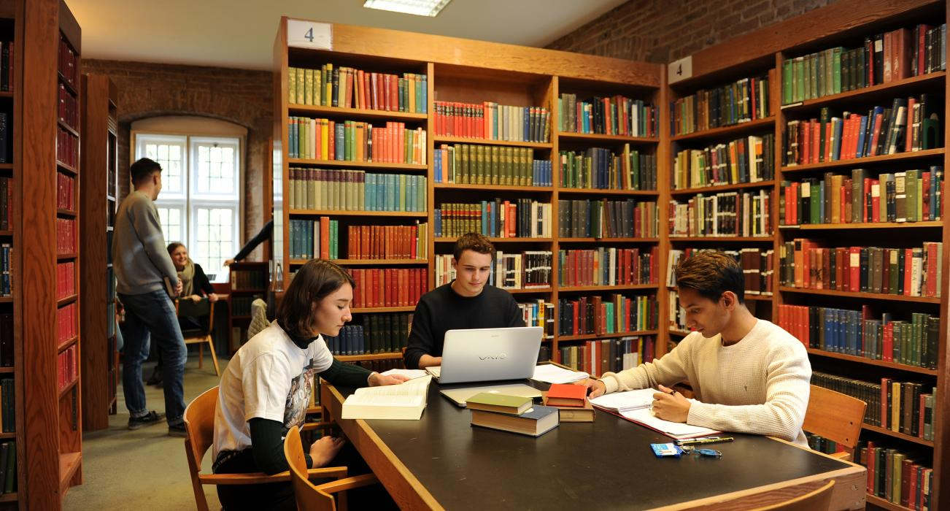

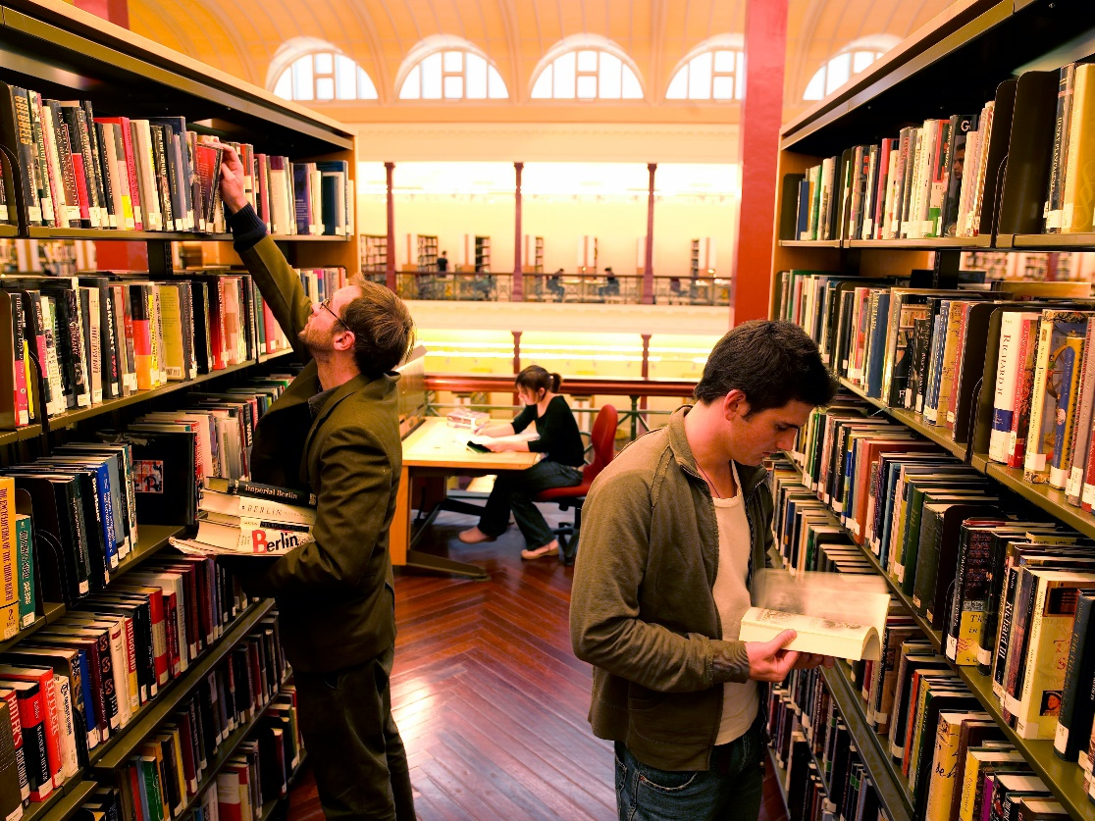
2023.4
嘉兴二模
英语介绍词
“书香校园”

Slide 3

介绍词
类型
时态
人称
语气
要点
give information
你校正在为即将举行的国际交流生研学活动布置校园文化宣传栏，请你为其中的“书香校园（Scholarly School）”板块写一篇英文介绍词，内容包括：
内涵意义；
具体实践
注意:
1.词数80左右；
2.可适当增加细节，
以使行文连贯。
一般现在时
现在完成时/一般现在时/ 一般将来时
审题
第三人称
formal
meaning
Para. 1 内涵意义
Para. 2 具体实践
activities

Slide 4


create a favorable/ an immersive (沉浸式的) atmosphere for reading
foster a thriving reading culture/ a routine reading atmosphere
venues—
library,
reading room,
classroom,
lecture hall.
activities—reading season/ month/ week;
book club;
reading salons/
circles;
lectures;
book fair;
discussions;
competitions
cultivate a thick atmosphere of reading books
raise students' awareness on the importance of reading;
cultivate their minds and build their reading ability;
increase teen's cultural literacy and develop critical thinking;
inspire young people to read to inherit the spirit of both ancient and modern civilizations.
boost their comprehension and help instill a lifelong love of reading
fragrance?
书 香 校园
Scholarly School
welcoming and inviting reading spaces

Slide 5

What are the benefits of reading?
A reader lives a thousand lives before he dies... The man who never reads lives only one. - George R.R. Martin
Reading is essential for those who seek to rise above the ordinary. - Jim Rohn
Today a reader, tomorrow a leader. - Margaret Fuller
There is more treasure in books than in all the pirate's loot (战利品) on Treasure Island. - Walt Disney
Reading is a discount ticket to everywhere. - Mary Schmich
Reading makes a full man. - Francis Bacon Of Studies
A book does hold a house of gold; a book does hide a charming bride.- Emperor Zhao Heng

Slide 6

内涵意义
Just as Francis Bacon puts it, “Reading makes a full man.” Our school has endeavoured/ strived to create a “Scholarly School” where students are immersed in a thick and thriving reading culture. Here, students are expected to read widely/ extensively (广泛地), develop critical thinking and instill a lifelong love of reading.
Aiming to foster a routine reading atmosphere, our school has long been devoted/ dedicated/ committed to creating a “Scholarly School” where students are encouraged to have immersive reading experiences and gain encyclopedic/ extracurricular knowledge beyond classrooms.
The “Scholarly School” our school has been working on is where students can foster/ cultivate literary quality (文学素养), explore into a wider world, and learn to think critically in an immersive reading atmosphere.

Slide 7


具体实践
transitional sentence:
To achieve this (goal), a diversity of funfilled and fulfilling/ engaging and educational activities/ events have been launched/ initiated.
specific activities:
sb. do sth. in sp. to + (purpose)
Students can choose from an abundant/ a rich collection of books in the library and enjoy reading in comfortable reading rooms.
With an abundance of books, our library gives students access to the vintage (最好最经典的东西) of human wisdom.
More reads will be added to not only speak to/ satisfy their interests but will also challenge them to think critically.

Slide 8


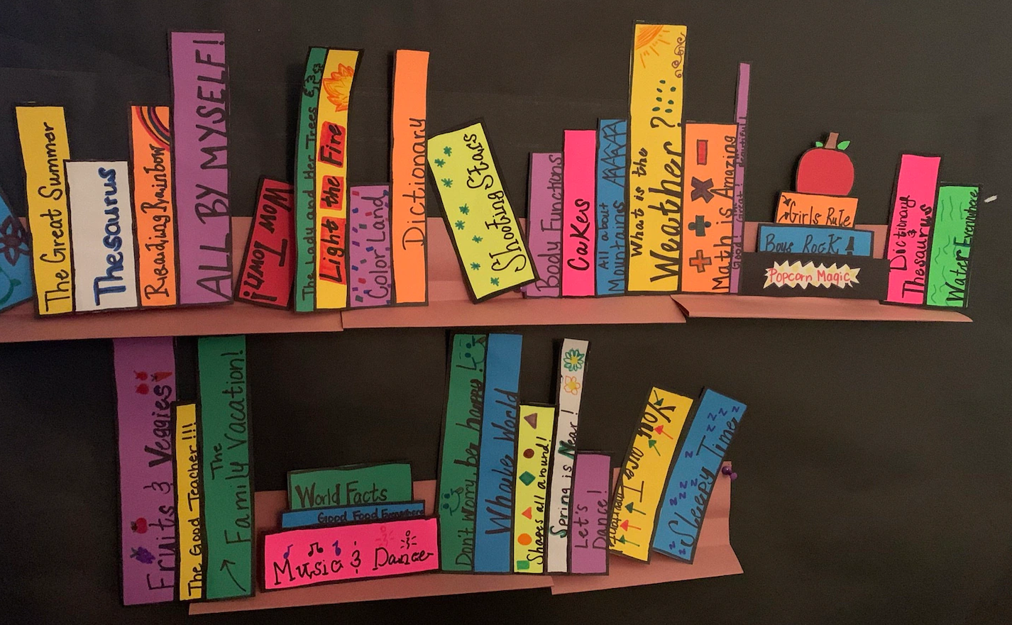
Reading seasons are launched quarterly by issuing a list of good books and inviting experts to tell their reading-related stories.
The school also holds open lectures to raise interactive topics by inviting youth readers to share their views on their favorite books in the form of writing, pictures or video messages/ vlogs.
Bulletin boards (布告栏) are set up to share students' well-written book reviews as well as their unique insights of a particular book.
For each reading circle, teachers will select a particular theme, based on which students are encouraged to have heated discussions or make an adaption to perform on stage.

Slide 9

We are a superb school boasting (拥有；享有) profound culture, and the scholarly school perfectly demonstrates (证实；展现) our culture-oriented school trait (办学特色). After years of endeavour, we now have nurtured (培育) a splendid (极好的) and inclusive (包容的) scholarly school. [内涵意义]
Specifically [discourse marker 1], in a spacious and well-lit library stocked with a wide selection of books, the monthly held literature salon is students' favorites, where they can enjoy the collision of diverse ideas (思想的碰撞). Also [discourse marker 2], to provide an outlet for students to talk with great minds, many prominent/ notable (著名的) professionals as well as writers have been invited to deliver some insightful (有洞察力的) and illuminating/ enlightening (有启发性的) lectures, which greatly widens students' knowledge scope.
(ZHANG Xinyu)

Slide 10
Having formed an atmosphere of reading, our school is rated as (被评为) a Scholarly School by providing every student with an outlet to either embark on a poetic literary journey or gain advanced scientific knowledge. Not only can it make students' thoughts mature but lay a solid foundation for their future improvement. [内涵意义]
Reading elements, ranging from the recommendation of good reads to insightful book reviews written by students, are posted on the school billboards and the official website. Additionally [discourse marker 1], a reading circle is held on a monthly basis in each class, where students can bounce around ideas with like-minded classmates. They can also [discourse marker 2] get a customized list of books from the library to satisfy their varied reading interest.
(HUANG Yilin)

Slide 11
A possible version:
Scholarly school is where students are motivated to read extensively, explore new ideas and develop critical thinking. It creates an atmosphere fostering interest in reading and promoting academic excellence.
Our school offers various resources, including libraries, lecture halls and specialized workshops. Students benefit from a series of interactive activities, like reading salons, book clubs, and quiz competitions. Additionally, distinguished experts are invited to offer guidance on effective reading and satisfy students' learning needs. All these practices equip students with rich knowledge and prepare them for a promising future.

