Slide 1

感恩遇见，相互成就，本课件资料仅供您个人参考、教学使用，严禁自行在网络传播，违者依知识产权法追究法律责任。
更多教学资源请关注
公众号：溯恩高中英语
知识产权声明

Slide 2
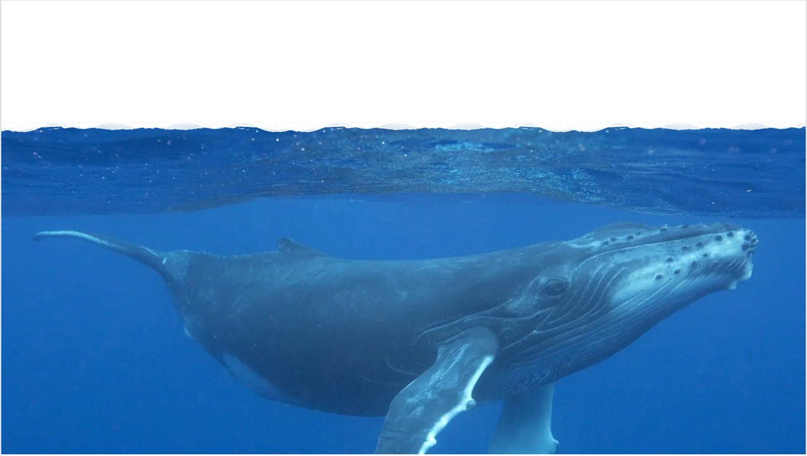


Slide 3
主题语境：人与自然
- What could probably be our focus?
①I live with my husband, Tyrone, in San Luis Obispo, California, about five kilometres from the beach. Every few years, the humpback whales come into the bay for a few days while they’re migrating. November 2020 was one of those times, so we took out our yellow double kayak to watch the wildlife. We paddled out the length of the pier and saw seals, dolphins and about 20 whales feeding on silver fish. We were in awe watching these graceful creatures—each one about 50 feet long—spray through their blowholes.
②At the time, my friend Liz Cottriel was staying with us. The next day, I asked her if she wanted to go out on the water to see them. With no such experience, she refused.“There’s nothing to worry about,” I assured her. “The craft is stable, and we can turn back any time.” Finally, she agreed to join me. I didn’t want her to miss this magnificent experience and regret it later.
③At 8:30 the following morning when we got out on the water, there were already about 15 other kayakers and surfers in the bay. After a half-hour, we had our first whale sighting just past the pier: two humpbacks swimming towards us. How amazing to be that close to a creature that size, I thought as the whale dipped under the waterline.
④When whales went down, they left what looks like oil on the water. I figured if we paddled towards that spot, we’d be safe from the whales, since they’d just left. We followed them at a distance—or what I thought was a distance. Suddenly, a tightly packed group of silverfish, started jumping out of the water into our kayak. Oh, no, we’re being attacked!
Para.1: What should have been a joyful moment was actually terrifying. Para.2: Meanwhile, a kayaker paddled over.

Slide 4
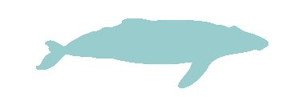
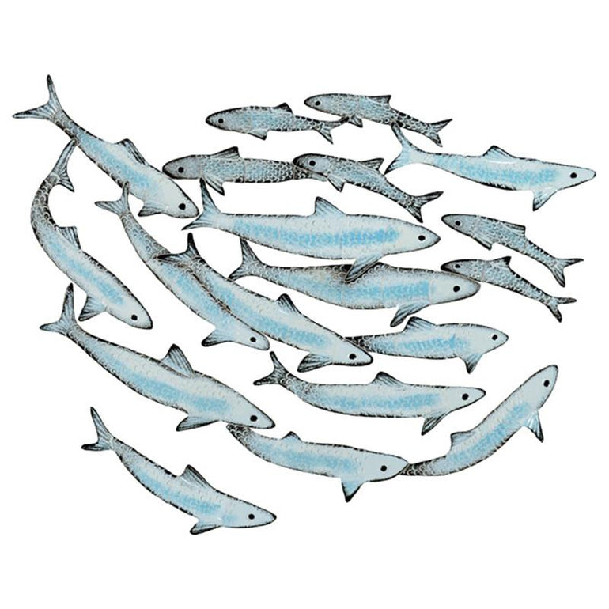
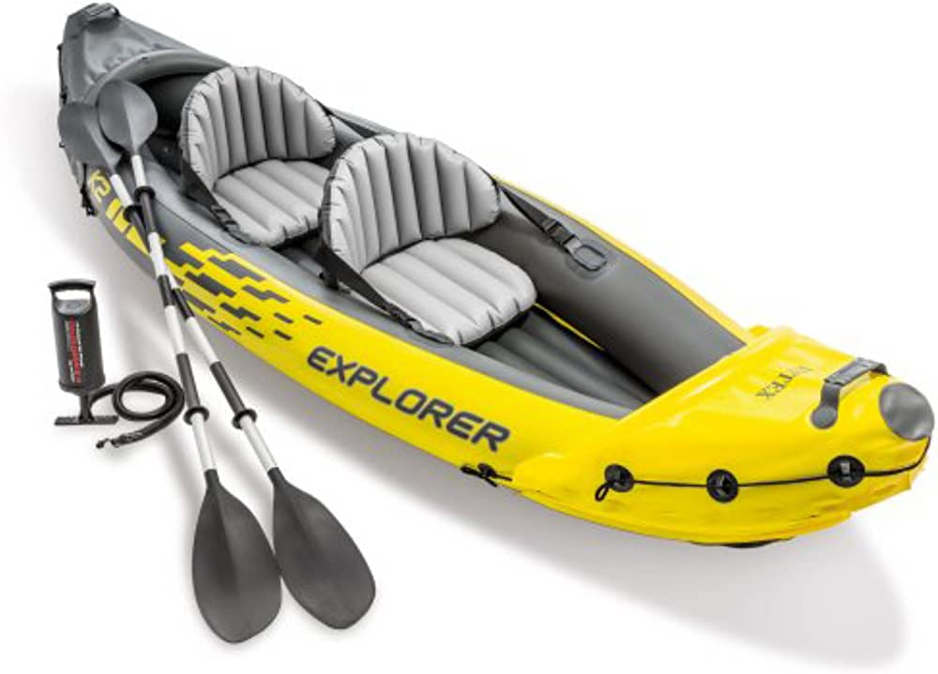
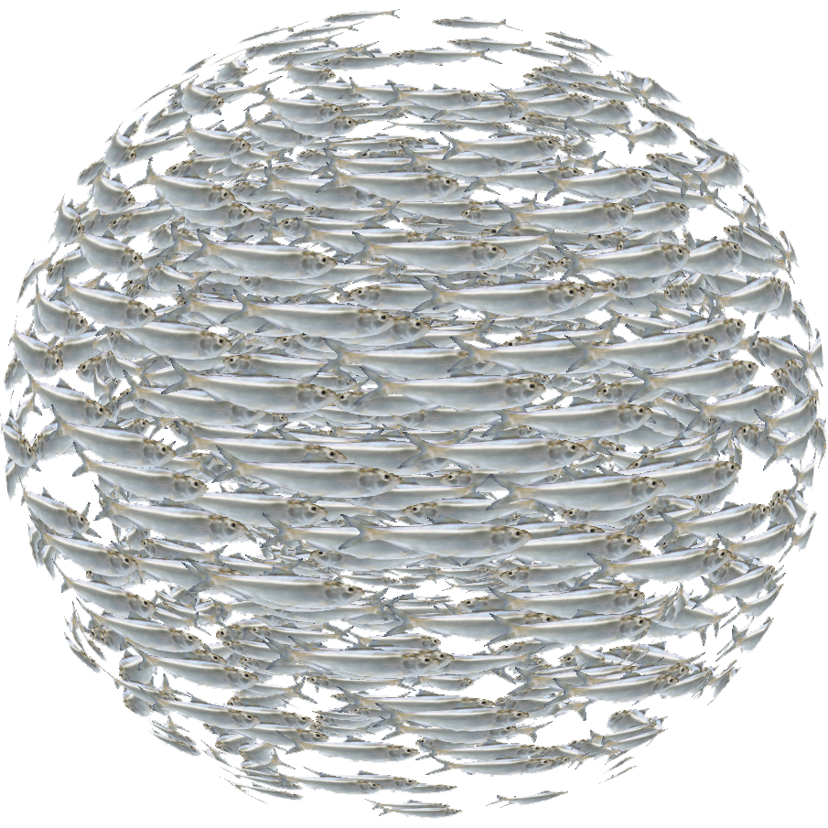

Background
attacked us- why?
joyful - terrifying
watch the wildlife
Confilict
graceful creatures
Tyrone
Liz& I
15 other kayakers and surfers
Characters
Liz& I
stable craft
turn back any time
won’t regret
yellow double kayak
finally agreed to join me
Expectation
feeding on silver fish
tightly packed- why?
a magnificent experience
Reality
We followed them at a distance—or what I thought was a distance.

Slide 5

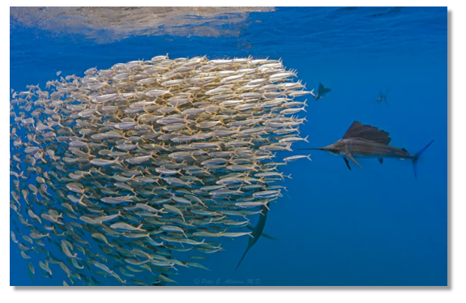

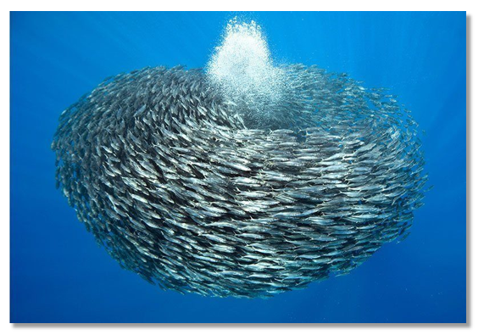
The tightly packed ball-like formation is known as “a bait ball”.
A bait ball, or baitball, occurs when small fish swarm in a tightly packed spherical formation.
It is a last-ditch(a final attempt) defensive measure adopted by small schooling fish when they are threatened by predators.
Small schooling fish are eaten by many types of predators, and for this reason they are called bait fish or forage fish(饵料鱼).
Bait is food which you put on a hook or in a trap in order to catch fish or animals.

Slide 6
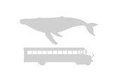
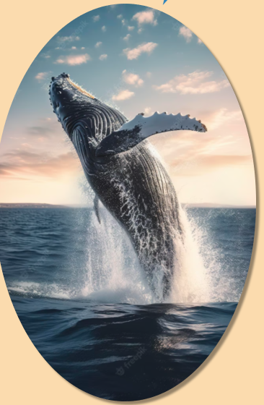
Size: 48 to 62.5 feet
Weight: 40 tons
Their Latin name, Megaptera novaeangliae, means "big wing of New England." It refers to their giant pectoral fins(胸鳍), which can grow up to 16 feet long.
They also have a small hump in front of their dorsal fins(背鳍), leading to the common name of "humpback."
Humpbacks are powerful swimmers, and they use their massive tail fins to propel(drive, push) themselves through the water and sometimes completely out of it. They regularly leap from the water, landing with a tremendous splash.

Slide 7

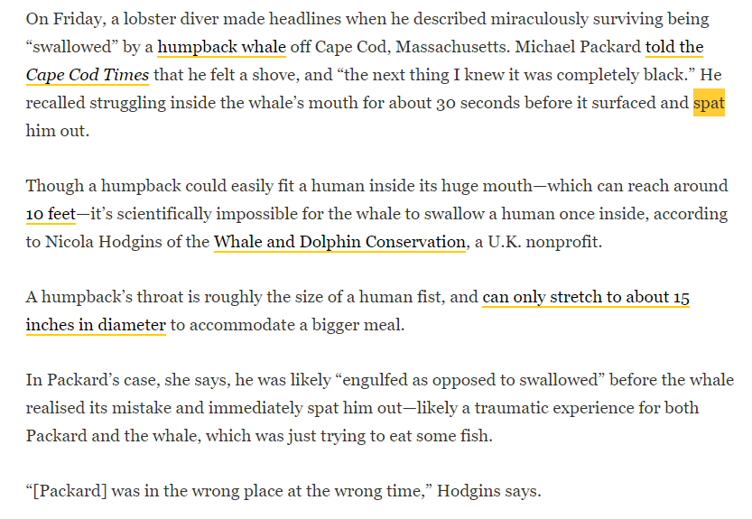
A humpback’s throat is roughly the size of a human fist, and can only stretch to about 15 inches(≈38cm) in diameter to accommodate a bigger meal.
So if the object it swallows is too big, what will the humpback whale do?
* Spit it out! spit-spat-spat

Slide 8


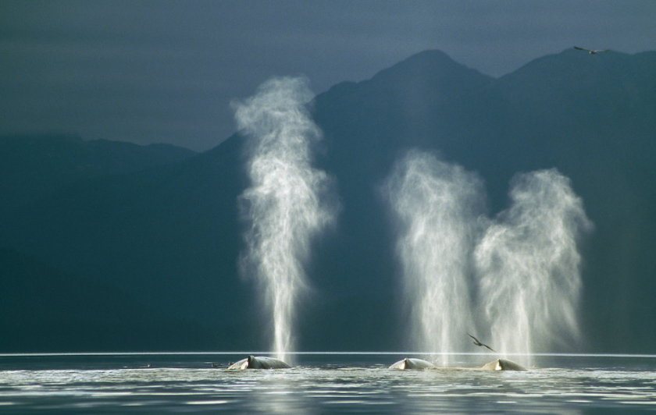
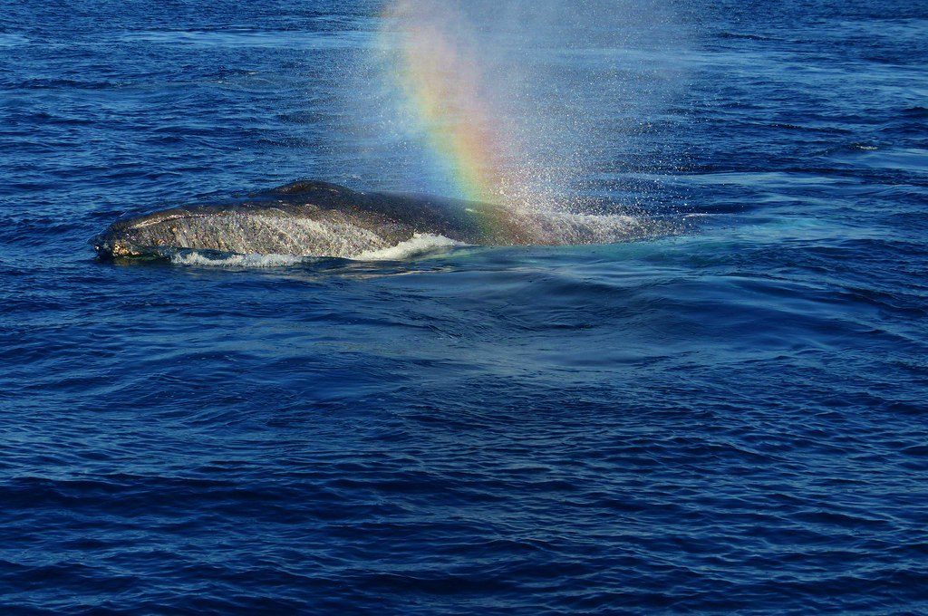
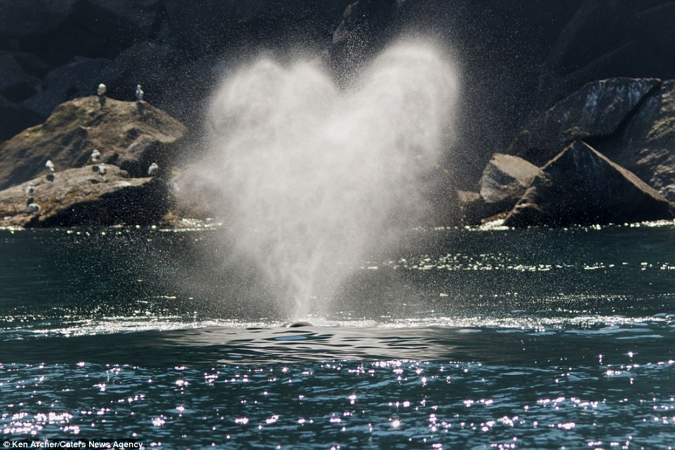
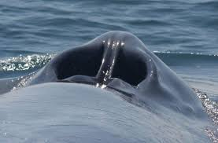
spray through their blowholes
Humpback whales are known for their magical songs, which travel for great distances through the world's oceans.
Scientists are studying these sounds. It is most likely that humpbacks sing to communicate with others and to attract potential mates. Humpback calves are known to "whisper" to their mothers.
How will you describe them? Can we apply them to writing?
sprayed a water spout rocketing into the sky through its blowhole like fireworks
sprayed a heart-shape fountain through its blowhole
the whale’s nostril
sprayed a faint rainbow through its blowhole in the sun

Slide 9
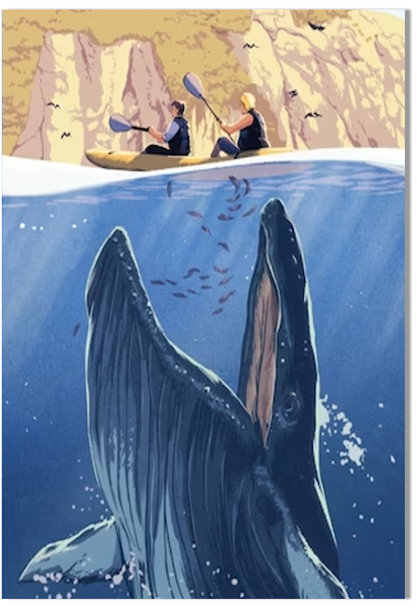
Analyze the plot:
Para.1: What should have been a joyful moment was actually terrifying.
Para.2: Meanwhile, a kayaker paddled over.
Para.1: What should have been a joyful moment was actually terrifying.
Para.2: Meanwhile, a kayaker paddled over.
What’s “terrifying” situation? (What caused it? )
What’s our condition?
What’s our feeling/thinking/reaction?
Silver fish jumped in. - A humpback was back, preying on them!
Sightseeing kayak- rocked in the sea-a bait boat?-overturned?
Liz& I- save ourselves-asked for help
(Who was the kayaker?)
What did he/she do/ say?(Helped/saved us)
reached out the paddle to..., pulled ... towards..., and helped ... board onto....
Reflection/Feeling- Theme related
someone nearby or Tyrone?
A magnificent experience? Did Liz regret it?
What did we learn from it?(followed a distance?)
What did we experience?

Slide 10
It seemed that the panic silverfish were hunted by some horrible monster, which left us in a dramatic danger. I strained to paddle away while Liz was throwing the silverfish back into the sea.
With the strike of the swarm of fish, our kayak shook violently with my heart beating wildly and Liz screaming. “The humpback!” A dark shadow was approaching rapidly!
In a flash, our boat was capsized. Never before in my life had I been so overcome by terror. I kicked my legs wildly, gasped for breath and felt a sense of hopelessness sweeping over me.
As an “experienced” kayaker, I pretended to keep calm and comforted Liz.
The kayak spun around like a top in the successive waves! A last-ditch idea came into my mind- jumping into the water!
A whale’s sudden attack extinguished our light of hope. At the snap of a finger, we found ourselves tossed up and down in the cold sea, crying for help and at a loss.
We swam away as quickly as we can to keep a distance- a really distant distance instead of what I thought distant.
Why terrifying?
How terrifying?
What were our feeling, thinking and reaction?
- 场景描写,铺垫原因， 承上启下
- 协同原文人物特征
- 协同原文细节
- 结合背景描写到位
spin-spun-spun-spinning

Slide 11
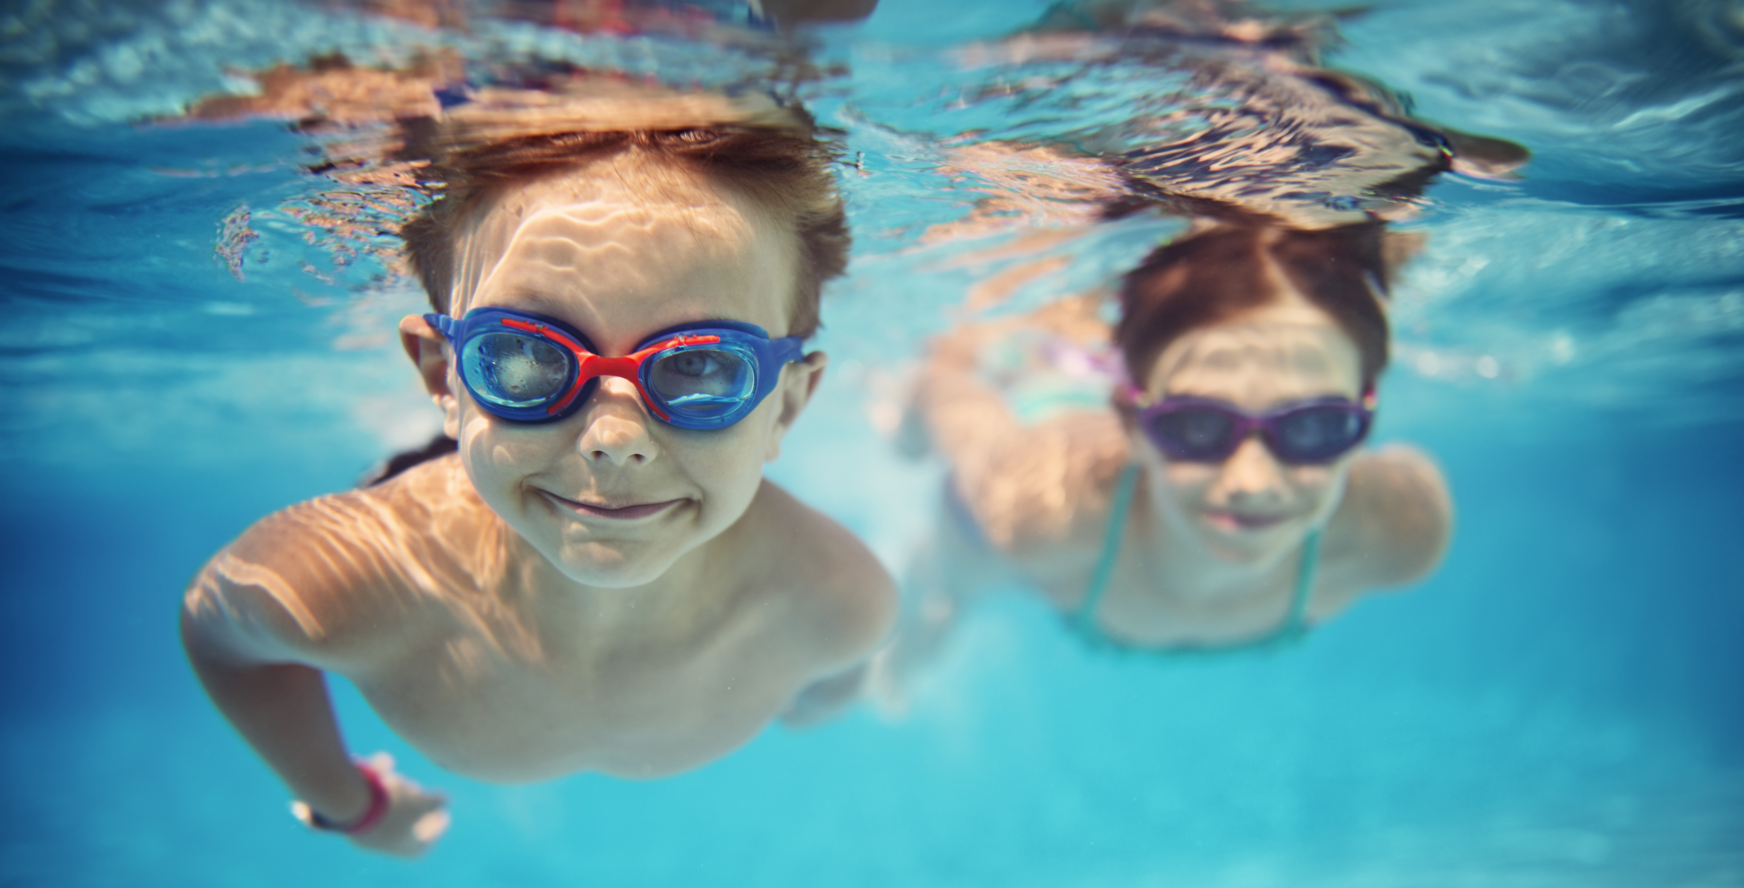
How to save yourself if you were falling into the water?
Try a flutter kick(浅踢). Point your toes out like a ballerina, keep your legs mostly straight, and alternate legs as you make small kicks.
With your arms, do the "crawl" motion, lifting one arm straight into the air and keeping it straight as it re-enters the water next to your head.
Tread water. Treading water can help you catch your breath and keep your head up without actually swimming.
If you're below water, use your arms to propel yourself. Put them straight up above your head, and quickly bring them down to your sides. This should push you up a few feet. Repeat until you break the surface.
tread-trod-trodden
scream for help
grasp the edge of the craft to float on the surface
I exerted every effort to try flutter kicks by alternating legs and repeat the crawl motions with my arms, propelling myself up to break the surface.
Legs kicking and arms crawling, I eventually bobbed to the surface and gasped a lungful of air.
Liz trod like crazy, used her hands to keep the balance by "sculling".

Slide 12

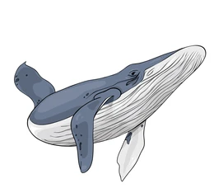
As we paddled to the beach, the sun shined in the blue sky dotted with white clouds and the sea had calmed down as if nothing had happened. It’s a magnificent experience indeed, but definitely more striking and unforgettable. What I learnt was that we’d better show more respect to our mother nature and creatures.
Liz was shaken up, likening the horrific experience to a near-death one, and she said her whale-watching days were over.
Puffing and panting, I kept visualizing the scene that we had been in the breaching picture. What I thought a safe distance became a deadly one.
I stared at the calm sea, where the whale breathed out water spouts gracefully. Everything was so peaceful. It struck me that the best way to get along well with nature was staying at a proper distance in both of our minds and admire each other.
....
A magnificent experience?
Did Liz regret it?
What did we learn from it?
(followed a distance?)
What did we experience?

Slide 13


原文协同到位，人物描写细腻，详略得当，句式丰富，承接自然。
What should have been a joyful moment was actually terrifying. My life flashed before my eyes as the “just-left” whales swam straight to us and turned our stable craft upside down into waves just like turning a toy boat.(呼应原文细节,运用修辞描绘骇人景象,画面感强,有效推进情节) Tossing in the water, my head went ups and downs repeatedly , so did Liz’s. Overwhelmed by anxiety, I shouted to her with quivering voice, “Swim to those kayakers!” This time it was not for fun, but for survival from the huge creature!(人物描写,烘托氛围,铺垫下文)As my lips went numb in the freezing cold water, the light of hope went bleak- How regretful I was for taking Liz for the trip! Nevertheless, I still stretched my arms and legs ceaselessly after her! (心理描写，协同原文，铺垫下文)
Meanwhile, a kayaker paddled over. At the sight of him, I gathered all my strength and kept yelling for help in the hope of being saved.(承接首句,铺垫后文) Fortunately, the kayaker was so calm and skillful that he soon grasped the big picture and helped us onto his craft. Finally, we paddled towards the beach.(人物动作描写,推进情节) “Never will I go watching whales so near again!” Liz closed her eyes, puffing and panting. It’s not until then did I realize it was us who bothered the creature and nature, swallowing the bitter pill.(人物语言及心理描写,阐述主题) Looking back, those graceful whales again sprayed through their blowholes in the sun, peacefully and breathtakingly.(协同原文细节,意味深长)

Slide 14
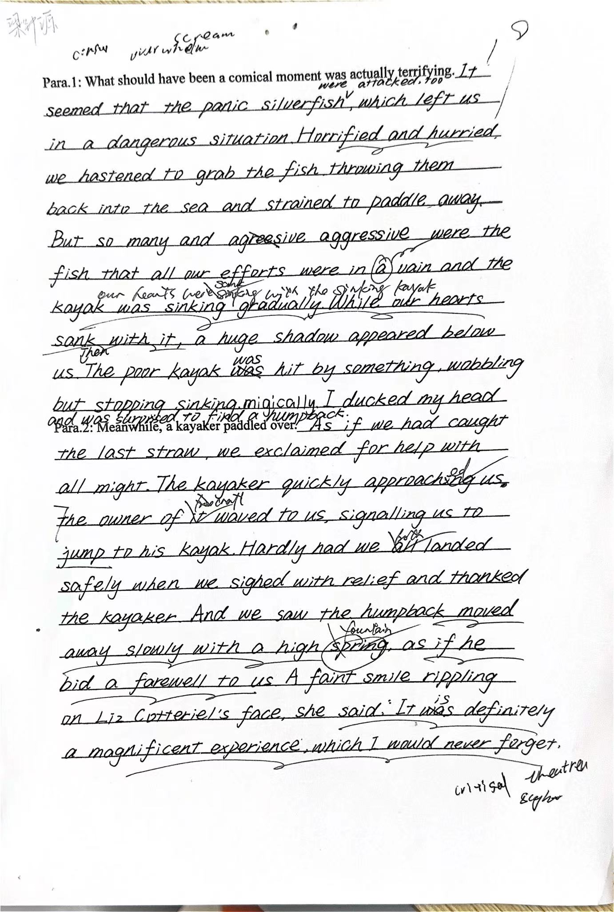
1.情节合理：
“成也萧何，败也萧何。”先因鲸而遇险，后因鲸而转危为安。符合原文设定，也符合鲸的生物特点。
2.衔接到位，有效推进情节
3.协同原文，人物描写多面，有粗有细
4.句式丰富，表达描写生动
美中不足：
1.主题意义没有深挖
2.部分表达的准确性有待加强

Slide 15
Official Reference:
What should have been a joyful moment was actually terrifying. In a split of second, our kayak was lifted out of the water about six feet by the massive jaws. Liz and I slipped out of the kayak into the whale’s mouth. My body was engulfed except for my right arm and paddle. So was Liz. As the whale’s mouth closed, Liz thrust her arm up to block it from crushing her. Feeling the creature begin to dive, I had to do everything possible to stop it.Suddenly, the paddle beside caught my eyes. Without hesitation, I seized the paddle, raised it to keep its mouth open. After a deep breath, I caught Liz by the arm and jumped out into the water.
Meanwhile, a kayaker paddled over. Upon getting close to us, he immediately stretched out his paddle, pulled us out of water and into his kayak, heading to the beach. It was until that moment that I recovered from the terror. Never was I so much more aware of the power of nature and the ocean than I was before. Liz was shaken up, likening the horrific experience to a near-death one, and she said her whale-watching days were over. But even she had to laugh when she got home that afternoon and realized she’d brought back a souvenir. When she pulled off her shirt, six silverfish flopped out.
引入主角“鲸”，描绘骇人场景，推进情节
人物动作及心理描写，铺垫后文
人物心理及动作描写，继续推进情节
承接首句,动作链推进情节
心理描写表达主题
人物动作及语言描写,协同原文

Slide 16
Teacher’s Version:
What should have been a joyful moment was actually terrifying. With the strike of the swarm of fish, we sank in a panic and our kayak rocked violently while my heart was pounding with a beat that choked me. Worse still, Liz’s yelling haunted my ears in the next second. An enormous dark shadow was charging towards. Yes! The humpback was back! In an instant, the heavy swell of waves overturned our little yellow double craft, which consequently dumped both Liz and I into the chilly but crystal water. Legs kicking and arms crawling like crazy, I eventually bobbed to the surface and gasped a lungful of air. Shortly, I spotted Liz’s figure not far away from me. “Swim!” She yelled!
Meanwhile, a kayaker paddled over. Thank God! It was my husband, Tyrone, who had intended to join in our anticipating trip. No sooner had he approached us than he reached out the long oar to pull us onto the craft one by one. Life had flipped on us! One minute, we were struggling in the whirlpool of the behemoth. The next, we were bounding for the beach-the solid land! As I looking back to the oil-like surface in the distance, again, a humpback gracefully floated onto the surface. Breaking through its blowhole was a silver water spout, which rocketed high into the sky and splashed like fireworks. The magnificent scene seemed to be a celebrating ritual by itself, breaking through the previous gloom in my heart as well.
人物心理及场景描写
承接首句
人物动作及心理描写，铺垫后文
人物心理及动作描写，继续推进情节
承接首句,动作链推进情节
心理描写表达主题
人物动作及语言描写,协同原文

