Slide 1

感恩遇见，相互成就，本课件资料仅供您个人参考、教学使用，严禁自行在网络传播，违者依知识产权法追究法律责任。
更多教学资源请关注
公众号：溯恩高中英语
知识产权声明

Slide 2


Practical Writing
23届苏锡常镇四市高三二模

Slide 3
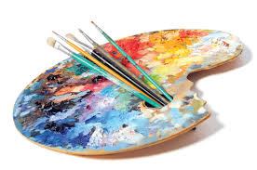
假如你是李华，你刚刚参观了你市博物馆举办的的一次“遇见艺术家”的展览，请为你校英文报写一则评论，内容包括：
1.展览概况；2.观展感受；3.意见建议。
注意：1.写作词数应为80左右；2.为使行文连贯，可适当增加细节。
Step 1: 审题
Genre:
Person:
Voice:
Contents:
Structure:
An observation
First& Third
Objective about the fact
Sentimental about feelings
General Introduction of the Exhibition
Personal Feeling and Reflection
Suggestion(s)
What is an observation?
Observation is more than just seeing and hearing. You should use your senses– you will be listening sounds, smelling scents, feeling sensations, watching scenarios and even tasting food if this applies. Do more than just observe little things. Observe the way everything works together, the processes involved, and the total gestalt (a set of things) experience.
What’s going on here?
What does this observed activity mean?
What else does this relate to?

Slide 4
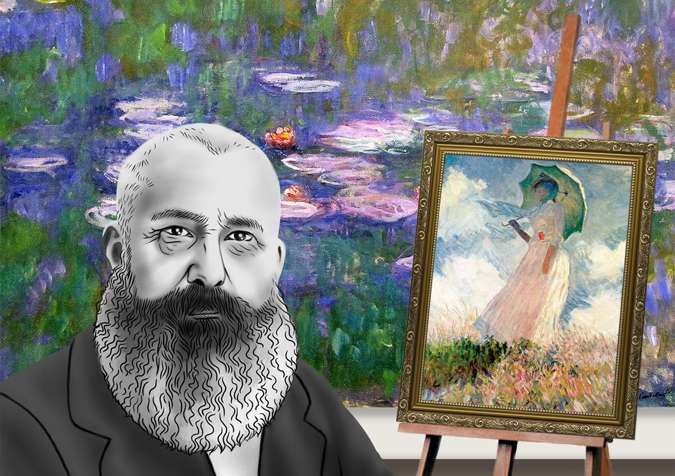
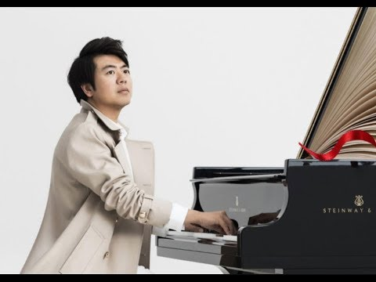
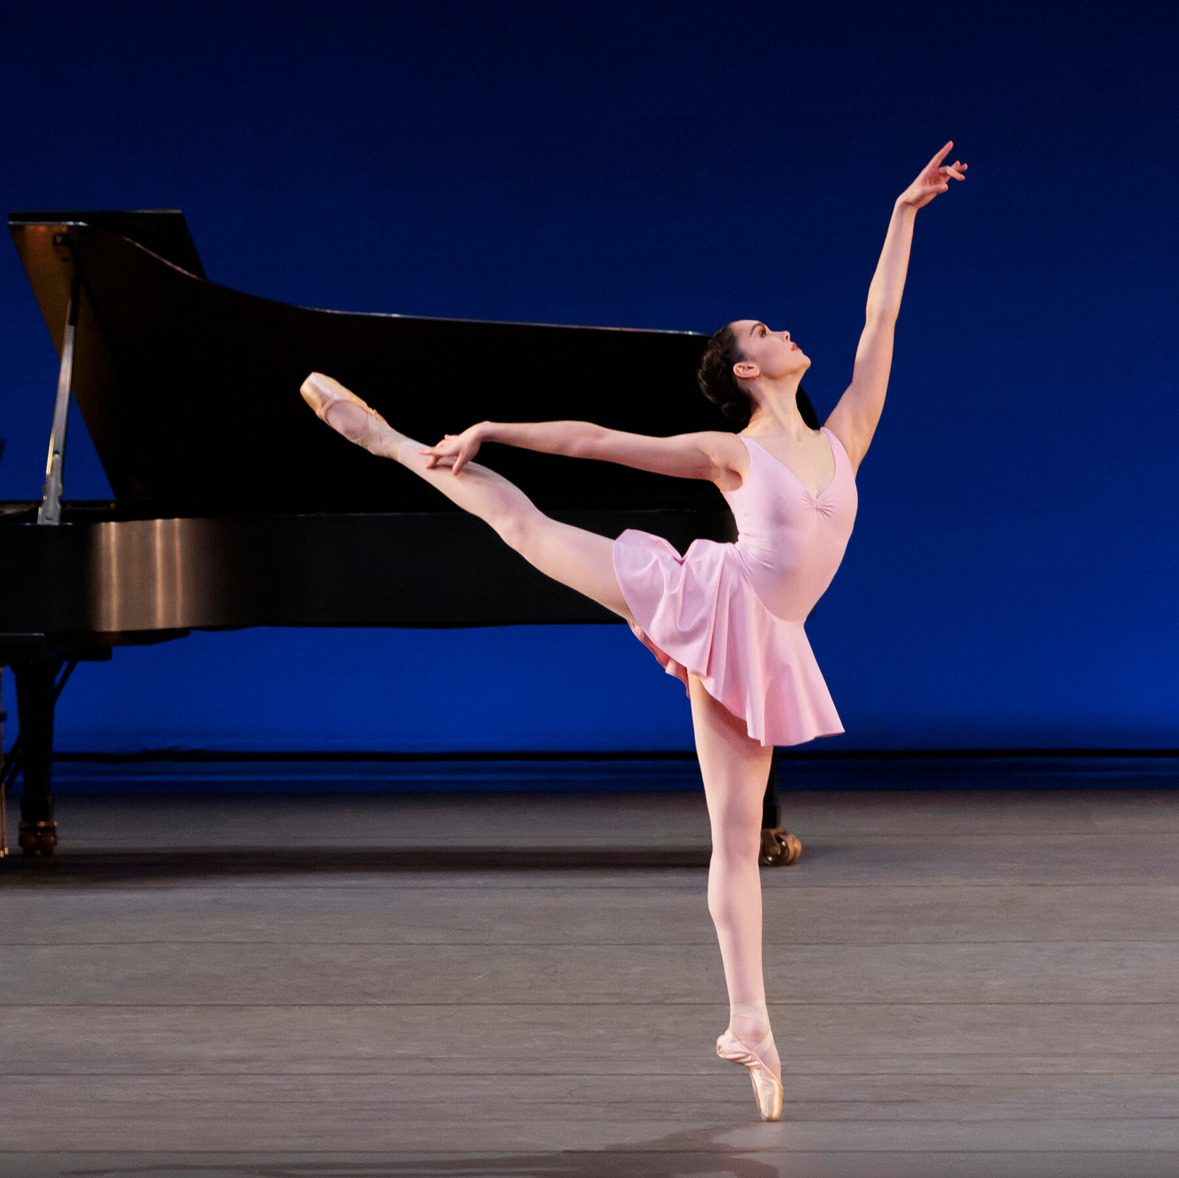


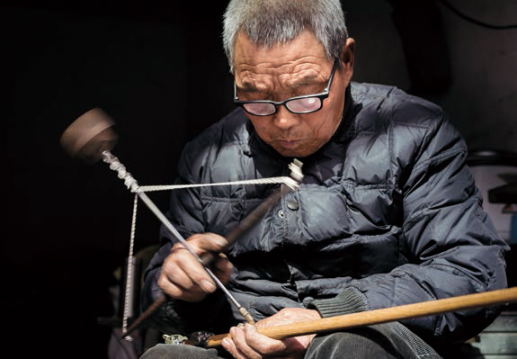
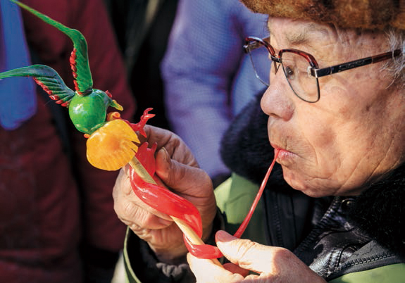
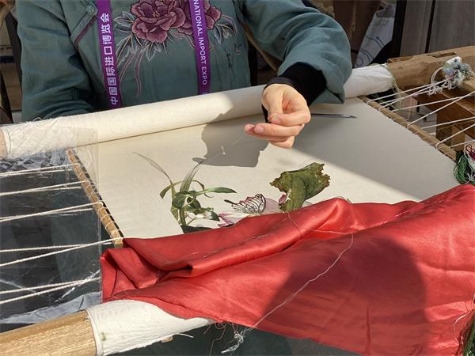
Who are the artists we can meet?
someone in museums
someone on the stage
someone skillful
literary men
someone around us- craftsmen
steelyard making
sugar-figure blowing
embroidery

Slide 5
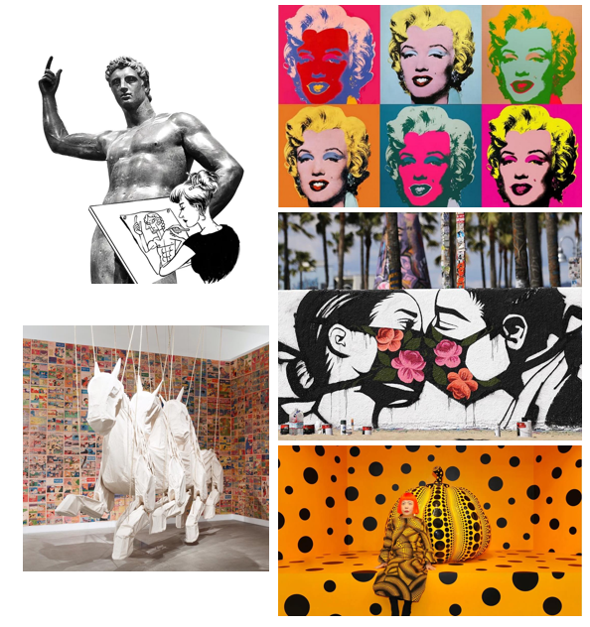
How can we “Meet the Artists” ?
a face-to-face meeting/ a direct communication
appreciate artworks on site
watch the documentary to learn further about them
immersive experience to admire the art
hands-on experience to make the art...
sculpture
pop art
The exhibition transported me to another time with its amazing collection of works to meet the artist.
A vivid introduction was given by the artist to enable me to know about the story behind the creation of the artworks. The art is brought to life.
The VR show of the works made the audience share the scene together with the artist.
street art
installation art
Artworks may include:
oil paintings, watercolor, ink wash paintings, folk art...
R&B, rock and roll, classic music...
ballet, folk/belly dance...
drama, literature, handcrafts...
visual art
Different forms and schools

Slide 6

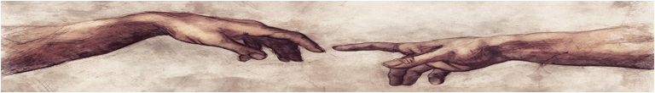
Basic info.:when, where, what, why, who...
Purpose?
Organized by the city museum for?
-- citizen oriented
display the exquiste beauty of traditional ink wash painting
explore the charm/glamor/realm of the visual art world
provide citizens with a fascinating source of inspiration
help the public get a deeper insight in ...
Last Saturday witnessed the “Meet the Artists” exhibition held in our city museum, which attracted hundreds of people to involve in. A series/string/ chain of abstract art by modern western artists was displayed, depicting the art communication in visual ways.
To/Aiming to/Aimed at enable/enabling more people to have a closer encounter with art and artists, the city museum organize the “Meet the Artists” exhibition during the past weekend. Throngs of visitors attended it in high spirits by awakening their visual imagination.
Yesterday, an exhibition themed on “Meet the Artists” was launched in the city museum. Featuring/Highlighting the traditional watercolor and ink wash paintings, the exhibition provide the art enthusiasts a fantastic feast for eyes.

Slide 7
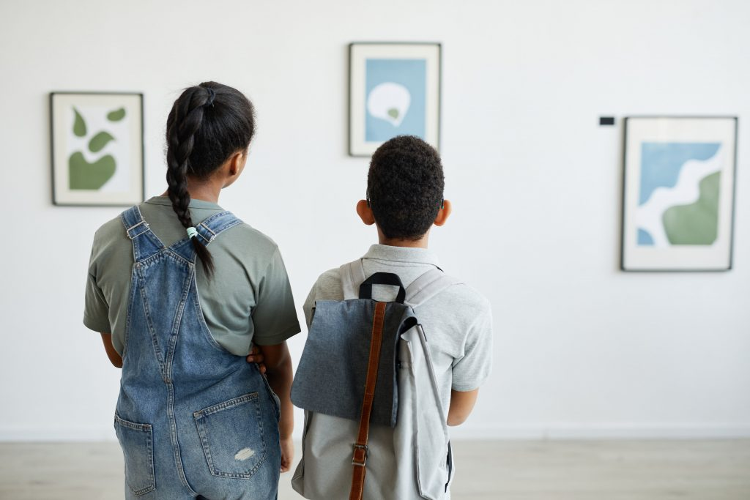
The analyses and interpretations of your observations;
Explain what observations mean to you;
Explain what they might mean to the potential readers.
I was amazed by the ink wash paintings’ delicate differences in the shade of black, grey and white. Their vivid portayal of landscapes and figures are appealing to the visitors.
The indoor aesthetic environment provides wonderful spaces and opportunities to boost inspiration and imagination in life.
The present artist’s guidance enabled the visitors like me to gain a deeper insight of the works and personally connect with the artworks, generating a deeper communication.
The interactive process of oil painting enable visitors to explore many cognitive concepts through the creative exploration.

Slide 8
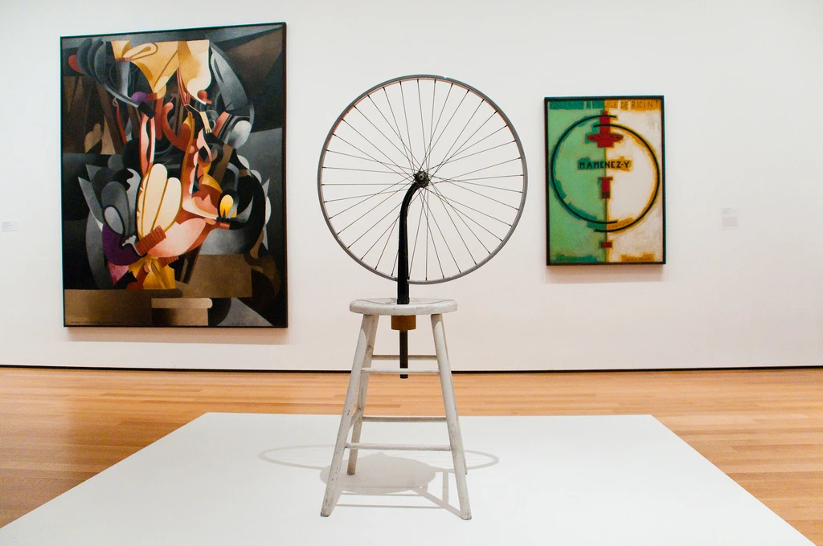
thing(s) can be improved or your further expectation
Suggestions
Expectations
or
To extend the exhibition duration for more days
To optimize the visual effects with modern tech
To add some interactive process ...
On present artists
On exhibition contents
On activities...
Hope the joy can be extended by organizing more similar activities in the following days.
Maybe an immersive process can be added in the following activities like this one.
More dimentions of art are expected to be displayed in the future!
...

Slide 9

This May Day saw numerous visitors to the “Meet the Artists” exhibition in our city museum. (when, who, what, where)To cultivate citizen’s artistic accomplishment, the museum exhibited many fantastic pictures of impressionists and post-impressionist, bringing a feast for the eyes of art lovers. (what, why)I enjoyed every second of the show and was particularly attracted by Van Gogh’s Starry Night and the Sunflowers. Exposed to his colors, forms and imagination, I seemed to have reached his passionate inner world. (feelings and gains)I hope in the future shows can last longer and more schools of pictures including Chinese masterpieces can be displayed. (expectations)
An exhibition themed on “Meet the Artists” was unveiled in the city museum yesterday. Featuring the pop visual artworks, the exhibition engage both the art enthusiasts’ eyes and minds with fantastic painting and sculptures. (when, who, what, where) The VR show of the renowned colorful Monroe’s portrait made the audience share the scene together with the artist. While, a vivid artwork consisting of comic books titled “Youth” bound me closer with a local artist for its vitality and creative form.(details) Weaving thoughts and spirits into the canvas delights our senses, which is far more than simply pleasurable for us visitors.(feelings and gains) More immersive events of this kind are highly anticipated!(suggestion& expectation)

