Slide 1

感恩遇见，相互成就，本课件资料仅供您个人参考、教学使用，严禁自行在网络传播，违者依知识产权法追究法律责任。
更多教学资源请关注
公众号：溯恩高中英语
知识产权声明

Slide 2
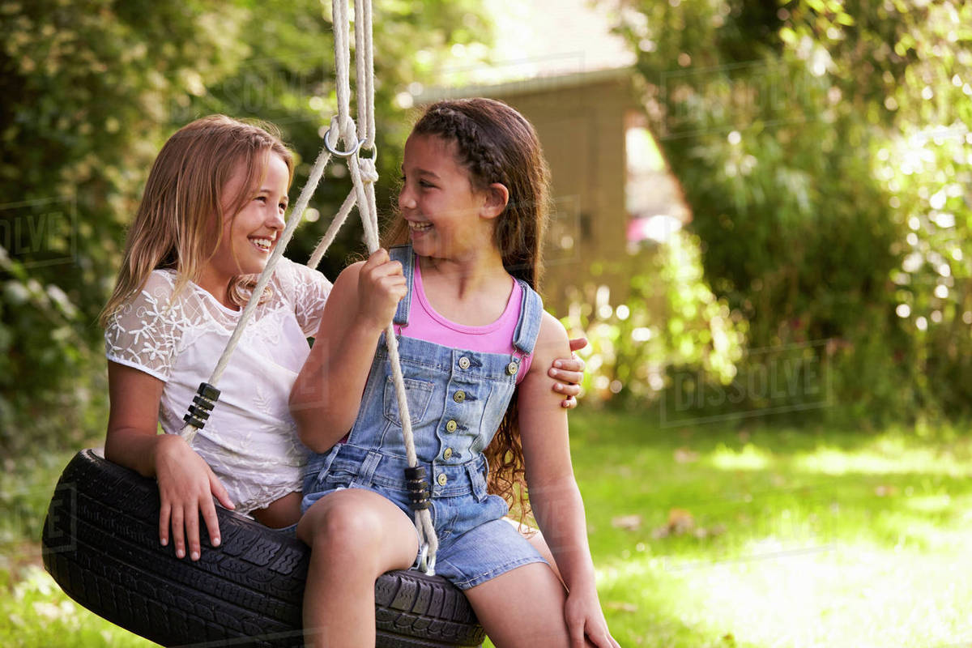
读后续写 义乌市划杠考
Gramma
--Cousins ought to know each other better

Slide 3
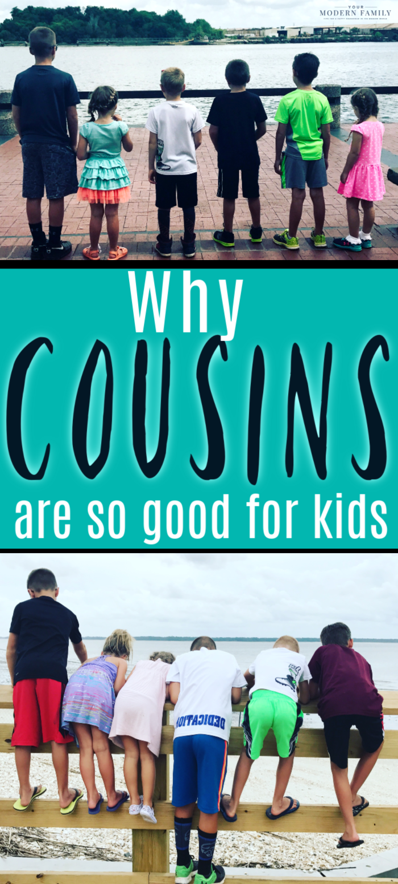
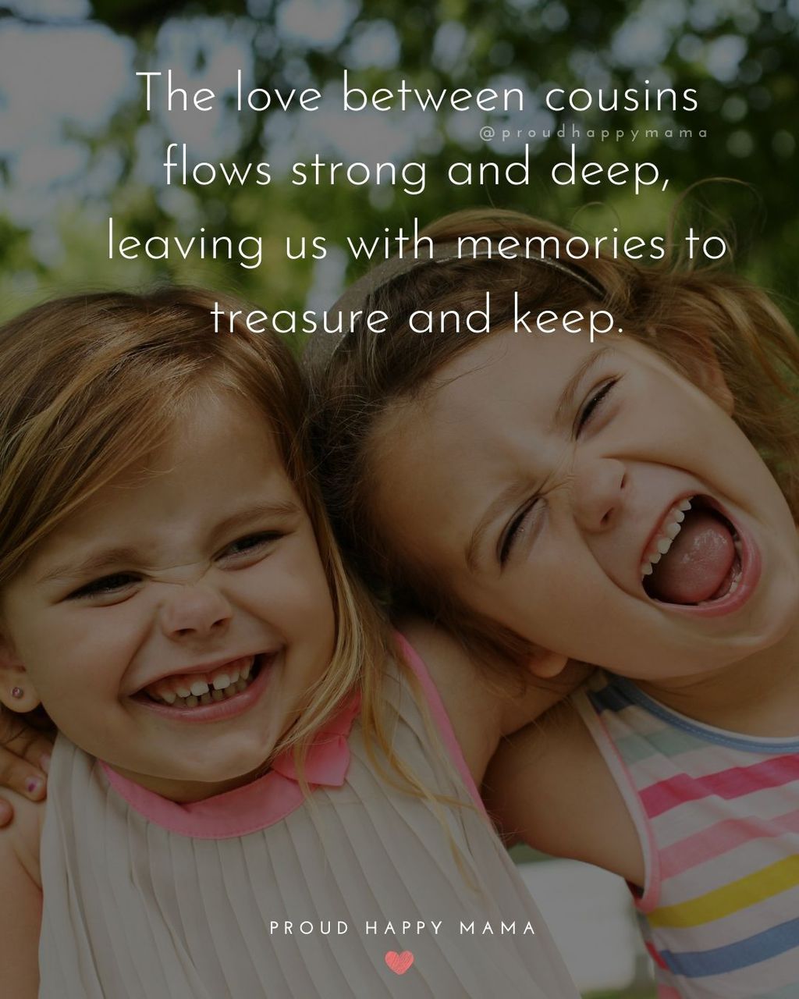
话题导入
They don’t care what they look like because they are cousins. They are accepted as they are. They share clothes, shoes, pajamas & beds without a second thought.
Cousins will always be best friends from the same family tree.
There’s nothing like family. The people we're related to by blood and marriage are expected to be our closest allies (盟友), our greatest sources of love and support.
“Grandma’s House is where cousins go to become friends.”

Slide 4
原题呈现
/ˈmaɪə, ˈmɑːjə, ˈmɑːjɑː/
①I like staying overnight at my Gramma’s house—that is, until Gramma starts telling me how wonderful my cousin Maya is. Then it’s Maya this and Maya that until I don’t ever want to hear another word about her.
②That’s why I wasn’t too excited when Gramma called me on the phone to “come on over and bring your pajamas.” When I got there, it was worse than I’d expected. There, in Grandpa’s big leather rocker, sat Maya, all dressed up and formal-looking and wearing fancy shoes as if she’d just been a party.
③“Surprise, Kristen!” Gramma said. “Your cousin Maya and her parents have traveled in from the East Coast on business. Maya gets to stay with us this afternoon.” Gramma chattered away about how excited she’d been for this surprise get-together, and how cousins ought to get to know each other better.
④I hung my baseball cap in the closet and set my backpack by the stairway, all the time smiling and nodding as if I’d been waiting forever for this chance to spend an afternoon with Maya. Grandpa’s chair squawked (咯咯叫) as Maya rocked back and forth. It’s the chair I like best in the house, the one I usually sit in. I sat down on the sofa across from her.
⑤Shortly, Gramma went off to the kitchen to “see about some lunch,” she’d said. That left me stuck in the living room with rocking Maya.
⑥She was still small but taller than I’d remembered her from her last visit four years ago. She was good at small talk, though, and was chatting away about how nice it was to see me again. But I could tell that she didn’t really think so. The last time she was here, we’d had hours of fun together building caves out of Gramma’s sofa pillows.
⑦After that, I’d heard about her only through Gramma’s tales. Maya taking piano lessons. Maya learning math. Maya, Maya, Maya. Now Maya was here, looking great with the latest haircut and a fancy dress.
Glancing down at my jeans and my old sneakers, I wished I hadn’t come.
“How do you know all these things about me?” I asked.

Slide 5
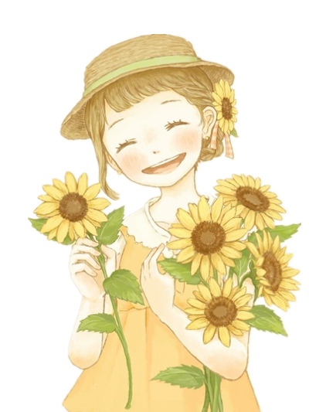

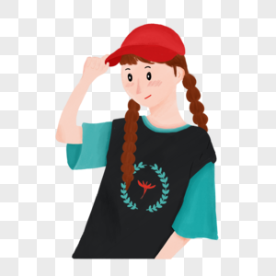
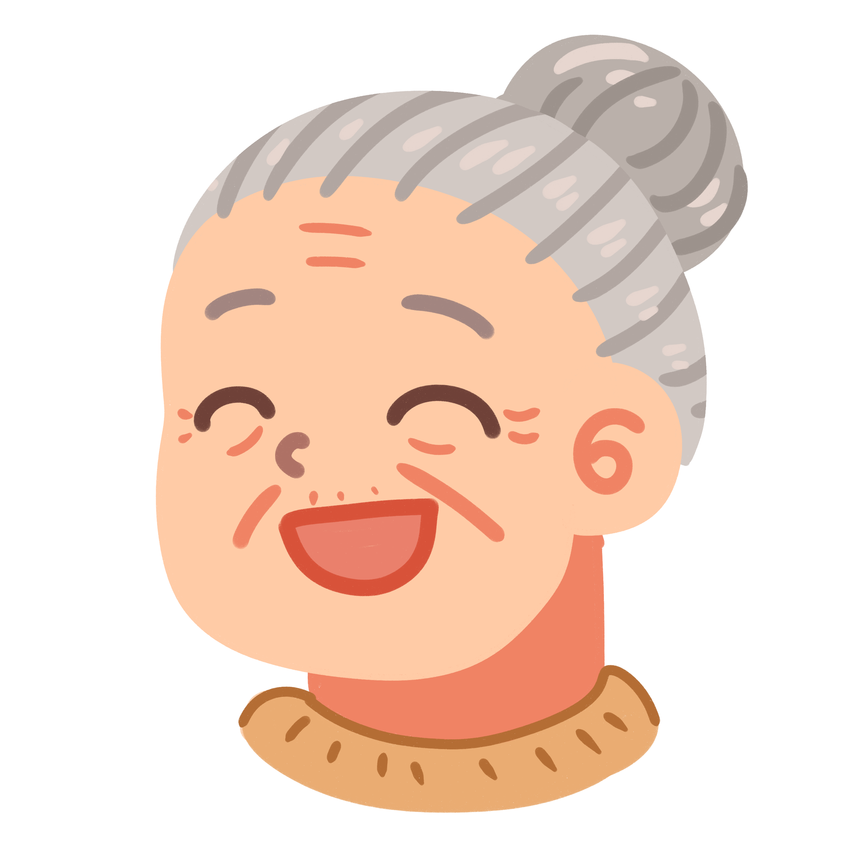
原题分析
Analyze the personality of each character (give supporting details from the original text)
Maya
Kristen
暗线：I acknowledged Gramma's real intention.
personal growth
a wonderful girl in Gramma's eyes
communicative
envious, reluctant to communicate
polite
“Gramma chattered away about how excited she’d been for this surprise get-together, and how cousins ought to get to know each other better.”
明线：Maya and “I” got to know each other better.

Slide 6

情节预测
Para. 1 Glancing down at my jeans and my old sneakers, I wished I hadn't come.
Para. 2 “How do you know all these things about me?” I asked.
1. Why did I think so? feelings?
2. How did we interact with each other?
3. What did Maya say about me?
difference--unwillingness &envy &unhappy
silence? smiling and nodding?
baseball cap, jeans and old sneakers 合理推测
change of feelings
change of interaction
1. What did Maya say in response?
2. How did I feel?
3. How did we interact with each other?
4. What reflection did I have?
Gramma!
relieved? happy?
harmony--sharing life
understand what Gramma intended to accomplish
personal growth

Slide 7

“回应”范例
(Para. 1) I like staying overnight at my Gramma’s house…
(Para. 2) That’s why I wasn’t too excited when Gramma called me on the phone to “come on over and bring your pajamas.”
(Para. 3) …stay with us this afternoon. Gramma chattered away about how excited she’d been for this surprise get-together, and how cousins ought to get to know each other better.
(Para. 6) She was still small but taller than I’d remembered her from her last visit four years ago… The last time she was here, we’d had hours of fun together building caves out of Gramma’s sofa pillows.
(ending)
1. That afternoon, both of us found back the lost delight we had had four years ago, not by building caves out of the sofa pillows since we had grown up/ matured, but through chatting about our shared and “told” stories.
2. Staying overnight at Gramma’s house, I finally acknowledged her real intention with the ecstasy of the regained connection to my cousin Maya.

Slide 8
contrast
“回应”范例
(Para. 1) …that is, until Gramma starts telling me how wonderful my cousin Maya is. Then it’s Maya this and Maya that until I don’t ever want to hear another word about her.
(Para. 4) …all the time smiling and nodding as if I’d been waiting for this chance to spend an afternoon with Maya. Grandpa’s chair squawked as Maya rocked back and forth. It’s the chair I like best in the house, the one I usually sit in.
(Para. 5) …That left me stuck in the living room with rocking Maya.
(Para. 6) …was good at small talk…
(Para. 7) After that, I’d heard about her only through Gramma’s tales. Maya taking piano lessons. Maya learning math. Maya, Maya, Maya. Now Maya was here, looking great with the latest haircut and a fancy dress.
1. Glancing down at my jeans and my old sneakers, I wished I hadn’t come.
(Para. 1开头+中间衔接)
There seemed to be an unbridgeable (无法弥合的；不可逾越的) gulf/ an unbreakable wall between us in the living room./ We were like people in two completely/ totally different worlds.
Maya was just the perfect wonderful fille (少女) in Gramma’s tale, elegant and confident; while I was only a sports-loving girl, having little interest in so-called classical music.
Forcing/ Managing a smile, I nodded every now and then, pretending to show interest in her small talk/ what she was talking about yet constantly distracted by squawks of my Grandpa's leather rocker.

Slide 9
“回应”范例
contrast
(Para. 1结尾)
To my great astonishment,/ It greatly surprised me that Maya should (竟然) mention my my recent improvement in study and even showed particular enthusiasm in my upcoming baseball match.
My attention gradually shifted/ was gradually distracted from the squawking sound as she talked something about my life. How could she know that!
(Para. 2开头+中间衔接)
“Gramma told me that!” she exclaimed.
It turned out that Gramma had been the bridge between us./ was chattering away about me on the phone with Maya, exactly the same with what happened to me.
The harsh/ strident (刺耳的) squawks/ screaks (嘎嘎响) ended up less annoying. Opening our hearts to each other, we shared the rocker and our personal life in the past four years as well (轭式结构), rocking back and forth at ease.
(Para. 1) …that is, until Gramma starts telling me how wonderful my cousin Maya is. Then it’s Maya this and Maya that until I don’t ever want to hear another word about her.
(Para. 4) I hung my baseball cap...Grandpa’s chair squawked as Maya rocked back and forth. It’s the chair I like best in the house, the one I usually sit in.
(Para. 5) …That left me stuck in the living room with rocking Maya.
(Para. 7) After that, I’d heard about her only through Gramma’s tales. Maya taking piano lessons. Maya learning math. Maya, Maya, Maya...
2. How do you know all these things about me?” I asked.

Slide 10
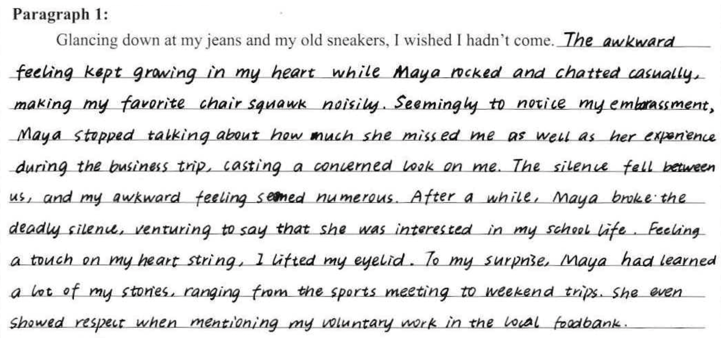
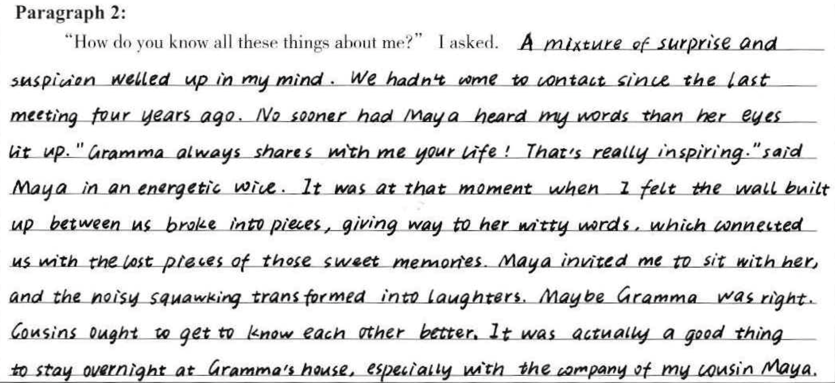
佳作赏析
阅卷给分：22分
情节合理
部分用词不够准确、不符合文意；
衔接与连贯不够

Slide 11
佳作赏析——修改稿
Glancing down at my jeans and my old sneakers, I wished I hadn’t come. The frustration kept mounting in my heart while the perfect “chatterbox” (话痨，体现心情) rocked and my favorite chair squawked noisily. But I had to force a smile, pretending to be enthusiastic. Seeming to notice my uneasiness, Maya stopped and cast a concerned look at me. Silence fell and I was nearly overwhelmed by enormous awkwardness. After a while, she broke the ice (破冰), talking about my school life. How could she know that? I looked up to her in confusion. Surprisingly, she detailed my baseball match, weekend getaways and even my voluntary work in local nursery I attended that morning. (99 words) “How do you know all these things about me?” I asked. A mixture of surprise and suspicion welled up in my mind. After all, we had never been in contact for four years. “Gramma always shares with me your life.” Her words floated into my ears as I met her knowing look. It was at that moment that the wall standing between us collapsed, instead, a bond was rebuilt, reminding me of the lost pieces of those sweet memories. During the afternoon, the living room was brimming with (充满；洋溢着) our laughters. I finally understood Gramma was right, and thanks to her, we indeed knew each other better. (97 words)

Slide 12
下水作文
Glancing down at my jeans and my old sneakers, I wished I hadn’t come. Her nice haircut, trendy outfit and graceful manner all made me feel inferior. (原因：自惭形秽) How could she be so perfect? I thought to myself, my head cluttered with (塞满) a mix of jealousy and embarrassment.(想法+情绪) Despite that, I still managed a smile and nodded every now and then as she was lecturing her experiences- what I had already heard of from Gramma for a thousand times! (互动+情绪体现) Time dragged, and the constant squawks of Grandpa’s rocker made it accumulatingly unbearable. (情绪升级) I was about to excuse myself off the living room when Maya said admiringly, “How does it feel winning the baseball match? I’ve never claimed the top spot.” Ignoring the apparent astonishment on my face, she continued mentioning my recent improvement in math and other private trivia (琐事).(转折点+衔接下文) (130 words)
“How do you know all these things about me?” I asked. “It was Gramma!” she grumbled (咕哝，抱怨), “She talked a lot about you on the phone. I rather envy you.”(真相) Her words came as a heavy blow in my heart.(情绪) It turned out Gramma had always been the bridge between us, bonding us with her special attention, and more importantly, her “storytelling”. (成长：认知) Later that afternoon, both of us found back the lost delight we had had four years ago through chatting about more than “told” stories over the hot tea prepared by Gramma. (互动变化) After Maya left, I gave Gramma a bear hug and thanked her for giving us a place to reconnect and showering us with unspoken love. With a settled heart, I fell sound asleep early at night, enjoying a sweet dream of regaining a wonderful cousin.(成长：行为) (135 words)

Slide 13
参考范文
Glancing down at my jeans and my old sneakers, I wished I hadn’t come. A rush of shame flooded over me as I compared myself to Maya – Gramma's favorite. She was smarter, prettier, and more talented than I could ever hope to be. The thought of being loved less by Gramma because of Maya was unbearable. “I hear you like to skate,” Maya's words crashed through my thoughts (打断思绪). What she announced was totally beyond my expectation. Astonished and speechless, I wondered how she knew about my skating. “I hear you are the captain of your baseball team. Even better, you are always competitive and aggressive in any sports activities,” she exclaimed, her eyes full of envy and admiration.
“How do you know all these things about me?” I asked. Shrugging and looking down, Maya told me that my Gramma wrote about me in her letters and that I was her favorite person to write about. Numb with shock, I stared at Maya's face, and the only thing that came to my mind was, “You won the first prize in the math competition, didn't you?” Maya looked up, confused. I explained that my Gramma talked about her all the time. We laughed, chatted about everything, and had fun building caves out of Gramma’s sofa pillows. Time flew by, and as Maya and her parents drove off, Gramma and I waved goodbye until they were out of sight. “Isn't Maya a lovely child!” Gramma grinned. “She's really nice,” I agreed, now understanding that Gramma had two favorites. （第一人称有限视角下的人物心情描写）

