Slide 1

感恩遇见，相互成就，本课件资料仅供您个人参考、教学使用，严禁自行在网络传播，违者依知识产权法追究法律责任。
更多教学资源请关注
公众号：溯恩高中英语
知识产权声明

Slide 2


冲刺2023高考 满分攻略
阅读理解A篇
Fay 2023.05
essay structure
quick positioning
accurate selection

Slide 3


CONTENTS
A篇真题通览与对比
A篇解题攻略
实例分析
建议

Slide 4
浙江卷阅读理解A篇通览
 | 体裁 | 字数 | 主题内容 | 题号 | 设问定位 | 题型
2023.01 浙江卷 | 应用文 | 205 | 人与社会：儿童露营的内容与安排 | 21 | 无标题/开头 | 细节信息
 |  |  |  | 22 | 小标题1 | 细节信息
 |  |  |  | 23 | 开头+小标题1 | 细节信息
2022.01 浙江卷 | 记叙文 | 354 | 人与自我：讲述Merebeth从事的新工作。近十年来，她一直是一名自营宠物运输专家。 | 21 | 无标题/段1 | 细节信息
 |  |  |  | 22 | 无标题/段2 | 词义猜测
 |  |  |  | 23 | 无标题/尾段 | 推理判断
2022.06 浙江卷 | 记叙文 | 329 | 人与自我：讲述了作者作为意大利人在美国的成长经历，展示了作者对多元文化的接纳过程 | 21 | 无标题/段1 | 细节信息
 |  |  |  | 22 | 无标题/段2 | 推理判断
 |  |  |  | 23 | 无标题/段3 | 推理判断
2021.01 浙江卷 | 记叙文 | 261 | 人与自我：文章主要讲述了布尔利小时候意外走失，长大后通过自己努力找回家人的故事。 | 21 | 无标题/段1 | 细节信息
 |  |  |  | 22 | 无标题/段4 | 细节信息
 |  |  |  | 23 | 无标题/尾段 | 细节信息
2021.06 浙江卷 | 记叙文 | 290 | 人与自我：文章介绍了著名影视明星Leslie Nielsen的星路历程---他的故事告诉我们，有志者事竟成。。 | 21 | 无标题/段1 | 细节信息
 |  |  |  | 22 | 无标题/段2 | 细节信息
 |  |  |  | 23 | 无标题/段3 | 推理判断
2020.01 浙江卷 | 记叙文 | 296 | 人与自我：作者回忆了她早年的图书馆阅读经历，母亲在阅读方面对她产生了很大的影响。 | 21 | 无标题/段1 | 推理判断
 |  |  |  | 22 | 无标题/段3 | 推理判断
 |  |  |  | 23 | 无标题/全文 | 推理判断

Slide 5




全国Ⅰ卷阅读理解A篇通览
 | 体裁 | 字数 | 主题内容 | 题号 | 设问定位 | 题型
2022 新高考Ⅰ卷 | 应用文 | 234 | 人与社会：文学概论课的评分政策，了解国外学校的课程学习评价方法 | 21 | 大小标题 | 推断体裁
 |  |  |  | 22 | 小标题234 | 细节信息
 |  |  |  | 23 | 小标题5 | 细节信息
2021 全国Ⅰ卷 | 应用文 | 281 | 人与社会：罗马住宿，介绍了罗马的几个价格低廉、安全舒适的旅馆 | 21 | 无标题/首段 | 细节信息
 |  |  |  | 22 | 小标题2 | 细节信息
 |  |  |  | 23 | 小标题4 | 细节信息
2020 全国Ⅰ卷 | 应用文 | 222 表格 | 人与社会：一些火车信息，如失物招领、出发时间等 | 21 | 无标题/首段 | 细节信息
 |  |  |  | 22 | 小标题1 | 细节信息
 |  |  |  | 23 | 表格/尾段 | 细节信息
2019 全国Ⅰ卷 | 应用文 | 261 | 人与社会：社会服务与人际沟通，加拿大安大略省政府给青少年提供暑期工作信息 | 21 | 小标题2 | 细节信息
 |  |  |  | 22 | 小标题3 | 细节信息
 |  |  |  | 23 | 小标题3 | 细节信息
2018 全国Ⅰ卷 | 应用文 | 260 | 人与社会：骑自行车到Washington, D.C.旅游的四中路线的相关行程及注意事项。 | 21 | 小标题1 | 细节信息
 |  |  |  | 22 | 小标题2 | 细节信息
 |  |  |  | 23 | 小标题4 | 细节信息
 | 浙江卷A篇 | 全国Ⅰ卷A篇
字数 | 300词左右 | 300词以内
体裁 | 记叙文为主 | 应用文为主
主题 | 人与自我为主 | 人与社会为主
设问定位 | 题文同序 均匀出题 | 题文同序 均匀出题
题型 | 细节信息+推理为主 | 细节信息题为主
应用文

Slide 6

Easy but not simple
应用文阅读
语篇特点
解题策略

Slide 7
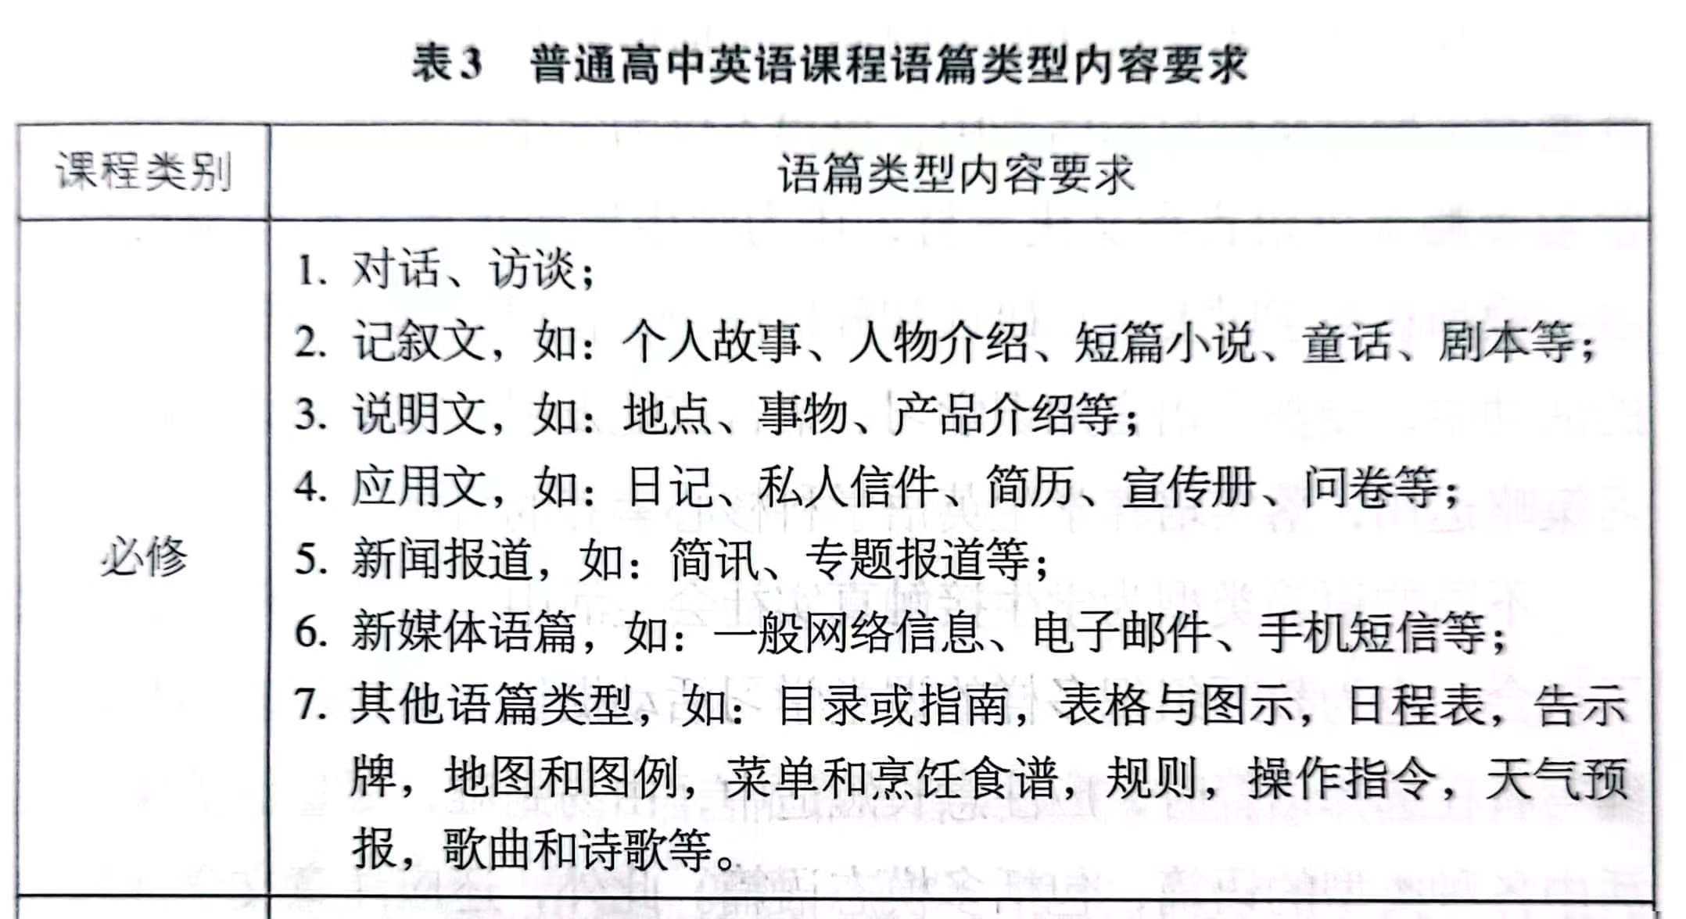


语篇特点
告知类：通知、指南、广告、倡议书、海报、报道、说明书等
功能
事务类：申请信、投诉信、邀请信等
礼仪类：感谢信等
应用文
为实现目的的组织信息：传递信息、处理事务、交流感情
连续性文本：完整、连续的句群组成的议论文、记叙文、说明文等
语篇
形式直观：图表、漫画、清单、问卷、网页、广告等
图文结合形式呈现的文本
目的明确
非连续性文本
语言简明：简洁、目的性、概括性
格式较固定
不同来源的各种文本片段

Slide 8
非连续性文本
选材特点 | 信息量大，文句精炼，形式灵活，用少篇幅表达最大量的信息
内容特点 | 生活化，实用化，多样化，如产品宣传、服务介绍、通知、海报、启示、招生招聘等。
形式特点 | 标题醒目，重点突出，条理清晰，常用图表、粗体字、下划线、图画或各类项目符号使文章的结构更鲜明。
语言特点 | 人名、地名、专有名词多；生词多；缩略词、祈使句、省略句多；结构不完整。
命题特点 | 主要考查考生提取信息和处理信息的能力，既注重特定细节的筛选、类比、综合，又注重推理判断题的考查，题目设置相对较容易。

Slide 9







解题策略
2定位信息
4排除错误答案
Skipping
1
分析题干/关键词
3分析比对
5
注意题干或选项的同义转换
原文的变形(如同义改写、词性转换等)
close reading

Slide 10

解题策略
A sample
大标题
导语/首段/碎片信息—— —— ——
小标题1
————————————————
小标题2
————————————————
小标题3
————————————————
（结语）
把握语篇结构
集中
人名、地名、数字、实词等
快速定位信息
分散
出题顺序/题文同序；均匀出题/分布均匀
印刷特征：大写、加粗、标记、汉字、括号、图表等

Slide 11

真题实例
We are the champion!

Slide 12


2022全国Ⅰ卷
A
Grading Policies for Introduction to Literature
Grading Scale
90-100, A; 80-89, B; 70-79, C; 60-69, D; Below 60, E.
Essays (60%)
Your four major essays will combine to form the main part of the grade for this course: Essay 1 = 10%; Essay 2 = 15%; Essay 3 = 15%; Essay 4 = 20%.
Group Assignments (30%)
Students will work in groups to complete four assignments (作业) during the course. All the assignments will be submitted by the assigned date through Blackboard, our online learning and course management system.
Daily Work/In-Class Writings and Tests/Group Work/Homework (10%)
Class activities will vary from day to day, but students must be ready to complete short in-class writings or tests drawn directly from assigned readings or notes from the previous class' lecture/discussion, so it is important to take careful notes during class. Additionally, from time to time I will assign group work to be completed in class or short assignments to be completed at home, both of which will be graded.
Late Work
An essay not submitted in class on the due date will lose a letter grade for each class period it is late. If it is not turned in by the 4th day after the due date, it will earn a zero. Daily assignments not completed during class will get a zero. Short writings missed as a result of an excused absence will be accepted.
TIP1:加强碎片化信息整合能力
分散各处
TIP2:提升语篇结构意识
21. Where is this text probably taken from?
A textbook. B. An exam paper.
C. A course plan. D. An academic article.
分散
22. How many parts is a student’s final grade made up of?
A. Two. B. Three. C. Four. D. Five.
23. What will happen if you submit an essay one week after the due date?
You will receive a zero.
B. You will lose a letter grade.
C. You will be given a test.
D. You will have to rewrite it.
集中一处

Slide 13


Explorers Camp
•Full day camp for kids aged 5-13.
•Monday-Friday, July 8-26, 9am-4pm. Week 1 | July 8-12
Week 2 | July 15-19
Week 3 | July 22-26
•Register for a single week or multiple weeks.
•Fees: $365 per week.
•The last day to cancel registration and receive a full refund(退款) is June 15.
Camp Structure
The day is divided into two thematic sessions per age group. Campers have a three- hour morning class engaging with a morning theme (9am to 12 noon) and a one-hour lunch break, followed by another three-hour class engaging with an afternoon theme(1pm to 4pm)。Snack periods are held throughout the day. All campers should bring their own bagged lunch and snacks.
Camp Content
Explorers Camp organizes engaging arts, history and science-related activities in every! class,
and focuses on a range of topics that emphasize active learning, exploration and, most of all, fun! All camp sessions are created with age-appropriate activities that are tailored to the multiple ways that kids learn.
Camp Staff
Campers enjoy a staff-to-child ratio ranging from 1:4 to 1:7 depending on the age group. Instructors are passionate educators who are experts in their fields and have undergone training and a background check.
2023浙江卷
TIP1:加强碎片化信息整合能力
TIP2:提升语篇结构意识
21.On which of the following dates can you cancel your registration with a full refund?
A. June 12. B. June 22.
C. July 19. D. July 26.
22.How are campers divided into different groups?
A. By gender.
B. By nationality.
C. By interest.
D. By age.
23.How many hours of class will you have altogether if you register for a single week?
A. 15. B. 21. C. 30. D. 42.
整合信息
整合信息

Slide 14

2018全国Ⅰ卷
A
Washington, D.C. Bicycle Tours
Cherry Blossom Bike Tour in Washington, D.C.
Duration Tour
This small group bike tour is a fantastic way to see a world-famous cherry trees with beautiful flowers of Washington, D.C. Your guide will provide a history lesson about the trees and the famous monuments where they blossom. Reserve your spot before availability — the cherry blossoms—disappear!
21.Which tour do you need to book in advance?
A. Cherry Blossom like Tour in Washington, D.C.
B. Washington capital Monuments Bicycle Tour.
C. Capital City Bike Tour in Washington, D.C.
D. Washington Capital Sites at Night Bicycle Tour.
同义转换
2021全国Ⅰ卷
A
Rome can be pricey for travelers, which is why many choose to stay in a hostel (旅社). The hostels in Rome offer a bed in a dorm room for around $25 a night, and for that, you’ll often get to stay in a central location (位置) with security and comfort.
Yellow Hostel
If I had to make just one recommendation for where to stay in Rome, it would be Yellow Hostel. It’s one of the best-rated hostels in the city, and for good reason. It’s affordable, and it’s got a fun atmosphere without being too noisy. As an added bonus, it’s close to the main train station.
Hostel Alessandro Palace
If you love social hostels, this is the best hostel for you in Rome. Hostel Alessandro Palace is fun. Staff members hold plenty of bar events for guests like free shots, bar crawls and karaoke. There’s also an area on the rooftop for hanging out with other travelers during the summer.
同义转换
21. What is probably the major concern of travelers who choose to stay in a hostel?
A. Comfort. B. Security. C. Price. D. Location.
22. Which hotel best suits people who enjoy an active social life?
A. Yellow Hostel.
B. Hostel Alessandro Palace.
C. Youth Station Hostel.
D. Hotel and Hostel Des Artistes.
词性变化
原词复现
TIP3:积累词库，关注题干与选项中的同义转换、词形变化。

Slide 15
Need a Job This Summer?
The provincial government and its partners offer many programs to help students find summer jobs. The deadlines and what you need to apply depend on the program.
Not a student? Go to the government website to learn about programs and online tools available to help people under 30 build skills, find a job or start businesses all year round.
Jobs for Youth
If you are a teenager living in certain parts of the province, you could be eligible(符合条件)for this program. Which provides eight weeks of paid employment along with training.
Who is eligible: Youth 15-18 years old in select communities(社区).
Summer Company
Summer Company provides students with hands-on business training and awards of up to $3,000 to start and run their own summer businesses.
Who is eligible: Students aged 15-29, returning to school in the fall.
Stewardship Youth Ranger Program
You could apply to be a Stewardship Youth Ranger and work on local natural resource management projects for eight weeks this summer.
Who is eligible: Students aged 16 or 17 at time of hire, but not turning 18 before December 31 this year.
Summer Employment Opportunities(机会)
Through the Summer Employment Opportunities program, students are hired each year in a variety of summer positions across the Provincial Public Service, its related agencies and community groups.
Who is eligible: Students aged 15 or older. Some positions require students to be 15 to 24 or up to 29 for persons with a disability.
2019全国Ⅰ卷
21. What is special about Summer Company?
A. It requires no training before employment.
B. It provides awards for running new businesses.
C. It allows one to work in the natural environment.
D. It offers more summer job opportunities.
22. What is the age range required by Stewardship Youth Ranger Program?
15-18. B. 15-24. C. 15-29. D. 16-17.
23. Which program favors the disabled?
Jobs for Youth.
B. Summer Company.
C. Stewardship Youth Ranger Program.
D. Summer Employment Opportunities.
利用标题快速定位
选项复现
选项复现
词性变化

Slide 16
2020全国Ⅰ卷
Train Information
All customers travelling on TransLink services must be in possession of a valid ticket before boarding. For ticket information，please ask at your local station or call 13 12 30.
While Queensland Rail makes every effort to ensure trains run as scheduled，there can be no guarantee of connections between trains or between train services and bus services.
Lost property(失物招领)
Call Lost Property on 13 16 17 during business hours for items lost on Queensland Rail services.
The lost property office is open Monday to Friday 7:30am to 5:00pm and is located(位于)at Roma Street station.
Public holidays
On public holidays, generally a Sunday timetable operates. On certain major event days，i.e.
Australia Day, Anzac Day, sporting and cultural days, special additional services may operate.
Christmas Day services operate to a Christmas Day timetable，Before travel please visit translink. com. au or call TransLink on 13 12 30 anytime.
Customers using mobility devices
Many stations have wheelchair access from the car park or entrance to the station platforms.
For assistance, please Queensland Rail on 13 16 17.
Guardian trains (outbound)
Depart | Origin | Destination | Arrive
6:42pm | Altandi | Varsity Lakes | 7:37pm
7:29pm | Central | Varsity Lakes | 8:52pm
8:57pm | Fortitude Valley | Varsity Lakes | 9:52pm
11:02pm | Roma Street | Varsity Lakes | 12:22am
21. What would you do get ticker information?
A. Call 13 16 17. B. Visit translink .com.au.
C. Ask at the local station. D. Check the train schedule.
22. At which station can you find the lost property office?
Altandi. B. Roma Street.
C. Varsity Lakes. D. Fortitude Valley.
23. Which train would you take if you go from Central to Varsity Lakes?
A. 6:42 pm. B. 7:29 pm. C. 8:57 pm. D. 11:02 pm.
TIP4:手动画出框架结构，迅速解题

Slide 17



2021全国Ⅰ卷A
Hotel and Hostel Des Artistes
Hotel and Hostel Des Artistes is located just a 10-minute walk from the central city station and it's close to all of the city's main attractions. The staff is friendly and helpful, providing you with a map of the city when you arrive, and offering advice if you require some. However, you need to pay 2 euros a day for Wi-Fi.
23. What is the disadvantage of Hotel and Hostel Des Artistes?
It gets noisy at night.
B. Its staff is too talkative.
C. It charges for Wi-Fi.
D. It’s inconveniently located.
获取信息：发现关键信息
分析信息：分析和归纳整合信息
评价信息：做到一些简单的推理
A
篇
考
察

Slide 18




备考建议
把握语篇、明确类别：文本结构、功能类型
分析题干、定位信息：划出相关信息
读懂语言、细致比对、做出判断
把相似文本进行关联阅读，在横向阅读中发现并掌握其表达特征和规律，丰富相应的思维图式。
掌握表单类文本的表达特点与快速地提取关键信息的方法与策略:①多练不同结构类型题如产品介绍、图表类等。
②复盘试卷题干选项中的同义词、词块、句转换
③关注碎片信息分布整合信息与集中段落易错选项
设置特点

Slide 19
其他语篇结构类型参考
2022全国乙卷
A
Henry Raeburn（1756-1823）
The Exhibition
This exhibition of some sixty masterpieces celebrating the life and work of Scotland's best loved painter, Sir Henry Raeburn, comes to London. Selected from collections throughout the world, it is the first major exhibition of his work to be held in over forty years.
Lecture Series
Scottish National Portrait（肖像画）Gallery presents a series of lectures for the general public. They are held in the Lecture Room. Admission to lectures is free.
Exhibition Times
Monday-Saturday 10.00-17.45 Sunday 12.00-17.45
Last admission to the exhibition: 17.15. There is no re-admission.
Closed: 24-26 December and 1 January.
Admission
£4. Children under 12 years accompanied by an adult are admitted free.
Schools and Colleges
A special low entrance charge of £2 per person is available to all in full-time education, up to and including those at first degree level, in organised groups with teachers.
2021全国乙卷
A
The Biggest Stadiums in the World
People have been pouring into stadiums since the days of ancient Greece. In around 80 A.D., the Romans built the Colosseum, which remains the world’s best known stadium and continues to inform contemporary design. Rome’s Colosseum was 157 feet tall and had 80 entrances, seating 50,000 people. However, that was small fry compared with the city’s Circus Maximus, which accommodated around 250,000 people.
These days, safety regulations-not to mention the modern sports fan’s desire for a good view and comfortable seat—tend to keep stadium capacities（容量） slightly lower. Even soccer fans tend to have a seat each; gone are the days of thousands standing to watch the match.
For the biggest stadiums in the world, we have used data supplied by the World Atlas list so far, which ranks them by their stated permanent capacity, as well as updated information from official stadium websites.
All these stadiums are still funtional, still open and still hosting the biggest events in world sport.
·Rungrado 1st of May Stadium, Pyongyang D.P.R. Korea. Capacity: 150,000. Opened: May 1,1989.
·Michigan Stadium, Ann Arbor, Michigan, U. S. Capacity: 107,601. Opened: October 1, 1927.
·Beaver Stadium, State College, Pennsylvania, U. S. Capacity: 106,572. Opened: September 17, 1960.
·Ohio Stadium, Columbus, Ohio, U. S. Capacity: 104,944. Opened: October 7,1922.
·Kyle Field, College Station, Texas, U. S. Capacity: 102,512. Opened: September 24, 1927.
An Introduction to Raeburn Sunday 26 Oct., 15.00 DUNCAN THOMSON | Raeburn's English Contemporaries Thursday 30 Oct., 13.10 JUDY EGERTON
Characters and Characterisation in Raeburn's Portraits Thursday 6 Nov., 13.10 NICHOLAS PHILLIPSON | Raeburn and Artist's Training in the 18th Century Thursday 13 Nov., 13.10 MARTIN POSTLE
图表结合文本
混合文本/连+非连
图表结合文本

Slide 20
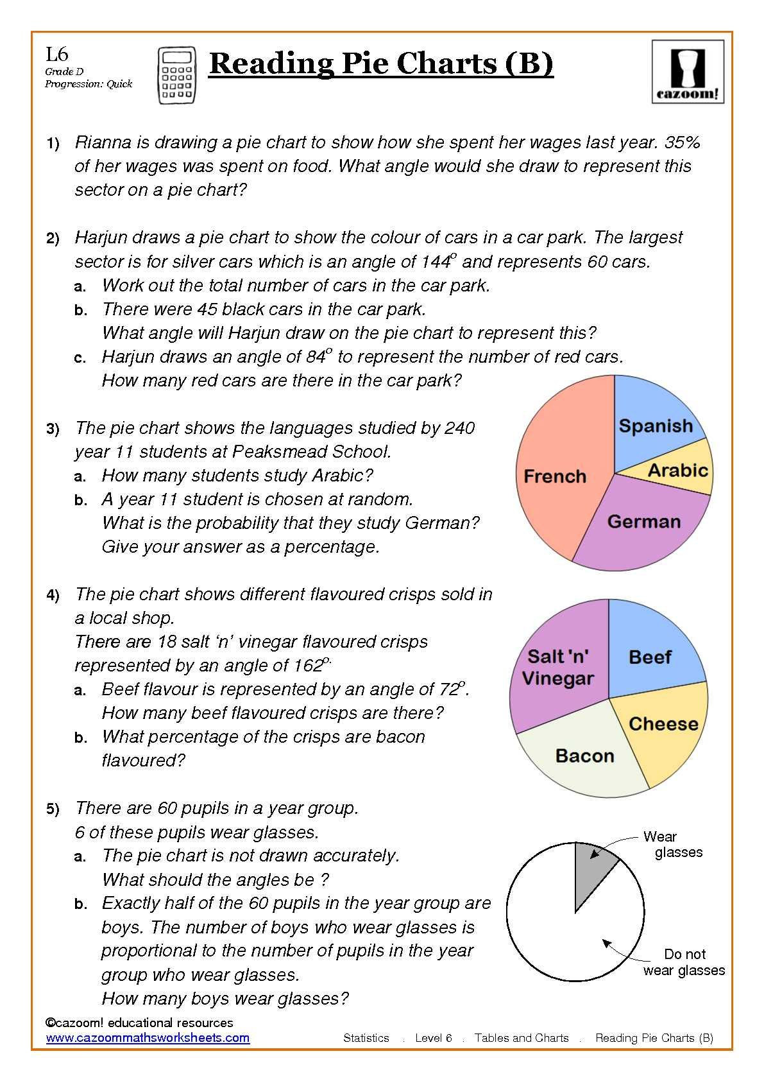
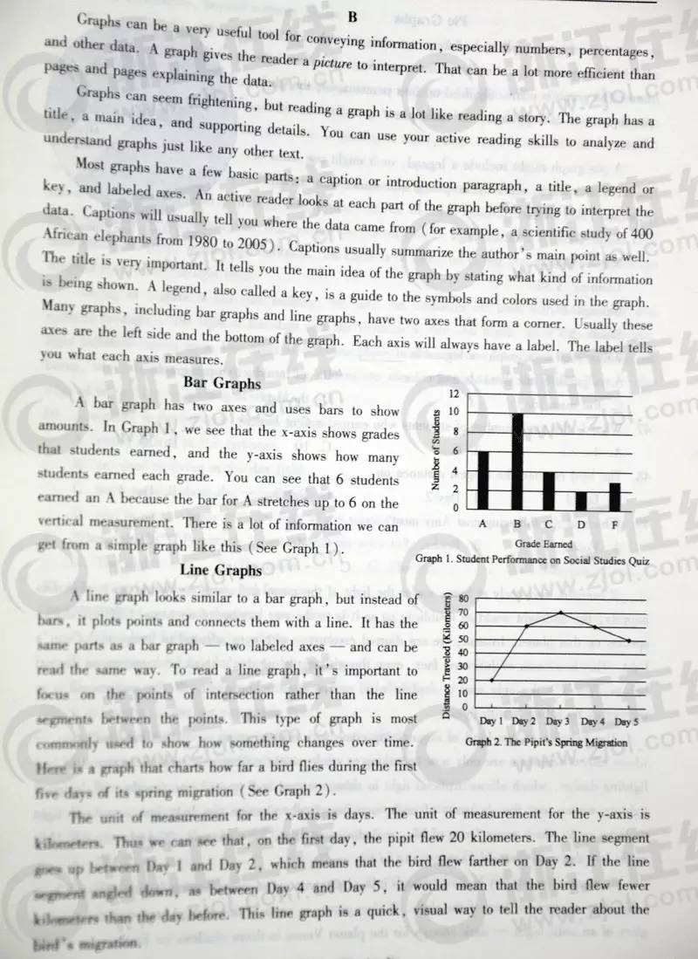
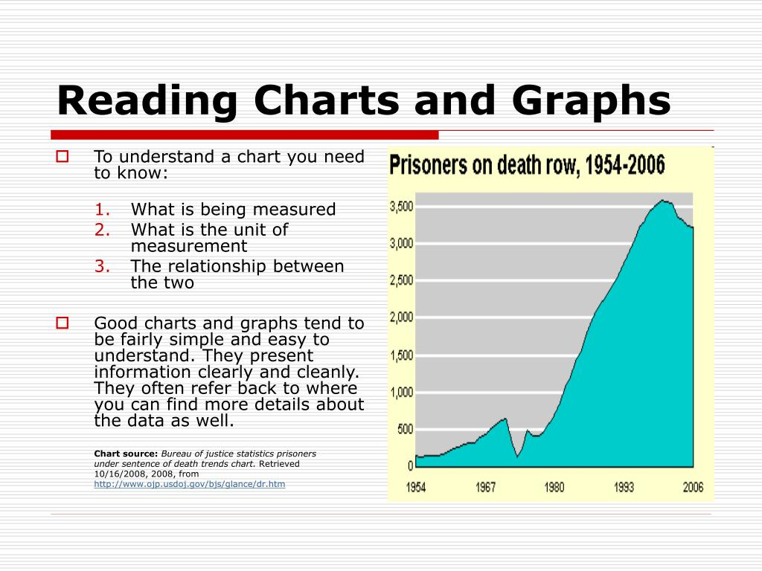
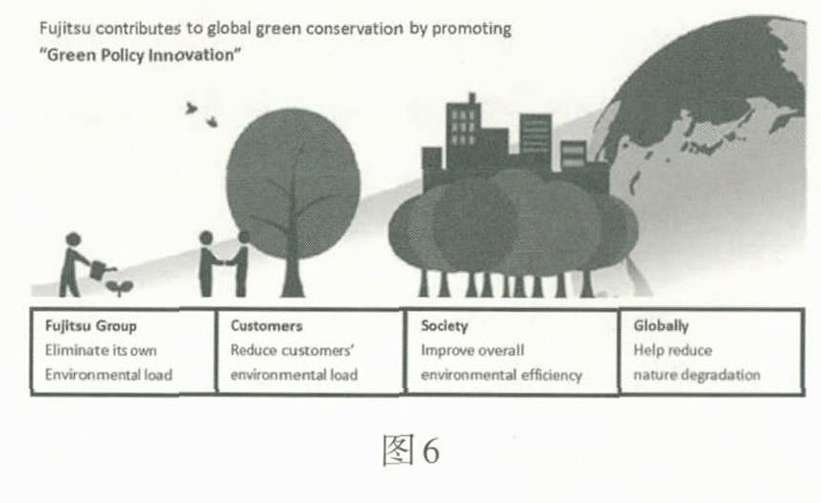
2015浙江卷B篇
各类图示文本阅读示例
不同类型图示阅读文本

Slide 21



We will go shore at last in the sunshine.
我们终究上岸，
阳光万里
感谢
观看
THANK
YOU
Fay

