Slide 1

感恩遇见，相互成就，本课件资料仅供您个人参考、教学使用，严禁自行在网络传播，违者依知识产权法追究法律责任。
更多教学资源请关注
公众号：溯恩高中英语
知识产权声明

Slide 2


4C教学模式下的应用文教学
台州市2023届高三二模 —— 邀请信
Invitation
2023

Slide 3

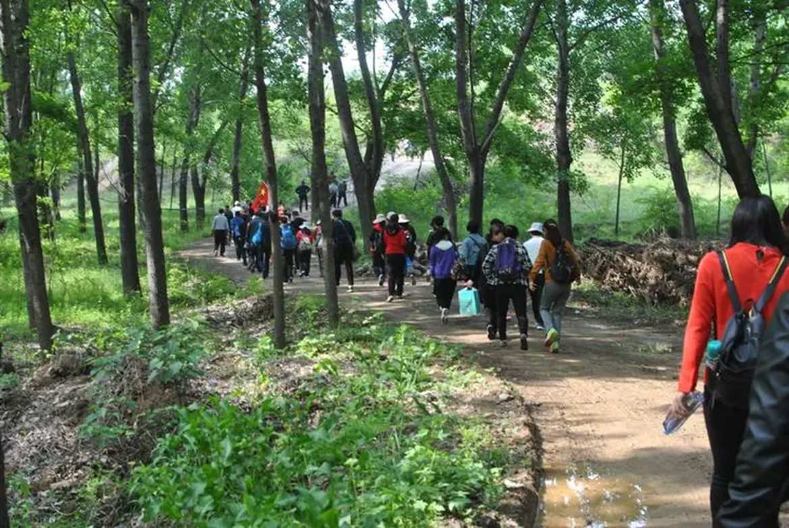
1.Connect
How to organize a hiking trip?
determine the ultimate destination of this hiking trip
1
2
consider the departure time
３
pay attention to safety
４
invite students and teachers
A hiking trip

Slide 4
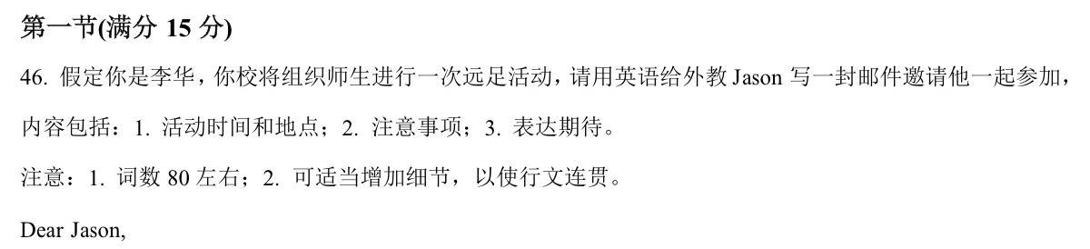
2. Construct
1.体裁
2.时态
3.对象
4.人称
5.语气
6.要点
邀请信
一般将来时为主
审题
外教Jason
第一人称/第二人称
正式、诚恳
（主要点）时间、地点、注意事项、表达期待。
（次要点）活动目的、感受。

Slide 5
2. Construct
An invitation
1. Beginning
③. When (departure time, date)
①. Greetings/ self-introduction
② Why (purpose)
④. Where (hiking place, meeting place)
2. Body
3. Ending
⑤. What (sight, consideration, feeling…)
⑥. (expectation, blessing)
邀请信总体结构

Slide 6
2. Construct
Beginning
篇首局：写作技巧以及功能句型
问候/渲染情感
+写作背景
+自我介绍
+目的
① Thrilled to learn that a group hiking trip is scheduled by our school, I am writing to invite you, a nature lover, to join us.
相似表达
② I hope this letter finds you well. Knowing that you are fond of hiking, I would like to sincerely invite you to join our hiking trip.
③ I am Li Hua. It is my pleasure to invite you to go hiking with us.
④ Taking the fact that you have a real enthusiasm for hiking, I’m writing to invite you come with us

Slide 7
2. Construct
详细阐述活动的时间，地点, 感受，活动形式和注意事项等
Body
篇中句：写作技巧以及功能句型
① We’re to gather at the school gate at 8:00 a.m. this Saturday and leave for our destination-South mountain park, a nature lover paradise.
② There we will hike through towering redwoods, marveling at natural wonders.
③ To make 3-hour hiking delightful, remember to prepare some essentials, such as snacks, drinks and sunscreen.
④ Also, you are supposed to wear comfortable and durable shoes to ensure your safety.

Slide 8
2. Construct
详细阐述活动的时间，地点, 感受，活动形式和注意事项等
Body
篇中句：写作技巧以及功能句型
① The event will take place on May 2nd and the destination is a scenic spot called South Mountain.
相似表达
② Our hiking trip is scheduled to start at the school gate at 8:00 a.m. this Saturday.
③ So charming are the sights that they leave a deep impression on visitors.
④ Wandering alongside streams and enjoying the magnificent view will be the prominent features in this trip/ will be the most exciting moment.
⑤ Not only will we enjoy the outdoors, but also we are going to explore a scenic trail.

Slide 9
2. Construct
详细阐述活动的时间，地点, 感受，活动形式和注意事项等
Body
篇中句：写作技巧以及功能句型
⑥ To make 3-hour hiking delightful, don’t forget to/ it is important to/ it should be a good idea to wear hiking boots and sturdy sneakers.
相似表达
⑦ You can also wear comfortable shoes, a hat and sunscreen.

Slide 10
2. Construct
Ending
篇尾句：写作技巧以及功能句型
表达期待+祝福
①. Looking forward to spending time with you/ hearing from you soon.
②. We do hope you are able to join us at this event.
③. We would feel much honoured if you could come.
④. We would be looking forward to your coming with great pleasure.
⑤. Your presence is highly expected. Best wishes for you.

Slide 11
2. Construct
范文
问候/渲染情感
+写作背景
+目的
+时间
+地点
+活动内容
+注意事项
+感受
+期待
Dear Jason, I hope this email finds you well. Our school is organizing a hiking trip and I would like to invite you to join us.
The event will take place on May 15th at Phoenix Mountain. We will be exploring a scenic trail and enjoying the outdoors. Please make sure to wear comfortable clothing and bring enough water and snacks for the trip. We also recommend wearing hiking boots or sturdy sneakers. We would be thrilled if you could join us for this exciting adventure. Looking forward to hearing from you soon!
Sincerely, Li Hu
Transition words

Slide 12
Create
假如你是李华，你的外教Linda对中国书法(calligraphy)很感兴趣。6月30日，城市文化中心将举行一个书法文化交流活动，请给她写一封邀请信，内容包括：
时间、地点；
活动内容：看展览、听讲座等；
活动的意义。
注意：写作词数应为80左右；可以适当增加细节，以使行文连贯。
1.体裁
2.时态
3.对象
4.人称
5.语气
6.要点
邀请信
一般将来时为主
审题
外教Linda
第一人称
正式、诚恳
（主要点）时间、地点、活动内容和意义。
（次要点）活动目的、感受。

Slide 13
Create
+写作背景
+目的
+时间
+地点
+活动内容
+意义
+期待
Dear Linda,
Knowing that you have a preference for Chinese calligraphy, I am writing to invite you to the calligraphy cultural exchange activity scheduled for May 30th in the City Culture Centre.
All the people present will have chances to enjoy an exhibition of traditional Chinese calligraphy and experience writing in the flesh. Besides, there will be a lecture addressed by a famous calligrapher, which will help you have a deep insight into Chinese classical culture.
Your presence is highly expected.
Yours sincerely,
Li Hua
Transition words

Slide 14
Criticize
Checklist
In my invitation letter, there are:
1. purpose | Yes No
2. time | Yes No
3. place | Yes No
4. consideration | Yes No
5. feeling | Yes No
6. expectation/ blessing | Yes No
In order to make the letter coherently, I (he or she) used:
Functional sentence pattern(s) | Yes No
Transition words | Yes No

Slide 15

Thank you

