Slide 1

感恩遇见，相互成就，本课件资料仅供您个人参考、教学使用，严禁自行在网络传播，违者依知识产权法追究法律责任。
更多教学资源请关注
公众号：溯恩高中英语
知识产权声明

Slide 2
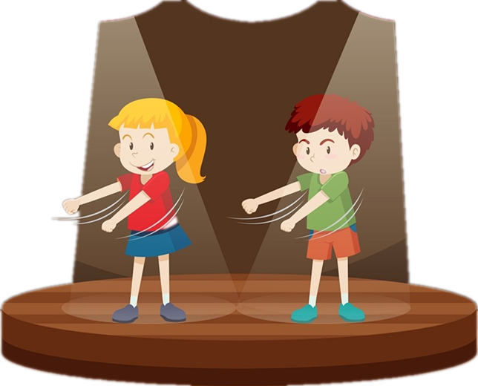
My New Brother
Continuation Writing
Shaoxing Yangming High School
Yao Jiaqi

Slide 3
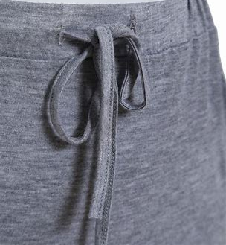
Analyze the text
I was in my room, feeling unwilling to head to the community theatre with "my brother" Henry. He had recently been adopted by my parents and I was not in the mood for being onstage with him.
"Kirstie, come here," my mom called. Following her voice, I found her outside the bathroom, holding a wet book. She gave the book a shake. "Henry's book was in the bathtub. Did you put it there?" She glared at me, something she had never done before Henry came to our home. I hadn't wet his book on purpose. Raindrops fell from my eyes. To make matters worse, she promised to buy him a new copy. My heart ached. Henry was stealing my mother's love. He was ruining my life.
Meanwhile, Henry was nearby, absorbed in working on a complicated rope knot（绳结）, something he liked to do. Why did a boy like him like doing girly work? It seemed far from manly（男子汉气概）.
Soon, it was time to set off to the community theatre. As Henry walked ahead of us to the car, my mom took me aside and said in a low voice, "It will be Henry's first time onstage. Be kind to him, honey." I nodded but sighed（叹气）. I hadn't always found it this difficult to be kind. But since Henry had moved in, everything felt different. The theatre used to be a special place for my parents and me. With Henry involved, it didn't seem so special any more. Finally, it was our stage time. My heart beat wildly. I forgot my annoyance at Henry for a while. As we kids lined up, ready to act out our short play, I realized how loosely I had tied the drawstring on my skirt. Sure enough, my skirt began to drop. I could hear the audience laughing. Even though I was wearing shorts under my skirt, I could feel my face burst into flames. However, my hands were full. If only someone could help me out.
Read the text and find out its main idea and “my” emotions.

Slide 4
Read for main idea and emotions
climax
P1: I was unwilling to be onstage with my adopted brother Henry.
ending
main idea
emotions
unwillingreluctant
KNOWN
UNKNOWN
Notes:
Now let’s analyze the plot we have known from the story. here is the hints for you.
the unknown part is what we should continue. But how?

Slide 5
Analyze the text
I was in my room, feeling unwilling to head to the community theatre with "my brother" Henry. He had recently been adopted by my parents and I was not in the mood for being onstage with him.
" Kirstie, come here," my mom called. Following her voice, I found her outside the bathroom, holding a wet book. She gave the book a shake. "Henry's book was in the bathtub. Did you put it there?" She glared at me, something she had never done before Henry came to our home. I hadn't wet his book on purpose. Raindrops fell from my eyes. To make matters worse, she promised to buy him a new copy. My heart ached. Henry was stealing my mother's love. He was ruining my life.
Meanwhile, Henry was nearby, absorbed in working on a complicated rope knot（绳结）, something he liked to do. Why did a boy like him like doing girly work? It seemed far from manly（男子汉气概）.
Soon, it was time to set off to the community theatre. As Henry walked ahead of us to the car, my mom took me aside and said in a low voice, "It will be Henry's first time onstage. Be kind to him, honey." I nodded but sighed（叹气）. I hadn't always found it this difficult to be kind. But since Henry had moved in, everything felt different. The theatre used to be a special place for my parents and me. With Henry involved, it didn't seem so special any more. Finally, it was our stage time. My heart beat wildly. I forgot my annoyance at Henry for a while. As we kids lined up, ready to act out our short play, I realized how loosely I had tied the drawstring on my skirt. Sure enough, my skirt began to drop. I could hear the audience laughing. Even though I was wearing shorts under my skirt, I could feel my face burst into flames. However, my hands were full. If only someone could help me out.
unwilling/reluctant
hurt/wronged
confused
embarrassed
helpless

Slide 6
Read for main idea and emotions
P4: While on stage, I realized my skirt was about to drop because the drawstring got loose.
?
P3: I couldn’t understand why Henry was absorbed in rope knots.
climax
P2: I was misunderstood by my mom for playing jokes on Henry deliberately.
embarrassed
helpless
P1: I was unwilling to be onstage with my adopted brother Henry.
ending
confused
main idea
emotions
hurt
wronged
unwillingreluctant
KNOWN
UNKNOWN
Notes:
Now let’s analyze the plot we have known from the story. here is the hints for you.
the unknown part is what we should continue. But how?

Slide 7
Design the plot
Para.1 Right then, Henry sensed my embarrassment.
linking 1
What did Henry do?
Para.2 After the performance, I found Henry and tapped him on the arm gratefully.

Slide 8
Read for clues
What can we infer from the following sentence?
Meanwhile, Henry was nearby, absorbed in working on a complicated rope knot, something he liked to do.
Henry had the ability to tie the drawstring on “my” skirt.

Slide 9
Design the plot
Para.1 Right then, Henry sensed my embarrassment.
linking 1
What did Henry do?
How did I feel?
help me tie my drawstring
surprised, relieved, ...
How was the performance?
successful, smooth, ...
linking 2
Para.2 After the performance, I found Henry and tapped him on the arm gratefully.
linking 3
How did I show gratitude?
What was Henry’s response?
What’s the theme?
express thanks, hug him tightly, ...
hug back, smile, no big deal, ...

Slide 10
Read for theme
Tip 1 Echo the text
1｜转变初始感受
(para.1) I was in my room, feeling unwilling to head to the community theatre with "my brother" Henry.
e.g. Maybe _____________________________________ in this new chapter of my world after all.
Change: unwilling→acceptable
it won’t be so bad to accept my new brother
2｜复现关键词块
(para.2) Henry was stealing my mother's love. He was ruining my life.
e.g. Henry was ______ stealing my mother's love ___ ruining my life. Instead, he __________________________________________.
Callback: steal my mother’s love; ruin my life
neither
nor
used his own power to bring new vigor into my life

Slide 11
Read for theme
3｜形成对比意识
e.g.It was at this moment that I realized families are ____________________________ (不是由血缘关系而是由爱所联结的).
e.g.It dawned on me that the string knot on the skirt would go untied, __________________________ and never(但是家庭的结永远不会解开).
Contrast: not...but...
not bonded by blood but by love
but the family knot wouldn’t

Slide 12
Accumulate the language
Example 1: Henry在台上的及时帮助
Ver. 1.0｜He rushed to help me.
Ver. 2.0｜Sentence pattern: Sb. did 1, did 2, and did 3.
(para.4)my mom took me aside and said in a low voice.
I nodded but sighed.
他毫不犹豫地快速靠近我，弯下腰/俯身蹲下来，为我系了一个牢固又漂亮的蝴蝶结。“搞定。”他悄声说道。
Without a second thought, he ______________________, _____________________________ and _________________________. “Nailed it.” He whispered.
Tip 2 Split the action
approached me quickly
bent down/dropped to a crouch
tied a beautiful firm bowknot

Slide 13
Accumulate the language
Example 2: 演出成功
Ver. 1.0｜The show was a huge success.
Ver. 2.0｜侧面描写观众反应
(para.4)My heart beat wildly. I forgot my annoyance at Henry for a while.
→My heart beating wildly, I forgot my annoyance at Henry for a while.
（独立主格结构）
演出一结束，观众就投来赞许的目光，雷鸣般的掌声回荡在大厅周围。
The moment the show was over, the audience cast approving glances at us, __________________________________________ around the hall.
Tip 3 Add detailed description from different perspectives
a shower/storm of thunderous applause echoing

Slide 14
Accumulate the language
Example 3: 我向Henry真心道谢
Ver. 1.0｜“Thank you, Henry.” I said sincerely.
Ver. 2.0｜with复合结构 / 虚拟语气
(para.4)With Henry involved, it didn't seem so special any more.
If only someone could help me out.
e.g.我的声音颤抖着，脸发烫。我不得不承认，要不是有他的帮助/要是没有他出色的打结技术，我就不会鼓起勇气站在舞台上。
My voice trembled __________________________. I had to admit that, ___________________________________________________________, I __________________________________ to stand on the stage.
Tip 4 Fill with advanced structures
with my face burning
but for his timely help / without his wonderful knotting skills
wouldn’t have plucked up the courage

Slide 15
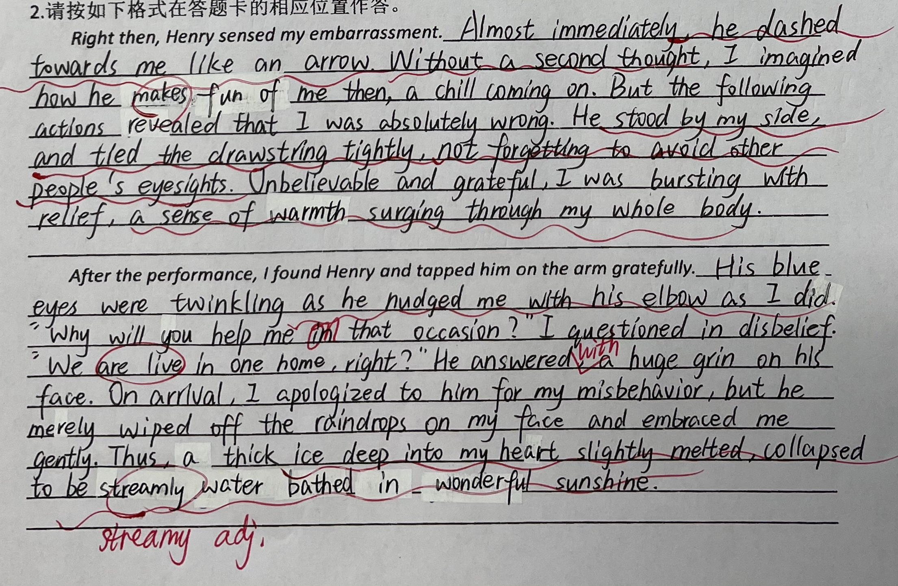
Peer revision
擅长运用多种高级表达以及画面定格、氛围渲染式结尾

Slide 16
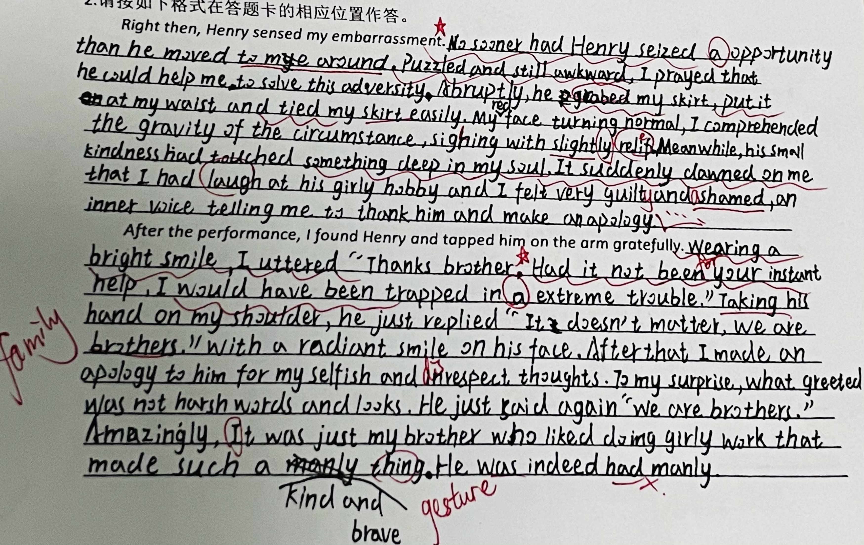
Peer revision
多次合理运用倒装句为本文增色

Slide 17
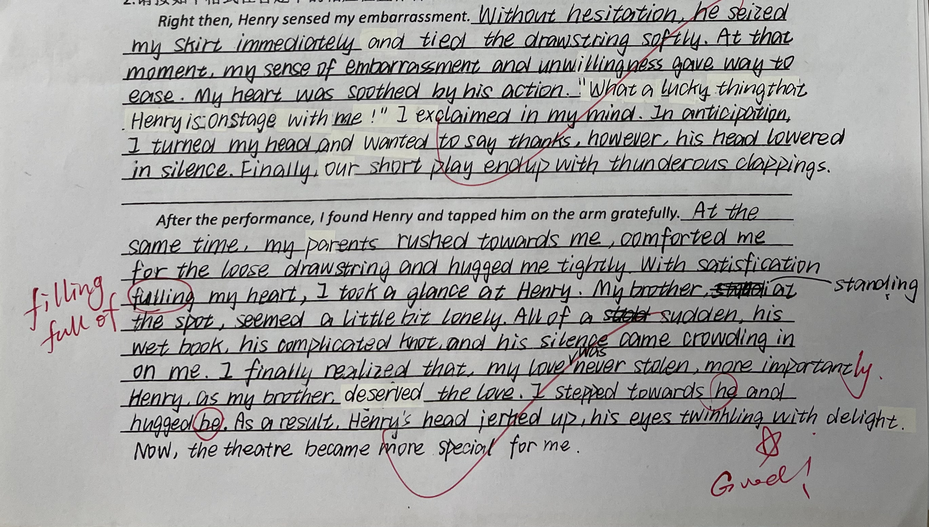
Peer revision
书写整齐美观，情节合理

Slide 18
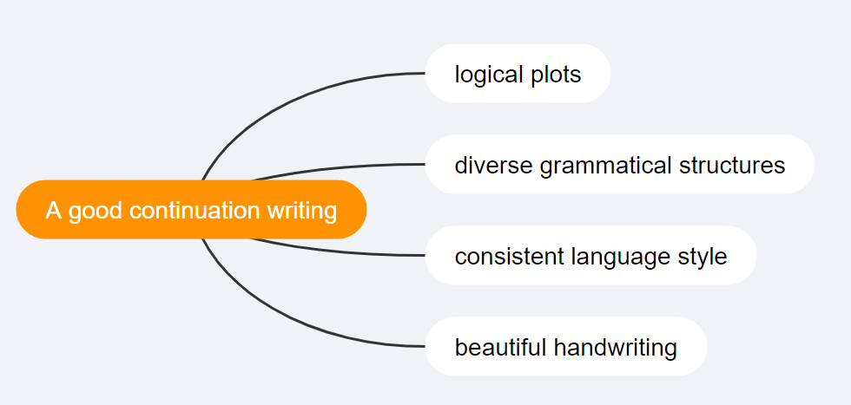
Summarize and appreciate
What makes a good continuation writing?

Slide 19
Summarize and appreciate
Right then, Henry sensed my embarrassment. Without a second thought, he approached me quickly, dropped to a crouch, and tied a beautiful firm bowknot. “Nailed it.” He whispered. Shocked by what he had done, I felt something deep in my mind began to change. It seemed as if his kind deeds had melted my heart. Thinking about what I had done to him, I felt ashamed of myself. While I was lost in thought, the music took me back to reality. We edged to the stage and started our performance. The moment the show was over, the audience cast approving glances at us, a storm of thunderous applause echoing around the hall.
After the performance, I found Henry and tapped him on the arm gratefully. "Thank ... you, Henry." My voice trembled with my face burning. I had to admit that, but for his timely help, I wouldn’t have plucked up my courage to stand on the stage. Without his wonderful knotting skills, the performance would have been quite different. Henry patted me gently on the shoulder, an enormous grin flashing across his face, "Not a problem. We are family, aren't we?" Tears blurred my eyes, words failing to convey my warmth, so I gave him a heartfelt hug. It was at this moment that I realized the string knot on the skirt would go untied, but the family knot wouldn’t and never.

Slide 20
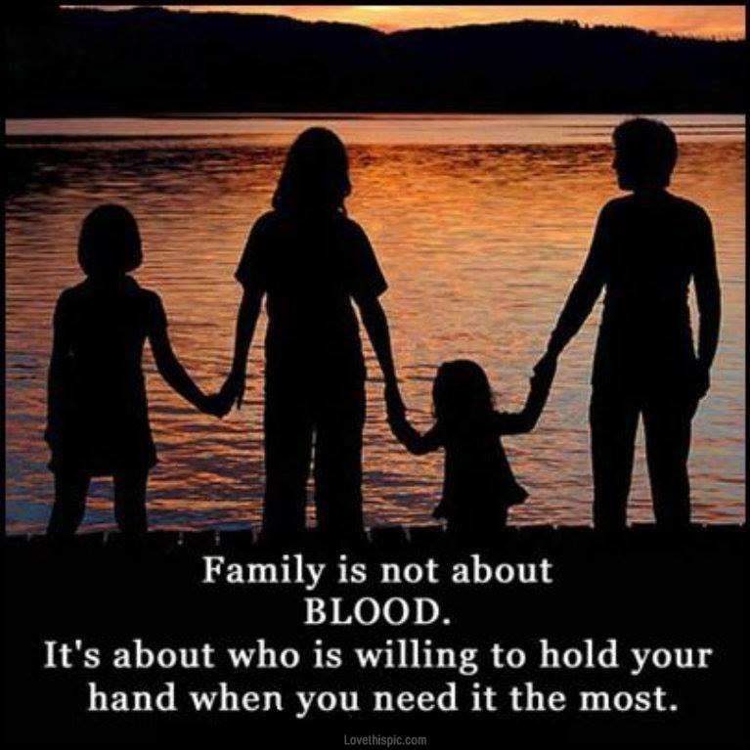
Assignment
Finish and polish your version of writing using the “SAFE” rule.

