Slide 1

感恩遇见，相互成就，本课件资料仅供您个人参考、教学使用，严禁自行在网络传播，违者依知识产权法追究法律责任。
更多教学资源请关注
公众号：溯恩高中英语
知识产权声明

Slide 2


2023高考满分攻略阅读理解之D篇
陈德荣
2023.05

Slide 3

2023高考满分攻略阅读理解之D篇
授课教师：陈德荣

Slide 4


大纲
Part Ⅰ
高考阅读理解之D篇命题特点
Part Ⅱ
高考阅读理解之D篇解题策略
Part Ⅱ

Slide 5
命题特点命题特点 | 1. 主题语境 | 1. 主题语境
命题特点 | 1. 主题语境
The High School Attached to Hunan Normal University
时间 | 篇目 | 主题语境 | 话题 | 体裁 | 说明对象
2023.1 浙江
 | D | 人与自然 | 太阳能农场 | 说明文 | 新事物
2022.6 新高考I
 | D | 人与社会 | 人类语音的发展与农业之间的关系 | 说明文 | 研究报告
2021.6 新高考I | D | 人与社会 | 情商的定义以及对有关于情商未来研究的 期望 | 说明文 | 研究报告
2020.6 新高考I
 | D | 人与社会 | 就餐同伴对饮食习惯的影响 | 说明文 | 研究报告
以“人与自然，人与社会”两大主题语境为主，涉及科学与技术、自然生态与环境等多个主题。

Slide 6
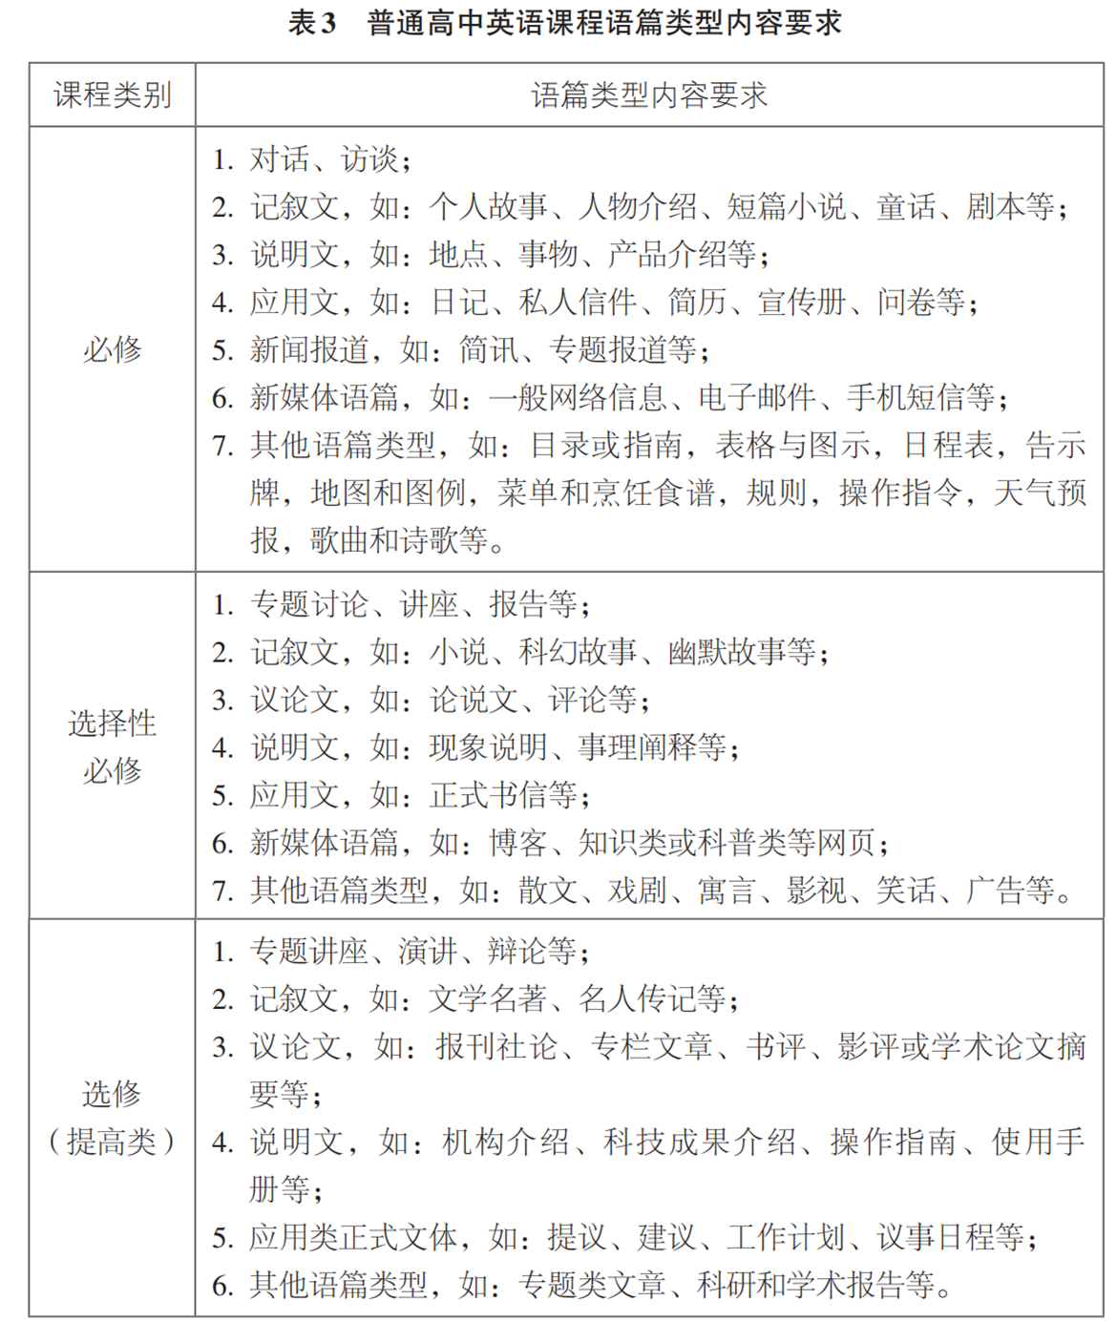
命题特命题特点 | 2. 内容倾向
命题特点 | 2. 内容倾向
The High School Attached to Hunan Normal University
时间 | 篇目 | 说明对象
2023.1 浙江
 | D | 新事物
2022.6 新高考I
 | D | 研究报告
2021.6 新高考I | D | 研究报告
2020.6 新高考I
 | D | 研究报告

Slide 7
命题特命题特点 | 3. 设题方式
命题特点 | 3. 设题方式
The High School Attached to Hunan Normal University
时间 | 篇目 | 细节 推理 | 猜词 | 主旨 标题 | 说明方法 | 写作目的 | 态度 | 说明对象
2023.1 浙江
 | D | 3 |  | 1 |  |  |  | 新事物
2022.6 新高考1
 | D | 3 |  | 1 |  |  |  | 研究报告
2021.6 新高考1 | D | 1 |  | 1 |  | 1 | 1 | 研究报告
2020.6 新高考I
 | D | 2 | 1 | 1 |  |  |  | 研究报告

Slide 8


Go!
Ready ?

Slide 9



Slide 10
策略一：语篇结构之研究报告类
新高考Ⅰ2022.D
2021.D
浙2022.1C 2021.6C,
2021.1C,
概括(General)
主旨大意最佳标题
研究结果
研究方法
研究报告
细节理解/推断
浙2022,C28,
2020.7C28
结论阐述
细节理解/推断
浙2021.6C29,
2020.7C29
2020.1C28、29
说明方法
专家评议
细节理解/推断
情感态度
新高考Ⅰ2022.D35
2021,1C27、28
2020.1C27
具体（Specific)
Notes:
更多模板亮亮图文旗舰店：https://liangliangtuwen.tmall.com

Slide 11
（2022年全国1卷D篇)
para1 Human speech contains more than 2,000 different sounds, from the common “m” and “a” to the rare clicks of some southern African languages. But why are certain sounds more common than others? A ground-breaking, five-year study shows that diet-related changes in human bite led to new speech sounds that are now found in half the world’s languages.
Task1：find the main idea of this paragraph
the research/study/report showed/ found/discovered that.....
result
The _____________of the research

Slide 12
（2022年全国1卷D篇)
para2 More than 30 years ago, the scholar Charles Hockett noted that speech sounds called labiodentals, such as “f” and “v”, were more common in the languages of societies that ate softer foods. Now a team of researchers led by
Damián Blasi at the University of Zurich, Switzerland, has found how and why this trend arose.
Task 2：find the main idea of this paragraph
The reason of conducting the research

Slide 13
（2022年全国1卷D篇)
para3.4 They discovered that the upper and lower front teeth of ancient human adults were aligned (对齐), making it hard to produce labiodentals, which are formed by touching the lower lip to the upper teeth. Later, our jaws changed to an
overbite structure (结构), making it easier to produce such sounds.
The team showed that this change in bite was connected with the development of agriculture in the Neolithic period. Food became easier to chew at this point. The jawbone didn’t have to do as much work and so didn’t grow to be so large.
Task 3：find the main idea of this paragraph
The discovery and possible explanation

Slide 14
para5 Analyses of a language database also confirmed that there was a global change in the sound of world languages after the Neolithic age, with the use of “f” and “v” increasing remarkably during the last few thousand years. These sounds are still not found in the languages of many hunter-gatherer people today.
（2022年全国1卷D篇)
Task 4：find the main idea of this paragraph
Further evidence

Slide 15
para6 This research overturns the popular view that all human speech sounds were present when human beings evolved around 300,000 years ago. ”The set of speech sounds we use has not necessarily remained stable since the appearance of human beings, but rather the huge variety of speech sounds that we find today is the product of a complex interplay of things like biological change and cultural evolution,“ said Steven Moran, a member of the research team.
（2022年全国1卷D篇)
Task 5：find the main idea of this paragraph
significance
The_____________ of the research

Slide 16
Human speech contains more than 2,000 different sounds, from the common “m” and “a” to the rare clicks of some southern African languages. But why are certain sounds more common than others? A ground-breaking, five-year study shows that diet-related changes in human bite led to new speech sounds that are now found in half the world’s languages.
More than 30 years ago, the scholar Charles Hockett noted that speech sounds called labiodentals, such as “f” and “v”, were more common in the languages of societies that ate softer foods. Now a team of researchers led by Damián Blasi at the University of Zurich, Switzerland, has found how and why this trend arose.
They discovered that the upper and lower front teeth of ancient human adults were aligned (对齐), making it hard to produce labiodentals, which are formed by touching the lower lip to the upper teeth. Later, our jaws changed to an overbite structure (结构), making it easier to produce such sounds.
32. Which aspect of the human speech sound does Damián Blasi’s research focus on?
Its variety.
B. Its distribution
C. Its quantity.
D. Its development.
33. Why was it difficult for ancient human adults to produce labiodentals?
They had fewer upper teeth than lower teeth.
B. They could not open and close their lips easily.
C. Their jaws were not conveniently structured.
D. Their lower front teeth were not large enough.
（Para.1-2）
（Para.3）
STEP1：标关键词
STEP2：定位信息段
STEP3：比对选项

Slide 17
The team showed that this change in bite was connected with the development of agriculture in the Neolithic period. Food became easier to chew at this point. The jawbone didn’t have to do as much work and so didn’t grow to be so large.
Analyses of a language database also confirmed that there was a global change in the sound of world languages after the Neolithic age, with the use of “f” and “v” increasing remarkably during the last few thousand years. These sounds are still not found in the languages of many hunter-gatherer people today.
This research overturns the popular view that all human speech sounds were present when human beings evolved around 300,000 years ago. ”The set of speech sounds we use has not necessarily remained stable since the appearance of human beings, but rather the huge variety of speech sounds that we find today is the product of a complex interplay of things like biological change and cultural evolution,“ said Steven Moran, a member of the research team.
（Para.1 result： changes）
34. What is paragraph 5 mainly about?
A. Supporting evidence for the research results.
B. Potential application of the research findings.
C. A further explanation of the research methods.
D. A reasonable doubt about the research process.
35. What does Steven Moran say about the
set of human speech sounds?
A. It is key to effective communication.
B. It contributes much to cultural diversity.
C. It is a complex and dynamic system.
D. It drives the evolution of human beings.
STEP1：寻找主题句
STEP2：信息归纳

Slide 18
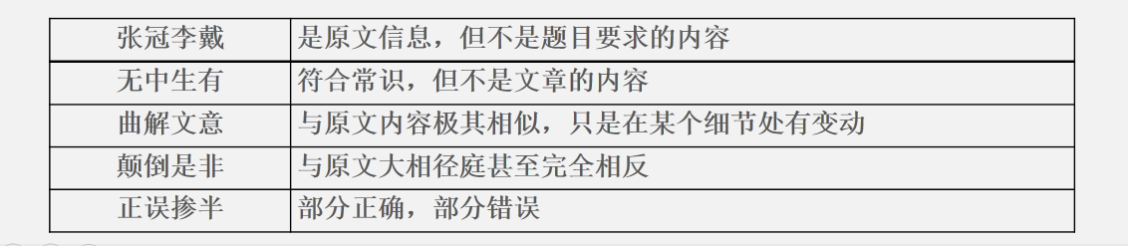
细节理解题
正确选项特征：
1.原文原词
2.同义替换：lose one’s job 换成 be out of work
disability 换成 disabled
3.信息归纳（用精炼的语言概括原文中分散或复杂信息）
概括细节理解题
干扰选项特征：

Slide 19
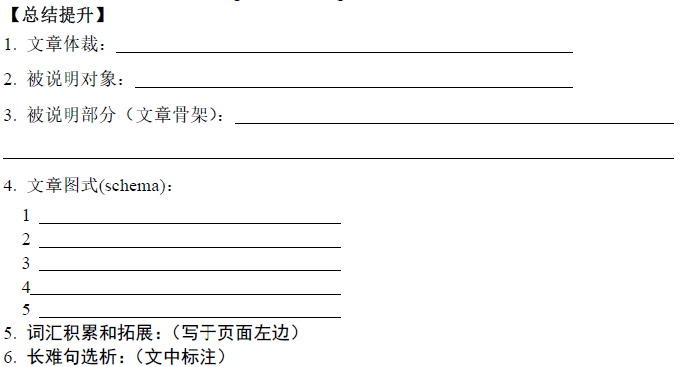

Slide 20
二：语篇结构之新事物
(2023.1·浙江)35. Which of the following is the best title for the text?文章主旨
(2019·全国卷I)31. Where is this text most likely from? 文章来源
引入新事物
（2020·浙江卷）25. What does the underlined word “that” in paragraph 2 refer to? （代词指代）
(2023·1浙江)32. What do solar developers often ignore? 细节理解
产生背景
(2019·全国卷I)28. Why do the researchers develop the smart keyboard? 细节理解
(2023·1浙江)33. What does InSPIRE aim to do?细节理解
新事物
运行原理
(2023·1浙江)34. What is the purpose of the laws mentioned in paragraph 4?细节理解
(2019·全国卷I)29. What makes the invention of the smart keyboard possible？细节理解
优缺点
（2020·浙江卷）26. What does Kevin Balke say about adaptive signals? 细节推断
(2019·全国卷I)30. What do the researchers expect of the smart keyboard？ 细节推断
评议、改进
（2020·浙江卷）27. What can we learn from Bellevue’s success? 细节推断
Notes:
更多模板亮亮图文旗舰店：https://liangliangtuwen.tmall.com

Slide 21
（2023.1浙江D） para1.2
According to the Solar Energy Industry Association, the number of solar panels installed (安 装) has grown rapidly in the past decade, and it has to grow even faster to meet climate goals. But all of that growth will take up a lot of space, and though more and more people accept the concept of solar energy, few like large solar panels to be installed near them.
Solar developers want to put up panels as quickly and cheaply as possible, so they haven't given much thought to what they put under them. Often, they'll end up filling the area with small stones and using chemicals to control weeds. The result is that many communities, especially in farming regions, see solar farms as destroyers of the soil.
Task 1：find the main idea of this paragraph
The background of the Solar projects

Slide 22
（2023.1浙江D） para3
“Solar projects need to be good neighbors,” says Jordan Macknick, the head of the Innovative Site Preparation and Impact Reductions on the Environment(InSPIRE) project. “They need to be protectors of the land and contribute to the agricultural economy.” InSPIRE is investigating practical approaches to “low-impact” solar development, which focuses on establishing and operating solar farms in a way that is kinder to the land. One of the easiest low-impact solar strategies is providing habitat for pollinators(传粉昆虫).
Task 2：find the main idea of this paragraph
introduction
The ____________ of the Solar Farms

Slide 23
（2023.1浙江D） para4
Habitat loss, pesticide use, and climate change have caused dramatic declines in pollinator populations over the past couple of decades, which has damaged the U.S. agricultural economy. Over 28 states have passed laws related to pollinator habitat protection and pesticide use. Conservation organizations put out pollinator-friendliness guidelines for home gardens, businesses, schools, cities—and now there are guidelines for solar farms.
Task 3：find the main idea of this paragraph
how Solar Farms work

Slide 24
（2023.1浙江D） para5
Over the past few years, many solar farm developers have transformed the space under their solar panels into a shelter for various kinds of pollinators, resulting in soil improvement and carbon reduction. “These pollinator-friendly solar farms can have a valuable impact on everything that's going on in the landscape,” says Macknick
Task 4：find the main idea of this paragraph
advantage
The _____________ of the Solar Farms

Slide 25
32. What do solar developers often ignore?
A.The decline in the demand for solar energy.
B.The negative impact of installing solar panels.
C.The rising labor cost of building solar farms.
D.The most recent advances in solar technology.
According to the Solar Energy Industry Association, the number of solar panels installed（安装）has grown rapidly in the past decade, and it has to grow even faster to meet climate goals. But all of that growth will take up a lot of space, and though more and more people accept the concept of solar energy, few like large solar panels to be installed near them.
Solar developers want to put up panels as quickly and cheaply as possible, so they haven't given much thought to what they put under them. Often, they'll end up filling the area with small stones and using chemicals to control weeds. The result is that many communities, especially in farming regions, see solar farms as destroyers of the soil.
STEP1：标关键词
STEP2：定位信息段
STEP3：比对选项

Slide 26
33.What does InSPIRE aim to do?
A.Improve the productivity of local farms.
B.Invent new methods for controlling weeds.
C.Make solar projects environmentally friendly.
D.Promote the use of solar energy in rural areas.
34.What is the purpose of the laws mentioned in paragraph 4?
A.To conserve pollinators.
B.To restrict solar development.
C.To diversify the economy.
D.To ensure the supply of energy.
“Solar projects need to be good neighbors,” says Jordan Macknick, the head of the Innovative Site Preparation and Impact Reductions on the Environment (InSPIRE) project."They need to be protectors of the land and contribute to the agricultural economy." InSPIRE is investigating practical approaches to "low-impact'' solar development, which focuses on establishing and operating solar farms in a way that is kinder to the land. One of the easiest low-impact solar strategies is providing habitat for pollinators（传粉昆虫）.
Habitat loss, pesticide use, and climate change have caused dramatic declines in pollinator populations over the past couple of decades, which has damaged the U.S.agricultural economy. Over 28 states have passed laws related to pollinator habitat protection and pesticide use. Conservation organizations put out pollinator-friendliness guidelines for home gardens, businesses, schools, cities—and now there are guidelines for solar farms.
STEP1：标关键词
STEP2：定位信息段
STEP3：比对选项

Slide 27
Over the past few years, many solar farm developers have transformed the space under their solar panels into a shelter for various kinds of pollinators, resulting in soil improvement and carbon reduction. “These pollinator-friendly solar farms can have a valuable impact on everything that's going on in the landscape,” says Macknick.
35. Which of the following is the best title for the text?
A.Pollinators:To Leave or to Stay
B.Solar Energy: Hope for the Future
C.InSPIRE: A Leader in Agriculture
D.Solar Farms: A New Development
Tip：属于新事物的说明文，新事物就是说明的对象也是文章的主要观点。

Slide 28
总结概括大意
如何选文章标题：
概括性 概括全文, 体现主旨
针对性 内涵相符, 范围一致
新颖性 新颖奇特, 吸引眼球
简短性 名词短语, 动名词短语或祈使句
四大特性
断章取义 仅为文中一细节
以偏概全
离题太远
文章标题
干扰项特 点
主题词法 根据主题句，提炼主题词
解题方法
写作法 以此作标题，我应怎么写

Slide 31
策略二：熟练掌握说明文常用说明方法
常见写作手法：
★分类法（by classification） ★比较法（by comparison） ★举例法（by example）
★程序法（by process） ★因果法（by cause and effect）
★定义法（by definition） ★时序法（by following the order of time）
★重要性法（by importance,） ★分析原因法（by analyzing cause） ★引入数据或研究（by using data or mentioning some studies） ★描述法（by description）

Slide 32
策略二：熟练掌握说明文常用说明方法
（2023.1浙江)A machine can now not only beat you at chess, it can also outperform you in debate. Last week, in a public debate in San Francisco, a software program called Project Debater beat its human opponents, including Noa Ovadia, Israel's former national debating champion.
Brilliant though it is, Project Debater has some weaknesses. It takes sentences from its library of documents and prebuilt arguments and strings them together. This can lead to the kinds of errors no human would make. Such wrinkles will no doubt be ironed out, yet they also point to a fundamental problem. As Kristian Hammond, professor of electrical engineering and computer science at Northwestern University, put it: “There's never a stage at which the system knows what it's talking about.”
......
用举例法说明它聪明
28. Why does the author mention Noa Ovadia in the first paragraph?
A. To explain the use of a software program.
B. To show the cleverness of Project Debater.
C. To introduce the designer of Project Debater.
D. To emphasize the fairness of the competition.

Slide 33
策略二：熟练掌握说明文常用说明方法
（2022新高考1)Like most of us, I try to be mindful of food that goes to waste. The arugula (芝麻菜)was to make a nice green salad, rounding out a roast chicken dinner. But I ended up working late. Then friends called with a dinner invitation. I stuck the chicken in the freezer. But as days passed, the arugula went bad. Even worse, I had unthinkingly bought way too much; I could have made six salads with what I threw out.
In a world where nearly 800 million people a year go hungry, “food waste goes against the moral grain,” as Elizabeth Royte writes in this month’s cover story. It’s jaw-dropping how much perfectly good food is thrown away — from “ugly” (but quite eatable) vegetables rejected by grocers to large amounts of uneaten dishes thrown into restaurant garbage cans.
Producing food that no one eats wastes the water, fuel, and other resources used to grow it. That makes food waste an environmental problem. In fact, Royte writes, “if food waste were a country, it would be the third largest producer of greenhouse gases in the world.”
......
用举例法引出话题
24. What does the author want to show by telling the arugula story?
A. We pay little attention to food waste.
B. We waste food unintentionally at times.
C. We waste more vegetables than meat.
D. We have good reasons for wasting food.

Slide 34
策略二：熟练掌握说明文常用说明方法
1（2020年7月C）Challenging work that requires lots of analytical thinking, planning and other managerial skills might help your brain stay sharp as you age, a study published Wednesday in the journal Neurology suggests. 2 Researchers from the University of Leipzig in Germany gathered more than 1, 000 retired workers who were over age 75 and assessed the volunteers’ memory and thinking skills through a battery of tests. Then, for eight years, the scientists asked the same group to come back to the lab every 18 months to take the same sorts of tests. 3 Those who had held mentally stimulating(刺激), demanding jobs before retirement tended to do the best on the tests. And they tended to lose cognitive(认知) function at a much slower rate than those with the least mentally challenging jobs. The results held true even after the scientists accounted for the participants’ overall health status. 4 “This works just like physical exercise, ” says Francisca Then, who led the study. “After a long run, you may feel like you’re in pain, you may feel tired. But it makes you fit. After a long day at work-sure, you will feel tired, but it can help your brain stay healthy. ”
......
用比较法
29.How does Francisca Then explain her findings in paragraph 4?
A.By using an expert’s words. B.By making acomparison.
C.By referring to another study. D.By introducing a concept.

Slide 35
策略二：熟练掌握说明文常用说明方法
（2019年6月C）California has lost half its big trees since the 1930s, according to a study to be published Tuesday and climate change seems to be a major factor(因素). The number of trees larger than two feet across has declined by 50 percent on more than 46, 000 square miles of California forests, the new study finds. No area was spared or unaffected, from the foggy northern coast to the Sierra Nevada Mountains to the San Gabriels above Los Angeles. In the Sierra high country, the number of big trees has fallen by more than 55 percent; in parts of southern California the decline was nearly 75 percent. Many factors contributed to the decline, said Patrick McIntyre, an ecologist who was the lead author of the study. Woodcutters targeted big trees. Housing development pushed into the woods. Aggressive wildfire control has left California forests crowded with small trees that compete with big trees for resources(资源). But in comparing a study of California forests done in the 1920s and 1930s with another one between 2001 and 2010, McIntyre and his colleagues documented a widespread death of big trees that was evident even in wildlands protected from woodcutting or development. ......
列数据说明其大树丧失严重
27.What is the second paragraph mainly about?
A.The seriousness of big-tree loss in California.
B.The increasing variety of California big trees.
C.The distribution of big trees in California forests.
D.The influence of farming on big trees in California.

Slide 36
策略二：熟练掌握说明文常用说明方法
In this paragraph how does the author demonstrate the idea that Honeybees and ants are both capable of learning? A. By using statistics. B. By explaining reasons. C. By referencing opinions. D. By presenting study findings.
引入研究
Honeybees and ants are both capable of learning. One Chinese study found that bees can be trained to learn and remember a route to a food source. The researchers also found that bees can be taught to recognize hidden objects and use the concepts of "sameness" and "difference" to accomplish certain tasks. Ants take this one step further. Recent American research has shown that ants not only have the ability to learn, but also can teach their foraging skills to other younger ants. They observed that older ants accompany young ants in search of food and teach them the route and how to avoid obstacles.

