Slide 1

感恩遇见，相互成就，本课件资料仅供您个人参考、教学使用，严禁自行在网络传播，违者依知识产权法追究法律责任。
更多教学资源请关注
公众号：溯恩高中英语
知识产权声明

Slide 2
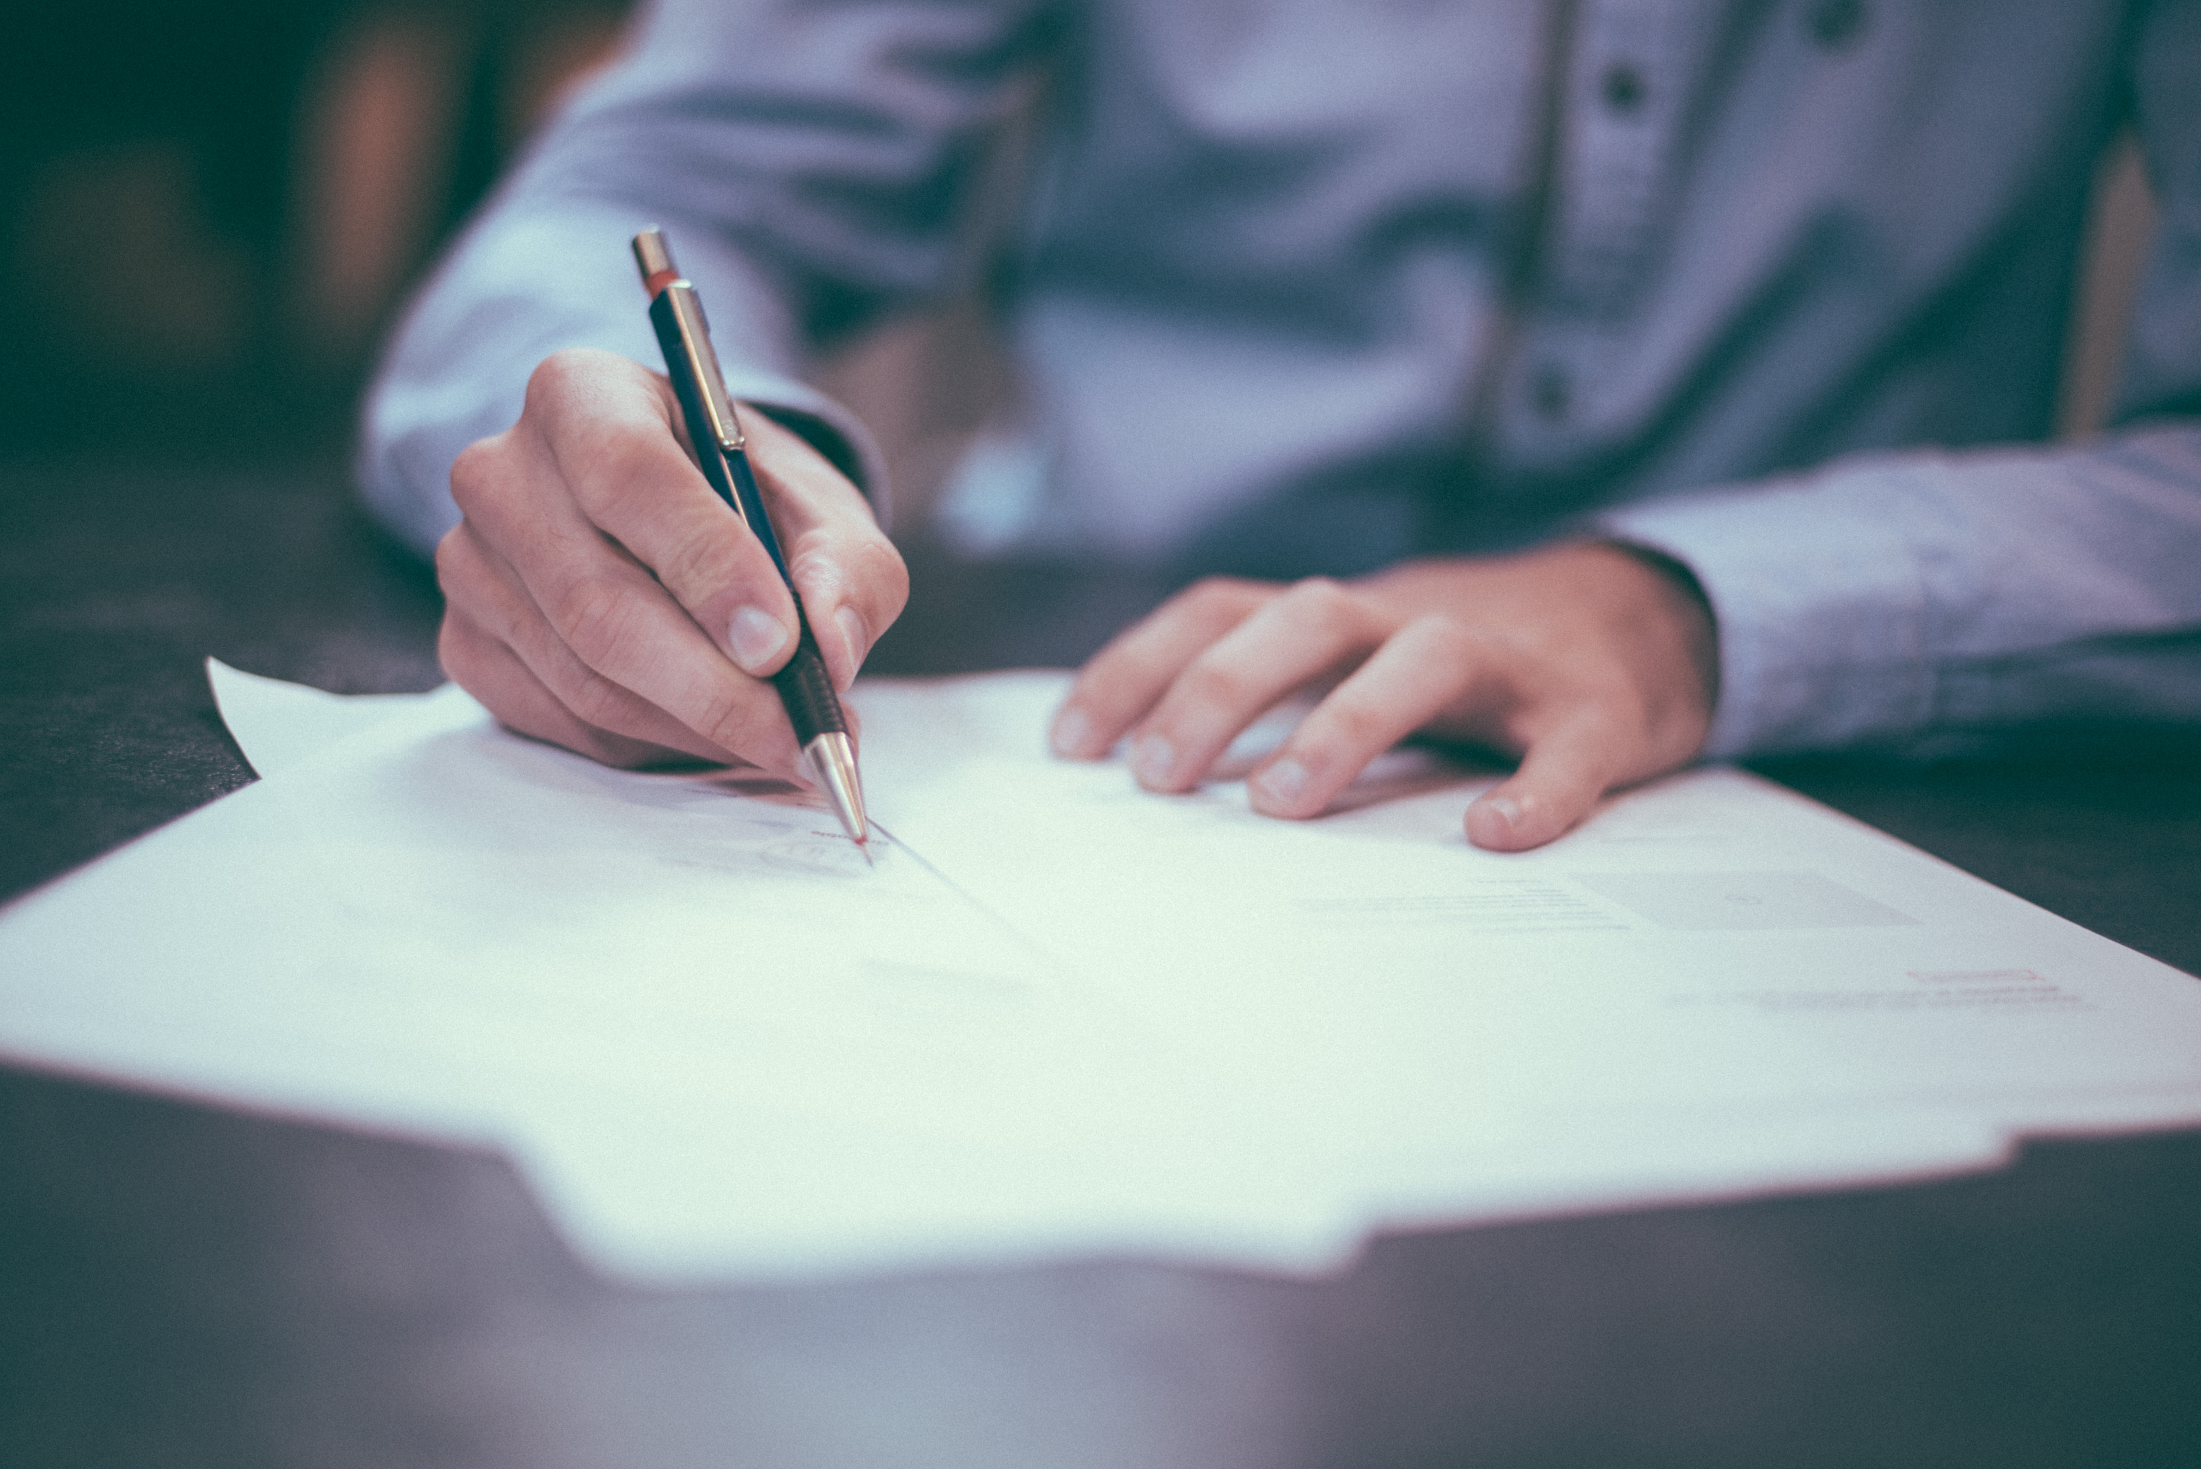
2023高考读后续写高分攻略
---侧重于内容形式的语言组织

Slide 3

浙江卷已考（主题及主题语境） |  |  |  | 考察
2016.10 | 夫妻野营吵架，独自出走，森林迷路 | 冒险脱险类 | 人与人（夫妻） | 人的感悟与成长
2017.6 | 森林骑行遇野狼 | 冒险脱险类 | 人与狼（脱险） | 互帮互助，和谐社会
2017.11 | 与健忘母亲在旅行路上的趣事 | 家庭趣事类 | 人与人（母女/子） | 正确看待人物与困难
2018.6 | 爸爸带儿子农场骑马，森林迷路 | 冒险脱险类 | 人与人（父子） | 人的感悟与成长
2020.1 | 抚养小狗幼崽 | 温馨家庭类 | 人与狗（解困） | 关心动物，和谐共存
2020.6 | 夫妻拍摄北极熊遇险 | 冒险脱险类 | 人与熊（脱险） | 环境保护人与动物和谐共存
2021.1 | 南瓜卡头 | 家庭趣事类 | 人与人（家人） | 积极看待“囧”事
2021.6 | 作者年幼时打工挣钱 | 温馨家庭类 | 人与人（父子/女） | 认识家庭责任，获得自我成长
2022.1 | 学渣和学霸的合作 | 交友互助类 | 人与人（朋友） | 正确与人交往
2022.6 | 我的志愿者经历——施粥 | 社会服务类 | 人与人（他人） | 守望相助，自我成长
2023.1 | 作者解救蜂鸟后遇其报恩 | 交友互助类 | 人与鸟（续情） | 爱护动物，和谐共存
按照行文关系和行文方向

Slide 4
全国1卷已考（主题及主题语境） 考察
2020年 | 卖爆米花救助穷人 | 社会服务类 | 人与人（他人） | 守望相助
2021年 | 母亲节给妈妈做早餐 | 温馨家庭类 | 人与人（家人） | 感悟成长
2022年 | 残疾男孩参加越野跑比赛 | 交友互助类 | 人与人（他人） | 感悟成长
按照行文关系和行文方向

Slide 5

学生续写常见问题：
人物关系混乱
情节设计凌乱
语言表达苍白
内容缺少连贯
文章主题跑题
人物形象脱节
...
按照行文关系和行文方向

Slide 6
01
理清文本结构，找到结构协同点
02
梳理文本情节，找到情节协同点
目 录
03
分析主要人物，找到人物协同点
Contents
04
品读文章语言，找到语言协同点

Slide 7


01
理清文本结构，找到结构协同点
(2023.1浙江高考续写)
1. I was invited to a cookout on an old friend's farm in western Washington. I parked my car outside the farm and walked past a milking house which had apparently not been used in many years. A noise at a window caught my attention, so I entered it. It was a hummingbird（蜂鸟）, desperately trying to escape. She was covered in spider-webs（蛛网）and was barely able to move her wings. She ceased her struggle the instant I picked her up.
2. With the bird in my cupped hand, I looked around to see how she had gotten in. The broken window glass was the likely answer. I stuffed a piece of cloth into the hole and took her outside, closing the door securely behind me.
3. When I opened my hand, the bird did not fly away; she sat looking at me with her bright eyes. I removed the sticky spider-webs that covered her head and wings. Still, she made no attempt to fly. Perhaps she had been struggling against the window too long and was too tired? Or too thirsty?
4. As I carried her up the blackberry-lined path toward my car where I kept a water bottle, she began to move. I stopped, and she soon took wing but did not immediately fly away. Hovering（悬停）, she approached within six inches of my face. For a long moment, this tiny creature looked into my eyes, turning her head from side to side. Then she flew quickly out of sight.
5. During the cookout, I told my hosts about the hummingbird incident. They promised to fix the window. As I was departing, my friends walked me to my car. I was standing by the car when a hummingbird flew to the center of our group and began hovering. She turned from person to person until she came to me. She again looked directly into my eyes, then let out a squeaking call and was gone. For a moment, all were speechless. Then someone said,"She must have come to say good-bye."
Para.1 A few weeks later, I went to the farm again.
Para.2 I was just about to leave when the hummingbird appeared.

Slide 8

续文 | 结构协同
para.1
para.2
A few weeks later, I went to the farm again. As I parked my car, stepped onto the blackberry-lined path, a sense of familiarity washed over me.I made my way towards the milking house, where I had first encoured the lovely hummingbird. The newly-installed window was sparkling in the sunlight, reflecting the pure blue of the clear sky. To my delight, I noticed that a new window had been installed in the milking house, and it sparkled in the sunlight, reflecting the clear blue sky. However, as I looked around, I realized that my little hummingbird was nowhere to be found. Despite my disappointment, I decided to enjoy the cookout with my friends on the farm. I couldn’t stop turning my head from side to side, expecting to meet my little friend again. Alas, my expectation remained unfulfilled and eventually I had to accept it.
协同
Conflict3: I expected to see her but didn’t find her.
Para.6 A few weeks later, I went to the farm again.
Conflict
运用conflict-solution模式进行续写(找到冲突—解决冲突)，使续文和原文结构协同。
Para.4-5 I noted she looked for me and squeaked goodbye .
para. ①
Conflict 3
(故地重游、想而未见)
C2-R2
conflict 2
C1-R1
Setting: a stuck bird
solution 1
solution 2
Para.2-3 I rescued the hummingbird.
I was just about to leave when the hummingbird appeared. A familiar squeaking call floated into my ears, breaking the silence. Hardly had the sound vanished in the wind when I turned to the position where it came and waved my hand to greet the hummingbird. Hovering, she looked into my eyes with her bright eyes. Without difficulty, she recognized me, which left me in exhilaration. Warmth filled up my body. On the same blackberry-lined path where we separated last time, we looked into each other’s eyes. The sun shone brightly, and a gentle breeze rustled through my hair. I flashed her a smile as the little creature squeaked and left with the hope of meeting her again.
C3-R3: reunited
conflict 1
Para.1I came across a stuck hummingbird.
Para.7 I was just about to leave when the hummingbird appeared.
C2-R2
para. ②
C1-R1
Solution 3
(最终相见、再续前缘)
Conflict

Slide 9
无人相助
Not a single soul would stop to assist my helpless family.
No one came into sight.
呼救无果 I kept shouting for help, hoping my shouts could be heard by someone, but there was no reply.
沟通障碍
She wanted to apologize, but words failed her. Not knowing what to say, she was just standing there stiffly.
Still reluctant to give in, the boy held his head high, insisting it was the cat that broke the vase.
情况变糟
What made him more upset was that Dad seemed to have noticed his secret.
Below, the captain realized to his horror that the ship was sinking rapidly.
Not even in his nightmares could he have imagined anything worse than this.
拓展：
语言篇
与出现冲突有关的语言

Slide 10
拓展：
希望渺茫：
My hope of receiving birthday presents began to fade.
He visited every expert, only to find his efforts in vain.
A terrible, empty silence hung in the air. 空气中弥漫着一种可怕的寂静。
自救无果Hard as she tried, that little effort would not help stop the boat sinking.
体力不支：
昏倒 That's when I passed out/fainted/collapsed.
环境阻力：
大风大雨The wind was so strong that he couldn't keep his eyes open. The rain poured down, stinging his face like a million bees.
风越来越大Their 12-foot boat was taking in water little by little, and the wind was picking up.
大风大雪The wind screamed in his ears as he staggered through the blinding snow, his whole body was numb.
与出现冲突有关的语言

Slide 11
浓烟The smokes stung his eyes and burned his lungs.
大火 One morning, they arrived to find the schoolhouse engulfed in flames.
爆炸+浓烟
A loud alarm sounded (警报声响起)inside the house, followed by a terrific explosion. A cloud of thick smoke billowed out ([ˈbɪləʊ]喷涌而出).
大浪
A rough wave grabbed hold of papa and swept him off the deck. In a blink, he was swallowed up by the sea and gone forever.
黑暗
As the sun began to sink behind the hills, cold feelings of dread crept along her spine.恐惧袭上她的脊梁，使她不寒而栗。
拓展：
与出现冲突有关的语言

Slide 12
有人相助：
Without a second thought, Dad offered to help.
A helicopter！Jezz leaped to her feet and searched the sky. It swooped 俯冲down a bit and hovered over her. A man leaned out and waved, shouting through a bullhorn(扩音器) "We are coming down for you."
Then Dad’s warnings flashed into my head. 回想起
And then I gave a cry of joy, because a tiny point of yellow light had suddenly appeared on the horizon.
呼救I radioed the camp manager for help. He told me a helicopter was on its way, but it would be 30minites before it arrived.
打电话Grabbing his cell phone, he entered the codes with shaking hands. “A bus is on fire! Close the tunnel gates!”
他救 At the very moment, several gunshots echoed to scare it off.
听到声音Just as I was at the point of desperation, I heard a voice from the distance.
出现希望 With sweat-soaked hair clinging to his forehead , Mac's eyes suddenly sparkled while his gaze briefly encountered Paul's, which instantly brought a ray of hope.
拓展：
与解决冲突有关的语言

Slide 13
意识改变：
Though anger,embarrassment and sadness hung heavily in the air, the voice drew me to the awareness of the mistakes I had made when I attempted to impress the boys.
坚持不懈：
Despite the countless failures, we still believed in miracles.
迸发力量：
With every bit of strength in his body, he'd pulled himself out of the water and wrapped his arms and legs around the trunk.
They held on with every ounce of strength they had.
John mustered the last of his strength and screamed out at the top of his lungs.
It was my wife’s encouragement that gave me an extra burst of energy.
鼓起勇气：
Max swallowed hard, gathering/mustering up his courage.使劲咽了口气
想象获力：
Instead she pictured Dad's hopeful eyes. She imagined her great grandfather Clive.
环境助力：
风小了Wind seemed to be dying down a bit.
拓展：
与解决冲突有关的语言

Slide 14
拓展：
脚步声Then came a burst of footsteps and noise, nearer and nearer.
看见光Gradually, a large thread of 一缕torch light came to his eyes.
态度改变：
He finally stammered out the truth. That was a great weight off his mind.
自救（想到办法）：
The idea flashed into Marcus's mind.
An idea suddenly popped into his head.
An idea flickered in its mind like a little flame.有了主意。
Understanding hit her like a bucket of cold water. 她就像被泼了一桶冷水，一下子就明白了。
急中生智It was then that my mind raced. "Listen, Dad, the rushing river water," I shouted excitedly, "we can return to the farm house down the river."
保持镇定+学以致用Nicholas had no idea where he was. He tried not to panic. He thought that it was time to put the tips he had learned to use.
与解决冲突有关的语言

Slide 15
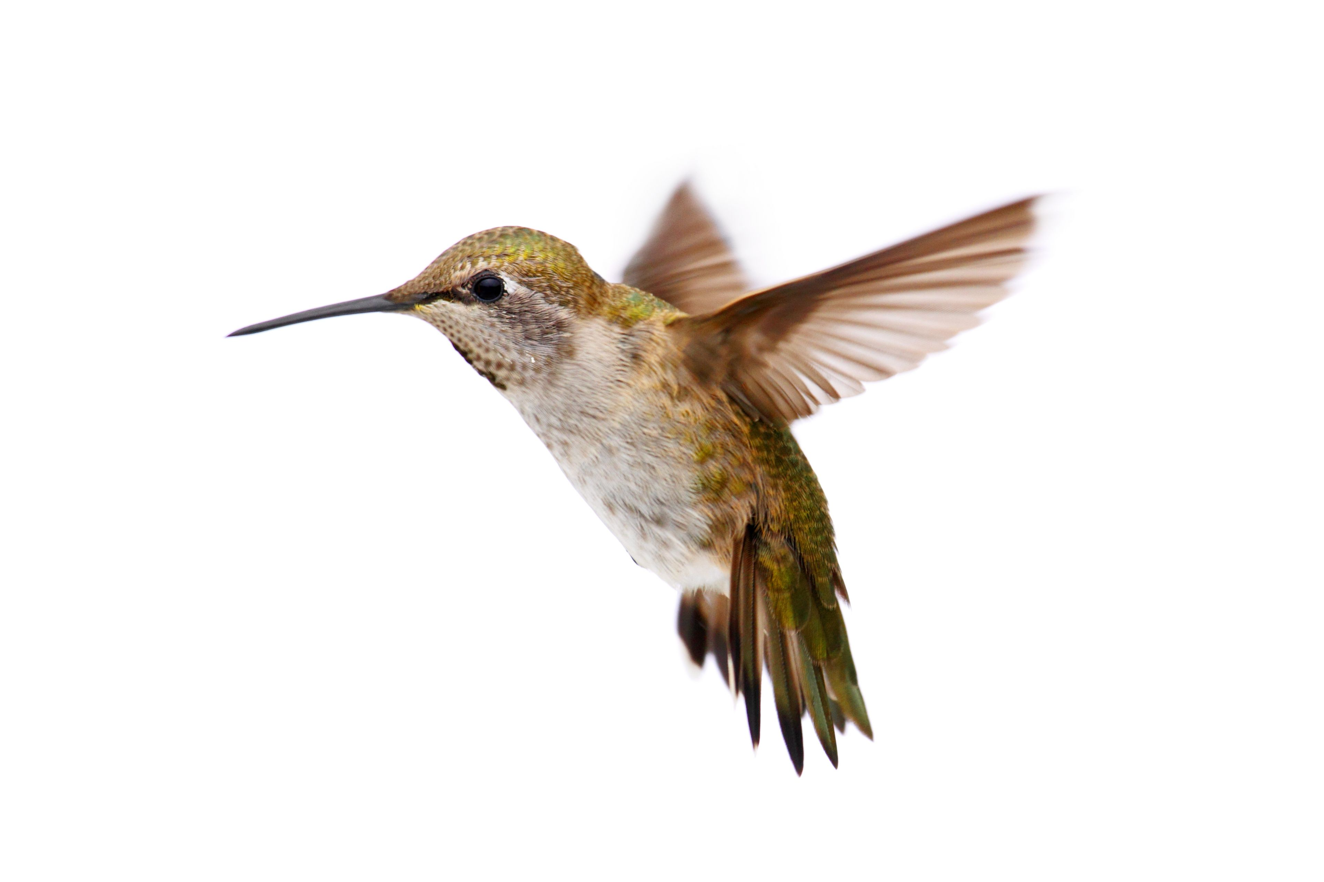
02
梳理文本情节，找到情节协同点
(2023.1浙江高考续写为例)
The broken window glass
I & she
(hummingbird)
friends
why
who
a milking house
my friend’s farm
where
I rescued a hummingbird
协同
what
1. 梳理情节要素
when
When I was invited to visit the farm for cookout

Slide 16
clues:
The broken window glass was the likely answer.
the bird did not fly away;
Still, she made no attempt to fly.
she soon took wing but did not immediately fly away. Hovering, she approached within six inches of my face. For a long moment, this tiny creature looked into my eyes, turning her head from side to side.
They promised to fix the window.
when a hummingbird flew to the center of our group and began hovering. She turned from person to person until she came to me. She again looked directly into my eyes, then let out a squeaking call and was gone. ...,"She must have come to say good-bye."
event3: She returned to squeak goodbye to me.
para.1 想见
______________________
______________________
______________________
para.2 “再”见
______________________
______________________
______________________
相识
event4: A few weeks later, I went to the farm again...
where: at the front of the milking house
who: I
what: I saw the window had been fixed; I recalled...I missed...
想见
event2: She hovered and looked at me before flying away.
on the farm
event5: I was just about to leave when the hummingbird appeared...
event1: A hummingbird was stuck in spider-webs and I picked her up.
“再”见
协同
who: hummingbird &I
what: the bird hovered/squeak/ perched/...
I saw .../greeted/...
in a milking house
2. 绘制情节曲线
初识
my 1st visit
my 2nd visit
harmony/trust between a human being and a bird
theme:__________________
theme:__________________________

Slide 17
技能篇
拓展：
指向不同主题的语言
（1）以景托情式
（2）道理寓意式
（3）温馨画面式
Outside the bakery, the birds chirped happily, as if celebrating their achievement.
Though she still was cold in her body, she felt warmth, just like a warm current rushing through her heart.
On the dinner table, they chatted about the university life and the many adventurous experiences, which pushed the atmosphere to the peak. Everyone’s face was reddened by the warmth including the two cheerful dogs. What a harmonious reunion!
That experience taught me an important lesson: Honesty is the best policy.

Slide 18
拓展：
（4）画面留白式
（5）前后呼应式
（6）自我反思式
指向不同主题的语言
I looked up at the sky. It was as if God, himself was weeping with pride. The rain that came that day was a miracle, saving our farm, just like my boy saved a life.
(miracle一词很好地呼应了前文中已出现的witnessed the only miracle I have seen with my own eyes.)
“Dad is right. We shall never judge a person by their appearance,” I thought.
Eventually, the pilot spotted her and down came the helicopter.

Slide 19
（1）助人为乐型
行动类：
1. 传递爱
I made up my mind to pass on “love” to others. Just as a saying goes : “ Roses given, fragrance in hand（赠人玫瑰，手有余香）. ”
I would always keep these changes in mind and remind myself of helping others in need.
感悟类：
1. 善良助梦
None of this would have been possible if that man hadn't given us the gift--the gift of kindness.
2. 心存希望
I began to know that there are lots of people out there that are kind and can bring back faith and hope to human. Just remember that, if life gives you lemons, make lemonade, and remember that there are some good people out there in the world.
拓展：
表达篇
指向不同主题的语言
（2）个人成长型

Slide 20
感动类：
1. 爱的纽带
In Henry's heart, Maple Street News was not just a news page, but a social bond. It not only brought locals convenience, but also wove love and kindness into it.
2. 英勇举动
Years later, what I remember most about that terrible night are the acts of bravery.
3. 临危不惧
These are civilian heroes who acted instinctively with courage and grace when caught up in extraordinary circumstances.这些都是平民英雄他们在特别危急的情况下，本能的作出勇敢而高尚的举动。
（1）助人为乐型
拓展：
指向不同主题的语言
（2）个人成长型

Slide 21
（2）个人成长型
拓展：
感悟类：
1. 及时联系
I see it as more of a lesson, a reminder of not to lose touch with loved ones. It is too easy to remain lost. After our sister-to-sister miracle, I don't plan to let that happen again. A family should never be separated.
2. 心怀感恩
From him we learned what it was to accept the bad without complaint and the good with gratitude.
3. 传递欢乐
Though embarrassed by my stupid behaviour, I was satisfied with the happiness and fun that I had brought to others.
4. 节日真谛
It was exactly at that moment that I came into the enlightenment that the great gifts for Christmas were understanding, grace, peace and forgiveness.
指向不同主题的语言
（2）个人成长型

Slide 22
（2）个人成长型
拓展：
5. 责任意识
It was then that I realized that the meaning of growing-up wasn’t contributing to the household but understanding your parents.
6. 家庭团结
My parents always taught me that family sticks together through the highest of the highs and the lowest of the lows.
7. 爱的认识
Only then did I realize Joe actually understood how to take care of me despite his trouble with the housework.
It turned out that every single act of kindness can make a big difference.
8. 比赛的认识
It's not whether you win or lose. It's how you play the game.
9. 找到勇气
Niesha cast a glance at Mr. Roberts standing in the corner smiling at her. A self-reassuring smile spread across Niesha’s face. She knew for sure that she had found her courage, in the mill and in the adversity.
指向不同主题的语言
（2）个人成长型

Slide 23
（3）其他
拓展：
善良带来的友情(交友类)
It was a casual greeting and kindness that brought us the precious friendship.
难忘的假期(冒险脱险类)
What a thrilling vacation, like never before, we had!
家人的力量(冒险脱险类)
Later, when asked what gave her the strength and perseverance to continue, both in the cold water and in great fear, Kiana thought it had to do with family. “I just wanted to save my family, and I didn’t want anything bad to happen to them. So I couldn't spare a second to worry or fear.” she said.
难忘经历(美好回忆类)
After so much practice and countless hardships, each of our actors played their roles and shined their own light. The show has ended, but the memorable experiences and happiness it left will never fade.
指向不同主题的语言
（2）个人成长型

Slide 24
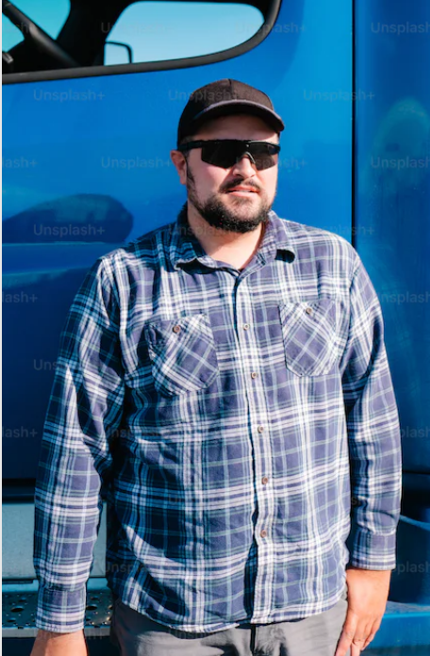




03
分析文本人物，找到人物协同点
1. My dad, George, only had an eighth grade education. A quiet man, he didn’t understand my world of school activities. From age 14, he worked. And his dad, Albert, took the money my dad earned and used it to pay family expenses.
2. I didn’t really understand his world either： He was a livestock trucker, and I thought that I would surpass（超过）anything he had accomplished by the time I walked across the stage at high school graduation.
3. Summers in the mid-70s were spent at home shooting baskets, hitting a baseball, or throwing a football, preparing for my future as a quarterback on a football team. In poor weather, I read about sports or practiced my trombone（长号）.
4. The summer before my eighth grade I was one of a group of boys that a neighboring farmer hired to work in his field. He explained our basic task, the tractor fired up and we were off, riding down the field looking for weeds to spray with chemicals. After a short way, the farmer stopped and pointed at a weed which we missed. Then we began again. This happened over and over, but we soon learned to identify different grasses like cockleburs, lamb’s-quarters, foxtails, and the king of weeds, the pretty purple thistle. It was tiring work, but I looked forward to the pay, even though I wasn’t sure how much it would amount to.
5. At home, my dad said, "A job’s a big step to growing up. I’m glad you will be contributing to the household." My dad’s words made me realize that my earnings might not be mine to do with as I wished.
6. My labors lasted about two weeks, and the farmer said there might be more work, but I wasn’t interested. I decided it was not fair that I had to contribute my money. (2021.6浙江高考续写为例)
Para.1When I brought my paycheck home-it was $119-my dad wanted to talk to me. ___________________
Para.2 I was surprised that my dad allowed me to use the money as I wished.________________________
原文中的人物形象：
协同
Character traits: My dad, George, only had an eighth grade education. A quiet man, he didn’t understand my world of school activities. From age 14, he worked.
Occupation: He was a livestock trucker
Attitudes towards my money: I’m glad ...allowed
聚焦主要人物，分析
人物性格特征、情感变化。
When I brought my paycheck home-it was $119-my dad wanted to talk to me._________________________________________
父亲的用语要符合卡车司机的身份
A. He sat down beside me on the sofa and then patted my shoulders. “How much did you get this summer?” He asked. “119 dollars.” I answered with my head dropped. “Wow. That’s a large amount. I’m proud of you.” ...
B. The door opened and in came my dad. He gently placed his right hand on my shoulder and said, “Success favors those who work hard. I firmly believe that, so long as you put your efforts, you can achieve whatever you want. So you deserve the money.”
When I brought my paycheck home-it was $119-my dad wanted to talk to me. ______

Slide 25

技能篇
拓展：
聚焦主要人物的描写
外貌描写
动作描写
复现
照应
心理描写
情感描写
神态描写
语言描写

Slide 26
para.2 I was surprised that my dad allowed me to use the money as I wished. In the blink of eye, numerous fun activities I could do presented themselves to me. I sprang to my feet and kept jumping, still wild with joy and astonishment. On that day, after calculating my budget, I went to the local store and bought many things I wanted-a new football, a baseball bat and a pair of sneakers and so on. Better yet, the idea of going back to the farmer and working more spread into my mind. At exactly that moment, I realized why my father let me have the money-it was his expectation for my future, his encouragement and quiet love. And that was something I might never surpass.
按照行文关系和行文方向
与续文para.1 照应
此处照应续文para.1中的语言描写:
He withdrew his hand and slowly continued, “You deserve the money and the money is yours now.”
与原文para.1 复现
此处复现原文para.1的quiet(人物性格特征词汇):
A quiet man, he didn’t understand my world of school activities.

Slide 27
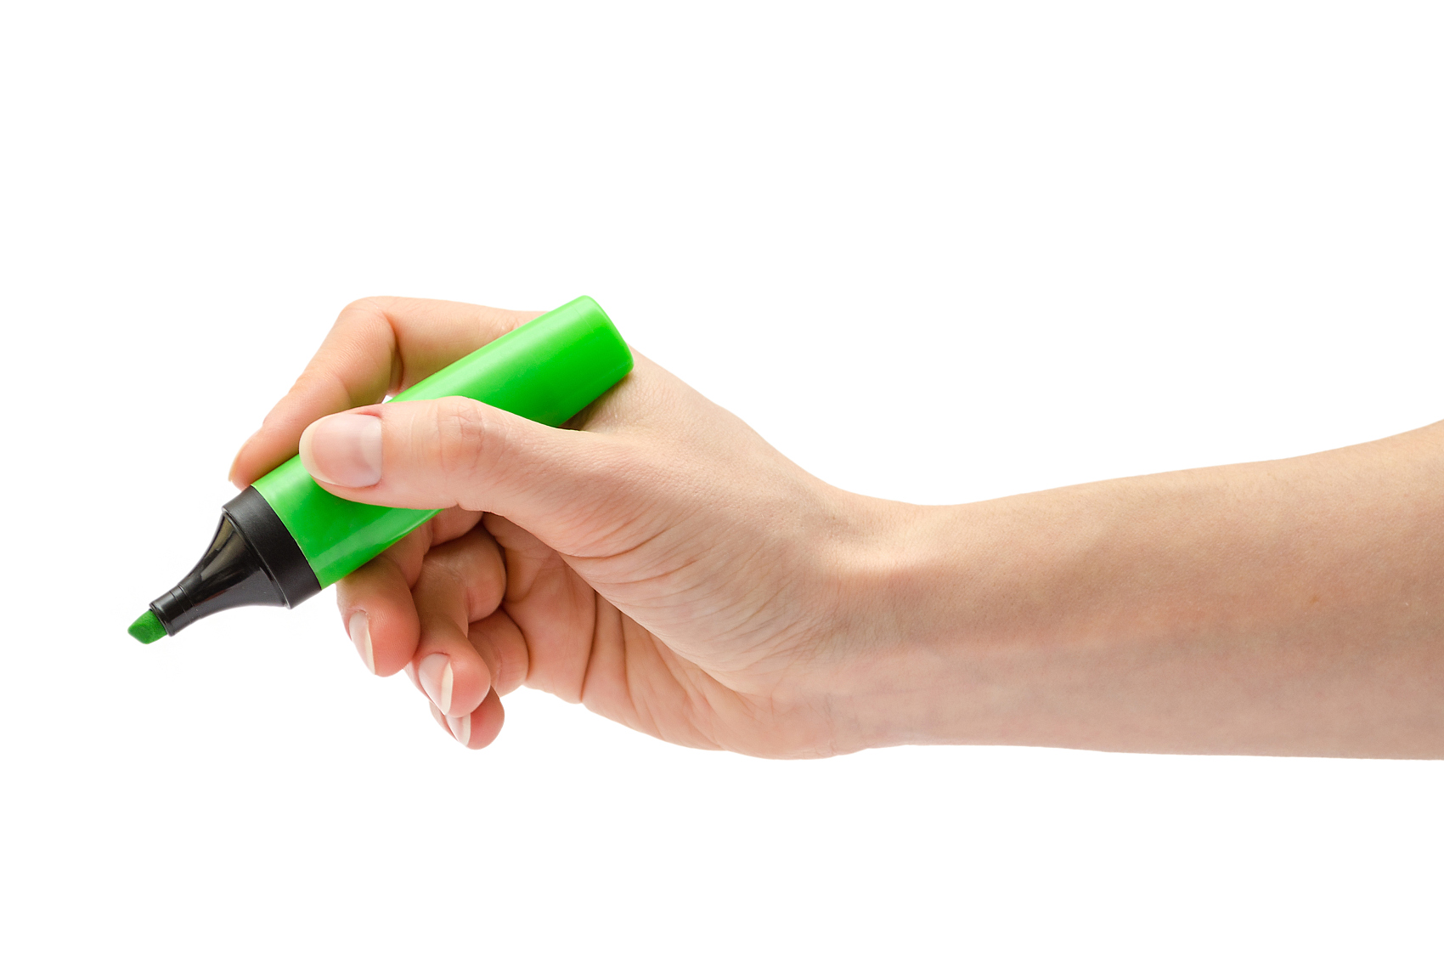
04
品读文章语言，找到语言协同点
(2021.浙江五校联盟)
1. It was August, the peak season for tourism. Olav Hylland, the owner of a local restaurant, was expecting as many as 500 tourists to visit and eat there. With a joyful heart, he jumped into a van, which he had just bought to transport cargo (货物) for his restaurant, and set off.
2. Leaving his home, he turned onto the main road with a tunnel (隧道) 300 meters ahead. The 11.4 kilometer tunnel was the only way to access the local scenic spot, where his restaurant was located. Two years earlier a truck caught fire inside it and the tunnel's closure for repairs was a disastrous blow to Olav's business. The road to his restaurant was blocked and the stream of tourists halted (停止). Although it was difficult, he managed to keep their staff on.
3. “And today will be a perfect day." Olav thought.
4. Inside the tunnel everything went normal. But when he was near the end, Olav spotted an unusual light 50 meters ahead. Then he saw something burning.
5. Horrified, he stopped dead in his tracks. A tour bus was on fire! At the back where the engine was, dozens of tourists were stumbling (跌跌撞撞地走） towards him, getting away from the flames." They're going the wrong way.” Olav thought, knowing the tunnel exit was just 500 meters ahead round a bend ahead of him. Then he realized the bus was now burning so fiercely that it was impossible for them to get around it.
6. As a former volunteer firefighter, Olav first had to raise the alarm. Grabbing his cell phone, he entered the codes with shaking hands. “A bus is on fire! Close the tunnel gates!” Both gates were shut to avoid the entry of more vehicles, but the thick smoke was pouring out of the bus in his direction under the influence of the strong wind. In no time it would black out the tunnel, choking and blinding anyone inside it.
7. There was no way the poor tourists could outrun the toxic (有毒的) fumes.
8. Every minute counted.
Para.1 Immediately, Olav turned the van round, jumped out and opened the sliding doors to the empty cargo space.
Para.2 After a 20 minutes' desperate drive, finally they arrived the exit of the tunnel!
用with复合结构表达人物心情
按照行文关系和行文方向
协同
用插叙补充背景，做好铺垫
用心理活动反映人物情绪、设置悬念
阅读原文语言形式、特征(如非谓语、状语从句、定语从句等的使用)及语言风格(如生动的动词和副词等的使用)，使续文和原文协同一致。
用形容词/标点符号传达人物情感状态
环境描写营造紧张、危急的氛围
连续动作烘托人物当机立断形象

Slide 28
技能篇
拓展：
Para.1 Immediately, Olav turned the van round, jumped out
and opened the sliding doors to the empty cargo space.
必备技能之
用小词拆解动作
场景1. Olav 呼叫人群上车
按照行文关系和行文方向
“Everyone, get in here!” he shouted, waved his arms in the air, and signaled people to run towards his van.
拆解动作：呼喊+示意+挥手 （A,B and C)
场景2. 人群跑来
Catching sight of this, the frightened tourists started to rush towards the van and piled in.
拆解动作：看到+跑来+上车 (非谓语)

Slide 29
拓展：
场景3.Olav 开车带游客冲向出口
必备技能之
用小词拆解动作
After making sure no one was left behind, he sprinted to the driver’s seat, stepped on the accelerator(油门), and flew to the exit like an arrow.
拆解动作：上车+踩油门+冲向出口 (A,B and C)
按照行文关系和行文方向
动作描写精准化、过程化

Slide 30
拓展：
场景4. 凶猛的大火浓烟增加阻力
必备技能之
无灵主语句
preying on(追捕)
The deadly fumes were _______________ mercilessly(无情地), ______________ everything in its path.
Under the influence of the strong wind, smoke spread even faster and soon __________the whole tunnel.
按照行文关系和行文方向
blanketing/swallowing
engulfed
动作描写修辞化

Slide 31
后悔 If only she had not left her mobile phone in the bag with Tom. Jane kept moving, but the farther she walked, the more confused she became.
挣扎 After a struggle in my heart, I decided to encourage myself to grasp the last minute.
焦虑 The father’s anxiety being apparent, other skiers in the parking lot offered to help.
内疚 A sense of guilt crowded into my soul.
不安 What made them more upset was that the vase was not a common decoration, but an antique.
羞愧 Feeling embarrassed and ashamed, she struggled to her feet.
紧张 His heart was pounding wildly.
高兴 So glad was she that her bright smile lit up the room./ She wept tears of joy.
笑容凝固 The smile froze on their lips, but they soon regained their warmth.
心情沉重 With a small fortune in hand. I still went home with a heavy heart.
兴奋 I couldn’t have been more excited./ Excitement took my breath away.
兴奋消失 My excitement suddenly faded at the thought of my dad’s words.
失望 No one came into sight, a feeling of disappointment flooding over me.
拓展：
常见与人物情感
相关表达
按照行文关系和行文方向

Slide 32
失望+悲伤 A wave of disappointment struck him. Sadness washed over him so suddenly that he couldn’t think of a word to say.
无助 I shook my head helplessly, unsure what to do.
无奈 John reluctantly turned around and strode out.
害怕 Panic consumed her.
沮丧 Depression settled over me like a heavy black cloud.
惊呆Dumbfounded, John was too embarrassed to utter a word.
惊讶 What was totally beyond my expectation was that she went on giving me so many purple potatoes only as a result of my casual appreciation and desire.
好奇 Finally, my curiosity got the best of me.
疑惑 A young man greeted us with a confused expression and asked us whether we had met somewhere.
感动 The feeling at that moment was indescribable.
生气 With her face flushing with anger, she was breathing fire and fury, accusing of my foolish idea.
如释重负 A wave of relief swept over me.
尴尬+如释重负 Suddenly a mixture of embarrassment and relief surged up from the bottom of her heart.
拓展：
常见与人物情感
相关表达
按照行文关系和行文方向

Slide 33
敲门She pounded the door: "Go downstairs. Go now!"
伸手取东西He fetched out his can of hair spray.
停车 He pulled in front of it as the wolf was catching up fast, just a dozen yards away now.
咳嗽By then, both of them were coughing and their eyes were stinging.
捂住鼻子Jane tried to shield her nose from the choking smoke.
手捧 He was cupping both hands in front of him as he walked very careful not to spill the water he held.
跳起来 We sprang to our feet and entered the living room eagerly.
咯咯笑 I giggled nervously.
飞快跑 He ran as fast as his legs could carry him./He sprinted across the street
突然想到All of a sudden it dawned on me that it was my father who had prepared the green bottle and the paper for my birthday!
蹲下 Squatting down to pick up the coins, she told them her phone number.
跪下He was on his knees, searching for the missing ring.
伸手+拥抱 I stretched out my arms and embraced my mother.
停下+哭 I froze in my steps in the middle of the road. Tears welled up in my eyes.
拓展：
常见与人物动作
相关表达
按照行文关系和行文方向

Slide 34
乞求 “Mom, get up,” I tearfully pleaded.
交换眼神 Jane exchanged a glance with his father and they winked at each other secretly.
看到 What came into view was the dream present she had wanted for ages.
想象 Picturing the scene of Billy sitting on the ground and wiping his eyes as Dexter walked away, Carter stepped toward the desk when the car was still drying.
想起 Images of dinner with Luke popped into my head.
垂头 The boy hung his head in shame.
跺脚 He stamped one's feet in anger.
疯狂地挥手He waved his hands frantically at the drivers passing by.
发帖子 He released a post on social media that she would be off work for a bit and was having an operation on Monday .
拍肩膀I tapped /patted the man on the shoulder and asked him to move.
鼓掌The moment he finished his speech in a magnetic voice, a wave of applause erupted from the audience.
拓展：
常见与人物动作
相关表达
按照行文关系和行文方向

Slide 35
怒气冲冲地走He stormed out and slammed the door shut.
握拳+咬牙+鼓起勇气Clenching my fists and gritting my teeth, I plucked up my courage.
高声喊 Blood rushing to his face, he leapt to his feet and yelled at the top of his voice.
小心翼翼移动He inched/edged closer to investigate what was going on.
踮脚走I tiptoed down the stairs in my bare feet.
拉响警报器He triggered/sounded/set off the alarm.
深情抚摸He strode forward, crouched down and stroked his hopeful face affectionately.
呻吟 Nick was lying on the floor, groaning with pain.
探出脑袋Then her dad stuck his head out of the back door.
吹哨The referee(裁判) blew his whistle and the match began again.
躲 He ducked behind a dustbin.
拓展：
常见与人物动作
相关表达
按照行文关系和行文方向

Slide 36
Summarize the whole class
理清文本结构，找到结构协同点
查找冲突解决
梳理文本情节，找到情节协同点
绘制情节曲线time
续写中的
语言组织
分析主要人物，找到人物协同点
读懂主要人物time
品读文章语言，找到语言协同点
看懂作者文风
Notes:
对本课件使用有任何疑问，请联系小助手：naodong12
更多优质内容，请关注微信公众号【脑洞英语课堂】

Slide 37
练手
（2022.4 稽阳联考）
1.The paper on my desk was yellow, with straight blue lines stretching across it. The lines repeated themselves all the way down the page. I counted them. Twenty-six straight lines across the paper. The yellow color reminded me of sunshine. In summer the sun is bright yellow like that, and the sky is blue like those lines. I loved blue---blue is for getting lost in.
2. “You haven't written a word yet, have your?" Miss Perry had found me out. I hung my head, as in past years, and gave her the lines I'd given previous teachers.
3. "I don't feel like it."
4. The truth was that I wanted to write about something different. "Write about Your Best Friend," demanded the assignment on the board. I didn't have a best friend. I had a few friends, but I didn't want to claim any of them as my "best"because I was afraid they might pick someone else. What if I picked a "best" friend and then someone different, who thought I was their best friend, heard my paragraph read aloud and then never spoke to me again? It was a stupid topic. I was disappointed in Miss Perry for choosing it.
5. I knew Miss Perry must have heard about me from my other teachers. I had already prepared myself for another year of listening to teachers scold me. I was only nine years old, but my ears had been dull to the voices of my elders. My teachers, my parents, and the school principal had all given me the "What are we supposed to do with you?" speech.That was probably what Miss Perry was about to say,too.
Paragraph 1: However,there was something different about Miss Perry.
Paragraph 2: I bet I was touched.
按照行文关系和行文方向

Slide 38
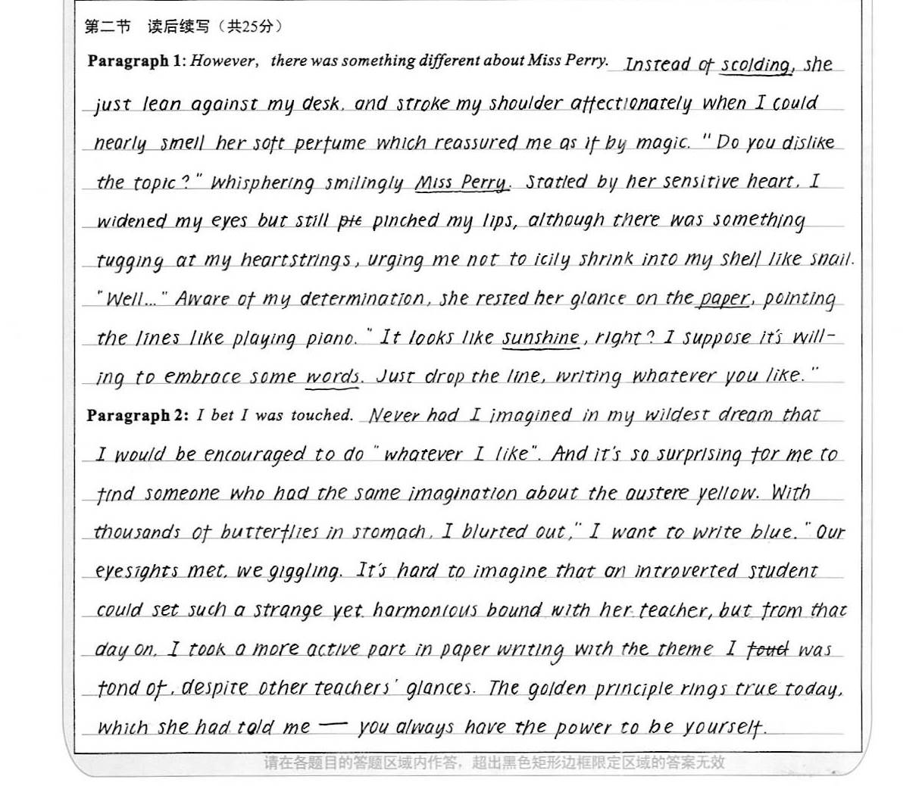
21.5
漂漂亮亮
1. 内容和结构与前文协同呼应，融洽度高，如在Para.1中呼应了前文的伏笔点”最爱的话题“， 也解决了前文故事遗留的冲突--老师要求完成命题作文但我有自己喜欢的话题。
2. 语言表达准确丰富，且自然流畅,与前文协同度高。如续文中模仿前文用了一些小词 “lean, stroke, whisper, rest”生动地展现了老师明察秋毫、和蔼可亲的形象。
3. 续文最后的主题（找回自我）很好地呼应了前文的“blue is for getting lost in...”，

Slide 39
Para.1
However, there was something different about Miss Perry. “What do you want to do, then?” she smiled, tenderly staring at me with deep blue watery eyes.(动作描写) What? My previous teachers would scold me or send me to the principal’s office. Miss Perry, however, stood in front of my desk and kept her soft gaze on my face.(心理描写) Without a word, I lowered my head to avoid her eyes. “You just think what it is that you want to write about? Then, come to share with me, and we’ll make some arrangements that you can live with(接受). Fair enough?” She patted me on the back. No teacher had touched me before(对话描写+动作描写).

Slide 40
Para.2
I bet I was touched. Automatically(不知不觉地), I raised my head and caught sight of her walking back to her desk. Wondering what to make of(了解) her, I received another glance（动作描写）. A sense of something different attacked（情感描写）. I looked out of the window. The trees, the rain, everything was in sight（环境描写）. Inspired, I rose from the seat. “I want to study the weather outside.” “You really like that? But promise to write down what you learn on that blank paper. Deal?” “Deal!”（对话描写） All that afternoon I studied clouds, winds and the rain. Amazingly, a rainbow hung above like an upside-down smile（双关）. For the first time in years, I was really concentrating on my school work.(主题——个人成长与改变)

Slide 41

Thank you

Slide 42
续文 | 结构协同
para.1
para.2
协同
Conflict3: I expected to see her but didn’t find her.
Para.6 A few weeks later, I went to the farm again.
运用conflict-solution模式进行续写(找到冲突—解决冲突)，使续文和原文结构协同。
Para.4-5 I noted she look for me and squeak goodbye .
para. ①
Conflict 3
(故地重游、想而未见)
C2-R2
conflict 2
C1-R1
Setting: a stuck bird
solution 1
solution 2
Para.2-3 I rescued the hummingbird.
C3-R3: reunited
conflict 1
Para.1I came across a stuck hummingbird.
Para.7 I was just about to leave when the hummingbird appeared.
C2-R2
para. ②
C1-R1
Solution 3
(最终相见、再续前缘)
Conflict

