Slide 1

感恩遇见，相互成就，本课件资料仅供您个人参考、教学使用，严禁自行在网络传播，违者依知识产权法追究法律责任。
更多教学资源请关注
公众号：溯恩高中英语
知识产权声明

Slide 2
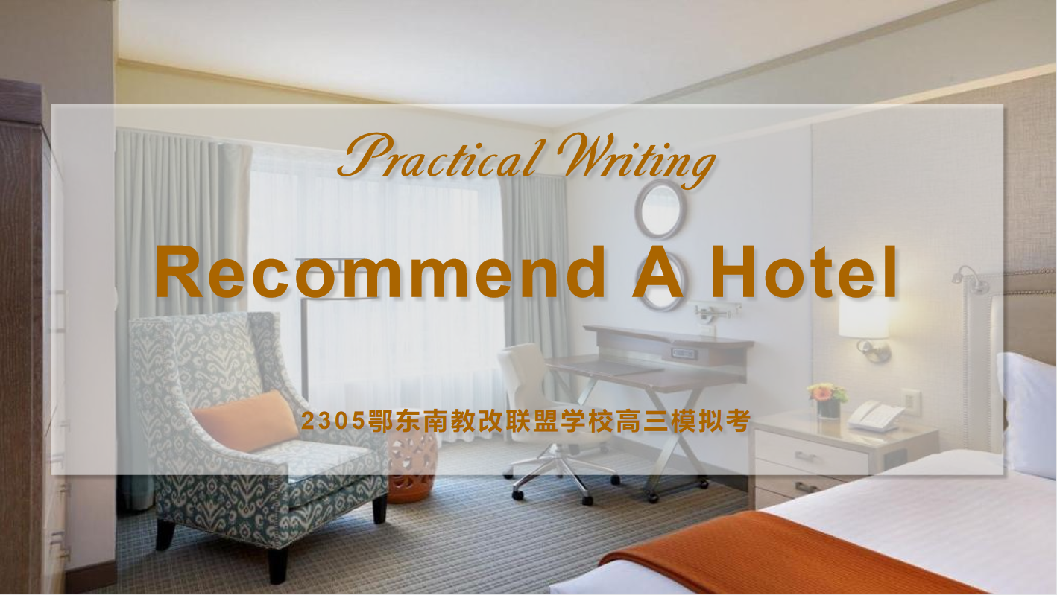

Slide 3

假定你是李华，你的爱尔兰网友 Tom 下周来你市参加短期语言培训，他发来邮件请你帮忙推荐一家酒店方便学习期间入住。请给他回信，主要内容包括：
1. 表示欢迎；
2. 推荐理由；
3. 表达祝愿。
注意：
1. 词数 80 左右；
2. 可以适当增加细节，以使行文连贯。
Re-analyze the requirements with your partner and check the missed points :
Genre:
Person:
Voice:
Subject:
Contents:
Structure:
Reply+ Recommendation
1st., 2nd. and 3rd.
friendly and casual
an Irish e-pal
Welcome
Reasons for recommendation
Wishes
Stick to the requirement& Be concrete!
(Reply to recommend)
+ Purpose
Para.1: Welcome
Para.2: Reasons for recommendation
Para.3: Wishes
(Hotel Name)
( anticipation or further Qs)
+?

Slide 4

an Irish e-pal
from Ireland to China
from his hometown to your city
from online to offline
feelings towards his coming
Welcome to China!
Welcome aboard my city!
A warm welcome on visiting China soon!
My hearty welcome goes to you for the coming visit!
I’m delighted/thrilled to have you visit my city next week!
I’d like to recommend a... hotel named... to you!
Let me recommend ... Hotel as you asked (in the letter).
I’m recommending ... Hotel according to your demands.

Slide 5



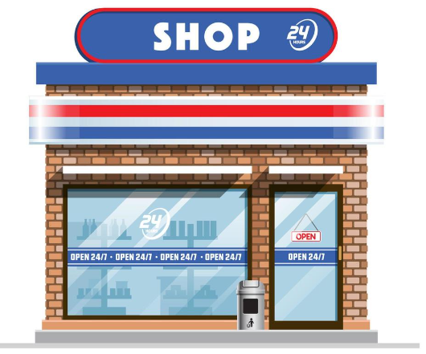




Be subjective or objective?
Li Hua oriented or Tom oriented?
an Irish e-pal
short-term language training or drill?
Why do you recommend it?
The hotel neighbors the language/training center, which helps you save a lot of traffic/commuting time...
In addition, the hotel will also offer signature “Express Start Breakfast”, speedy check-in, and power showers to ensure you are recharged for the day.
Moreover, the hotel offers a rich international buffet breakfast with a hot & cold food selection, which definitely fuels your day with nutrition and energy....
five minutes’ walk to the subway station...
shuttle bus to the airport
the MRT stations are within striking distance...
be in a walking distance to...
merely one bus stop away from
within a 20-minute drive of...
in the heart of ...
Transportation
city library
convenience stores
pharmacy...
Location
Surroundings
clean, quiet,
cozy and comfortable
well-organized...
Meals
Internal Environment
nutritious breakfast
tasty food...
Random combination?
Serve the subject, serve the purpose!
Facilities
high-speed/ free WiFi...
printer at the business center
Staff
Think it over and draft your own versions to make an effective recommendation!
Service
friendly, helpful, warm-hearted, hospitable...
fluent in English...
convenient and complete
morning call
laundry...

Slide 6

About the stay:
About the trip:
About the training:
About the following issues:
About the coming gathering:
About the recommendation:
Wish you a pleasant stay in the city!
May you be safe throughout the journey!
Enjoy a smooth/fruitful/ productive training in the city!
Hope everything goes on well in the following!
Look forward to the offline meet with you!
Hope you’ll find the information helpful!

Slide 7

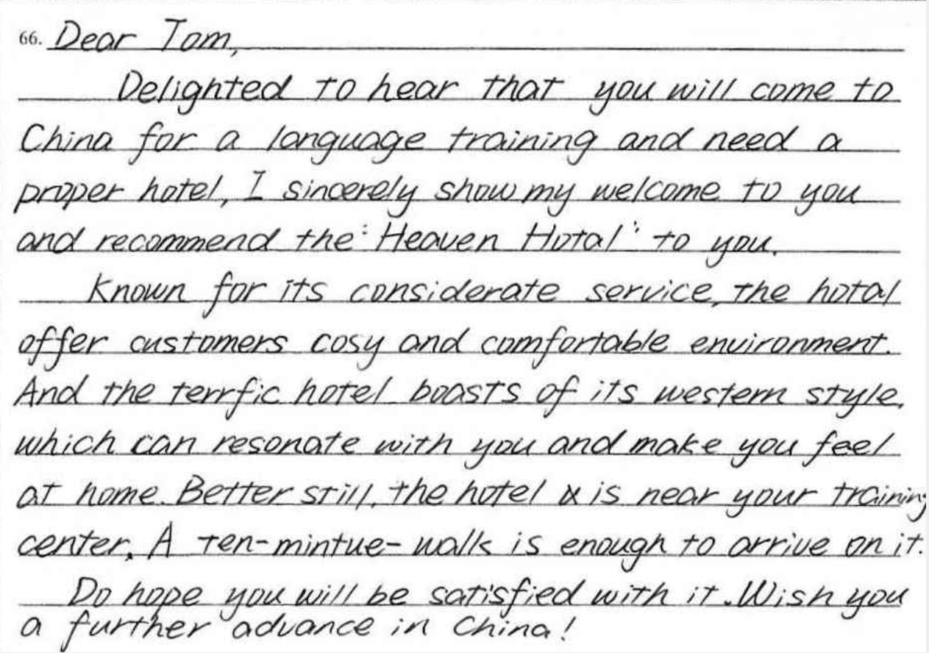
Discuss in groups& Polish the passage!
Dear Tom,
Delighted to hear that you will come to my city(指代更扣题) for a language training and need a proper hotel, I’d like to convey my sincere welcome(优化表达,更简练) and recommend the Heaven Hotel to you.
In a ten minutes’ walk distance to the training center, the hotel is known for its considerate service and cosy(cozy) environment, which will save you a lot of traffic time and recharge you day with good rests.(扣题,调整优先顺序,丰富内容,提升句式) Better still, it also boasts of its western style.You’ll feel at home by resonating with it. (长短句结合)
Do hope you’ll be satisfied with it! Wish you further progress in China!
Yours,
Li Hua

Slide 8

Official version
Teacher’s version
Dear Tom,
Welcome to my city for a language training next week. I’d like to recommend an affordable and comfortable hotel named Tower Hotel to you.
Tower Hotel is an international hotel whose staff can communicate with foreign tourists fluently. The reason why I recommend you to choose the hotel is that it is well equipped. Not only is free WiFi available everywhere, but also a wake-up call service is provided. More importantly, located on a main road, the hotel is close to the Language Training Center. I’ll be more than happy if you find my recommendation of help.
Wish you a pleasant stay in the city.
Yours,
Li Hua
Dear Tom,
Welcome aboard my city next week! Let me recommend the well-located and cost-effective Sprint Hotel as your demanded in the previous email!
With a walking distance to the training center and an official reception qualification for foreigners, it’s a high-rated chain hotel listed on Tripadvisor, which has met with broadly positive reviews. Also, it features full-equipped services like high-speed WiFi and printing, together with hospitable staff speaking fluent English. The comfort and convenience provided won’t disappoint you! Please find the attached contact information for your easy reference.
All the best for everything ahead! Can’t wait to see you!
Yours,
Li Hua

