Slide 1

感恩遇见，相互成就，本课件资料仅供您个人参考、教学使用，严禁自行在网络传播，违者依知识产权法追究法律责任。
更多教学资源请关注
公众号：溯恩高中英语
知识产权声明

Slide 2
三步简化法---英语C篇阅读理解答题策略
湖北省应城市第一高级中学 范静静 13789957350

Slide 3
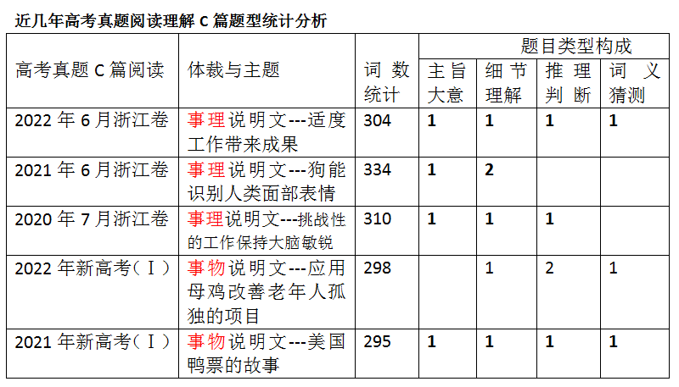
事理说明文：
多采用递进式，一层一层论据剖析证明事理
切入点
篇章结构
事物说明文：
多采用总分式，“分”的部分常按并列方式安排

Slide 4
三步简化法攻破说明文阅读
简化大意---浏览全文，标记关键
1
Contents
简化题干---按词索骥，精准定位
2
简化长难句---横向分析，纵向比对
3

Slide 5
命题规律-------浏览全文，标记关键信息的指导方针
研究近几年高考试题可以发现，高考阅读理解设置的问题往往反映了一篇文章的主要信息和脉络，命题者通常从以下几个维度设题：
1.段首、段尾句：第一段首句或末句往往是该段的主题句。因此，命题者一般针对它们设置主旨大意题目。
2.特殊标点处：破折号、冒号、括号、引号后的内容往往是对前面内容的进一步解释、说明或补充。命题者往往针对这些标点符号后的内容设置细节理解、推理判断、主旨大意等题目。
3. 转折、对比处：一般来说，表示转折意义的信号词but、howerer、yet、on the contrary、in fact或体现对比关系的提示词unlike、while等后面的内容往往是表意重点。因此，命题者常常抓住这一特点设置推理判断、观点态度等题目。
4. 引用人物论断处：为了表达自己的观点或使论点更有说服力，作者常常引用他人的论断或重要发现进行证明。命题者常常针对它们设置观点态度推理判断题目。
5. 举例子、打比方处：为了使自己的观点更有说服力，作者常常采用举例子或打比方等方法。命题者常常针对它们设置细节推理判断题目。
6. 体现因果关系处：命题者常常针对体现因果关系的because、for、as、since、now that、as a result、consequently、result in、result from等信号词设置细节理解、推理判断、观点态度题目。
7. 复杂句式处：复杂句式一般包括同位语、插入语、长难句等，它们往往对考生准确理解文意形成障碍。命题者往往针对这些复杂句式设置词义猜测、推理判断等题目。

Slide 6
Practice 1
事理说明文
2022年浙江卷C篇

Slide 7
Step1:简化大意---浏览全文，标关键，定中心，分层次，找联络
Many people believe that working to the maximum is the secret to success, but research has found that moderation（适度）also gets results on the job. In a study led by Ellen Langer of Harvard University, researchers asked people to translate sentences into a new a made-up language. Subjects who practiced the language moderately beforehand made fewer errors than those who practiced extensively or not at all. High levels of knowledge can make people too attached to traditional ways of viewing problems across fields the arts, sciences, and politics. High conscientiousness is related to lower job performance, especially in simple jobs where it doesn't pay to be a perfectionist. How long we stay on the clock and how we spend that time are under careful examination in many workplaces. The young banker who eats lunch at his desk is probably seen as a go-getter, while his colleagues who chat over a relaxed conference-room meal get dirty looks from the corner office. “People from cultures that value relationships more than ours does are shocked by the thought of eating alone in front of a computer", says Art Markman, a professor of psychology at the University of Texas, Austin. Social interaction has been shown to lift mood and get people thinking in new directions and in ways that could help improve any post-lunch effort.
Markman also promotes off-task time. “Part of being a good thinker is experiencing things that are seemingly unrelated to what you are working on at the moment but give you fresh ideas about your work,” he says. “Also, there is a lot of research showing that a positive mood leads to higher levels of productivity and creativity. So, when people do things to increase their life satisfaction, they also make themselves more effective at work.”
Para1：引出文章主旨：研究发现适度工作也会带来成果。
Para2 运用论据（哈佛大学的研究）：解说论证第一段文章主旨结论
Para3运用对比举例论证：很多工作场合如何花时间的会被全面的审视，适当的社交是能提高工作效率的。
Para4 进一步引用名人观点论证：匀些时间不工作来生活是对工作效率有帮助的。

Slide 8
Step2：简化题干---按词索骥，精准定位
27. What does Ellen Langer's study show? A. It is worthwhile to be a perfectionist B. Translation makes people knowledgeable. C. Simpler jobs require greater caution. D. Moderate effort produces the best result. 28. The underlined word "go-getter" in paragraph 3 refers to someone who . A. is good at handling pressure
B. works hard to become successful C. a has a natural talent for his job.
D. gets on well with his co-workers 29. What can be inferred from the last paragraph? A. A good thinker is able to inspire other people. B. Experience unrelated to your job is useless. C. A cheerful mood helps make a creative mind. D. Focusing on what you do raises productivity. 30. What does the text seem to advocate? A. Middle-of-the-road work habits. B. Balance between work and family. C. Long-standing cultural traditions. D. Harmony in the work environment.
Para2. The Second sentence
Para3. The second sentence
Para4. The last sentence
Para1&4 : Last sentences 结论句

Slide 9
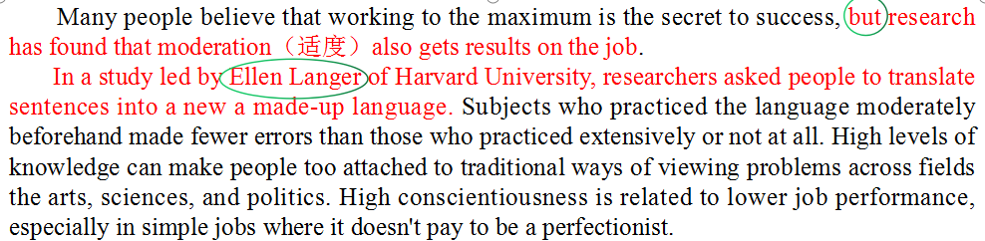
Step3：简化长难句---原文横向分析，选项纵向对比
本题考查的是事实细节分析：
简化上一步定位的长难句
（第2段，第二句）
意为适度练习的人比大量练习的人或者不练习的人犯错误更少。
27. What does Ellen Langer's study show? A. It is worthwhile to be a perfectionist B. Translation makes people knowledgeable. C. Simpler jobs require greater caution. D. Moderate effort produces the best result.
纵向对比选项
与定位简化的细节进行匹配：可知D 为合理解读 同时根据文章篇章结构与第一段主旨相呼应匹配。

Slide 10
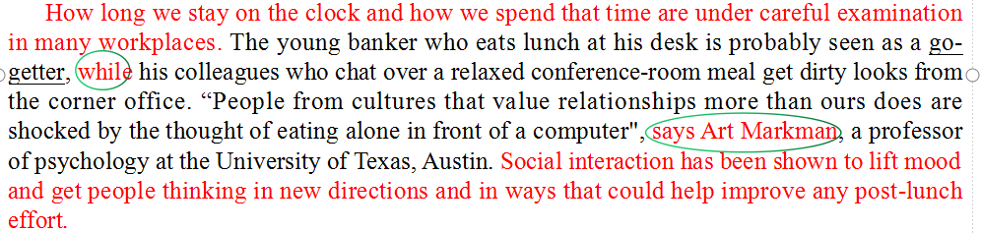
Step3：简化长难句---横向分析，纵向对比
对比 转折
28. The underlined word "go-getter" in paragraph 3 refers to someone who .
A. is good at handling pressure
B. works hard to become successful
C. has a natural talent for his job.
D. gets on well with his co-workers
本题考查的是词义猜测：
简化定位的长难句
（第3段，第2句）
意为：后半句的同事会得到别人不屑的目光，while 前后对比，前半句的一类人被视为go-getter (应是别人投来的褒义评价）。
纵向对比选项
与定位的细节简化句去匹配：：B项反应的是人们对他工作态度的积极，与下句投去不屑的目光完美对比.

Slide 11
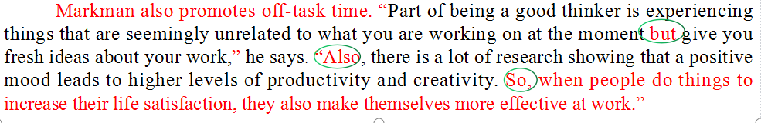
Step3：简化长难句---横向分析，纵向对比
29. What can be inferred from the last paragraph?
A. A good thinker is able to inspire other people.
B. Experience unrelated to your job is useless.
C. A cheerful mood helps make a creative mind.
D. Focusing on what you do raises productivity.
本题考查的是推理判断：
简化最后一段的2，3,4句
意为：做些与手头工作无关的事情带来好心情，从而会提高创造性与效率。
纵向对比选项
与定位的细节简化句去匹配：C项意为愉快的心情能够提高创造性思维，更能与原文相关细节匹配。

Slide 12
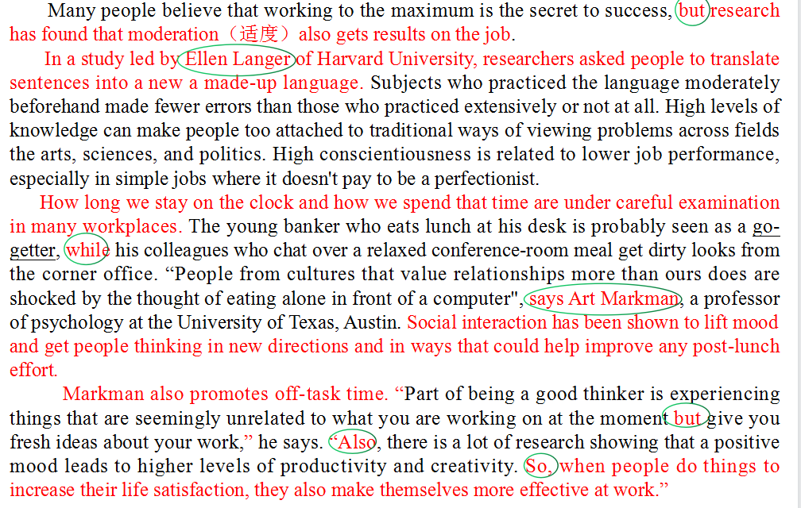
Step3：简化长难句---横向分析，纵向对比
本题考查的是对全文主旨理解的推理判断：简化文章中心句 及各段中心句 再进行选项纵向对比匹配作 A项意为提倡中庸的工作习惯，即适度工作有利于工作效果。
30. What does the text seem to advocate?
A. Middle-of-the-road work habits.
B. Balance between work and family.
C. Long-standing cultural traditions.
D. Harmony in the work environment.

Slide 13
Practice 2
事理说明文
2020年浙江卷C篇

Slide 14
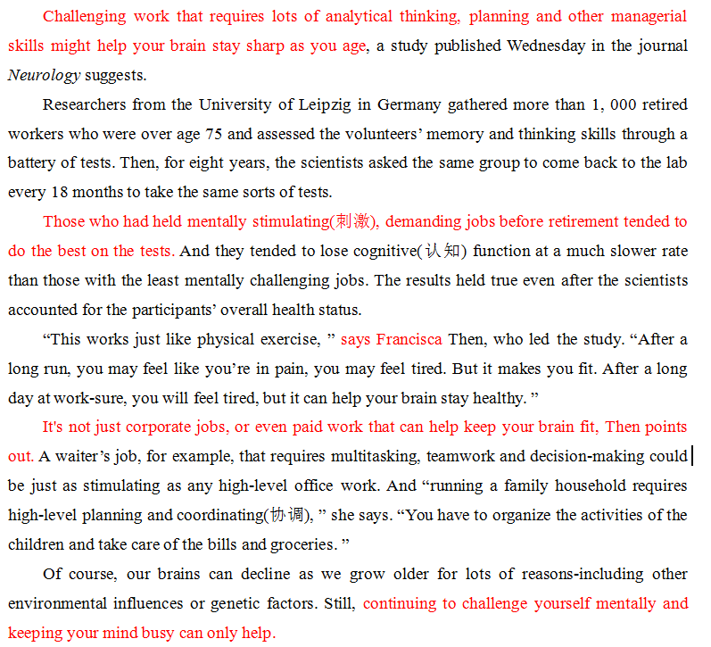
Step1:简化大意---浏览全文，标关键，定中心，分层次，找联络
总
Para1：topic: A new study finding
Para2：The process of the research
Para3：The result of the research
分
Para4：Further explanation
Para5：Another supporting example
总
Para6：Restress the point

Slide 15
Tip:没有明显中心句的段落，观察句式类别进行概括 如：P ara 2& 4
说明文论据类段落常见句式分类：
Para2：process of the research
表研究过程类句式
表研究理论类句式
表工作原理类句式
表研究对象类句式
表研究结论类句式
表研究意义类句式
表研究应用类句式
表研究前景类句式
表研究评价类句式
Para4：detailed function

Slide 16
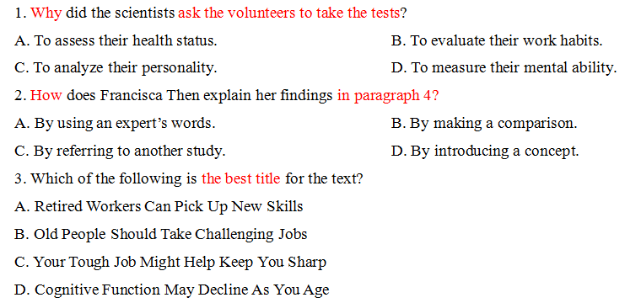
Step2：简化题干---按词索骥，精准定位
Para2. The first sentence
Para4. The last two senteces
Para1&6 : 首位主旨段中心句

Slide 17
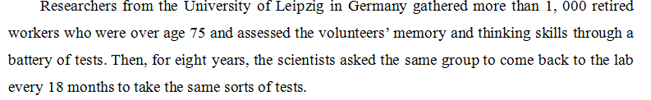
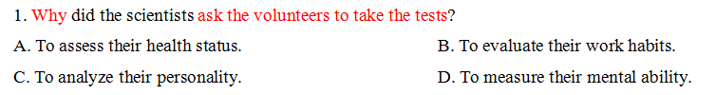
Step3：简化长难句---横向分析，纵向对比
本题考查的主旨大意：
简化第2段第1句：
意为：研究人员招募志愿者来评估他们的记忆以及思维能力。
纵向对比选项
与定位的细节简化句去匹配：D项的大脑意识呢能力更能与原文相关细节匹配。

Slide 18

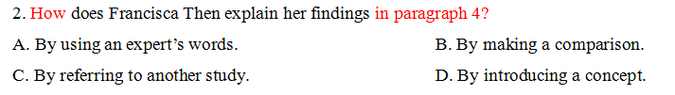
Step3：简化长难句---横向分析，纵向对比
Tip：说明文常用的论证方法梳理
Giving an example
Listing numbers
Making a comparison
Using a quotation
Making a definition
Making an explanation ...
本题考查的说明手法与段落内部逻辑：
简化本段3句话：作者用
打比方的手法将抽象的问题具体化，并用对比的手法进行论证解释。

Slide 19
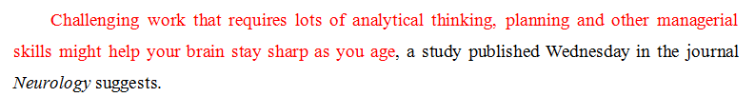

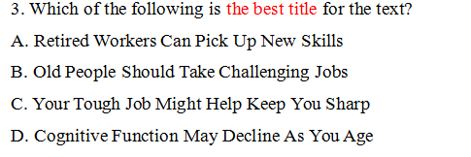
Step3：简化长难句---横向分析，纵向对比
本题考查的主旨大意：
简化第一段和最后一段最后一句：文章中心为挑战性的工作使大脑保持敏捷。
纵向对比选项
与定位的细节简化句去匹配：C项更能与原文相关细节匹配。

Slide 20
Practice 3
事物说明文
2021 新课标新高考I C篇

Slide 21
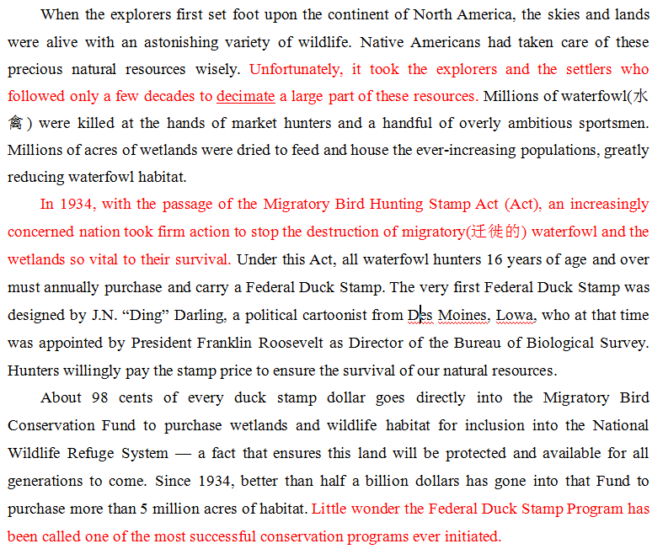
Step1:简化大意---浏览全文，标关键，定中心，分层次，找联络
（2021 新课标新高考I ， C篇）
事物说明文
Para1：background :
problem
Para2：solution:
the coming into being of the object of the text
Para3：the development of the object
Tip: 事物说明文的常用图式是：背景导入+中心话题+发展过程+总结评价
（粗略以时间顺序展开）

Slide 22
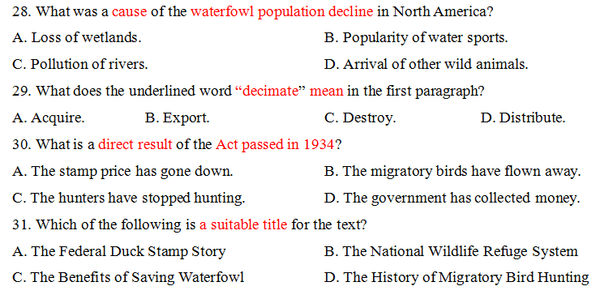
Step2：简化题干---按词索骥，精准定位
Para1. The last but one sentence
Para1. The second sentence
Para3 : The first sentence
Para2&3 : 概括大意

Slide 23

Step3：简化长难句---横向分析，纵向对比

Slide 24
此处：转折 对比
Tip: 词义猜测的核心是把握段落内部相关句子之间的的逻辑关系，包括递进，转折，解释说明，具体到抽象，范畴由大到小。。。

Slide 25


Slide 26
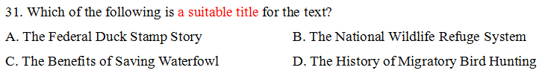
Para1：background :
problem
Para2：solution:
the coming into being object of the text
Para3：the development of the object
Tip: 文章反复大范围出现覆盖解释的名词基本就是文章的topic，切忌说明主体范围表述的过大或过小

Slide 27
长难句阅读四技巧
1.复杂从句【解题技巧】找谓语,定主语，主从分层理解再整合
【原文例句】Subjects who practiced the language moderately beforehand made fewer errors than those who practiced extensively or not at all.
【名师点拨】该句比较长,去掉两个who引导的定语从句,句子的主干为: Subjects made fewer errors than those 。此时明确句式为第一类人比第二类人少犯错误。 然后再另行分别翻译定语，明确两类人区别在哪里。
【参考译文】 那些事先适度练习这门语言的受试者比那些全力练习或者根本不练习的受试者犯的错误更少。

Slide 28
长难句阅读四技巧
2.分割结构【解题技巧】去枝叶,提主干
【原文例句】High levels of knowledge can make people too attached to traditional ways of viewing problems across fields the arts, sciences, and politics.
High conscientiousness is related to lower job performance, especially in simple jobs where it doesn't pay to be a perfectionist.
【名师点拨】这两句比较长,去掉一些细节解释与补充说明等介词短语，状语，主干为High levels of knowledge can make people too attached to traditional ways；High conscientiousness is related to lower job performance
【参考译文】高水平的知识会使人们过于依赖于传统的方式来看待艺术、科学和政治等领域的问题。高度尽责与较低的工作表现有关，尤其是在简单的工作中，完美主义者是没有好处的。

Slide 29
长难句阅读四技巧
3.成分省略【解题技巧】看主句,巧补全
【经典例句】Those given night milk, which contained 10 times the amount of melatonin, were less active and less anxious than those fed with the milk collected during daytime, according to the study published in The Journal of Medicinal Food.
【名师点拨】分析句子结构可知,该句的主句是Those...were less active than those...which引导的是非限制性定语从句,than引导的是比较状语从句。given和fed with是过去分词做定语,可扩展为定语从句: Those who were given...和those who were fed with...10 times the amount of melatonin后面省略了of the milk collected during daytime。
【参考译文】根据刊登在《医药食品杂志》上的一篇研究报道,喂了夜晚采集的奶的老鼠,含有10倍的褪黑激素,和喂了白天采集的奶的老鼠相比,不活跃,也不那么焦虑。

Slide 30
长难句阅读四技巧
4.改变语序【解题技巧】找连词,辨句式
【经典例句】Apple trees had been introduced here only thirty or forty years before, and not until after the foundation of new China, particularly in the last few years, did they began to be planted on a large scale.
【名师点拨】本句总体上是一个由and连接的并列句。第一个分句比较正常,但是第二个分句较为复杂。我们首先找出句子中的连接词not until...,根据此判断后面的句子是倒装句。
【参考译文】栽植苹果,只不过是近三四十年的事情,大规模发展,却是在中华人民共和国成立之后,尤其是近几年来。

Slide 31
格局：科学阅读图式引导
明方向
精步骤
提质量
细节：长难句分析训练
熟练：三步简化法操练
任何策略的前提是基础

Slide 32
THANKS

