Slide 1

感恩遇见，相互成就，本课件资料仅供您个人参考、教学使用，严禁自行在网络传播，违者依知识产权法追究法律责任。
更多教学资源请关注
公众号：溯恩高中英语
知识产权声明

Slide 2


202302杭州八县市高二期末应用文
讲评
Longyou High School Michelle 颜运珍

Slide 3

审 题
假定你是李华，从互联网假定你是李华，从互联网（the Internet）上得知一个国际中学生组织将在新加坡（Singapore）举办冬令营，欢迎各国学生参加。请写一封电子邮件申请参加。申请信审题：①冬自营1内容包括：
1．自我介绍（包括英语能力）；
②时态：■
2．参加意图。
人称：I
注意：
1ade（the Internet）上得知一个国际中学生组织将在新加坡（Singapore）举办冬令营，欢迎各国学生参加。请写一封电子邮件申请参加。申请信审题：①冬自营1内容包括：
1．自我介绍（包括英语能力）；
②时态：■
2．参加意图。
人称：I
注意：
1ade
假定你是李华，从互联网（the Internet）上得知一个国际中学生组织将在新加坡（Singapore）举办冬令营，欢迎各国学生参加。请写一封电子邮件申请参加。
内容包括：
1．自我介绍（包括英语能力）
2．参加意图。
一审 体裁： an application letter
二审 人称： first person
三审 时态 : simple present tense;
simple future tense

Slide 4


The structure of an appliction
potential employer
to whom it may concern
To whom
land / secure a job
be a member of a club/ group
be admitted to a school
Application
Letter
For what purpose
hard skills:
soft skills:
Your qualifications
Your willingness
language proficiency
personality traits, such as communication skills ; previous exprience ...

Slide 5
Part 1 夺人眼球开头句——开篇表意，提出申请
开篇表意
提出申请
申请理由阐述优势
结尾点题盼回复
Li Hua’s identity
Note:
the relationship between Li Hua and the receiver

Slide 6
夺人眼球开头句——开篇表意，提出申请
Dear Sir or Madam,
I”m Lihua, a high school student from China . I am very interested in
your winter camp.
★ Delighted to know that _____________________________________________,
I’m writing to apply to be one of them.
★ Interested in ___________________________________________________,
I’d like to ___________________________________.
you are recruiting members for the winter camp
the winter camp recently advertised on the Internet,
join it/ take part in it / participate in it

Slide 7
夺人眼球开头句: 举一反三
More sentences to express eagerness for an application.
★ Interested in your recently advertised position for... , I’m gladly writing to apply for ...
★ Learning that volunteers are needed for ..., I can’t wait to apply for it.
★ I have recently heard that some ... are needed, which aroused my great interest.
★ Having been attracted by the position ... posted on the website, I couldn’t contain my excitement to apply for it.
★ Being a volunteer in... has long been my dream, so I’m writing with the hope that you can give me a chance.

Slide 8
Part 2 亮点出彩篇中句
—— 阐述优势(资格、性格特征、语言能力、交际能力和相关经验
How to show your qualifications
and advantages ?
自我介绍
写信目的
申请理由阐述优势
1. 资格（证书或必备语言能力）
be qualified for , a good command of oral/spoken English
2. 性格优势 交际能力
be optimistic and enthusiastic
3. 相关经验
previous experience

Slide 9
亮点出彩篇中句
—— 阐述优势(资格、性格特征、语言能力、交际能力和相关经验
★ Having acquired a good knowledge of ..., I’m confident that I’m qualified to ...
★ Having a good command of oral English enables me to communicate well with
foreigners.
★ Sociable and responsible, I do believe I’m perfectly qualified to take part in ...
★ Not ony am I outgoing and energetic, but I’m also optimistic and enthusiastic,
which enables me to do the job well.
★ Honestly, I have organized such great activities/ have taken part in such activities before several times, equipping me with relevant experience.
★ My previous volunteering experience will qualify me for the position.

Slide 10
Practice 亮点出彩篇中句
1. have a good command of oral /spoken English
★ 我认为我能成为一名好的冬令营成员。首先，我英语非常流利，这使得我能够很好地/ 很轻松地与来自其他国家的成员进行交流。
★ 能够流畅地用英语进行交流，这是我优势之一。（v-ing 或者 with的复合结构）
I believe I am qualified to be a good member of the winter camp.
Firstly, I have a good command of spoken English, _____________________________________________________.
which enables me to communicate with other people with ease
enabling me to communicate with other people with ease
_______________________ is one of my biggest advantages/strengths.
________________________ , I can communicate well with others.
Being fluent in spoken English
With fluent spoken English

Slide 11
2. be optimistic and enthusiastic 或 previous experiences
★ 乐观又热情，我会积极地参与各种活动。
★ 我不仅善于交际，而且乐于承担责任，我会积极地参与各种活动。
★ 我曾经参与过类似的活动，我相信我可以向大家更好地介绍中国，同时也增进对他国文化的理解。
____________________, I will actively take part in various activities.
Optimistic and enthusiastic
____________________________________, which will contribute to
my participation in all kinds of activities.
Not only am I sociable, but also I am responsible
____________________________________, I’m confident that I can
introduce my country China to students from other countries, and meanwhile learn about their countries as well.
Having acquired some relevant experiences

Slide 12

3. broaden my horizons as well as improve myself
★ 我相信这次活动不仅能拓展我的视野，更能给我提供一个好的交友的机会。
★ 参加冬令营不仅能丰富我的阅历，而且能让我对其他国家的文化有更深刻的认识。
________________________________________, but also provide
me with a good platform / opportunity to make more friends.
I believe this activity will not only broaden my horizons
Not only will this activity enrich my life experience
______________________________________, but also it ____________________________________.
helps me gain a deeper glimpse of other cultures

Slide 13
Part 3 韵味无穷结尾句 （结尾点题，盼回复）
the tone ?
the language?
开篇表意
提出申请
申请理由阐述优势
结尾点题盼回复
The ending should be sincere and polite.
The language should be concise.

Slide 14
韵味无穷结尾句 （结尾点题，盼回复）
★ Should you treat my application favorably, I would spare no effort to offer my best service.
★ If you consider I’m the perfect person for the job, please contact me at your earlist convenience.
★ I’d appreciate it if you could offer me the opportunity. I’m certain I can be of great help to you.
★ If given the opportunity to be ..., I’ll spare no effort to do everything I can.
★ If I’m lucky enough to be chosen as one of them, I would work hard to prove myself.

Slide 15
Practice 韵味无穷结尾句
★ 如果你认为我能成为一名合格的冬令营成员，请尽快联系我。
If you consider I’m the perfect person for the winter camp, please contact me at your earliest convenience.
★ 如果能给我这个机会，我将不胜感激。我不会让您失望的。
I’d appreciate it if I could be offered the opportunity, and I will not let you down.
★ 如果有机会成为冬令营的一员，我将竭尽全力做到最好。
。
If given the opportunity to be a member of the winter camp, I will
spare no effort to do everything I can.

Slide 16
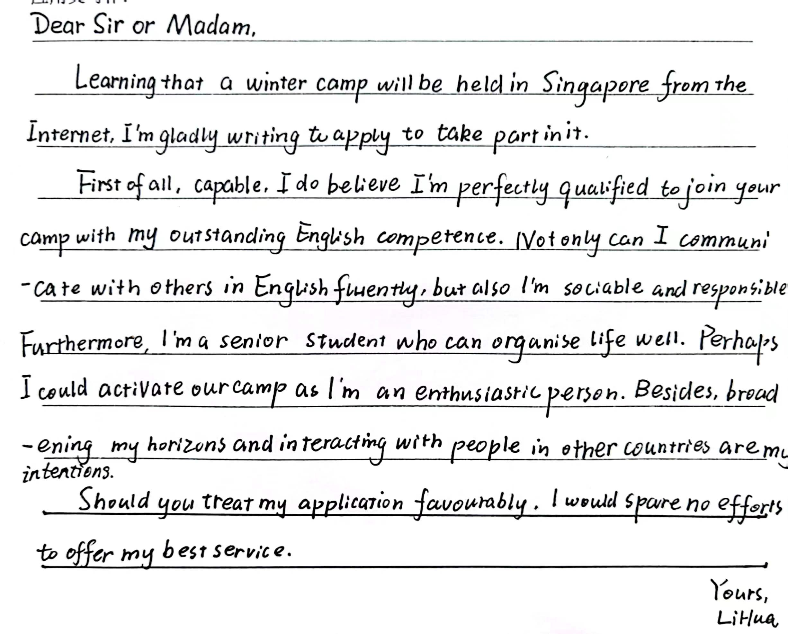
Discuss in groups & Polish the passage!
Dear Sir or Madam ,
I’m Li Hua, a student from Shanghai, China. (自我介绍要到位，同位语) Learning that a winter camp is to be held in Singapore, I’m more than glad to apply to join it. (优化表达,更简练)
With a good command of English , I do believe I can communicate with all the others with ease. (扣题,调整优先顺序) Besides, being sociable and responsible, I can activate the atmosphere of the camp by taking part in various activities. (性格优点更突出). Last but not the least, I hope to catch this chance to broaden my horizon as well as making more friends, which is bound to be rewarding. (彰显诚挚之情，句式多样)
If given the opportunity to be a member of the winter camp, I will spare no effort to do everything I can. (结尾更得体）
Yours,
Li Hua

Slide 17
Official version
Teacher’s version
Dear Sir or Madam,
I'm Li Hua, a middle school student from China. Interested in the announcement of the winter camp you have posted on the Internet, I'm writing to apply to be one of the members.
As an outgoing and warm-hearted boy, I'm more than willing to communicate with others. More importantly, my good command of spoken English enables me to introduce my country China to students from other countries,and meanwhile learn about their countries as well. This is definitely a good chance to broaden my horizon.
I do hope you can take my application into consideration. Looking forward to your reply!
Yours, Li Hua
Dear Sir or Madam,
I'm Li Hua, a middle school student from China. Delighted to know that an international winter camp will be held in Singapore, I can’t wait to apply for it.
I believe I’m qualified to join the camp. Firstly, with a good command of English, I can communicate with others with ease. Additionally, not only am I outgoing, but also enthusiastic, which will help me introduce my country China to students from other countries. I believe it will be a golden chance for me to broaden my horizons as well as make more friends.
If given the opportunity to be a member of the winter camp, I will spare no effort to do everything I can. Looking forward to your reply.
Yours, Li Hua

Slide 18
Assignment for consolidation
假定你是李华，寒假在纽约学习，得知当地艺术家协会要举办中国书法展览。请写一封信请做志愿者。
内容包括：
1．写信目的；
2．个人优势；
3．能做的事情。
注意：（1）写作字数应为80左右。
（2）可以适当增加细节，以使行文连贯。

Slide 19
Practice makes perfect!
Thank you

Slide 20
One possible version
Dear Sir or Madam,
I'm a Chinese student named Li Hua, studying in NewYork during the winter
vacation. Learning the local Artists Association will hold an exhibition of Chinese calligraphy, I'm writing to apply for volunteering.
Having practiseed Chinese calligraphy since 5 years old, I am delighted to have an opportunity to introduce Chinese calligraphy to foreigners. Additionally, my fluent spoken English and rich knowledge about Chinese calligraphy will help visitors understand the meaning behind each calligraphy work deeply.
I'd appreciate it if you could take my application into account. Looking
forward to your early reply.
Yours,
Li Hua

