Slide 1

感恩遇见，相互成就，本课件资料仅供您个人参考、教学使用，严禁自行在网络传播，违者依知识产权法追究法律责任。
更多教学资源请关注
公众号：溯恩高中英语
知识产权声明

Slide 2

山东高考第二次听力精听课件
瑞安新纪元高中
焦海滨老师制作

Slide 3
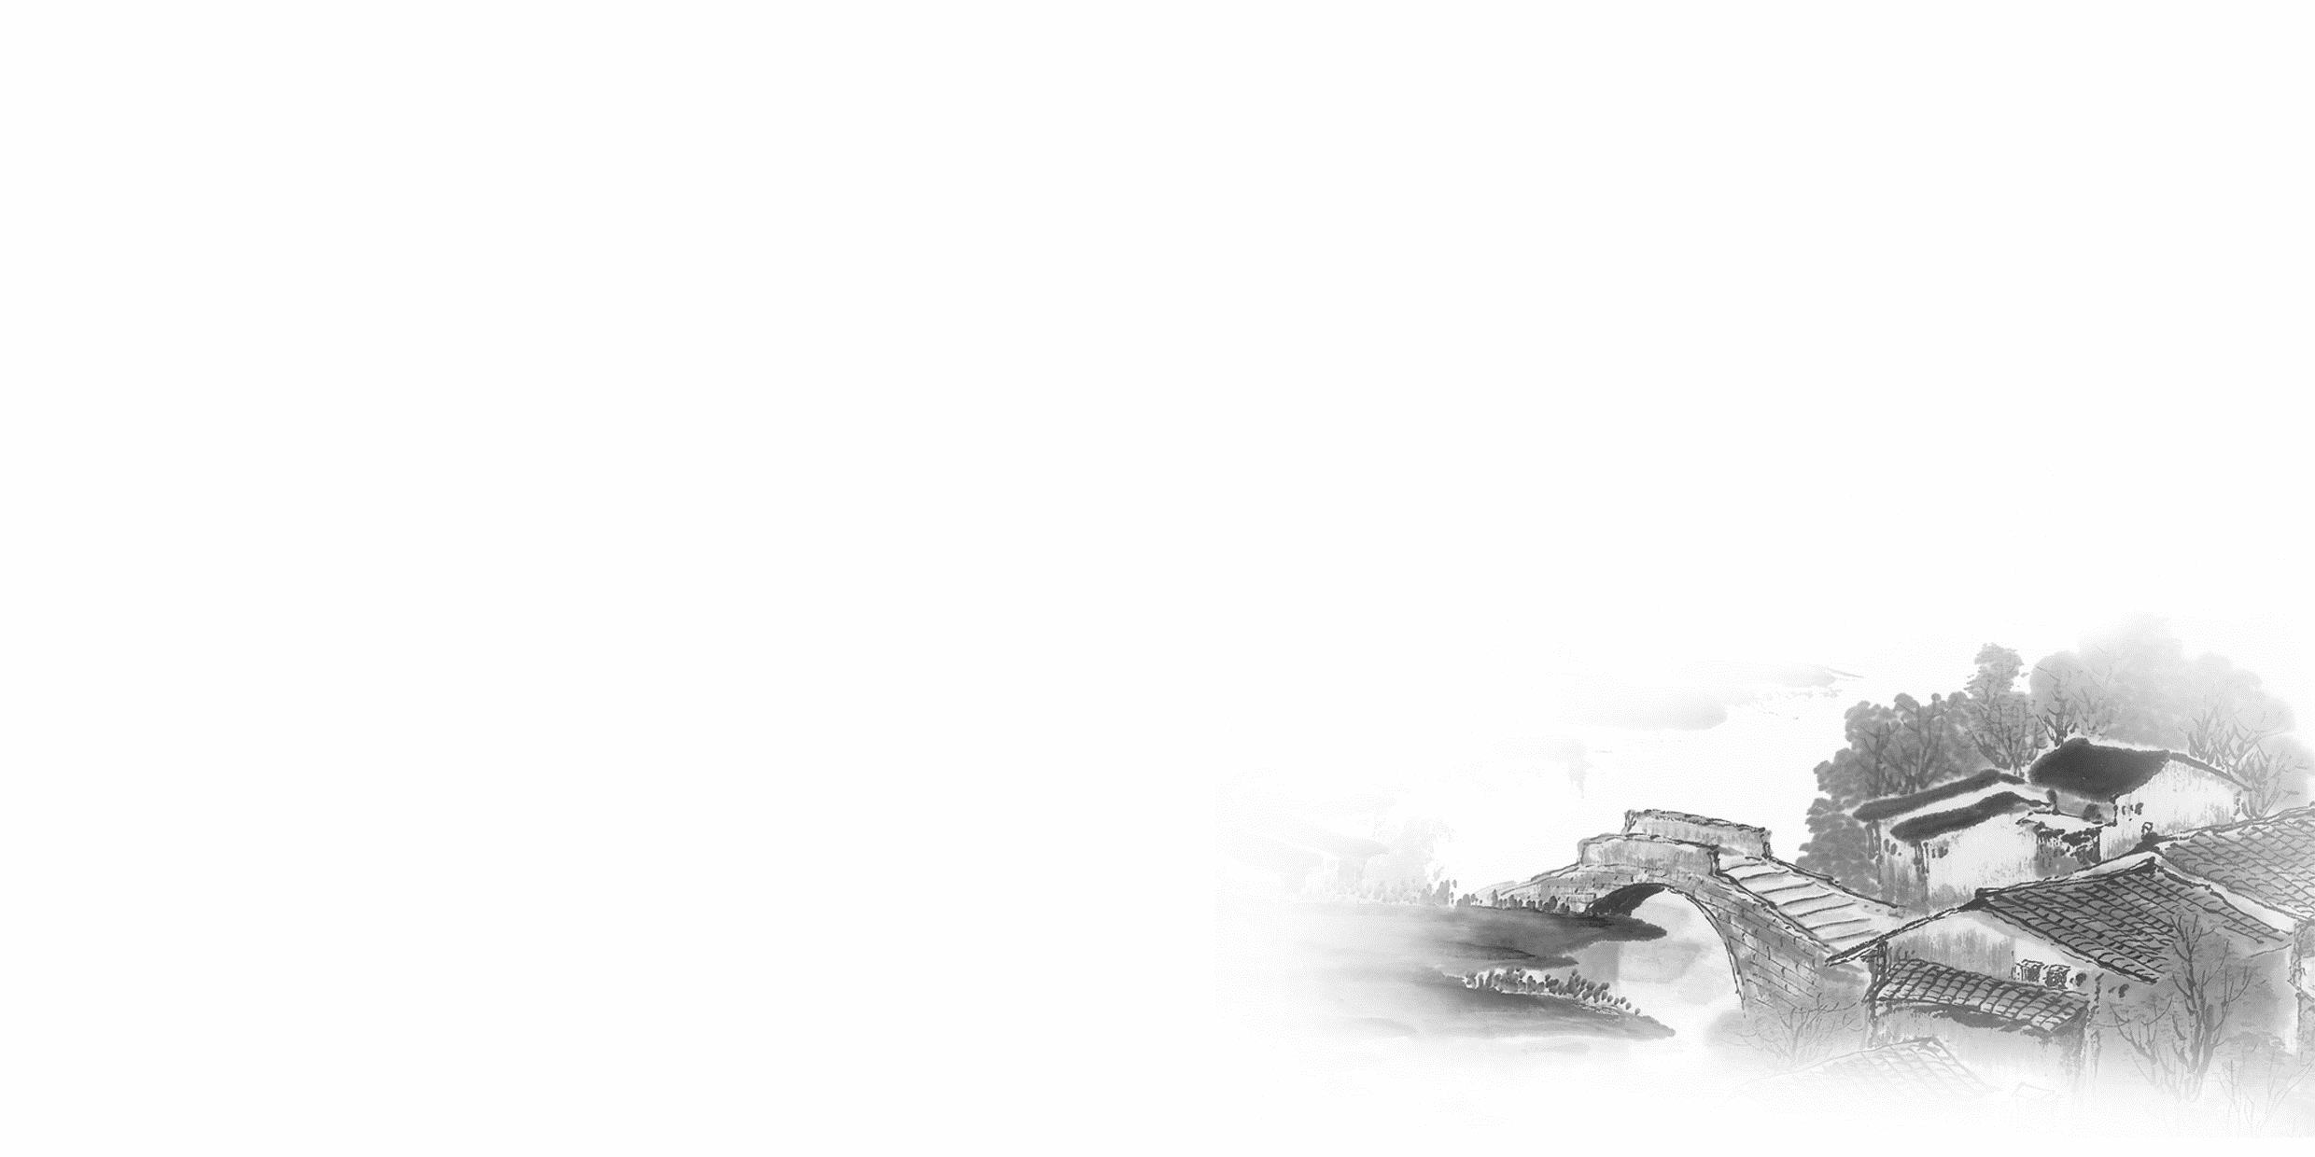

影响听力的因素
心理因素学生在进行听力练习或考试时往往表现为听音时感到紧张、焦虑因而导致无法正常听音。
壹
缺乏背景知识由于没有语言环境，学生很少了解听力材料中的背景知识，无法做出正确的判断、推理、猜测。
贰
叁
学生缺乏听力解题技巧研究发现，很多情况下由于听者未能掌握相关的听力技巧，因而不能很好地理解听力材料。
肆
词汇储备不足一个学生的听、说、读、写要达到一定的水平，必须拥有相应数量的必备词汇。

Slide 4

语音知识对听力的影响
在听力理解的过程中，语音是第一位的，听者首先接受的是语音信息，大脑接受了因素，音节，中音等因素构成的单词，短语和句子后使他们在自己的语言图式中“对号入座”，根据已有的知识结构( 图式 ),开始对该信息进行建构，以理解其意义。

Slide 5
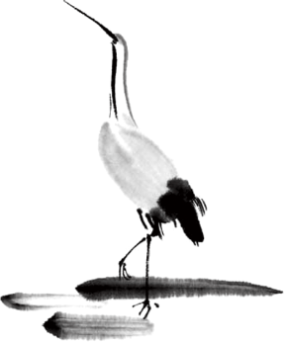
语速的加快主要有一下三种原因
壹
贰
叁
连读
（ 以下用红色标记 )
省音
（ 以下用蓝色标记 ）
音变
（以下用黄色标记 ）

Slide 6


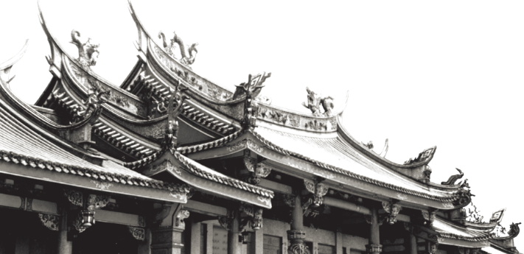
一，连读 （ 以下用红色标记 )
1，“辅音+元音”型连读（异性相吸）
如：I’d like another bowl of rice.
2、“辅音+半元音”型连读英语语音中的/j/和/w/是半元音，如果前一个词是以辅音结尾，后一个词是以半元音，特别是/j/开头，此时也要连读。Thank you .

Slide 7

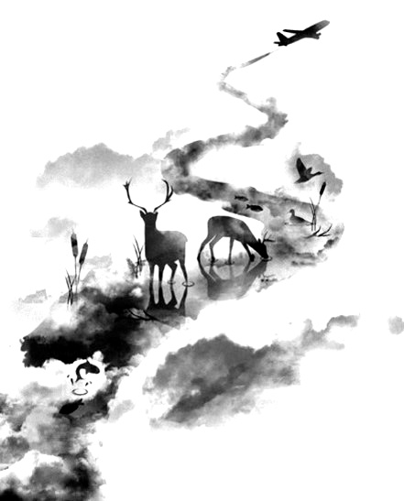

二，省音 （以下用蓝色标记）
01
壹
一、爆破音/b/ /p/ /d/ /t/ /g/ /k/
1.以上任何一个爆破音后面如果紧接着是一个辅音或者半元音，那么这个爆破音将不再发音，仅空半拍就行。如：Good morning!可以发为/gu_'mɔ:niŋ/。
2.以上任何一个爆破音在句尾时，这个爆破音不再发音。如：Good night!最后的/t/音便不再发，整句话可读作/gu_nai_/。

Slide 8
省音 （以下用蓝色标记）
01
二、不完全爆破
① 爆破音中的任何两个爆破音相邻时，前一爆破音失去爆破。如：a big car等。
② 爆破音中的任何一个后接摩擦音f,h,x,sh,s,r时，前面的爆破音失去爆破。
如：I didn't say so.
③ 爆破音后接/t/， /d/， /tr/， /dr /时，前面的爆破音失去爆破。如：a great change等。
④ 爆破音后接/m/, /n/, /l/, /s/时，前面的爆破音失去爆破。如：a bit more expensive等。

Slide 9
省音 （以下用蓝色标记）
01
三、/s/-/z/ /ts/-/dz/ /∫/-/ ʒ / /t∫/-/ dʒ / /θ/-/ ð / ds发/dz以上任何两个音相遇，只读后面的那个音，而前面的音则省略不发。
如：Who is Stone?可把前面一个/z/省掉，只读作/hu i stəun /。

Slide 10
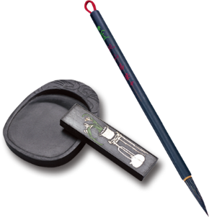
音的变化也是一种连读现象，两个词之间非常平滑的
过渡，导致一个音受临音影响而变化。
主要是以下两种方式：
1、 辅音[d]与[j]相邻时，被同化为[dʒ]：
Would you....?
2、 辅音[t]与[j]相邻时，被同化为[t∫]：
Can’t you？
三，音变
（以下用黄色标记 ）

Slide 11
听力试音材料
M:Hello ! International Friends Club , can I help you ?
W: Oh , hello ! I read about your club in the paper today . And I thought I’d phone to find out a bit more .
M:Yes , certainly . well , we’re a sort of social club for people from different countries . It’s quite a new club .we have about 50 members at the moment but we’re growing all the time .

Slide 12
听力试音材料
W: That sounds interesting .I’m British actually ,and I came to Washington about three months ago ,I’m looking for ways to meet people . . Er ,what kinds of events do you organize ?
M: well , we have social get-togethers ,and sports events ,and we also have language evenings
W: Could you tell me something about the language evenings ?

Slide 13
听力试音材料
M: Yes , every day except Thursday , we have a language evening. People can come and practice their languages .you know , over a drink or something .we have different languages on different evenings . Monday -Spanish; Tuesday- Italian ;Wednesday- German and Friday- French .On Thursday we usually have a meal in a restaurant for everyone who wants to come .

Slide 14
听力试音材料
W:well,that sounds Great , I really need to practice my French .
M: Ok , well if you can just give me your name and address I’ll send you the form and some more information .If you join now ,you can have first month free .

Slide 15
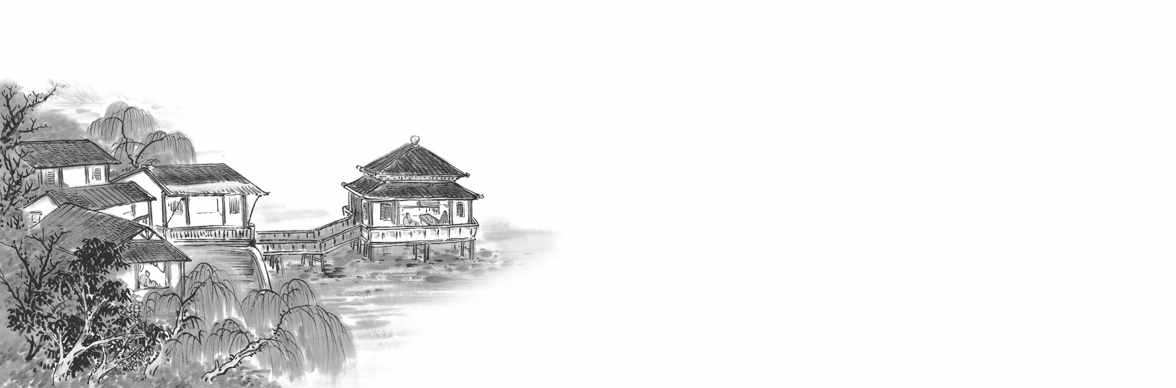

例题
M:Excuse me ,can you tell me how much the shirt is ?
W：Yes, it’s nine-fifteen.
例：How much is the shirt?
A. ￡19.15. B. ￡9.18. C. ￡9.15.

Slide 16


Text 1 购买生日礼物 词数：30 时长：12秒
W: Tom, shall we buy a gift for _______ ________?
M: Yes, but I don’t know what she likes.
W: Let’s call her roommate, Sofia. She might know what to buy for her. 1. Whose birthday is coming up?
A. Sofia’s.
B. Maggie’s.
C. Tom’s.

Slide 17

Text 1
W: Tom, shall we buy a gift for Maggie’s birthday?
M: Yes, but I don’t know what she likes.
W: Let’s call her roommate, Sofia. She might know what to buy for her.
1. Whose birthday is coming up?( 细节题 ）
A. Sofia’s.
B. Maggie’s.
C. Tom’s.

Slide 18
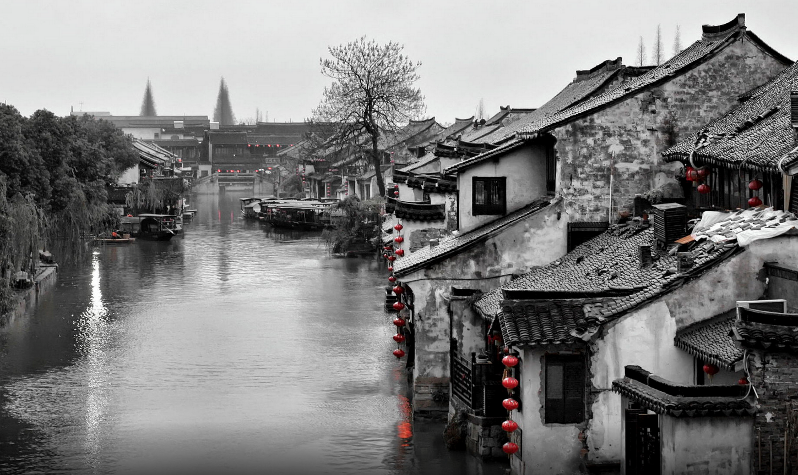
Text 2 核对账单 词数：32 时长：14 秒
——————————
Text 2
W: Could you _________for me? I ___ think _________.
M: Certainly. First, did you have two coffees?
W: Oh, did I?
M: Yes. You had one before the meal and another after.
2. Why did the woman raise the problem?
A. The man is forgetful.
B. The bill was wrong.
C. The coffee tasted bad.

Slide 19

——————————
W: Could you check this bill for me? I don’t think it’s right.
M: Certainly. First, did you have two coffees?
W: Oh, did I?
M: Yes. You had one before the meal and another after.
2. Why did the woman raise the problem? （ 推理题 ）
A. The man is forgetful.
B. The bill was wrong.
C. The coffee tasted bad.
bill 账单
certainly 当然，行

Slide 20
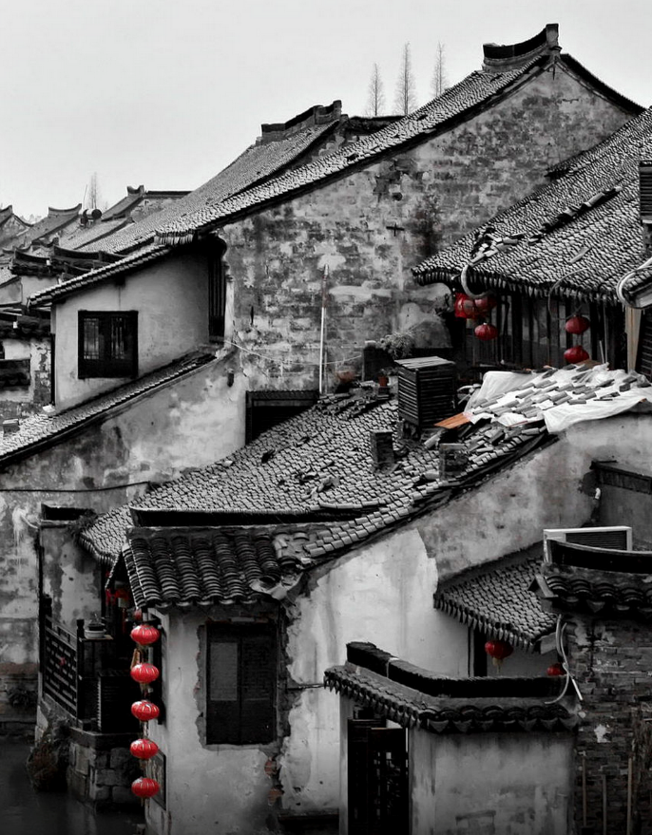
Text 3 学生选课 词数：31 时长：14秒
W: Hi, Mike. What are you doing here? I remember you finished your final exams.
M: Yes, but I’ve got to _______________________.
W: Oh, that’s good. We can do this together.
3. What is Mike doing?
A. Registering for courses.
B. Preparing for final tests.
C. Writing a term paper.
天人合一
天 下 皆 知 美 之 为 美 ， 斯 恶 已
皆 知 善 之 为 善 ， 斯 不 善 已
有 无 相 生 ， 难 易 相 成 ， 长 短 相 形
高 下 相 盈 ， 音 声 相 和 ， 前 后 相 随
恒 也

Slide 21
W: Hi, Mike. What are you doing here? I remember you finished your final exams.
M: Yes, but I’ve got to select next term’s courses.
W: Oh, that’s good. We can do this together.
3. What is Mike doing? （ 同义转述 ）
A. Registering for courses.
B. Preparing for final tests.
C. Writing a term paper.
天人合一
天 下 皆 知 美 之 为 美 ， 斯 恶 已
皆 知 善 之 为 善 ， 斯 不 善 已
有 无 相 生 ， 难 易 相 成 ， 长 短 相 形
高 下 相 盈 ， 音 声 相 和 ， 前 后 相 随
恒 也
register for courses 注册课程
prepare for the final test 准备期末考试
write a term paper 写一篇学期论文

Slide 22

T Text 4 看电影 词数：34 时长：15秒
(Text 4)
W: How much time do we have before the movie? We won’t have to hurry, will we?
M: Don’t worry. It’s 6:30 now. We still have _______. It takes only 30 minutes to get there.
4. How soon will the movie start?
A. In half an hour.
B. In one hour.
C. In two hours.

Slide 23
(Text 4)
W: How much time do we have before the movie? We won’t have to hurry, will we?
M: Don’t worry. It’s 6:30 now. We still have two hours . It takes only 30 minutes to get there.
4. How soon will the movie start?( 细节题 ）
A. In half an hour.
B. In one hour.
C. In two hours.

Slide 24
Text 5 机场采访 词数：30 时长：11秒t
W: Good morning, sir. I’d like to ____________________ if I may.
M: Well, I’m waiting for my flight. So I guess _____ if you make it brief.
5. What will the man probably do next?
A. Answer questions.
B. Wait for friends.
C. Book a flight.

Slide 25
W: Good morning, sir. I’d like to ask you a few questions if I may.
M: Well, I’m waiting for my flight. So I guess I can if you make it brief.
5. What will the man probably do next? ( 推理题 ）
A. Answer questions.
B. Wait for friends.
C. Book a flight.
if I may 如果可以的话
make it brief 简短一点

Slide 26
Text 6 询问订单发货 词数：137 时长：56秒
M: Hello, can I speak to the sales manager, please?
W: Yes, I’m the sales manager. Can I help you?
M: Right. Well, I phoned two days ago to say I___________________ and I’m ringing again to say it ______________.
W: Can I just take your name, please?
M: Yes, it’s Frank Edward.
W: Ah, Mr. Edward. I think there’s been a problem with that order.
M: What kind of problem?
W: You see, part of the order _____________ at the storehouse. So we________________until we’d received everything from ____________.
M: Well, surely that was not my problem. I placed this order weeks ago.
W: Yeah, I’m sorry about this, Mr. Edward. But we’ll do everything we can to send this out to you today.
M: Right, please do. I am badly in need of it.

Slide 27

M: Hello, can I speak to the sales manager, please?
W: Yes, I’m the sales manager. Can I help you?
M: Right. Well, I phoned two days ago to say I hadn’t received my order and I’m ringing again to say it still hasn’t arrived.
W: Can I just take your name, please?
M: Yes, it’s Frank Edward.
W: Ah, Mr. Edward. I think there’s been a problem with that order.
M: What kind of problem?
W: You see, part of the order didn’t arrive here at the storehouse. So we couldn’t send it out until we’d received everything from the supplier.
M: Well, surely that was not my problem. I placed this order weeks ago.
W: Yeah, I’m sorry about this, Mr. Edward. But we’ll do everything we can to send this out to you today.
M: Right, please do. I am badly in need of it.
storehouse n 仓库 supplier n 供应商
take sb’s name 记下某人名字
be badly in need of 急需

Slide 28
6. What’s wrong with the man’s order?（ 推理题 ） A. It has been misplaced.
B. It has been delayed. C. It has been lost.
7 Who is to blame for this problem ?( 推理题 ）
A . The sales manager . B . The customer. C. The supplier .
7 Who is to blame for this problem ? A . The sales manager .
B . The customer.
C. The supplier .
misplace 放错地方
delay 延迟
be to blame for 归咎于…

Slide 29
Text 7 航行中遇咖啡店 词数129 时长：58秒
W: Mmm, there’s a wonderful smell of fresh coffee in the air.
M: Oh, ________! This is the _________. It’s the best in the world, and you can only get it here.
W: And, where is here?
M: The Festo Island.
W: Festo Island? So that’s where we are. Goodness, we really have gone off course.
M: Where are you heading?
W: We set off at Cape Island and ____________ be sailing toward ____________, but we got lost when our GPS broke.
M: Oh, you don’t have to worry about that. My brother fixes things. I’m sure he can help. Let me take it for you, and if you can come back at four o’clock, it will be ready, hopefully.
W: Brilliant, and while I’m here, ____________ some of those ___________?

Slide 30
W: Mmm, there’s a wonderful smell of fresh coffee in the air.
M: Oh, welcome! This is the Festo Coffee. It’s the best in the world, and you can only get it here.
W: And, where is here?
M: The Festo Island.
W: Festo Island? So that’s where we are. Goodness, we really have gone off course.
M: Where are you heading?
W: We set off at Cape Island and were supposed to be sailing toward Dennis Island, but we got lost when our GPS broke.
M: Oh, you don’t have to worry about that. My brother fixes things. I’m sure he can help. Let me take it for you, and if you can come back at four o’clock, it will be ready, hopefully.
W: Brilliant, and while I’m here, can I buy some of those coffee beans?
GPS 全球定位系统 brilliant 棒极了
off course 偏离航向 coffee beans 咖啡豆
be supposed to do sth 应该做某事

Slide 31
8. Where did the woman plan to go?（ 细节题 ）
A. Cape Island.
B. Festo Island.
C. Dennis Island.
9. What does the man do?（ 推理题 ）
A. A tourist.
B. A shop owner.
C. A mechanic.
10. What will the woman do next? （ 推理题 ）
A. Fix her boat.
B. Talk to the man’s brother.
C. Buy some coffee beans.
天人合一
天 下 皆 知 美 之 为 美 ， 斯 恶 已
皆 知 善 之 为 善 ， 斯 不 善 已
有 无 相 生 ， 难 易 相 成 ， 长 短 相 形
高 下 相 盈 ， 音 声 相 和 ， 前 后 相 随
恒 也
mechanic n 技工，机修工

Slide 32
Text 8 滑冰 词数：138 时长：63秒
W: Hey, Alexis. Great to see you! Ready for a bit of skating?
M: Yeah, but I haven’t been skating for ages, Martha.
W: Me neither, but I’m _________ when ___________. So, what’s in your bag?
M: A few things — a hat, gloves, a jacket, the usual skating safety equipment.
W: We’re only going around the park.
M: Well, you never know.
W: I don’t bother with hats and gloves or that sort of things. I find it gets in the way.
M: Don’t you ___________________?
W: No, I love adventures. Just the other day, I went climbing on this climbing wall, and I didn’t even use safety equipment. If I ________, I just ____________.
M: Well, I am not __________.
W: Hey, come on. Let’s get going.
M: Wait a second. I need to ________________.

Slide 33
W: Hey, Alexis. Great to see you! Ready for a bit of skating?
M: Yeah, but I haven’t been skating for ages, Martha.
W: Me neither, but I’m a natural when it comes to sports. So, what’s in your bag?
M: A few things — a hat, gloves, a jacket, the usual skating safety equipment.
W: We’re only going around the park.
M: Well, you never know.
W: I don’t bother with hats and gloves or that sort of things. I find it gets in the way.
M: Don’t you worry about getting hurt?
W: No, I love adventures. Just the other day, I went climbing on this climbing wall, and I didn’t even use safety equipment. If I get hurt, I just ignore the pain.
M: Well, I am not that brave.
W: Hey, come on. Let’s get going.
M: Wait a second. I need to get my equipment on.
natural n 有天赋的人（熟词生义）for ages 好久；
When it comes to sth 当涉及到 safety equipment 安全设备
you never know 说不准；很难说 not bother with 懒得用/戴

Slide 34

11. What does the woman think of herself? ( 推理题 ）
A. A skilled coach.
B. A reliable teammate.
C. A talented sportswoman.
12. Why is the man going here with equipment? （ 推理题 ）
A. To climb the wall.
B. To protect himself.
C. To share with the woman.
13. How can the man be described? ( 推理题 ）
A. Careful.
B. Generous.
C. Brave.
a skilled coach 熟练的教练
a reliable teammate 可靠的队友
a talented sportswoman 有天赋的运动员

Slide 35
Text 9 偶遇寒暄 词数：207 时长：89秒
M: Hello, Claudia. Do you remember me? W: Of course. Hello, Chris. You look well.
M: It must be ________since you left school.
W: That’s right. You were ________________ me. I was in the same year as ______________, Stephanie? M: Yes, ______________.
W: Is Stephanie here for the 50-year celebration of ____________?
M: No, she is in Denmark for business. W: What are you doing now?
M: After school, I got a place at university and I am majoring in business studies.
W: That sounds interesting. I got a job as an interpreter.
M: What languages do you speak? W: Apart from English, I speak French and German.
M: I didn’t get on well with my French teacher here at school, so I dropped the subject at the end of my fifth year. W: Where do you study? M: In London. I enjoy living in London.
W: I sometimes travel to different parts of Britain with _________ to ___________________. __________, he has a conference in _________.
M: Will you have time to call and visit me while you’re in the area?
W: Yes, I’d love to. M: I’ll give you my phone number. Ring me in the evening.
W: Thank you. We’ll be able to have more time to catch up.

Slide 36
M: Hello, Claudia. Do you remember me? W: Of course. Hello, Chris. You look well.
M: It must be eight years since you left school.
W: That’s right. You were four years below me. I was in the same year as your older sister, Stephanie? M: Yes, you two were very close.
W: Is Stephanie here for the 50-year celebration of our school?
M: No, she is in Denmark for business. W: What are you doing now?
M: After school, I got a place in a university and I am majoring in business studies.
W: That sounds interesting. I got a job as an interpreter.
M: What languages do you speak? W: Apart from English, I speak French and German.
M: I didn’t get on well with my French teacher here at school, so I dropped the subject at the end of my fifth year. W: Where do you study? M: In London. I enjoy living in London.
W: I sometimes travel to different parts of Britain with my boss to do interpreting for him. Next week, he has a conference in London.
M: Will you have time to call and visit me while you’re in the area?
W: Yes, I’d love to. M: I’ll give you my phone number. Ring me in the evening.
W: Thank you. We’ll be able to have more time to catch up.
place n 入学名额（入学名额） interpreter n 口译工作者
drop vt 停止；终止；放弃 major in 主修 catch up 别后叙旧

Slide 37
14. How long has it been since the woman left school?( 细节题 ）
A. 4 years. B. 5 years. C. 8 years.
15. Where does the man know about the woman? （ 推理题 ）
A. From his sister.
B. From a meeting.
C. From his teacher.
16. What is the woman going to do next week in London? ( 细节题 ）
A. Visit her old friend.
B. Give a presentation.
C. Interpret for her boss.
17. What is the relationship between the speakers? （ 推理题 ）
A. Schoolmates.
B. Teacher and student.
C. Boss and employee.
give a presentation 发表演讲
interpret v 口译；解释

Slide 38
Text 10 观光巴士日常安排 词数：122 时长：100秒、
W: Welcome aboard our city tour bus. First, let me tell you about the tour. We’re going to travel through the most historic parts of the city for about an hour, with lots of chances for you to take photos or just enjoy the wonderful buildings like the City Hall and the Royal Theater. Then, we’ll drop you off_________. You have about two hours there. At __________, we’ll start for our____________ — the Stanley Market. You may buy some fruit and cheese from the marketplace and have a light meal in the park nearby. But please, please, please come back on time at 1:30 p.m. We can’t wait for any latecomers. Now, I’ll give you _____________.

Slide 39
W: Welcome aboard our city tour bus. First, let me tell you about the tour. We’re going to travel through the most historic parts of the city for about an hour, with lots of chances for you to take photos or just enjoy the wonderful buildings like the City Hall and the Royal Theater. Then, we’ll drop you off at the museum. You have about two hours there. At 11:30, we’ll start for our next destination — the Stanley Market. You may buy some fruit and cheese from the marketplace and have a light meal in the park nearby. But please, please, please come back on time at 1:30 p.m. We can’t wait for any latecomers. Now, I’ll give you some instructions on safety.
historic adj历史上著名（或重要的 ）marktetplace n 集市；市场
latecomer n 迟到者 instructions n 指示；命令
drop sb off 把某人送到；让。。。某人下车 have a light meal 吃顿便餐

Slide 40
18. What is the first destination of the tour? （ 细节题 ）
A. The museum.
B. The City Hall.
C. The park.
19. What time will they leave for the Stanley Market
A. At 9:30 a.m. （ 细节题 ）
B. At 11:30 a.m.
C. At 1:30 p.m.
20. What is the speaker talking about next? ( 细节题 ）
A. Safety information.
B. The gathering time.
C. Meal plans.

Slide 41
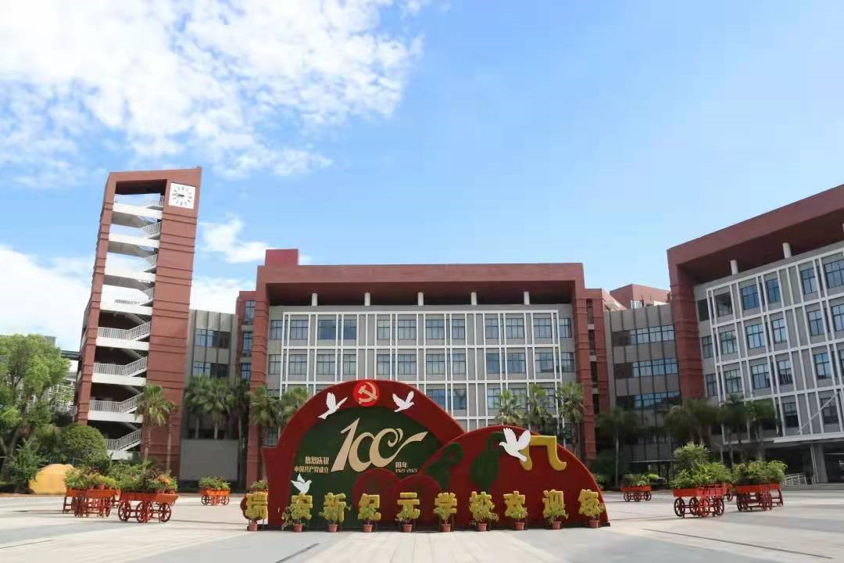
祝各位考生金榜题名！
欢迎指导

