Slide 1

感恩遇见，相互成就，本课件资料仅供您个人参考、教学使用，严禁自行在网络传播，违者依知识产权法追究法律责任。
更多教学资源请关注
公众号：溯恩高中英语
知识产权声明

Slide 2


2023年6月全国高考新课标I卷 语法填空讲评 中华美食小笼包
Shttp://www.sunedu.com
浙江省常山一中：吴俊峰
01

Slide 3
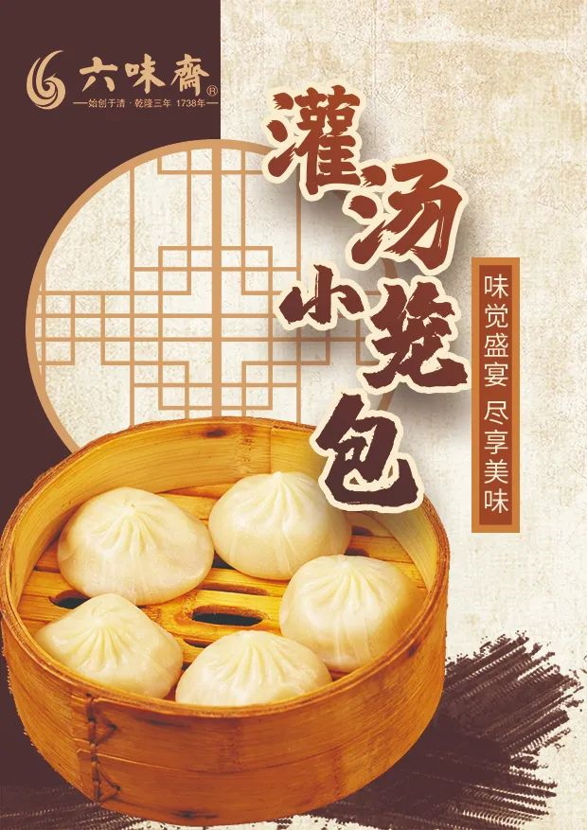
CONTENTS
重语篇 明词性 建语块 析句子
——解题方法和理念突破
1
2
语法填空的试题分析和备考建议
——聚焦传统文化，重视语篇分析
延伸外刊阅读，体验中华美食
——真实语篇阅读，多模态体验
3
延伸外刊阅读，玩转语法填空
——改编语法填空题
4

Slide 4

2023年6月全国高考新课标I卷语法填空真题
溯恩英语 2023年6月全国高考新课标I卷语法填空讲评
Xiao long bao(soup dumplings), those amazing constructions of delicate dumpling wrappers, encasing hot, 56_______(taste) soup and sweet, fresh meat, are far and away my favorite Chinese street food. The dumplings arrive steaming and dangerously hot. To eat one, you have to decide whether 57 ______(bite) a small hole in it first, releasing the stream and risking a spill (溢出), 58_____to put the whole dumpling in your mouth, letting the hot soup explode on your tongue.
Shanghai may be the 59______(recognize)home of the soup dumplings but food historians will actually point you to the neighboring canal town of Nanxiang as Xiao long bao's birthplace. There you will find them prepared differently-more dumpling and less soup, and the wrappers are pressed 60______ hand rather than rolled.
Nanxiang aside, the best Xiao long bao have a fine skin, allowing them 61_______ (lift) out of the steamer basket without tearing or spilling any of 62______(they) contents. The meat should be fresh with 63______ touch of sweetness and the soup hot, clear and delicious.
No matter where I buy them, though, one steamer is 64_______(rare) enough, yet two seems greedy, so I am always left 65 _____(want) more next time.

Slide 5

重语篇 明词性 建语块 析句子
溯恩英语 2023年6月全国高考新课标I卷语法填空讲评
明词性 —— 词性是句法功能的基础
重语篇 —— 语篇是整体认知的建构
语法填空的差异主要体现在不同词性对应不同的句法功能，因此词性的潜意识运用和词性的明晰定位是语法填空的基础。
语法填空是基于理性的语篇型完形填空，语篇的衔接连贯和理解语篇的深层意义是学生语法填空题提分的关键。语法参与传递语篇的基本意义，语法形式的选择取决于具体语境中所表达的语用意义。
建语块 —— 语块是快速解题的关键
建语块
语块Chunk是语言中的一种多词词汇现象，包括固定搭配、相对固化的短语框架以及惯常使用的句子框架。
语块能力是衡量语言使用准确性、地道性和流利性的一个重要标志。语块融合了语法、语义和语境的优势, 具有特定的表达功能, 可作为整体储存和提取，从而减少大脑处理信息时的认知负担，提升语法填空的速度和准确率。
析句子 —— 句子是基于语篇的统一
熟悉五种基本句型；
警惕逗号粘连错误，掌握“一个句子一个谓，两个句子连词成对，没有连词用非谓”的句式特点；
立足语篇语境，研判谓语动词和非谓语动词及其形态。

Slide 6

重语篇——语篇整体认知的建构
溯恩英语 2023年6月全国高考新课标I卷语法填空讲评
Xiao long bao(soup dumplings), those amazing constructions of delicate dumpling wrappers, encasing hot, 56_____ __(taste) soup and sweet, fresh meat, are far and away my favorite Chinese street food. The dumplings arrive steaming and dangerously hot. To eat one, you have to decide whether 57 ___ ___(bite) a small hole in it first, releasing the stream and risking a spill (溢出), 58__ ___to put the whole dumpling in your mouth, letting the hot soup explode on your tongue.
Shanghai may be the 59__ ____(recognize)home of the soup dumplings but food historians will actually point you to the neighboring canal town of Nanxiang as Xiao long bao's birthplace. There you will find them prepared differently-more dumpling and less soup, and the wrappers are pressed 60__ ____ hand rather than rolled.
Nanxiang aside, the best Xiao long bao have a fine skin, allowing them 61___ ____ (lift) out of the steamer basket without tearing or spilling any of 62__ ____(they) contents. The meat should be fresh with 63_ _____ touch of sweetness and the soup hot, clear and delicious.
No matter where I buy them, though, one steamer is 64__ _____(rare) enough, yet two seems greedy, so I am always left 65 _ ____(want) more next time.
1.以作者的亲身体验，生动描述小笼包的色香味形，美味冲击力
2.探究小笼包的发源地，比较各地制作特色，体现中华美食的博大
3.介绍作者发现的最好小笼包的特色，体现中华美食的精深精致
4.讲述作者对小笼包的喜爱之情，余香绕梁，欲罢不能
擅长语篇分析是核心技能
本文是选自游记What to Eat in China: A Traveler's Guide, 菲奥娜·赖利(Fiona Reilly)是一名自由撰稿人和摄影师，对中国的美食和旅行充满热情。 作者文笔细腻， 观察细致，描写生动形象，文风幽默风趣。
本篇文体应是记叙文，语篇以浸润的方式，采用“体验--探究--发现--留恋”的描述顺序 ，一步步带领读者打开味蕾记忆，一起体验小笼包那深入人心的味道，感叹中华美食的博大精深。
选材很好地体现了新课标的英语教学语法观，即语法参与传递语篇的基本意义，语法形式的选择取决于具体语境中所表达的语用意义，有效的语言使用还涉及说话人的意图、情感态度及其对具体语境下参与人角色和身份的理解。

Slide 7
明词性 —— 词性是句法功能的基础
溯恩英语 2023年6月全国高考新课标I卷语法填空讲评
Xiao long bao(soup dumplings), those amazing constructions of delicate dumpling wrappers, encasing hot, 56_____ __(taste) soup and sweet, fresh meat, are far and away my favorite Chinese street food. The dumplings arrive steaming and dangerously hot. To eat one, you have to decide whether 57 ___ ___(bite) a small hole in it first, releasing the stream and risking a spill (溢出), 58__ ___to put the whole dumpling in your mouth, letting the hot soup explode on your tongue.
Shanghai may be the 59__ ____(recognize)home of the soup dumplings but food historians will actually point you to the neighboring canal town of Nanxiang as Xiao long bao's birthplace. There you will find them prepared differently-more dumpling and less soup, and the wrappers are pressed 60__ ____ hand rather than rolled.
Nanxiang aside, the best Xiao long bao have a fine skin, allowing them 61___ ____ (lift) out of the steamer basket without tearing or spilling any of 62__ ____(they) contents. The meat should be fresh with 63_ _____ touch of sweetness and the soup hot, clear and delicious.
No matter where I buy them, though, one steamer is 64__ _____(rare) enough, yet two seems greedy, so I am always left 65 _ ____(want) more next time.
词性是句法功能的基础
56题查词性的判断: 根据前后语境， (taste) soup与后文and sweet, fresh meat形成并列关系，构成语义连贯“美味的汤汁和香甜的鲜肉”，tasty 意为“美味的”。 –y后缀的形容词 dirty; lucky; healthy; wealthy; greedy; cloudy; stormy; risky; thirsty; shiny/shining; noisy; scary; funny; sunny; foggy; hungry; angry
62题考查词性的判断: 根据句意“没有撕破面皮或洒出任何汤汁”。代词的转换要根据上下文语境提示、语意或句子成分。名词contents前需加形容词性物主代词their.

Slide 8
明词性 —— 词性是句法功能的基础
溯恩英语 2023年6月全国高考新课标I卷语法填空讲评
Xiao long bao(soup dumplings), those amazing constructions of delicate dumpling wrappers, encasing hot, 56_____ __(taste) soup and sweet, fresh meat, are far and away my favorite Chinese street food. The dumplings arrive steaming and dangerously hot. To eat one, you have to decide whether 57 ___ ___(bite) a small hole in it first, releasing the stream and risking a spill (溢出), 58__ ___to put the whole dumpling in your mouth, letting the hot soup explode on your tongue.
Shanghai may be the 59__ ____(recognize)home of the soup dumplings but food historians will actually point you to the neighboring canal town of Nanxiang as Xiao long bao's birthplace. There you will find them prepared differently-more dumpling and less soup, and the wrappers are pressed 60__ ____ hand rather than rolled.
Nanxiang aside, the best Xiao long bao have a fine skin, allowing them 61___ ____ (lift) out of the steamer basket without tearing or spilling any of 62__ ____(they) contents. The meat should be fresh with 63_ _____ touch of sweetness and the soup hot, clear and delicious.
No matter where I buy them, though, one steamer is 64__ _____(rare) enough, yet two seems greedy, so I am always left 65 _ ____(want) more next time.
词性是句法功能的基础
64题考查词性的判断: rare的副词修饰形容词enough，考查学生的基本功，形容词变副词的基本规律：
1.绝大多数辅音字母加e结尾的形容词直接加-ly 如：politely; widely; wisely; rudely; nicely 但truly例外
2.以辅音字母加le结尾时,去e加y 如：simply; terribly; gently; possibly; comfortably;considerably; probably; incredibly
3. 以“y”结尾的，且读音为 / i /， 先将“y”改成“i”，再加“ly” 如：happily; heavily; angrily; busily
但是如果读音为 / ai /， 直接加ly，如： shy---shyly
4.以ic 结尾的词，加ally 如：economically; basically; scientifically; automatically; energetically; 但publicly 例外。

Slide 9
建语块 —— 语块是快速解题的关键
溯恩英语 2023年6月全国高考新课标I卷语法填空讲评
Xiao long bao(soup dumplings), those amazing constructions of delicate dumpling wrappers, encasing hot, 56_____ __(taste) soup and sweet, fresh meat, are far and away my favorite Chinese street food. The dumplings arrive steaming and dangerously hot. To eat one, you have to decide whether 57 ___ ___(bite) a small hole in it first, releasing the stream and risking a spill (溢出), 58__ ___to put the whole dumpling in your mouth, letting the hot soup explode on your tongue.
Shanghai may be the 59__ ____(recognize)home of the soup dumplings but food historians will actually point you to the neighboring canal town of Nanxiang as Xiao long bao's birthplace. There you will find them prepared differently-more dumpling and less soup, and the wrappers are pressed 60__ ____ hand rather than rolled.
Nanxiang aside, the best Xiao long bao have a fine skin, allowing them 61___ ____ (lift) out of the steamer basket without tearing or spilling any of 62__ ____(they) contents. The meat should be fresh with 63_ _____ touch of sweetness and the soup hot, clear and delicious.
No matter where I buy them, though, one steamer is 64__ _____(rare) enough, yet two seems greedy, so I am always left 65 _ ____(want) more next time.
语块是语法、语义和语境的深度融合
59题考查语块的快速建构的能力。单个的过去分词做定语时，放在被修饰的名词之前，具备形容词的词性，具有被动和完成的含义。本句句意“上海可能是公认的汤包之乡，但美食历史学家会告诉你，邻近的运河古镇南翔才是小笼包的发源地。”，recognized意为“公认的，认可的”，历年高考真题如：
Of the nineteen recognized polar bear subpopulations_{在19个公认的北极熊亚种群中}, three are declining, six are stable, one is increasing, and nine lack enough data. _{2019年高考英语全国卷I 语法填空 原文}

Slide 10
建语块 —— 语块是快速解题的关键
溯恩英语 2023年6月全国高考新课标I卷语法填空讲评
Xiao long bao(soup dumplings), those amazing constructions of delicate dumpling wrappers, encasing hot, 56_____ __(taste) soup and sweet, fresh meat, are far and away my favorite Chinese street food. The dumplings arrive steaming and dangerously hot. To eat one, you have to decide whether 57 ___ ___(bite) a small hole in it first, releasing the stream and risking a spill (溢出), 58__ ___to put the whole dumpling in your mouth, letting the hot soup explode on your tongue.
Shanghai may be the 59__ ____(recognize)home of the soup dumplings but food historians will actually point you to the neighboring canal town of Nanxiang as Xiao long bao's birthplace. There you will find them prepared differently-more dumpling and less soup, and the wrappers are pressed 60__ ____ hand rather than rolled.
Nanxiang aside, the best Xiao long bao have a fine skin, allowing them 61___ ____ (lift) out of the steamer basket without tearing or spilling any of 62__ ____(they) contents. The meat should be fresh with 63_ _____ touch of sweetness and the soup hot, clear and delicious.
No matter where I buy them, though, one steamer is 64__ _____(rare) enough, yet two seems greedy, so I am always left 65 _ ____(want) more next time.
语块存在于固定搭配的短语框架中
60题考查语块的快速建构的能力。分析句子结构 the wrappers are pressed hand rather than rolled, 可知 设空处为“用手压的”，与下文rather than“而不是卷起来的”构成对立相反的逻辑关系。介词短语by hand意为“ 手工”，注意区分： 1. to hand 在手边，随时可得到
2. on hand 现有（尤指帮助）
3. in hand 在手头；在掌握中；在处理中；按（月/周等）领薪
4. (close/near) at hand（在时间或距离上）接近，即将到来

Slide 11
建语块 —— 语块是快速解题的关键
溯恩英语 2023年6月全国高考新课标I卷语法填空讲评
Xiao long bao(soup dumplings), those amazing constructions of delicate dumpling wrappers, encasing hot, 56_____ __(taste) soup and sweet, fresh meat, are far and away my favorite Chinese street food. The dumplings arrive steaming and dangerously hot. To eat one, you have to decide whether 57 ___ ___(bite) a small hole in it first, releasing the stream and risking a spill (溢出), 58__ ___to put the whole dumpling in your mouth, letting the hot soup explode on your tongue.
Shanghai may be the 59__ ____(recognize)home of the soup dumplings but food historians will actually point you to the neighboring canal town of Nanxiang as Xiao long bao's birthplace. There you will find them prepared differently-more dumpling and less soup, and the wrappers are pressed 60__ ____ hand rather than rolled.
Nanxiang aside, the best Xiao long bao have a fine skin, allowing them 61___ ____ (lift) out of the steamer basket without tearing or spilling any of 62__ ____(they) contents. The meat should be fresh with 63_ _____ touch of sweetness and the soup hot, clear and delicious.
No matter where I buy them, though, one steamer is 64__ _____(rare) enough, yet two seems greedy, so I am always left 65 _ ____(want) more next time.
语块存在于固定搭配的短语框架中
61题考查语义理解和语块建构的能力。快速理解句意“the best xiao long bao have a fine skin, allowing them to be lifted out of the steamer basket without tearing or spilling any of their contents. 最好的小笼包外皮细腻，从蒸笼中被取出时不会撕裂面皮或洒出任何馅料汤汁”，本句中“them”指代上文“xiao long bao”，与“allow ... to do ...”搭配构成语块做结果状语，各根据句意，设空处需用动词不定式被动形式to be lifted作宾语补足语。

Slide 12
建语块 —— 语块是快速解题的关键
溯恩英语 2023年6月全国高考新课标I卷语法填空讲评
Xiao long bao(soup dumplings), those amazing constructions of delicate dumpling wrappers, encasing hot, 56_____ __(taste) soup and sweet, fresh meat, are far and away my favorite Chinese street food. The dumplings arrive steaming and dangerously hot. To eat one, you have to decide whether 57 ___ ___(bite) a small hole in it first, releasing the stream and risking a spill (溢出), 58__ ___to put the whole dumpling in your mouth, letting the hot soup explode on your tongue.
Shanghai may be the 59__ ____(recognize)home of the soup dumplings but food historians will actually point you to the neighboring canal town of Nanxiang as Xiao long bao's birthplace. There you will find them prepared differently-more dumpling and less soup, and the wrappers are pressed 60__ ____ hand rather than rolled.
Nanxiang aside, the best Xiao long bao have a fine skin, allowing them 61___ ____ (lift) out of the steamer basket without tearing or spilling any of 62__ ____(they) contents. The meat should be fresh with 63_ _____ touch of sweetness and the soup hot, clear and delicious.
No matter where I buy them, though, one steamer is 64__ _____(rare) enough, yet two seems greedy, so I am always left 65 _ ____(want) more next time.
语块是语法、语义和语境的深度融合
63题考查语义理解和语块建构的能力。本句句意“肉应该是新鲜的，有一点甜味，汤应该是热的，清澈的，美味的”。 a touch of sth 作为短语，意为“一丝......，一点.....”. 如: a touch of love 一丝爱意；a touch of luck 一点儿运气；a touch of kindness 一点儿好意；with a touch of vinegar有点刻薄
I smelled a touch of irony in his words.我从他的话中感受到一点点讽刺的意味。
"I think it must be the field-mice," replied the Mole, with a touch of pride in his manner.
“我想一定是田鼠们来了，”莫尔回答说，脸上带着一丝骄傲。

Slide 13
析句子 —— 句子是基于语篇的统一
溯恩英语 2023年6月全国高考新课标I卷语法填空讲评
Xiao long bao(soup dumplings), those amazing constructions of delicate dumpling wrappers, encasing hot, 56_____ __(taste) soup and sweet, fresh meat, are far and away my favorite Chinese street food. The dumplings arrive steaming and dangerously hot. To eat one, you have to decide whether 57 ___ ___(bite) a small hole in it first, releasing the stream and risking a spill (溢出), 58__ ___to put the whole dumpling in your mouth, letting the hot soup explode on your tongue.
Shanghai may be the 59__ ____(recognize)home of the soup dumplings but food historians will actually point you to the neighboring canal town of Nanxiang as Xiao long bao's birthplace. There you will find them prepared differently-more dumpling and less soup, and the wrappers are pressed 60__ ____ hand rather than rolled.
Nanxiang aside, the best Xiao long bao have a fine skin, allowing them 61___ ____ (lift) out of the steamer basket without tearing or spilling any of 62__ ____(they) contents. The meat should be fresh with 63_ _____ touch of sweetness and the soup hot, clear and delicious.
No matter where I buy them, though, one steamer is 64__ _____(rare) enough, yet two seems greedy, so I am always left 65 _ ____(want) more next time.
运用衔接连贯理论精准分析句子
To eat one, you have to decide whether 57 _____(bite) a small hole in it first, releasing the stream and risking a spill , 58_____to put the whole dumpling in your mouth, letting the hot soup explode on your tongue.
主语
谓语
宾语从句
状语
状语
本句长难句的难点是whether引导的宾语从句的分析和内在逻辑的理解：to bite a small hole in it first, releasing the stream and risking a spill 与to put the whole dumpling in your mouth, letting the hot soup explode on your tongue为并列的选择关系，连词whether...or...体现了语意和句式的连贯。

Slide 14
析句子 —— 句子是基于语篇的统一
溯恩英语 2023年6月全国高考新课标I卷语法填空讲评
Xiao long bao(soup dumplings), those amazing constructions of delicate dumpling wrappers, encasing hot, 56_____ __(taste) soup and sweet, fresh meat, are far and away my favorite Chinese street food. The dumplings arrive steaming and dangerously hot. To eat one, you have to decide whether 57 ___ ___(bite) a small hole in it first, releasing the stream and risking a spill (溢出), 58__ ___to put the whole dumpling in your mouth, letting the hot soup explode on your tongue.
Shanghai may be the 59__ ____(recognize)ho——me of the soup dumplings but food historians will actually point you to the neighboring canal town of Nanxiang as Xiao long bao's birthplace. There you will find them prepared differently-more dumpling and less soup, and the wrappers are pressed 60__ ____ hand rather than rolled.
Nanxiang aside, the best Xiao long bao have a fine skin, allowing them 61___ ____ (lift) out of the steamer basket without tearing or spilling any of 62__ ____(they) contents. The meat should be fresh with 63_ _____ touch of sweetness and the soup hot, clear and delicious.
No matter where I buy them, though, one steamer is 64__ _____(rare) enough, yet two seems greedy, so I am always left 65 _ ____(want) more next time.
关注说话人的意图、情感态度
本段讲述作者对小笼包的喜爱之情，余香绕梁，欲罢不能。 “无论我在哪里买，一笼小笼包总嫌不够，两笼又显得太贪心而怕别人笑话笑我不淑女，所以我总是欲罢不能，意犹未尽。” “though，yet，so，always ”等小词的表意功能突出表现作者复杂的心情，对小笼包的真爱。有效的语言使用还涉及说话人的意图、情感态度及其对具体语境下参与人角色和身份（女性记者）的理解。
leave sb/sth +宾补to do/doing/done 作为固定短语，意为“让某人或某物处于某种状态（将要/正在/已经）”: 设空处描述作者既满足又期待的状态，基于整句分析“下次还想再吃，念念不忘”，较好地传递了人物内心情感。

Slide 15
2022年1月和 2022年6月 浙江卷答案分布的特点
溯恩英语 2023年6月全国高考新课标I卷语法填空讲评
2022-1月浙江卷
56.who/that 57.is viewed/has been viewed 58.are 59.changing 60.roughly 61.have promised 62.whether/if 63.the 64.invitation 65.to continue
分析：
1. 答案分布打破了规律，如：2022-1月考查了2个从属连词，2022-6月考查了两个动词加-ed；
2. 动词的考查明显加大，谓语和非谓的考查多达5题；
3. 文本的地道性增强，2022-1月破折号出现4处；2022-6月破折号出现1处，加大了句子分析和语义理解的难度；
4. 生词增多：2022-1月 academic_{大学教师，学者}；remotely_{远程地}； question_{质疑。}2022-6月textured_{纹理的}；neuroplasticity_{神经可塑性。}需强化语境运用和语篇分析的能力，来增强文本的理解。
2022-1月 浙江卷答案分布特点：
① 考查动词有6题（1题词形变换，3题时态，2题非谓）
② 没有考查名词复数和介词
③ 考查从属连词2题（56,62）
2022-6月 浙江卷
56. be appreciated 57. to do 58. photographer 59. the 60. existing 61. sighted 62.at 63. noticed
64. independence 65. and
2022-6月 浙江卷答案分布特点：
① 考查动词有6题（1题词形变换，2题时态，3题非谓）
② 61题和63题均是加-ed, 导致很多考生不敢填
③ 没有考查名词复数和从属连词

Slide 16
2023年1月浙江卷和 2023年6月新课标I卷 答案分布的特点
溯恩英语 2023年6月全国高考新课标I卷语法填空讲评
2023-1月浙江卷
56.and 57.originally 58.surrounded 59.were permitted 60.featured 61.spacious 62.simpler/more simple 63.as 64.events 65.the
分析：
1. 答案分布打破了规律，如：2023-1月考查了《新课标》词汇能力迁移的“派生词或衍生词”spacious，学生得分率低。2023-6月没有没有考查谓语动词，但同时考查了2个动词不定式；
2. 动词的考查依然是重点；
3. 文本的地道性增强，在真实、地道的英语语境中考查基础语言知识和文化知识，加大了句子分析和语义理解的难度；
4. 话题融入中华优秀传统文化，但切口小（胡同，小笼包），涉及较多专业表达，派生词明显增多，需强化语境运用和语篇分析的能力，来增强文本的理解。
2023-1月 浙江卷答案分布特点：
① 考查动词有3题（2题时态，1题非谓）
② 考查面广：1题名词复数，3题词形变换，1题定冠词，连词2题
③ 没有考查介词
2023-6月 新课标I卷
56.tasty 57.to bite 58.or 59.recognized 60.by
61.to be lifted 62.their 63.a 64.rarely 65.wanting
2022-6月 浙江卷答案分布特点：
① 考查动词有4题，均是非谓动词，没有考查谓语动词
② 57题和61题均是动词不定式, 导致很多考生不敢填
③ 没有考查名词复数和从属连词

Slide 17
语法填空的备考建议
1.基本词形变换的规律要万无一失，烂熟于心。即使在紧张的高考环境中也能母语式地精准条件反射。
No matter where I buy them, though, one steamer is 64 (rare) enough_{(2023新课标I卷)}
When the answer was no, she declined the 64 (invite)._{（2022年1月浙江卷）}
2.由于语篇难度加大，涉及到不少课标外的词汇，要加大培养语篇分析的能力，考生在正确理解语篇主旨大意的基础上，关注具体语境中不同词语、句子与整个篇章结构之间的联系，培养考生对英语词法、句法以及语篇知识的掌握运用。如：
To eat one, you have to decide whether 57 (bite) a small hole in it first, releasing the stream and risking a spill (溢出), 58 to put the whole dumpling in your mouth, letting the hot soup explode on your tongue._{(2023新课标I卷)}
Cobb, for her part, started to ask conference organizers who invited her to speak 62 . she could do so remotely; about three-quarters of 63 time, they agreed. When the answer was no, she declined._{（2022年1月浙江卷）}
rarely
invitation
or
whether

Slide 18
语法填空的备考建议
3. 加强新课标词汇的理解和运用, 在日常训练尤其是高考题中关注新课标词汇的熟词生义和引申义。如 be the 59 (recognize)home ，很多考生对recognized做形容词“公认的”用法不敢肯定，模棱两可。在历年高考题中recognize多次出现：
① Items like T-shirts that allow volunteers to be recognized publicly _{被公众认可} for their contributions can help strengthen role identity._{2015年高考英语江苏卷 阅读理解 阅读C 原文}
② James Brindley is recognized as _{被公认或接受为某种身份、地位或特点} one of the leading early canal engineers._{2015年高考英语全国卷1 阅读理解 阅读A 原文}
③ No sooner did she leave my doorstep than I had emails from two women whose kids go to my son's nursery and who recognized my face_{认出了我的脸}._{2019年高考英语天津卷 完形填空 原文}
④ Of the nineteen recognized polar bear subpopulations_{在19个公认的北极熊亚种群中}, three are declining, six are stable, one is increasing, and nine lack enough data. _{2019年高考英语全国卷I 语法填空 原文}
⑤ We recognized that _{我们意识到/承认} kurt wasn't just trying to make a sale._{2016年高考英语江苏卷 完形填空 原文}
⑥ When a dark-colored cake was served on a black plate rather than a white one, customers recognized_{觉得/认为} it as sweeter and more tasty._{2018年高考英语江苏卷 阅读理解 阅读B 原文}

Slide 19
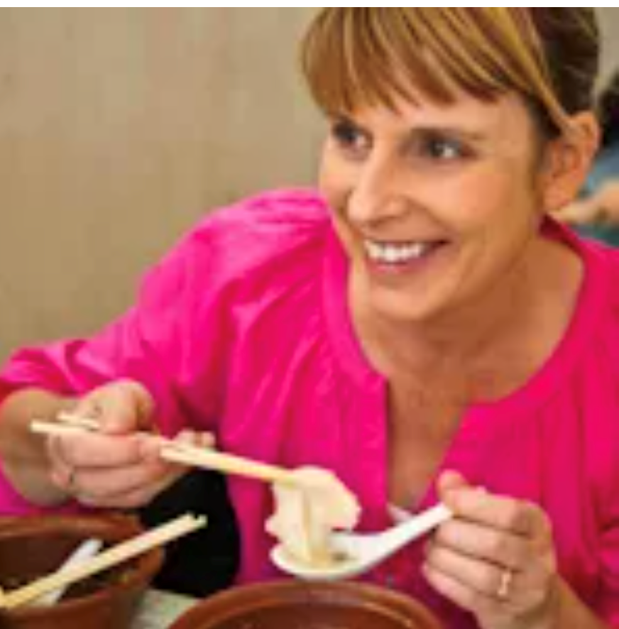
拓展外刊阅读:What to Eat in China: A Traveler's Guide
溯恩英语 2023年6月全国高考新课标I卷语法填空讲评
Xiao long bao, those miraculous constructions of delicate dumpling wrappers encasing a big slurp of hot, savory soup and sweet, fragrant ground pork, are far and away my favorite Chinese street food. The pocket of soupy stock is the dumpling's essential element: a flavored pork aspic, typically made with pork skin, chicken bones, ginger, scallions, and Shaoxing wine, simmered for hours until the collagen-heavy ingredients have turned to gelatin, and then cooled until it sets. The dumplings arrive steaming and dangerously hot—to eat one, you have to decide whether to nibble a hole in it first, releasing the steam and risking a spill, or throw caution to the wind and pop the whole dumpling in your mouth, a burst of near-scalding broth exploding on your tongue.
miraculous /mɪˈrækjələs/adj.奇迹般的，不可思议的
delicate /ˈdelɪkət/精致的，精巧的
wrapper /ˈræpə(r)/包装纸;饺子皮
encase /ɪnˈkeɪs/ vt.包住；围绕；包装
slurp /slɜːp/n. 吃的声音；啜食声
savory /ˈseɪvəri/adj.可口的；风味极佳的；味美的
far and away 遥不可及：无法比拟;无疑地
aspic /ˈæspɪk/n.肉冻，花色肉冻
simmer /ˈsɪmə(r)/v.炖，煨；
ingredient /ɪnˈɡriːdiənt/ n.成分，原料；要素
nibble/ˈnɪb(ə)l/v.啃，小口咬；反复轻咬
throw caution to the wind抛开谨慎，冒险行事
scald /skɔːld/ vt.烫伤；烫洗
broth /brɒθ/ n.肉汤

Slide 20
拓展外刊阅读:What to Eat in China: A Traveler's Guide
溯恩英语 2023年6月全国高考新课标I卷语法填空讲评
Xiao long bao, those miraculous constructions of delicate dumpling wrappers encasing a big slurp of hot, savory soup and sweet, fragrant ground pork, are far and away my favorite Chinese street food. The pocket of soupy stock is the dumpling's essential element: a flavored pork aspic, typically made with pork skin, chicken bones, ginger, scallions, and Shaoxing wine, simmered for hours until the collagen-heavy ingredients have turned to gelatin, and then cooled until it sets. The dumplings arrive steaming and dangerously hot—to eat one, you have to decide whether to nibble a hole in it first, releasing the steam and risking a spill, or throw caution to the wind and pop the whole dumpling in your mouth, a burst of near-scalding broth exploding on your tongue.
小笼包，精致的饺子皮包裹着一大口热腾腾的、香喷喷的汤和甜美、香喷喷的肉末，这些神奇的构造无疑是我最喜欢的中国街头小吃。汤包是饺子的基本成分:一种调味猪肉肉冻，通常由猪皮、鸡骨、生姜、葱和绍兴酒制成，炖几个小时直到富含胶原蛋白的成分变成明胶，然后冷却直到它凝固。饺子冒着热气冒着热气一-要吃个，你必须决定是先在上面啃一个洞，释放蒸汽，冒着溢出的危险，还是抛开顾虑，把整个饺子塞进嘴里一阵近乎滚烫的汤汁在你的舌头上炸开。

Slide 21
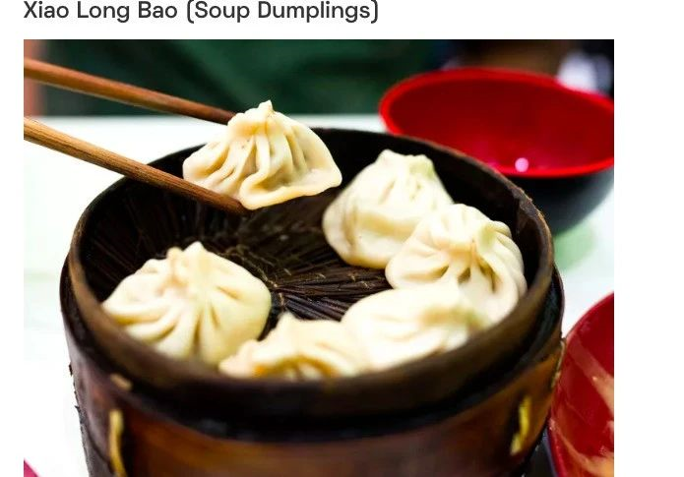
拓展外刊阅读:What to Eat in China: A Traveler's Guide
溯恩英语 2023年6月全国高考新课标I卷语法填空讲评
Shanghai may be the recognized home of the soup dumpling, but food historians will actually point you to the neighboring ancient canal town of Nanxiang as xiao long bao's birthplace. There, you'll find them rustically prepared—more dumpling and less soup—and the wrappers are pressed by hand rather than rolled, for a thicker and heartier dough.
上海可能是公认的灌汤包之乡，但食品历史学家实际指出，邻近的运河古镇南翔才小笼包的诞生地。那里，您会发现它们以质朴的方式烹制而成——更多的是饺子，更少的汤一一而且包装纸是用手压的，而不是卷起来的，这样面团会更厚更香。
canal /kəˈnæl/ n. 运河
rustically /ˈrʌstɪkli/adv.朴素地；乡土气地；不事修饰地
heartier亲切的（hearty 的比较级）
dough/dəʊ/ n.生面团

Slide 22
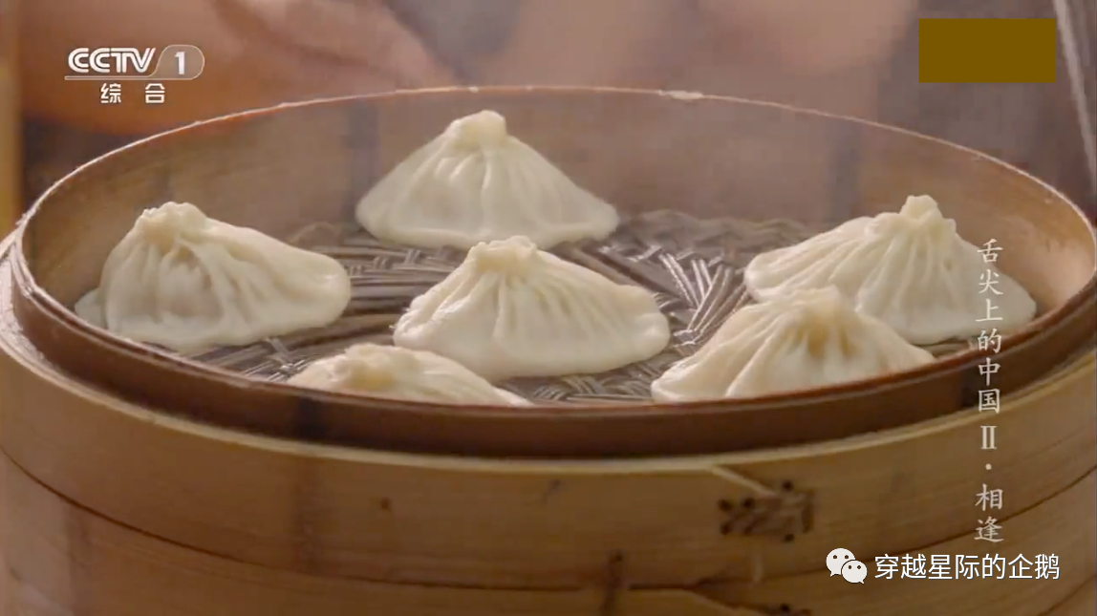
拓展外刊阅读:What to Eat in China: A Traveler's Guide
溯恩英语 2023年6月全国高考新课标I卷语法填空讲评
Nanxiang aside, the best xiao long bao have a fine, almost translucent skin, allowing them to be lifted out of the steamer basket without tearing or spilling any of their contents. The meat should be savory with a touch of sweetness, and the surrounding broth hot, clear, and aromatic with pork, ginger, and Shaoxing wine. Most vendors serve them with tangy, dark Zhenjiang vinegar and slivers of fresh ginger to complement the sticky-rich soup, though you'll also find them served alongside a bowl of clear soup. If you're lucky enough to be in China during hairy crab season, you can also find the pork mixed with the meat and roe of the crab, for an even sweeter, richer filling. No matter where I buy them, though, one steamer basket is rarely enough, yet two seems greedy, and so I am always left wanting more next time.
translucent /trænzˈluːs(ə)nt/adj.半透明的
steamer basket 蒸笼
aromatic /ˌærəˈmætɪk/ adj.芳香的，芬芳的
vendor /ˈvendə(r)/n.小贩，摊贩
tangy /ˈtæŋi/adj.扑鼻的；有刺激性的；强烈的；咸的
complement /ˈkɒmplɪment/ v.补充，补足
hairy crab 大闸蟹; 毛蟹
roe /rəʊ/ n.鱼卵，鱼子

Slide 23
拓展外刊阅读:What to Eat in China: A Traveler's Guide
溯恩英语 2023年6月全国高考新课标I卷语法填空讲评
Nanxiang aside, the best xiao long bao have a fine, almost translucent skin, allowing them to be lifted out of the steamer basket without tearing or spilling any of their contents. The meat should be savory with a touch of sweetness, and the surrounding broth hot, clear, and aromatic with pork, ginger, and Shaoxing wine. Most vendors serve them with tangy, dark Zhenjiang vinegar and slivers of fresh ginger to complement the sticky-rich soup, though you'll also find them served alongside a bowl of clear soup. If you're lucky enough to be in China during hairy crab season, you can also find the pork mixed with the meat and roe of the crab, for an even sweeter, richer filling. No matter where I buy them, though, one steamer basket is rarely enough, yet two seems greedy, and so I am always left wanting more next time.
除了南翔，最好的小笼包外皮细腻几乎是半透明的，可以将它们从蒸笼中取出而不会撕裂或溢出任何陷。肉应该是咸的，带有一丝甜味，周围的肉汤又热又清，带有猪肉、生姜和绍兴酒的香味。大多数供应商都会用味道浓郁的镇江黑醋和新鲜生姜片来搭配粘稠的汤，不过你也会发现它们会和一碗清汤一起上桌。如果你有幸在大闸蟹季节来到中国，你还可以找到与蟹肉和蟹籽混合的猪肉，以获得更甜、更丰富的馅料。
不过，无论我在哪里买，一笼小笼包总嫌不够，两笼又显得太贪心而怕别人笑话笑我不淑女，所以我总是欲罢不能，意犹未尽，期待着下次的美好。

Slide 24
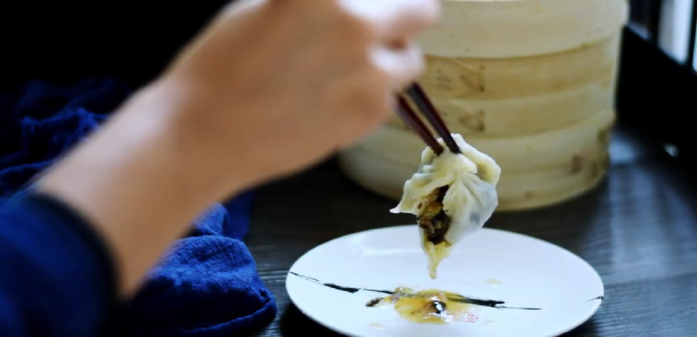
纯素灌汤小笼包_{(视频来源：Handmade Story手作传说)}
溯恩英语 2023年6月全国高考新课标I卷语法填空讲评

Slide 25
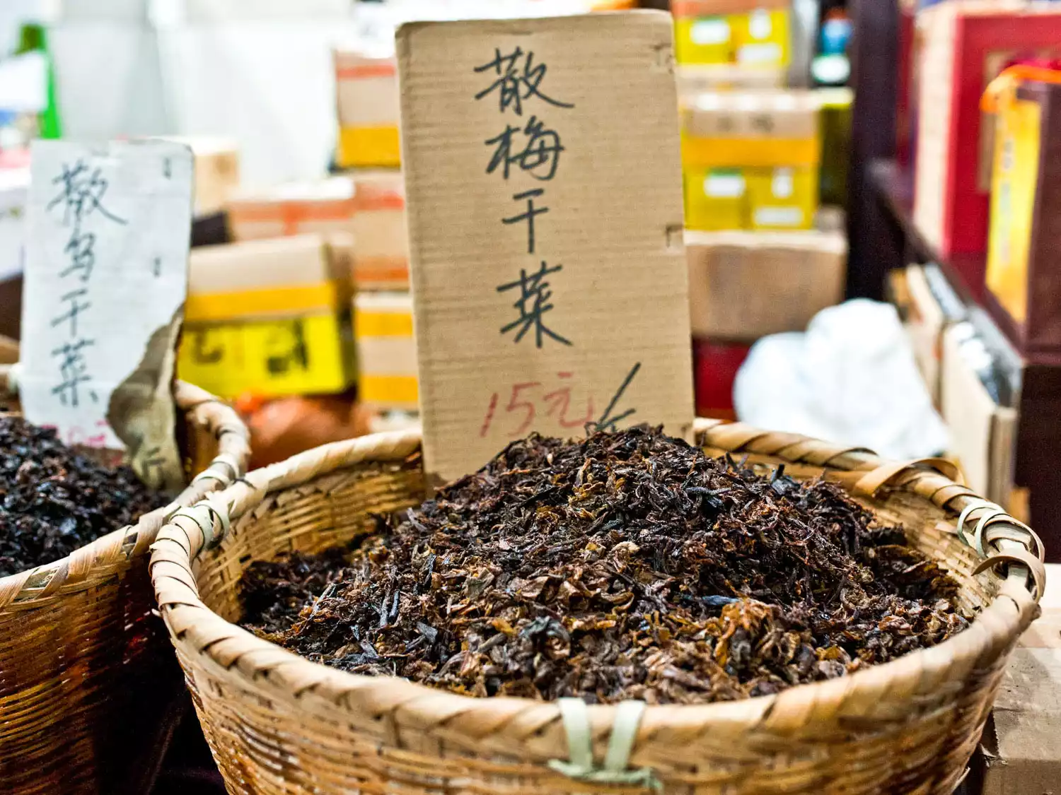
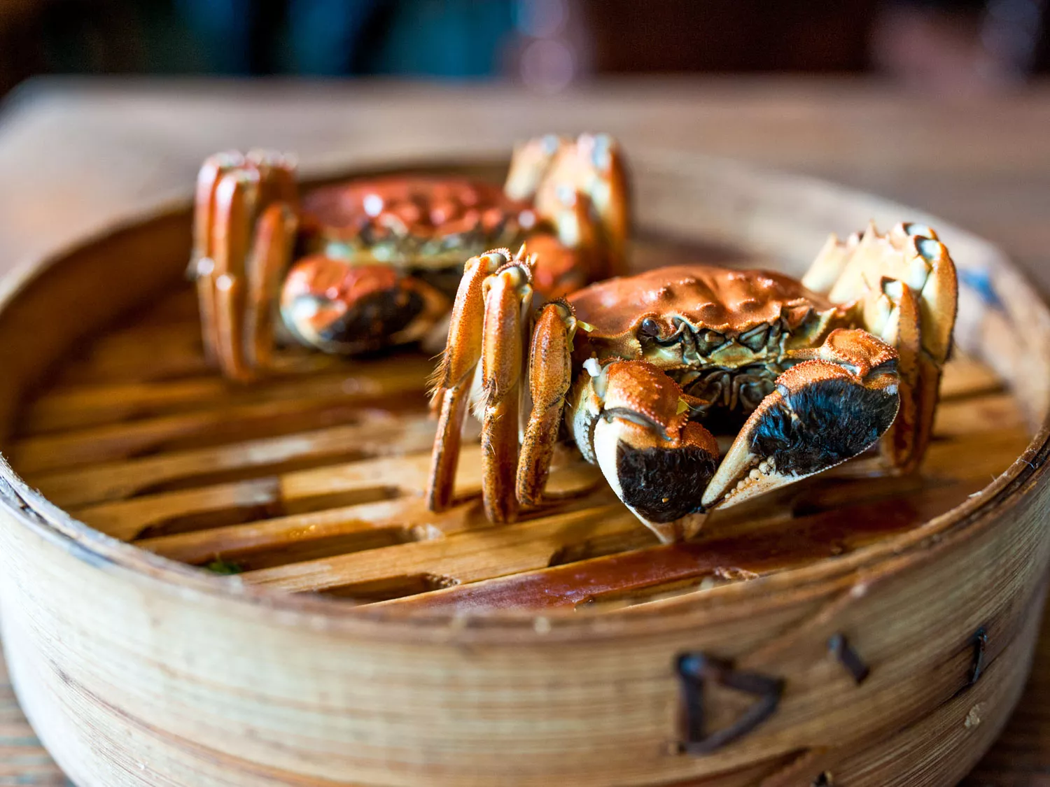
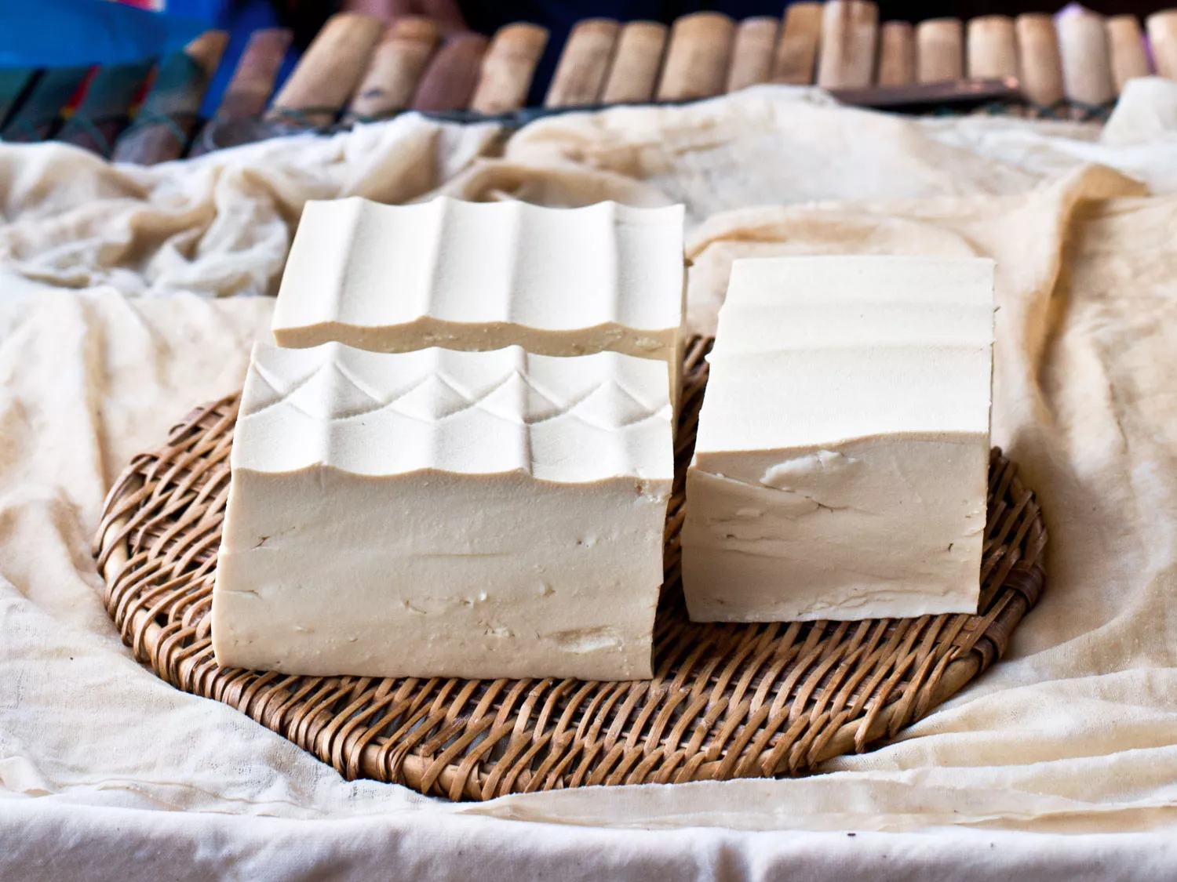
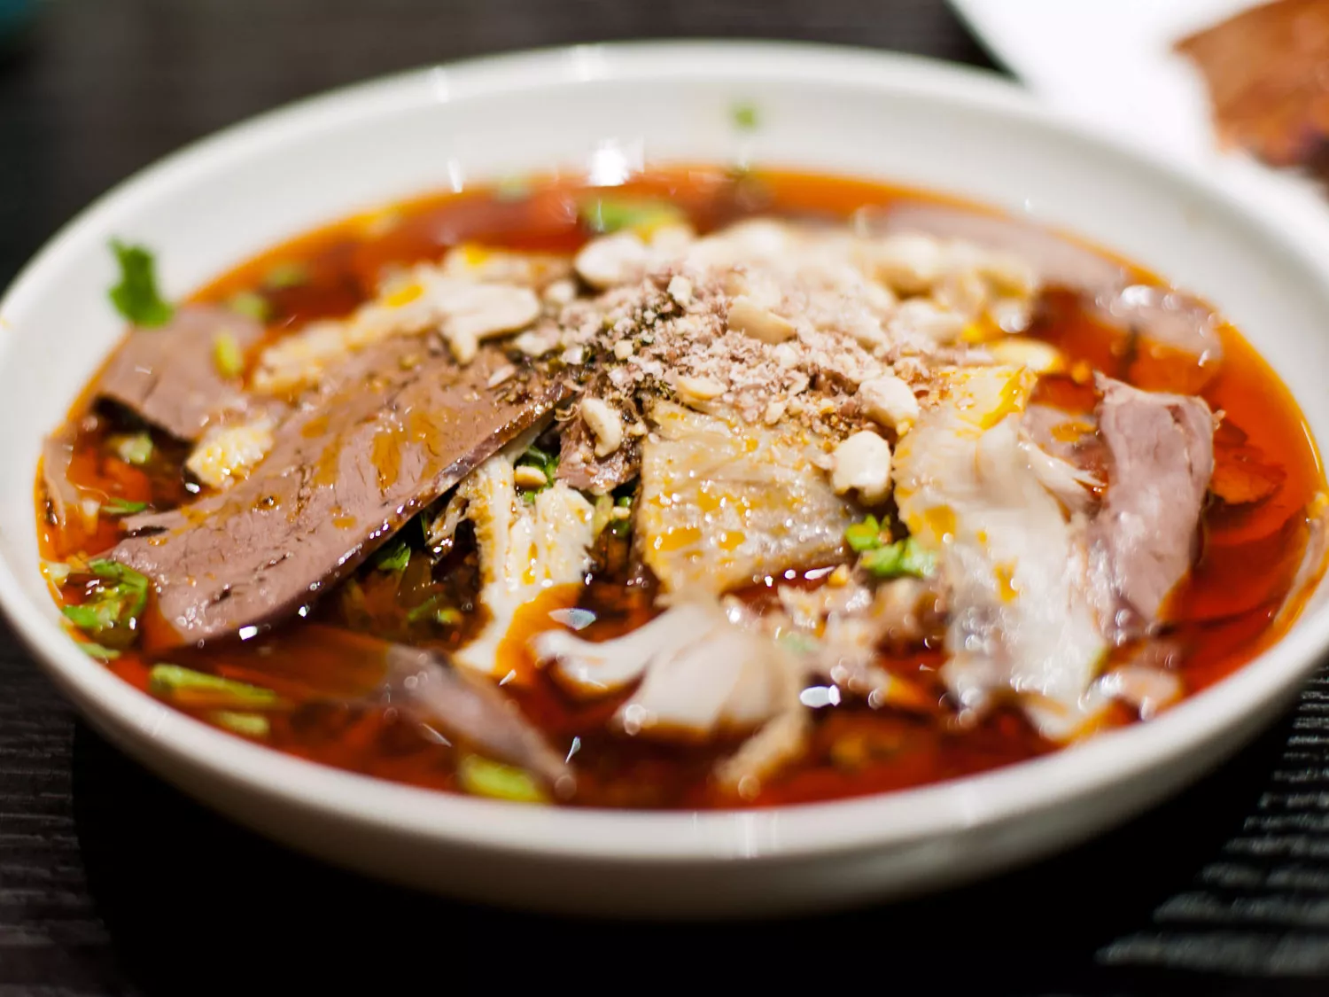
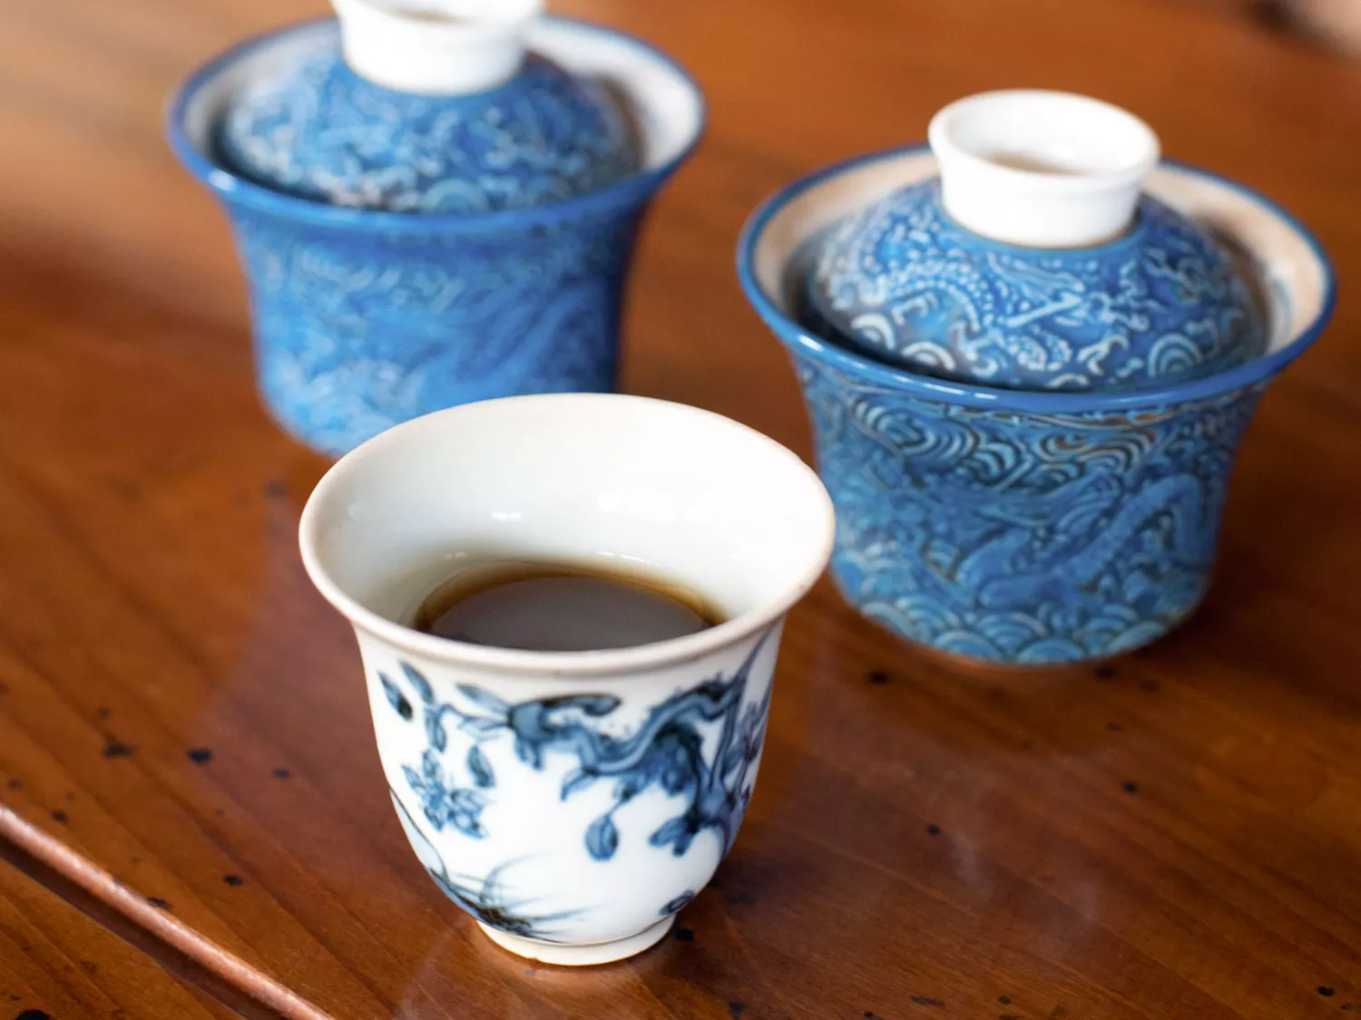
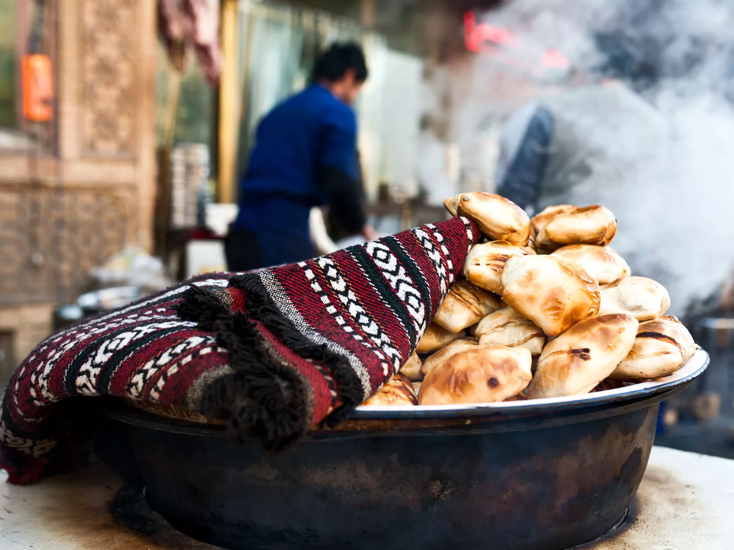
Homework: 延伸外刊阅读挖呀挖呀挖，玩转语法填空开出小红花
溯恩英语 2023年6月全国高考新课标I卷语法填空讲评

Slide 26
http://www.sunedu.com
Thank you for listening
2023.6.10

